Slide 1

The Machine Learning and Pianos Project

Slide 2
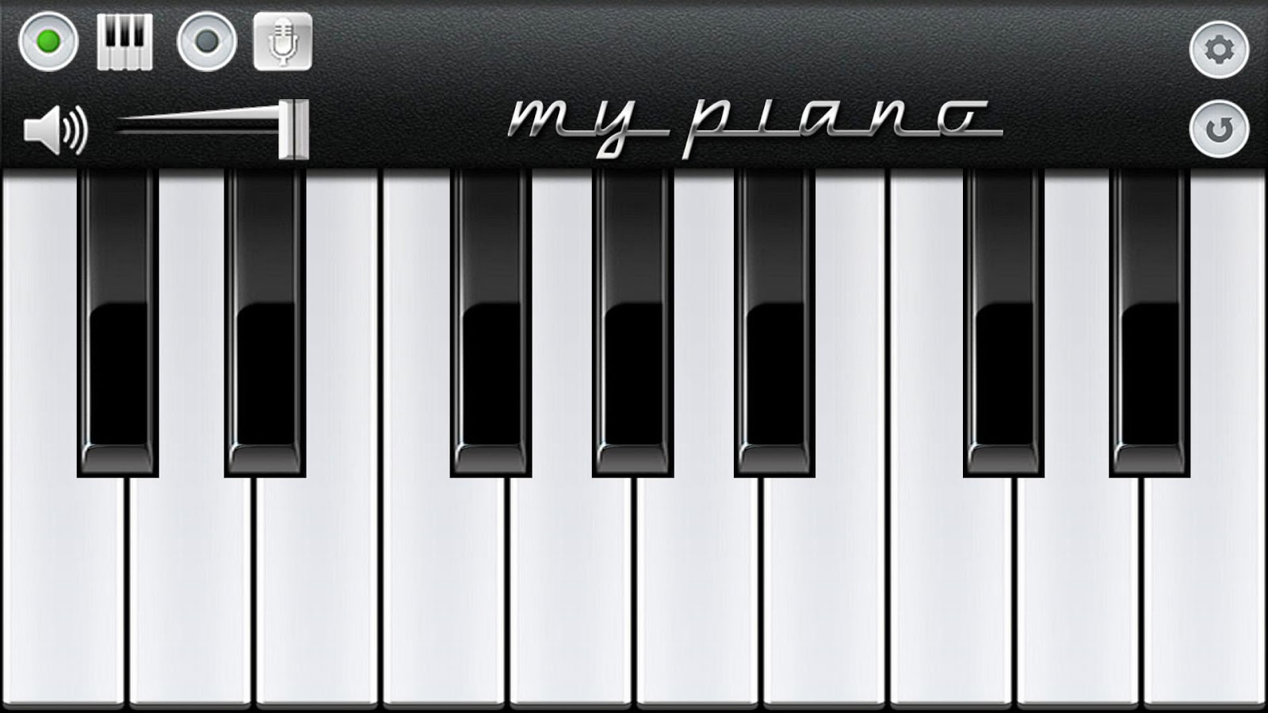



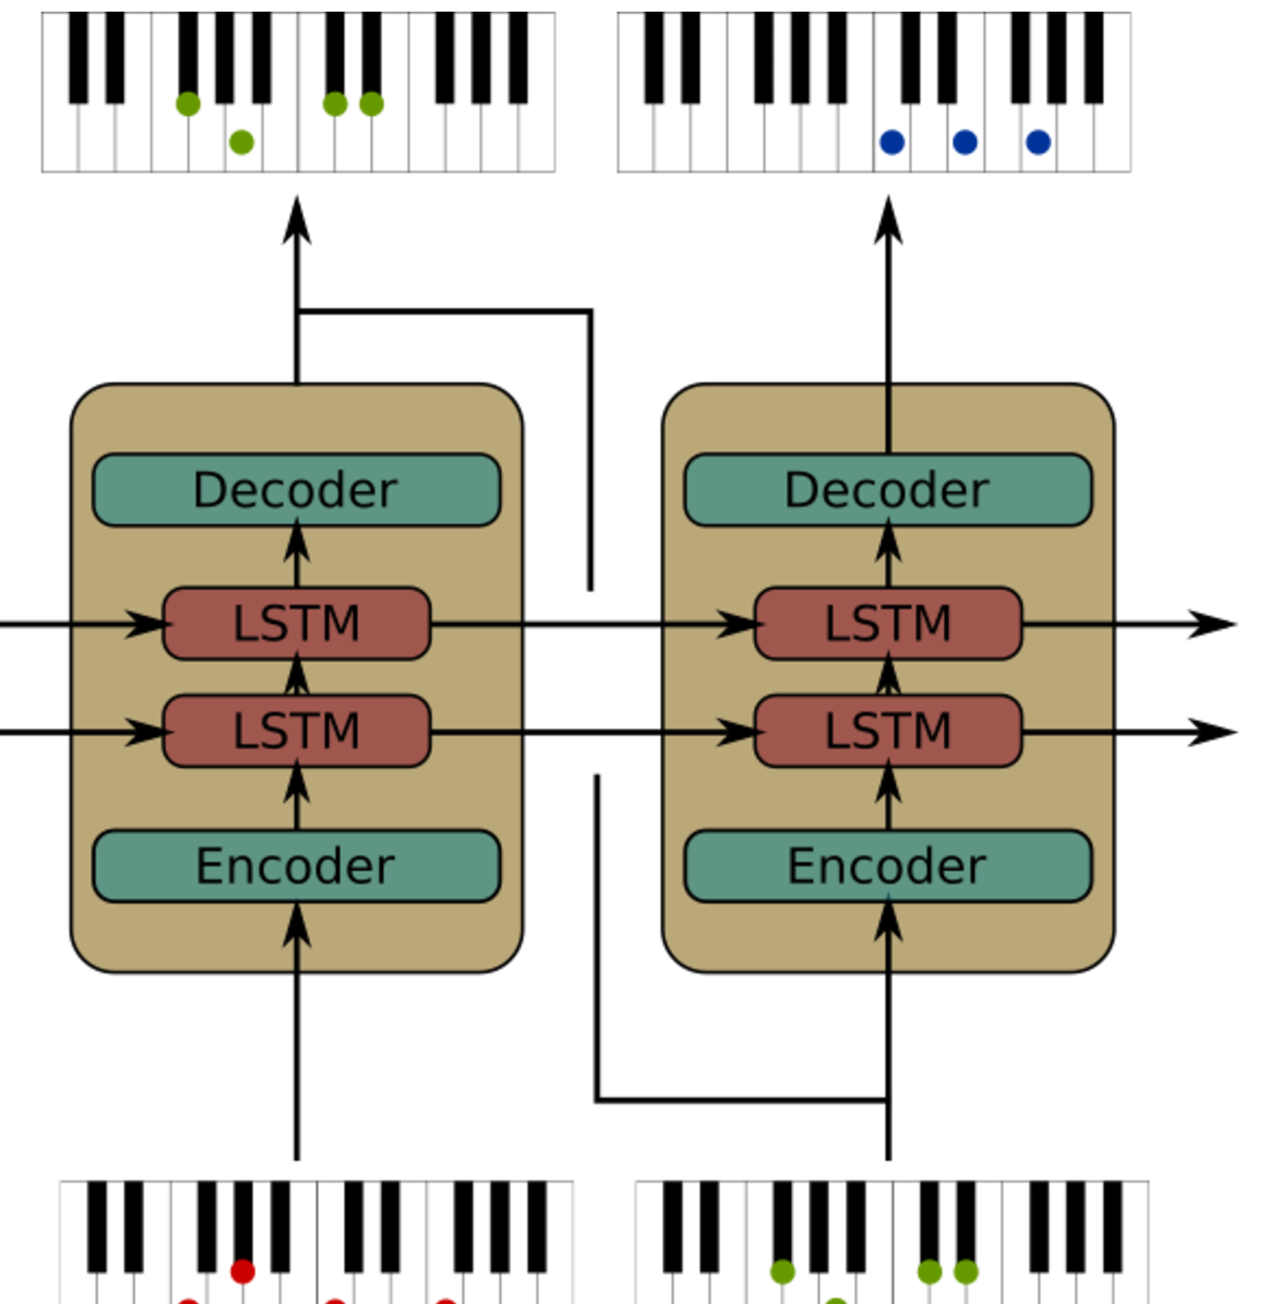

The Machine Learning and Pianos Project

Slide 3
GitHub
https://aka.ms/mlpiano

Slide 4
Credits
Ender Barillas
Frank Cheng
Corey Fogg
Safia Hassan
Abhi Sharma

