Slide 1

GitHub
The best thing since sliced bread!
Notes:
Links to open:
https://svnbook.red-bean.com/
https://git-scm.com/book/en/v2

Slide 2

Git
Git is not GitHub!
Released in 2005
Decentralized Version Control System
Important concepts
Working copy
Repository
Branch
Commit
Push

Slide 3

Version Control
Large projects require multiple contributors
Multiple contributors want to work simultaneously
Same file may be edited differently by two people
Edits may conflict with each other
CVS
Released in 1990
Used locking system
SVN
Released in 2000
Uses merging system

Slide 4

GitHub
Released in 2008
Front end for Git!
Hosts repositories
Adds features that make life easier

Slide 5
Getting Started
Get Git
Notes:
Links to open:

Slide 6
Install Git
MacOS
Install Homebrew (https://brew.sh/)
brew install git
Windows
Download Git Installer (https://git-scm.com/download/win)
Run the installer
Notes:
Links to Open:
https://brew.sh/
Brew install git

Slide 7
GitHub Account
go to https://github.com
click “sign up” to create an account

Slide 8
Local Account Setup
Install GitHub CLI
MacOS: brew install gh
Windows: https://cli.github.com
gh auth login

Slide 9
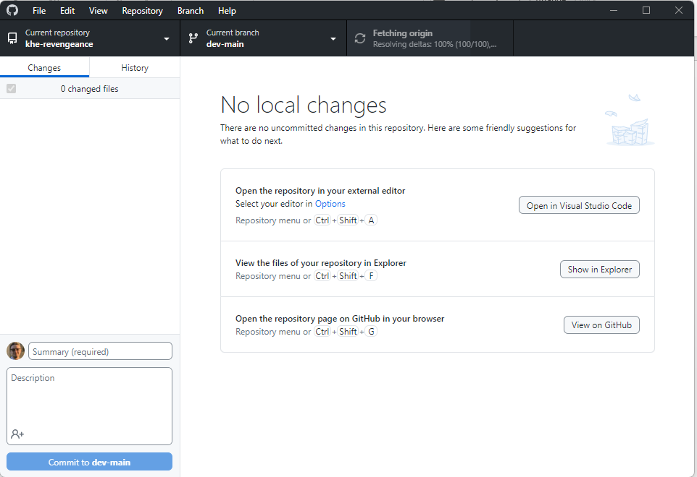
GitHub Desktop

Slide 10
Working with GitHub
Clone a repository
Creating a new branch
Add and commit files
Push to repository on GitHub
Pull requests and merging
Notes:
At this point the presenter should open github
Walk through repository creation
Clone the repository

