Slide 1
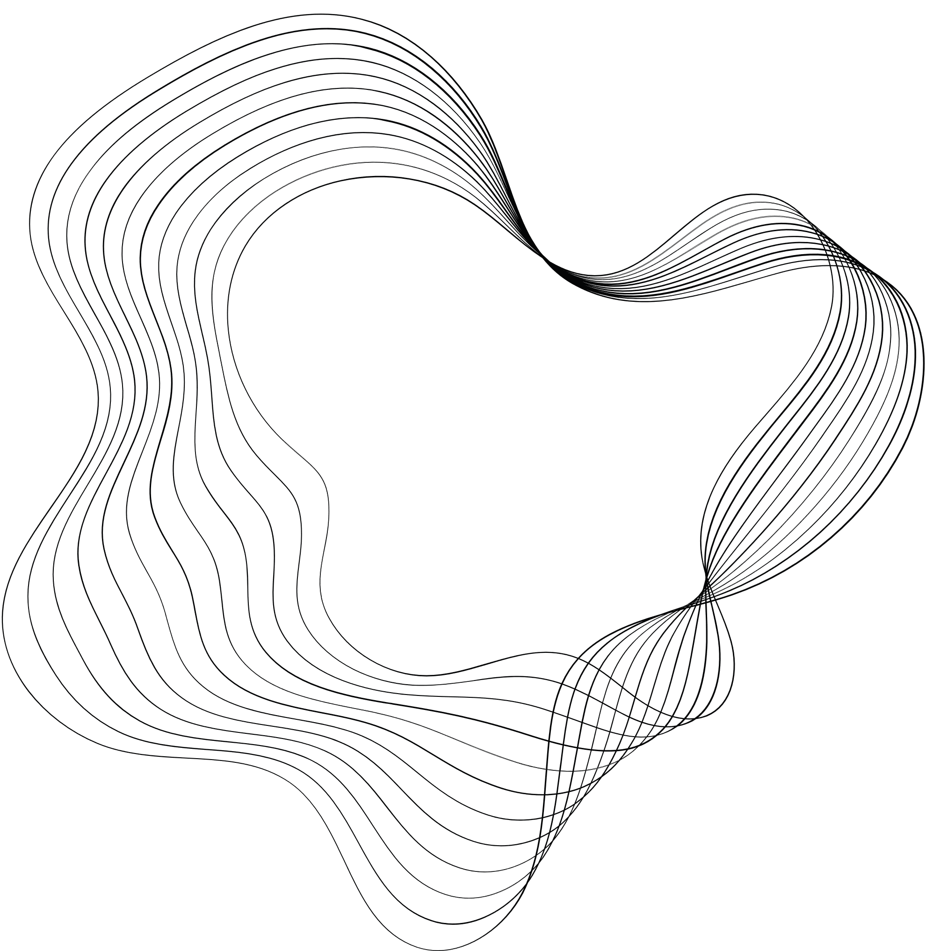


Università degli Studi di Salerno
CarROS
A SIMPLE SEMI-AUTOMATIC ROBOT CAR IN ROS
Robot Programming Project
Antonio Garofalo

Slide 2
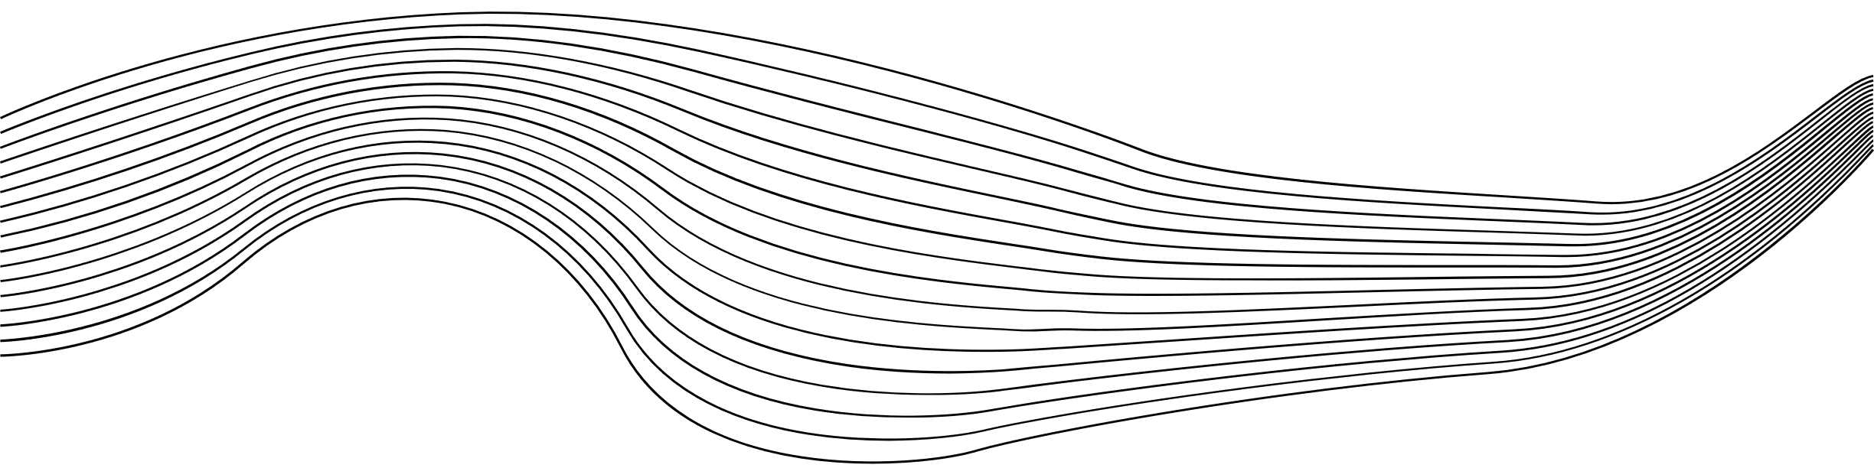
CONTENT
01
Concept Idea
ROS setup and Environment implementation
02
03
Design specifications
(nodes, topics, services and parameters)
04
Conclusions and future developments

Slide 3

What is this project?
CONCEPT IDEA

Slide 4






CONCEPT
Create an autonomous car that can navigate an environment with obstacles and interact with randomly generated waypoints, integrating manual control as an additional option.
The car uses waypoint following algorithm for navigation point-to-point and a simple wall following algorithm with 2D Lidar for obstacle avoidance.
The GUI allows driving the car manually via ROS_LIB.js and connection via ROS Master URI exposed on a bridge (rosbridge).
Gazebo is used for environment simulation, while RViz allows sensors and trajectories to be monitored in real time.

Slide 5
How the project was created?
ENVIRONMENT

Slide 6

GAZEBO
Gazebo is a simulation platform that allows creating realistic virtual environments to safely and efficiently test and validate robotics algorithms.
Empty World with Random Obstacles
The simulated environment consists of an empty space with randomly generated obstacles to test the robot's adaptability.
Types of obstacles: cubes, cylinders, and walls, placed randomly to mimic real-world scenarios.
Purpose of the Environment
Validation of autonomous navigation algorithms (waypoint following and wall following).
Testing the robot's response to 2D Lidar data and ROS commands.
Integration with ROS
Gazebo is used for physical simulation and communication with ROS nodes for control and monitoring
https://gazebosim.org/home
Notes:
Effetto valanga avvenuto con successo (tipo reti SPN).

Slide 7
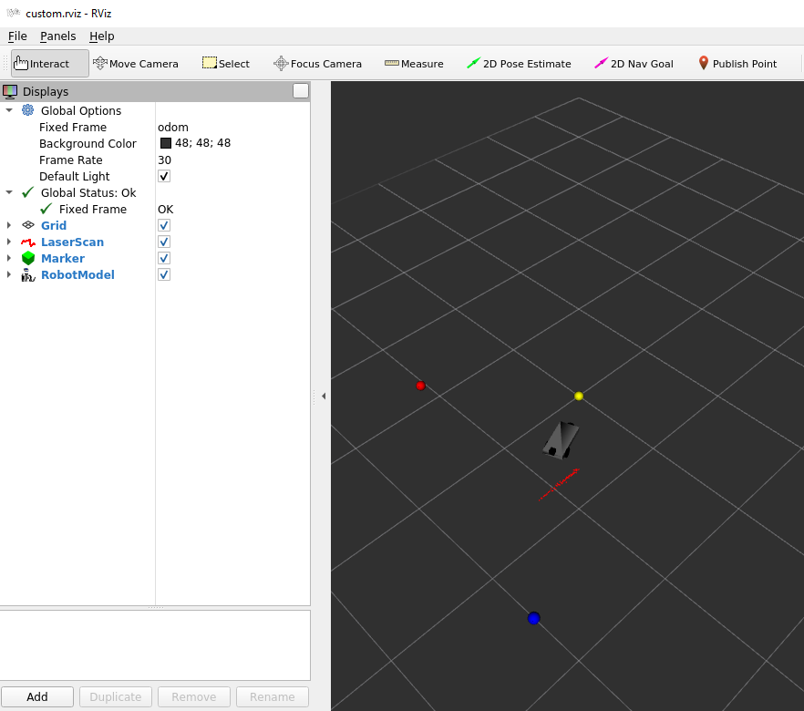
CarROS
This setup is typically used for monitoring and debugging a robot's navigation and perception system in real-time. This image shows a visualization in RViz, a tool commonly used in robotics applications.
LaserScan/2D Lidar Reflections: The red points around the robot show the environment's reflections detected by the robot's 2D Lidar sensor.
Markers: The yellow, blue, and red markers represent the last, next, and current waypoints (yellow, blue, red), respectively, for a robot's navigation task.
Robot Model: The small black car-like structure in the center represents the robot.
Grid: The black and gray grid in the background helps to visualize the spatial layout and orientation in the fixed frame ("odom").
Display Panel: On the left, the RViz settings panel displays the configured visualizations with their corresponding topics and statuses.

Slide 8

RVIZ
RViz is a 3D visualization tool that provides real-time insights into sensor data, robot models, and navigation algorithms, enabling easier debugging and system analysis.
Visualized Elements
Grid: Provides a reference plane for localization and orientation.
LaserScan: Displays 2D Lidar data for obstacle detection and avoidance.
Markers: Visualizes waypoints (current, next, and last) for navigation.
Robot Model: Shows the robot’s structure, sensors and state in real time.
Key Tools
2D Pose Estimate: Sets the robot's initial position manually.
2D Nav Goal: Sends manual navigation goals for testing or control.
Publish Point: Allows selecting specific points in the environment for interaction.
Purpose of Rviz
Real-time monitoring of sensor data and algorithm outputs.
Facilitates debugging, calibration, and visualization of the robot's behavior.
https://wiki.ros.org/rviz/UserGuide

Slide 9
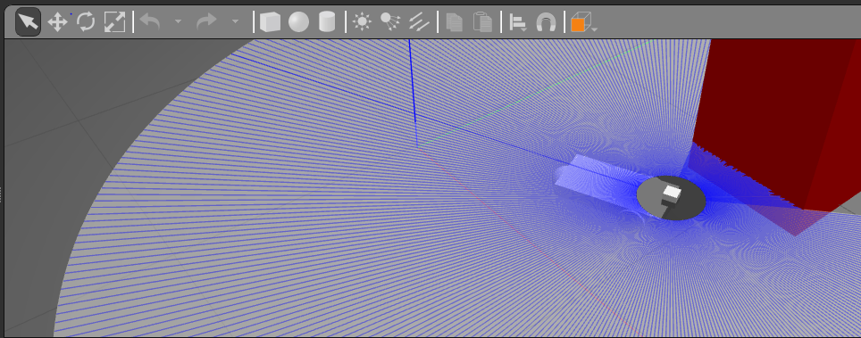
CarROS
This simulation is often used to test and evaluate how a robot perceives its environment and interacts with obstacles using its Lidar sensor in a controlled environment.
Lidar Beams: The numerous blue lines extending outward from the robot illustrate the laser beams emitted by the Lidar to scan the environment.
Sensor Coverage: The blue visualization depicts the Lidar's field of view, showing the range and area covered by the sensor in the simulation.
Robot: The black and white circular object in the center represents the simulated robot equipped with a 2D Lidar sensor.
Obstacle: The large red structure in the scene represents an obstacle being detected by the Lidar. The beams that intersect with the obstacle terminate at its surface, simulating the reflections captured by the sensor.

Slide 10
How is the project structured?
STRUCTURE

Slide 11
NODES
Nodes are executable programs that communicate with each other to perform specific tasks in a distributed system. They can publish/subscribe to topics, provide/consume services, and interact with the ROS parameter server.
Manual
Autonomus
Teleop:
Handles communication with the robot using ROS Master URI and port forwarding for remote control.
ROS Bridge:
A tool that enables communication between ROS and
non-ROS systems, such as web applications, using protocols
like WebSocket.
Waypoint Navigator:
An autonomous navigation node that processes randomly generated waypoints.
Uses obstacle avoidance algorithms (e.g., wall following) based on sensor data like Lidar.
Subscribes to topics for waypoints and publishes commands to control the car's movement.
Common
Waypoint Visualizer:
Visualizes waypoints in RViz to provide feedback on the car's navigation goals.
Publishes markers to show the car's current, next, and past waypoints.
Waypoint Manager:
Manages the creation, deletion, and modification of waypoints.
Handles user input from the interface to define navigation targets.
Gazebo Node:
Simulates the car in a virtual environment with realistic physics and sensors.
Provides simulated Lidar, odometry, and other data for testing.
RViz Node:
Visualizes the car's state, sensor data, and environment in 3D.
Displays real-time updates on navigation and obstacle avoidance.

Slide 12
TOPICS
Topics are named communication channels used by nodes to publish and subscribe to messages asynchronously, enabling data exchange in a distributed system.
/cmd_vel:
Topic for velocity commands; used to control the robot's linear and angular speeds.
/odom:
Provides odometry data, including the robot's position and orientation in the world.
Gazebo-Specific Topics:
Used to interact with the Gazebo simulation environment, such as resetting the robot's position or restarting the simulation.
Rviz-Specific Topics:
Used to interact with the Rviz simulation environment, such as marker visualization, map, and other things.
Custom Topic Services:
Custom topics used for tasks like waypoint management or mode switching are transformed into services for more structured, request-response interactions.

Slide 13
SERVICES
Services provide a synchronous communication mechanism where nodes can send a request and receive a response, typically used for tasks that require immediate feedback or one-time operations.
/waypoint_request: This service accepts a secret key as input and returns the “last”, “current”, and “next” waypoints, managing navigation data.
/reset_pose:
Used to reset the robot's position to a predefined state within the simulation.
/gazebo/set_model_state:
Allows setting the state (e.g., position and orientation) of a model in the Gazebo simulation.
/gazebo/spawn_sdf_model: Spawns a new model into the Gazebo environment using an SDF file for model configuration.

Slide 14
MESSAGES
Messages are structured data formats used for communication between nodes via topics or services. They define the type and structure of the data being exchanged.
Custom
Common
MoveControls.msg This message defines commands for controlling the robot’s movement.
uint8 command, which specifies the current movement command.
SpeedControls.msg This message specifies the speed settings for the robot’s movement.
float32 linear_speed, representing the forward/backward velocity.
float32 angular_speed, representing the rotational velocity.
Twist: This message represents velocity commands, including both linear and angular velocity components, used for controlling robot motion.
Odometry: This message provides data on the robot’s position, orientation, and velocity over time, essential for navigation and localization.
LaserScan: This message publishes data from a 2D Lidar sensor, detailing distances to surrounding obstacles and enabling obstacle avoidance.
Marker: This message is used to visualize objects like waypoints or obstacles in RViz, providing a graphical representation of data in the environment.
Pose: This message describes the position (x, y, z) and orientation (quaternion) of an entity, such as the robot or a specific object, within the simulation.

Slide 15
PARAMETERS
Parameters are configurable values stored on a parameter server that nodes can access and modify. They are used for dynamic configuration of nodes and provide a way to store persistent data globally across the system.
car_params.yaml:
linear_speed: Linear speed of the robot (0.3 m/s).
angular_speed: Angular speed of the robot (0.5 rad/s).
kp_angular: Proportional gain for angular control (1.0).
ki_angular: Integral gain for angular control (0.0).
kd_angular: Derivative gain for angular control (0.5).
front_angle_width: Angle width of the scanner (30°).
obstacle_threshold: Threshold distance for detecting obstacles (0.3 m).
wall_follow_distance: Desired distance for wall following (0.7 m).
secret_key.yaml:
secret_key: A private key used for secure communication ("ros_car_key").
start_params.yaml:
initial_x: Initial x-coordinate for spawning (0.0 m).
initial_y: Initial y-coordinate for spawning (0.0 m).
initial_yaw: Initial orientation (yaw) for spawning (0.0 rad).
world_bounds.yaml:
current_waypoint: Current robot waypoint ([0.0, 0.0]).
last_waypoint: Last reached waypoint ([-1.0, -1.0]).
next_waypoint: Next target waypoint ([2.0, 1.5]).
alignment_tolerance: Tolerance for waypoint alignment (0.2 m).
arrival_threshold: Threshold for arrival at a waypoint (0.3 m).
x_min, x_max: X-axis world boundaries (-3.3 to 3.3).
y_min, y_max: Y-axis world boundaries (-3.3 to 3.3).
«some parameters are implicit»

Slide 16
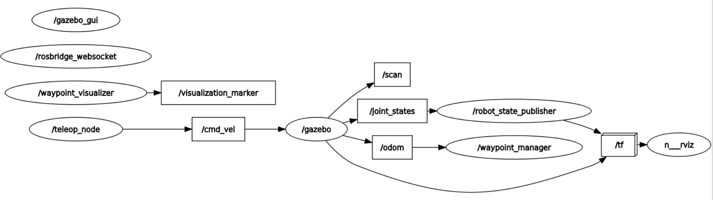
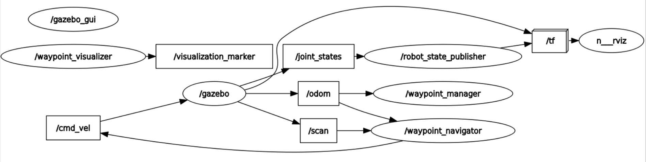
The graph provides a visual representation of the ROS system, showing active nodes, topics, and their interconnections. It helps in understanding data flow, debugging, and optimizing communication.
Graph
The graph provides a visual representation of the ROS system, showing active nodes, topics, and their interconnections. It helps in understanding data flow, debugging, and optimizing communication.
Manual
Autonomus

Slide 17
And now?
CONCLUSION

Slide 18





Future developments
Better Scanning
Shortest Path Algorithm
Random Environment
Enhanced environmental scanning using a 3D Lidar: Implementation of a 3D Lidar sensor to achieve more detailed and accurate mapping of the surrounding environment.
Integration of multi-sensor data fusion: Combining data from Lidar, cameras, and other sensors to improve the reliability and robustness of environmental perception.
Use of more complex algorithms for autonomous driving (i.e shortest path): Integration of advanced pathfinding algorithms like Dijkstra or A* to optimize navigation efficiency.
Implementation of real-time obstacle avoidance: Developing algorithms capable of dynamically avoiding obstacles while maintaining the optimal route.
Creation of a dynamically generated procedural environment: Development of systems to procedurally generate diverse and variable environments for testing.
Simulation of unpredictable elements in real-time: Adding dynamic obstacles or environmental changes (e.g., moving objects or weather variations) to improve system adaptability.

Slide 19


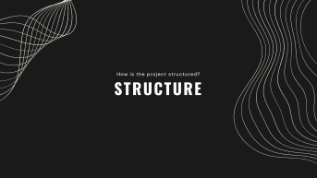
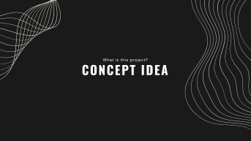

Thank you
https://github.com/Endless077
Highlights
Garofalo Antonio

