Slide 1
Pages in Demo Video

Slide 2
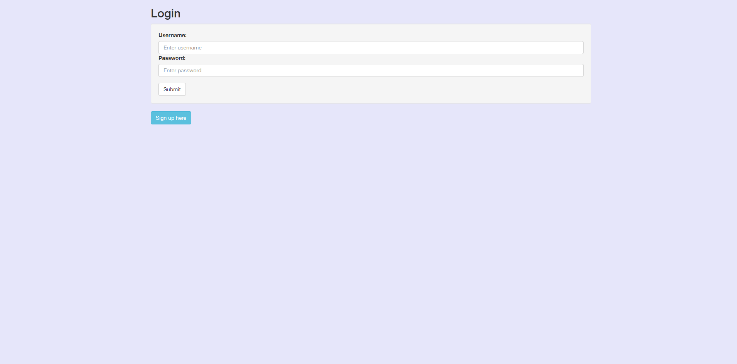
Login Page

Slide 3
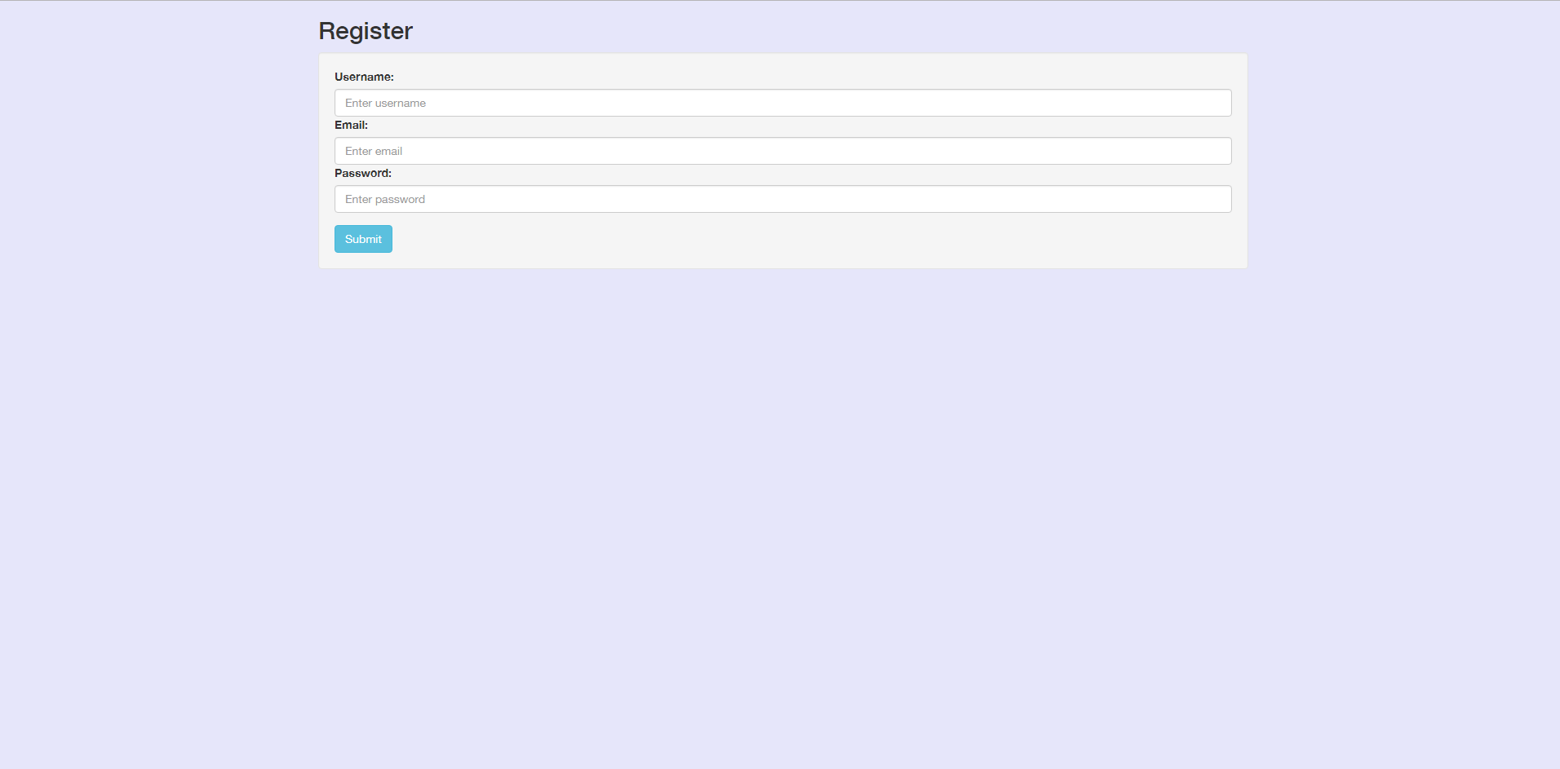
Register Page

Slide 4
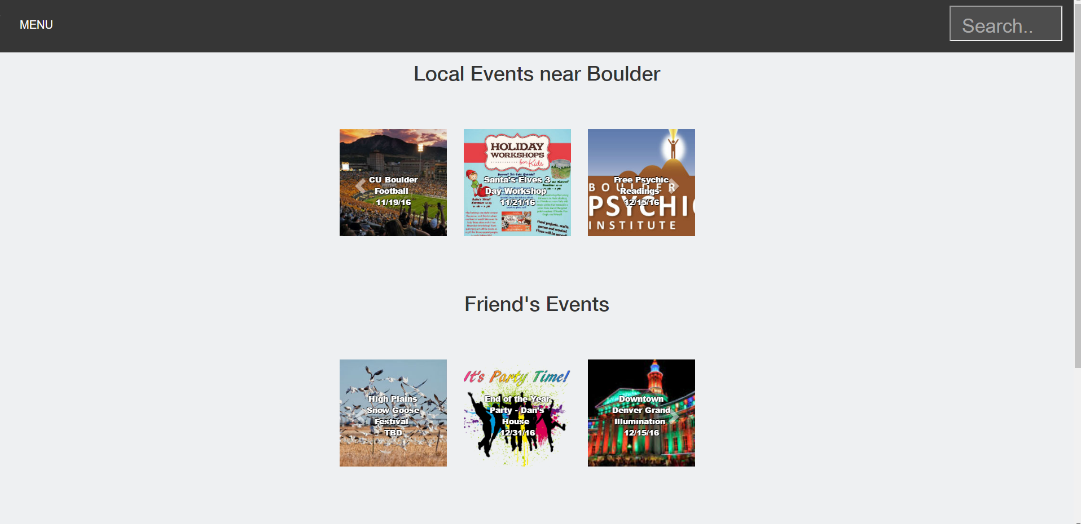
Home Page

Slide 5
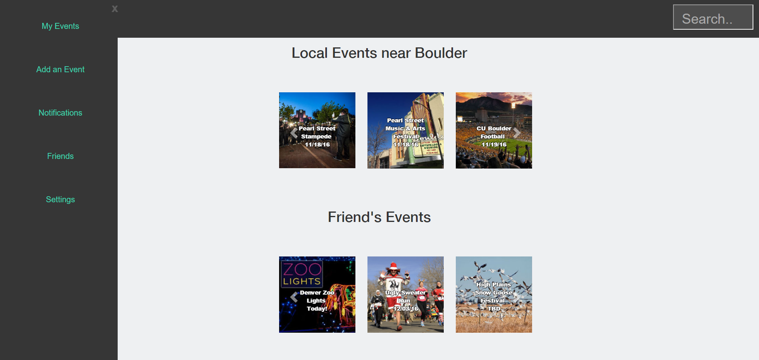
Home Page with Menu

Slide 6
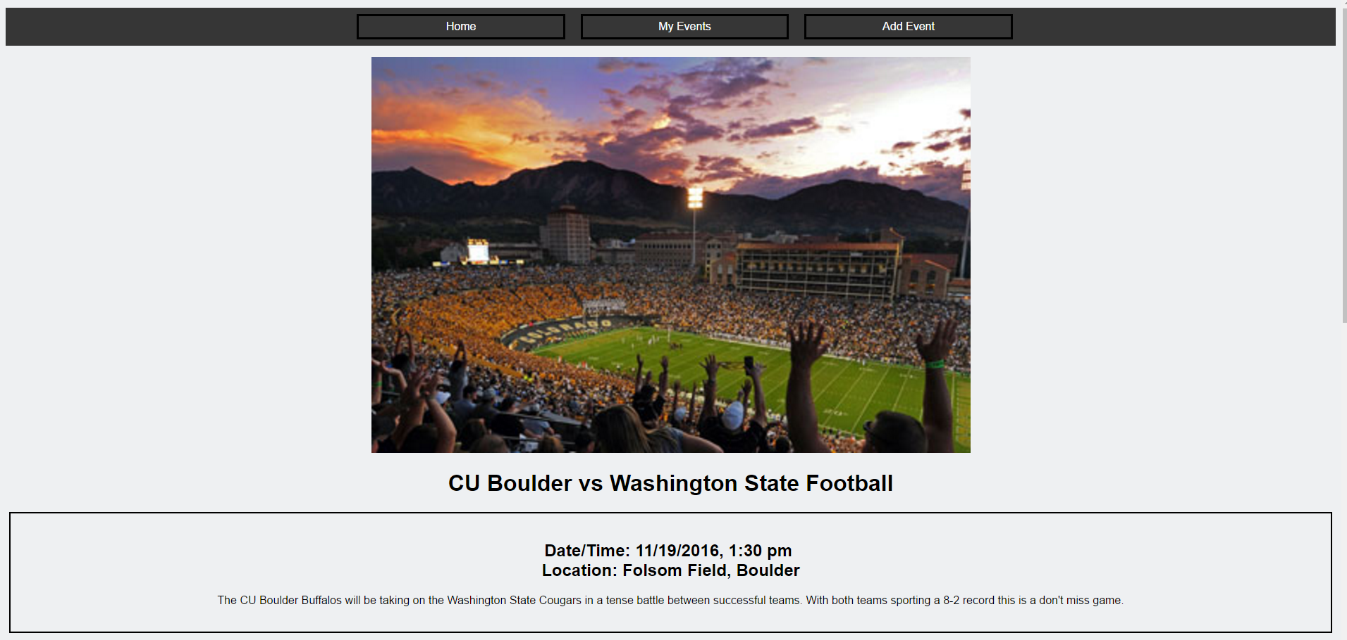
Event Example Page

