Slide 1


AIRFLOW RATE PREDICTION
Automated Airflow Rate Prediction from IR Imaging:
A Hybrid Segmentation & Machine Learning Pipeline

Slide 2
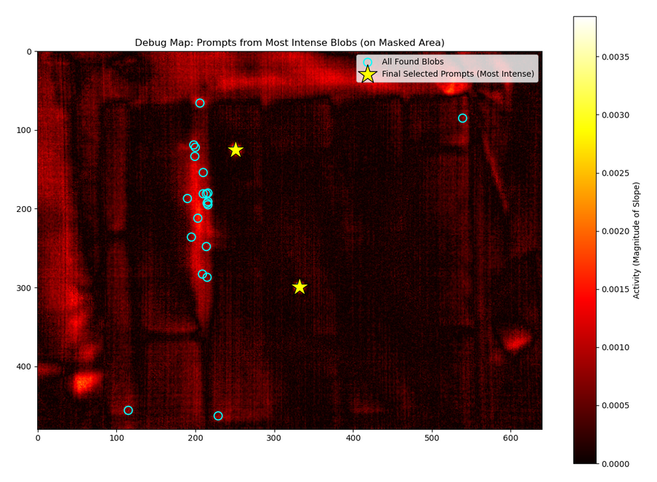
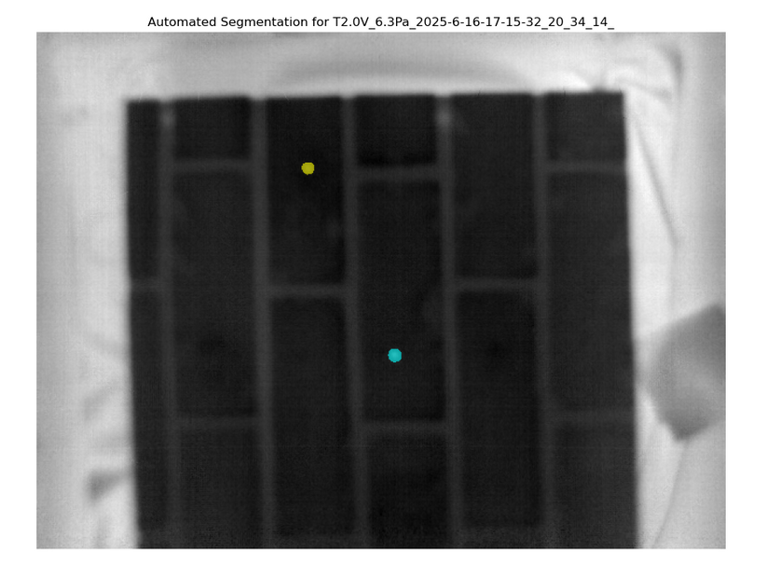
OVERVIEW
Step 1: Temporal Analysis
After applying temporal smoothing on the raw IR videos, we use Theil-Sen slope on IR videos to generate Activity Maps.
Step 2: ROI & Prompt Generation
Otsu Thresholding to define ROI, identify peaks for prompts
Step 3: SAM Segmentation
Use Segment Anything Model (SAM) with generated prompts.
Step 4: Final Output
Accurate spatial segmentation to yield Hotspot Mask.

Slide 3
RESULTS
Machine Learning Pipeline & Performance
Methodology:
• Inputs: Auto-generated Masks, IR Videos
•Features:hotspot_area_log,hotspot_avg_temp_change_rate_initial_norm, material
• Evaluation: Nested CV (N=33), Hold-Out Set (N=6)
Key Performance:
• Nested CV Mean R²: 0.62 (Realistic estimate)
• Hold-Out Set R²: 0.96 (Small test dataset result)
Model Insights:
• Variance is limited; more data will improve the performance

Slide 4
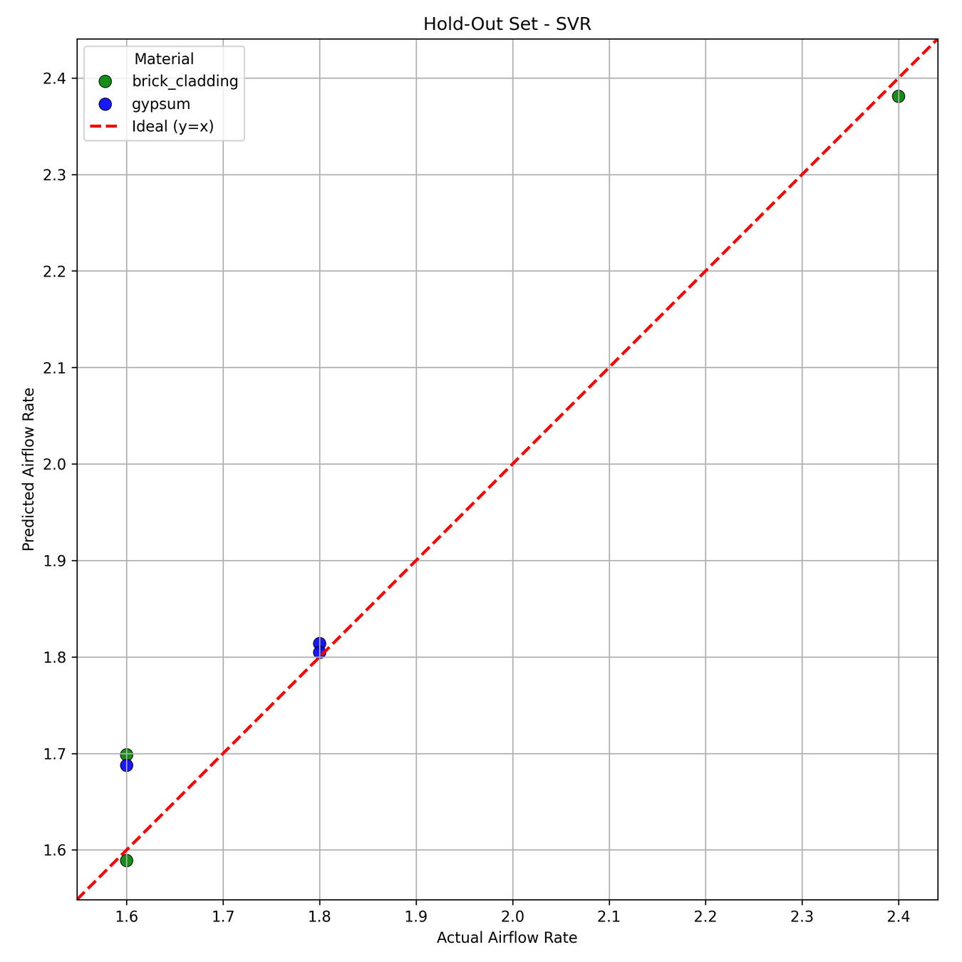
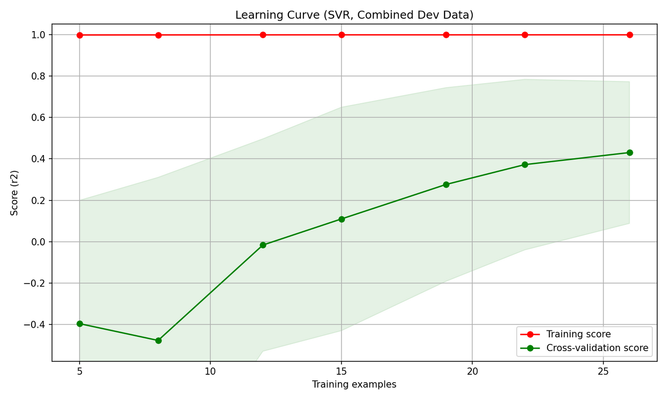
ML PIPELINE RESULTS

Slide 5
Thank You

