Slide 1

The next level of coding on the JVM
Kotlin

Slide 2
What are we about to witness
?
Who am I listening to?
Why should I care about Kotlin?
The basics
The cool stuff
How do I get my hands on it?
Uhmmm.. I might need some help on this
Awe and applause

Slide 3


About box
David Hardy
high tech ict
www.endran.nl

Slide 4
Why Kotlin
Android stuck on Java 6.. Or 7.. Or 8
Java can be way to verbose
Ceremonies and red tape
Non capturing anon inner classes
Lambda’s, Streams, try with resources
Notes:
Why do we need uodate of Java:
Try with resources
Lambdas
Streams

Slide 5
Why Kotlin
Restriction of Java
No way of adding methods to classes
Nullabilty all over the place
A lot of code needed for basic stuff
Problems with Android
A lot of nulls
A lot of inheritance
A lot of code needed for basic stuff
Notes:
How many util classes do you have?
How many null checks or Nullability annotations do you use

Slide 6
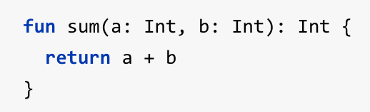

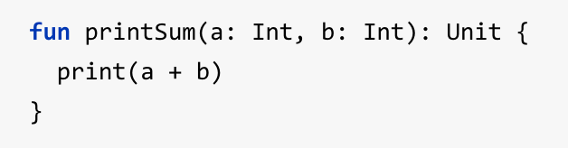
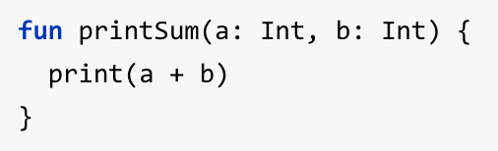
Crash course Kotlin
Function Declaration
Name of variable : Type
Return type on the end
Function with expression body
Return type inferred
Function with “void” return type
Method invocation
Unit return type can be omitted

Slide 7



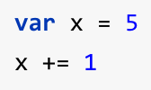
Crash course Kotlin
Value; write once / read only,
Like ‘final int a = 1;’
Type inferred
Declaration and non option assignment
Variable; mutable value

Slide 8
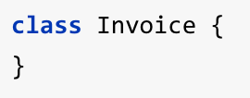
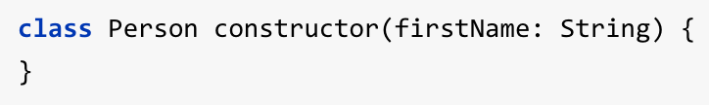
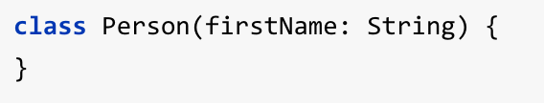
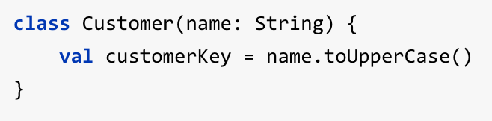
Crash course Kotlin
Class, regular POJO
Primary constructor
Can be omitted if no modifier, and no secondary constructor
Can be used for initialization

Slide 9
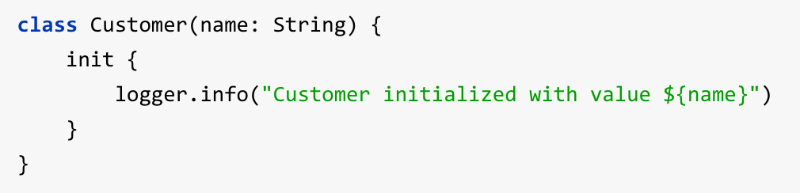
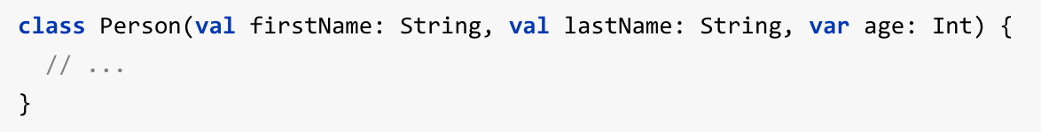
Crash course Kotlin
Execute logic (and string interpolation)
Properties, public by default
Immutable data containers
Notes:
By default classes are immutable, final. Which causes less inheritance and there are other paradigms to create the same functionality, in a better way.

Slide 10









Crash course Kotlin
Mutable, but never null
Optional, can be null
Safe calls will only execute if non-null
Elvis operator
NPE operator

Slide 11
Demotime!
How to add to project
Convert from Java
Function Extensions
Lambda’s
Notes:
1) Create Example.kt
-> Click add Kotlin to project
-> Show gradle file
-> add: classpath "org.jetbrains.kotlin:kotlin-android-extensions:$kotlin_version"
2) Convert Activity to Kotlin
-> Show how click listener is converted to lambda (Explain lambda vs annon inner class and outer class reference)
-> Remove menu code
3) Give fab as constructor parameter and make it as a property
-> Move fab code into new method, using tooling
4) Extract message and create extension method “showSnackBarOnClick”
-> Move extension method to separate class, pay attention to method signature
-> Show usage of “it” in 1 arg lambda
5) Pass int instead of string and show string interpolation
6) Change signature of extensions function to take two int and a higher order function
-> Then show usage of that method with ill places brackets around lambda’s
-> Then show intended use
7) As a kicker show usage of default extensions of list with reduce
-> And extract lambda as function
-> Perhaps some inlining

Slide 12
Why Kotlin
Concise
Expressive
Safe
Versatile
Interoperable
Notes:
Concise, reducing the amount of code it takes for you to achieve something;
Expressive, making your code more readable and understandable;
Safe, removing the possibility for you to create errors;
Versatile, targets the JVM and JavaScript you can run it in many places;
Interoperable, what that means is you can call Java code from Kotlin and Kotlin code from Java, and they aim to be 100% interoperable.

Slide 13
Is Kotlin here to stay?
Developped by Jetbrains
Development started 5 to 6 years ago
Targets the JVM, compiles to byte code
Jetbrains.. So here to stay
More than a non-profit thing, they depend on it. Selling idea’s is their business
Kotlin is optimized for toolability
Notes:
The need to stuck to Java, since the majority of their code base (IDE’s (All of their IDE’s execpt for C# is on the JVM)) depend on Java. They needed to overcome some issues with Java.
At the time ‘Scala’ was there, but it wasn’t for them.
The primary reason to development was for internal use.
Apache 2.0 licenses -> open source
Interoperation with Java was key for Jetbrains. Some of their own tools already have Kotlin, live in the field/production.
Name comes from an island near St. Petersburg. They have a main RnD office there.
Statically typed, like Java. Tooling for staitically tpyes languages of way easier. Also development is less complex.
Kotlin has to be consince, so that’s why type inference comes in. So no over explict type notation. Cuts down on boilerplate code.
By default classes are immutable, final. Which causes less inheritance and there are other paradigms to create the same functionality, in a better way.
Kotlin is optimized for toolabilty, and less verbose, more explicit code. The compile time is slightly slower then Java, but becoming faster with every version. At run time is is the same as Java, or even faster since it compiles down to more efficient code.
Kotlin does not have it’s own web framework or other basic stuff. They rely on existing (Java) libraries, often with a thin Kotlin facade. All Java libraries work for Kotlin, including annotation processors.
The new power of Kotlin on the Java 6 JVM open a whole new world for Android developers. Enjoy all the new good stuff ☺

Slide 14
Is Kotlin here to stay?
Developped by Jetbrains
Resharper
IntelliJ IDEA
Android studio
Rubymine
Appcode
Webstorm
…
Notes:
The need to stuck to Java, since the majority of their code base (IDE’s (All of their IDE’s execpt for C# is on the JVM)) depend on Java. They needed to overcome some issues with Java.

Slide 15
Is Kotlin here to stay?
Developped by Jetbrains
Reasoning
Need for richer code, compatible with Java
Internal use
Toolability
More than a non-profit thing, they depend on it. Selling IDE’s is their business
Notes:
At the time ‘Scala’ was there, but it wasn’t for them.
The primary reason to development was for internal use.
Apache 2.0 licenses -> open source
Interoperation with Java was key for Jetbrains. Some of their own tools already have Kotlin, live in the field/production.
Name comes from an island near St. Petersburg. They have a main RnD office there.
Statically typed, like Java. Tooling for staitically tpyes languages of way easier. Also development is less complex.
Kotlin has to be consince, so that’s why type inference comes in. So no over explict type notation. Cuts down on boilerplate code.
Kotlin is optimized for toolabilty, and less verbose, more explicit code. The compile time is slightly slower then Java, but becoming faster with every version. At run time is is the same as Java, or even faster since it compiles down to more efficient code.
Kotlin does not have it’s own web framework or other basic stuff. They rely on existing (Java) libraries, often with a thin Kotlin facade. All Java libraries work for Kotlin, including annotation processors.
The new power of Kotlin on the Java 6 JVM open a whole new world for Android developers. Enjoy all the new good stuff ☺

Slide 16
Kotlin advocates
Jake Wharton
Micheal Prado
Jetbrains.. So here to stay
More than a non-profit thing, they depend on it. Selling idea’s is their business
Kotlin is optimized for toolability

Slide 17
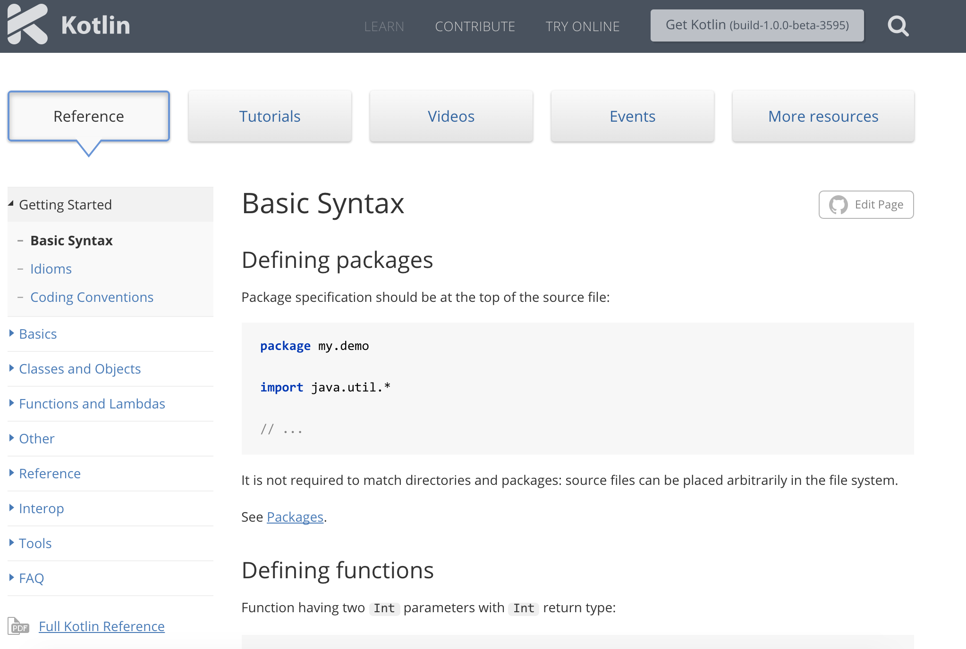
It works… but how do I make it work
Documentation at official website
www.kotlinlang.org

Slide 18
It works… but how do I make it work
Documentation at official website
Skillscast recording of Jake Wharton at DroidCon UK
https://skillsmatter.com/skillscasts/6651-advancing-development-with-the-kotlin-language

Slide 19
It works… but how do I make it work
Documentation at official website
Skillscast recording of Jake Wharton
Fragmented podcast with Hadi Hariri from Jetbrains
http://fragmentedpodcast.com/episodes/20/

Slide 20
It works… but how do I make it work
Documentation at official website
Skillscast recording of Jake Wharton
Fragmented podcast with Hadi Hariri
Talk of Michael Prado at DroidCon New York
https://realm.io/news/droidcon-michael-pardo-kotlin/

Slide 21
It works… but how do I make it work
Documentation at official website
Skillscast recording of Jake Wharton
Fragmented podcast with Hadi Hariri
Talk of Michael Prado
Ask me, I have like 1 month of experience, so that’s about 33% of the lifetime of version 1.0.0 beta

Slide 22
Awe… perhaps applause and
Questions

