Slide 1

The next level of coding on the JVM
Kotlin

Slide 2
What are we about to witness
?
Who am I listening to?
Why should I care about Kotlin?
The basics
The cool stuff
How do I get my hands on it?
Uhmmm.. I might need some help on this
Awe and applause

Slide 3


The about box
David Hardy
high tech ict
www.endran.nl

Slide 4
Why Kotlin
Android stuck on Java 6.. Or 7.. Or 8
Java can be way to verbose
Ceremonies and red tape
Non capturing anon inner classes
Lambda’s, Streams, try with resources
Notes:
Why do we need uodate of Java:
Try with resources
Lambdas
Streams

Slide 5
Why Kotlin
Restriction of Java
No way of adding methods to classes
Nullabilty all over the place
A lot of code needed for basic stuff
Problems with Android
A lot of nulls
A lot of inheritance
A lot of code needed for basic stuff
Notes:
How many util classes do you have?
How many null checks or Nullability annotations do you use

Slide 6
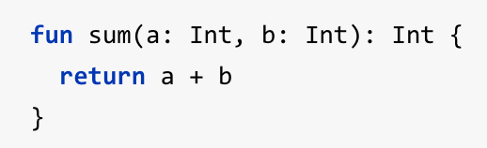

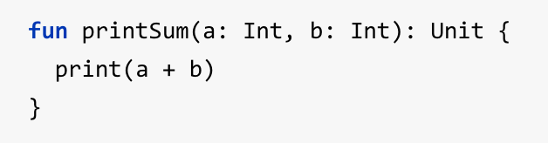
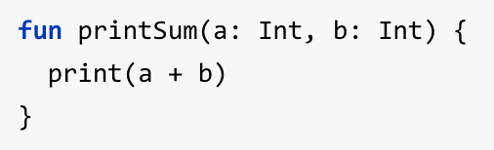
Crash course Kotlin
Function Declaration
Name of variable : Type
Return type on the end
Function with expression body
Return type inferred
Function with “void” return type
Method invocation
Unit return type can be omitted

Slide 7



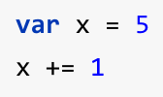
Crash course Kotlin
Value; write once / read only,
Like ‘final int a = 1;’
Type inferred
Declaration and non option assignment
Variable; mutable value

Slide 8
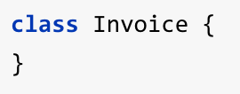
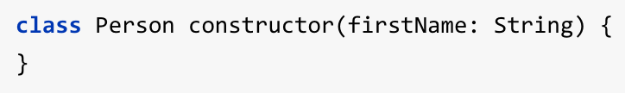
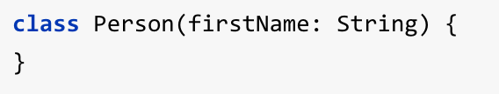
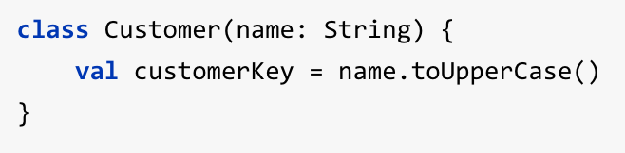
Crash course Kotlin
Class, regular POJO
Primary constructor
Can be omitted if no modifier, and no secondary constructor
Can be used for initialization

Slide 9
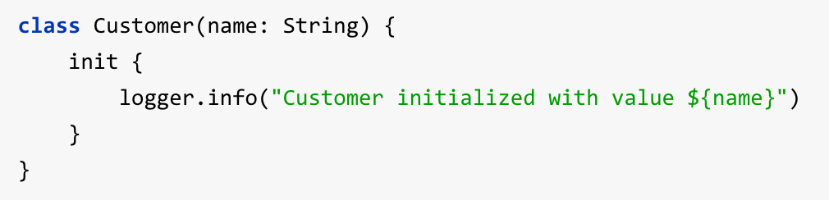
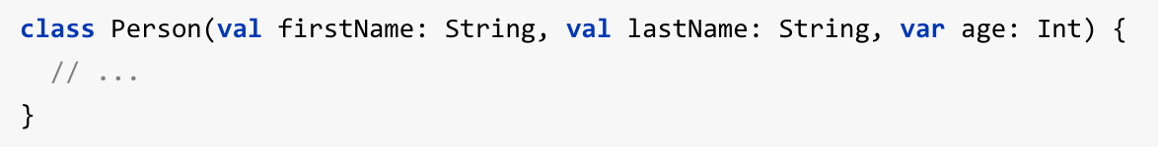
Crash course Kotlin
Execute logic (and string interpolation)
Properties, public by default
Immutable data containers

Slide 10









Crash course Kotlin
Mutable, but never null
Optional, can be null
Safe calls will only execute if non-null
Elvis operator
NPE operator

Slide 11
Demotime!
How to add to project
Convert from Java
Function Extensions
Lambda’s
Notes:
Why do we need uodate of Java:
Try with resources
Lambdas
Streams

Slide 12
Why Kotlin
Backing parties, Jake Wharton
Optimized for tooling
Jetbrains.. So here to stay
More than a non-profit thing, they depend on it. Selling idea’s is their business
Kotlin is optimized for toolability

Slide 13
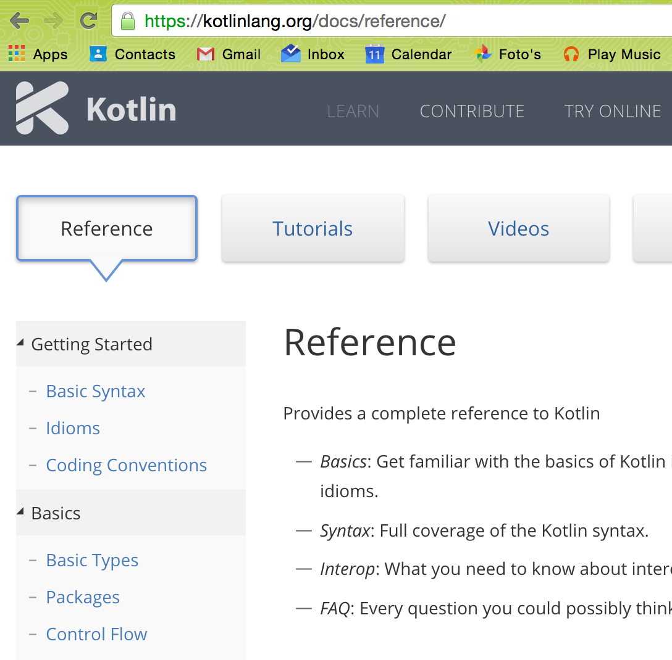
It works… but how do I make it work
Documentation at official website
www.kotlinlang.org

Slide 14
It works… but how do I make it work
Documentation at official website
Skillscast recording of Jake Wharton
https://skillsmatter.com/skillscasts/6651-advancing-development-with-the-kotlin-language

Slide 15
It works… but how do I make it work
Documentation at official website
Skillscast recording of Jake Wharton
Fragmented podcast with guys from IntelliJ
http://fragmentedpodcast.com/episodes/20/

Slide 16
It works… but how do I make it work
Documentation at official website
Skillscast recording of Jake Wharton
Fragmented podcast with guys from IntelliJ
Ask me, I have like 1 month of experience, so that’s about 33% of the lifetime of version 1.0.0 beta

Slide 17
Awe… perhaps applause and
Questions

