Slide 1
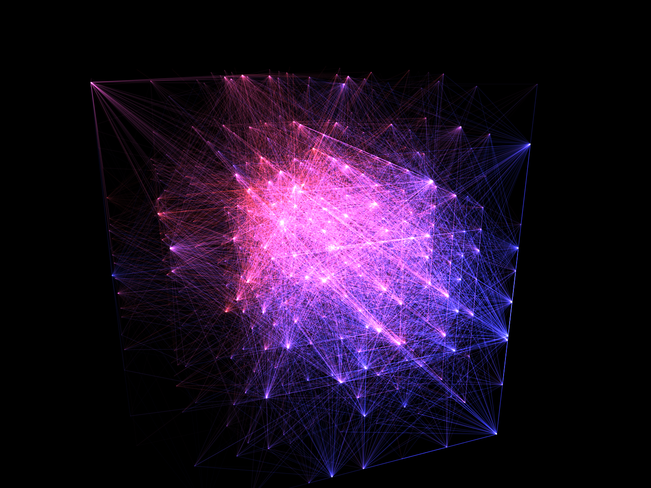
A Deep Learning Approach to Thyroid Disease Classification
A presentation by Endri Kastrati
October 19, 2017
Notes:
Good afternoon everyone, I’m Endri Kastrati and I will be presenting my computer science project title A deep learning approach to thyroid disease classification.

Slide 2
Introduction
Medical diagnosis is difficult and complex
Preexisting data-sets rich in features and content
Re-emergence of artificial neural networks
Confidence reinforcement tool, not a replacement
Notes:
The diagnosis of thyroid diseases is a very difficult and complex process that depends on a variety of medical factors and empirical tests. The accumulation of vast quantities of data by medical institutions and the increase in computational power has led to the re-emergence of artificial neural networks. The purpose of these models is not to replace the expert but rather enhance their diagnostics skills.

Slide 3
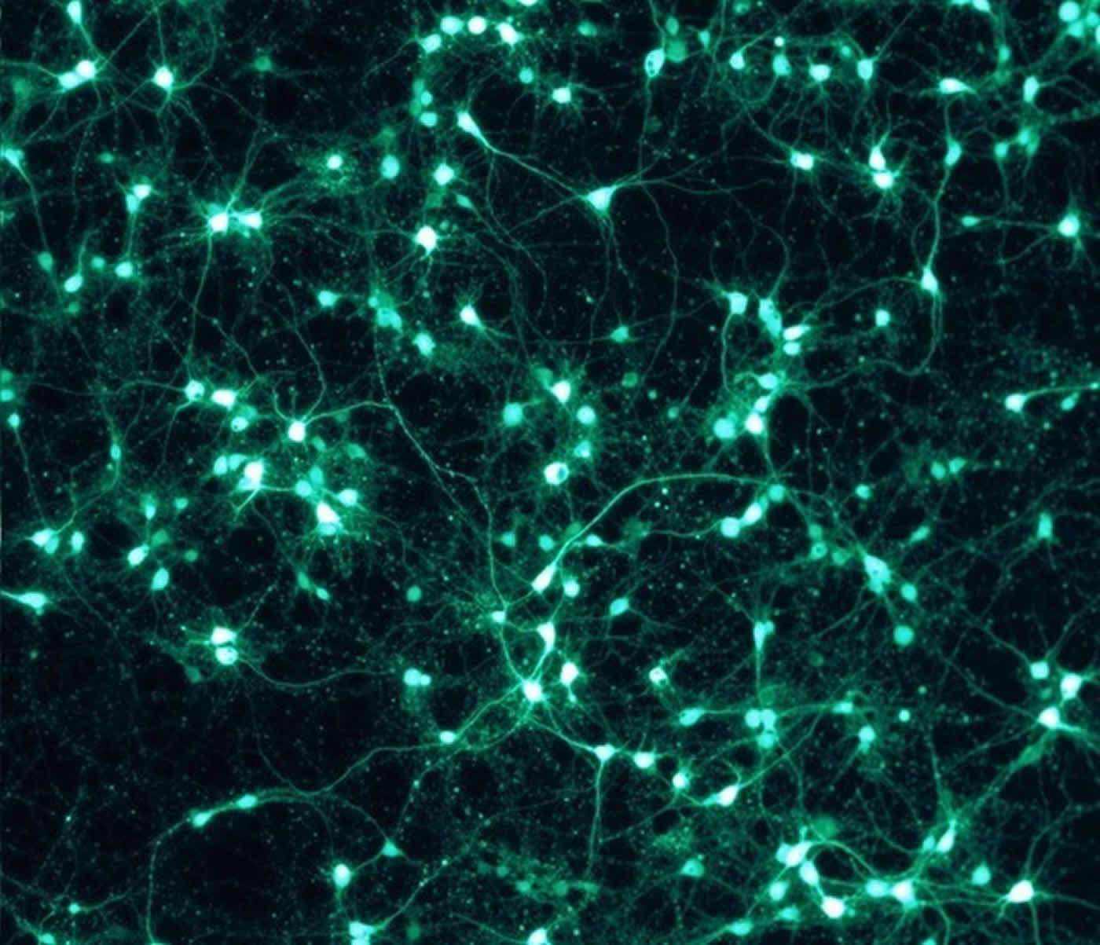
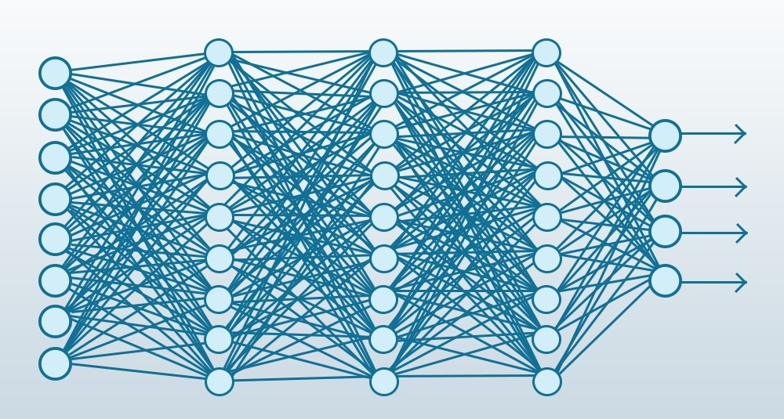
Artificial Neural Networks
A set of supervised learning algorithms
Computational models based on biological systems
Black-box model / encoded generalization
Pattern classification
Curve approximation
Time-variant systems
Notes:
An artificial neural network is an abstract concept of a computational model, based on biological systems, that can extract patterns from data-sets. During the training process a generalizer is encoded within the synaptic weights of the neural network. This encoding prevents us from gaining any insight regarding the inner-workings and that is why ANN are also refereed to as block-box models. Neural nets are used primarily for pattern classification, curve approximation and prediction in time-variant systems.

Slide 4
Aims and Objectives
“Deployment of artificial neural networks for the precise classification of diagnostics regarding thyroid diseases.”
Notes:
The main object of this project is the deployment of artificial neural networks for the precise classification of diagnostics regarding thyroid diseases.

Slide 5
Deliverables
Design of an artificial neural network library
Unix application programming interface
A minimalist web application for the medical expert
Notes:
The project has three deliverables, the first deliverable is the design of a portable and highly flexible ANN library. The second deliverable is the implementation of a command line program that can train models based on data-sets and save into or load from the file-system for future deployments. The command line program will be used to built an optimal thyroid disease classifier. The final deliverable is simple web application interface that can interact with the trained classifier.

Slide 6

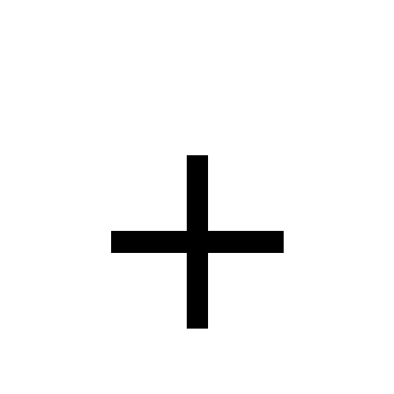
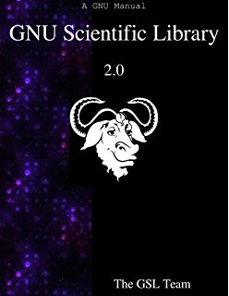
ANN library
Written in the C programming language
Extensive use of the GNU scientific library
Highly portable / minimalist design ( 5 modules + main )
Computational properties
  Time complexity: O(n³) per training epoch
  Space complexity: O(n²) per training process
Notes:
The first project deliverable is the Artificial neural network library. The library is written in the C programming language and uses the GNU scientific library for vector and matrix operations. The nested loops per training epoch never exceed the upper bound complexity of cubic power. The size of memory allocated depends entirely on the number of rows and columns per data-set which yields an upper bound complexity of quadratic power.

Slide 7
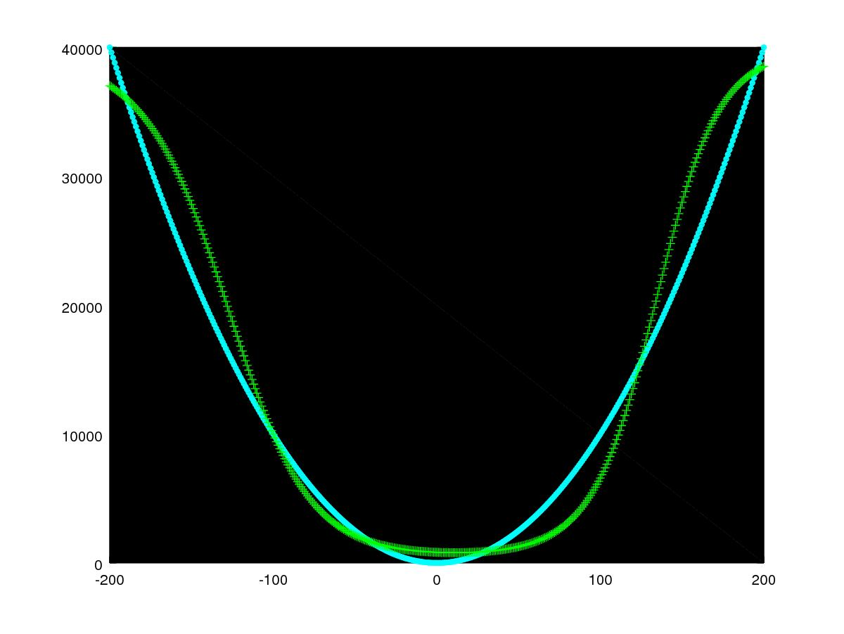
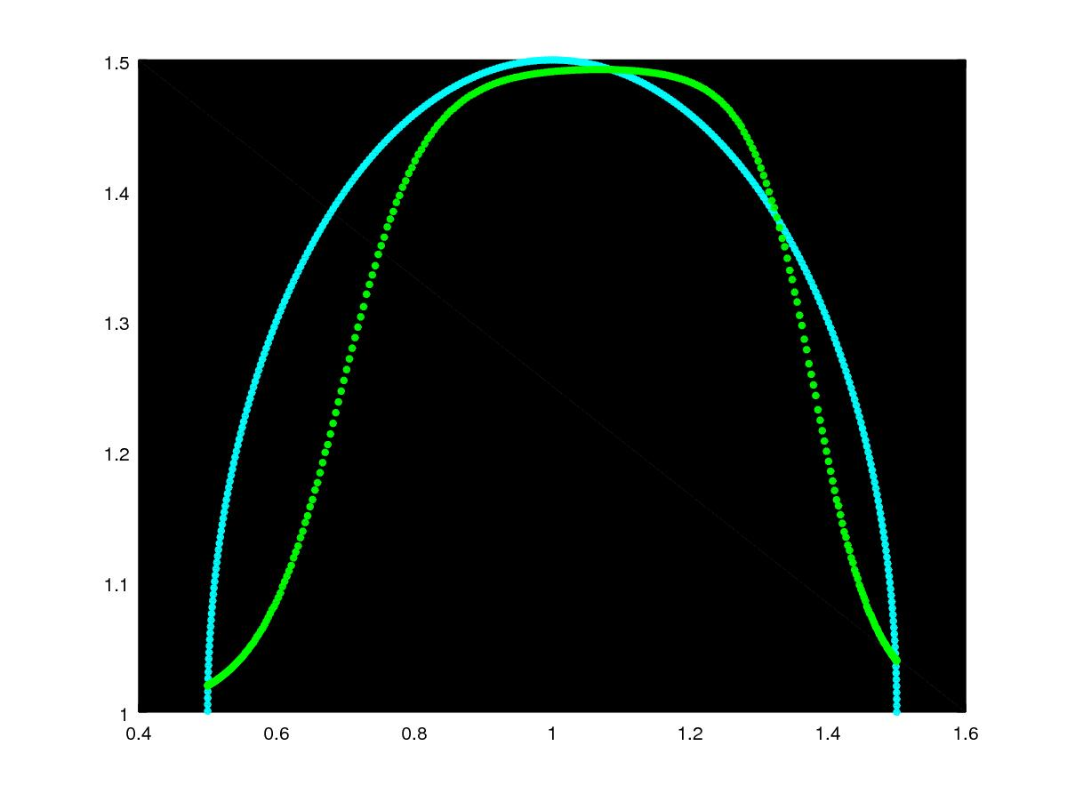
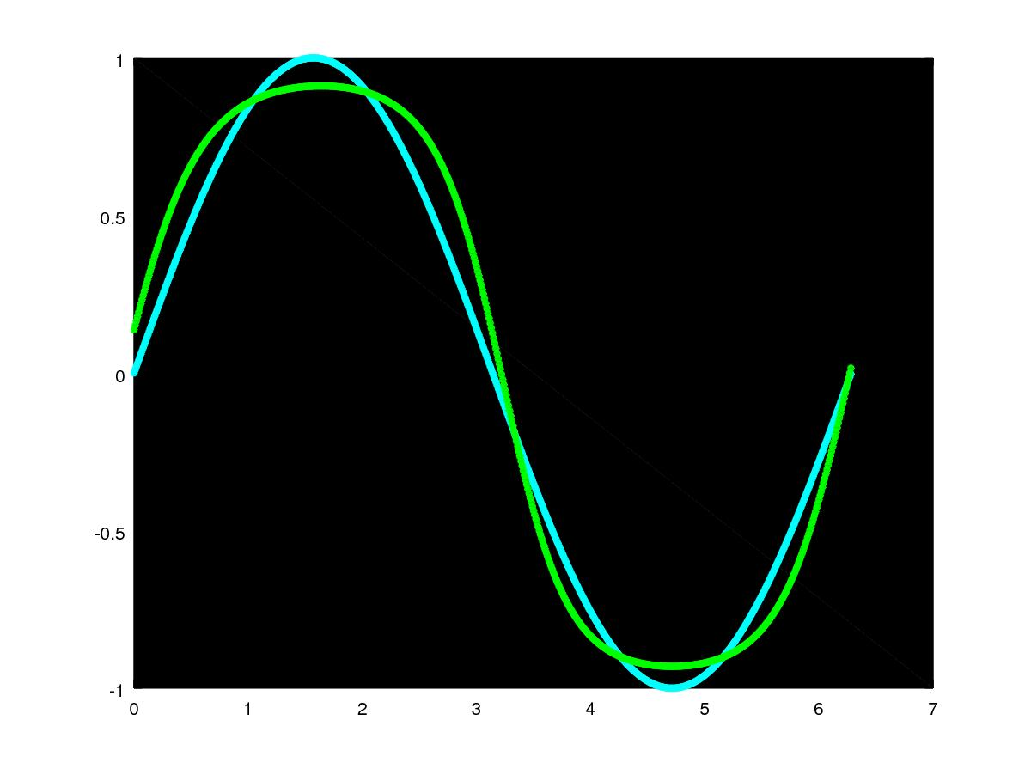
Correctness of ANN library
“Multi-layer feed-forward neural networks are universal function approximators”
M. Stinchcombe, H. White and K. Hornik
Notes:
As we previously mentioned, ANN are black-box models so it is really hard to prove correctness explicitly. But we can prove the correctness implicitly by gathering empirical evidence and showing that the library holds the properties of an universal function approximator.

Slide 8
Thyroid disease dataset
Established by the department of mathematics and statistics at James Cook University, Australia
Used for the comparison of multivariate discriminant techniques and medical decision making applications.
Dataset contains 5 features and 3 target classes, euthyroidism, hyperthyroidism and hypothyroidism.

Slide 9
Dataset class distributions
Notes:
The class distributions are satisfactory, with 70% of the instances belong to the hyperthyroidism class, while 14% and 16% belong to the hyperthyroidism and hypothyroidism classes respectively.

Slide 10
Obtaining a classifier
Through repetitive experimentation the following configurations give an optimal thyroid disease classifier.
Neural layers: | 2
Neurons per layer: | 20,3
Activation function: | Logistic function
Convergence rate: | 1e-12
Learning rate: | 0.5
Momentum rate: | 0.009
Epochs: | 700

Slide 11
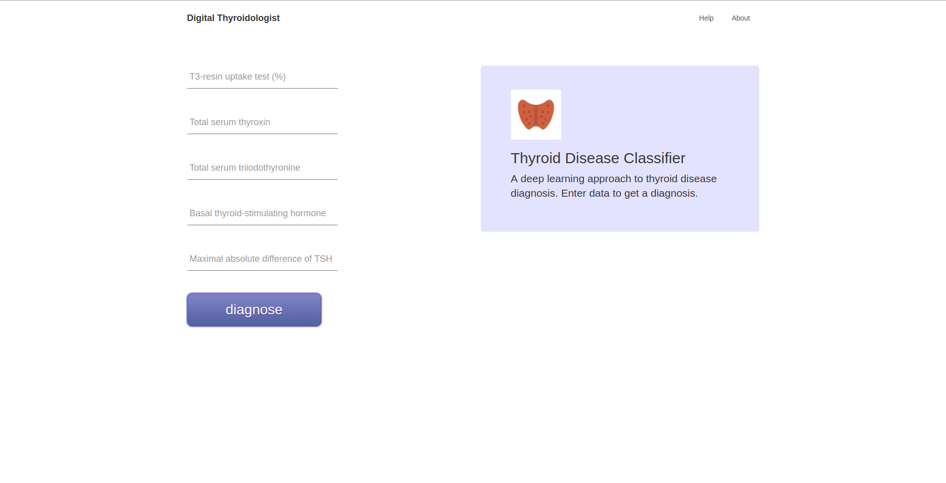
Web application
A simplified interface for interacting with the classifier
Nodejs environment and express framework
Using processes and web sockets for real-time interaction

Slide 12
Demonstration
Iris flower classifier, training and deployment
Curve approximation and visualization via octave
Thyroid disease classifier, training and deployment
Web application interface demo
Notes:
5.2 4.1 1.5 0.1 - Iris Setosa
5.5 2.4 3.8 1.1 - Iris Versicolour
6.7 2.5 5.8 1.8 - Iris Virginica
2.2 122 9.7 1.6 0.9 – Euthyroidism
-0.6 84 21.5 2.7 1.1 – Hyperthyroidism
25.9 125 3.7 1.1 8.5 – Hypothyroidism

Slide 13
Future
Expand the capabilities to support time-variant systems
Higher levels of abstractions to support all kinds of ANN
Genetic algorithms to find optimal ANN configurations
Implementation of cross-validation techniques
Improve design of web interface

Slide 14
Conclusion
ANNs are excellent models for pattern classification
ANNs can reduce the degree of uncertainty
Depend on the quality and size of the data-sets
Difficult to figure optimal configuration

Slide 15
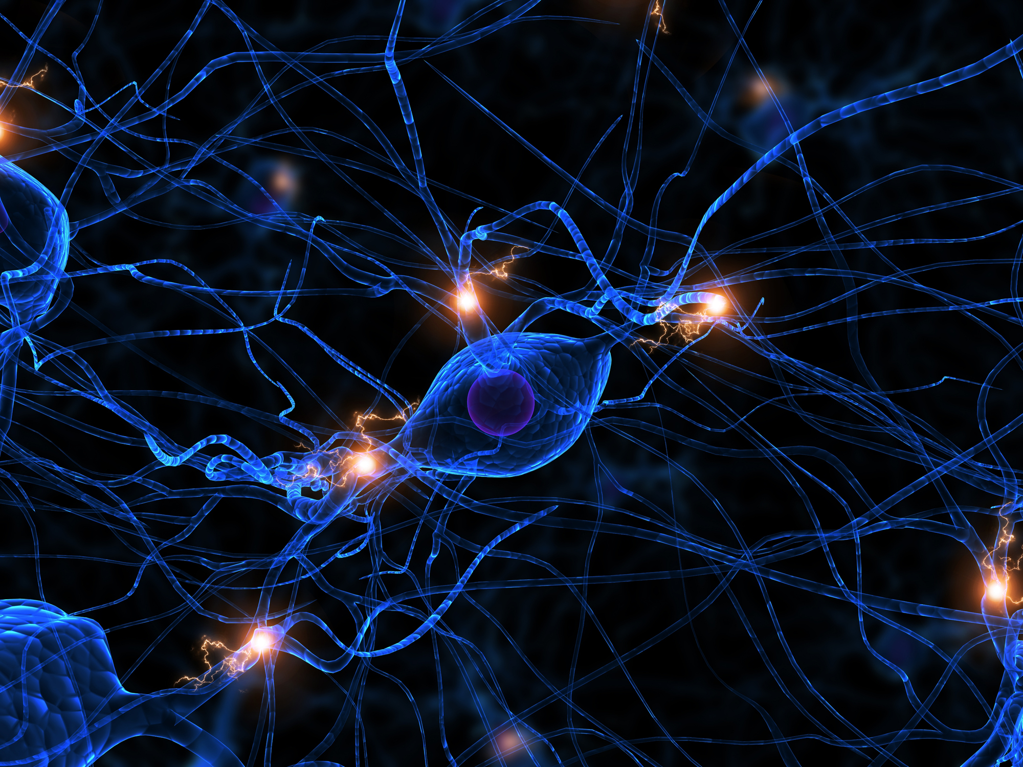
The End, Thank you!

