Slide 1
COMPSYS701
Designing a ReCOP

Slide 2
Differences between Phases 1 &2

Slide 3
Differences between SystemC and VHDL

Slide 4
Recop Capabilities
Instructions relating to the ring counter
Load, ALU operations, Jump etc

Slide 5
Recop Incapabilities
Unable to complete data calls
Blocking working to a certain degree
Non Blocking not quite implemented

Slide 6
Ring Counter Simulation Results

Slide 7
Ring Counter Synthesis Results
Resource Usage Count
LEs
852
Maximum Operating Frequency

Slide 8
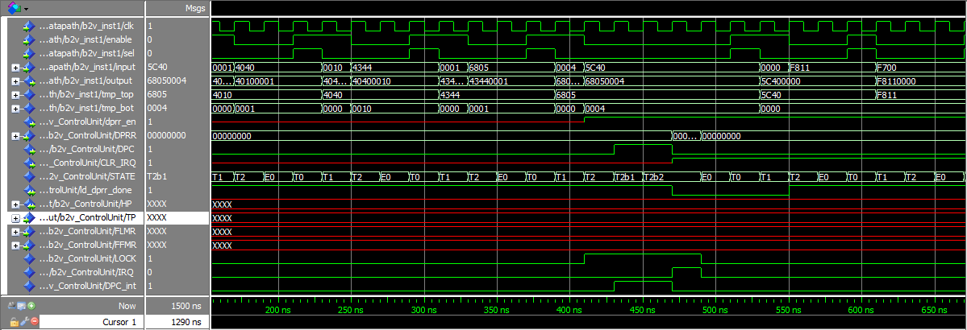
Blocking Data Call Simulation

Slide 9
Blocking Call Synthesis Results

Slide 10
Non-Blocking Future Development
Adding the FIFO memory to communicate between the ReCOP and the JOP
Changing Control Unit to allow for correct operation
Writing an adequate testbench

Slide 11
Group Work and Hours
NAME | Sections worked on | Hours
Endrico Bester | Component Creation, Datapath, Simulation | 30
Diwakar Somu | Component Creation, Synthesis, Simulation
Noah Miller | Component Creation, Control Unit

