Slide 1
COMPSYS701
Designing a ReCOP

Slide 2
Differences between Phases 1 &2

Slide 3
Differences between SystemC and VHDL

Slide 4
Recop Capabilities
Instructions relating to the ring counter
Load, ALU operations, Jump etc

Slide 5
Recop Incapabilities
Unable to complete data calls
Blocking working to a certain degree
Non Blocking not quite implemented

Slide 6
Ring Counter Simulation Results

Slide 7
Ring Counter Synthesis Information
Resource Usage Count
LEs
852
Maximum Operating Frequency

Slide 8
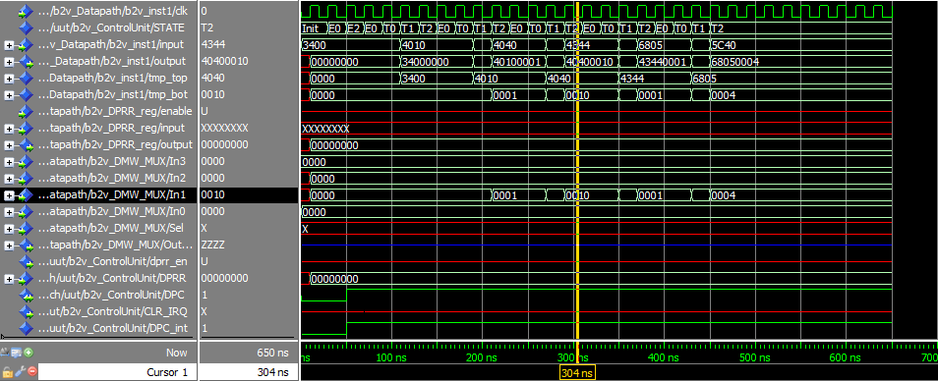
Blocking Data Call Simulation

Slide 9
Group Work and Hours
NAME | Sections worked on | Hours
Endrico Bester | Component Creation, Datapath, Simulation | 30
Diwakar Somu | Component Creation, Synthesis, Simulation
Noah Miller | Component Creation, Control Unit

