Slide 1
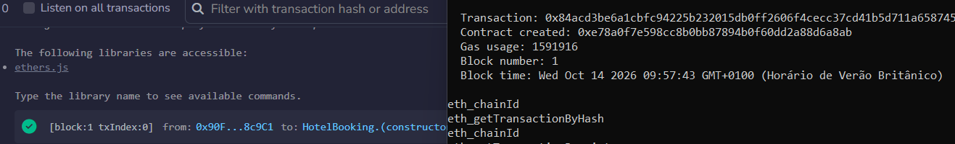
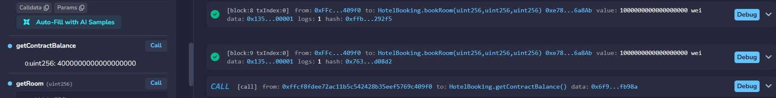
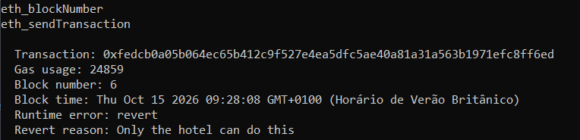
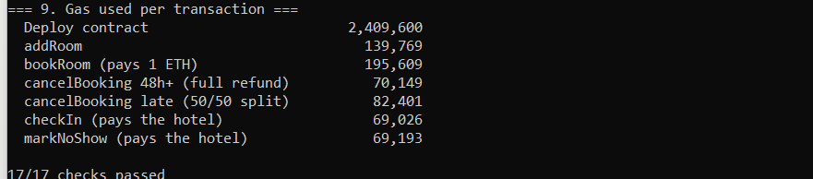
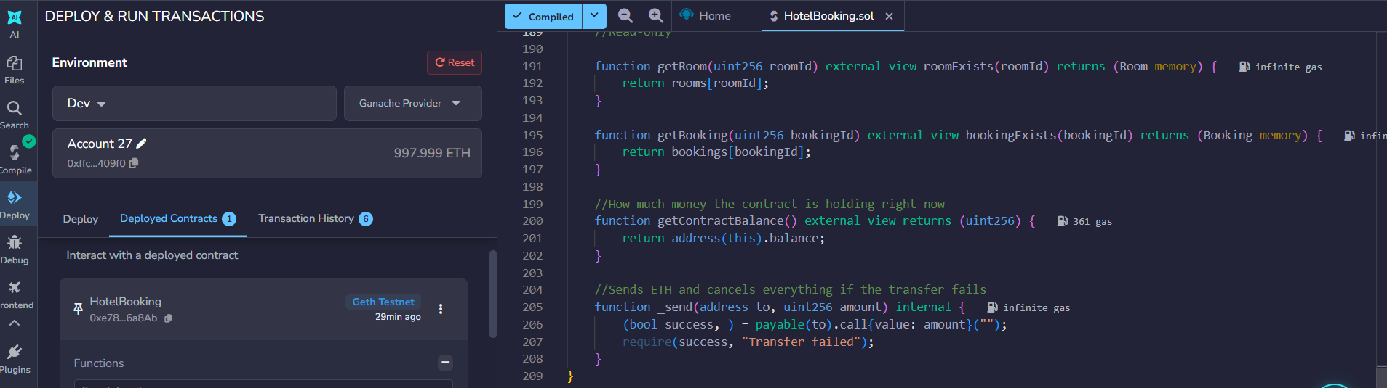
Hotel Booking on the Blockchain: a Smart Contract Escrow between Guest and Hotel
Endrius Alberto Mazui Noronha (2024241) · BSc (Hons) in Computing in IT · CCT College Dublin · Distributed Digital Transactions – CA1 · November 2026
Keywords: smart contract · escrow · Solidity · ECDSA · hotel distribution GitHub: github.com/Endrius-Albert/Hotel-booking-dapp
INTRODUCTION
SYSTEM DESIGN
RECENT ADVANCEMENTS
TESTING AND RESULTS
Online Travel Agencies (OTAs) hold guests' payments, set cancellation rules and take commission on every hotel booking. This project proposes a decentralised application (DApp) in which an Ethereum smart contract replaces that middleman: the guest (sender) pays the contract, which holds the money in escrow until public rules release it to the hotel (receiver) or refund the guest.
The hotel deploys the contract and becomes its owner; every other account is a guest. Each booking ends in exactly one final state, and every action first checks that it is still Booked, so money can only move once.
NFT
Resellable bookings
€
Regulated stablecoins
Functions were first tested by hand in Remix on Ganache. Then run.sh starts a fresh Ganache and interact.py deploys the contract and runs 17 checks, moving the chain clock forward with evm_increaseTime. All 17 passed and the contract ended with 0 ETH.
Takyon and Buk turn bookings into tokens that can be resold, creating a second-hand market for hotel stays (Aysan, Tunali and Gozgor, 2023).
MiCA has fully applied since December 2024, so a hotel can be paid in EURC without crypto volatility (Norton Rose Fulbright, n.d.).
«contract» HotelBooking
«struct» Room
Area | Scenario | Expected | Result
Access | Guest calls addRoom | Rejected | PASS
Access | Other account cancels a booking | Rejected | PASS
Access | Guest confirms check-in | Rejected | PASS
Payment | Wrong amount / hotel books own room | Rejected | PASS
Payment | Room already booked | Rejected | PASS
Escrow | 4 bookings of 1 ETH | 4 ETH held | PASS
Refund | Cancel 48h+ before | 100% to guest | PASS
Refund | Cancel later | 50% / 50% | PASS
Time | Check-in or no-show too early | Rejected | PASS
Time | +3 days: check-in, no-show | 1 ETH each to hotel | PASS
Security | Second check-in | Rejected | PASS
Final | Contract balance | 0 ETH | PASS
hotel : address
id, pricePerNight
L2
Cheaper Layer 2
ID
EU Digital Identity Wallet
THE CURRENT SYSTEM
roomCount, bookingCount : uint256
name : string
FREE_CANCELLATION_WINDOW = 48 hours
available, isBooked
Ethereum's Dencun upgrade (March 2024) cut Layer 2 fees by 63–88% within 48 hours (Fig. 8).
Required in every EU state by the end of 2026 and already piloted at hotel check-in (EU Perspectives, 2026).
NO_SHOW_WINDOW = 24 hours
«struct» Booking
Direct sales still lead, but OTAs grew from 19.7% of European hotel bookings in 2013 to 29.9% in 2025, and the OTA market is concentrated in two groups (Figs. 1–2). Commission typically ranges from 10% to 30% and is charged even on no-shows. In 2024 Booking Holdings was named a gatekeeper under the EU Digital Markets Act (PhocusWire, 2026).
+ addRoom(name, price) «onlyHotel»
id, roomId
+ setRoomAvailability(id, bool)
guest : address
+ bookRoom(id, date, nights) «payable»
checkInDate, nights
+ cancelBooking(id) «guest only»
amountPaid
+ checkIn(id) «onlyHotel»
status : Status
+ markNoShow(id) «onlyHotel»
+ getRoom / getBooking / getContractBalance
«enum» Status
− _send(to, amount) «internal»
Booked · CheckedIn
Cancelled · NoShow
Fig. 5 – UML class diagram of HotelBooking.sol
Fig. 8 – Layer 2 fees after EIP-4844 (Haig, 2024)
Table 3 – Test matrix
Sender – middle layer – receiver interaction
BENEFITS AND CHALLENGES
Guest (sender)
HotelBooking contract
Hotel (receiver)
Benefits
Challenges
bookRoom(id, date, nights) + 1 ETH
addRoom("Room 101", 1 ETH)
Lower cost: no 10–30% commission, only network fees.
Transparent rules: the refund policy is public code, fixed at booking.
Guaranteed escrow: the hotel sees the money is locked; the guest knows it is released only at check-in.
Automatic refunds: no customer service and no waiting.
Shared audit trail: every step is an event both sides can check.
Check-in trust: the contract cannot see the guest arrive, so it relies on the hotel; trust is reduced, not removed.
GDPR: on-chain data cannot be erased and wallet addresses are personal data (EDPB, 2025); only addresses are stored.
Key loss: lost keys cannot be recovered; $3.4bn was stolen in 2025 (The Block, 2025).
Permanent bugs: deployed code cannot simply be changed, hence the 17 tests.
Adoption: few guests use wallets, and OTAs still bring the visibility.
Fig. 1 – OTA share in Europe Fig. 2 – OTA market, 2025 (PhocusWire, 2026)
alt
1 ETH held in escrow
Fig. 11 – Gas per function (deploy: 2,409,600); booking costs most because it stores data
[guest arrives]
checkIn(id)
[cancels 48h+ before]
1 ETH (100%)
cancelBooking(id)
1 ETH refund
Fig. 12 – Deployment: Remix transaction and Ganache "Contract created" in block 1
[cancels later]
cancelBooking(id)
Fig. 3 – Typical OTA commission ranges (Guesty, n.d.; Preno, n.d.)
0.5 ETH
0.5 ETH
PROPOSED BUSINESS MODEL
[no-show, 24h after date]
markNoShow(id)
The benefits sit in the middle of the process, where money and rules live; the challenges sit at the edges, where the blockchain meets the real world.
Fig. 13 – Four bookings paid: 4 ETH held by the contract (escrow)
TODAY
1 ETH (100%)
Guest
OTA platform
holds the money · sets the rules
10–30% commission
Hotel
Fig. 6 – UML sequence diagram: solid = function call, dashed green = ETH transfer
SMART CONTRACT IMPLEMENTATION
CRYPTOGRAPHY: ECDSA + KECCAK-256
Remix IDE
write · compile
Ganache
local blockchain
Python
web3.py tests
Shell
run.sh
WITH THIS DAPP
Private key
256-bit secret
ECDSA
secp256k1: × G
Public key
512-bit
Keccak-256
last 20 bytes
Address
0x90F8…c9C1
Fig. 14 – Ganache rejects the guest: "Only the hotel can do this"
Guest
(sender)
Smart contract (middle layer)
escrow · public rules
network fees only
Hotel
(receiver)
Solidity 0.8.20 (EVM: Paris), 209 lines, 6 events. Every money-moving function follows checks–effects–interactions: the status changes before ETH is sent, which blocks double payments and re-entrancy.
Fig. 4 – The contract takes over the payment role of the OTA
Hotel signs tx
with private key
Nodes verify
ECDSA signature
msg.sender
= proven address
onlyHotel
checkIn() allowed
The disruption is not new hotels or new guests but a new middle layer: code instead of a company. Visibility is the one OTA role the contract cannot replace, so the model pairs it with metasearch, which 58% of European hotels already connect to directly and which can link guests straight to the hotel's own booking page.
Fig. 7 – Address derivation (top) and how a signature becomes access control (bottom)
function checkIn(uint256 bookingId) external onlyHotel bookingExists(bookingId) {
Booking storage booking = bookings[bookingId];
require(booking.status == Status.Booked, "Booking is not active"); //checks
require(block.timestamp >= booking.checkInDate, "Too early to check in");
booking.status = Status.CheckedIn; //effects
rooms[booking.roomId].isBooked = false;
_send(hotel, booking.amountPaid); //interaction
emit CheckedIn(bookingId, booking.amountPaid);
}
Authentication and non-repudiation. Only the private-key holder can produce a valid signature, and the contract trusts the proven address (msg.sender): only the guest can cancel, only the hotel can confirm check-in, and neither can deny an action.
Integrity. Keccak-256 fingerprints every transaction and block, and each block stores the previous hash, so editing a past booking breaks the chain.
Limit. Signatures do not hide data, so no names or documents are stored on-chain.
Fig. 15 – Automated run of scripts/run.sh: gas report and 17/17 checks passed
CONCLUSION
Aspect | Today (OTA) | With the DApp
Who holds the money | The platform | The contract (escrow)
Who sets the rules | Platform terms | Public code, fixed at booking
Cost to the hotel | 10–30% commission | Network fees only
Refunds | Customer service | Automatic and instant
Record of events | Private database | Public event log
Trust placed in | The platform | Code + hotel at check-in
Fig. 9 – checkIn() from HotelBooking.sol
A smart contract can take over the payment and rule-enforcement role of OTAs: the guest pays, the contract holds the money and the hotel is paid automatically, with every action authenticated by ECDSA signatures. The 17/17 test results show the rules hold. Visibility and trust at check-in remain, so adoption, not technology, is the main barrier.
Method | Proves who acted | Key for ~128-bit security | Verdict
ECDSA (secp256k1) | Yes | 256-bit | Chosen
RSA | Yes | 3,072-bit | Larger keys, higher fees
AES | No (shared key) | 128-bit | Cannot prove the sender
Keccak-256 (hash) | Integrity only | 256-bit digest | Used with ECDSA
REFERENCES
Table 1 – Disruption of the current model
Fig. 10 – Development: HotelBooking.sol (209 lines) compiled in Remix and deployed to Ganache
Aysan, A.F., Tunali, A.S. and Gozgor, G. (2023) 'Non-fungible token potentials for hotel bookings', Annals of Tourism Research Empirical Insights, 4(1), 100087.
Barker, E. (2020) Recommendation for key management: Part 1 – General (NIST SP 800-57 Pt 1 Rev 5). doi:10.6028/NIST.SP.800-57pt1r5.
EDPB (2025) Guidelines 02/2025 on processing of personal data through blockchain technologies. Available at: edpb.europa.eu.
Ethereum.org (2026) Ethereum accounts. Available at: ethereum.org/developers/docs/accounts.
EU Perspectives (2026) EU Digital Identity Wallet faces 2026 deadline. Available at: euperspectives.eu.
Guesty (n.d.) How much does Booking.com charge hosts? Available at: guesty.com.
Haig, S. (2024) Transaction fees on Layer 2 plummet post Dencun. The Defiant. Available at: thedefiant.io.
Norton Rose Fulbright (n.d.) Regulating crypto-assets in Europe: practical guide to MiCA. Available at: nortonrosefulbright.com.
PhocusWire (2026) Hotel direct and OTA distribution in Europe: HOTREC study. Available at: phocuswire.com.
Preno (n.d.) How much commission does Airbnb, Expedia and Booking.com take? Available at: prenohq.com.
Tageskarte (2026) Europäische Beherbergungsbetriebe verzeichnen hohe OTA-Marktkonzentration. Available at: tageskarte.io.
The Block (2025) Crypto hacks hit $3.4 billion in 2025: Chainalysis. Available at: theblock.co/post/382477.
TUROB (2023) HOTREC online distribution channels analysis 2022. Available at: turob.com.
Table 2 – Why ECDSA fits this scenario
Notes:
VIDEO OUTLINE (max. 4:00) – speak in your own words; this text does not print.
0:00–0:20 Introduction: who you are and the problem (OTAs hold the money and the rules).
0:20–0:50 Current system: Figs 1–3 (85%+ in two groups, 10–30% commission, charged on no-shows).
0:50–1:20 Business model: Fig 4 and Table 1 – the contract is the new middle layer between sender and receiver.
1:20–1:45 Design: Fig 5 (class) and Fig 6 (sequence: the four outcomes and where the money goes).
1:45–2:10 Cryptography: Fig 7 and Table 2 – private key -> signature -> msg.sender -> onlyHotel; why not RSA or AES.
2:10–2:30 Recent advancements: stablecoins (MiCA), Layer 2 (Fig 8), NFTs, EU wallet.
2:30–3:30 Live demo: Remix (Figs 9–10), then run scripts/run.sh and comment each block; show escrow (Fig 13) and the revert (Fig 14).
3:30–4:00 Benefits and challenges, then the conclusion.

