Slide 1
TerraVista: Autonomous, Predictive, and Intelligent Garden Management
Leveraging LLMs, CNN, Vision model and RAG for Smart Plant Care
Piyush Kanthak:r23eq071
Jeevan C:R23eq044
Santosh :R23EQ046

Slide 2
Problem Statement
Garden upkeep still depends on manual observation and guesswork.
Plant diseases are detected late, often after irreversible damage.
Growth tracking (grass length, fruit maturity) requires physical inspection.
Unstructured tools like reminders or soil sensors don’t provide real insights.
Lack of integration: No unified view combining vision, weather, and care data.
Inconsistent maintenance: Busy schedules cause skipped watering or late pruning.
Expertise gap: Most home gardeners lack professional-level plant knowledge.
Environmental uncertainty: Weather fluctuations disrupt planting and harvest plans.
Data blindness: Traditional cameras capture rich information that remains unused.
→ The result: reactive care, wasted effort, and missed opportunities for optimal growth.

Slide 3
Product/ Solution - Innovation
What It Is
TerraVista is an AI-powered garden intelligence system that autonomously monitor, understand, and optimize plant care.
It analyzes live video to identify plants, detect diseases, estimate growth, and predict future needs — turning any garden into a self-managing, data-driven ecosystem.
How It Solves the Problems
Replaces manual monitoring with continuous AI vision analysis.
Detects issues early — pests, nutrient deficiencies, or overgrowth — before visible damage.
Provides expert-level guidance via LLM reasoning trained on horticulture data.
Integrates weather forecasts to predict watering, pruning, and harvest timings.

Slide 4
What We’ve Achieved
AI Detection: Trained model detects 4 common apple leaf diseases
Interactive Front-End: Live camera feed with instant disease identification
Smart Recommendations: Language-based guidance for gardeners
Branding Video: 30-second showcase explaining the system

Slide 5
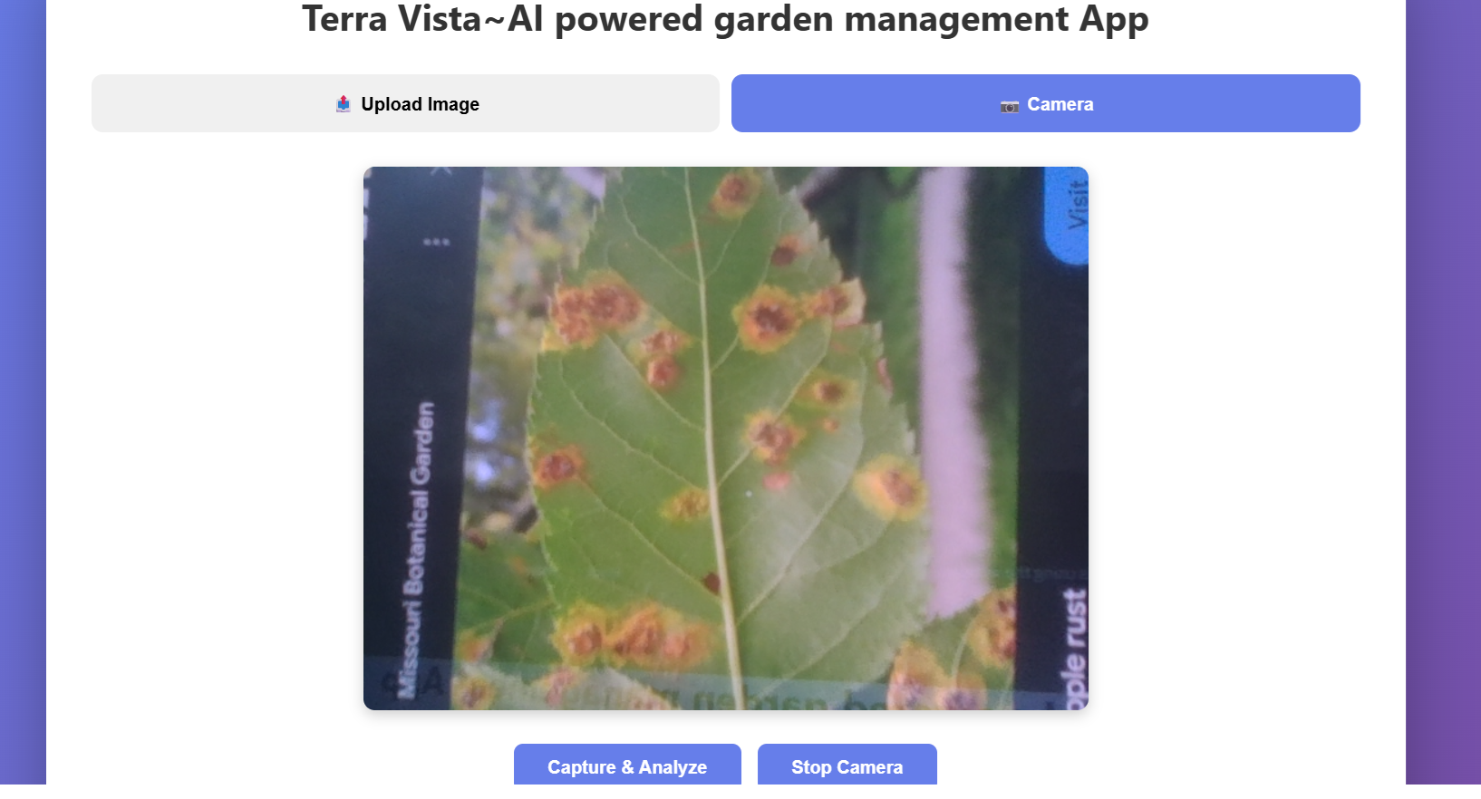
Product showcase

Slide 6
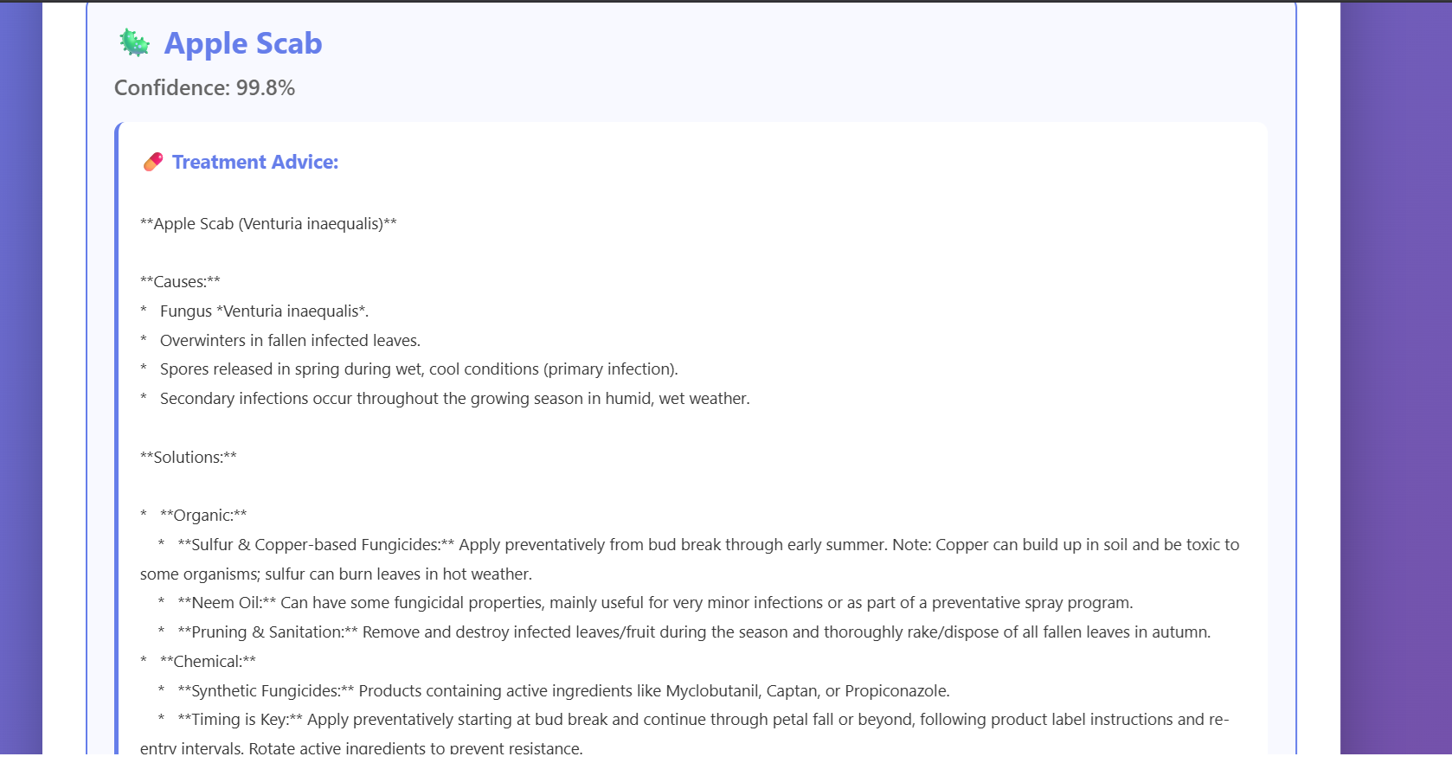
Solutions

Slide 7

Branding video

Slide 8
Future Roadmap
Where We’re Heading Next
Expand AI to more plants and diseases
Add automated irrigation and care recommendations
Deploy on mobile/tablet for wider access
Implementing Vrikshayurveda: Our next implementation

Slide 9
Vrikshayurveda: The Next Evolution
“Our next step: Smarter, holistic gardening guided by centuries of knowledge”
Expand AI Knowledge: Incorporate ancient plant care techniques for actionable insights
Holistic Recommendations: Personalized suggestions combining modern detection + traditional wisdom
Future-Proof & Scalable: Adaptable to multiple plant types and regions
Interactive & Engaging: Mobile-friendly guidance that feels intuitive and alive
“Vrikshayurveda represents our vision of blending technology with nature — smarter gardening starts here.”

Slide 10
.
Thank you

