Slide 1
Fastag Fraud Detection
This project focuses on leveraging machine learning classification techniques to develop an effective fraud detection system for Fastag transactions. The dataset comprises key features such as transaction details, vehicle information, geographical location, and transaction amounts. The goal is to create a robust model that can accurately identify instances of fraudulent activity, ensuring the integrity and security of Fastag transactions.

Slide 2
Steps:
Import Libraries
Read the data set
EDA
Save the file
Train Test Split
Model training
Model comparing
Final Model – LightGBM
Model saving and Prediction

Slide 3
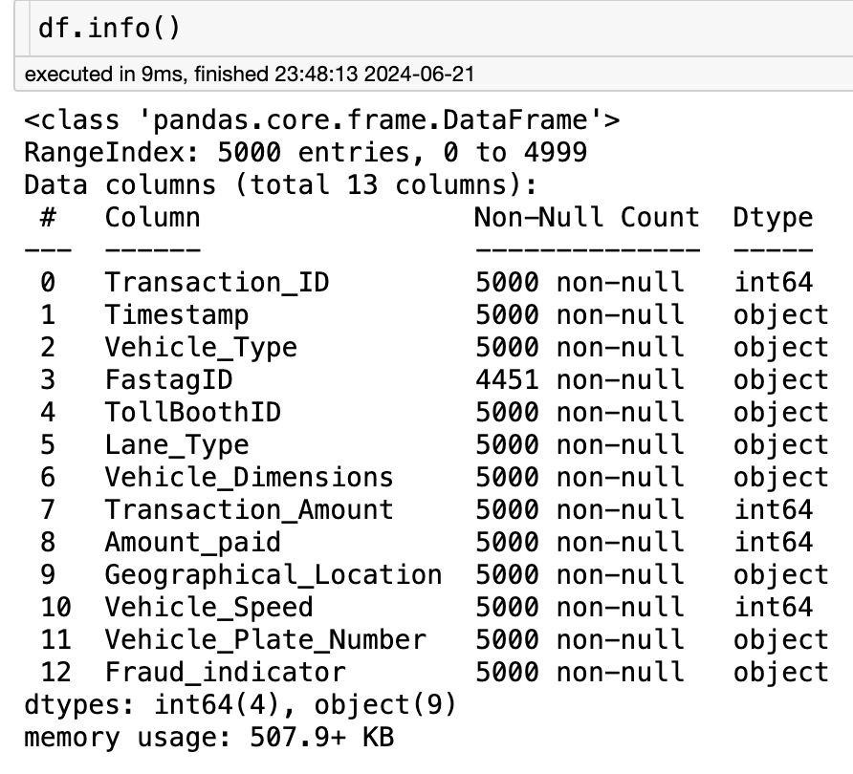
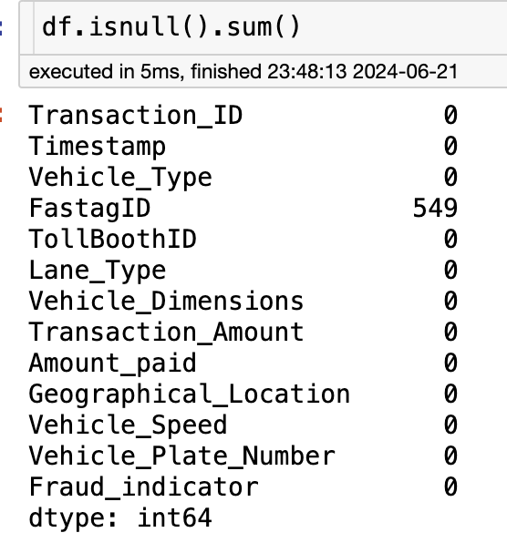
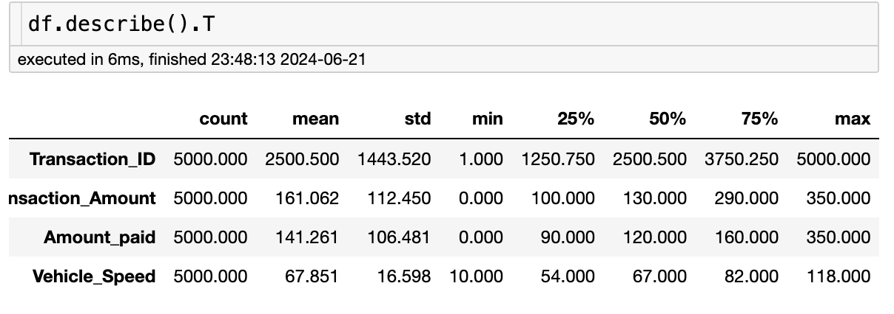
EDA:

Slide 4
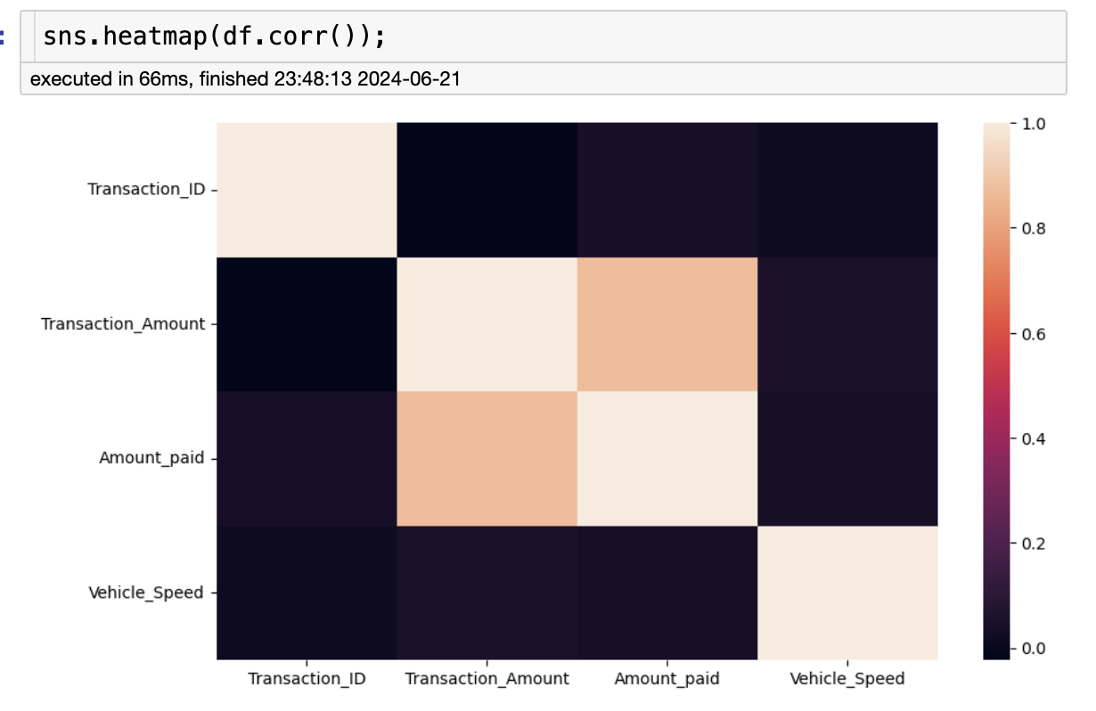
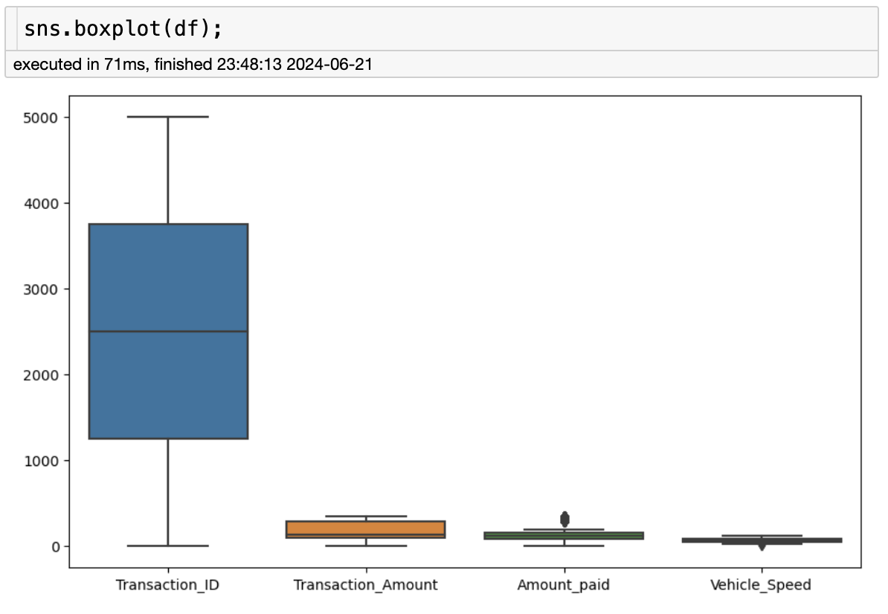
Visualization

Slide 5
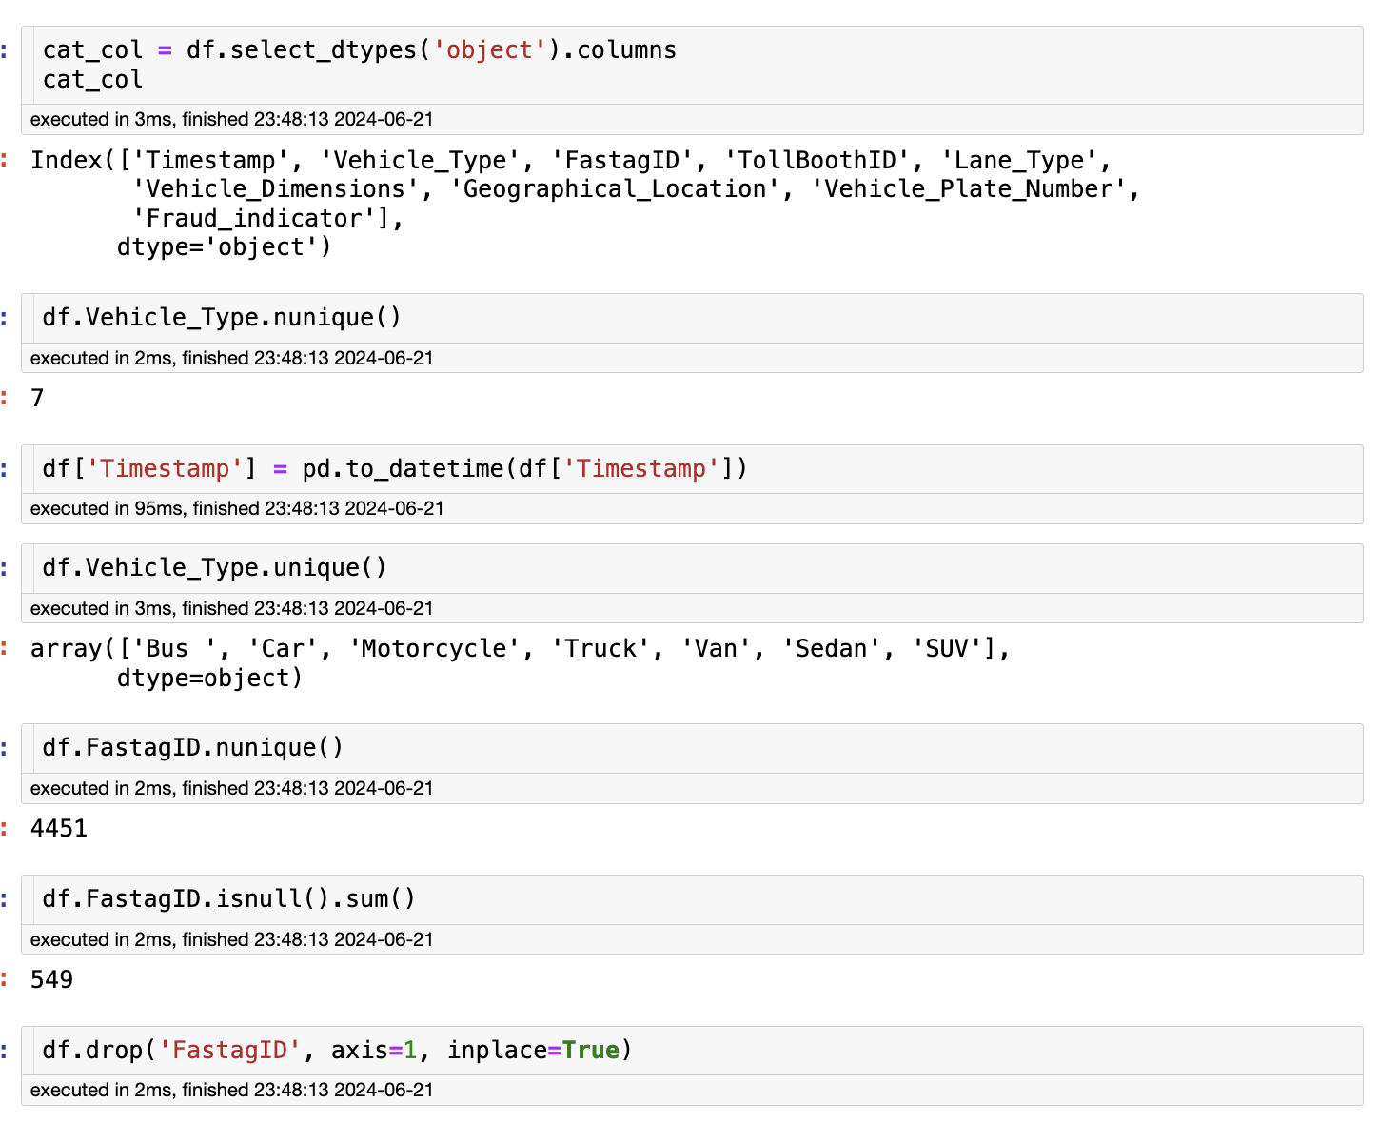
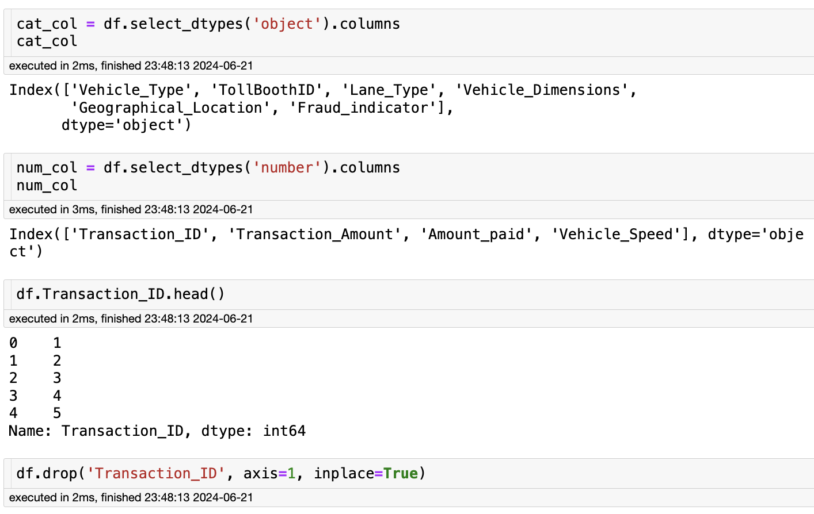
Other controls

Slide 6
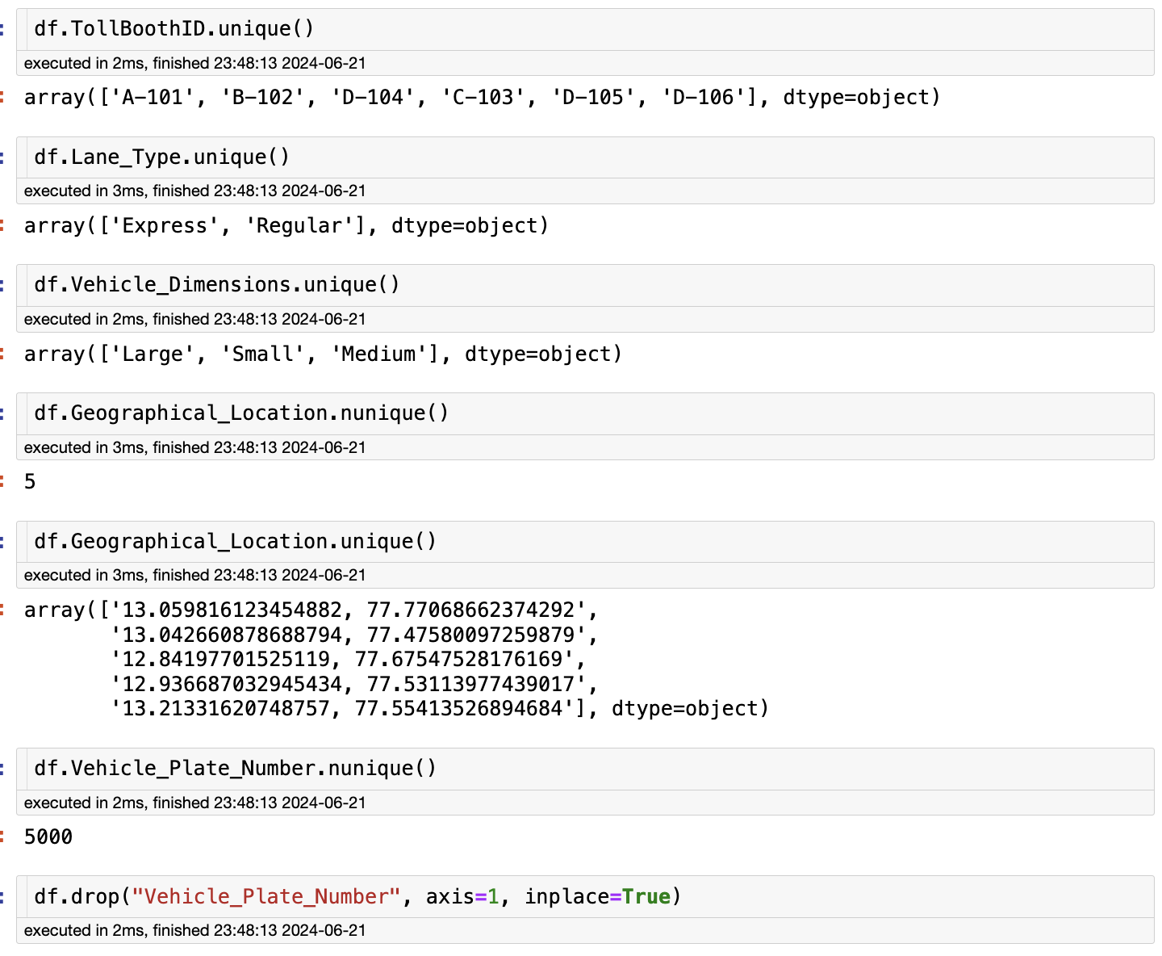
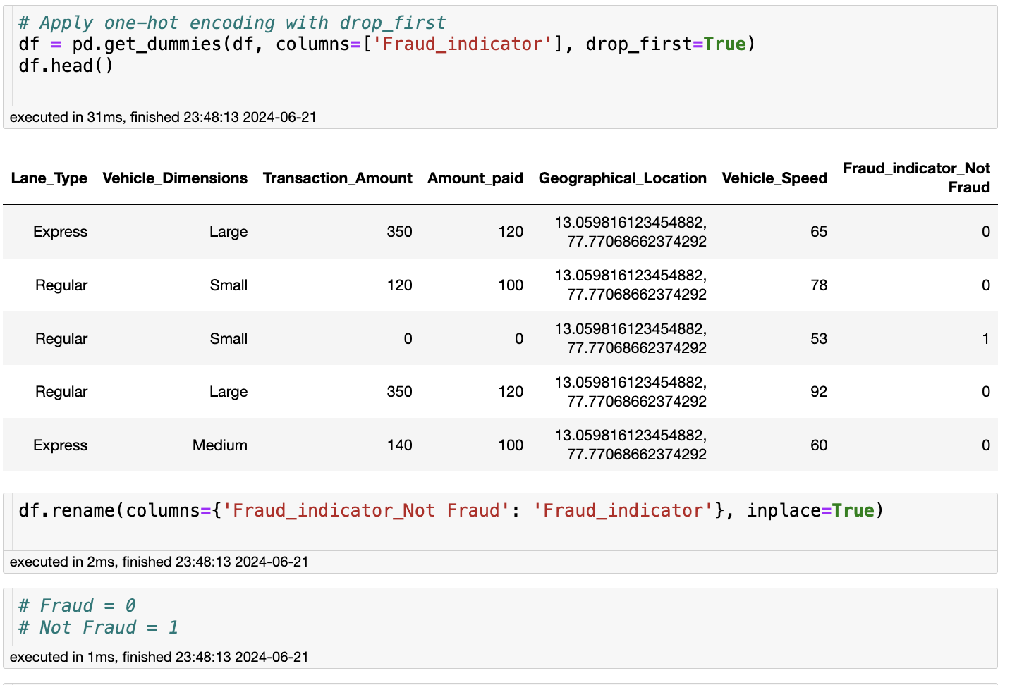
other operations

Slide 7
Save the file
df.to_csv("fastag_eda.csv")

Slide 8
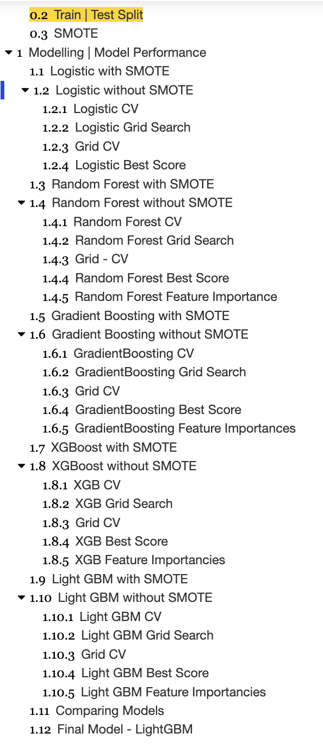
Train Test Split and model training

Slide 9
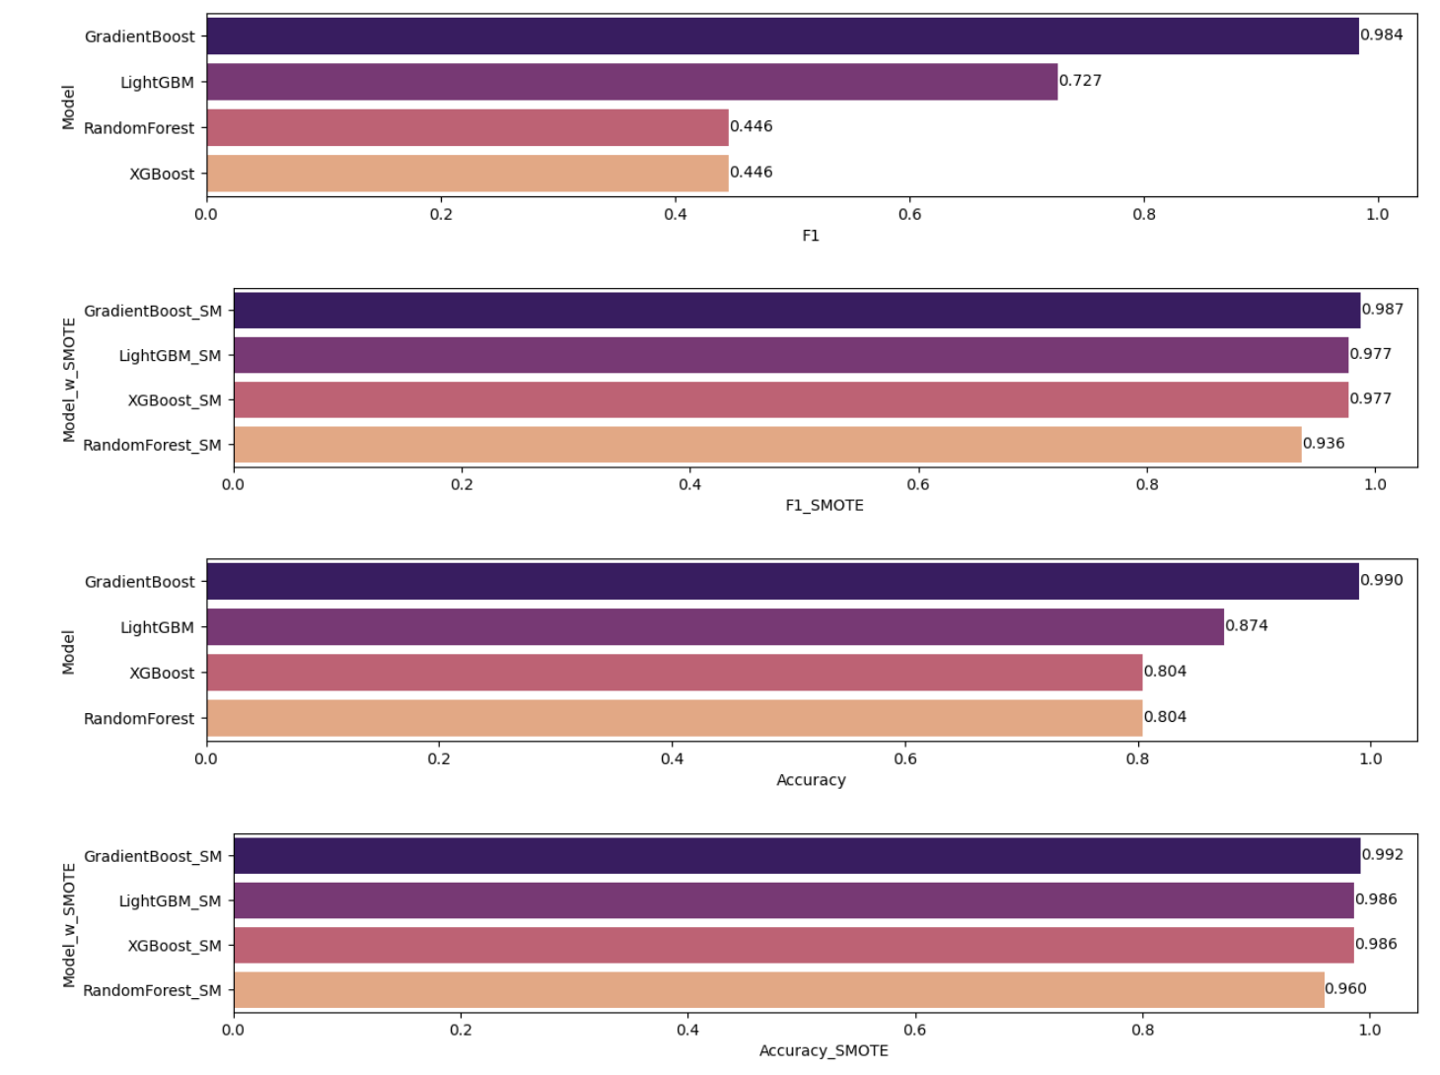
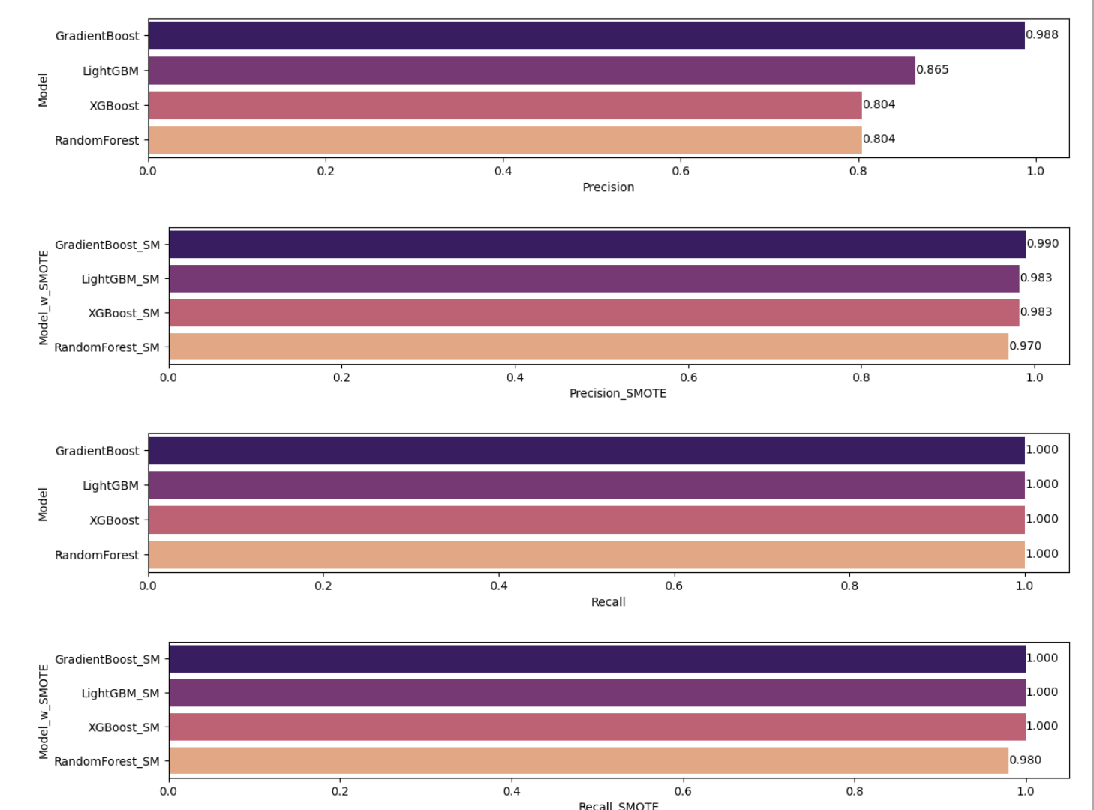
Model comparing

Slide 10
Final Model - LightGBM

Slide 11
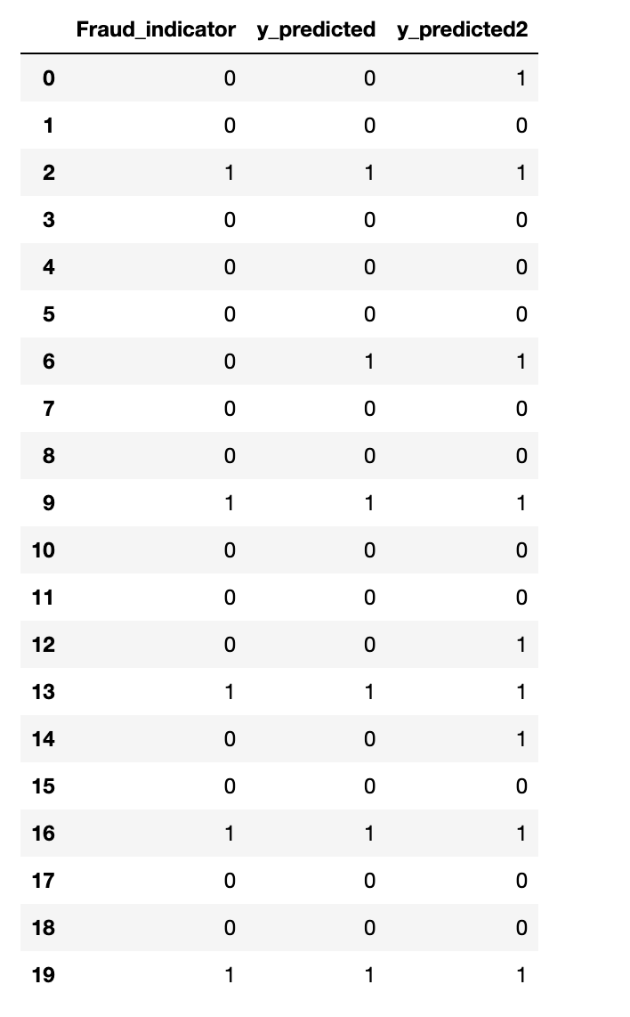
Model saving and Prediction

Slide 12
Conclusion
It gives better result when we use all features that left in our new saved file, insead of choosing important features.

