Slide 1
The difference between K-means, Hierarchical clustering, and DBSCAN:
These are all unsupervised learning algorithms used for clustering,
but they differ significantly in their approaches and use cases.
Notes:
Here, I have shared detailed information for each model type, so for now, I'm skipping them. If you want to review, you can pause the video and take a look.
To make the differences between these models more clear and concise, I will continue through a website.

Slide 2
1. K-means Clustering
K-means is a centroid-based clustering algorithm where the aim is to partition the data into K clusters, each represented by the mean of the points in the cluster (centroid).
Algorithm Steps:
1. Initialization: Select K initial centroids randomly.
2. Assignment: Assign each data point to the nearest centroid based on the Euclidean distance.
3. Update: Calculate the new centroids as the mean of all data points assigned to each centroid.
4. Repeat: Repeat the assignment and update steps until the centroids no longer change significantly (convergence).
Advantages:
- Simple and easy to implement.
- Computationally efficient, especially for large datasets.
- Works well when clusters are spherical and evenly sized.
Disadvantages:
- The number of clusters K must be specified in advance.
- Sensitive to the initial placement of centroids.
- Does not work well with clusters of varying shapes and densities.
- Can get stuck in local optima (though techniques like K-means++ help).
Use Cases:
- Market segmentation.
- Document clustering.
- Image compression.
Notes:
Here, I have shared detailed information for each model type, so for now, I'm skipping them. If you want to review, you can pause the video and take a look. To make the differences between these models more clear and concise, I will continue through a website.

Slide 3
2. Hierarchical Clustering
Hierarchical clustering creates a tree of clusters (dendrogram). It can be either agglomerative (bottom-up approach) or divisive (top-down approach).
Algorithm Steps (Agglomerative):
1. Initialization: Start with each data point as its own cluster.
2. Merge Clusters: Find the pair of clusters that are closest together and merge them into a single cluster.
3. Repeat: Repeat the merging step until all points are in a single cluster.
Types of Linkages:
- Single Linkage: Distance between the closest points of the clusters.
- Complete Linkage: Distance between the farthest points of the clusters.
- Average Linkage: Average distance between all points in the clusters.
- Ward's Method: Minimize the variance within clusters.
Advantages:
- Does not require the number of clusters to be specified in advance.
- Produces a dendrogram, which can be a useful tool for determining the number of clusters.
Disadvantages:
- Computationally intensive for large datasets (complexity \ O(n^3) )).
- Sensitive to noise and outliers.
- Once a merge or split is made, it cannot be undone (greedy approach).
Use Cases:
- Gene expression data analysis.
- Social network analysis.
- Document and text clustering.
Notes:
Here, I have shared detailed information for each model type, so for now, I'm skipping them. If you want to review, you can pause the video and take a look. To make the differences between these models more clear and concise, I will continue through a website.

Slide 4
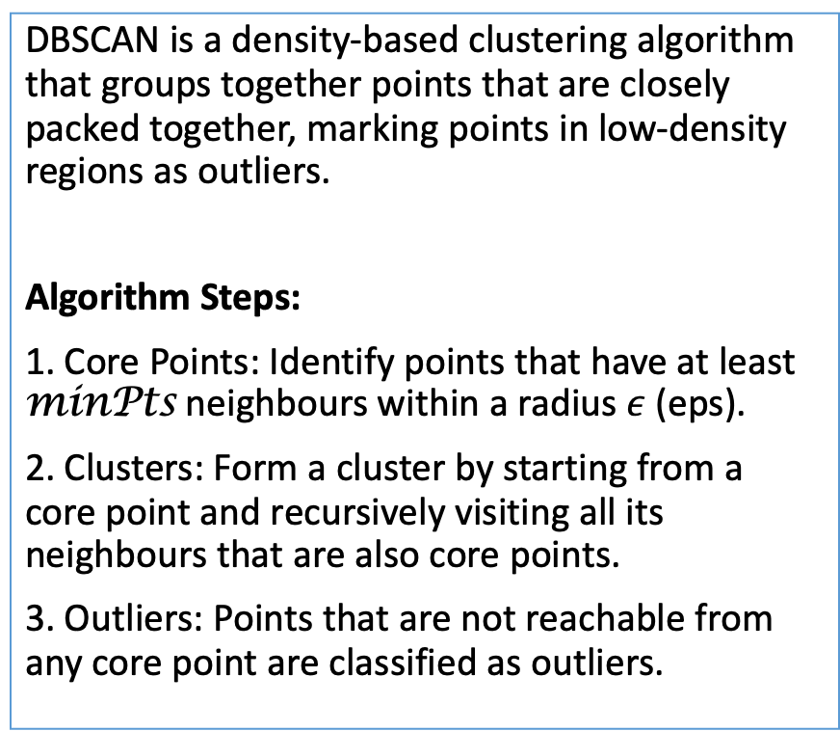
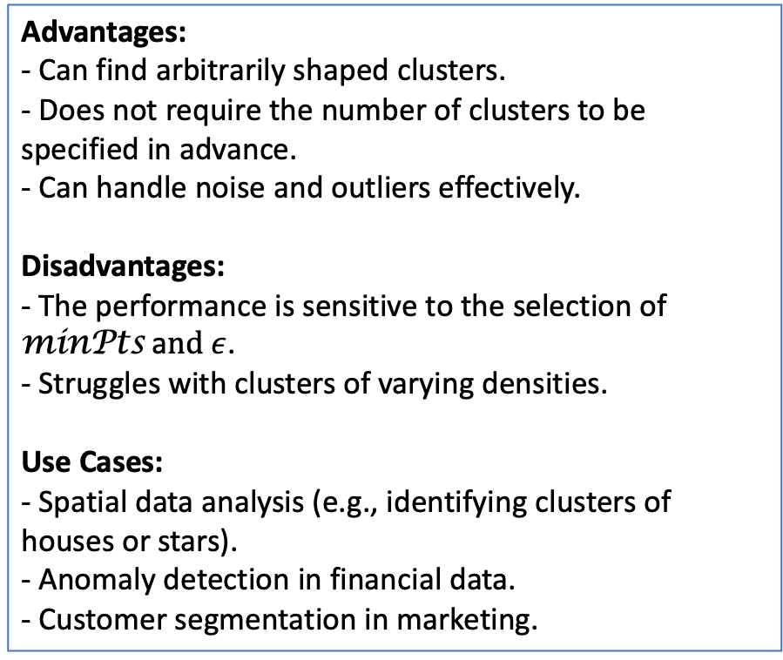
3. DBSCAN (Density-Based Spatial Clustering of Applications with Noise)
DBSCAN is a density-based clustering algorithm that groups together points that are closely packed together, marking points in low-density regions as outliers.
Algorithm Steps:
1. Core Points: Identify points that have at least minPts neighbours within a radius $ε$ (eps).
2. Clusters: Form a cluster by starting from a core point and recursively visiting all its neighbours that are also core points.
3. Outliers: Points that are not reachable from any core point are classified as outliers.
Advantages:
- Can find arbitrarily shaped clusters.
- Does not require the number of clusters to be specified in advance.
- Can handle noise and outliers effectively.
Disadvantages:
- The performance is sensitive to the selection of minPts a$nd ε$.
- Struggles with clusters of varying densities.
Use Cases:
- Spatial data analysis (e.g., identifying clusters of houses or stars).
- Anomaly detection in financial data.
- Customer segmentation in marketing.
Notes:
Here, I have shared detailed information for each model type, so for now, I'm skipping them. If you want to review, you can pause the video and take a look. To make the differences between these models more clear and concise, I will continue through a website.

Slide 5
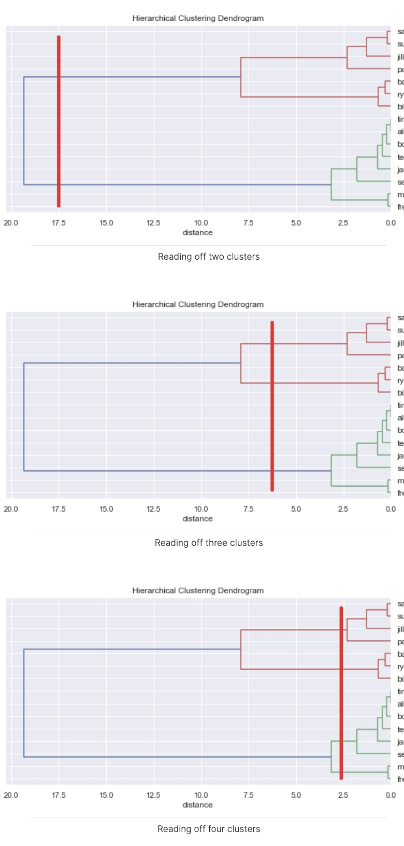
clustering-visualizer
Notes:
Here, I have shared detailed information for each model type, so for now, I'm skipping them. If you want to review, you can pause the video and take a look. To make the differences between these models more clear and concise, I will continue through a website.

Slide 6
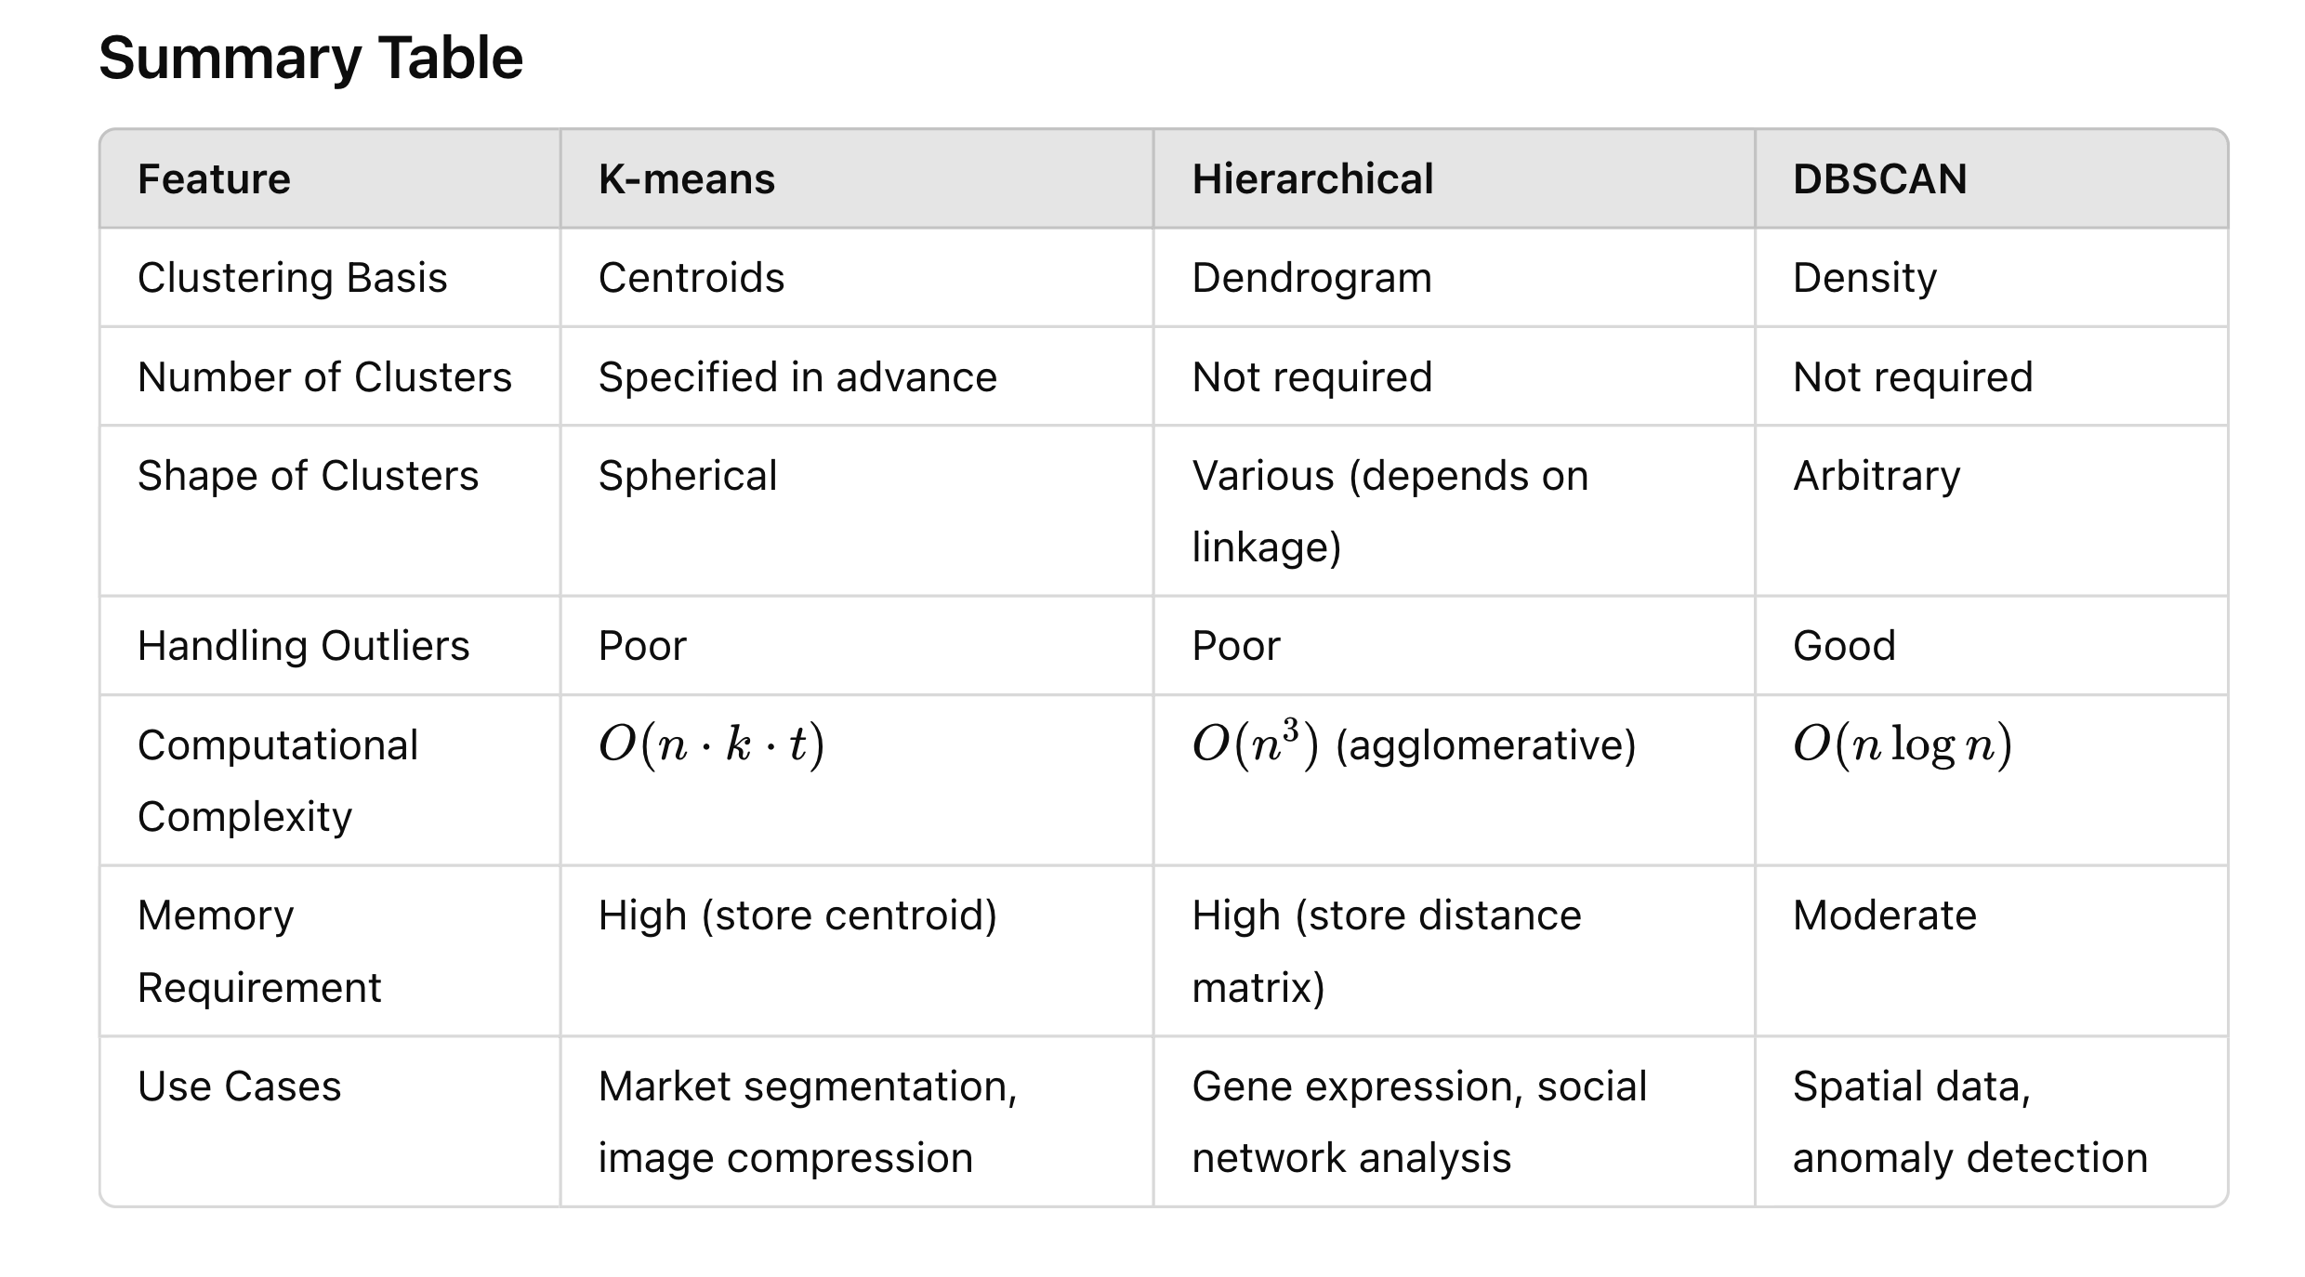
Summary Table

Slide 7
Conclusion
Each clustering method has its strengths and weaknesses. The choice of method depends on the specific characteristics of your dataset and the goals of your analysis.

