Slide 1
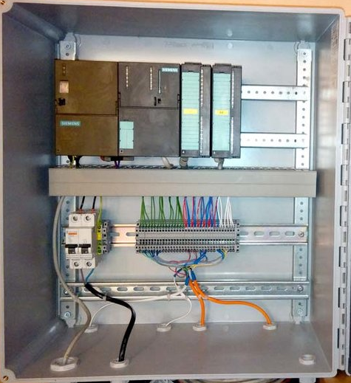
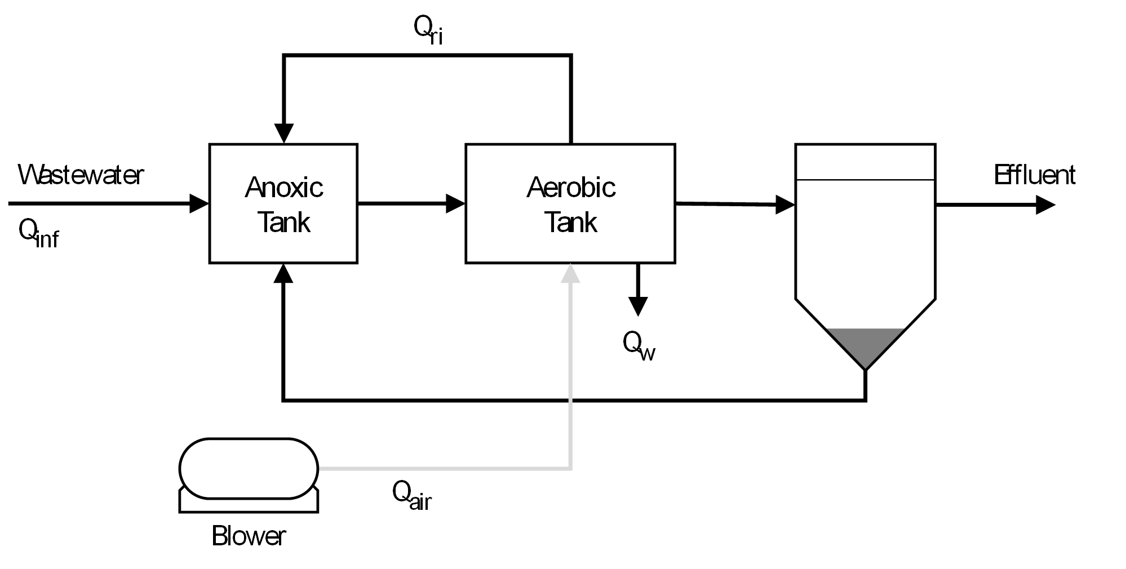

Performance test
Cybersecurity Lab
plc cabinet
MODBUS Client TOOL
WWTP on Simulink
Modbus
hardware in the loop
n
1

Slide 2

Performance test
Cybersecurity Lab
MODBUS Client TOOL
OPEN plc
WWTP on Simulink
Modbus
hardware in the loop
n
1

Slide 3

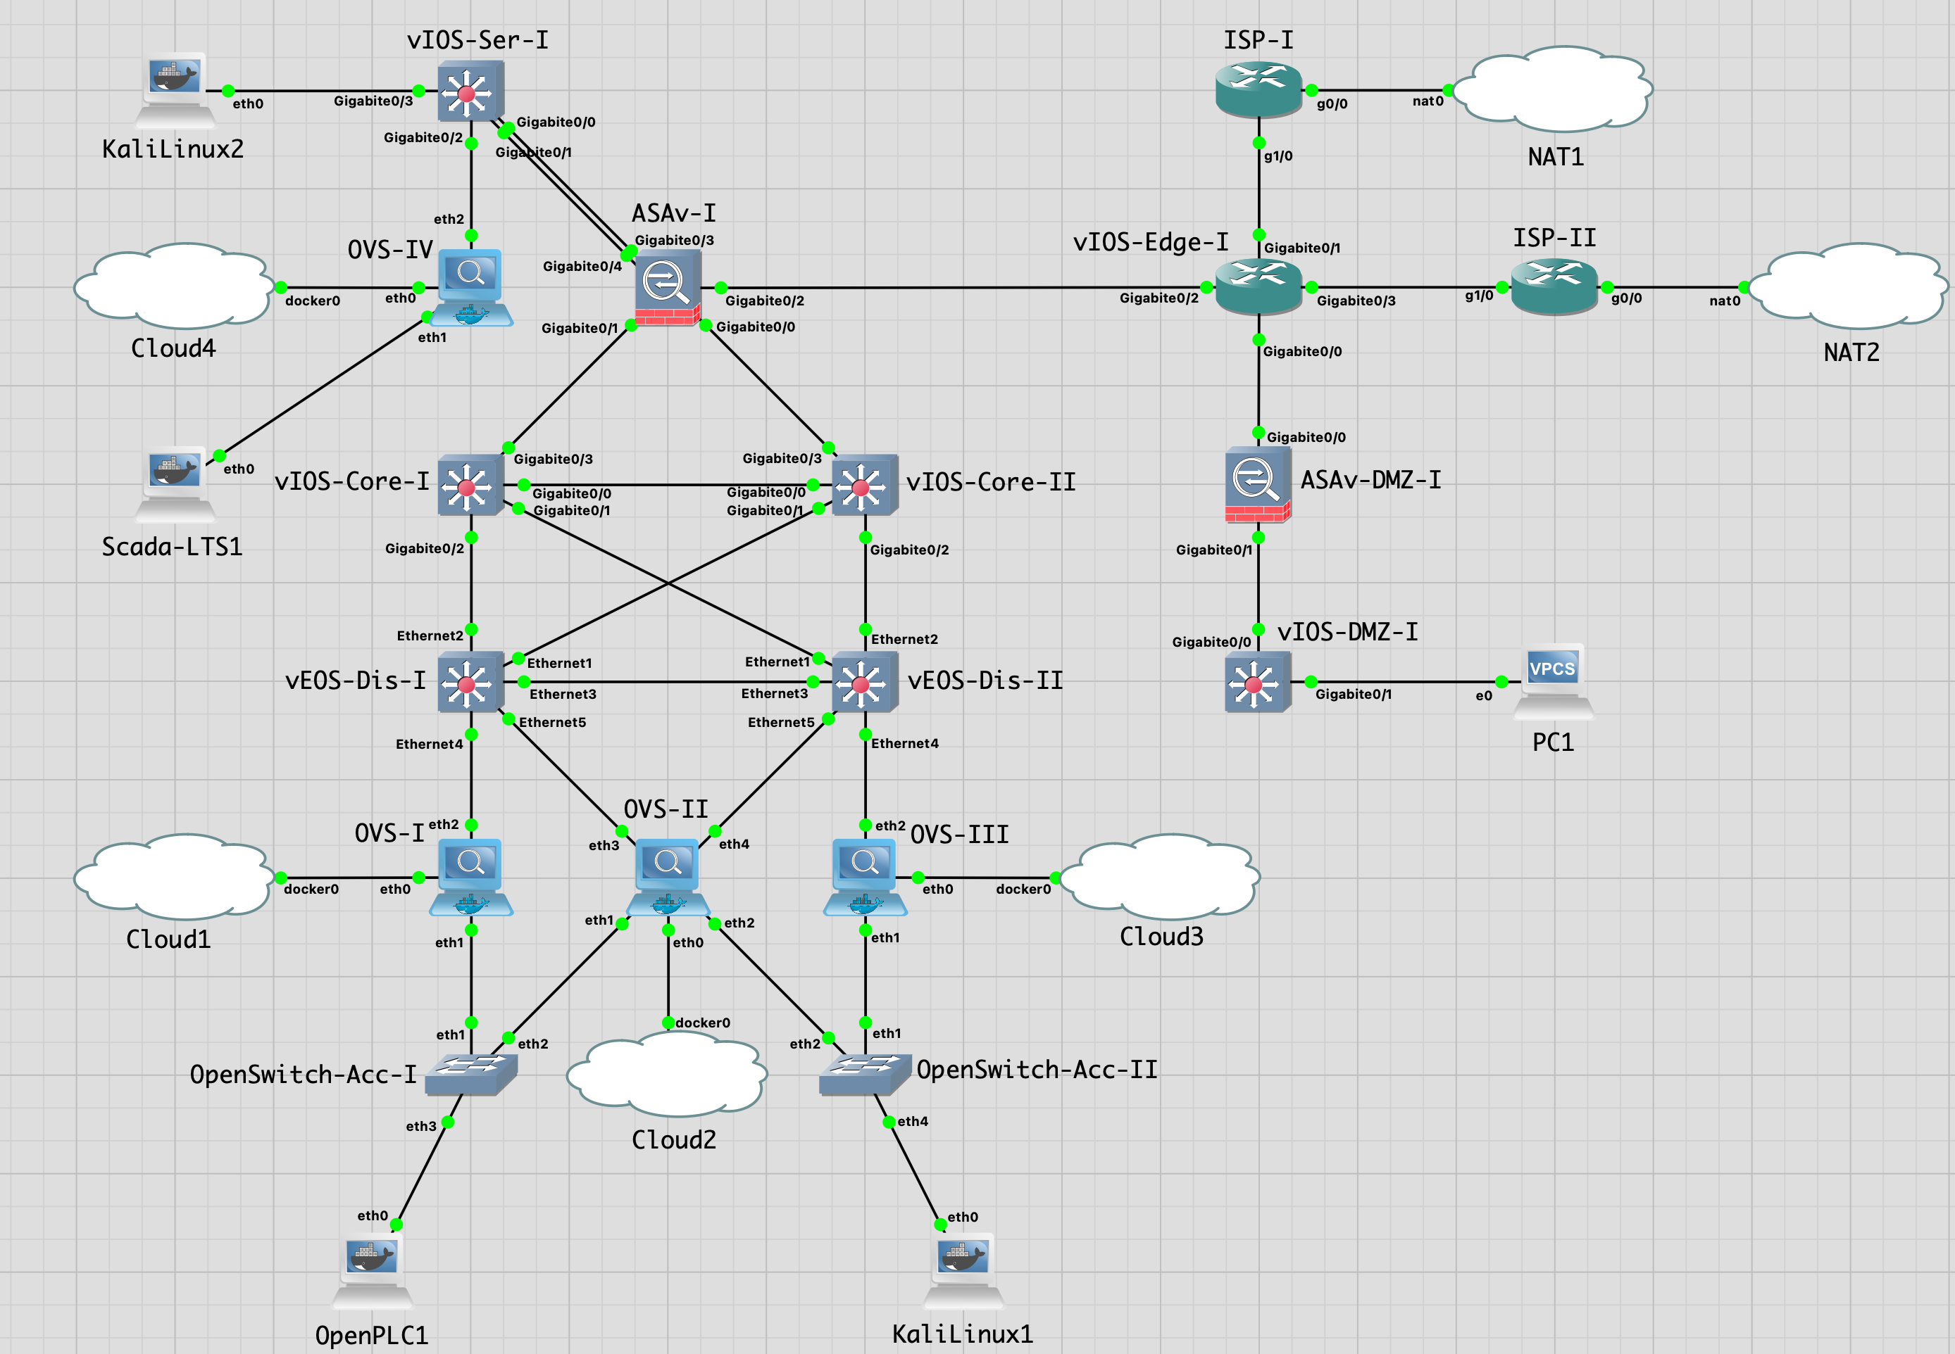
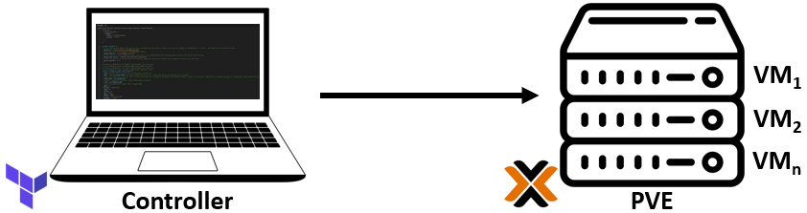



ICS SECURITY: DIGITAL TWIN DEPLOYMENT
Beacon
Neuron-Dones
Digital Twin creation based on Purdue Model
Virtualization environments: GNS3
Industrial process (containerized in MatLab)
WWTP
Chemical/Nuclear -> Tennessee Eastman
Smart Grids
Automate network deployment using Terraform, Ansible
Expected: 8
Current: 3
Notes:
The next step is the creation of a digital twin or a virtualized ICS network on a network simulation software like GNS3 on which, we will integrate the use cases that must be modular. For example, the Tennessee Eastman as a Chemical/Nuclear simulator.

Slide 4
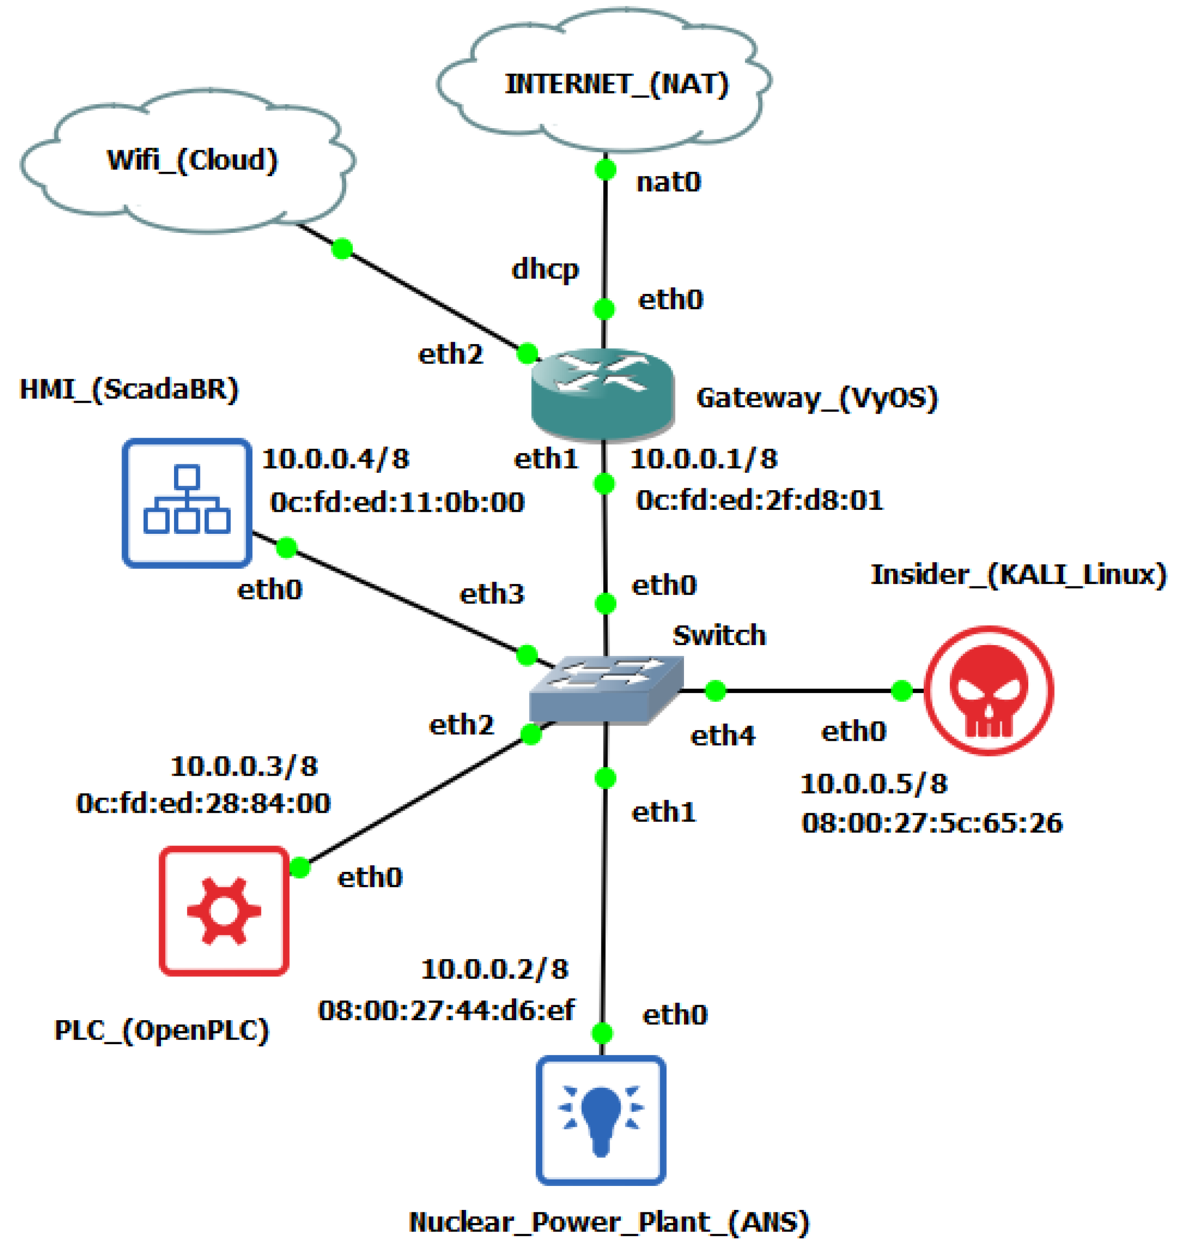
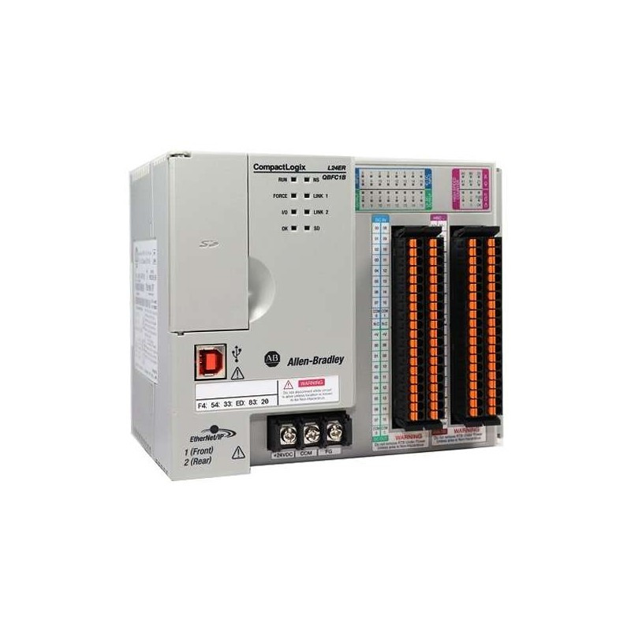

ICS SECURITY: ATTACK TOOL INTEGRATION/GENERATION
Beacon
Neuron-Dones
Mitre Attack framework
Search for third party exploits. E.g.: Chernovite pipedream
Design and implementation of proprietary attack tools
Automate the deployment of the tool
Protocols:
Modbus
Hybrid scenarios
DNP3
BACnet
Real Devices
Virtual Devices
Profinet
…
Third-party tools
Proprietary attack tools
Expected: 6
Current: 1
Notes:
Time to deploy attacks on the virtualized network.
First, we study the Mitre Attack framework
Next, we search for third party exploits. For example: Chernovite pipedream
Next, we design and implement proprietaries attack tools
Finally, we automate the deployment of the tool
There are several protocols of interest for us such as Modbus or OSPF

