Slide 1
Clustering Pretoria Neighbourhoods
Applied Data Science Capstone Project

Slide 2
Introduction
Pretoria is home to 3 universities and numerous colleges.
It has a large student population, with the University of Pretoria alone having 60 000 students.
Accommodation is scarce for students, especially new students who haven’t learnt to navigate the city.
This project clustered 87 Pretoria suburbs to suggest the ones best suited for students in order to make it easier for them to find accommodation.

Slide 3
Data
The data contained geospatial data for 87 suburbs and the various venues in each suburb.
In total, there were 140 different kinds of establishments in the 87 suburbs

Slide 4
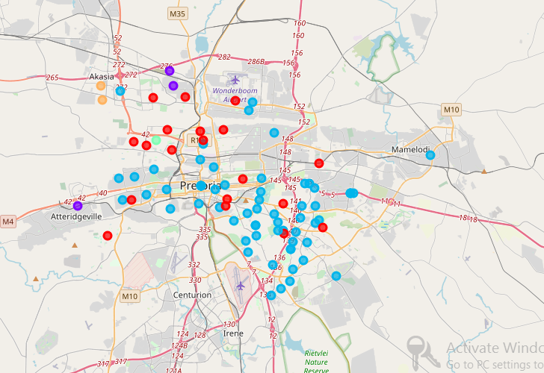
Results

Slide 5
Results contd
A majority of suburbs are in the same cluster and they are all close to a campus for the universities and colleges
These are the suburbs we would recommend to the students

