Slide 1
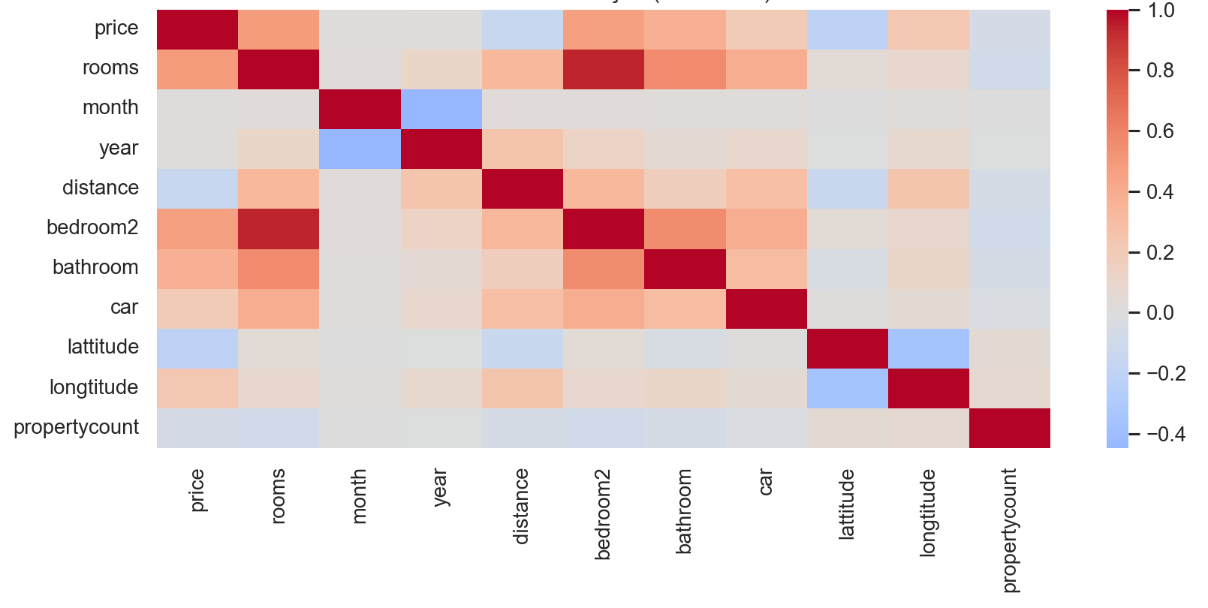
EDA.py
rooms 0.486273
bedroom2 0.465119
bathroom 0.378034
longtitude 0.225740
lattitude -0.215418
car 0.198836
distance -0.153266
propertycount -0.064435
year 0.016201
month 0.015167
type F= 1898.996 p=0.000000
method F= 37.537 p=0.000000

Slide 2
