Slide 1
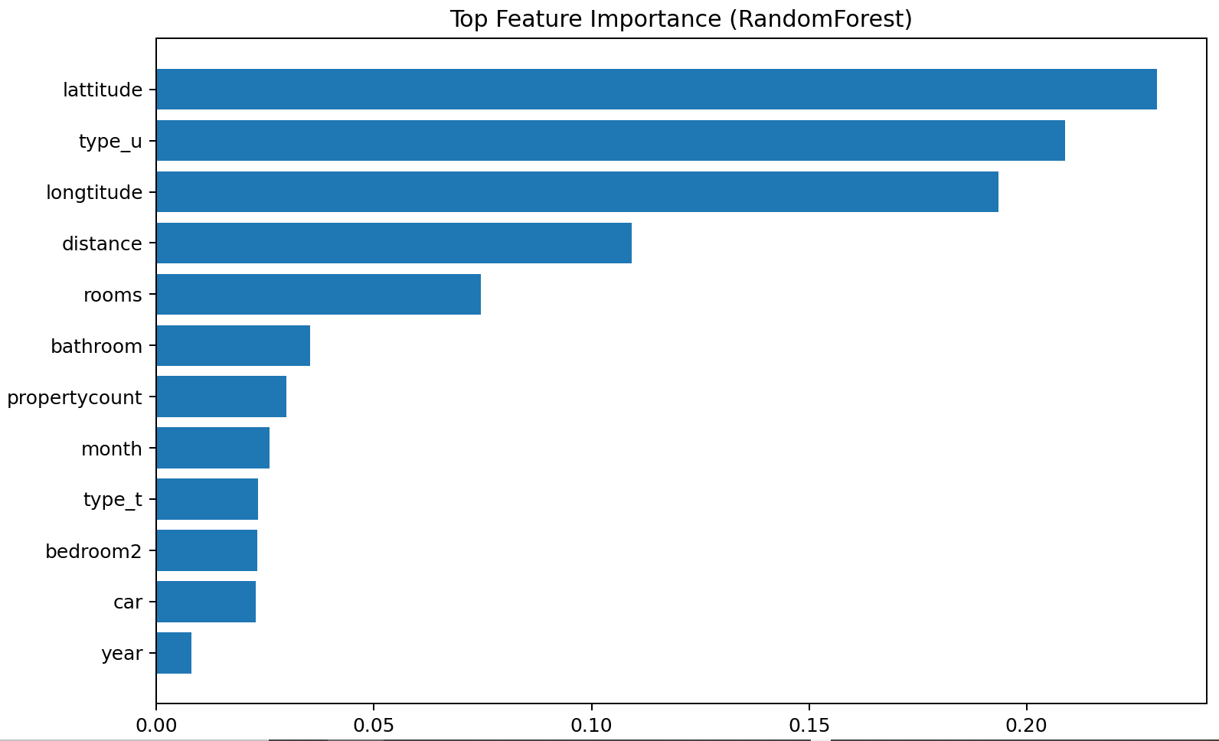
Importance_Permutation5

