Slide 1
Turn detection in conversational AI
Zahra Sayedi – 97722104
Amin Pourdabiri – 97722041

Slide 2

History of our idea ☺

Slide 3
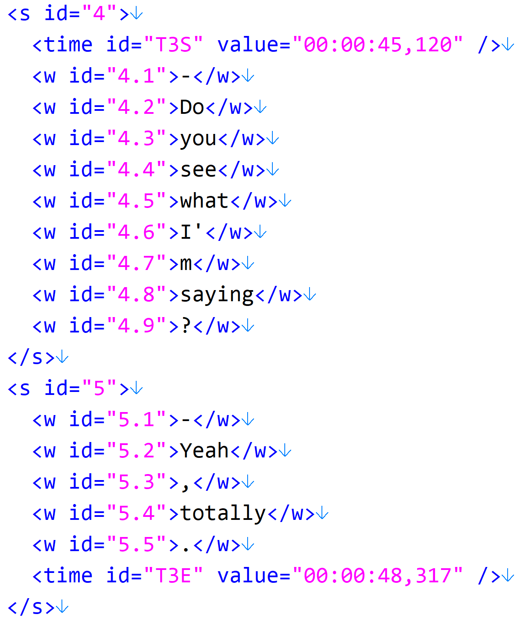
Opensubtitle dataset
3

Slide 4
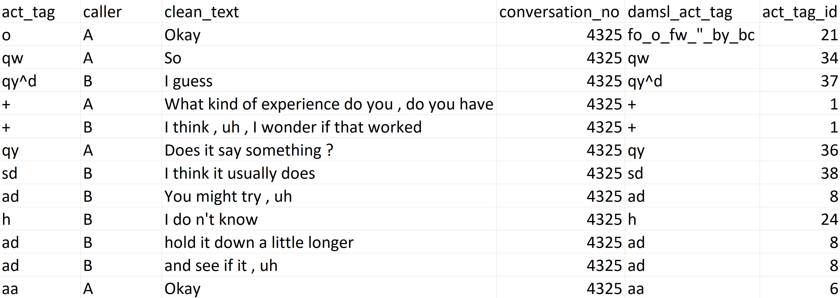
Our used dataset
SwDA (Switchboard Dialog Act Corpus)
Consists of THOUSANDS of telephone speech

Slide 5
Dataset modification
Changing “caller” values to match our problem
Using only “clean_text” column for further processing
Preprocessing texts to fit them with turn detection task!
A little different with normal text preprocessing
For example we don’t delete punctuation marks like: ! ? .
We need some postfixes or identifiers

Slide 6
At the beginning
Feature engineering tasks
PoS-Tag
Unigram
Bigram
BoW (Bag of Words)
Feature selection
Using one or more of these tasks
Combining them based on our turn detection task (modified feature engineering)

Slide 7
Our experiments
At first we ran basic classification methods
In this course:
BERT
LSTM
BiLSTM
BiLSTM with Attention
Note that we used word embeddings like GloVe in addition to these methods

Slide 8
Our results up to now ☺
The majority baseline was 52%
It means that 52% of tags were “Don’t change or New”
All of the reported accuracies are based on SwDA dataset
BERT: 64%
LSTM: 70%
BiLSTM: 83%
BiLSTM with Attention: 86%

Slide 9
Besides…
We made a tagged dataset of OpenSubtitle
They were about 1000 sentences
We used them to evaluate our trained model of SwDA
Our best model did not bad!!!
The “LSTM with attention” model got about 70% accuracy
It might overfit to SwDA (It might come in handy with bigger dataset!)

Slide 10
further more…
Using this model to tag OpenSubtitle dataset
We may need multimodal representations to improve our model
Use that dataset to train a chatbot
Note that it may overfit to OpenSubtitle!!!
And it may not! (Because of its conversation-based dataset)

Slide 11
Thank you for your attention
Any questions?

