Slide 1
Design and Manufacture of a Syringe Pump
Daniel Woolsey

Slide 2
Project Objectives
Improve upon the Open Source Syringe Pump Library
  Take inspiration from commercial pumps and other projects
Allow for easy extensibility into dual pump system
Add the ability to withdraw solutions into the pump
Design touchscreen interface for ease of operation
Compare accuracy of different stepper motors and the benefits of micro-stepping
Current market analysis of Syringe Pumps
  Compare to predictions made in case study from ‘Quantifying the Value of Open Source Hardware Development

Slide 3
Project Objectives
Develop an Android application as another means of operation
Display use of Jira and the KanBan methodology in developing a project
MOST IMPORTANTLY
Show the process of developing an open-source project
  Best practices to follow
  Following 7 key design principles

Slide 4
Design Principles
Functionality – Develop for an application
Robustness – Design with variation in mind
Safety – Communicate hazards to users
Simplicity – Make easy to source, build and operate
Modularity – Build independent and individual units
Benchmarking – Validate with standard protocols
Documentation – Describe the design completely

Slide 5
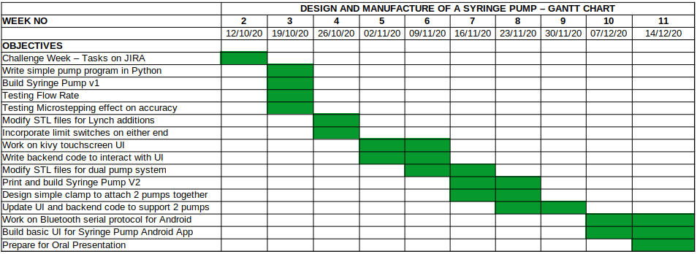
Implementation Plan

Slide 6
Risks
Lack of novel hardware design changes
  Software will be novel
Damage to equipment
  Everything is cheap and easily replaceable
With more modifications, project loses simplicity
  Keep everything modular, get a layman to build and operate the SP based on written documentation

Slide 7
Context
Commercial Lab equipment is expensive and unsuitable for modification
  Open source is inexpensive and (usually) designed with modification in mind
  The quality of commercial syringe pumps is easily achievable at a low cost
Updating design for the modern-day user
  Mobile phones are widespread and easily understood by most everyone
  Build an interface to reflect mobile app design principles for HCI

Slide 8
Context
Quantifying the Value of Open Source Hardware Development
  In 2014, predictions made about the future of the Syringe Pump market
Latest Syringe Pump Projects
  PDSP – Evolved UI and extensibility
  Poseidon – Focus on micro-fluidics and open-source design principles, strong documentation

Slide 9
Achievements during Challenge Week
Applying KanBan methodology to daily project tasks
3D printed parts for Syringe Pump and ordered all items on the Bill of Materials
Timeline of objectives up until Week 11
Completed Analysis of Related Works for Background Reading

