Slide 1
Design and Manufacture of a Syringe Pump
Daniel Woolsey
Supervisor: Dr Nick Zakhleniuk
2nd Assessor: Dr Vishwanathan Mohan

Slide 2
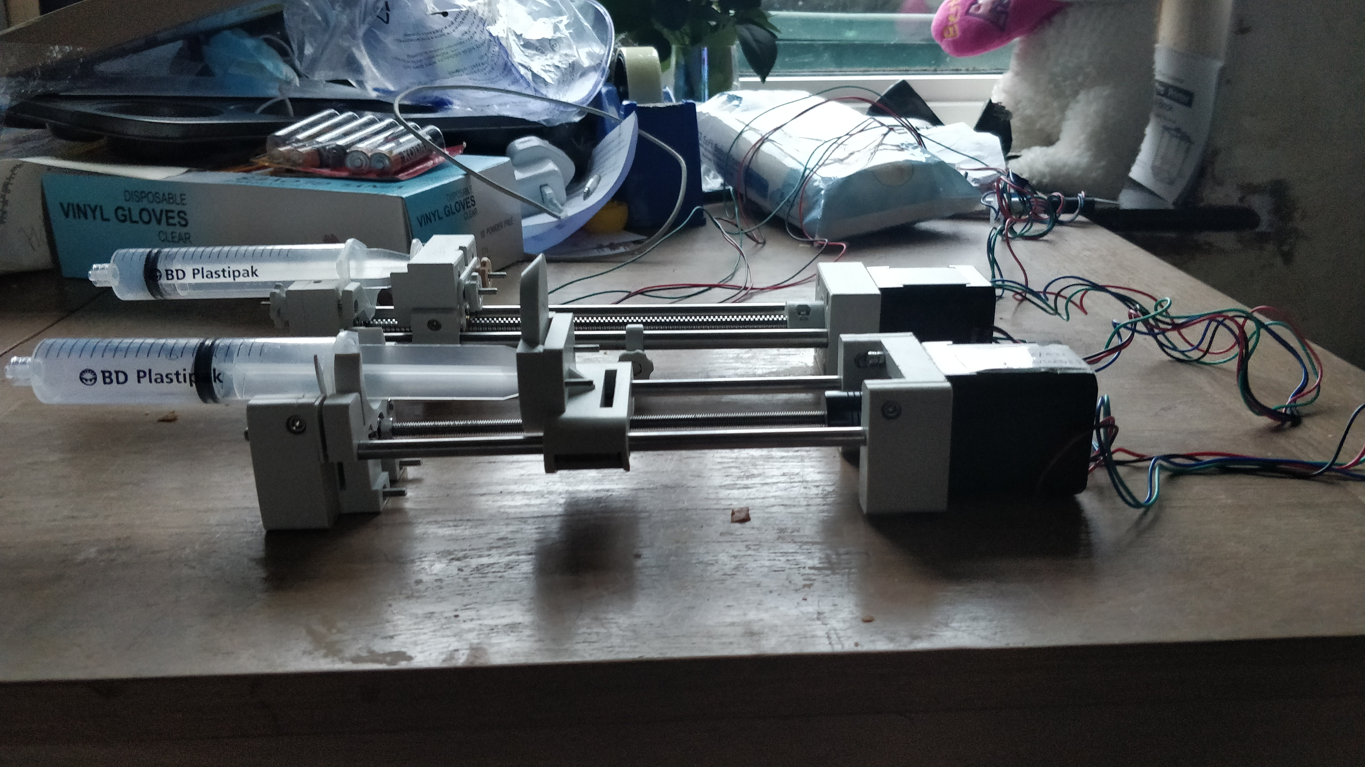
Contents
Project Goals and Objectives
Current Progress
Project Planning (Agile/Jira)
Project Management
Future Work
Conclusions

Slide 3
Project Goals and Objectives
Need for low cost syringe pumps; motivation
Print and build a Syringe Pump
Design and implement modifications to improve operation and usability in a medical context
Incorporate a touchscreen interface as the primary method of control
Build an Android application that can monitor and control the pump over Bluetooth
Design and print a housing to mimic commercial syringe pumps
Detail the process, benefits and difficulties of undertaking an open-source hardware project

Slide 4
Current Progress
3D Printer Equipment
Building and calibration of the printers hardware and software
Proper setup so it prints good quality parts every time that wont break with repeated use
Modifying pre-existing model files and designing parts that fit my pump specifications

Slide 5
Current Progress
Building the Pump V1 – Preparatory Work (Hardware)
Ordering necessary hardware that can't be printed
  Steel rods, bolts, nuts, motor, electronics
Deciding on appropriate motor specifications
  Voltage, Current, Size, Steps per revolution
  Proper setup of the motor driver current limiter
Putting together a bill of materials and build guide

Slide 6
Current Progress
Building the Pump V1 – Preparatory Work (Software)
Choosing an appropriate microcontroller that fits my objectives
  Touchscreen capable, Bluetooth and WiFi, Digital I/O pins
Setting up the motor driver, Raspberry Pi and power supplies
Calculating flow rate based on
  Motor specs, syringe size, threaded rod diameter and pitch
Coding a test suite and extending that to an object oriented solution

Slide 7
Current Progress
Design Work - Modifications and Building Pump V2
Improved carriage design to fit bearings and syringe plunger
Idler end body holder widened to fit appropriate syringe sizes
  20ml to 60ml syringes are common for hospital uses
Addition of limit switches to track carriage location and avoid damaging the printed parts
Adjustable hand knobs to ensure the syringe is held tightly to the carriage and idler end
Wider steel and threaded rod diameter to increase stability and reduce vibration

Slide 8
Current Progress
Design Work - User Interface Design
Deciding on a GUI library with touchscreen capability
  Kivy
Design a UI allowing users to enter basic operation information
  Syringe size, infusion time, continued withdraw and continued infusion
Incorporate pump operation code into buttons on the UI
Make code base extensible so other operations can be added
  Connection to Android device, choice of syringe brands, store and load previous operations

Slide 9
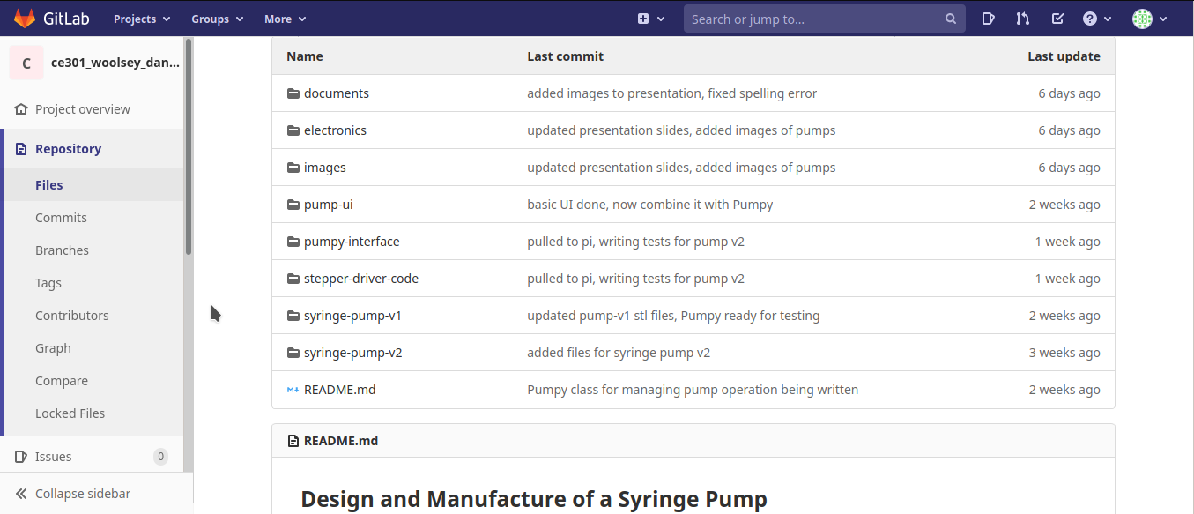
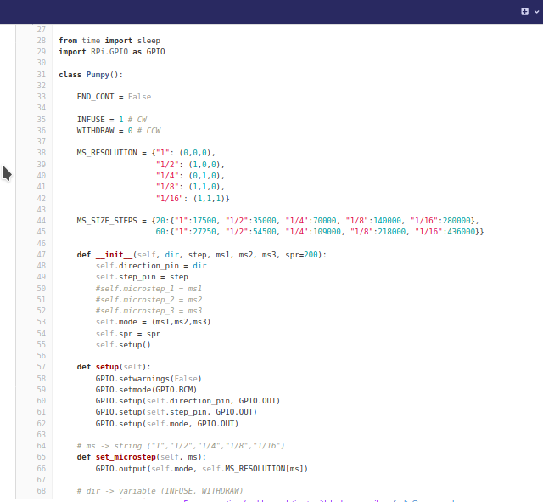
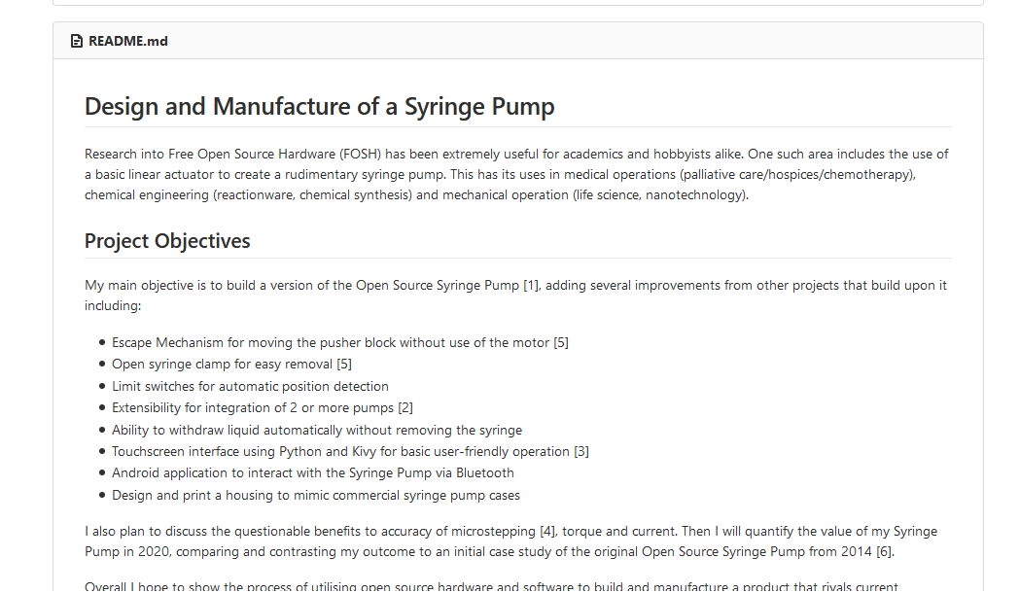
GitLab Snapshots

Slide 10
Syringe Pump v2 Demo

Slide 11
Project Planning
Designed a Gantt Chart during Challenge Week as a guide
  Used this to update my KanBan board
Continued weekly meetings with my supervisor discussing deliverable progress, related work and future ideas – similar to scrums in the Agile Methodology
Updating GitLab with each pump iterations bill of materials, build guide and printable files
  Means my work can be recreated for educational purposes
Following related work on autonomous medical equipment and open-source hardware projects
  The novelty of the project is to create a cost-effective, autonomous syringe pump for medical use

Slide 12
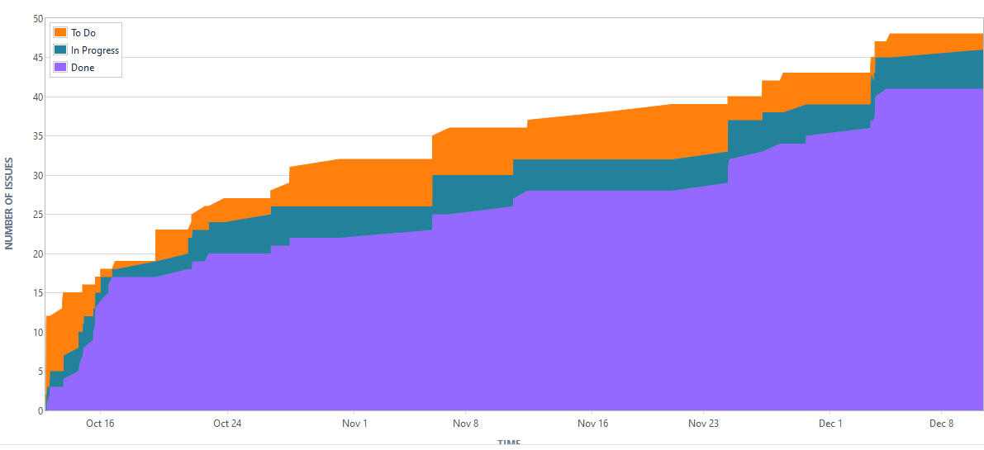
Project Management
Jira – Cumulative Flow Diagram

Slide 13
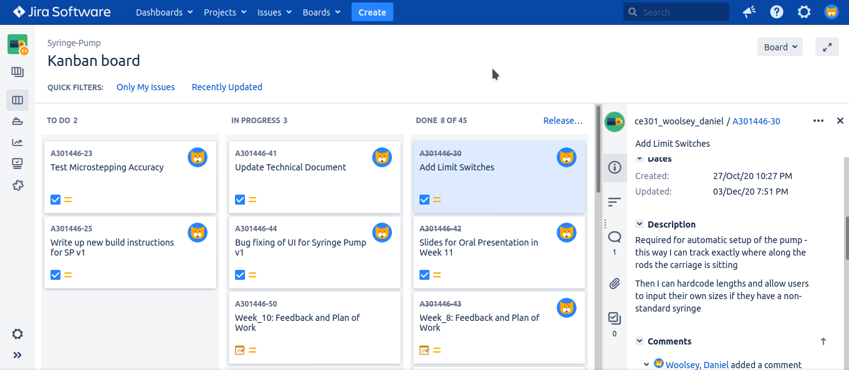
KanBan Board – Current State

Slide 14
Future Work
Custom PCB for managing motor driver, limit switches and power
Improved touchscreen UI following Android Design Principles
Bluetooth interface between RPi and Android application
Modifications to Syringe Pump V2
  Attachment for connecting multiple pumps together
  Case to protect electronics and hide power supply wires
JOGL – Just One Giant Lab – Medical Syringe Pump
  Follow continued progress
  Get involved in software development where possible

Slide 15
Conclusions
Built 2 versions of the Syringe Pump, made the necessary modifications to fit my use case (medical operation)
Researched a number of other Syringe Pump projects and been in communication with an ongoing project
Built a minimal and extensible touchscreen UI for pump operation
Maintained a code base and documentation through GitLab
Made effective use of Jira to define clear goals for the project and maintain continuous progress
Defined future goals to work towards in the coming months

