Slide 1


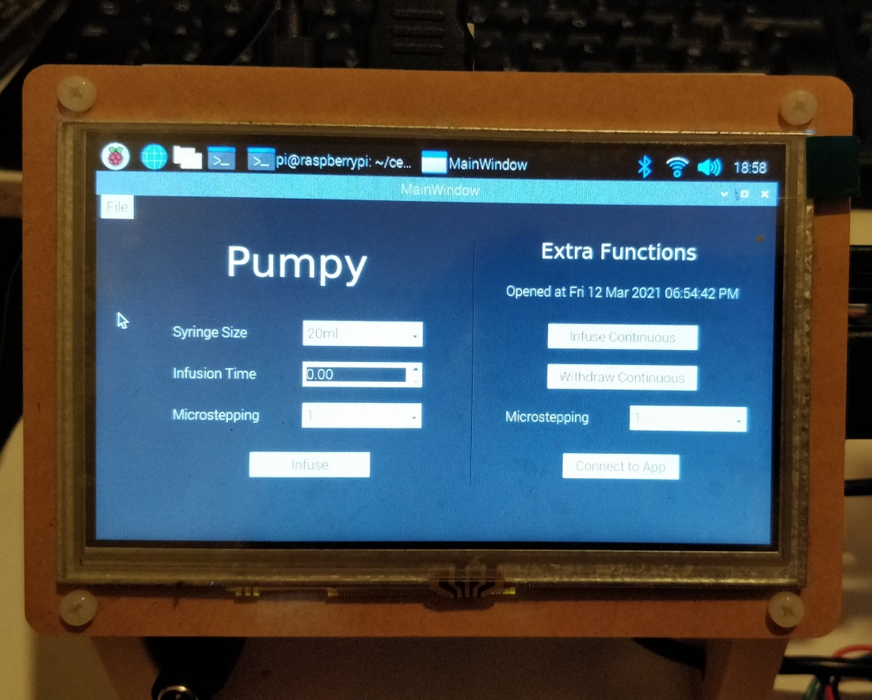
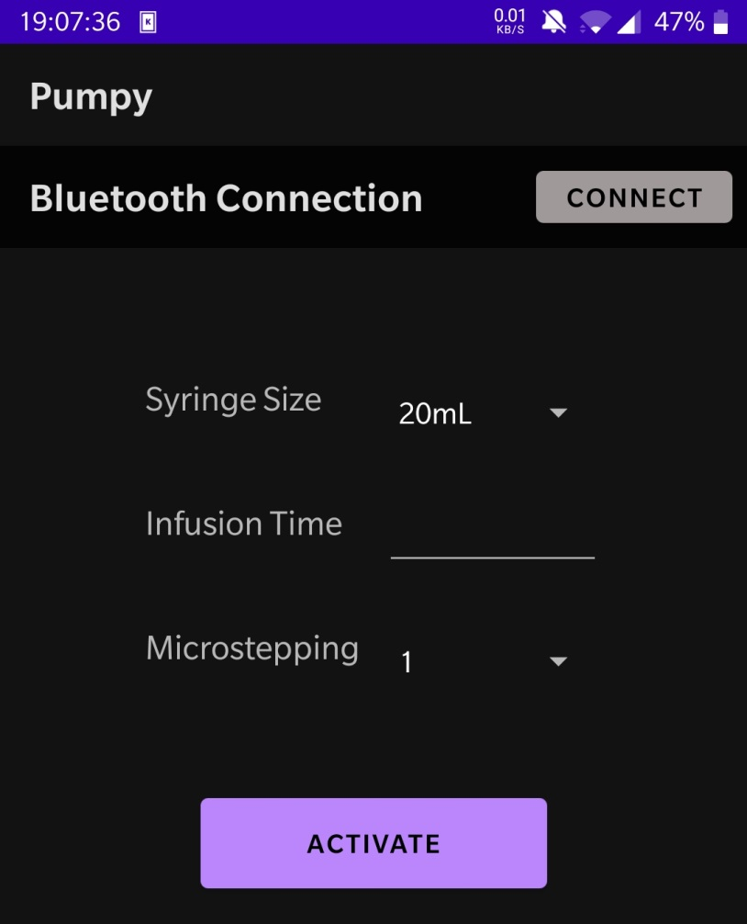
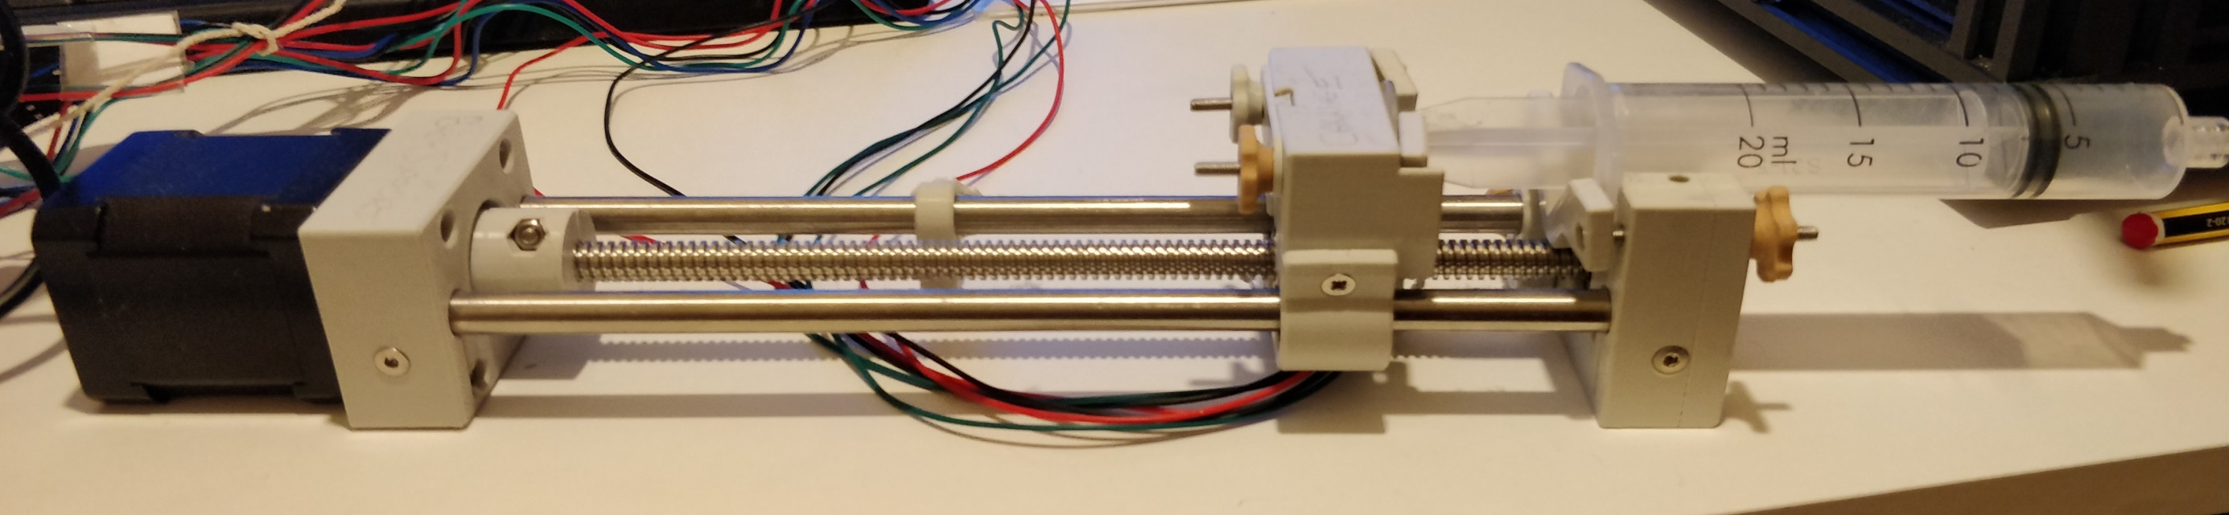
Pumpy
Design and Manufacture of a Syringe Pump
AIM
To build a touchscreen ready, mobile phone controlled, cost-efficient, open source Syringe Pump for a real-world medical applications (estimated costs under £150)
Student: Daniel Woolsey
Supervisor: Nick Zakhleniuk
BACKGROUND
Typical medical-use Syringe Pumps cost > £1000
Medical equipment is in short supply due to COVID-19
Open-source Syringe Pumps have only been used in bespoke labs
3D printing has paved the way for democratised production
Eventually, hospitals could print their own equipment
The approach and the product can be used in areas with limited access to modern technology
Minimal User Interface
Wi-Fi and Bluetooth
Compatible
Powered by a Raspberry
Pi computer
Touchscreen interface
Stored backlog of previous
operations
Android application for remote
pump control
Stepper motor for precise movement
Mostly 3D printed parts to reduce cost
Hand knobs for easy syringe replacement
Limit switches on the carriage prevent
damage to the pump
Connects to the Raspberry Pi
over Bluetooth
All remote operations are stored
on the pump
RESULT
We have demonstrated and implemented a 3D printing-based approach to the manufacture of Syringe Pumps for a variety of medical applications

