Slide 1

Development of Powertrain Component Models, Energy Management Strategies, and Economic and Performance Surrogate Models for All-Electric Aircraft in an Open-Source Framework
Nathaniel Cooper
08/28/2026

Slide 2
Personal Information
Bachelor’s of Science, Mechanical Engineering, University of South Carolina, May 2015
Master’s of Science, Mechanical Engineering, University of South Carolina, December 2020
Current Employment: Senior Engineer at Savannah River National Laboratory
Hobbies: Film, Science Fiction, Piano and Organ, Chess, Table-top games

Slide 3
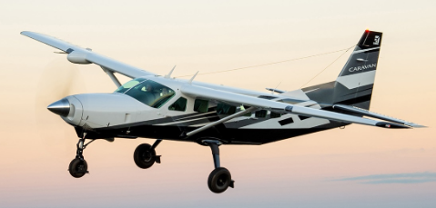
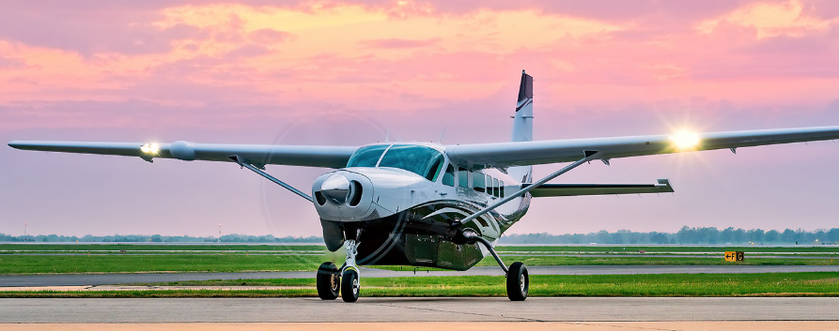
Agenda
Publications
Motivation
Background
  Hybrid Architectures
  Energy Management Systems
  Power Train Modeling & Initial Results
Research Objectives
  Complete Hybrid Electric Library
  Develop and Demonstrate Controllers
  Explore Simulation Space
Timeline
https://cessna.txtav.com/en/turboprop/caravan

Slide 4
Relevant Publications
JOURNAL ARTICLES:
Nathaniel Cooper, Ali Mahboub Rad, Korebami Adebajo, Austin R. J. Downey, and Jie Zhang. Impact of high-power transients and load
fluctuations on lithium-ion battery degradation in hydrogen fuel cell-battery hybrid regional utility aircraft.
Currently under development; adaptation and extension of 2025 IMECE paper
Adds thermal loop for temperature control of components, implementation of liquid H2 storage and supply, and expanded results
Harshal D. Kaushik, Ali Mahboub Rad, Nathaniel Cooper, Korebami Adebajo, Austin R. J. Downey, and Jie Zhang. Stochastic sizing and
balance-of-plant design of hybrid hydrogen fuel cell powertrains with lithium-ion and aluminum-air Batteries for Cessna 208.
Currently under review; adaptation and extension of 2025 IDETC paper
Multi-physics modeling, aircraft layout, and balance-of-plant conceptual design
Korebami O., Adebajo, Austin R.J. Downey, Jie Zhang, Nathaniel Cooper, Malichi Flemming, Kaydon Stanzione, and Carrie Queenan.
Battery degradation and replacement cost impacts on profitability in electric light utility aircraft using a multiphysics modeling approach.
Currently under review
Aircraft layout, balance-of-plant development

Slide 5
Relevant Publications
PEER-REVIEWED CONFERENCE PAPERS:
Nathaniel Cooper, Ali Mahboub Rad, Korebami Adebajo, Austin R. J. Downey, and Jie Zhang. Physics-based prediction of remaining
useful life of lithium-ion batteries in fuel cell-battery hybrid aircraft using an open-source Modelica framework. In Volume 9: Micro- and
Nano-Systems Engineering and Packaging; Safety Engineering, Risk and Reliability Analysis; Special Symposium on Additive
Manufacturing on Benchmark Test Series; Special Symposium on Power; Research Posters, IMECE2025. American Society of Mechanical
Engineers, November 2025. doi:10.1115/imece2025-168114
Programming of battery and fuel cell models, parameterization of battery stacks from experimental data, programming of gaseous H2 storage and supply, partial development of flight profile and load sharing/controller, simulation and post-processing
Harshal Kaushik, Ali Mahboub Rad, Korebami Adebajo, Sobhan Badakhshan, Nathaniel Cooper, Austin Downey, and Jie Zhang. Hybrid
powertrain optimization for regional aircraft integrating hydrogen fuel cells and aluminum air batteries. In Volume 3A: 51st Design
Automation Conference (DAC), IDETC-CIE2025. American Society of Mechanical Engineers, August 2025. doi:10.1115/detc2025-168547
Multi-physics modeling, aircraft layout, and balance-of-plant conceptual design
Nathaniel Cooper, George Anthony, Jarett Peskar, Austin R Downey, and Kristen Booth. Data assimilation in a Modelica framework for
optimizing battery longevity in electric aircraft. In AIAA SCITECH 2025 Forum, page 2706, 2025. doi:10.2514/6.2025-2706
Parameterization of battery stacks, design of generic flight profile, simulation and post-processing
George Anthony, Nathaniel Cooper, Jarrett Peskar, Austin R. Downey, and Kristen Booth. Extending battery life via load sharing in electric
aircraft. In AIAA SCITECH 2024 Forum. American Institute of Aeronautics and Astronautics, January 2024.
Parameterization and programming of battery stack models

Slide 6
Other Publications
JOURNAL ARTICLES:
Korebami Adebajo, Ali Mahboub Rad, Nolan Shute, Matthew Whetham, Nathaniel Cooper, Andrew Huebner, Austin R. J.
Downey, and Jie Zhang. Design and Experimental Validation of a Cyber-Physical SMR emulator for digital twin-based control via
time-constant synchronization.
Currently under review; adaptation and extension of 2026 IDETC paper
Background knowledge on reactors/SMRs, advice on testbed loop, manuscript review and feedback
PEER-REVIEWED CONFERENCE PAPERS:
Korebami O. Adebajo, Nathaniel Cooper, Ali Mahboub Rad, Matthew Whetham, Nolan Shute, Andrew Huebner, Austin R. J.
Downey, Jie Zhang, Jamil Khan, and Travis Knight. Design architecture of a cyber-physical small modular reactor emulator for
real-time control and grid interaction. Proceedings of the ASME 2026 International Design Engineering Technical Conferences &
Computers and Information in Engineering Conference. American Society of Engineers, August 2026.
Background knowledge on reactors/SMRs, advice on testbed loop, manuscript review and feedback

Slide 7
Other Publications (Master’s Degree)
JOURNAL ARTICLES:
Islam, F., Cooper, N., Abboud, A. W., Farouk, T., Khan, J., Guillen, D. P., & Knight, T. (2024). CFD model for
predicting spent nuclear fuel drying conditions. Nuclear Science and Technology Open Research, 2(49), 49.
PEER-REVIEWED CONFERENCE PAPERS:
Cooper, N. (2020). Development of a CFD model for the drying of aluminum-clad spent fuel. Transactions of the
American Nuclear Society, 122, 66-67. https://doi.org/10.13182/T122-32601
OTHER PUBLICATIONS:
Cooper, N. (2020). Development of a CFD Model for the Drying of Aluminum-clad Spent Nuclear Fuel (Master’s
thesis, University of South Carolina).
Knight, T., Cooper, N., Shalloo, M., Farouk, T., Wang, Y., Khan, J., and Smith, R. (2019). Aluminum-clad Spent
Nuclear Fuel Engineering Scale Drying Experiment Design. INL/EXT-19-56017.

Slide 8
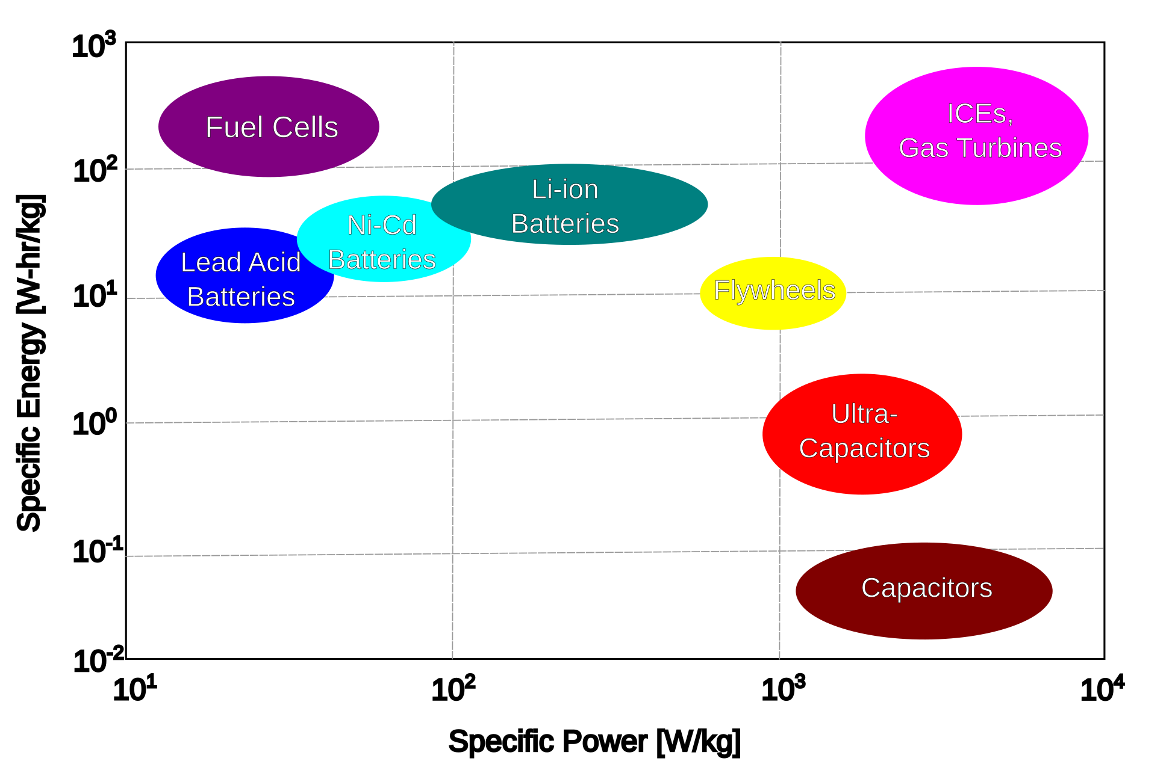
Motivation
Electrification of the aviation sector will lead to reduced emissions and improved mechanical efficiency
Energy Management Systems (EMS) key to performance and load balancing
In hybrid electric systems, battery stacks represent the maintenance bottleneck
Objective: Develop component models and controllers to optimize battery useful life in all-electric hybrid aircraft

Slide 9
Background and Initial Results

Slide 10
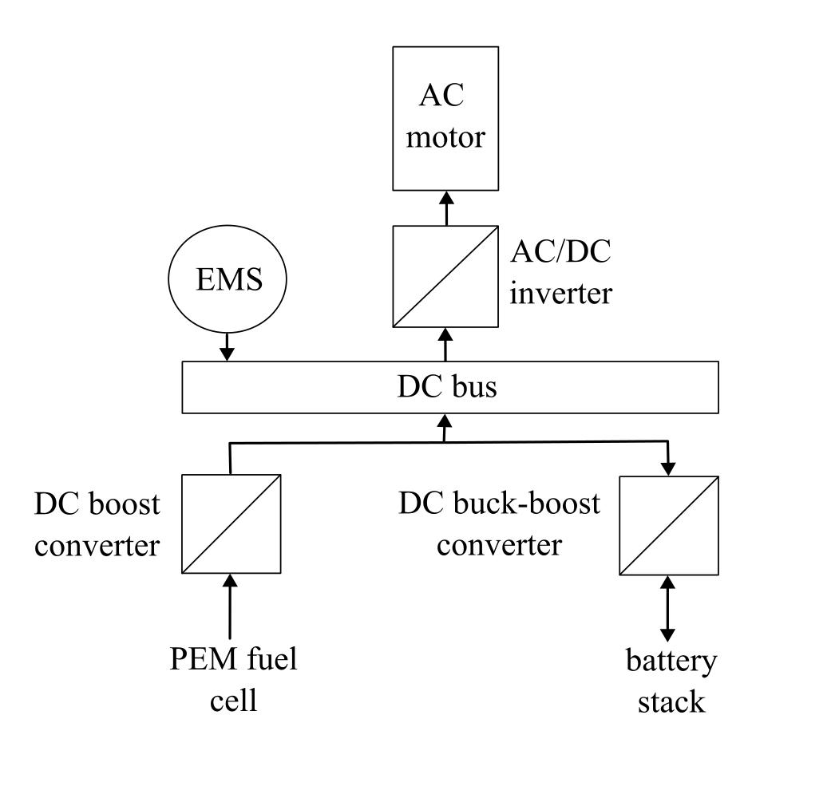
Hybrid Electric Architectures
Majority of research focuses on land vehicles: cars, buses, etc.
Typical configuration is a fuel cell/battery hybrid
  Either can operate as the primary or the secondary power supply, or as a simple range extender
Ultracapacitors are frequently used, either in combination with the other power supplies or as a substitute (most frequently for the battery)

Slide 11
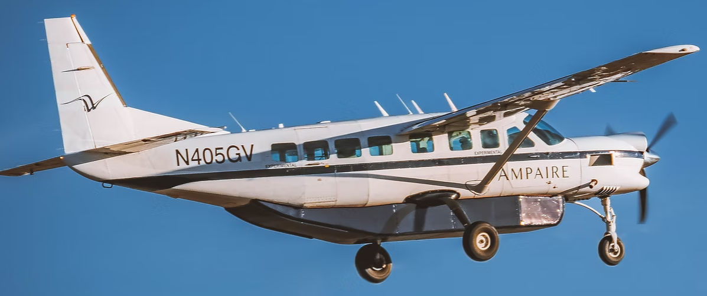
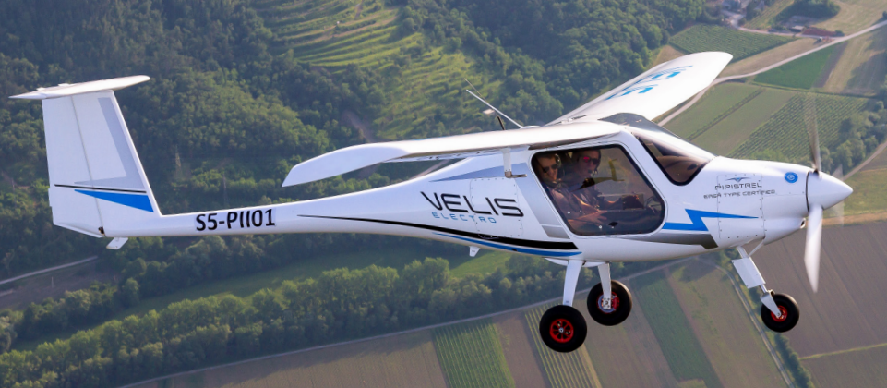
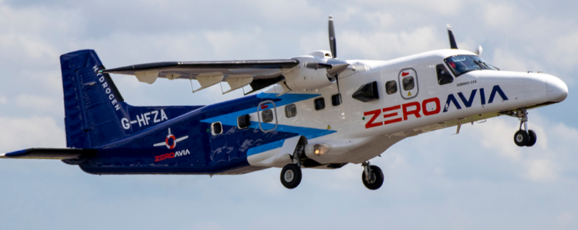
Hybrid Electric Architectures
Historically focused on turbogenerator/battery or turbogenerator/fuel cell aircraft
Full electrification limited by battery technology; mainly limited to 1-2 seat trainer craft
https://www.ampaire.com/vehicles/eco-caravan
Image credit: Pipistrel Velis Pilot’s Manual, June 2020
Top: Ampaire Eco Caravan
Bottom Left: ZeroAvia Dornier 228
Bottom Right: Pipistrel Velis Electro
https://zeroavia.com/complete-flight-test/
Notes:
Top: Ampaire Eco Caravan adapted from the Cessna 208, a turbogenerator/battery hybrid
Bottom Left: ZeroAvia Dornier 228, a turbogenerator/fuel cell hybrid
Bottom Right: Pipistrel Velis Electro

Slide 12
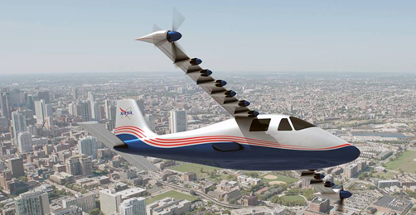
Hybrid Electric Architectures
Prominent example of an all-electric hybrid: NASA’s X-57 Maxwell
  Fuel cell/battery hybrid adapted from Tecnam P2006T
  Project begun in 2016; cancelled in 2023
  Note: Utilized solid oxide fuel cells (SOFC), rather than the more common proton exchange membrane
https://www.nasa.gov/centers-and-facilities/armstrong/x-57-maxwell/

Slide 13
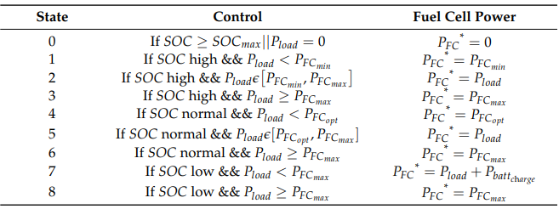
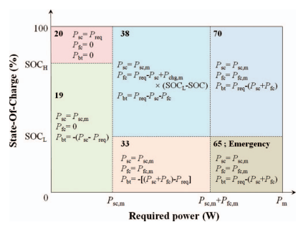
Energy Management Systems
Four primary approaches:
  Operational Mode-Based Control (OMC)
  Fuzzy Logic Control (FLC)
  Equivalent Consumption Minimization Strategies (ECMS)
  Predictive Controls
Wise et. al. 2026, [35]
OMC defines a number of operating “modes” and assigns output power for each supply accordingly
Also called rules-based control or state-machines
Lee et. al. 2014, [38]
Notes:
Drawbacks to OMC: Have to cover every possible operating state. Power allocation within each state has to be optimized.

Slide 14
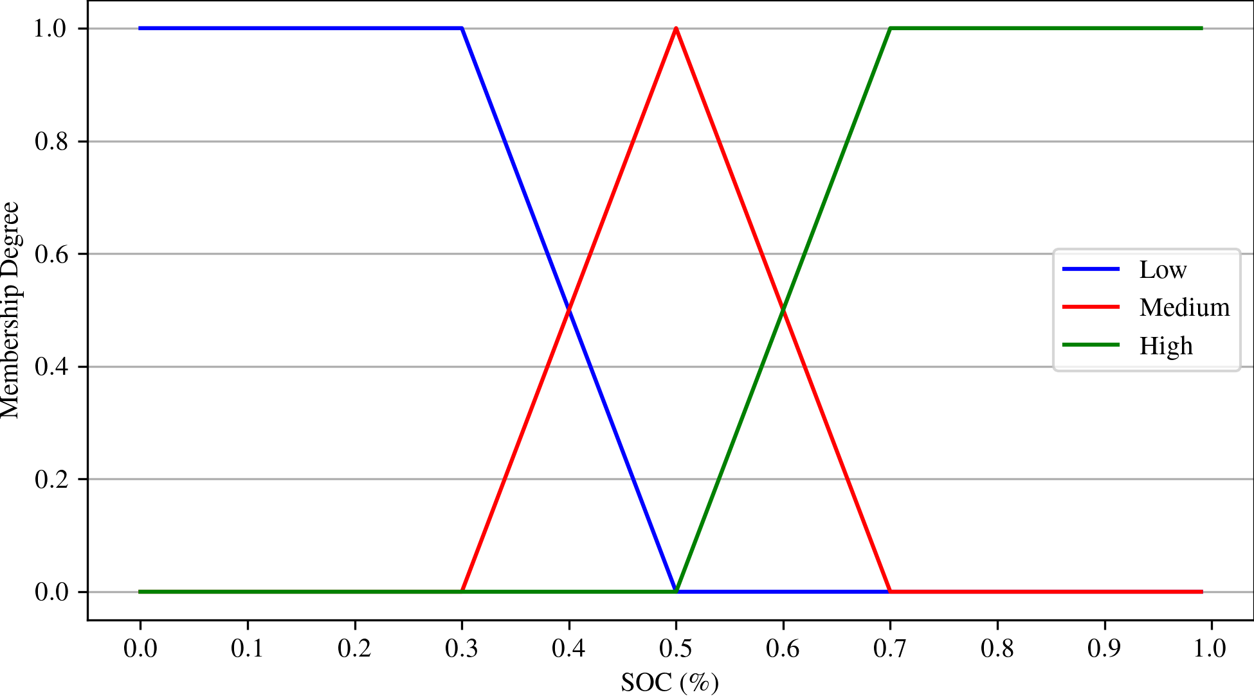
Energy Management Systems
FLC’s combine aspects of machine learning and rules-based controllers
Inputs are classified using a set of membership functions
Classified inputs subjected to a set of logical rules similar to an OMC to determine output
Generally more flexible and better accounts for grey areas in between states
Number of inputs is arbitrary; battery SOC and power demand most commonly used
  Suggested additions: hydrogen consumption, fuel tank level, ultracapacitor SOC (if present)

Slide 15
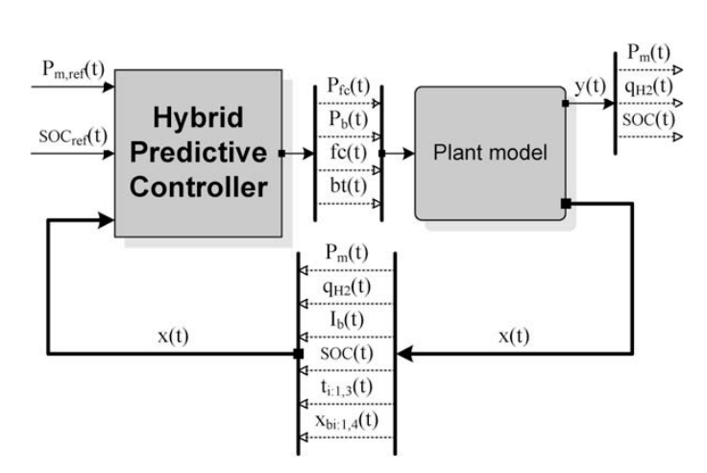

Energy Management Systems
ECMS aims to minimize hydrogen consumption, like so:
Coefficients k₁ and k₂ represent penalties used to maintain SOC within a certain band
Predictive controls govern output by forward projection of the system state
At each sampling instant, measure the state and compare to current and future predictions
Optimize changes in the manipulated variables to bring outputs into agreement with set point
$$P_{fc}=min⁡\left(C_{fc}+k_{1}C_{bat}+k_{2}C_{sc}\right)$$
Arce et. al. 2009, [32]

Slide 16
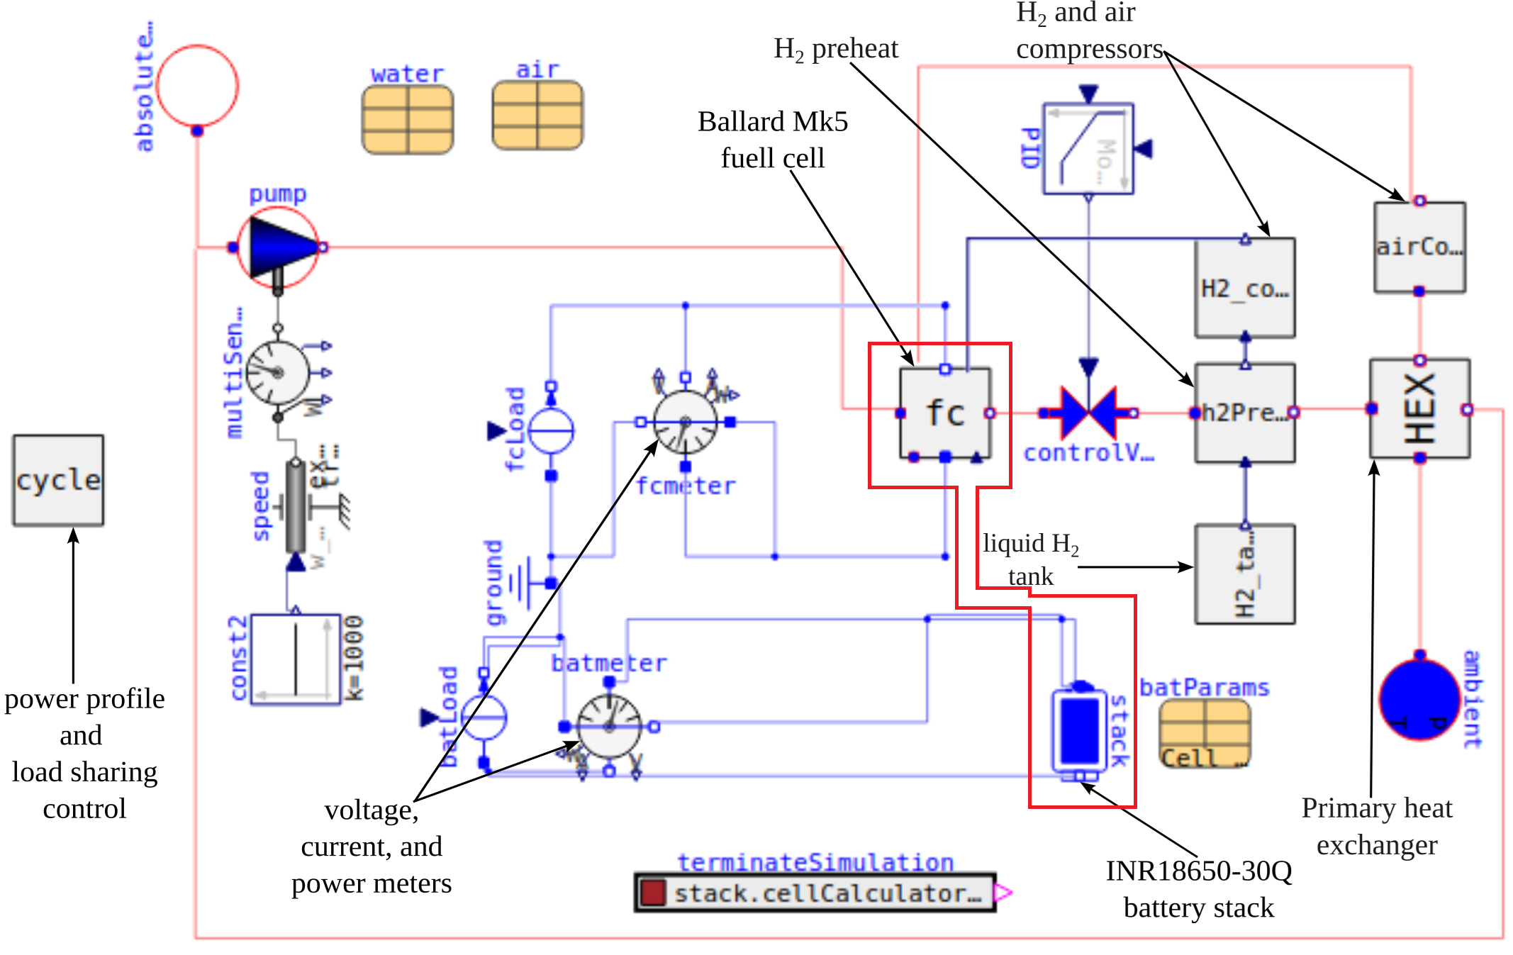
Power Train Modeling: Power Supplies
Component models developed from OpenModelica, an open-source multiphysics package written in the Modelica language
Primary components: fuel cell and battery stacks

Slide 17
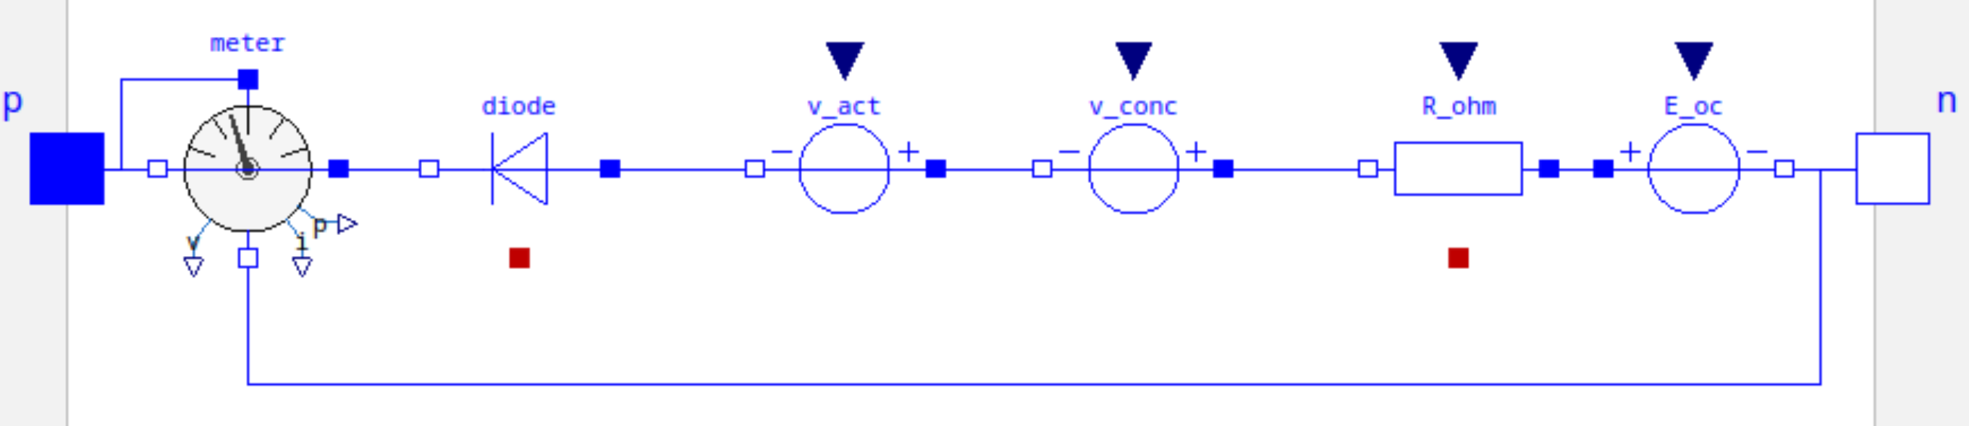
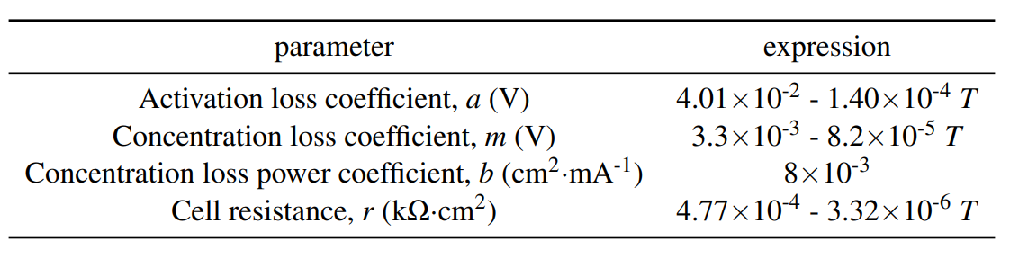




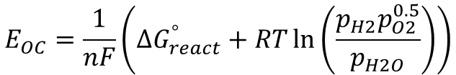
Power Train Modeling: Fuel Cell
Behavior of fuel cell stack is a summation of the open-circuit voltage and the overvoltages:
$$E_{fc}=NN_{m}\left(E_{OC}+V_{act}+V_{conc}+V_{ohm}\right)$$
The overvoltages are further defined by:
$$E_{OC}=\frac{1}{nF}\left({∆G}_{react}^{°}+RT\ln\left(\frac{p_{H2}p_{O2}^{0.5}}{p_{H2O}}\right)\right)$$
$$V_{act}=a\ln{i}$$
$$V_{conc}=me^{bi}$$
Some textbooks also include a double-layer capacitance term in parallel with V_{act}; however, very little data exists in the literature to parameterize this
$$V_{ohm}=ri$$
Notes:
Ballard MK5 cell

Slide 18
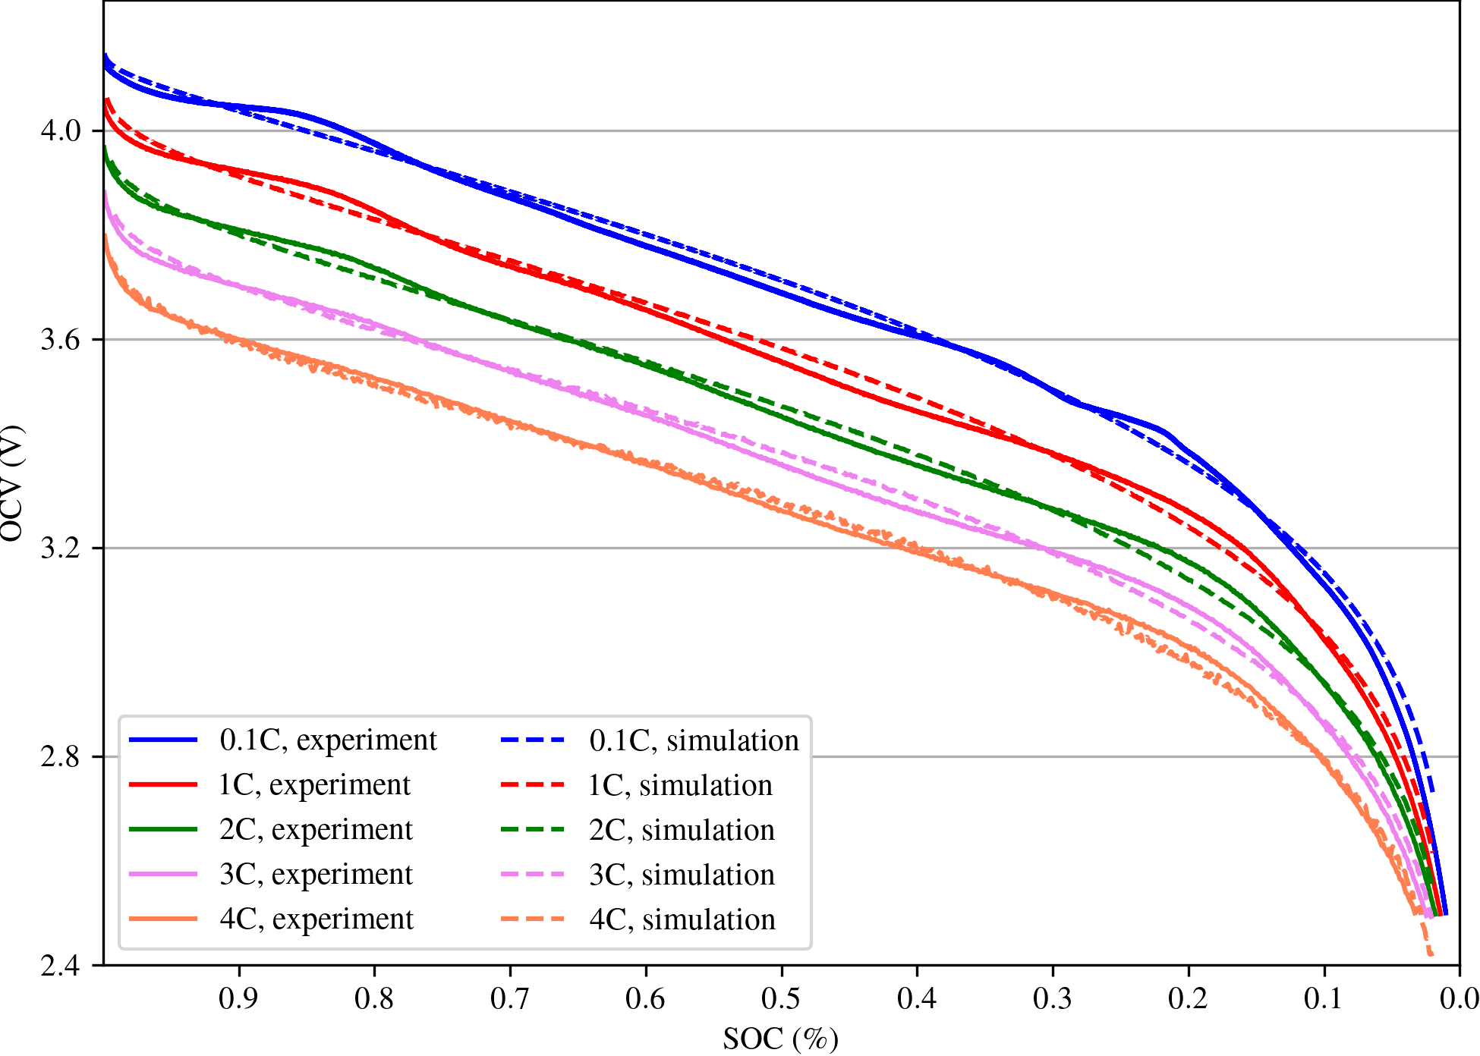
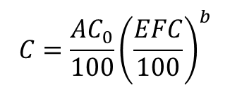
Power Train Modeling: Battery Stack
Battery is based on the INR 18650-30Q, a LiCo₂ cell manufactured by Samsung
Parameterized using experimental data from the ARTS Lab
SOC-OCV curve given by:
$$OCV=K_{0}+K_{1}SOC+K_{2}\ln{SOC}+K_{3}\ln\left(1−SOC\right)$$
Five sets of coefficients derived for five different discharge rates
Initial results overestimated cell voltage by 3-5%; adjusted K₀ accordingly
Additionally, degradation model implemented to estimate capacity fade with use:
$$C=\frac{AC_{0}}{100}{\left(\frac{EFC}{100}\right)}^{b}$$
$$A=3.25{SOC}_{m}\left(100+3.25DOD−{2.25DOD}^{2}\right)$$

Slide 19
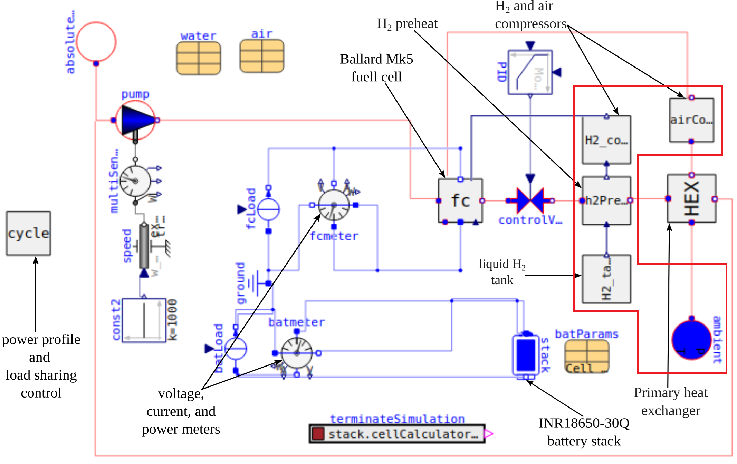
Power Train Modeling: Fuel & Air Supply Systems
Main components include:
  Liquid H₂ storage tank
  H₂ preheat
  Air intake
  Air and H₂ compressors

Slide 20

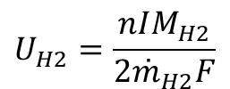
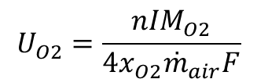


Power Train Modeling: Fuel & Air Supply Systems
Hydrogen and oxygen are provided to the fuel cell at partial pressures and with utilization rates given by:
Standard practice is to store liquid H₂ in cryogenic tanks at atmospheric pressure and 20 K (just below boiling point)
H₂ undergoes a preheat to 26.85°C using coolant discharged from the fuel cell; air goes through a similar process in the main heat exchanger
Finally, a compressor boosts both inflows to working pressure
$$p_{H2}=\left(1−U_{H2}\right)x_{H2}p_{fuel}$$
$$p_{O2}=\left(1−U_{O2}\right)x_{O2}p_{air}$$
$$p_{H2O}=\left(x_{H2O}+2x_{O2}U_{O2}\right)p_{air}$$
$$U_{O2}=\frac{nIM_{O2}}{4x_{O2}{\overset{˙}{m}}_{air}F}$$
$$U_{H2}=\frac{nIM_{H2}}{2{\overset{˙}{m}}_{H2}F}$$

Slide 21
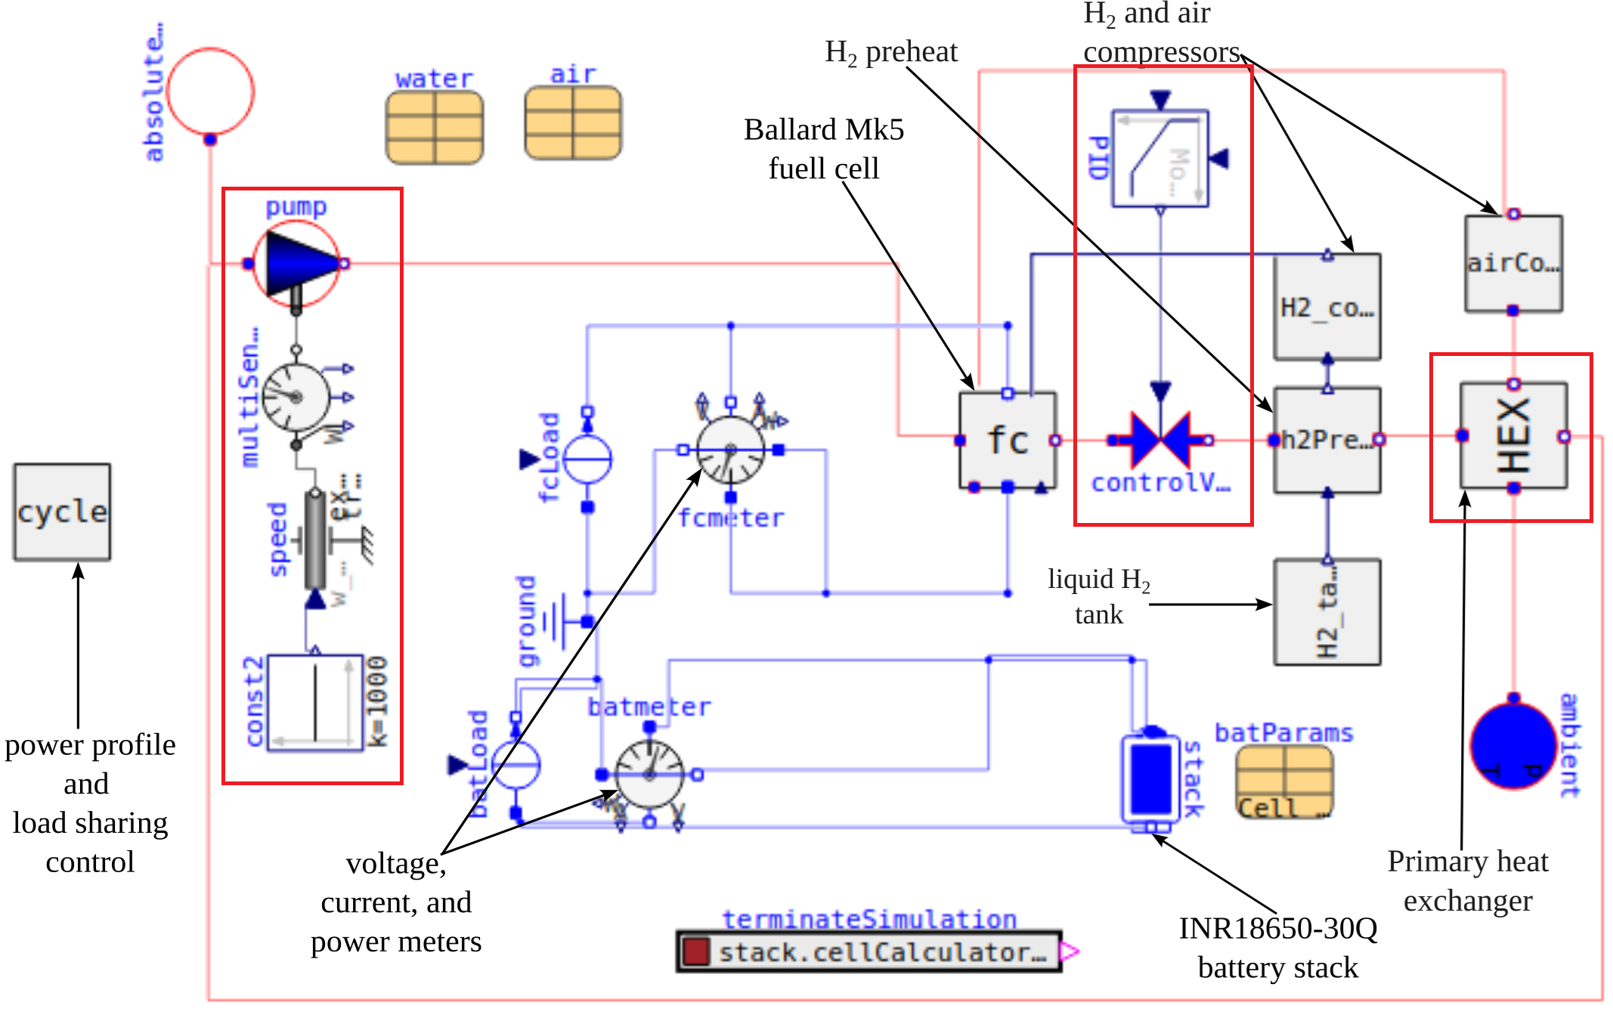
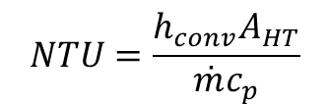
Power Train Modeling: Thermal Loop
Circulates water to provide cooling
Main components include main heat exchanger, throttle valve with PI control, and coolant pump.
H₂ preheat provides secondary source of cooling
Fuel cell interfaces with the system via cooling plates
Number of thermal units (NTU) commonly used in heat exchanger analysis, defined as
$$NTU=\frac{h_{conv}A_{HT}}{\overset{˙}{m}c_{p}}$$

Slide 22
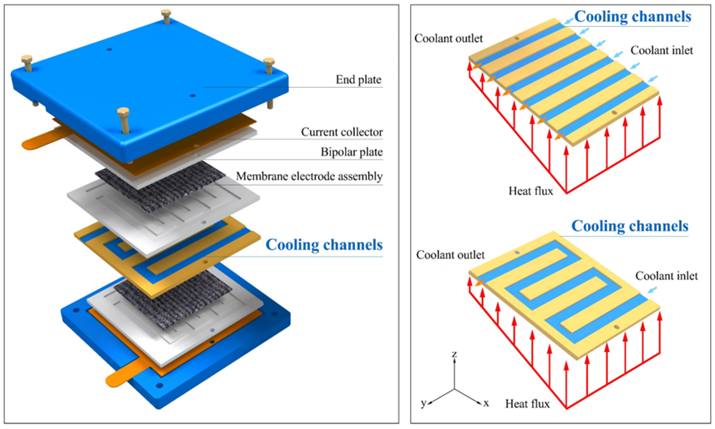
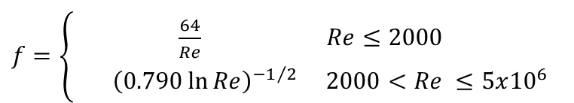
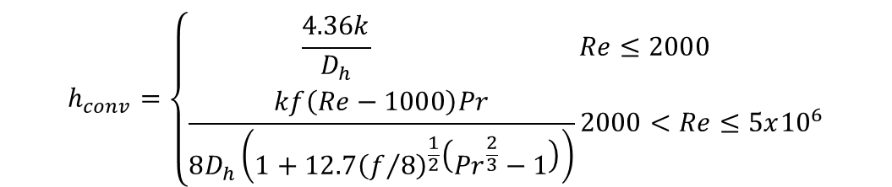
Power Train Modeling: Fuel Cell Cooling Plates
Typical method for temperature control for fuel cells is a cooling plate
Assume parallel channels and a constant, averaged heat flux
Friction factor and convection coefficient based on empirical correlations
Shamsizadeh et. al., 2025
$$h_{conv}=\left\{\begin{aligned}\frac{4.36k}{D_{h}} Re≤2000 \\ \frac{kf\left(Re−1000\right)Pr}{8D_{h}\left(1+12.7{\left(f/8\right)}^{\frac{1}{2}}\left({Pr}^{\frac{2}{3}}−1\right)\right)}2000<Re≤5x{10}^{6}\end{aligned}\right.$$
$f=\left\{\begin{aligned}\frac{64}{Re} Re≤2000 \\ { \left(0.790\ln{Re}\right)}^{{−1}/2} 2000<Re ≤5x{10}^{6}\end{aligned}\right.$

Slide 23
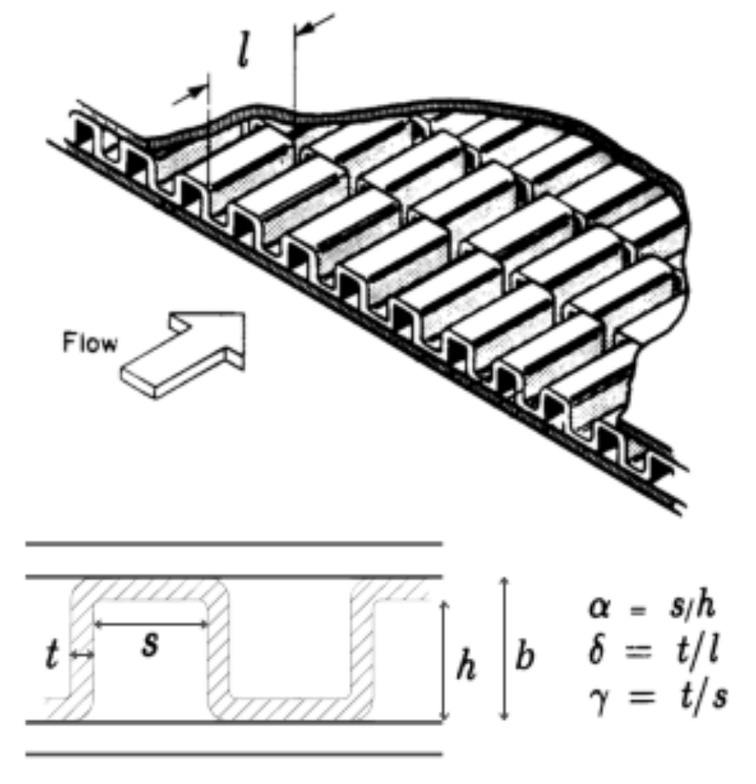

Power Train Modeling: Effectiveness-NTU Relations
Relations for heat exchanger effectiveness and NTU are commonly found in many textbooks for a variety of heat exchanger (HEX) types
For a single-sided HEX (i.e., cooling plates):
The main heat exchanger uses the same method and water/air as working fluids
Two models currently available: a simple crossflow HEX with a user-specified effectiveness, and a more detailed strip-fin crossflow HEX
Empirical relation for the Colburn factor j used to compute Nusselt number and convection coefficient
Effectiveness-NTU relation given by:
$$ε_{fc}=1−exp\left(−NTU\right)=\frac{{∆T}_{cool}}{T_{fc}−T_{in,cool}}$$
$$ε=\frac{{\left(\overset{˙}{m}c_{p}\right)}_{min}\left(T_{hot,in}−T_{cold,in}\right)}{{\left(\overset{˙}{m}c_{p}\right)}_{cold}{∆T}_{cold}}=1−exp\left[\frac{1}{{\left(\overset{˙}{m}c_{p}\right)}_{r}}{\left(NTU\right)}^{0.22}\left\{exp\left[−{\left(\overset{˙}{m}c_{p}\right)}_{r}{\left(NTU\right)}^{0.78}\right]−1\right\}\right]$$
Notes:
Strip-fin crossflow heat exchanger
Colburn Factor: j=Nu/(Re*(Pr^1/3))

Slide 24
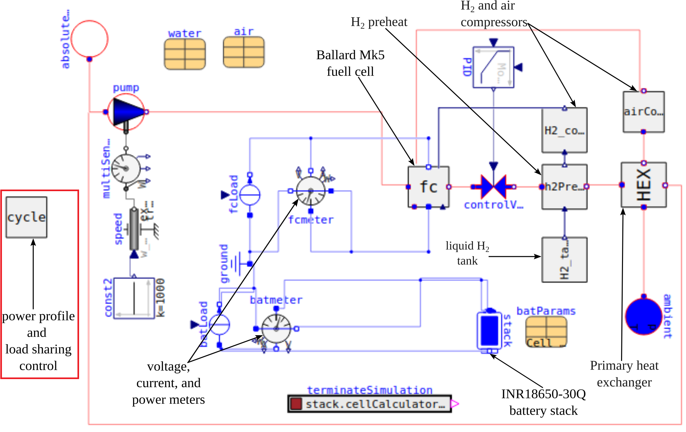
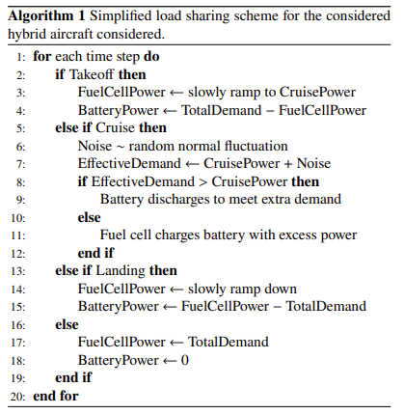
Power Train Modeling: Operational Mode Control
Basic flight profile and controller are lumped together in the “cycle” block
Controller is effectively a very simple OMC, with four states: taxi, takeoff, cruise, and descent

Slide 25
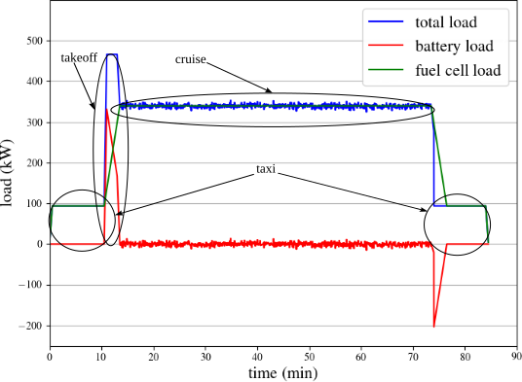
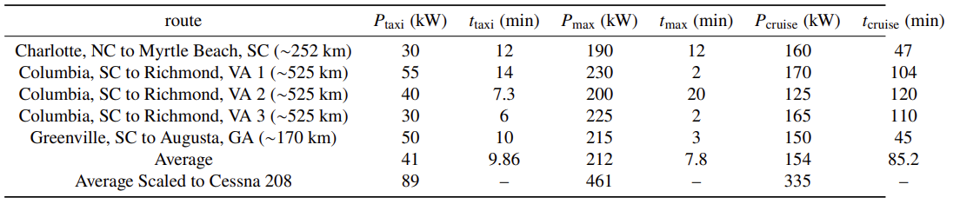
Generic Flight Profile
Generic flight profile built based publicly available data for several regional Southeastern flights
  Note: Only Cessna 206 data was available; data was rescaled for the larger engine of a 208
Substantial noise amounting to σ=1.37% cruise power observed in the data set; noise generator added to the cruise phase to mimic this
  Manipulating this “noise” parameter to increase the number and intensity of the load fluctuations has a surprisingly substantial impact on the battery stack’s useful life

Slide 26
Fluctuations Study: Stack Sizing and Study Parameters
Fuel cell required to supply 335 kW power during cruise
  Short calculation indicates 10 fuel cell modules of 350 cells each sufficient
  Estimated mass: 677 kg
Battery stack intended to act as emergency power supply capable of maintaining cruise for 30 minutes
  4 modules with configuration 270S60P meet requirement while minimizing weight
  Estimated Mass: 778 kg
Total Mass: 1455 kg (Cessna 208 power plant and fuel: 1200 kg)
  Does NOT include weight of H₂ tank or coolant
Performed a battery of simulations for a variety of combinations of cruise time and the “noise” parameter
  Three cruise lengths: “short” (60 min), “medium” (90 min), and “long” (120 min)
  Four “noise” parameters (as a percentage of cruise power): 2.740%, 1.370% (as observed in data), 0.685%, and an ideal case (no noise, 0.000%)
Each simulation repeated the flight profile until the battery stack reached 0% remaining useful life (RUL)
  Short rest period observed between flights to charge battery to at least 80% SOC and refill fuel tank
Noise Generator Standard Deviation | 0.000% P_{cruise} | 0.685% P_{cruise} | 1.370% P_{cruise} | 2.74% P_{cruise}
Power | 0 kW | 2.296 kW | 4.591 kW | 9.183 kW
Cruise Length | “Short” | “Medium” | “Long”
Time | 60 min | 90 min | 120 min

Slide 27
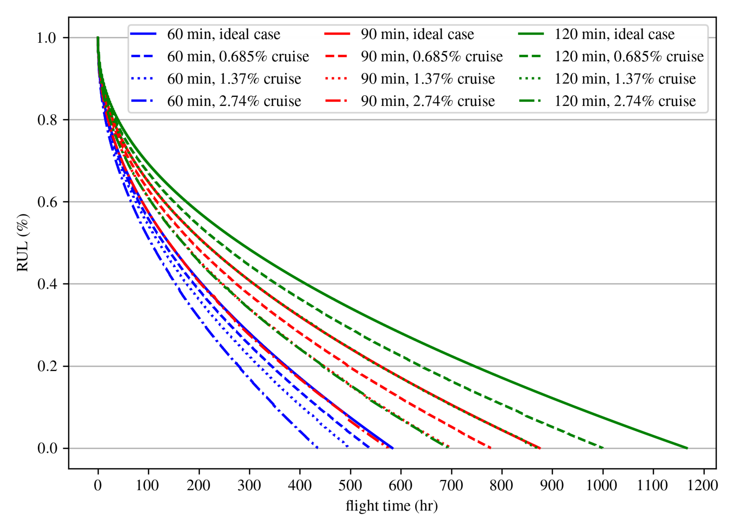
Fluctuations Study: Initial Results
Under ideal case, aircraft achieved 600 flight hours under “short” cruise, 900 hours under “medium” cruise, and 1200 hours under “long” cruise
  Takeoff identified as a major stressor
Losses from load fluctuations increased with cruise length
  Ex., with fluctuations 2.740% P_{cruise}, RUL decreased ~20% for “short” cruise, ~33% for “medium” cruise, and ~41% from ideal case for “long” cruise

Slide 28
Objectives and Research Plan

Slide 29
Major Objectives
Task 1: Complete hybrid electric aircraft toolbox. Expanding upon the base packages provided by OpenModelica, complete the previously described physics models. Construct and validate models on a laboratory-scale testbed.
Task 2: Develop Energy Management Systems and Controllers. Develop autonomous EMSs that allocate power between the fuel cell and battery while preserving battery life, satisfying mission demand, and maintaining safe operation. Move beyond manual controller fine-tuning by studying autonomous calibration and optimization methods.
Task 3: Explore Simulation Space. Identify key parameters impacting battery useful life. Quantify the effect a range of values for these parameters on power train performance and economics.

Slide 30
Task 1: Complete hybrid electric toolbox
Subtask 1.1: Develop modular multi-physics power train library.
  Estimated 80% complete
  Major items remaining: complete integration of battery stack into thermal loop, time-averaged DC/DC boosters, review and clarify existing code
  Aspirational items: Additional HEX models (parallel flow, counter flow), ultracapacitor banks
Subtask 1.2: Integrate battery degradation and mission-profile modeling
  Estimated 80% complete
  Mandatory items remaining: Introduce irregularities (i.e., in-flight ascents and descents) and emergency conditions (aborted take-offs/landings, loss of primary power supply)
  Aspirational items: Make available additional degradation models for alternative cell chemistries

Slide 31
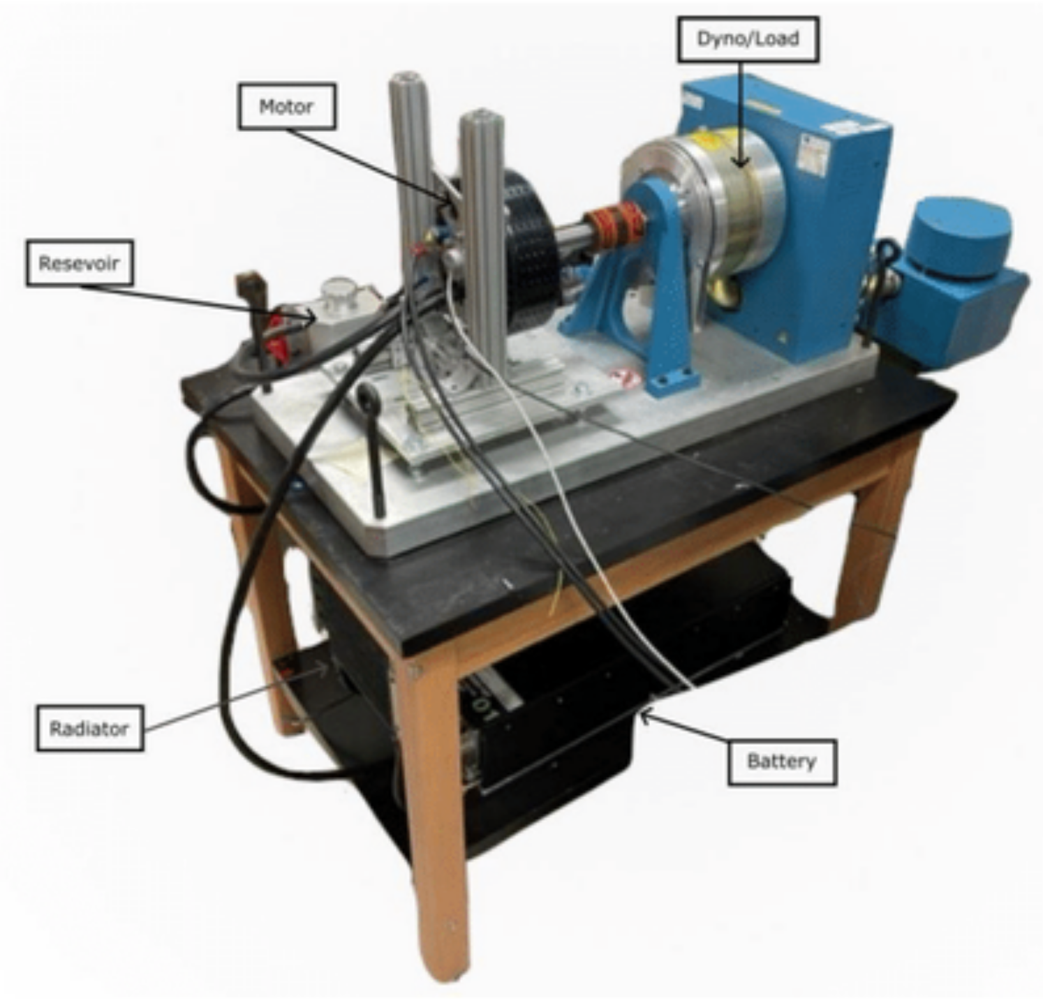
Task 1: Complete hybrid electric toolbox
Subtask 1.3: Construct laboratory-scale testbed and validate models
  Estimated 5% complete
  Aim is to reactive, repurpose, and expand testbed built for a previous NASA project
  Currently consists of a small 18650-30Q battery stack, an EMRAX 268 AC motor, and a short thermal loop
  Propose adding a programmable DC power supply in lieu of fuel cell stack
  May require aid of undergraduate students

Slide 32
Task 2: Develop Energy Management Systems and Controllers
Subtask 2.1: Develop baseline and advanced EMS controllers
  Estimated 5% complete
  Mandatory items: Extend current OCM to include additional states, implement FLC and ECMS
  Aspirational items: Experiment with unorthodox FLC membership functions
Subtask 2.2: Investigate autonomous controller calibration methods
  Goal to reduce reliance on manual calibration by developing automated techniques to optimize performance
  Candidate approaches include optimization-based calibration, Bayesian optimization, and adaptive membership function adjustment (for FLC)
Subtask 2.3: Validate EMS performance on the hardware testbed

Slide 33
Task 3: Explore Simulation Space
Subtask 3.1: Investigate sensitivity of battery life and cost to design parameters
  Explore impact of key design and operating parameters on performance
  Complete sensitivity study identifying key parameters influencing aircraft and battery performance and viability
Subtask 3.2: Develop parametric design-space simulations
  Perform comprehensive parametric simulation campaign emphasizing the key parameters identified in Subtask 3.1
  Resulting dataset will establish relationships between design choices and performance metrics

Slide 34
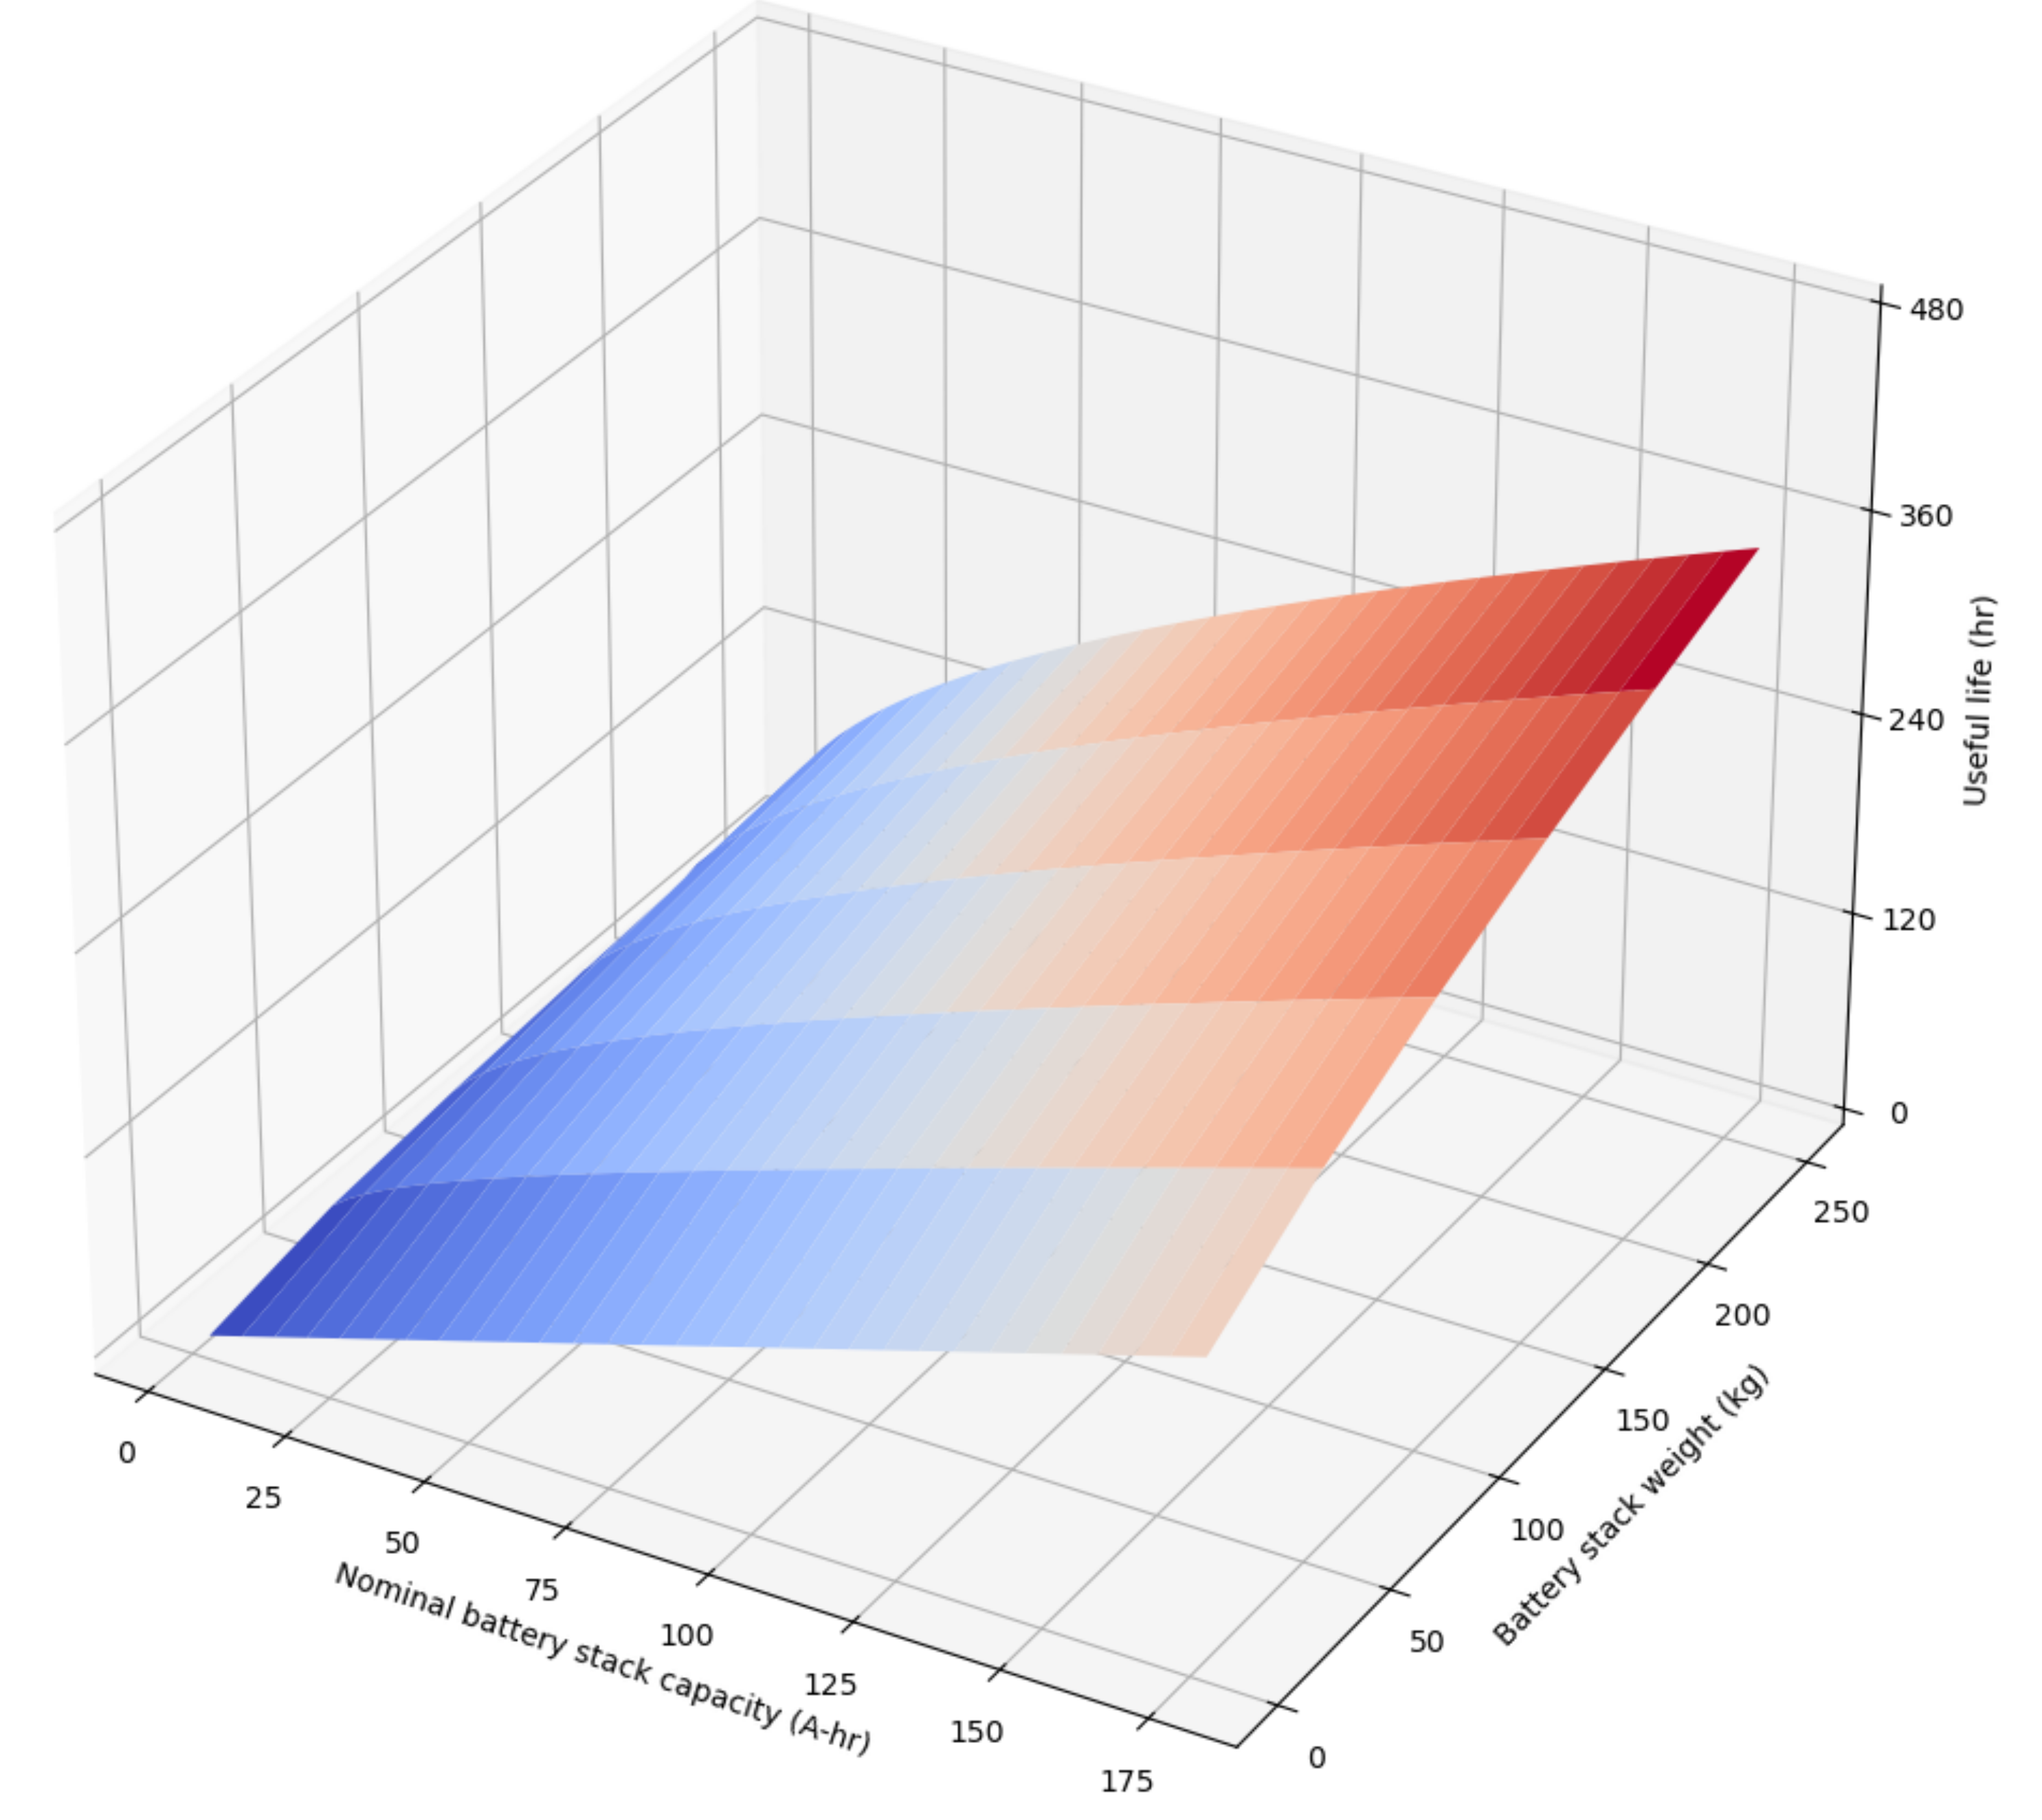
Task 3: Explore Simulation Space
Subtask 3.3: Develop Kriging-based surrogate models for aircraft-level performance
  Develop surrogate models mapping the parametric results of Subtask 3.2 to aircraft-level outcomes, such as battery useful life, H₂ consumption, maintenance burden, life cycle cost, and aircraft availability
  Function as a design tool identifying optimal design and control strategies for desired performance metrics
Conceptual surrogate model mapping stack capacity and weight onto useful life

Slide 35
Proposed Timeline
September 2026: Completion of physical component models (Subtask 1.1). Begin construction of testbed (Subtask 1.3).
October 2026: Complete degradation models (Subtask 1.2) and basic EMS controller models (Subtask 2.1) and obtain initial simulation results (Subtask 1.2).
November 2026: Complete testbed construction (Subtask 1.3).
December 2026 and January 2027: Calibrate controllers (Subtast 2.2) and validate results on testbed (Subtask 2.3).
February 2027: Perform sensitivity analysis and parametric study (Subtask 3.1 and 3.2).
March and April 2027: Build surrogate models (Subtask 3.3) and submit final results for defense and publication

Slide 36



Acknowledgements
This material is based in part upon work supported by the Air Force Office of Scientific Research (AFOSR) through award no. FA9550-21-1-0083. This work is also partly supported by the National Science Foundation (NSF) grant number 2237696. Any opinions, findings, conclusions, or recommendations expressed in this material are those of the authors and do not necessarily reflect the views of the National Science Foundation or the United States Air Force
Notes:
Thank you for your attention! You can find all the design files and details on GitHub. The data used in this talk is also freely available and we are happy to share more if anyone is interested. Feel free to scan the QR code or visit our GitHub page for more information. My name is Austin Downey, I teach at the University of South Carolina, and I am happy to answer any questions you may have.

Slide 37
Acknowledgements
Special thanks to the following people:
Jim Ferguson, Tim Gabriel, Michael Romero, and Kenny Dukes of SRNL for their support
Dr. Asimov and Mr. Anderson, Clarke, and Rodenberry for providing personal inspiration
Notes:
Thank you for your attention! You can find all the design files and details on GitHub. The data used in this talk is also freely available and we are happy to share more if anyone is interested. Feel free to scan the QR code or visit our GitHub page for more information. My name is Austin Downey, I teach at the University of South Carolina, and I am happy to answer any questions you may have.

Slide 38

Thank You for Your Time
https://xkcd.com/2268/
Name: Nathaniel Cooper
Title: Doctoral Candidate
Email: coopern2@email.sc.edu
Lab GitHub: github.com/arts-laboratory

