Slide 1
Energy Storage and Transport
Modeling example

Slide 2







The model development cycle
Modelling objective
Physical phenomena
Model selection
Mathematical elaboration
Implemen-tation
Validation & verification
Reflection
Analyze the context and define an objective for modeling. Which purpose can a model serve in the project?
Perform research to understand the physical phenomena that play a role in the project. How do they relate to the modelling objective?
Select which phenomena are essential to include and which may be neglected. Which simplifications and assumptions can be made?
Define and combine the mathematical relations that describe the physical phenomena and apply the selected simplifications.
Create the model which uses the mathematical relations to predict (an) outcome(s) based on given inputs.
Validate: does the model solve the right equations?
Verify: does the model solve the equations correctly?
Is the modelling objective met? What are the uses and limitations of the model?
How can it be improved?
Iterate steps when appropriate

Slide 3





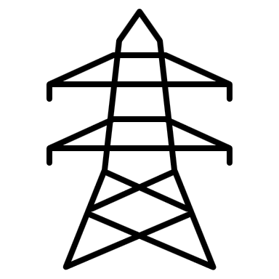






Energy Storage and Transport
Modelling objective
Physical phenomena
Supply: 100 x 10 MW
Model selection
Transport to storage
Storage
Mathematical elaboration
Implementation
100-mile transmission line
Large off-shore wind farm, transporting electric energy to a hydroelectricity dam using high-voltage transmission lines.
Topic of this lecture: Model development for the transmission lines
Validation & verification
Reflection

Slide 4









Modelling objective
The model as a black box
Physical phenomena
Transmission system model
$$P_{in}$$
$$P_{out}$$
Model selection
Mathematical elaboration
$$P_{loss}$$
Implementation
The transmission line model should provide a relation between:
Input: power supplied by the turbines
Output: power delivered to the storage
Validation & verification
Reflection

Slide 5
Modeling questions
Modelling objective
Physical phenomena
How much energy is lost in the transmission lines?
How do these losses depend on the transport system parameters?
Length of the transmission lines
Electricity transport voltage and power
Type of transmission cables
Type of transformers
Etc.
Model selection
Mathematical elaboration
Implementation
Validation & verification
Reflection

Slide 6
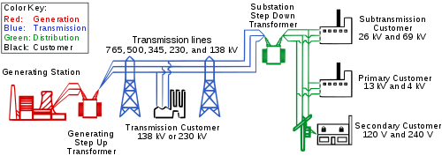
What are typical losses?
Modelling objective
Physical phenomena
1000 MW @ 765 kV
Example from literature:
A 100 mi (160 km) span at 765 kV carrying 1000 MW of power can have losses of 0.5% to 1.1%.
A 345 kV line carrying the same load across the same distance has losses of 4.2%.
Model selection
→ Loss: 0.5-1.1 %
Mathematical elaboration
1000 MW @ 345 kV
Implementation
→ Loss: 4.2 %
Validation & verification
100 mile
Reflection

Slide 7

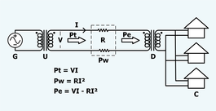
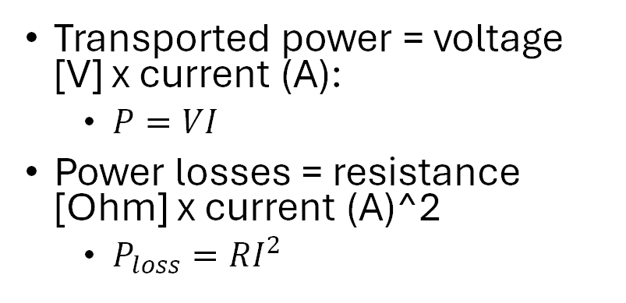
Why is a higher voltage better?
Modelling objective
Physical phenomena
Transported power = voltage [V] x current (A):
$P=VI$
Power losses = resistance [Ohm] x current (A)^2
$P_{loss}=RI^{2}$
Model selection
Mathematical elaboration
Implementation
Best to transport energy at a low current
Given a fixed transport power, the current can be lowered by increasing the voltage
Validation & verification
Reflection

Slide 8
What causes the losses?
Modelling objective
Physical phenomena
Joule heating
resistance of wires
Dependent on properties of cables and power current
→ Assumption: main source of loss
Inductance
caused by magnetic field
Only relevant for alternating current
→ Assumption: direct current is used
Corona losses
air ionization
Only relevant when voltage exceeds the corona threshold
Dependent on weather conditions and temperature
→ Assumption: can be neglected
Model selection
Mathematical elaboration
Implementation
Leakage
to ground
Minimal in a correctly designed system
→ Assumption: can be neglected
Transformer losses
efficiency of transformer
Expected to be small, but significant
→ Assumption: take into account
Validation & verification
Reflection

Slide 9








The energy flow diagram
Modelling objective
Physical phenomena
Transmission system model
$$P_{in}$$
Transf up
$$P_{1}$$
Transm lines
$$P_{2}$$
Transf down
$$P_{out}$$
Model selection
Mathematical elaboration
$$D_{1}$$
$$D_{2}$$
$$D_{3}$$
Implementation
$$P_{loss}$$
The structure of your model:
How do the sub-components connect ?
Where are the losses?
Validation & verification
Reflection

Slide 10
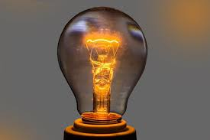



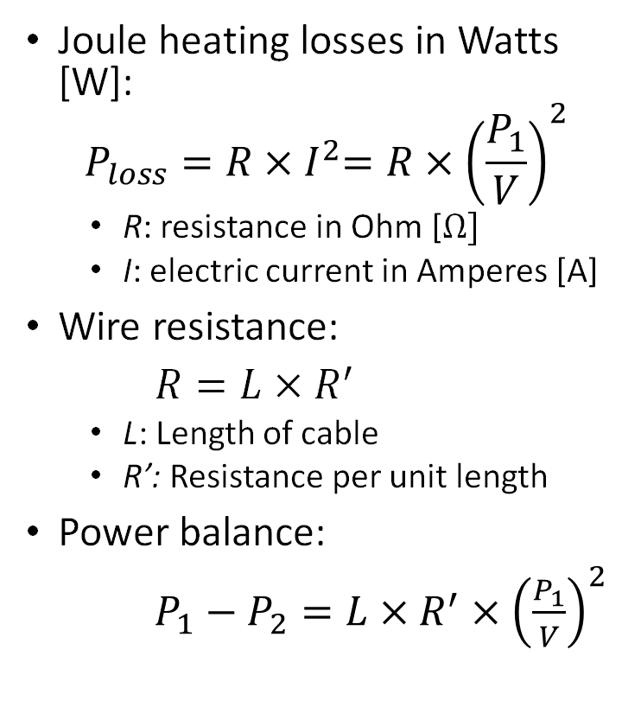
The transmission lines
Modelling objective
Physical phenomena
Cables
$$P_{2}$$
$$P_{1}$$
Joule heating losses in Watts [W]:
$$P_{loss}=R{×I}^{2}=R×{\left(\frac{P_{1}}{V}\right)}^{2}$$
R: resistance in Ohm [$Ω]$
I: electric current in Amperes [A]
Wire resistance:
$R=L×R^{′}$
L: Length of cable
R’: Resistance per unit length
Power balance:
$P_{1}−P_{2}={L×R}^{′}×{\left(\frac{P_{1}}{V}\right)}^{2}$
Model selection
$$D_{2}$$
Mathematical elaboration
Implementation
Validation & verification
Reflection

Slide 11

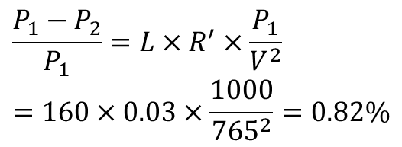
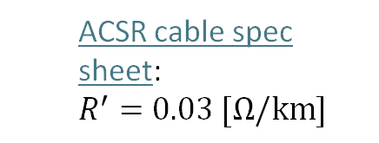
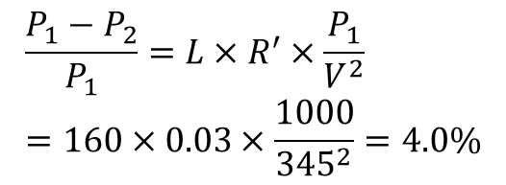
Does it make sense?
Modelling objective
Physical phenomena
ACSR cable spec sheet: $$R^{′}=0.03 [Ω/km]$$
1000 MW @ 765 kV
Model selection
→ Loss: 0.5-1.1 %
$$\frac{P_{1}−P_{2}}{P_{1}}={L×R}^{′}×\frac{P_{1}}{V^{2}}=160×0.03×\frac{1000}{{765}^{2}}=0.82\%$$
Mathematical relations
1000 MW @ 345 kV
Implementation
→ Loss: 4.2 %
$$\frac{P_{1}−P_{2}}{P_{1}}={L×R}^{′}×\frac{P_{1}}{V^{2}}=160×0.03×\frac{1000}{{345}^{2}}=4.0\%$$
Validation & verification
100 mile
Reflection

Slide 12
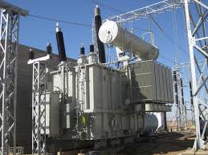

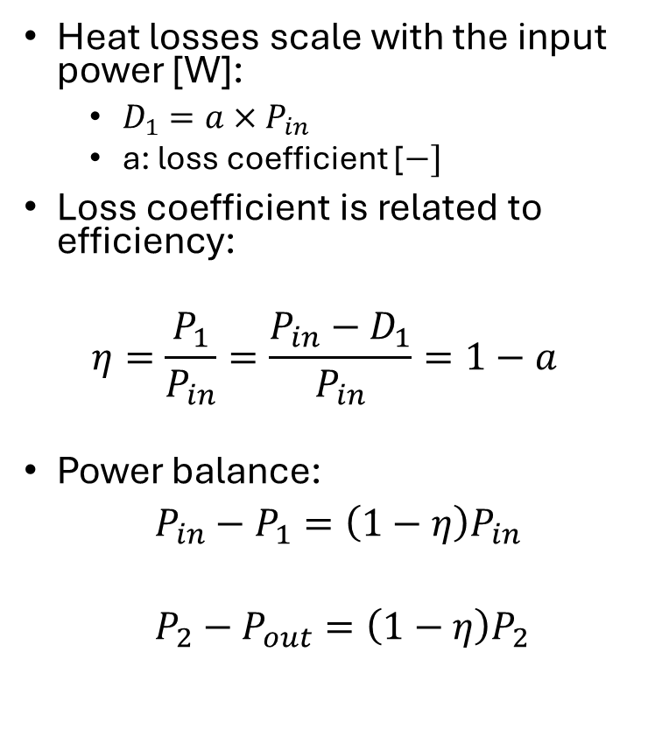

The transformers
Modelling objective
Physical phenomena
Heat losses scale with the input power [W]:
$D_{1}=a×P_{in}$
a: loss coefficient [$−]$
Loss coefficient is related to efficiency:
$$η=\frac{P_{1}}{P_{in}}=\frac{P_{in}−D_{1}}{P_{in}}=1−a$$
Power balance:
${P_{in}−P}_{1}=\left(1−η\right)P_{in}$
${P_{2}−P}_{out}=\left(1−η\right)P_{2}$
$$P_{in}$$
Transformer
$$P_{1}$$
Model selection
Mathematical elaboration
$$D_{1}$$
Implementation
Validation & verification
Reflection

Slide 13


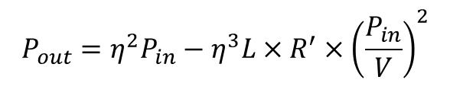


Modelling objective
Putting the model together
Physical phenomena
Transmission system model
Model selection
$$P_{in}$$
Transfup
$$P_{1}$$
Transm lines
$$P_{2}$$
Transf down
$$P_{out}$$
Mathematical elaboration
$$D_{2}$$
$$D_{1}$$
$$D_{3}$$
Implementation
$$P_{loss}$$
$$P_{1}={ηP}_{in}$$
$$P_{2}=P_{1}−{L×R}^{′}×{\left(\frac{P_{1}}{V}\right)}^{2}={ηP}_{in}−{L×R}^{′}×{\left(\frac{{ηP}_{in}}{V}\right)}^{2}$$
$$P_{out}=ηP_{2}={η^{2}P}_{in}−η^{3}{L×R}^{′}×{\left(\frac{P_{in}}{V}\right)}^{2}$$
Validation & verification
$$P_{out}={η^{2}P}_{in}−η^{3}{L×R}^{′}×{\left(\frac{P_{in}}{V}\right)}^{2}$$
Reflection

Slide 14

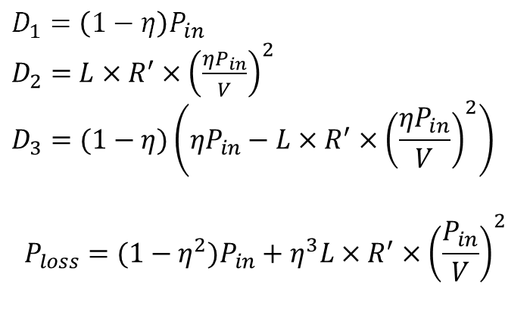
Checking the result
Modelling objective
Physical phenomena
Transmission system model
Model selection
$$P_{in}$$
Transfup
$$P_{1}$$
Transm lines
$$P_{2}$$
Transf down
$$P_{out}$$
Mathematical relations
$$D_{2}$$
$$D_{1}$$
$$D_{3}$$
Implementation
$$P_{loss}$$
$$D_{1}=\left(1−η\right)P_{in}$$
$D_{2}=$ ${L×R}^{′}×{\left(\frac{{ηP}_{in}}{V}\right)}^{2}$
$$D_{3}=(1−η)\left({ηP}_{in}−{L×R}^{′}×{\left(\frac{{ηP}_{in}}{V}\right)}^{2}\right)$$
$$P_{loss}={{(1−η}^{2})P}_{in}+η^{3}{L×R}^{′}×{\left(\frac{P_{in}}{V}\right)}^{2}$$
Validation & verification
+
Reflection
$P_{loss}=P_{in}−P_{out}$

Slide 15
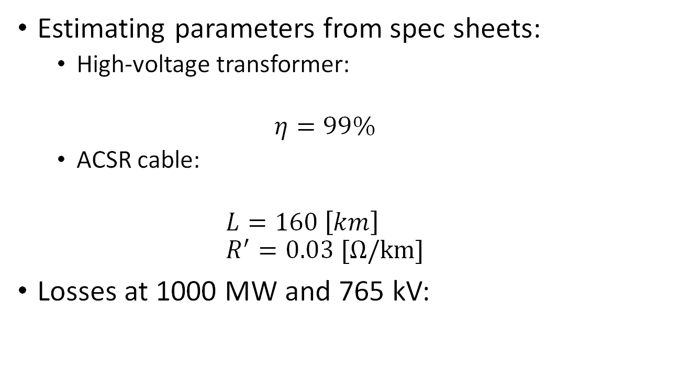
Does the result make sense?
Modelling objective
Physical phenomena
Estimating parameters from spec sheets:
High-voltage transformer:
$$η=99\%$$
ACSR cable:
$$L=160 \left[km\right] \\ R^{′}=0.03 [Ω/km]$$
Losses at 1000 MW and 765 kV:
Model selection
Mathematical elaboration
Implementation
Validation & verification
$P_{loss}={(1−0.99}^{2})×1000+{0.99}^{3}×160×0.03×{\left(\frac{1000}{765}\right)}^{2}=27.9 [MW]=2.79\%$
Reflection

Slide 16
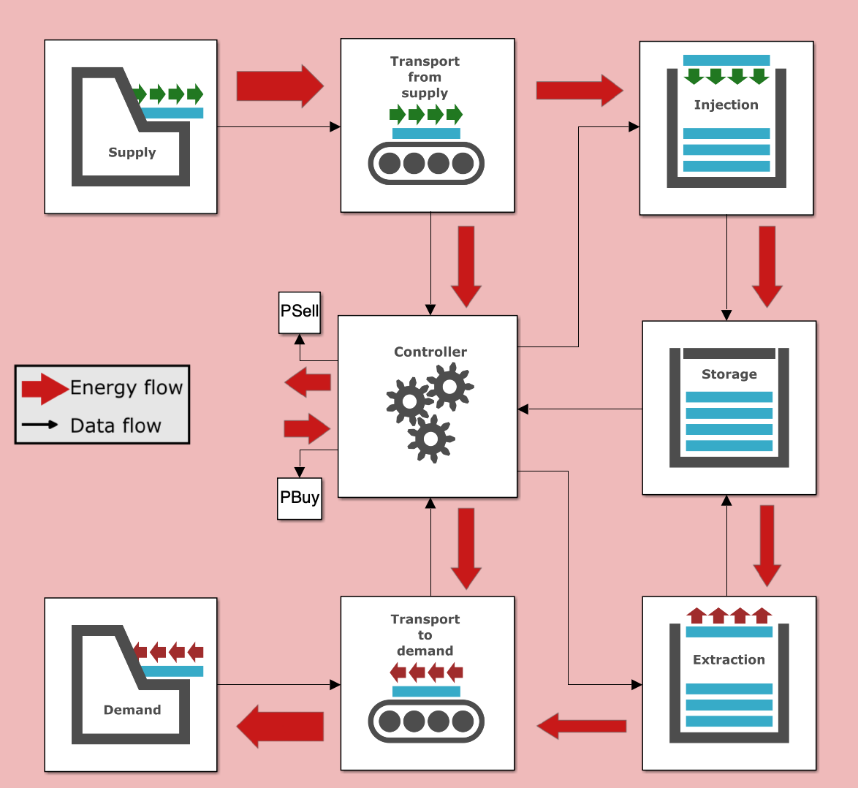
The transport function block
Modelling objective
Physical phenomena
Model selection
Mathematical elaboration
Implementation
Validation & verification
Reflection

Slide 17
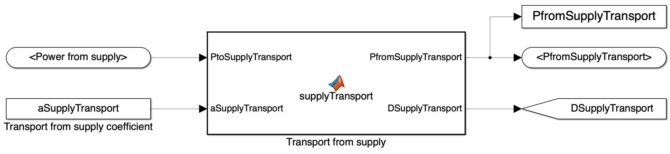
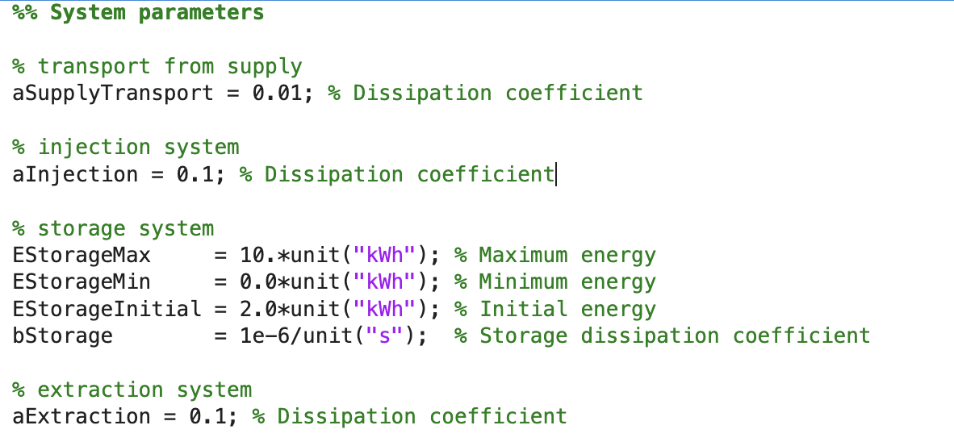
The transport function block
Modelling objective
Physical phenomena
Inside the "Transport from supply" block:
Model selection
Mathematical elaboration
Implementation
Effective loss parameter in baseline implementation
preprocessing.m
Validation & verification
Reflection

Slide 18
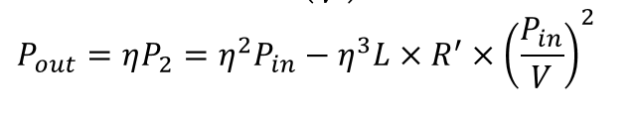
The implementation of the model
Modelling objective
Physical phenomena
Inside the "supplyTransport" function block:
Model selection
Mathematical elaboration
Implementation
Not of the form same form due to quadratic dependence on the input power.
Requires new implementation of the Matlab function.
Validation & verification
Reflection

Slide 19
The implementation of the model
Modelling objective
Physical phenomena
Inside the "supplyTransport" function block:
Model selection
Mathematical elaboration
Implementation
Validation & verification
Reflection

Slide 20
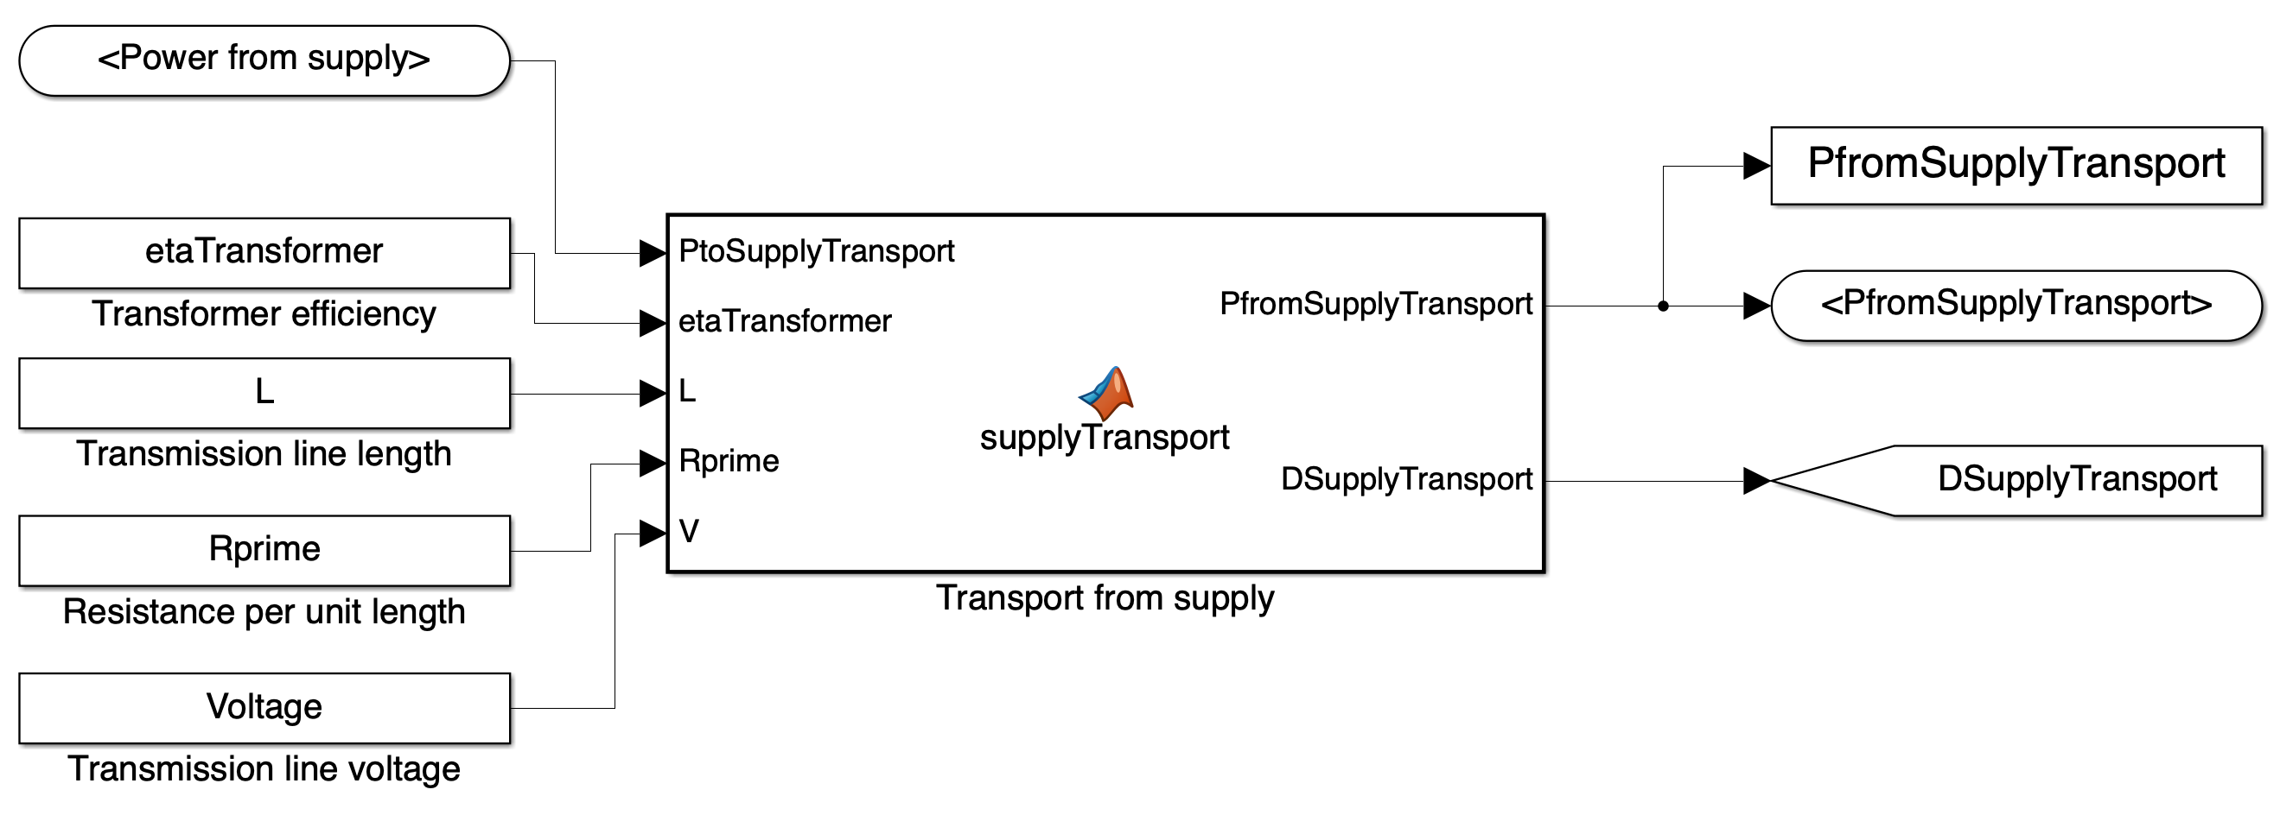
The transport function block
Modelling objective
Physical phenomena
Inside the "Transport from supply" block:
Model selection
Mathematical elaboration
Implementation
Validation & verification
Reflection

Slide 21
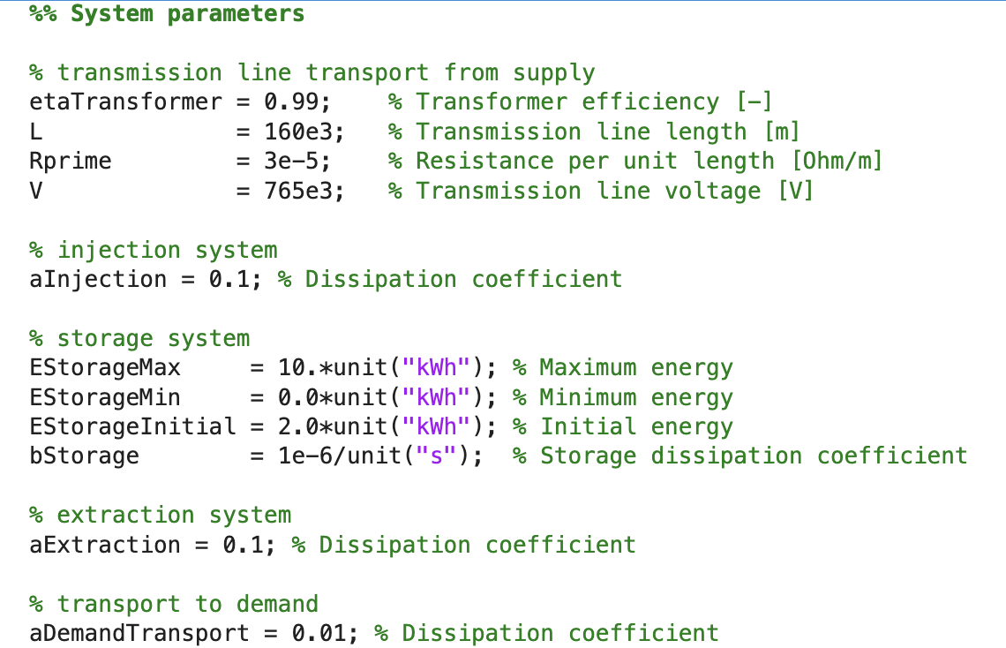
The physical input parameters
Modelling objective
Physical phenomena
preprocessing.m
Model selection
Mathematical elaboration
Implementation
Validation & verification
Reflection

Slide 22
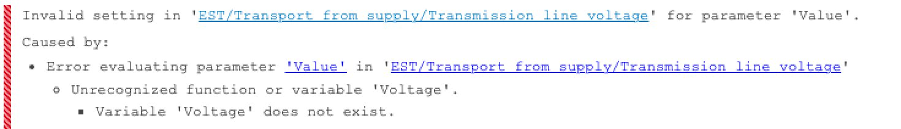
Debugging
Modelling objective
Physical phenomena
Model selection
Mathematical elaboration
Study the error message to understand what is wrong.
If you cannot find the bug, revert to the version that worked, and then make step-by-step changes.
Create test cases to track the bug.
Implementation
Validation & verification
Reflection

Slide 23
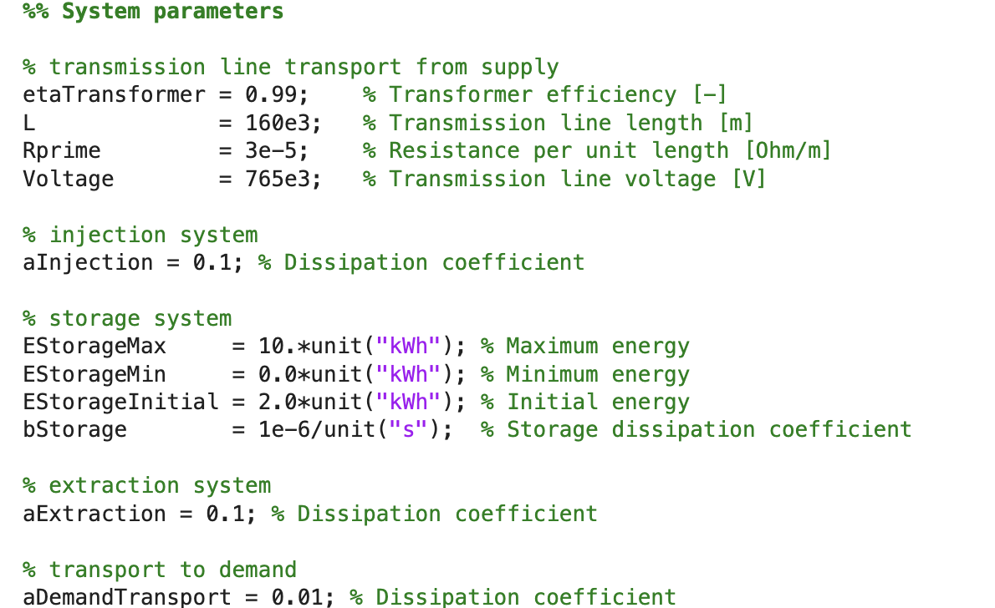
The physical input parameters
Modelling objective
Physical phenomena
preprocessing.m
Model selection
Mathematical elaboration
Implementation
Validation & verification
Reflection

Slide 24
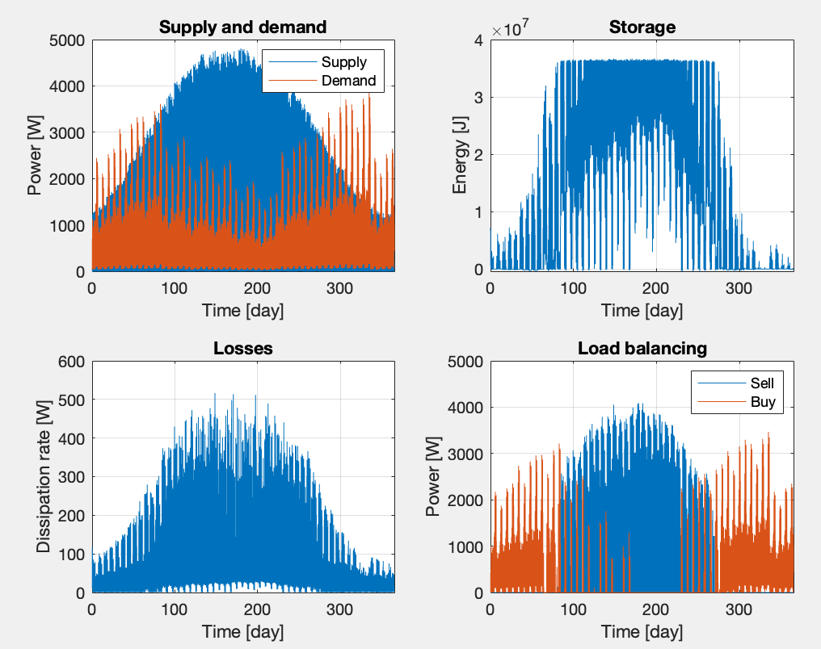
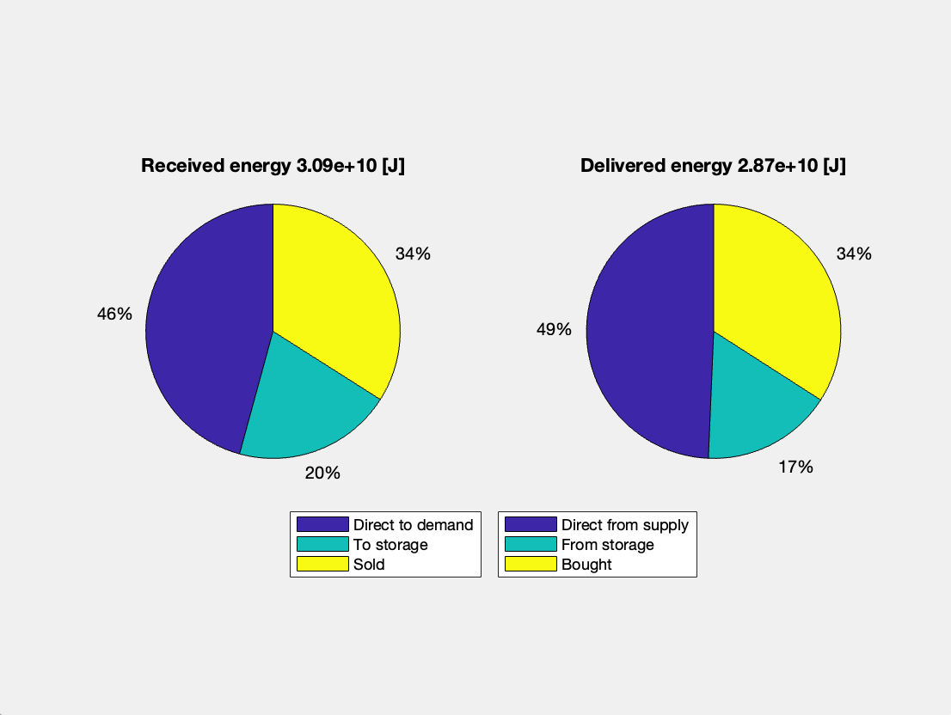
Do the results make sense?
Modelling objective
Physical phenomena
Model selection
Mathematical elaboration
Implementation
Validation & verification
Standard output does not properly visualize the change.
Add additional output to assess model change.
Reflection

Slide 25
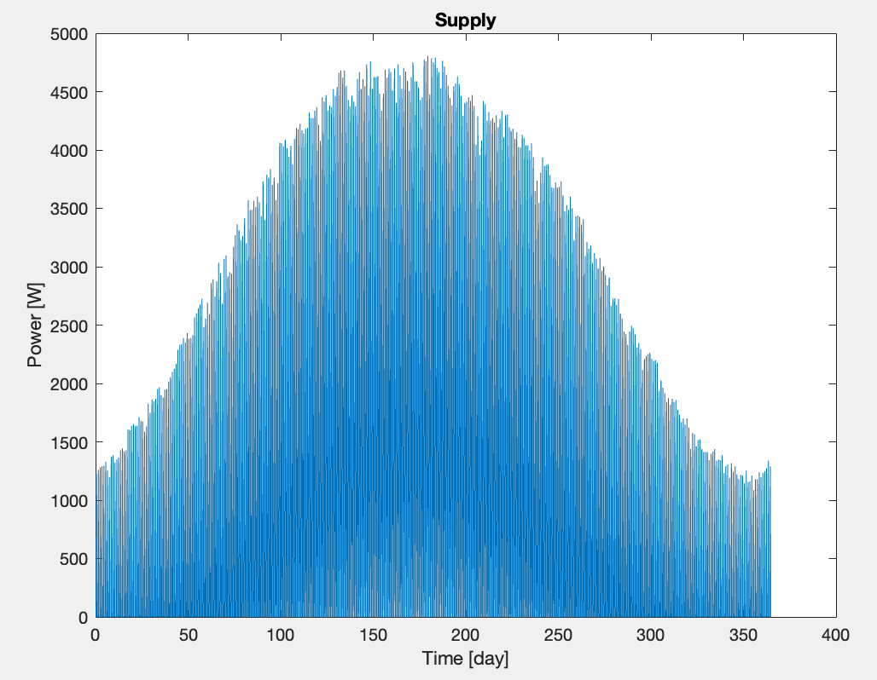
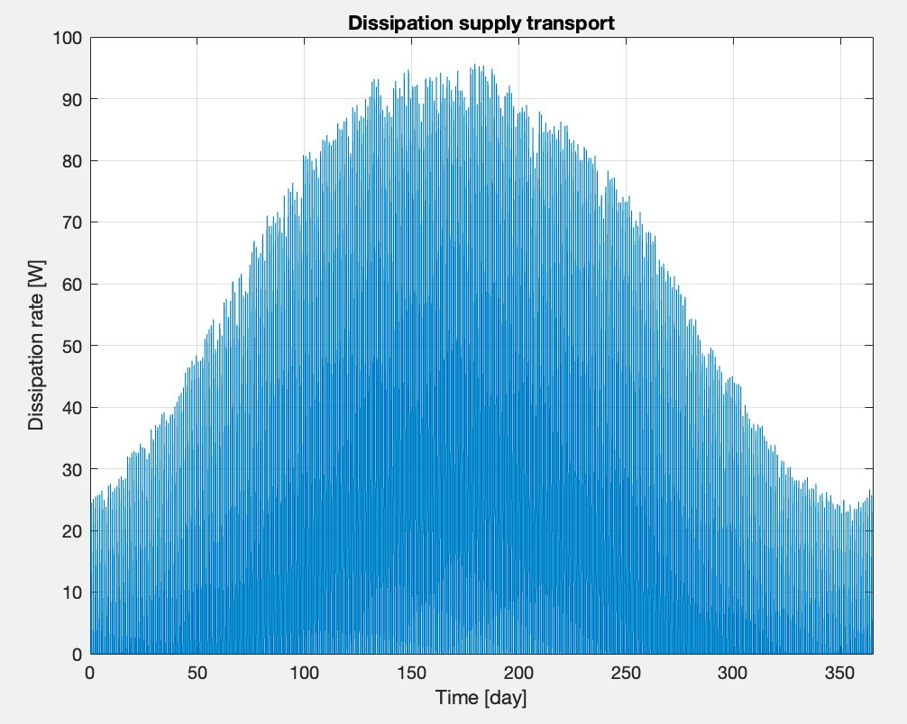
Do the results make sense?
Modelling objective
Physical phenomena
Model selection
Mathematical elaboration
Implementation
Validation & verification
Losses around 2%
Dominated by transformers because of low power
Additional testing at high powers needed
Reflection

Slide 26
What can the model do?
Modelling objective
Physical phenomena
Provide estimate of power losses in DC transmission lines
Model allows variation of:
Length of transmission line
Resistance of lines (material property)
Voltage in transmission line
Transformer efficiencies
Results correspond well with literature observations
Model selection
Mathematical elaboration
Implementation
Validation & verification
Reflection

Slide 27
What can be improved?
Modelling objective
Physical phenomena
Further validation by considering higher powers
Extend to AC transmission lines by including inductance in the model
Add an improved model for the transformers
Model selection
Mathematical elaboration
Implementation
Validation & verification
Reflection

Slide 28
Energy Storage and Transport
Modeling example

