Slide 1







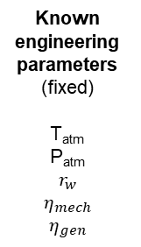

Operational
parameters
(unknown)
$$r_{p}$$
$$\dot{m}$$
Known
engineering
parameters
(fixed)
T_{atm}
P_{atm}
$$r_{w}$$
$$η_{mech}$$
$$η_{gen}$$
Uncertain parameters
$$∂T/∂z$$
$$∂P_{aq}/∂z$$
$$∂P_{f}/∂z$$
$${\dot{m}}_{leak}$$
$$n$$
$$z$$
$$h$$
$$φ$$
$$k$$
Guess
Constant
Expected value
Distributions
Constant
caes
model
Update
$$\dot{m}$$
$$r_{p}$$
caes
model
100 trials
per location
Error < 10⁻⁶
RTE
Power
Duration
Sized $\dot{m}$
Sized $r_{p}$
System sizing
Monte Carlo simulation

