Slide 1


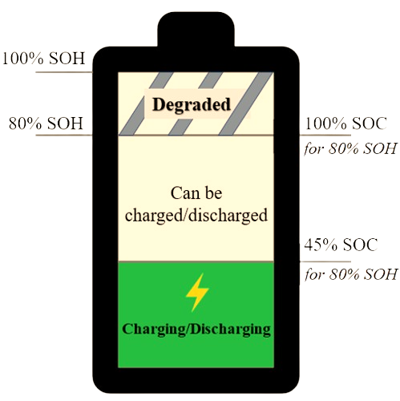
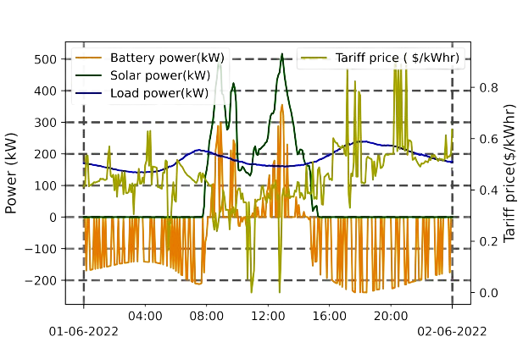
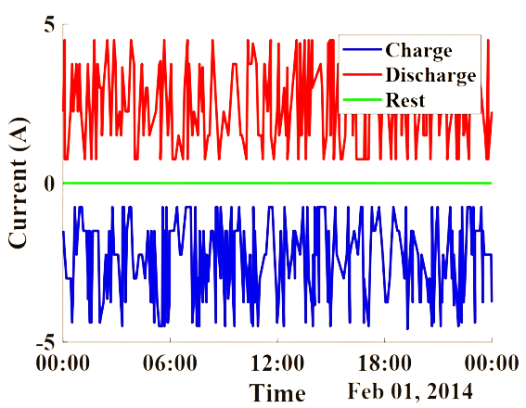
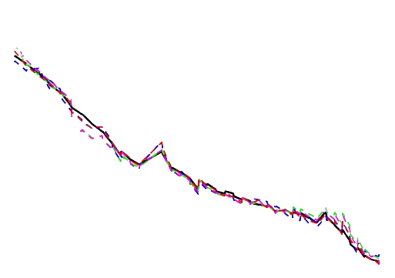
Control Algorithm
BESS
SoH Predictor
SoH predictor uses GP to compute SOH accurately in the presence of RW
DRL in [2] achieves frequent switching of BESS Setpoints
RW appears in BESS patterns including voltage, current and temperature
SoH (%)
Time (days)

