Slide 1
A Generalized
Multi-receiver with a
Common DC BUS
for 2-element compensation

Slide 2
The multi-receivers can be used for :
Fault-Tolerance
Stress-on semiconductor
Required passive elements(Inductance)
Heat Capacitance and Thermal Management
More than one load

Slide 3
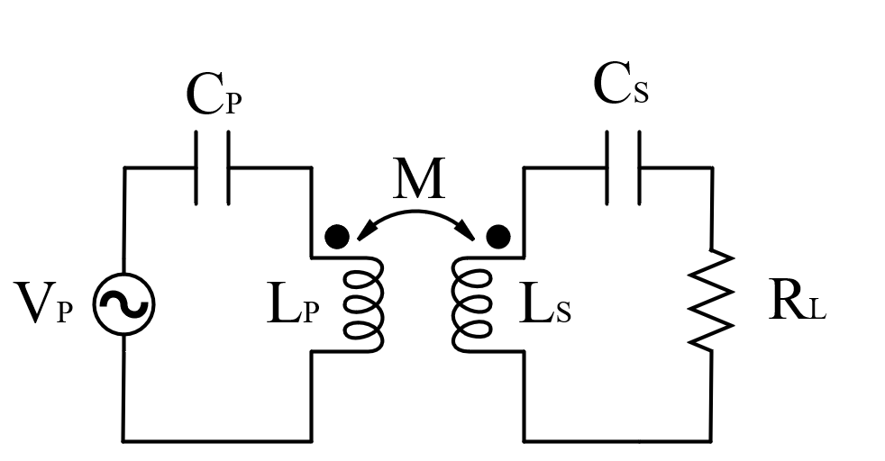
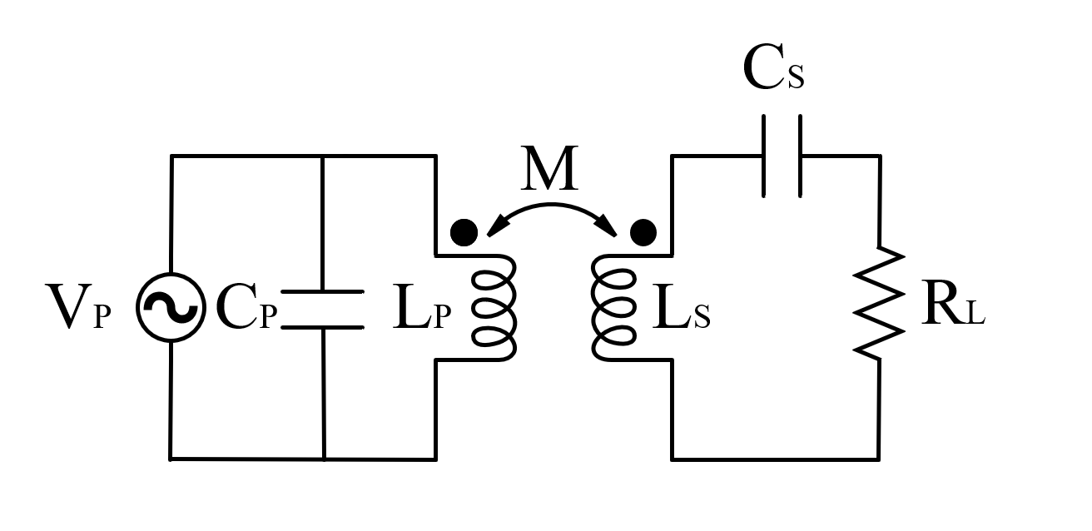
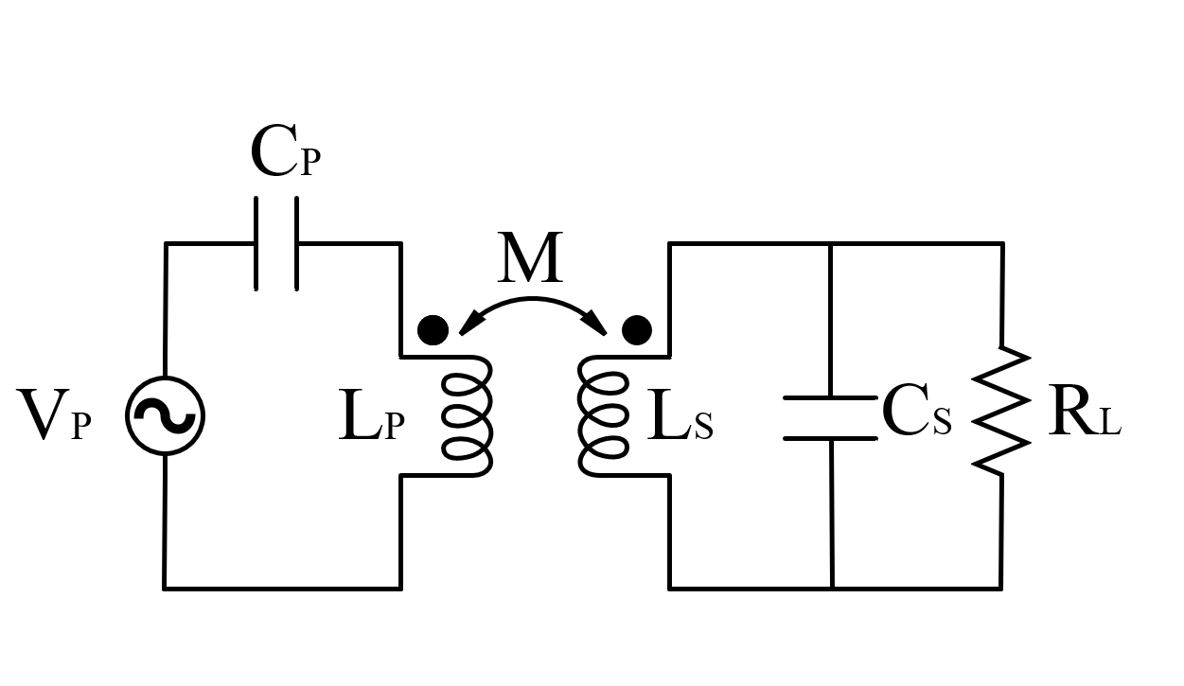
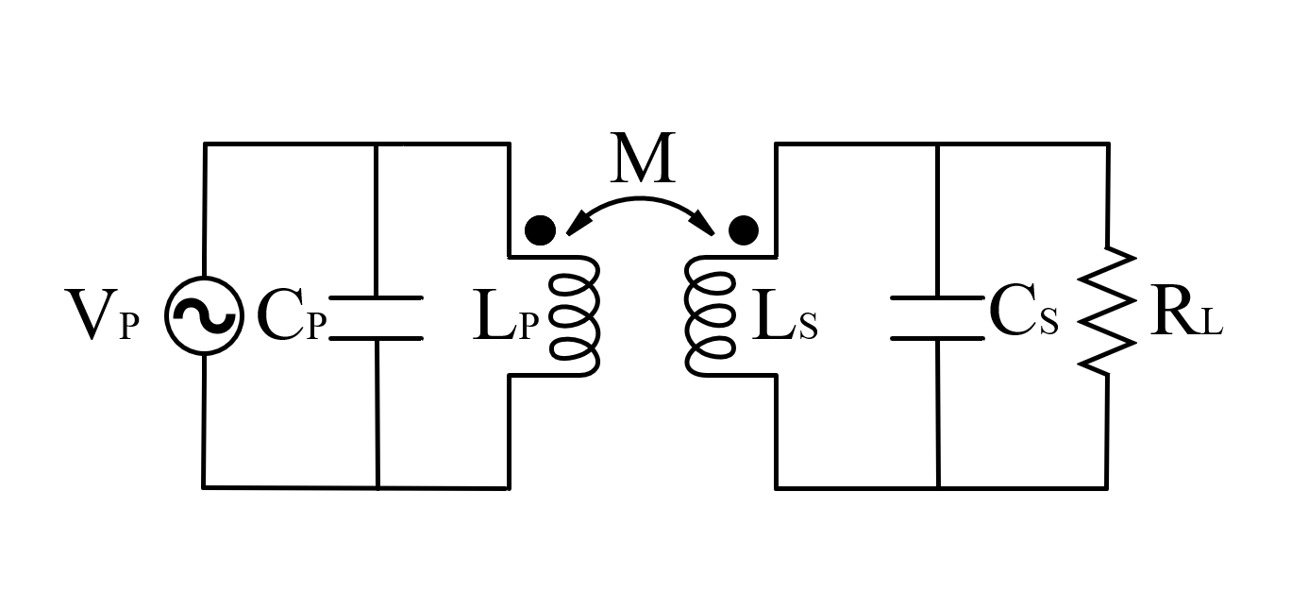
Compensation Methods
Voltage Source Input
Series-Series
Parallel-Series
Series-Parallel
Parallel-Parallel

Slide 4
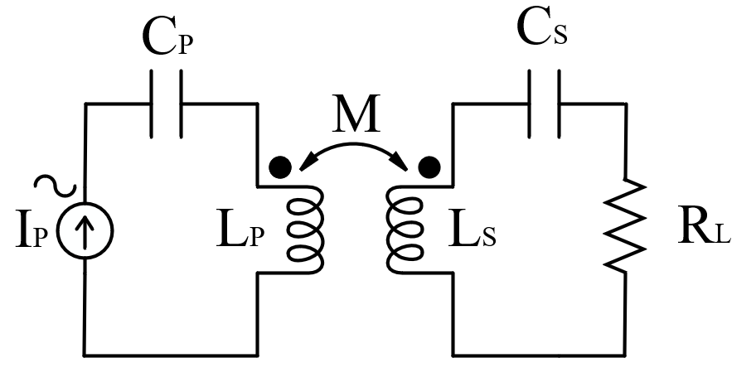
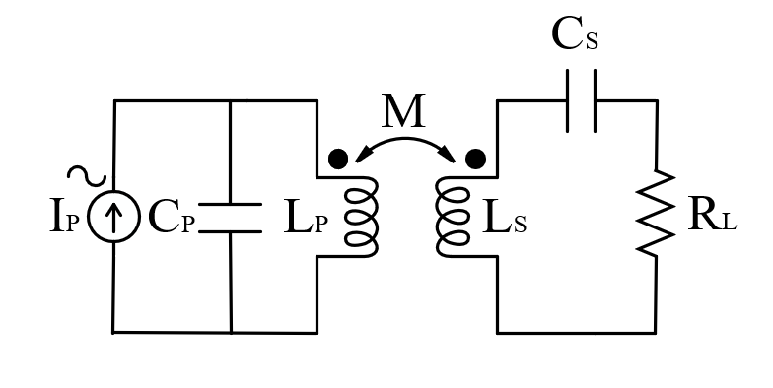
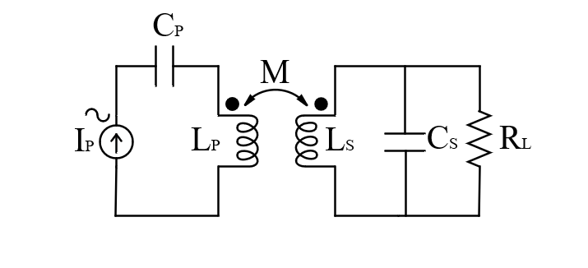
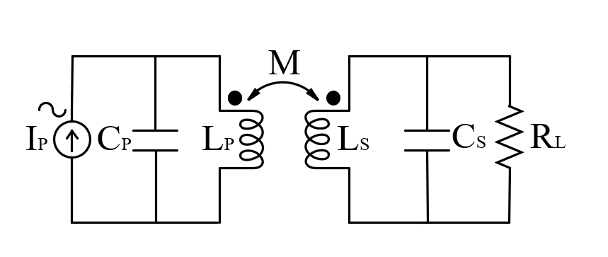
Current Source Input
Series-Series
Parallel-Series
Series-Parallel
Parallel-Parallel

Slide 5
Transmitter Side:
If Pulse Generator is a voltage-source fed, the transmitter side is chosen as Series-Compensation to filter DC-Voltage and the resonant inductor current will be sinusoidal.
If Pulse Generator is a current-source fed, the transmitter side is chosen as Parallel-Compensation to filter DC-Current and the resonant inductor current will be sinusoidal.

Slide 6
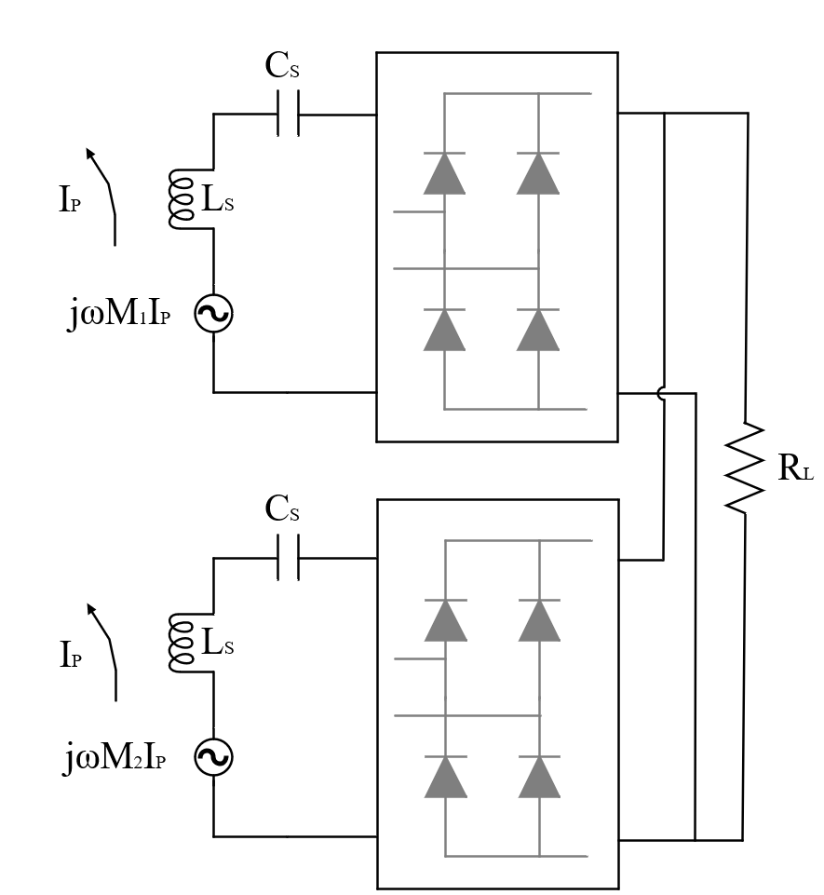
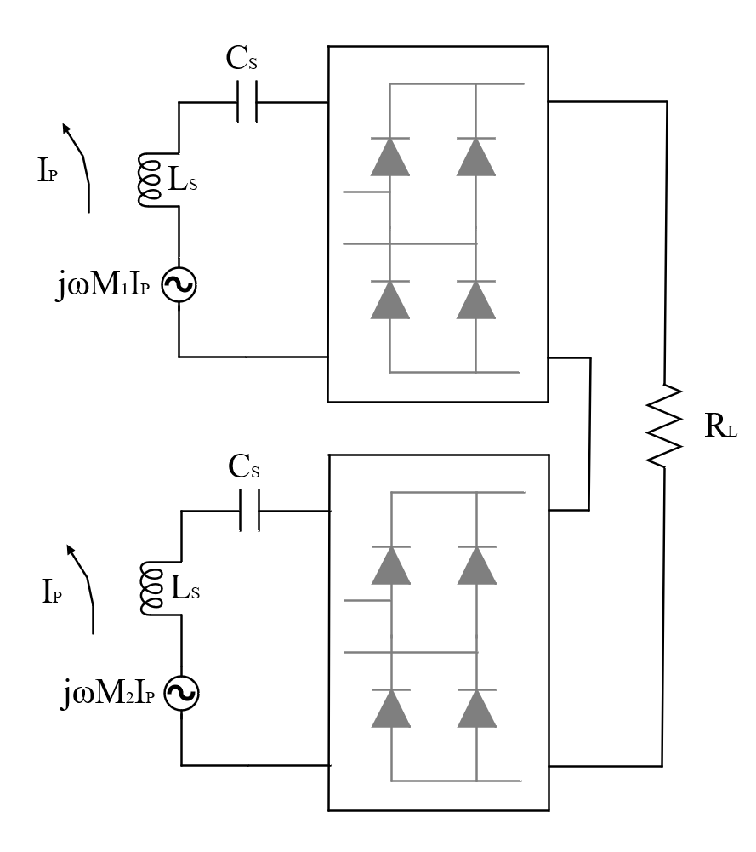
The design variants of Common DC-Bus
Series Compensation

Slide 7
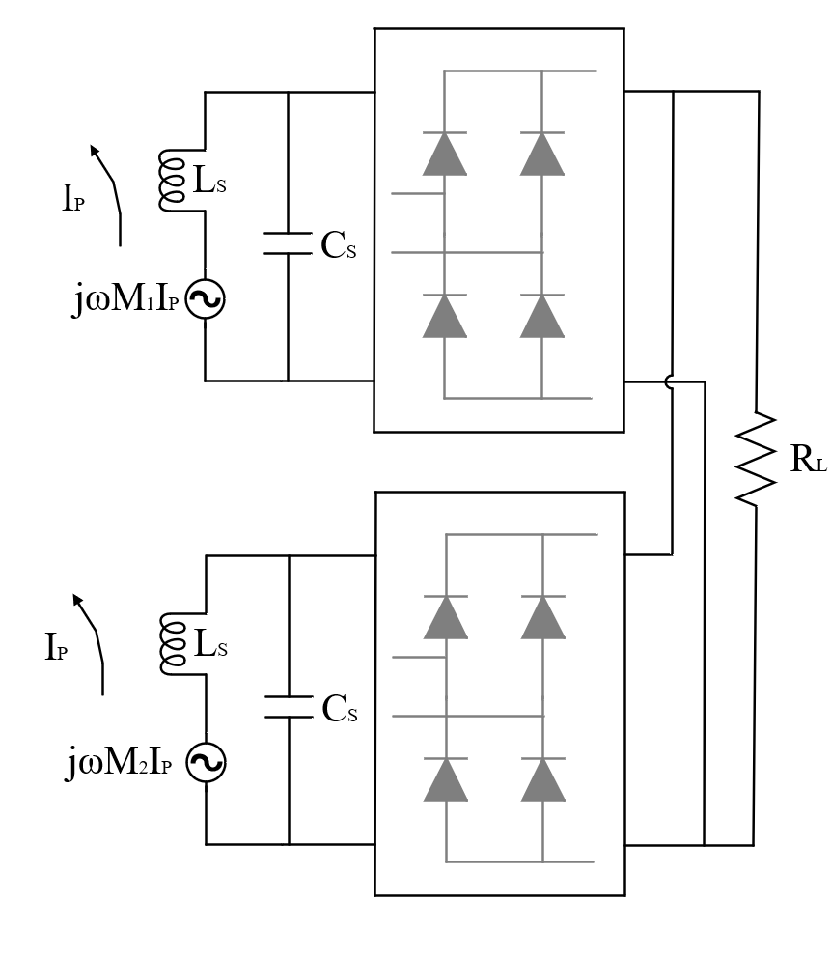
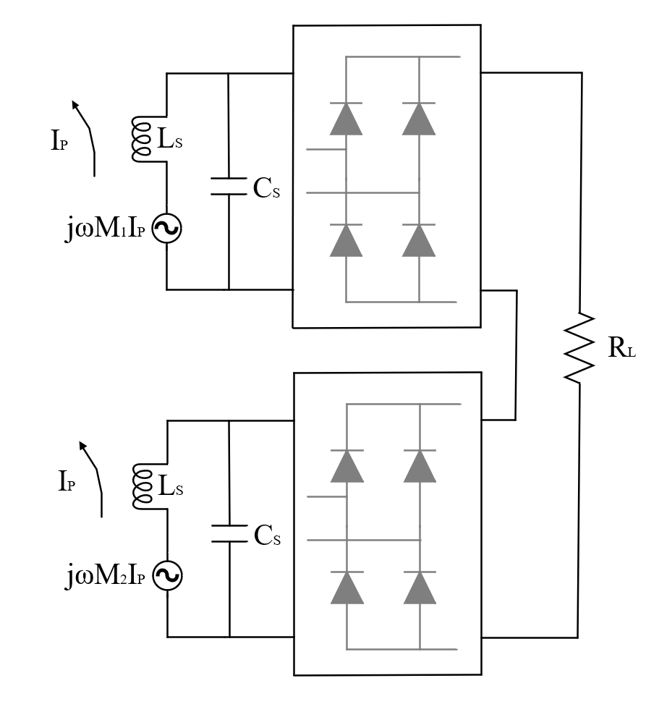
Parallel Compensation

Slide 8
Analytical Modelling
Series Compensation- Series DC BUS
Series Compensation- Parallel DC BUS
Parallel Compensation- Series DC BUS
Parallel Compensation- Parallel DC BUS

Slide 9
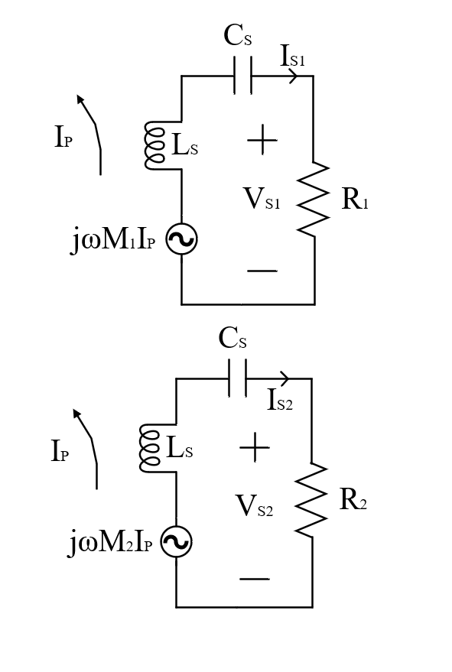


Series Compensation- Series DC BUS
$$I_{S1}=I_{S2} ….(1)$$
$$R_{1}+R_{2}=R_{L} …. (2)$$

Slide 10
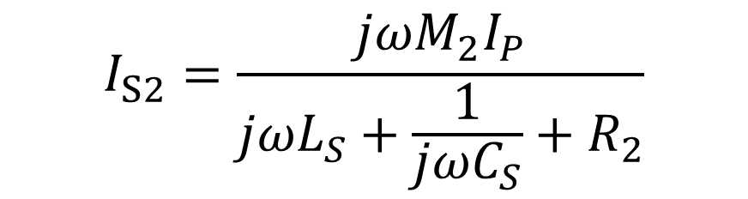
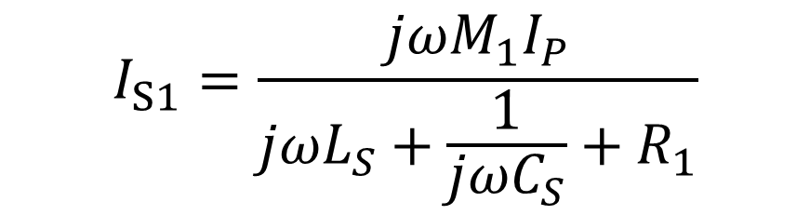
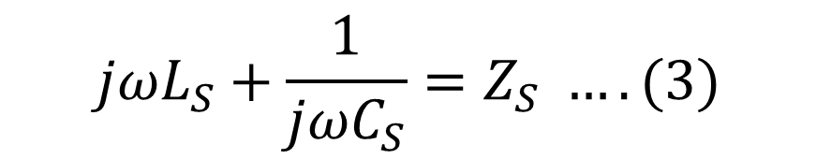

$$I_{S1}=\frac{jωM_{1}I_{P}}{jωL_{S}+\frac{1}{jωC_{S}}+R_{1}}$$
$$I_{S2}=\frac{jωM_{2}I_{P}}{jωL_{S}+\frac{1}{jωC_{S}}+R_{2}}$$
$$jωL_{S}+\frac{1}{jωC_{S}}=Z_{S} ….(3)$$
From (1) and (3)
$$\frac{jωM_{1}I_{P}}{Z_{S}+R_{1}}=\frac{jωM_{2}I_{P}}{Z_{S}+R_{2}}$$

Slide 11


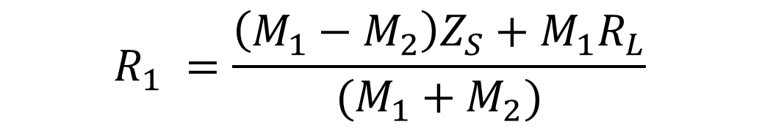
$${(Z}_{S}+R_{1})M_{2}={(Z}_{S}+R_{2})M_{1}$$
$$\left(M_{1}−M_{2}\right)Z_{S}=M_{2}R_{1}−M_{1}R_{2}$$
From (2)
$$\left(M_{1}−M_{2}\right)Z_{S}=M_{2}R_{1}−M_{1}(R_{L}−R_{1})$$
From (1)
$$\left(M_{1}−M_{2}\right)Z_{S}=R_{1}\left(M_{1}+M_{2}\right)−M_{1}R_{L}$$
$$R_{1} =\frac{\left(M_{1}−M_{2}\right)Z_{S}+M_{1}R_{L}}{(M_{1}+M_{2})}$$

Slide 12


Only Reel part of load
$$R_{1} =\frac{M_{1}R_{L}}{(M_{1}+M_{2})}$$
$$R_{2} =\frac{M_{2}R_{L}}{(M_{1}+M_{2})}$$

