Slide 1
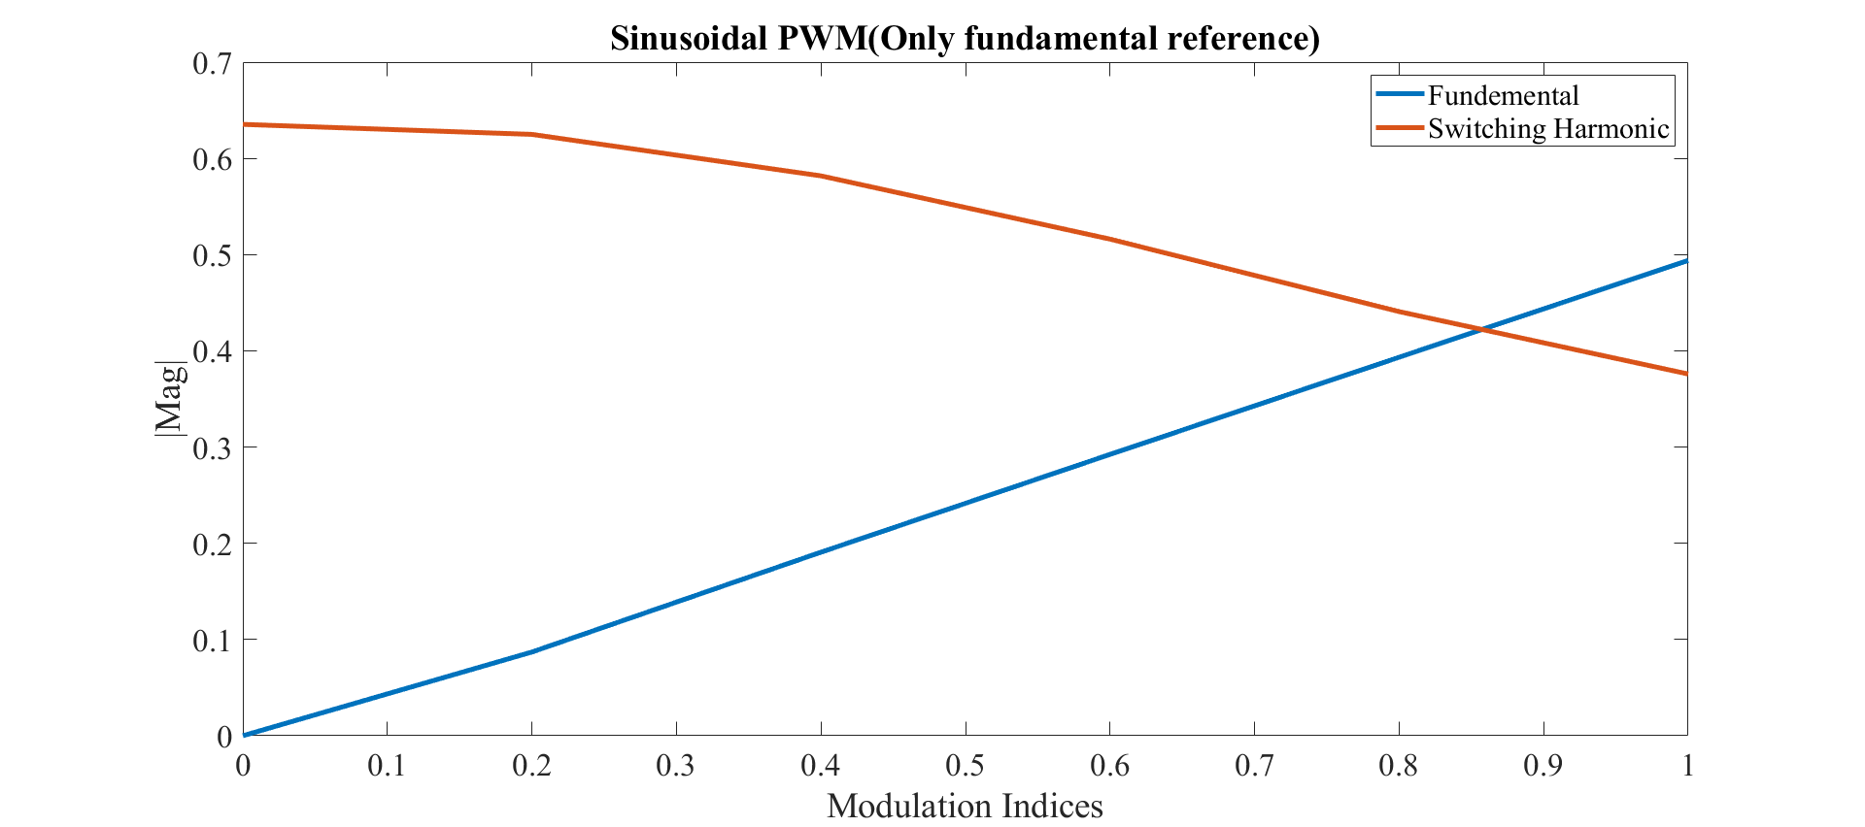
About 300 W
0-24 Vpeak
Fundamental
Main Load
24 V
DC-AC
Converter
About 50 W
WPT
30-16 Vpeak
Switching Frequency
Actually,
For a unipolar switching with single phase inverter
We observe that double switching frequency

Slide 2
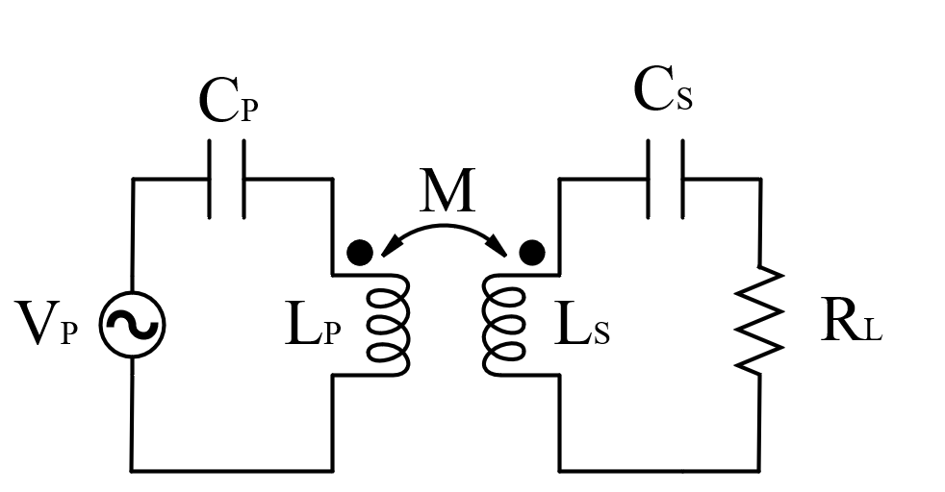
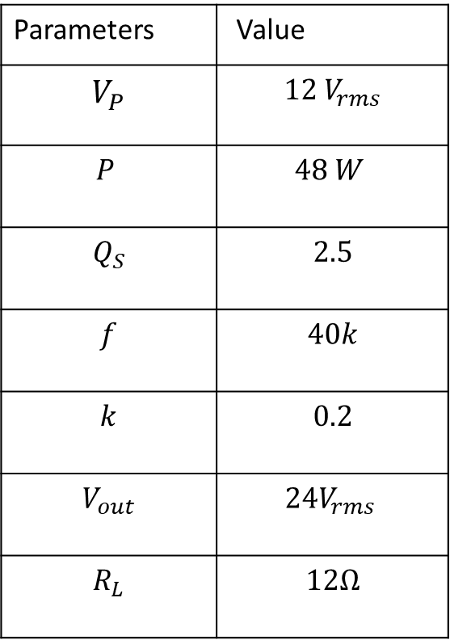
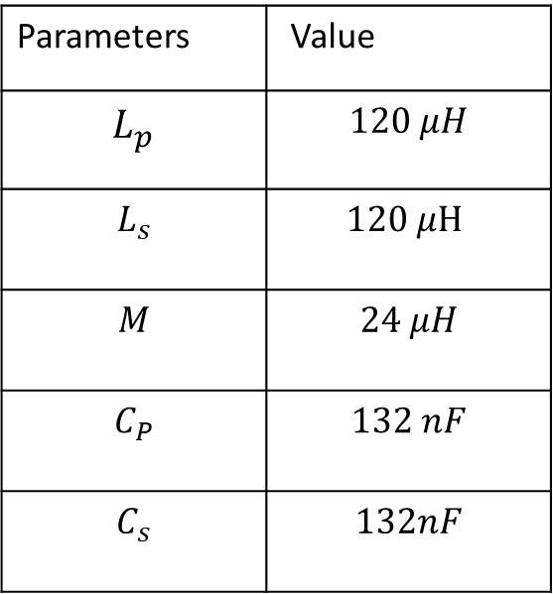
Series Compensated IPT
Parameters | Value
$$V_{P}$$ | $$12 V_{rms}$$
$$P$$ | $$48 W$$
$$Q_{S}$$ | $$2.5$$
$$f$$ | $$40k$$
$$k$$ | $$0.2$$
$$V_{out}$$ | $$24V_{rms }$$
$$R_{L}$$ | $$12Ω$$
Parameters | Value
$$L_{p}$$ | $$120 μH$$
$$L_{s}$$ | $$120 μH$$
$$M$$ | $$24 μH$$
$$C_{P}$$ | $$132 nF$$
$$C_{s}$$ | $$132nF$$
Changing load
Voltage source input

Slide 3
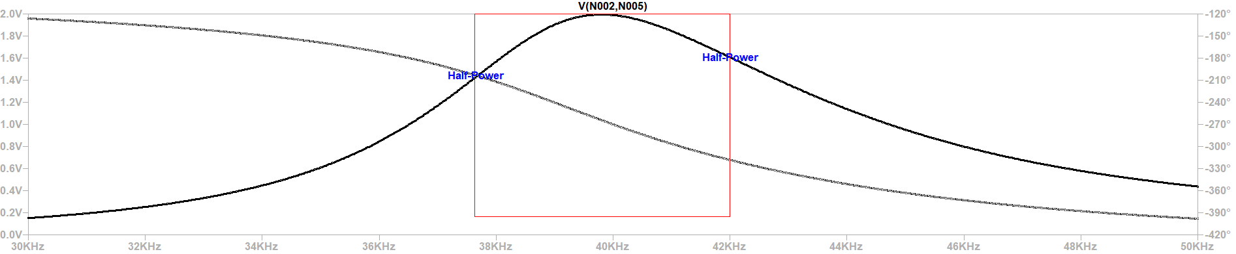
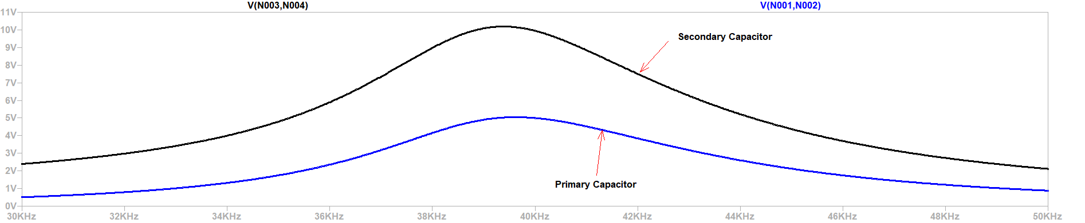

Slide 4
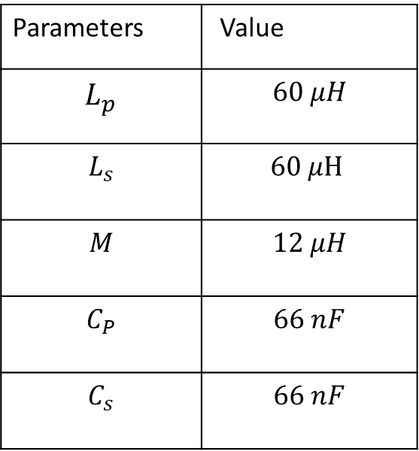
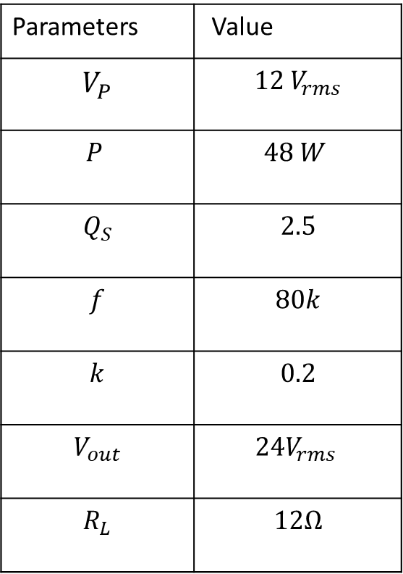
For Unipolar Switching
Parameters | Value
$$V_{P}$$ | $$12 V_{rms}$$
$$P$$ | $$48 W$$
$$Q_{S}$$ | $$2.5$$
$$f$$ | $$80k$$
$$k$$ | $$0.2$$
$$V_{out}$$ | $$24V_{rms }$$
$$R_{L}$$ | $$12Ω$$
Parameters | Value
$$L_{p}$$ | $$60 μH$$
$$L_{s}$$ | $$60 μH$$
$$M$$ | $$12 μH$$
$$C_{P}$$ | $$66 nF$$
$$C_{s}$$ | $$66 nF$$

Slide 5
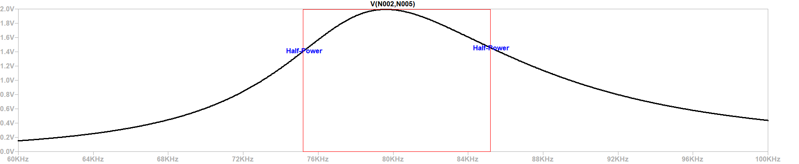
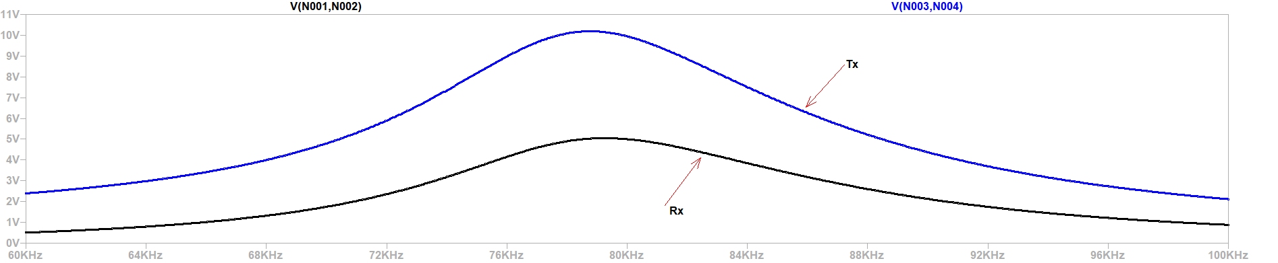

Slide 6
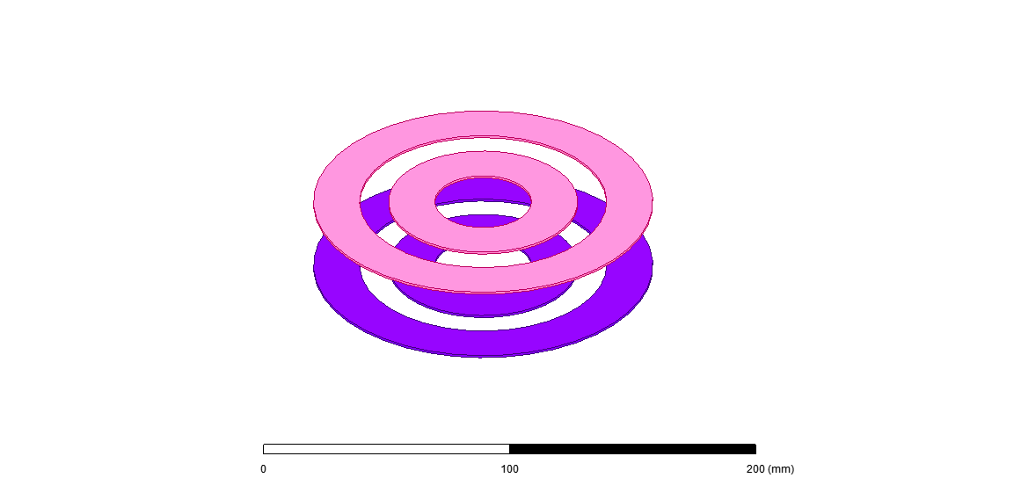
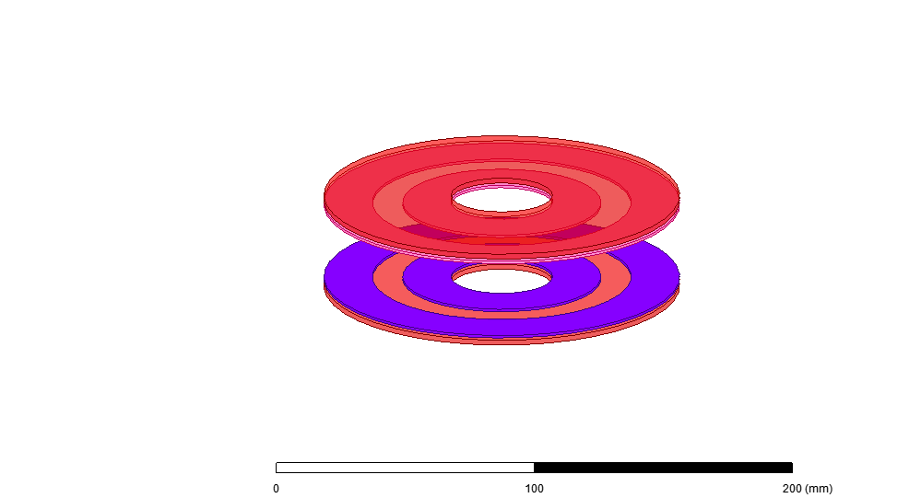
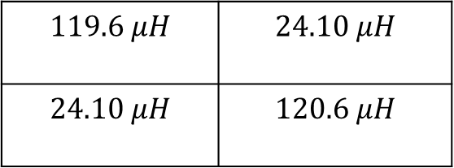
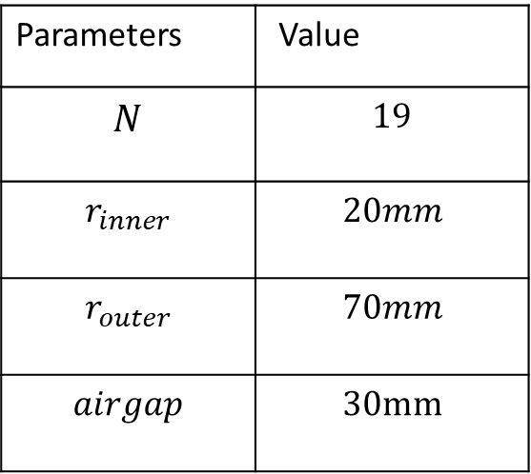
Both N-turn
Conductor height is taken 1mm
Parameters | Value
$$N$$ | $$19$$
$$r_{inner}$$ | $$20mm$$
$$r_{outer}$$ | $$70mm$$
$$airgap$$ | $$30mm$$
To decrease the radius,
Multi layer design
Will be required
Also, decreasing
Airgap to
$$119.6 μH$$ | $$24.10 μH$$
$$24.10 μH$$ | $$120.6 μH$$

