Slide 1
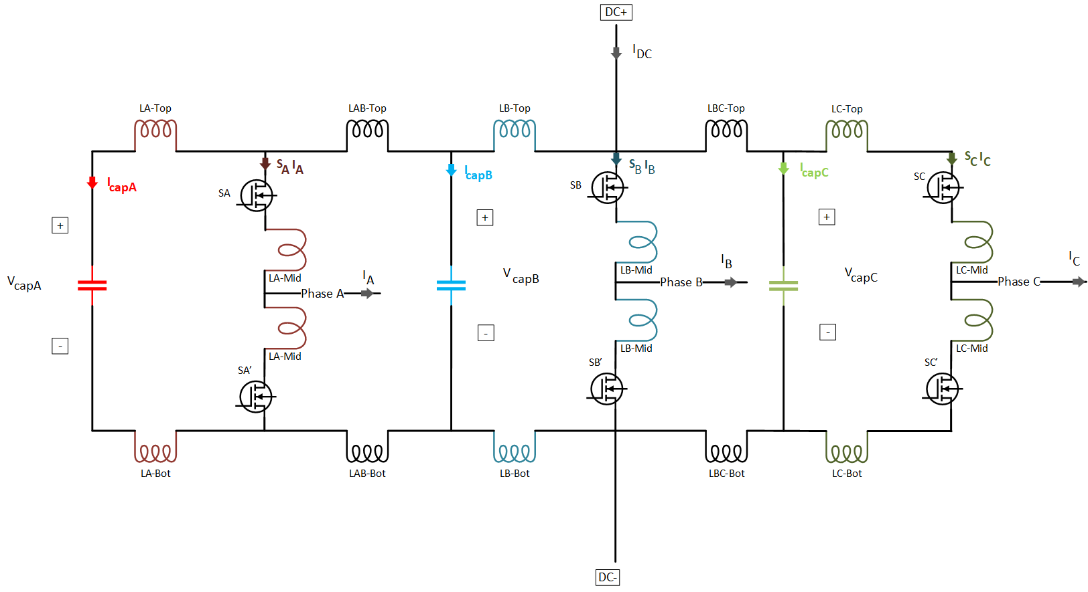

Measurements:
Capacitor currents ($I_{capA}$, $I_{capB}$, $I_{capC}$)
Capacitor voltages ($V_{capA}$, $V_{capB}$, $V_{capC}$)
Leg Currents ($S_{A}I_{A}$, $S_{B}I_{B}$, $S_{C}I_{C}$)
Phase Currents ($I_{A}$, $I_{B}$, $I_{C}$)
DC input ($V_{DC}$, $I_{DC}$)

Slide 2
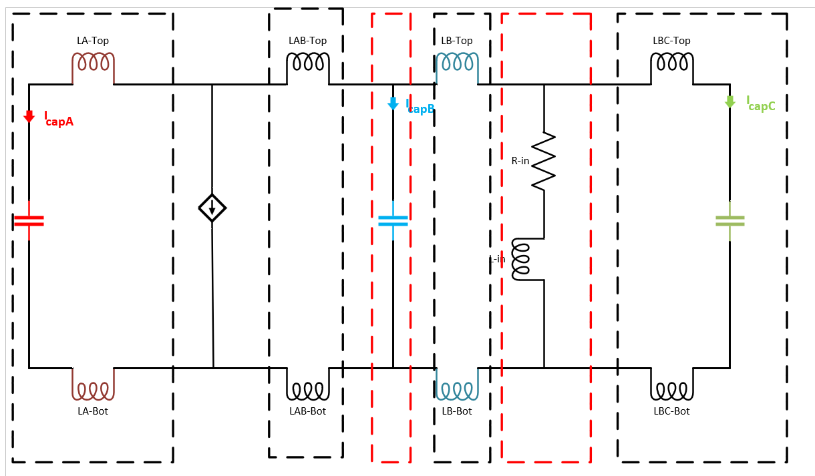

Slide 3
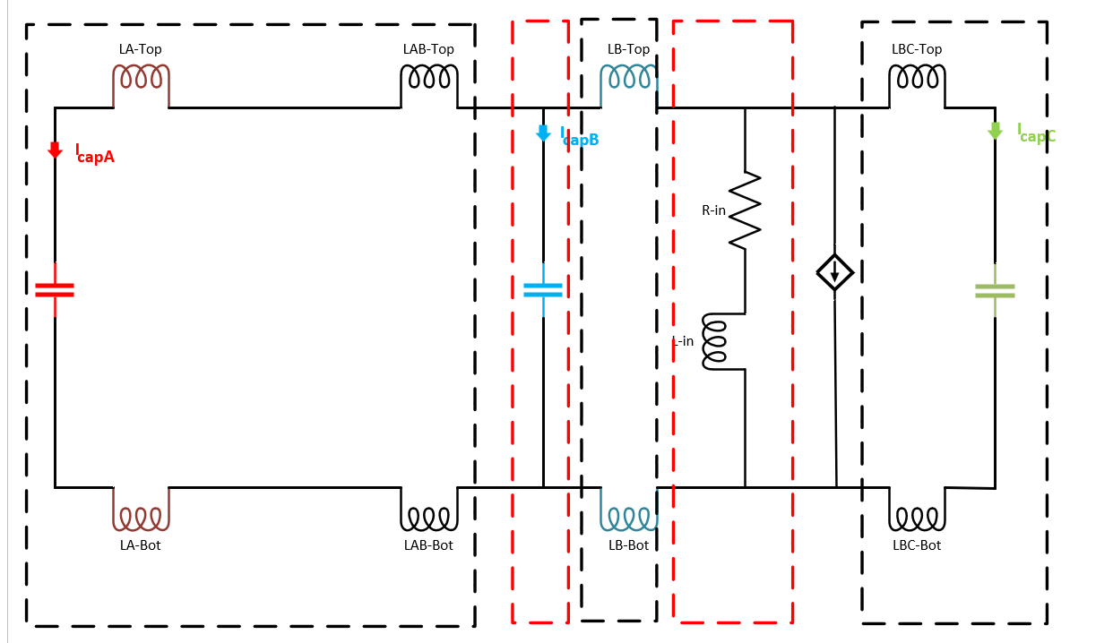

Slide 4
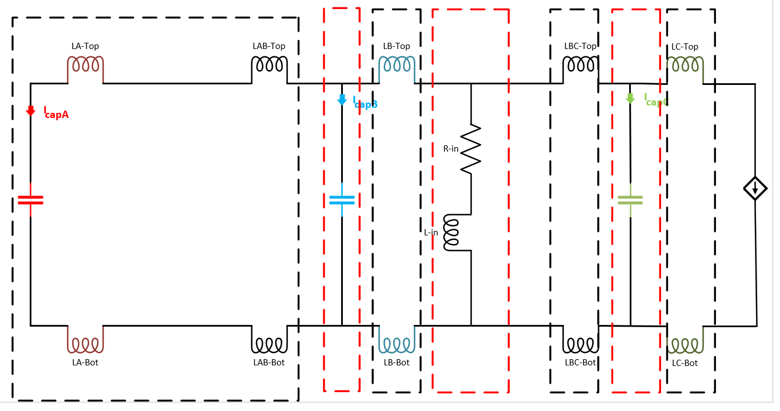

Slide 5
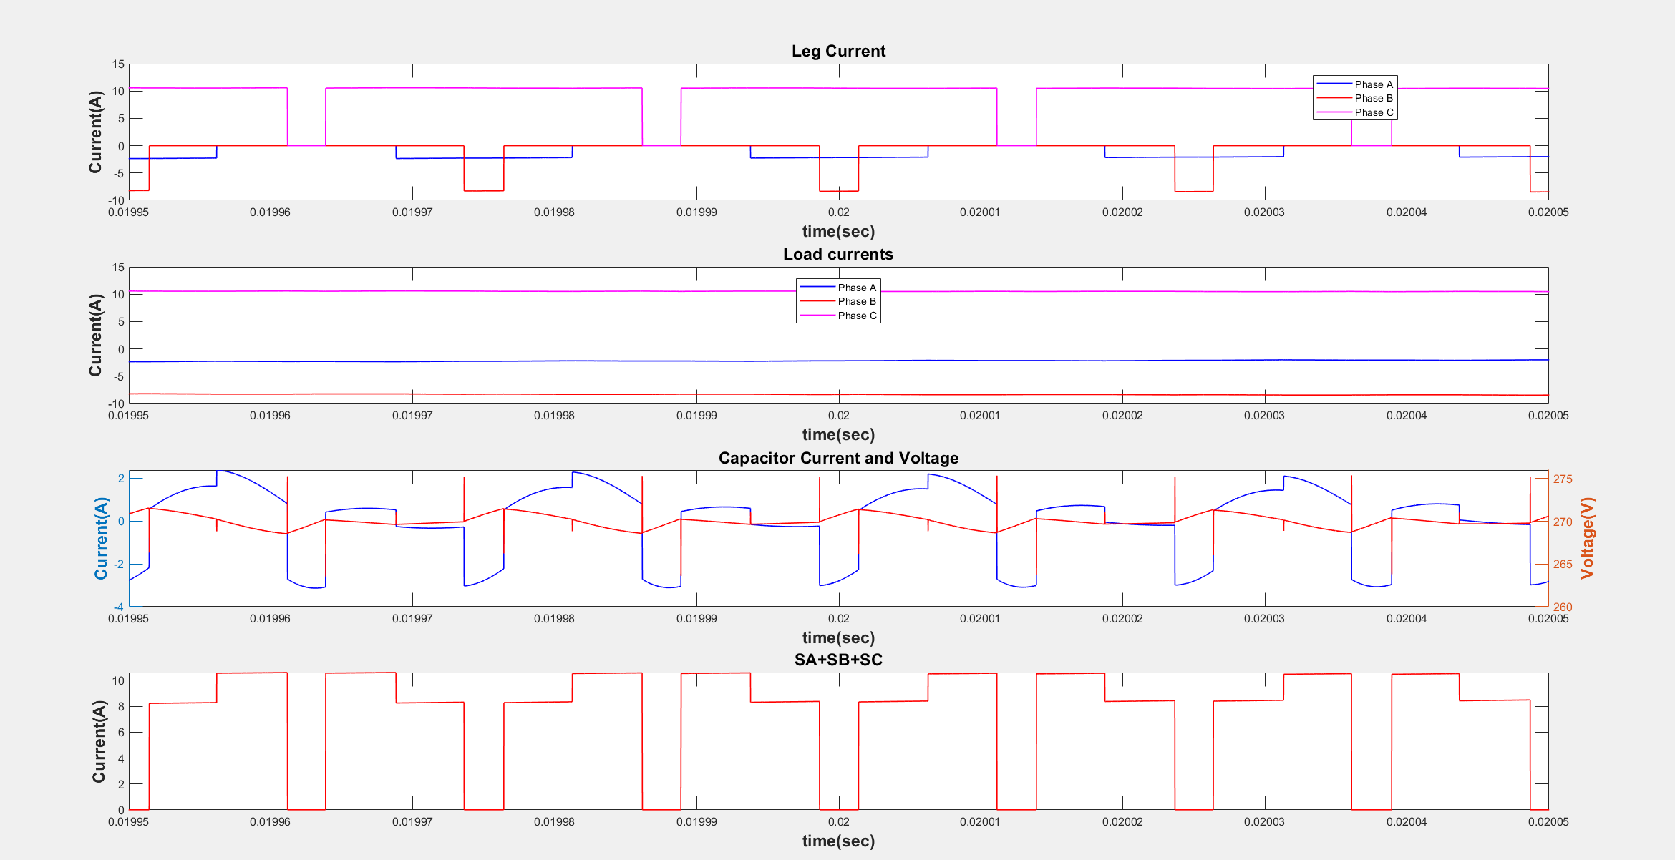

Slide 6
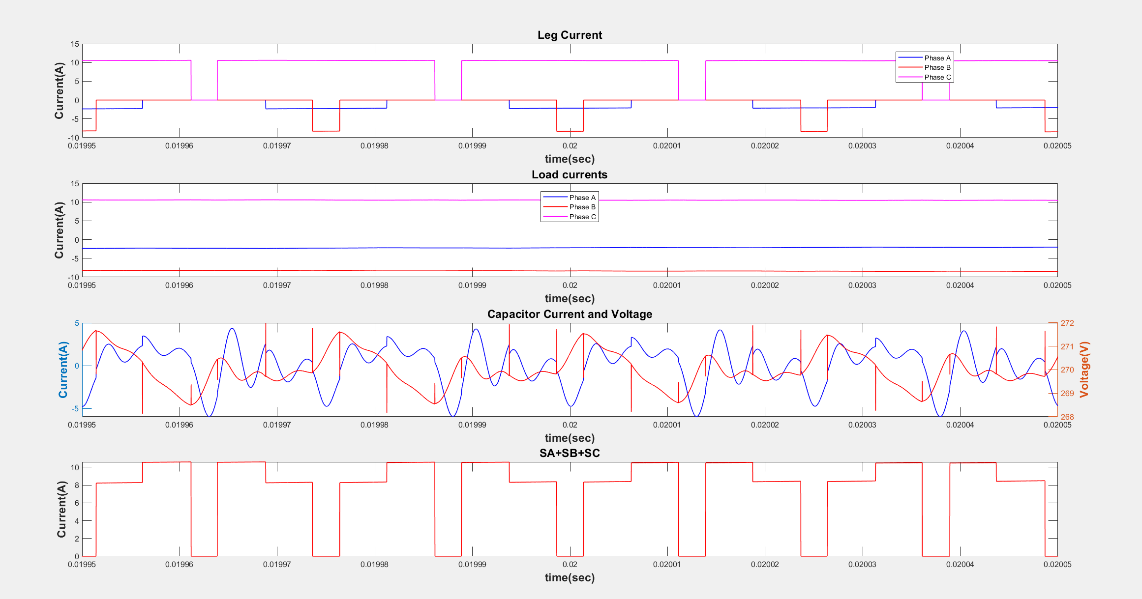

Slide 7
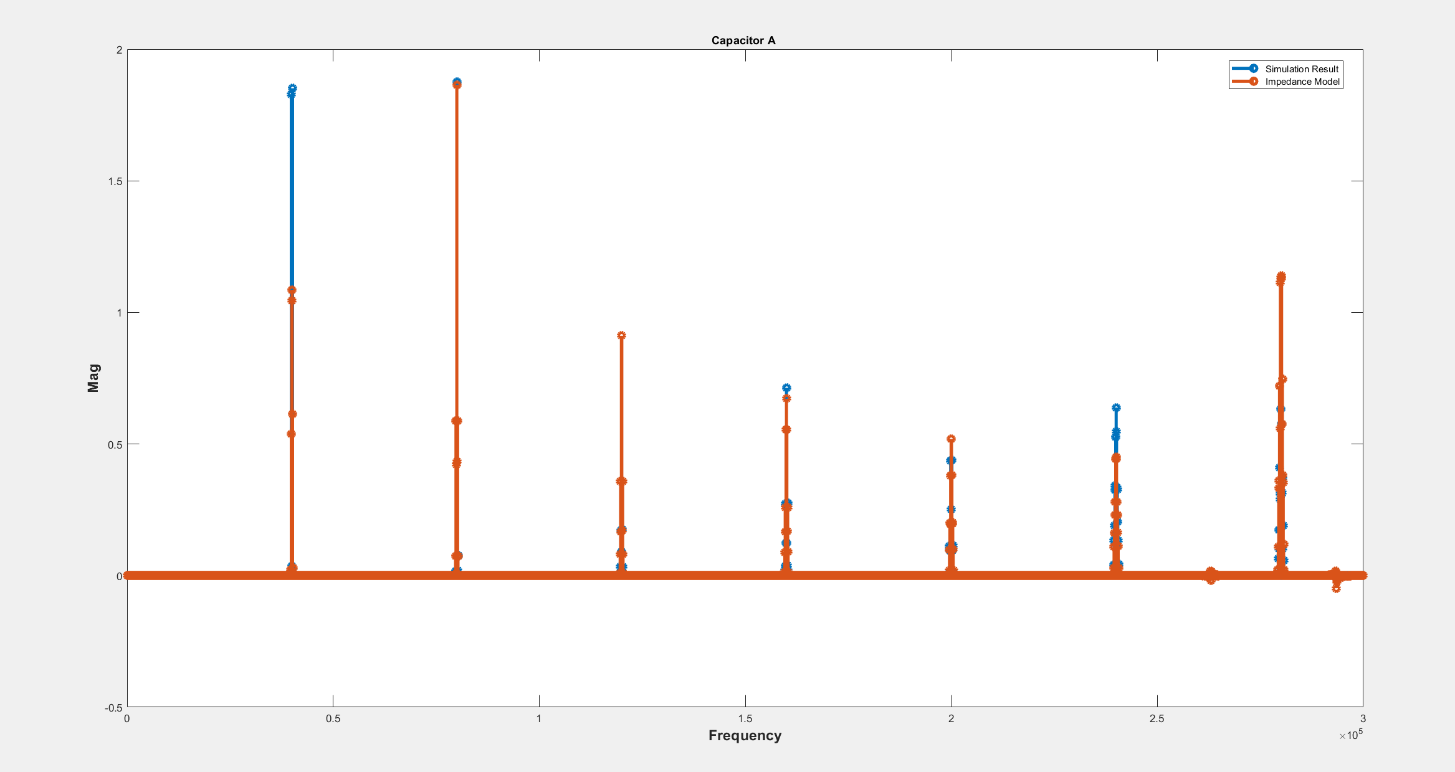
Rin=0.1

Slide 8
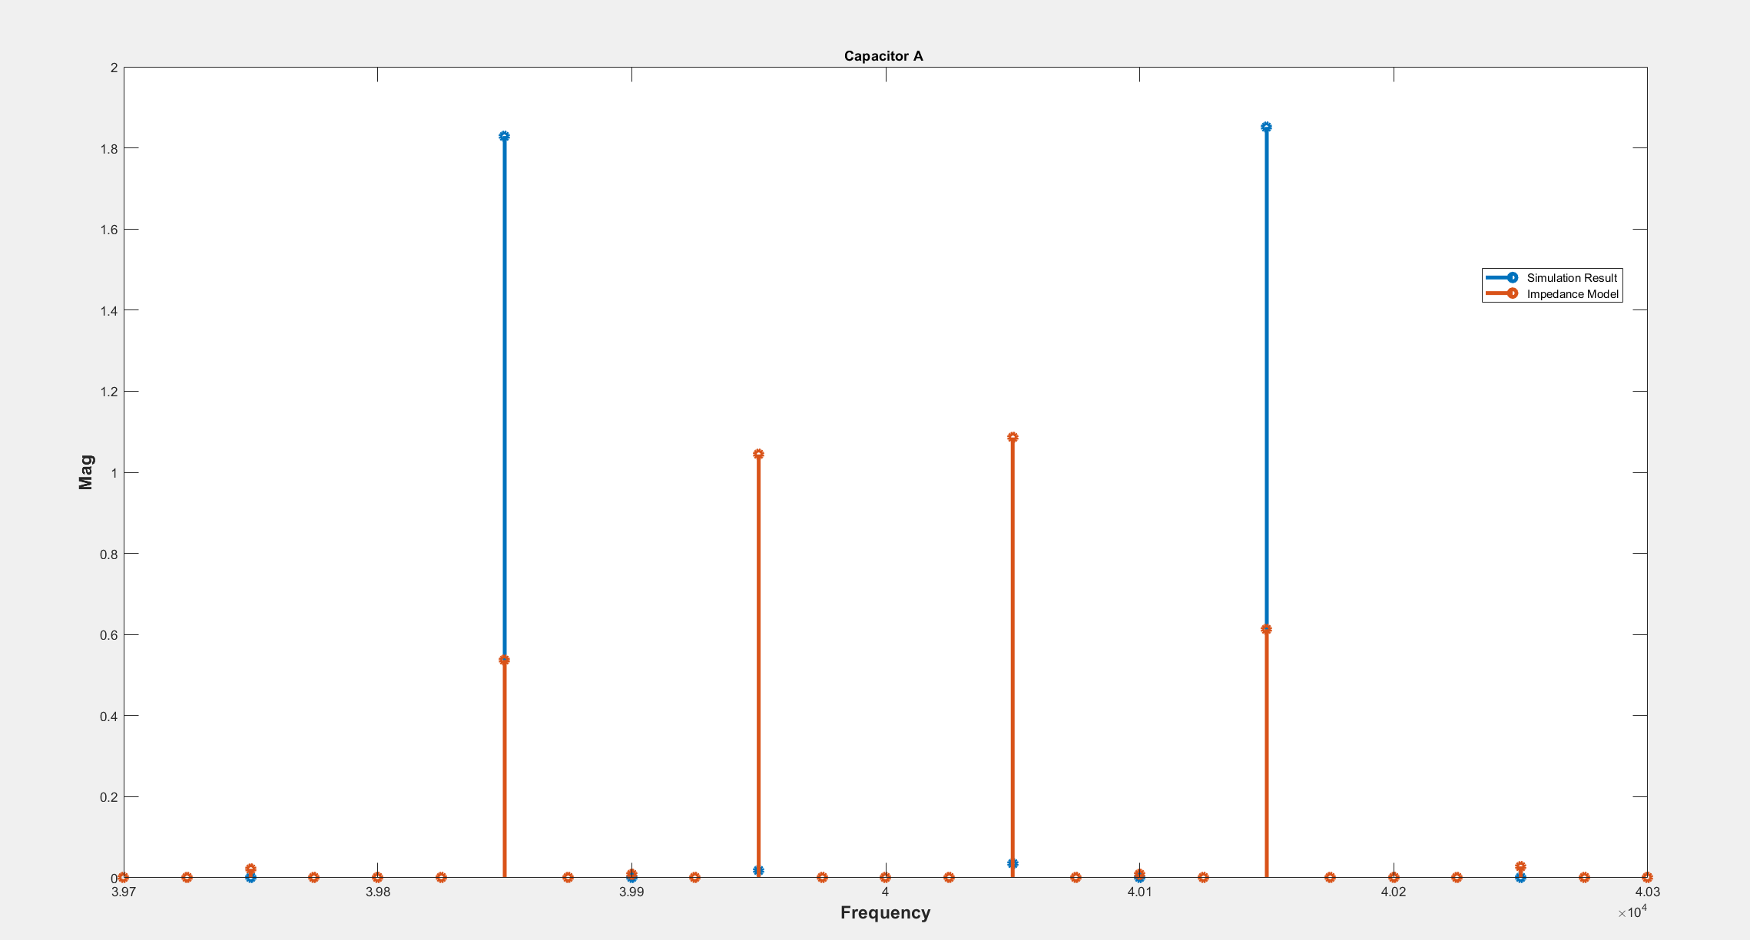
Rin=0.1

Slide 9
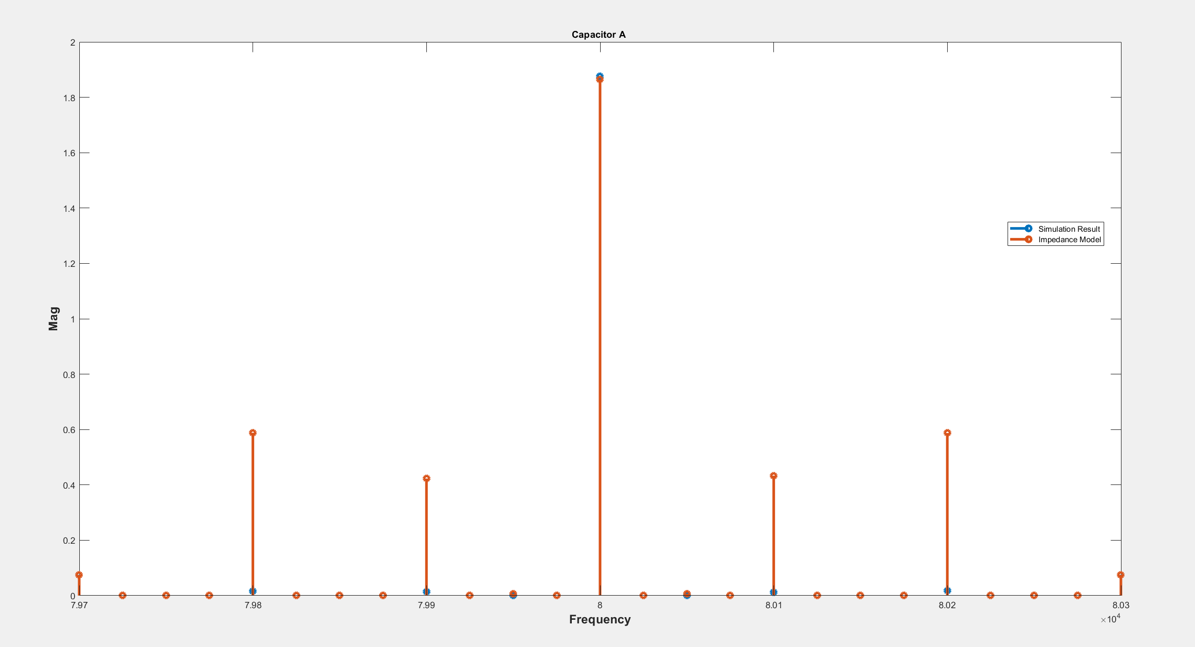
Rin=0.1

Slide 10
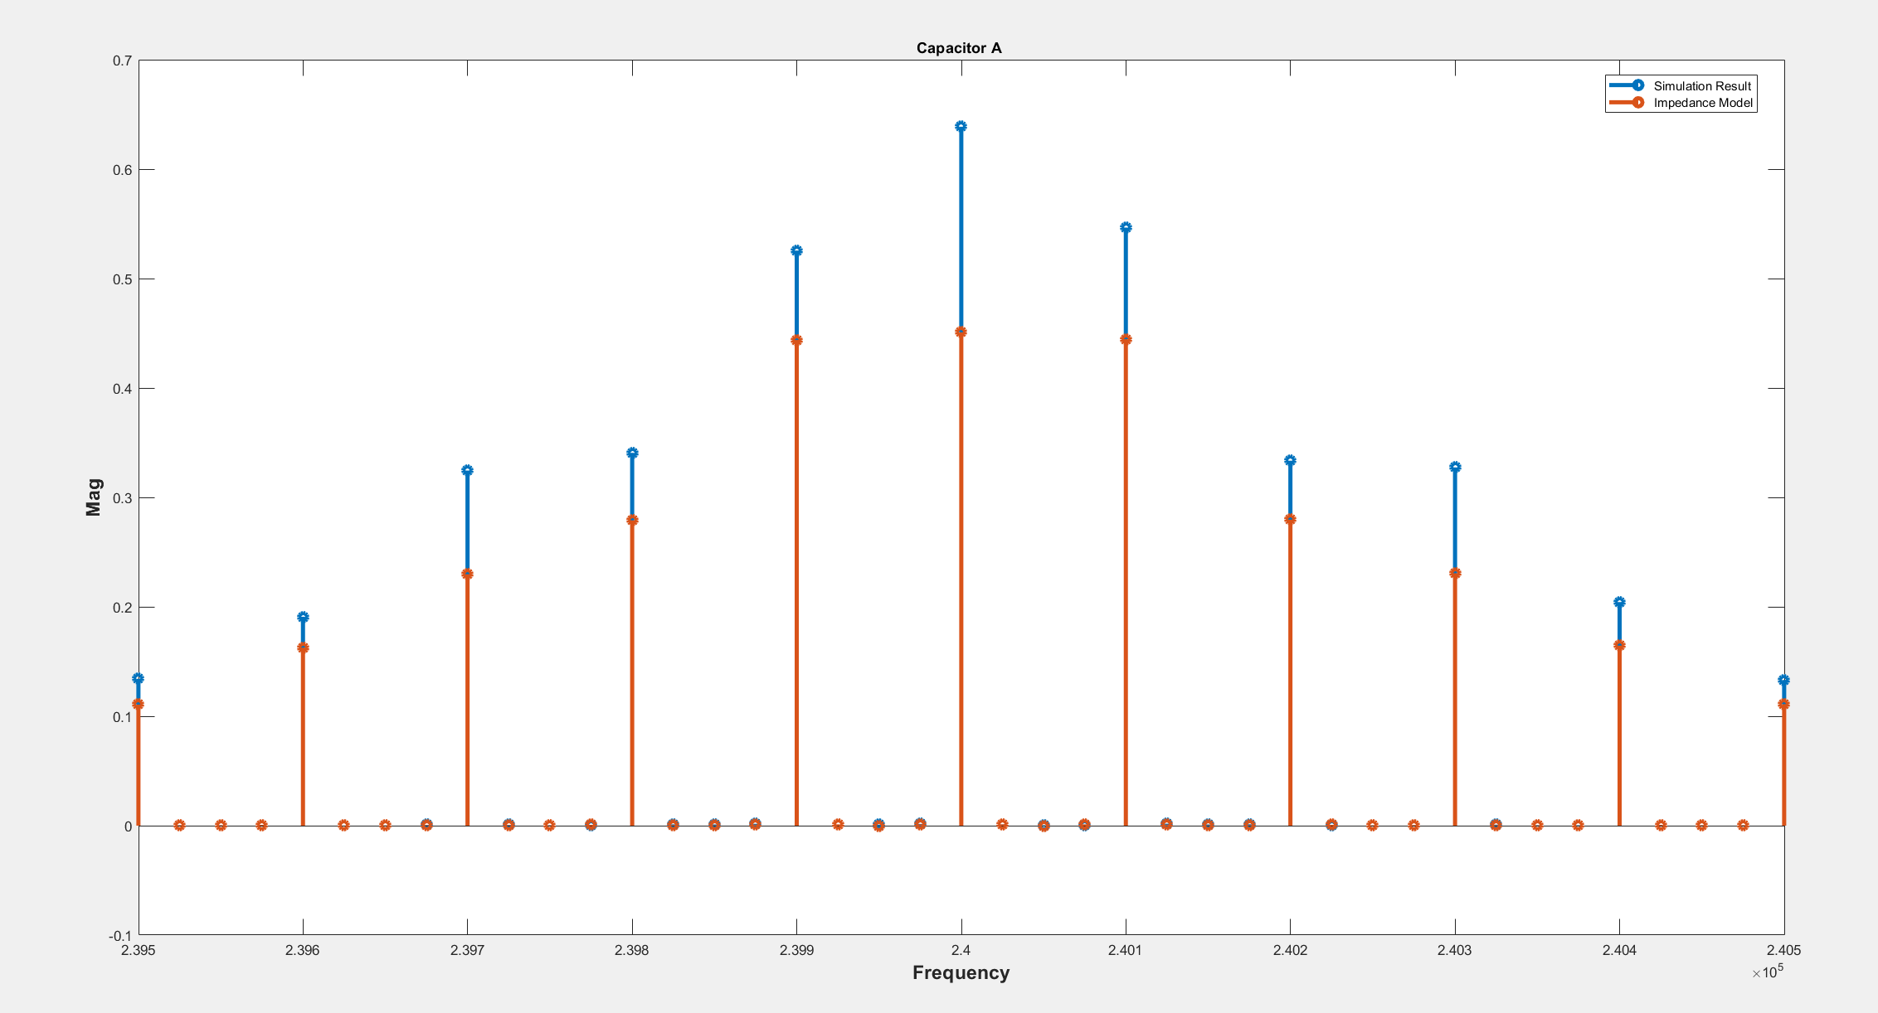
Rin=0.1

Slide 11
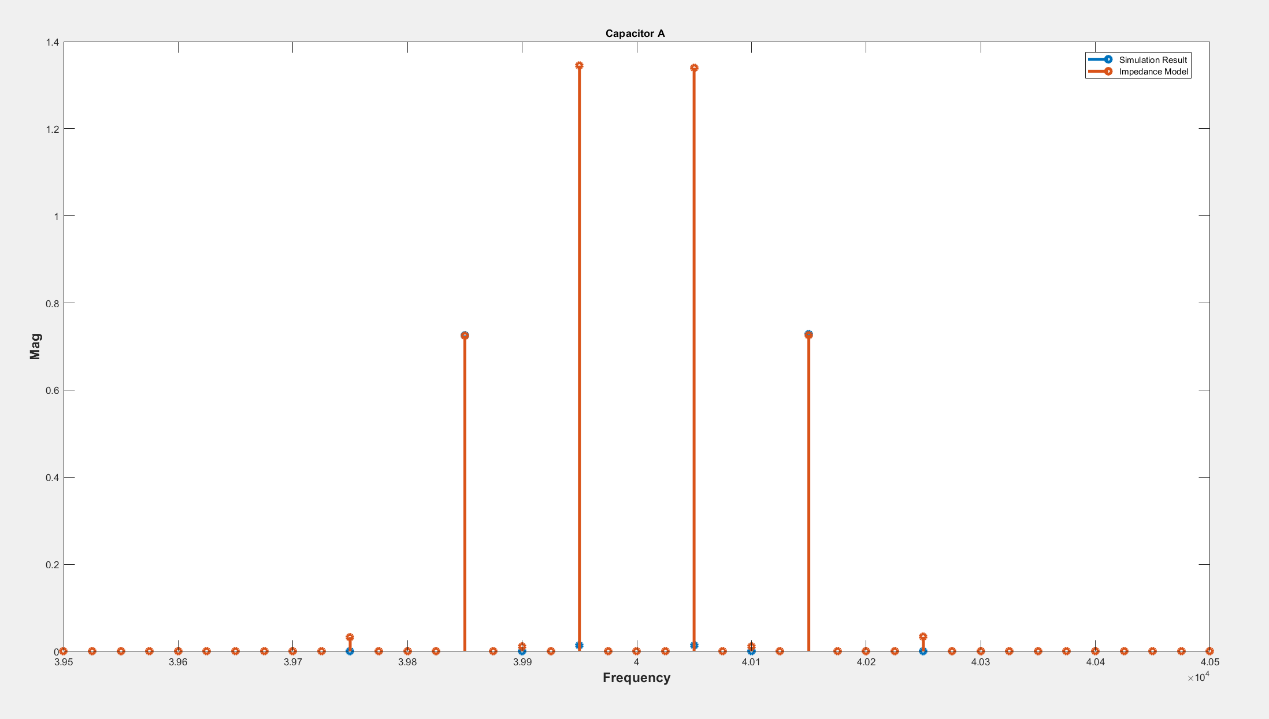
Rin=20

Slide 12
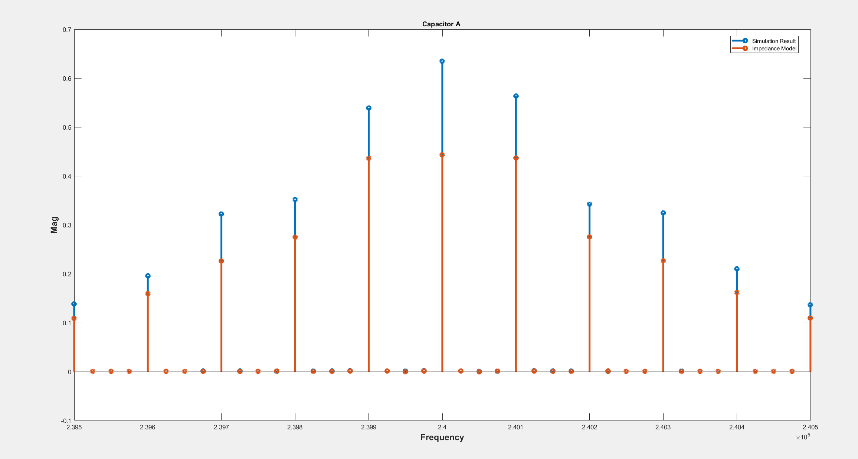

Slide 13
