Slide 1
Simulation Results of with and without parasitics for 50 ohm input resistance
TIME DOMAIN COMPARISONS
Comparison of input currents
Comparison of leg currents
Comparison of capacitor currents
Frequency DOMAIN COMPARISONS
Comparison of input currents
Comparison of leg currents
Comparison of capacitor currents

Slide 2
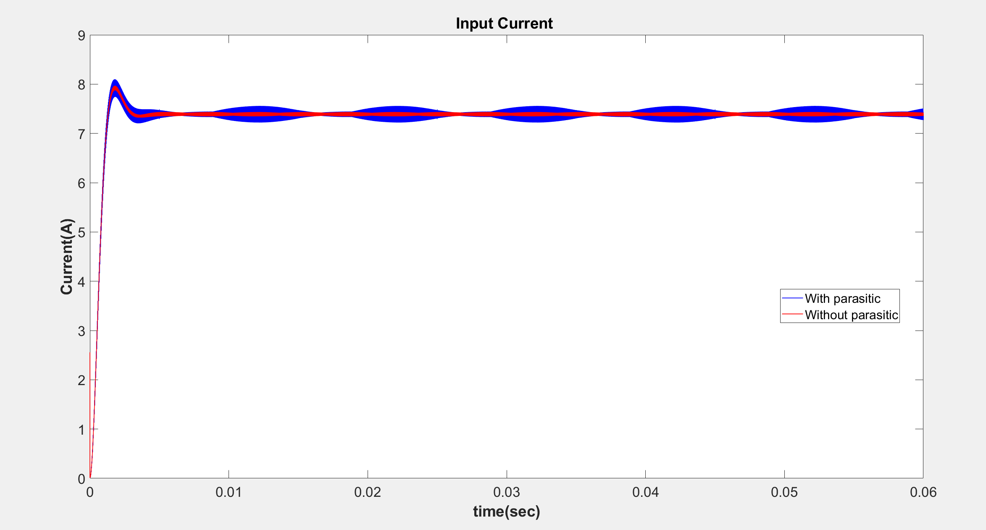

Slide 3
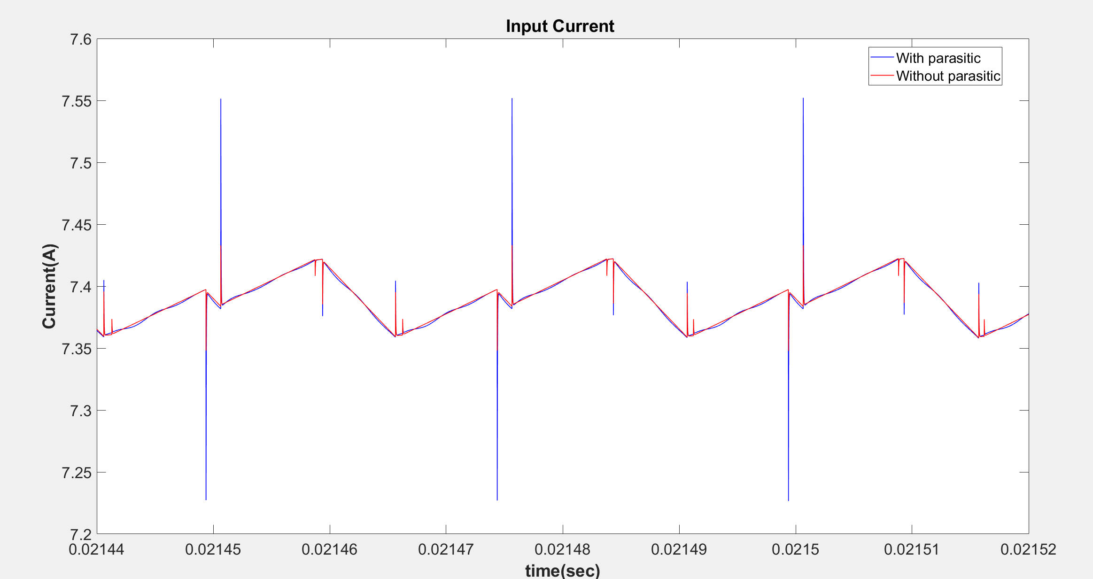

Slide 4
 | Input Current (Mean)
With Parasitic | 7.3198
Without Parasitic | 7.3204

Slide 5
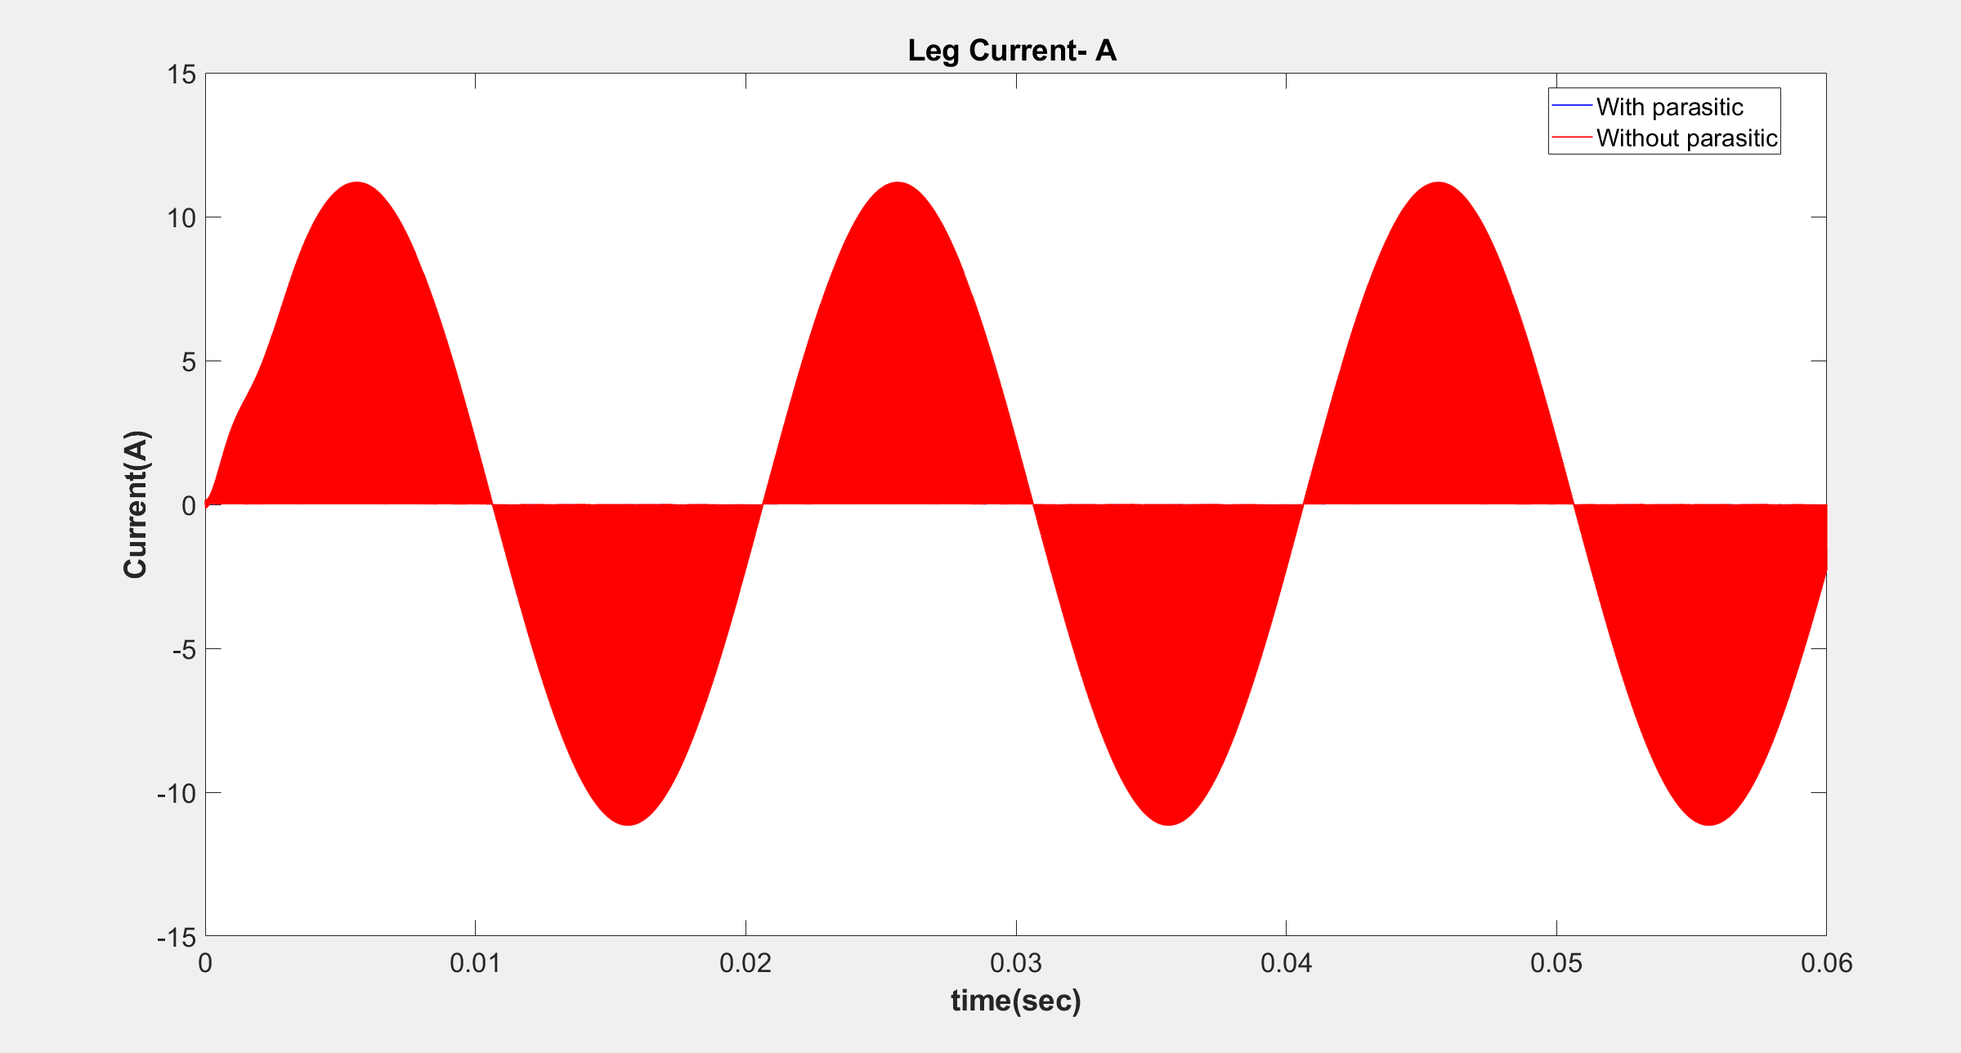

Slide 6
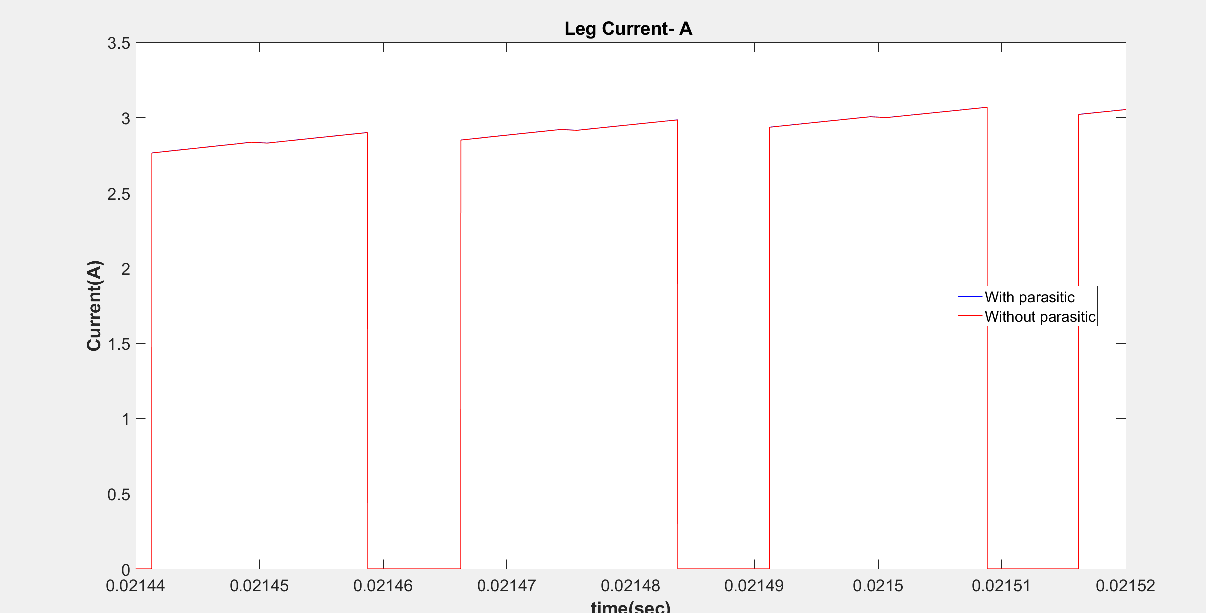

Slide 7
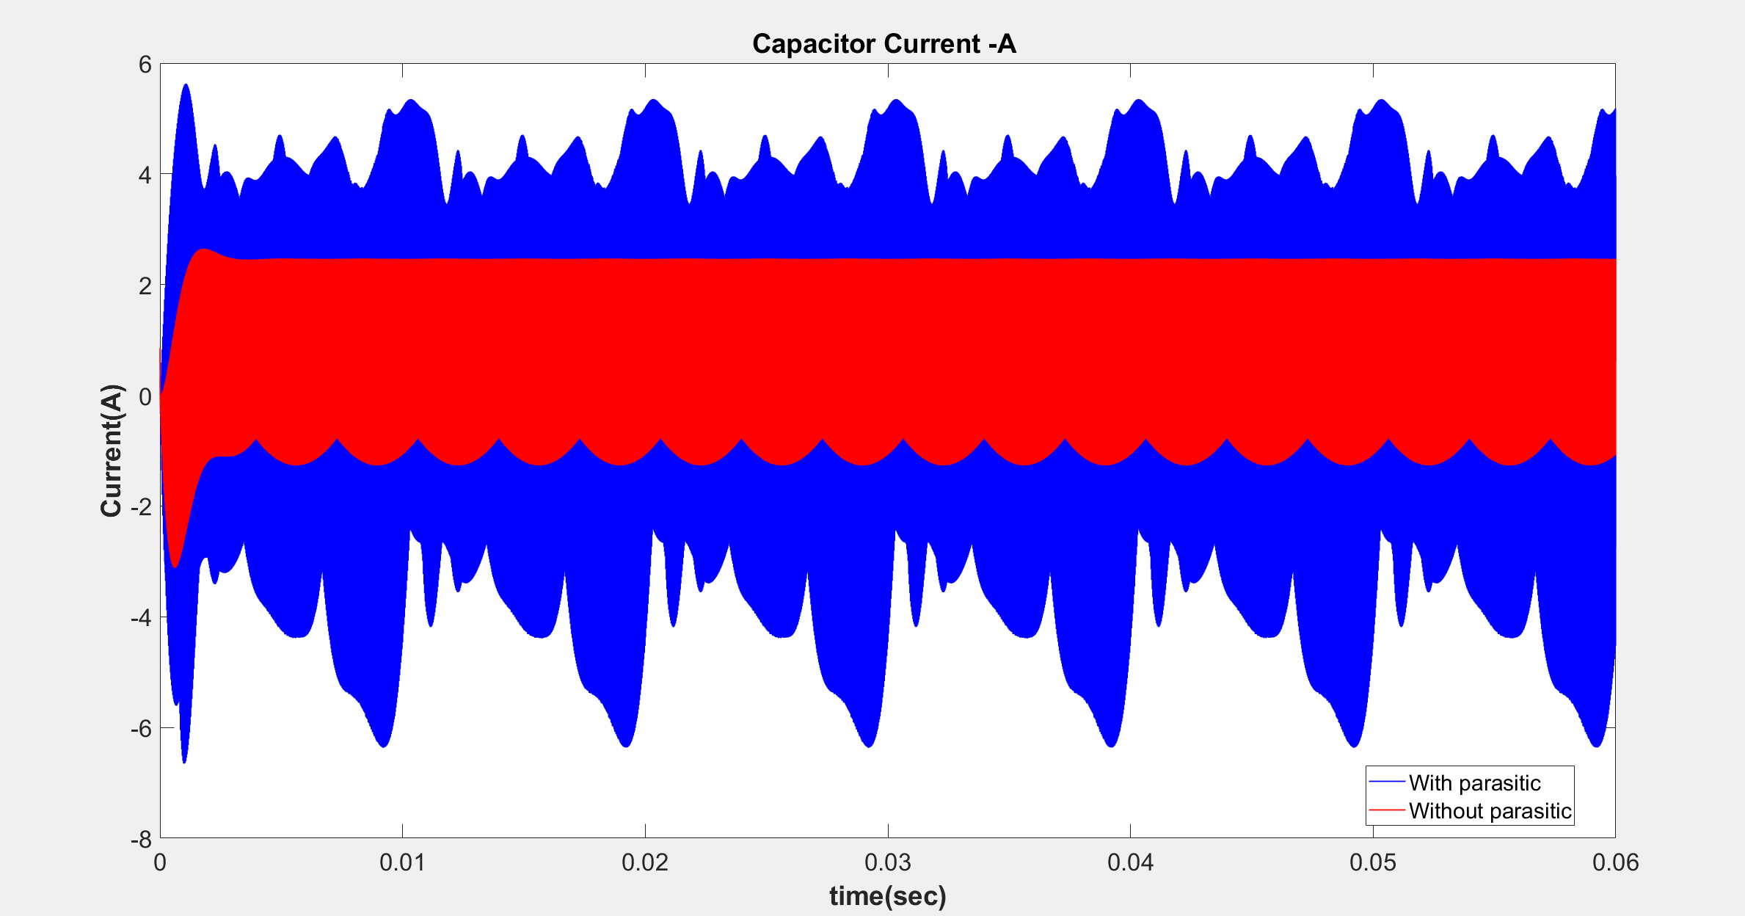

Slide 8
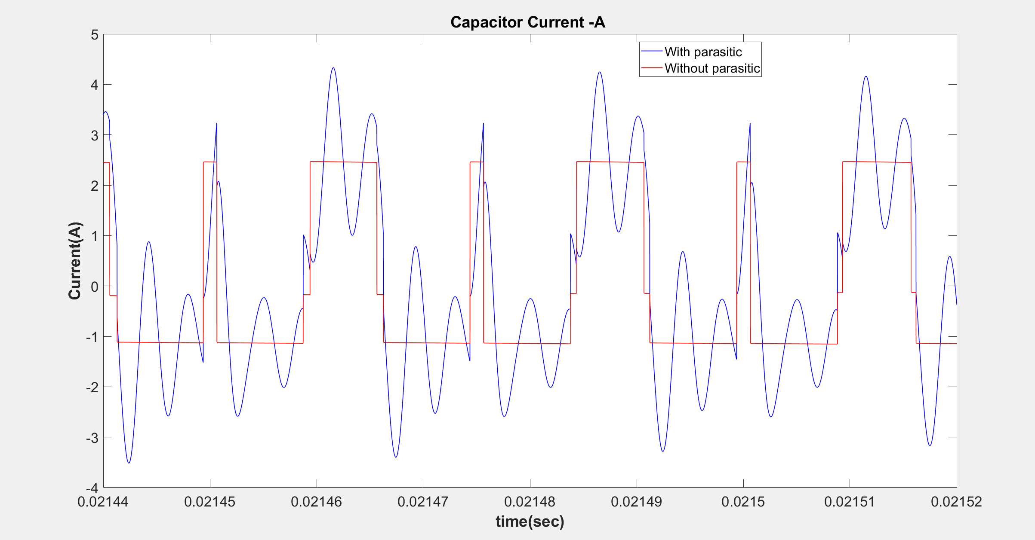

Slide 9
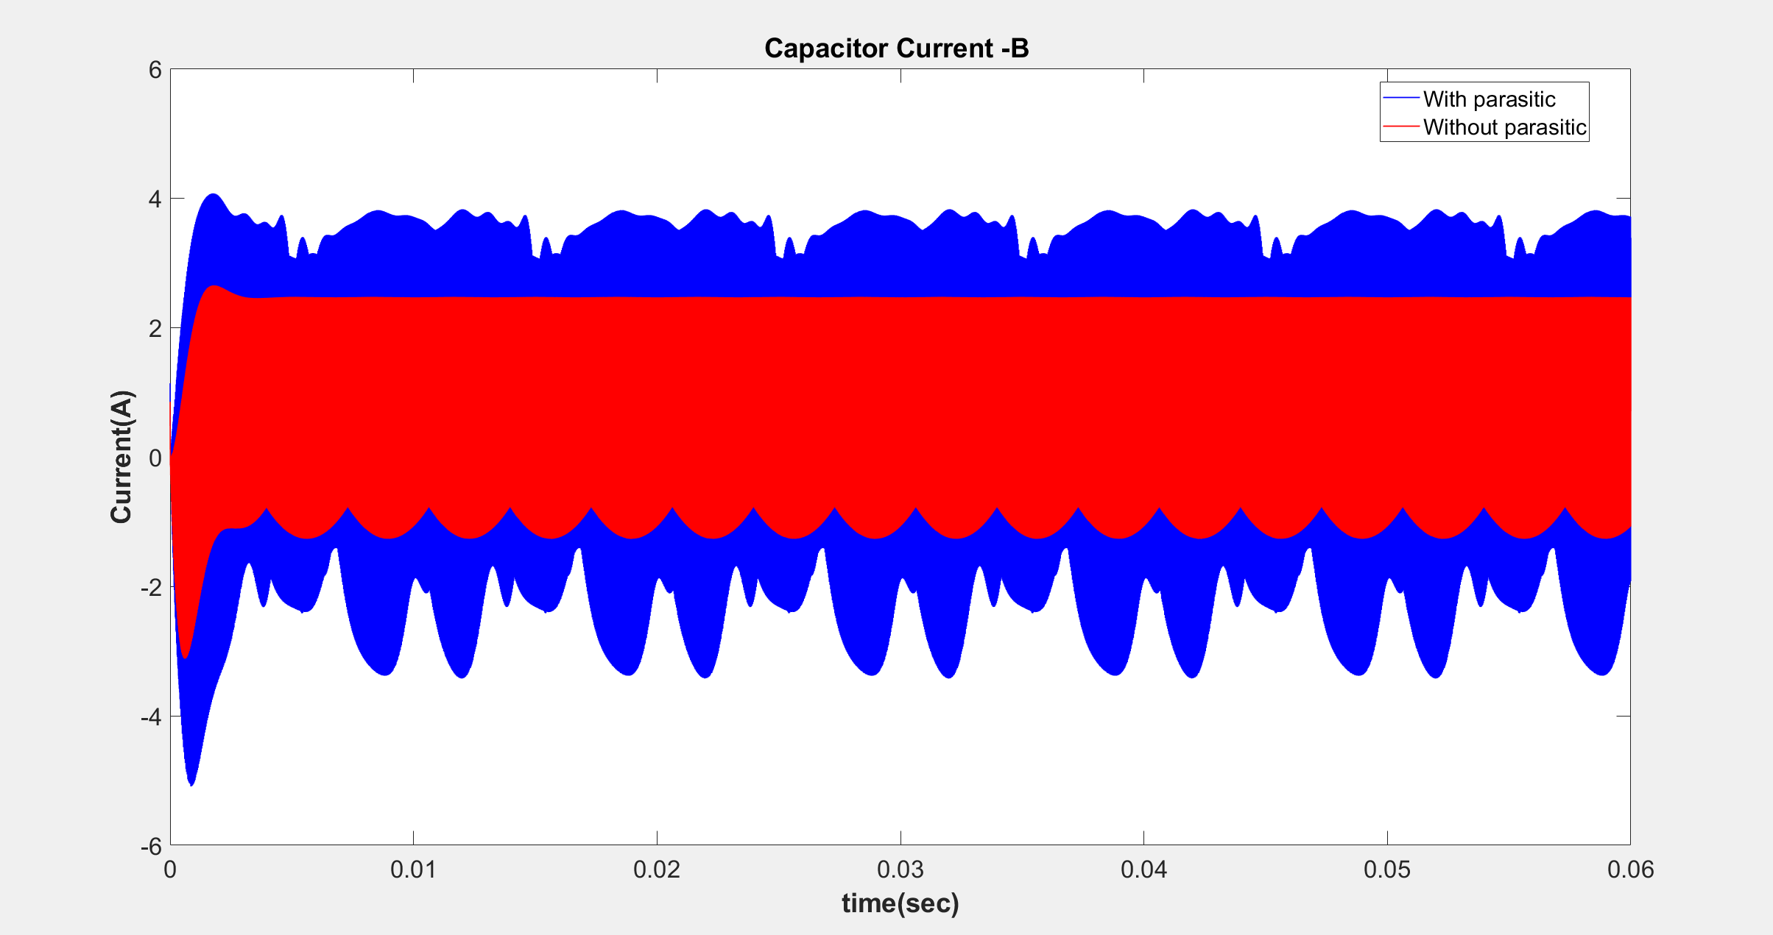

Slide 10
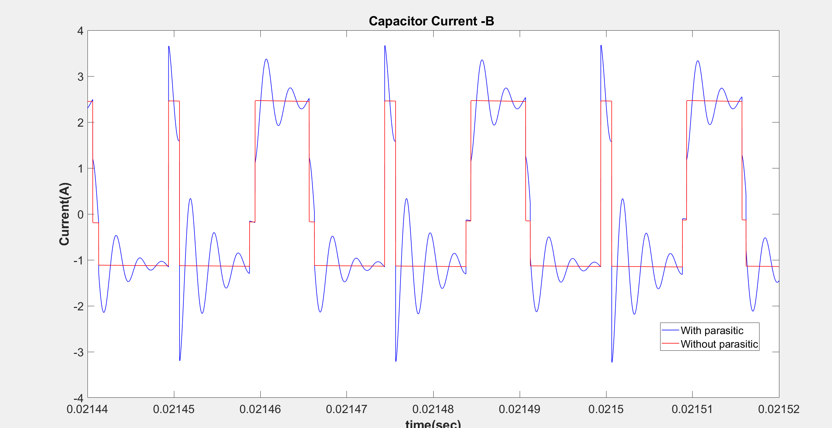

Slide 11
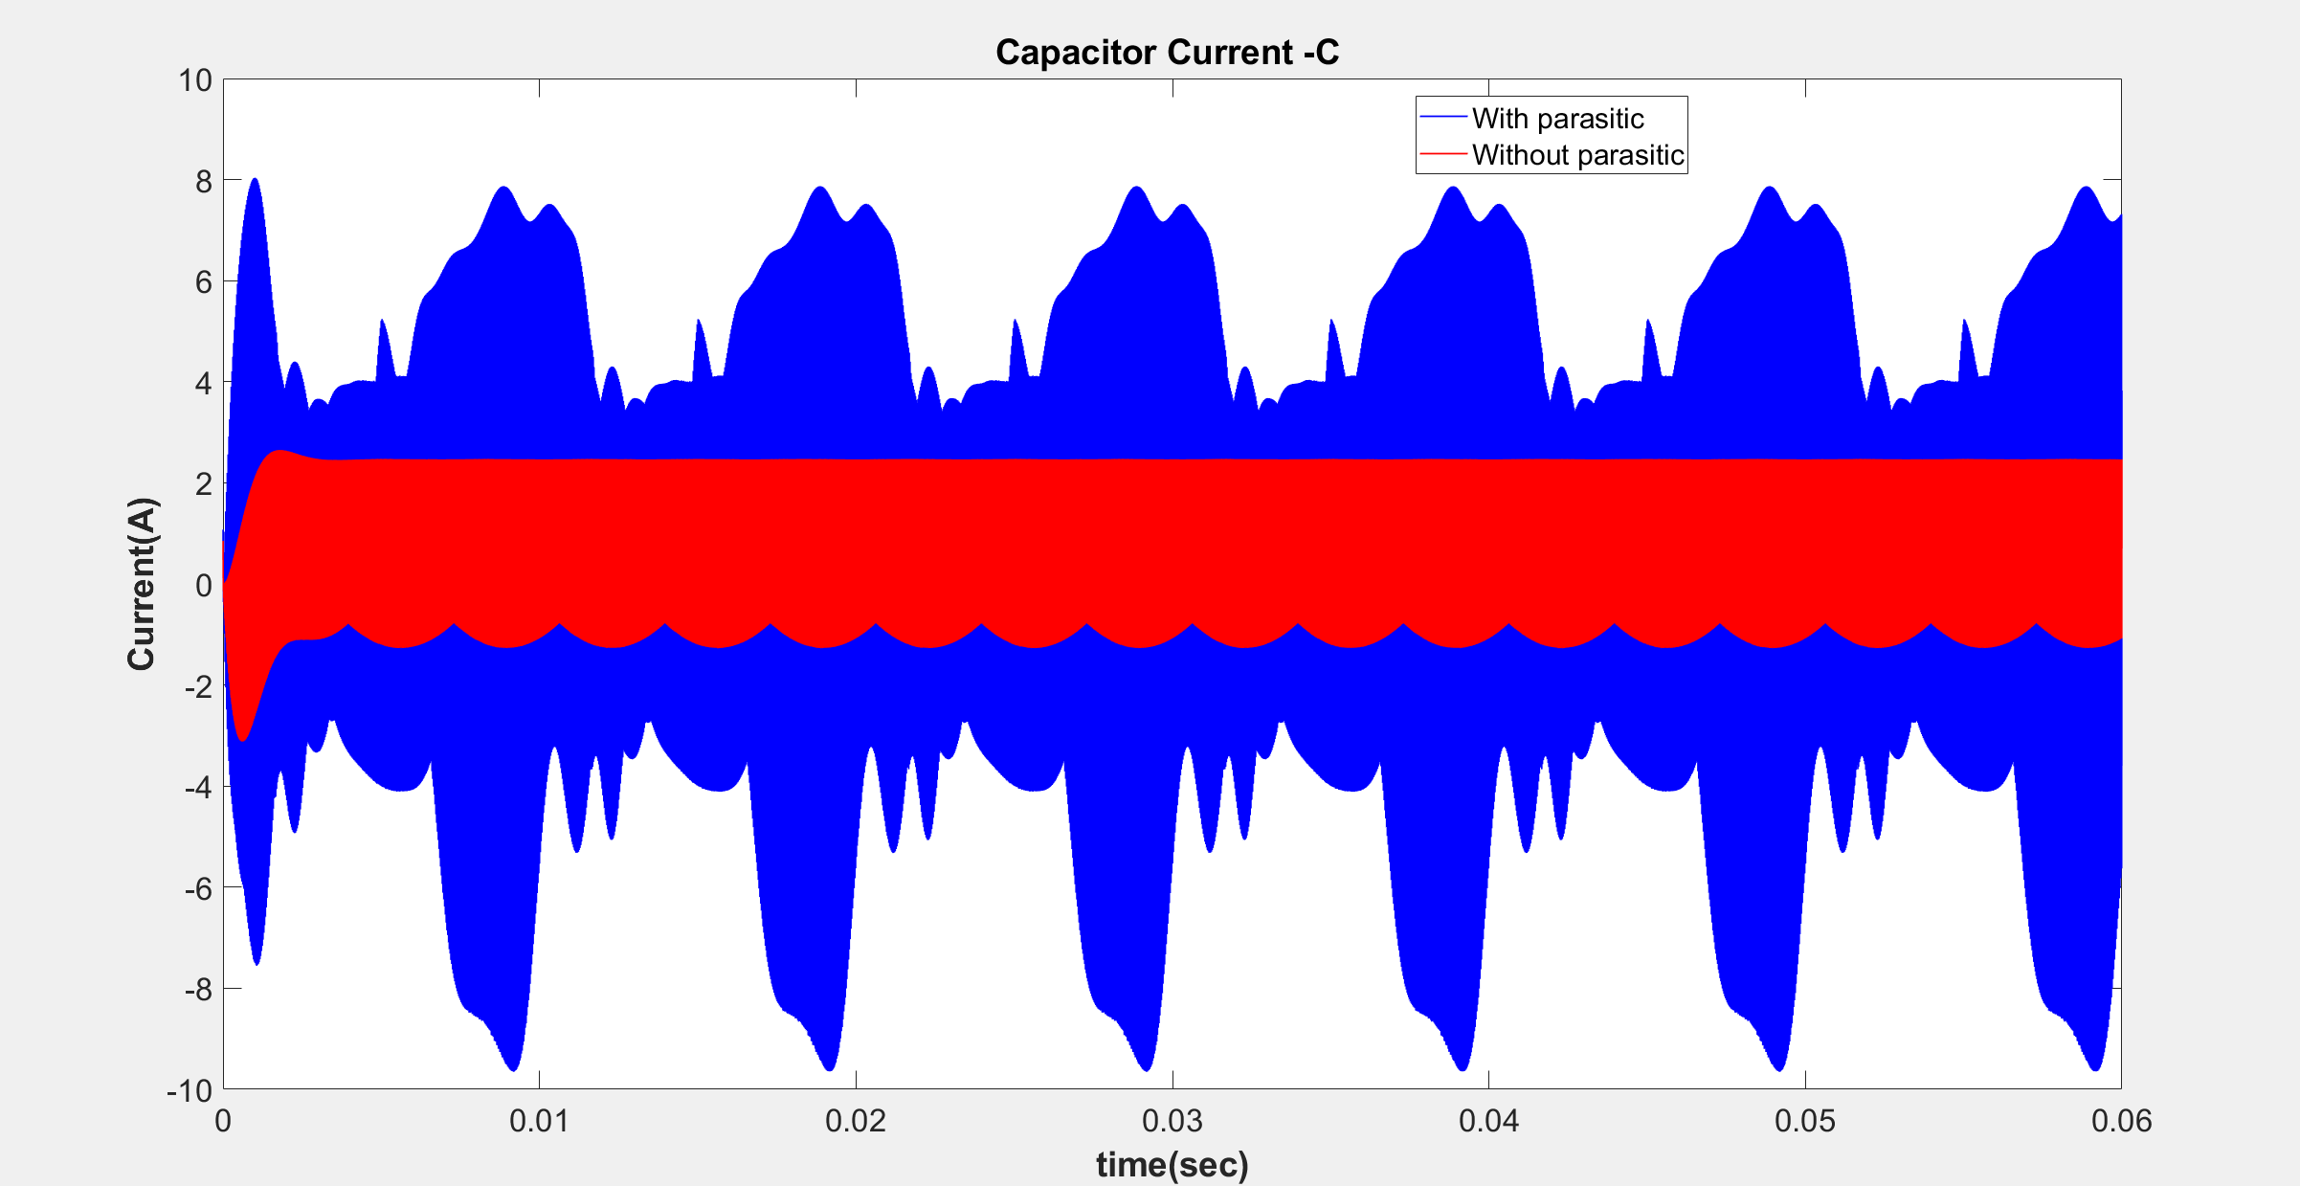

Slide 12
