Slide 1
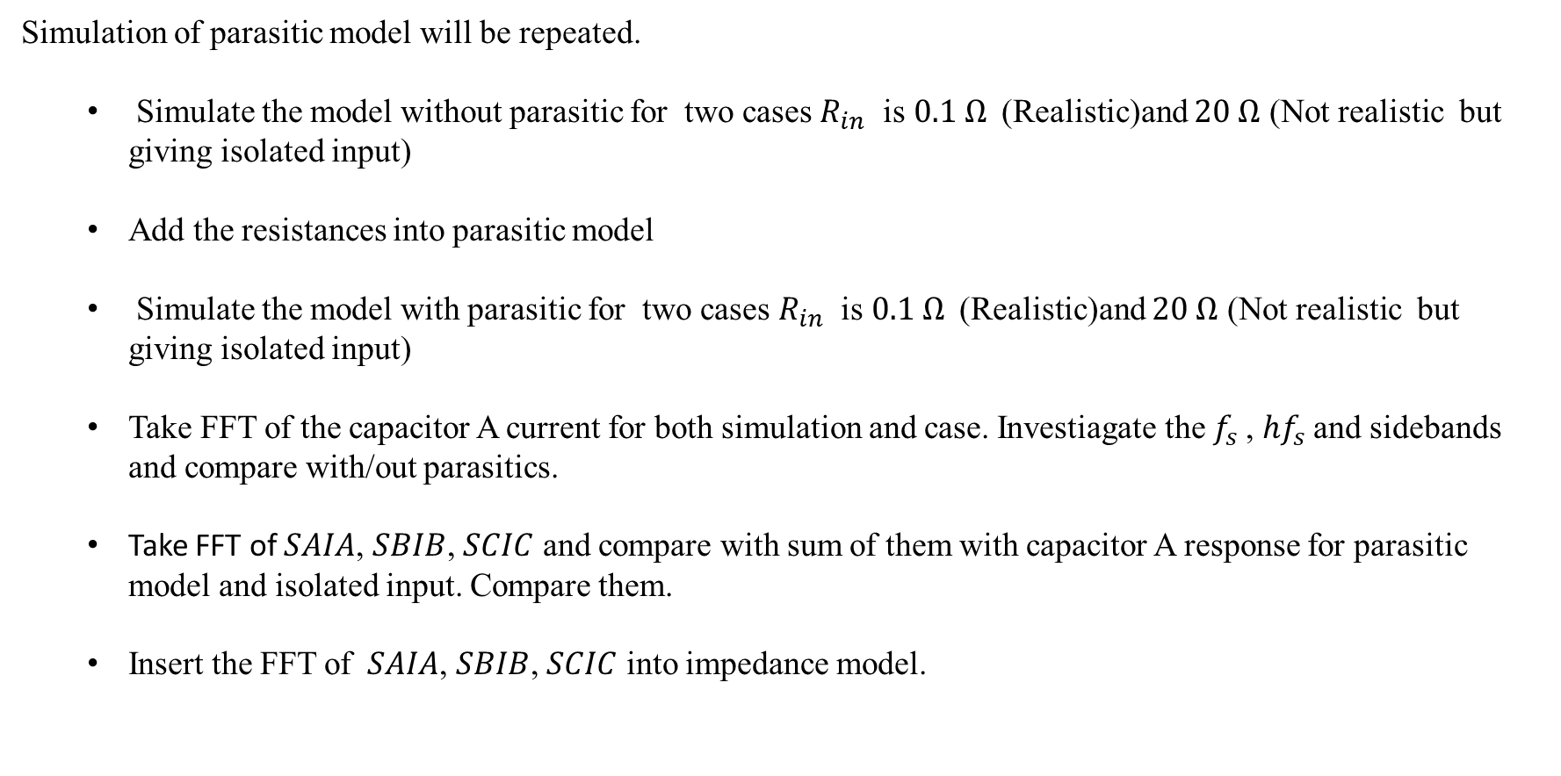
IMMD
Simulation of parasitic model will be repeated.
Simulate the model without parasitic for two cases $R_{in}$ is $0.1 Ω$(Realistic)and $20 Ω$ (Not realistic but giving isolated input)
Add the resistances into parasitic model
Simulate the model with parasitic for two cases $R_{in}$ is $0.1 Ω$(Realistic)and $20 Ω$ (Not realistic but giving isolated input)
Take FFT of the capacitor A current for both simulation and case. Investiagate the $f_{s}$, ${hf}_{s}$and sidebands and compare with/out parasitics.
Take FFT of $SAIA$, $SBIB$, $SCIC$ and compare with sum of them with capacitor A response for parasitic model and isolated input. Compare them.
Insert the FFT of $SAIA$, $SBIB$, $SCIC$ into impedance model.

Slide 2
WPT
After fabrication:
Update design procedure by considering the fabricated inductance values
Simulate 2Tx-4Rx simulation by updating the parameters
Control loop can be added to constant current and flux in primer side

