Slide 1
Requirements
Coil size is restricted to 50mm radius
Coil provide with various inductances such as 60uH and 120uH
The coil can conduct the current until electrical frequency 80kHz (40 kHz and 80kHz)
The eddy loss due to B-field at the shaft should be minimized.

Slide 2
Via should be maximum 23 mil (2.5mm^2) $$$$$$$$$$
12 mil
Black cable is on the top
Red cable is on the bottom
8 mil $$$$$$
Total distance depend on
required copper area
Depend on cable width (skin dept)
Distance between 2 cable,on the top, is $11.5+8+w$ ➔ $w=9 mil$

Slide 3
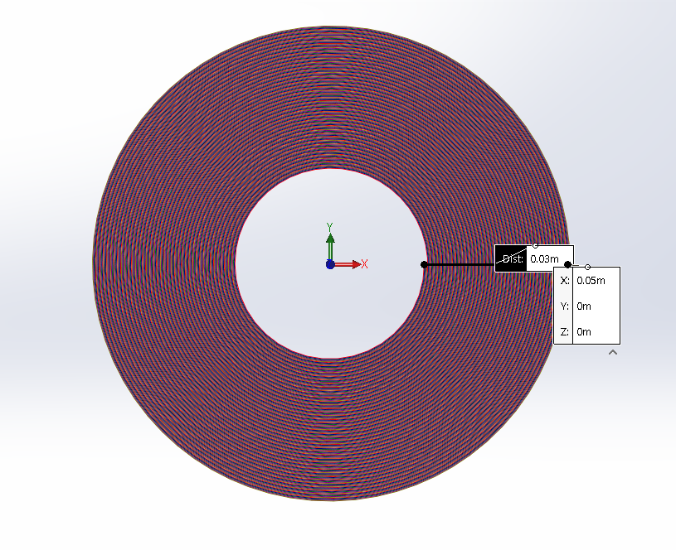
Archimed spiral

