Slide 1
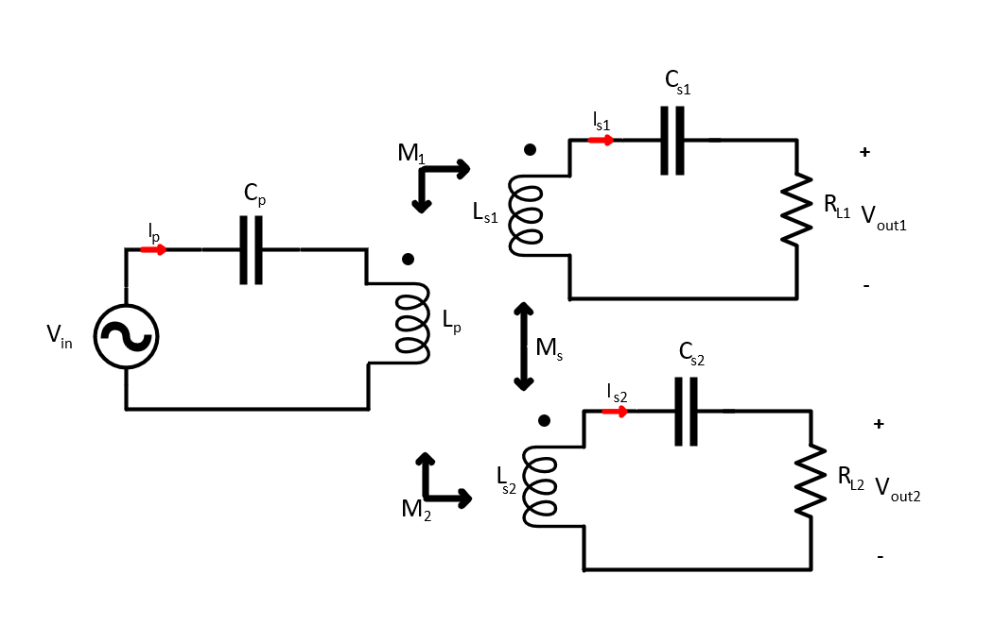
BRIEF EXPLANATION
In this presentation, we try to validate our proposed methods to share current in paralled connected common DC Bus series-series WPT system.
The test data will be compared with each others and LTSpice models.

Slide 2
Test
Decoupled Receiver |  |  |  | Cross-coupled receivers
Full-Aligned |  | Misaligned |  | Full-Aligned |  | Misaligned
150kHz Resonant Cap | 135kHz Resonant Cap | 150kHz Resonant Cap | 135kHz Resonant Cap | 150kHz Resonant Cap | 135kHz Resonant Cap | 150kHz Resonant Cap | 135kHz Resonant Cap
Tx Current | Tx Current | Tx Current | Tx Current | Tx Current | Tx Current | Tx Current | Tx Current
Rx-1 Current | Rx-1 Current | Rx-1 Current | Rx-1 Current | Rx-1 Current | Rx-1 Current | Rx-1 Current | Rx-1 Current
Rx-2 Current | Rx-2 Current | Rx-2 Current | Rx-2 Current | Rx-2 Current | Rx-2 Current | Rx-2 Current | Rx-2 Current
Tx Voltage (Square) | Tx Voltage (Square) | Tx Voltage (Square) | Tx Voltage (Square) | Tx Voltage (Square) | Tx Voltage (Square) | Tx Voltage (Square) | Tx Voltage (Square)

Slide 3
First mission : We investigate the secondary coupling effect by using the test data which are decoupled 150Khz resonant capacitor and cross-coupled 150kHz resonant capacitor for both aligned and misaligned conditions.
Second mission: We investigate the effect of resonance frequency of receeiver side by using test data which are decoupled 150kHz and 135kHz resonant capacitor for both aligned and misaligned condition.
For first and second missions, we took the inductance matrice data and output resistance and voltage. We will establish Spice model and it will be compared with our experiment results.
The inductance matrices for Full-Aligned and Misaligned conditions for both decoupled and coupled conditions are given.

Slide 4
Full-Aligned Coupled

Slide 5
Miss-Aligned Coupled

Slide 6
Full-Aligned Decoupled

Slide 7
Miss-Aligned Decoupled

Slide 8
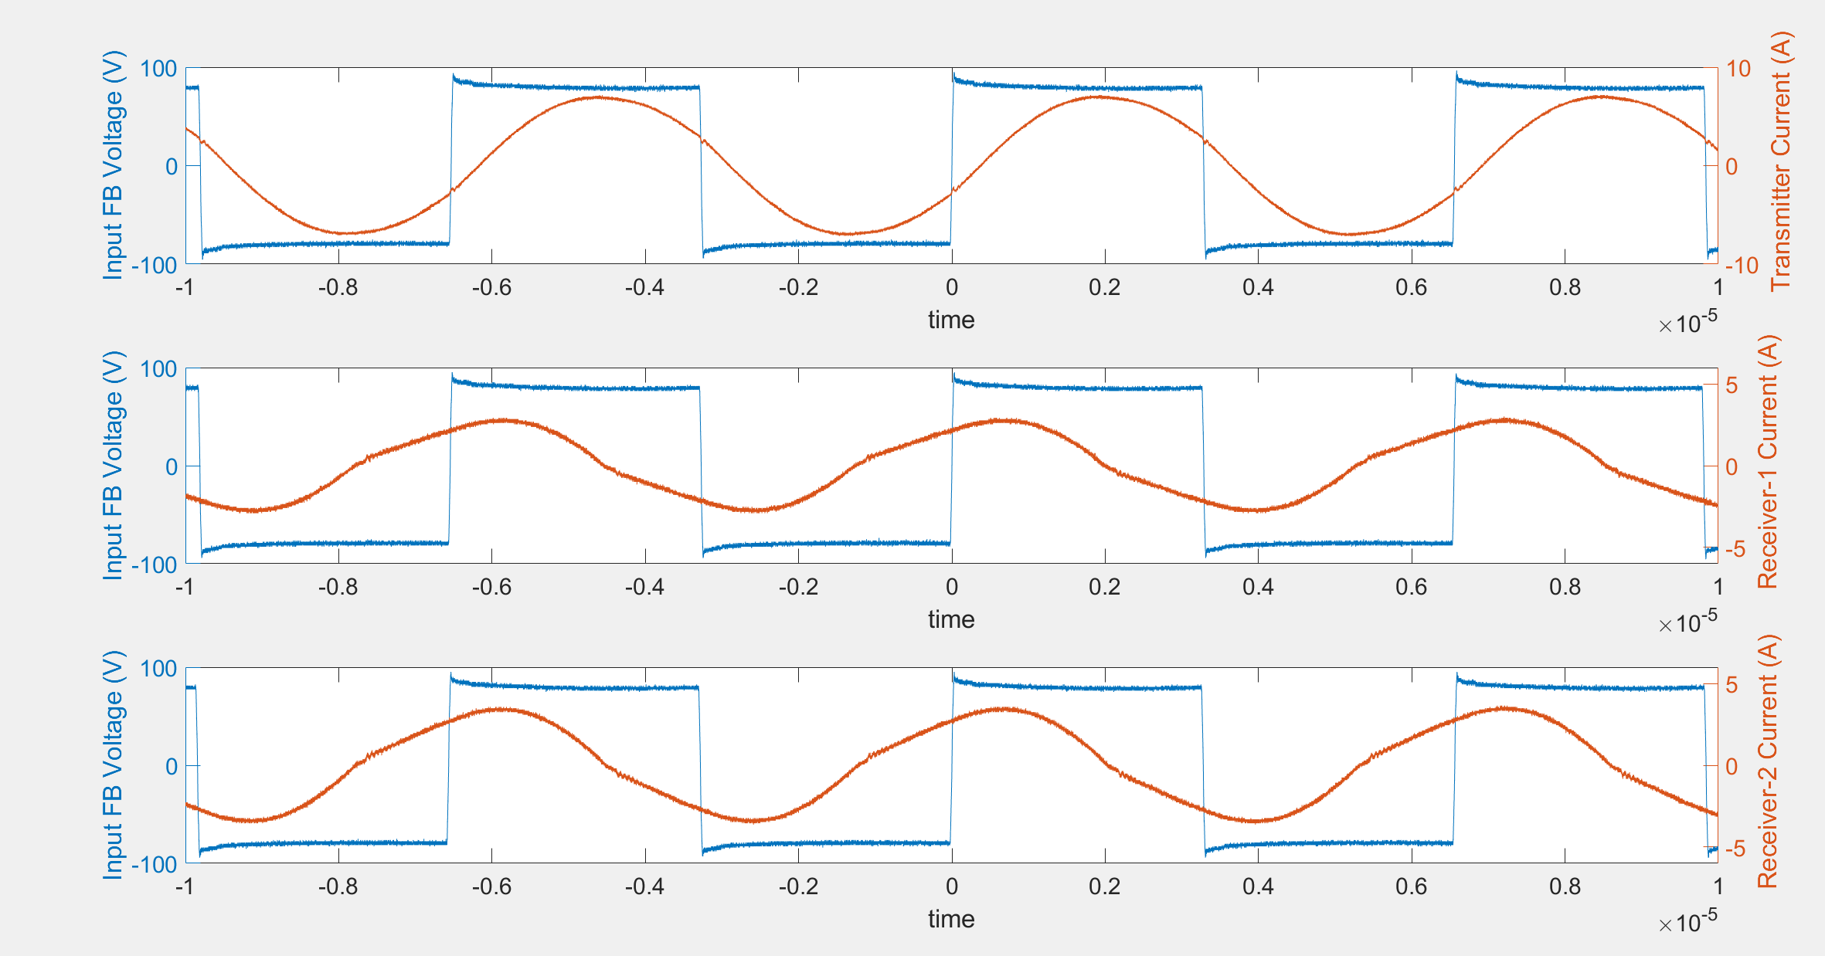
FA-Decoupled-150kHz
Frequency | Ip (peak) | Is1(peak) | Is2(peak) | Ip (angle) | Is1(angle) | Is2(angle)
152kHz | 7.17A | 2.93A | 3.57A | 19.93 | 67.5 | 65.2

Slide 9
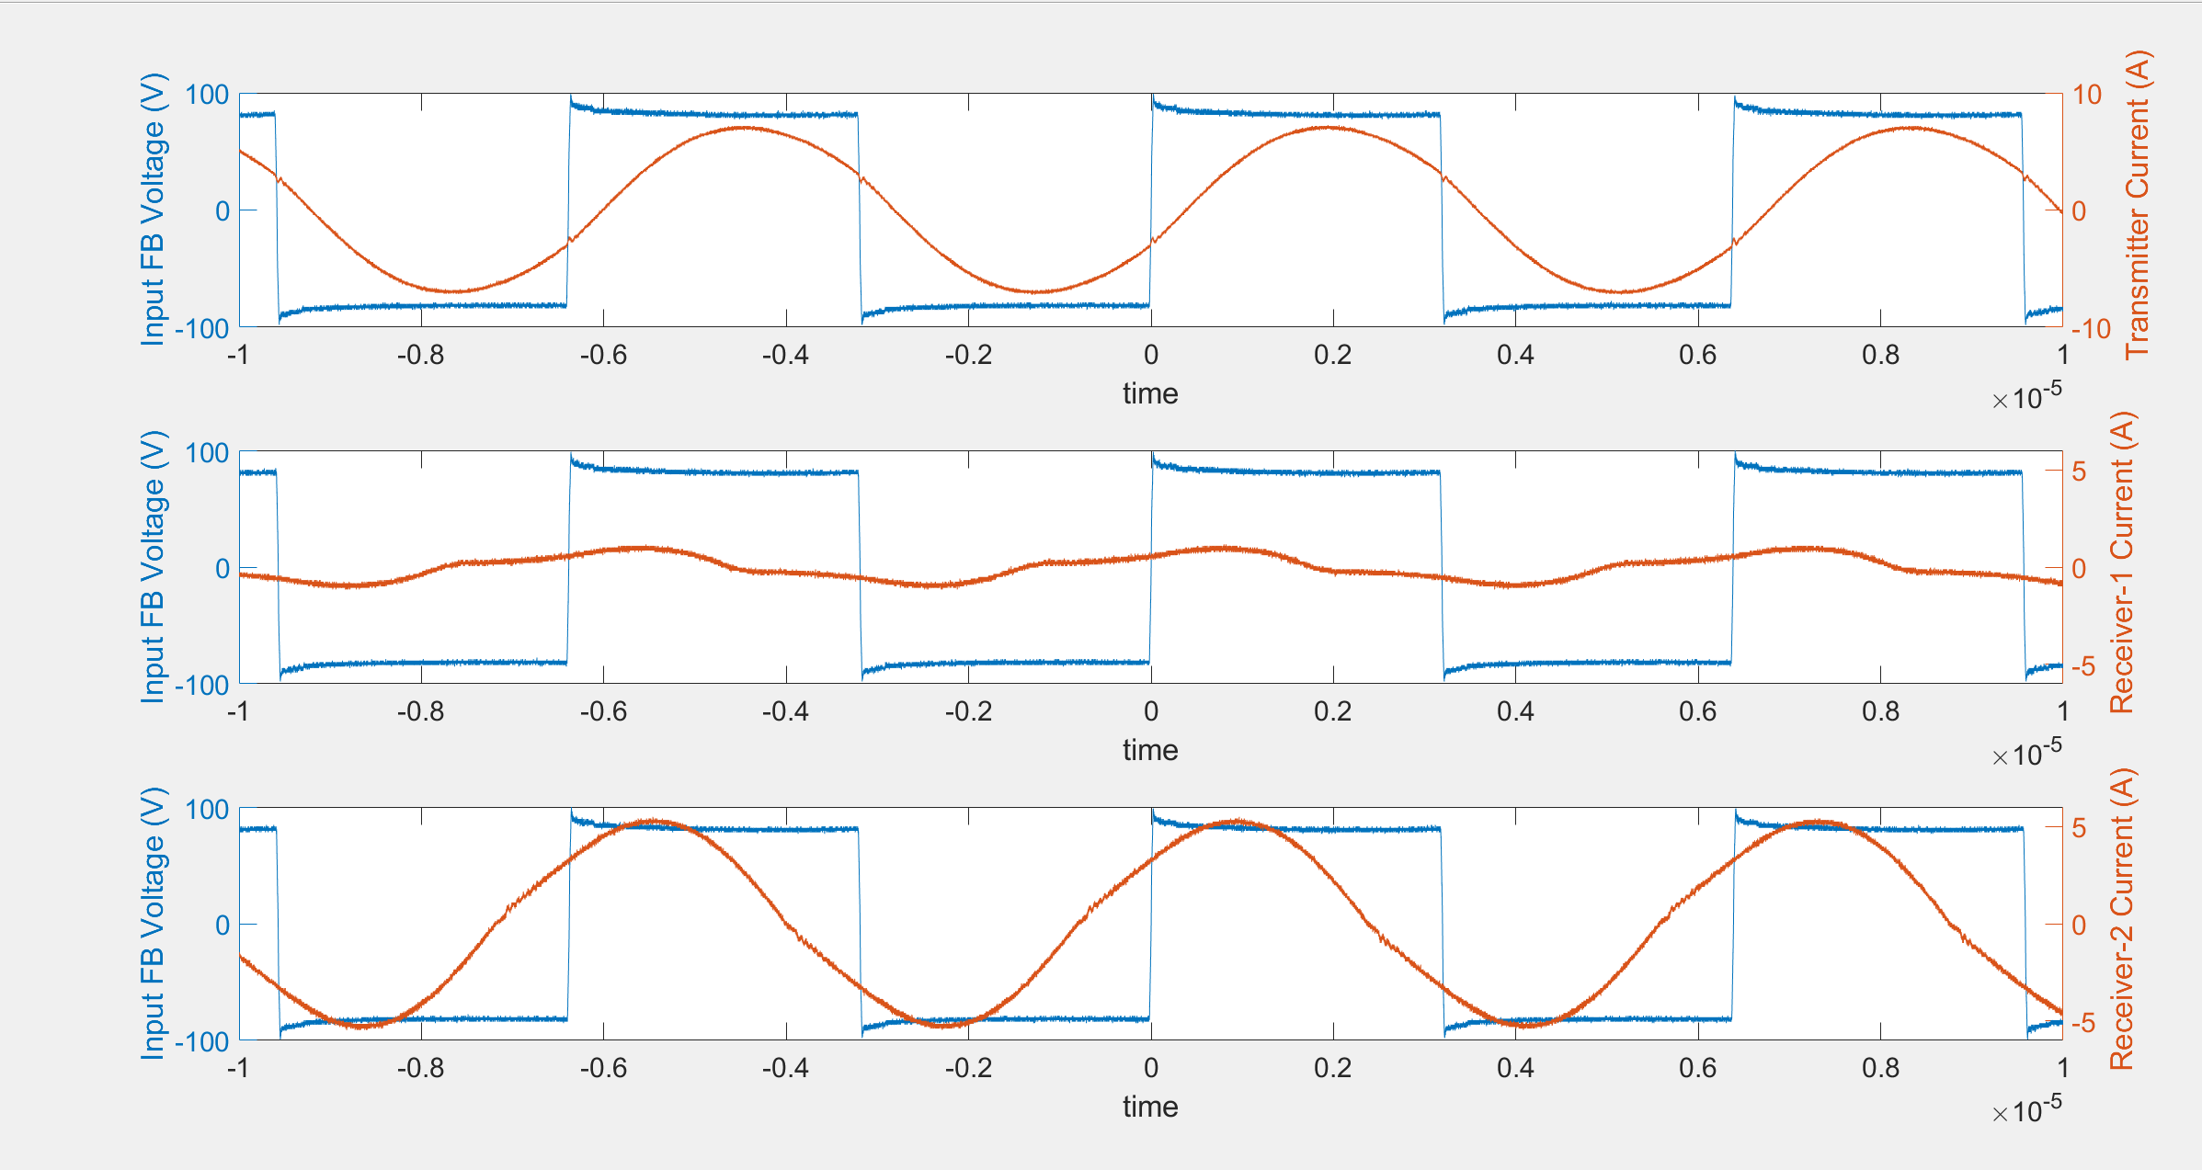
MA-Decoupled-150kHz
Frequency | Ip (peak) | Is1(peak) | Is2(peak) | Ip (angle) | Is1(angle) | Is2(angle)
156.8kHz | 7.25A | 1.17A | 5.09A | 22.8711 | 74.8448 | 44.1957

Slide 10
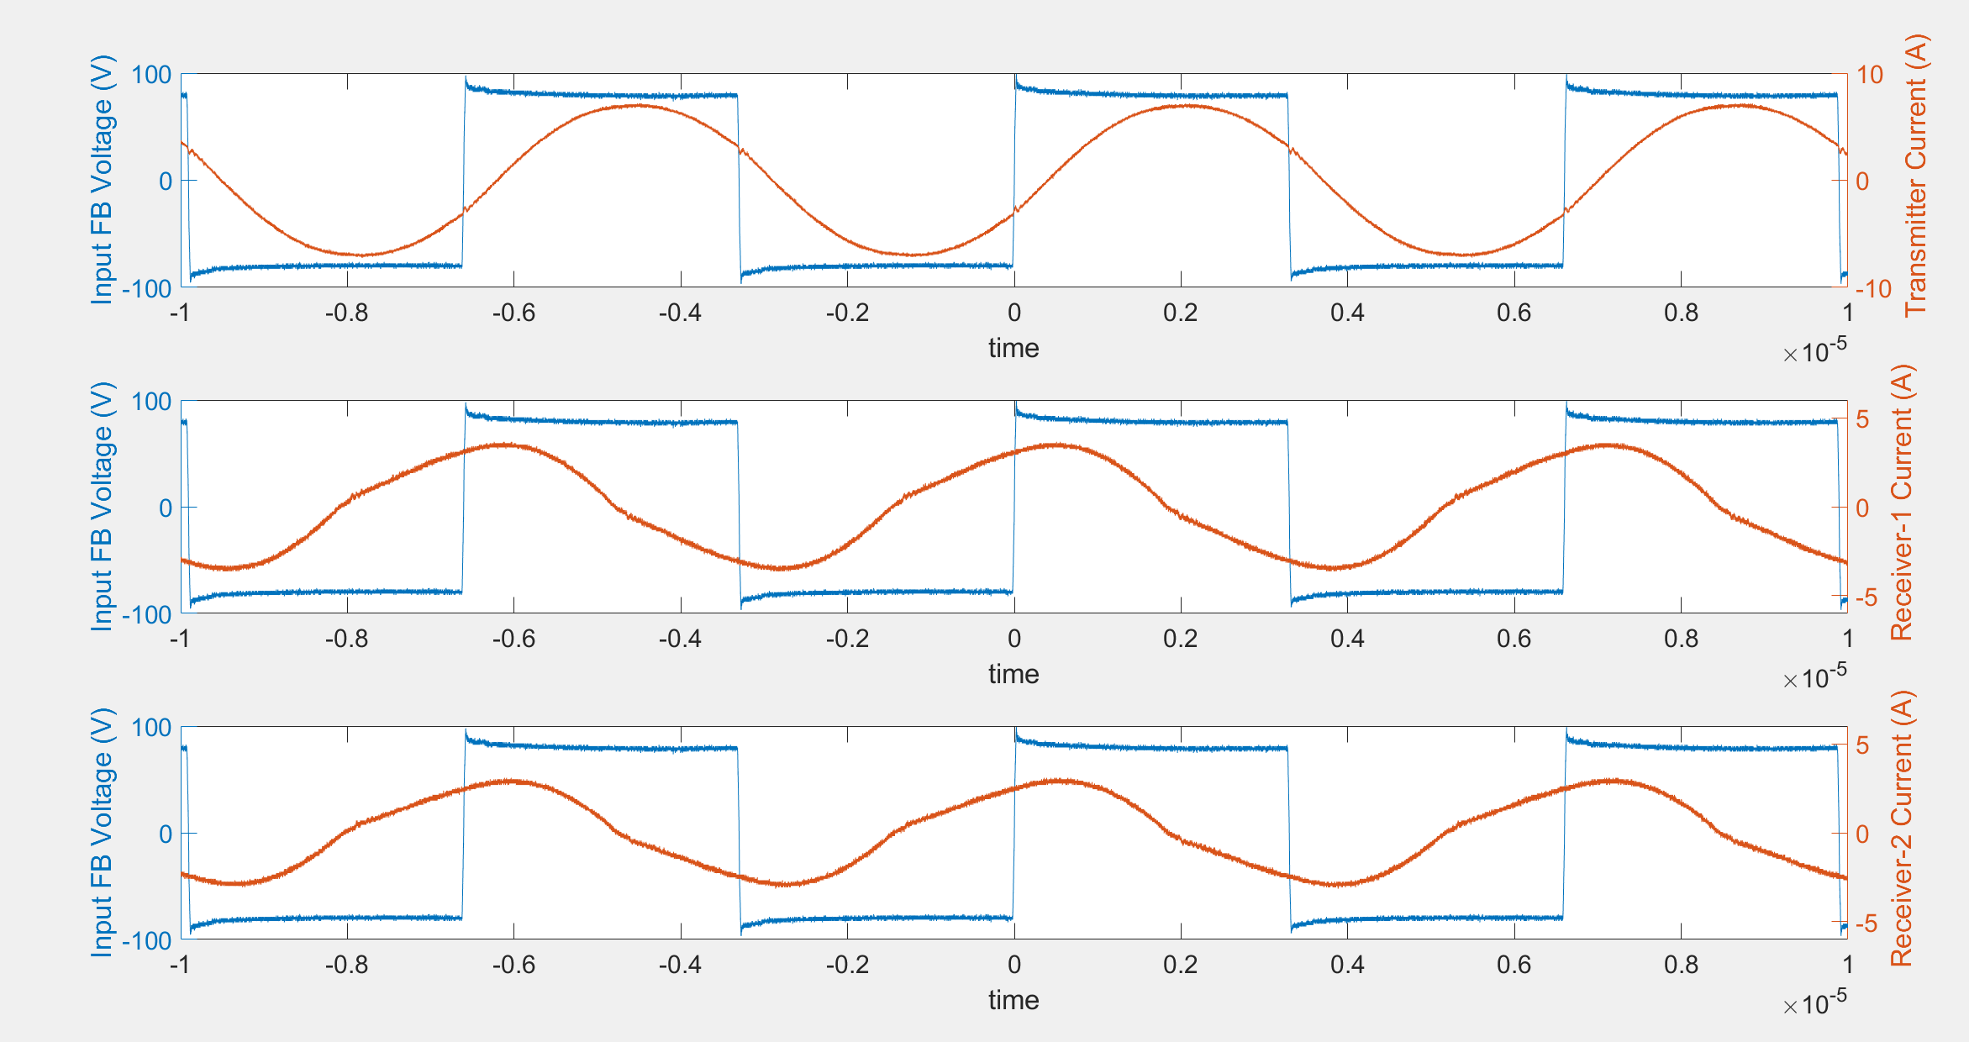
FA-Coupled-150kHz
Frequency | Ip (peak) | Is1(peak) | Is2(peak) | Ip (angle) | Is1(angle) | Is2(angle)
151.6kHz | 7.17A | 3.65A | 3.09A | 22.524 | 76.68 | 74.1722

Slide 11
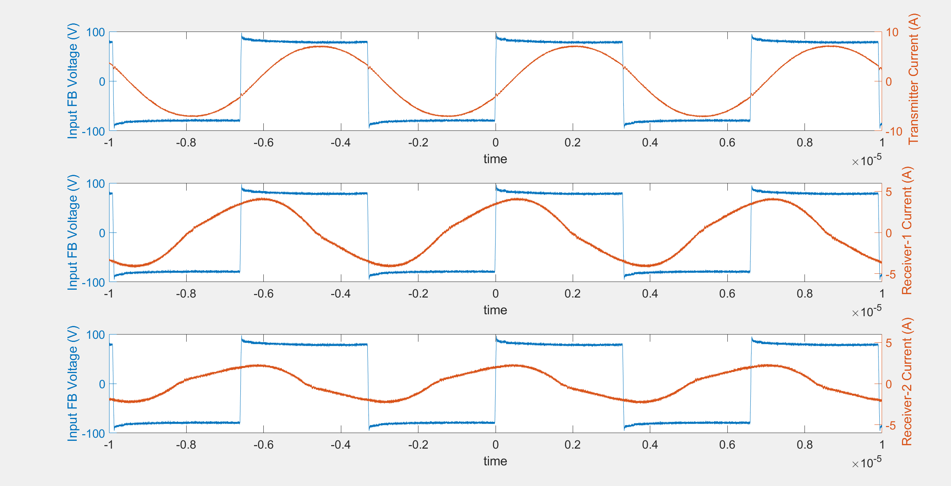
MA-Coupled-150kHz
Frequency | Ip (peak) | Is1(peak) | Is2(peak) | Ip (angle) | Is1(angle) | Is2(angle)
151.3kHz | 7.17A | 4.21A | 2.37A | 22.31 | 72.18 | 82.7542

