Slide 1
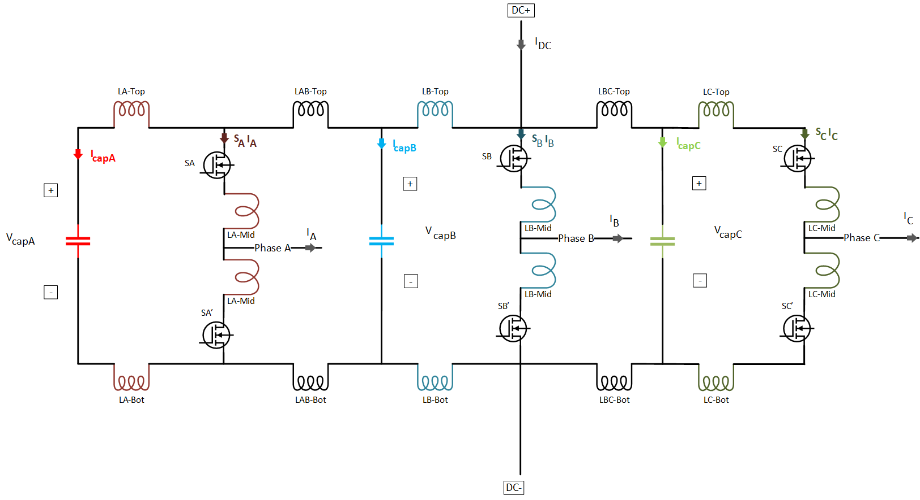

Measurements:
Capacitor currents ($I_{capA}$, $I_{capB}$, $I_{capC}$)
Capacitor voltages ($V_{capA}$, $V_{capB}$, $V_{capC}$)
Leg Currents ($S_{A}I_{A}$, $S_{B}I_{B}$, $S_{C}I_{C}$)
Phase Currents ($I_{A}$, $I_{B}$, $I_{C}$)
DC input ($V_{DC}$, $I_{DC}$)

Slide 2
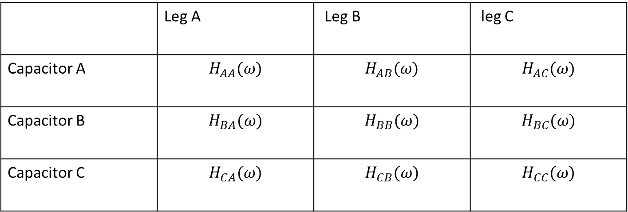
Impedance Model
Show the responce of capacitors for each leg.
We find how to distribute leg A current to A,B,C capacitors.
There are 9 situation shown below.
 | Leg A | Leg B | leg C
Capacitor A | $$H_{AA}(ω)$$ | $$H_{AB}(ω)$$ | $$H_{AC}(ω)$$
Capacitor B | $$H_{BA}(ω)$$ | $$H_{BB}(ω)$$ | $$H_{BC}(ω)$$
Capacitor C | $$H_{CA}(ω)$$ | $$H_{CB}(ω)$$ | $$H_{CC}(ω)$$
The response of capacitor A for each leg should be calculated as:
$I_{capA}= {S_{A}I_{A}H}_{AA}\left(ω\right)+{S_{B}I_{B}H}_{AB}(ω)$+${S_{C}I_{C}H}_{AC}(ω)$

Slide 3
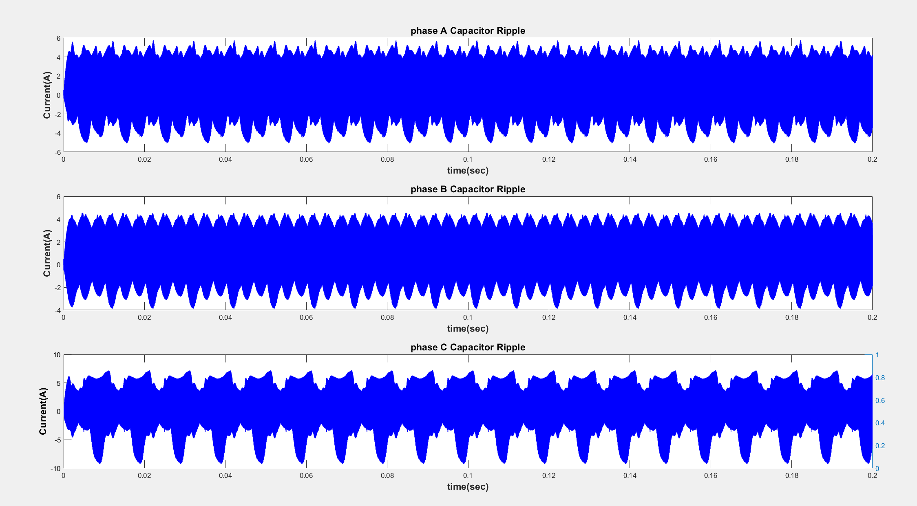
Here, we observe that the current and voltage waveform are distinct

Slide 4
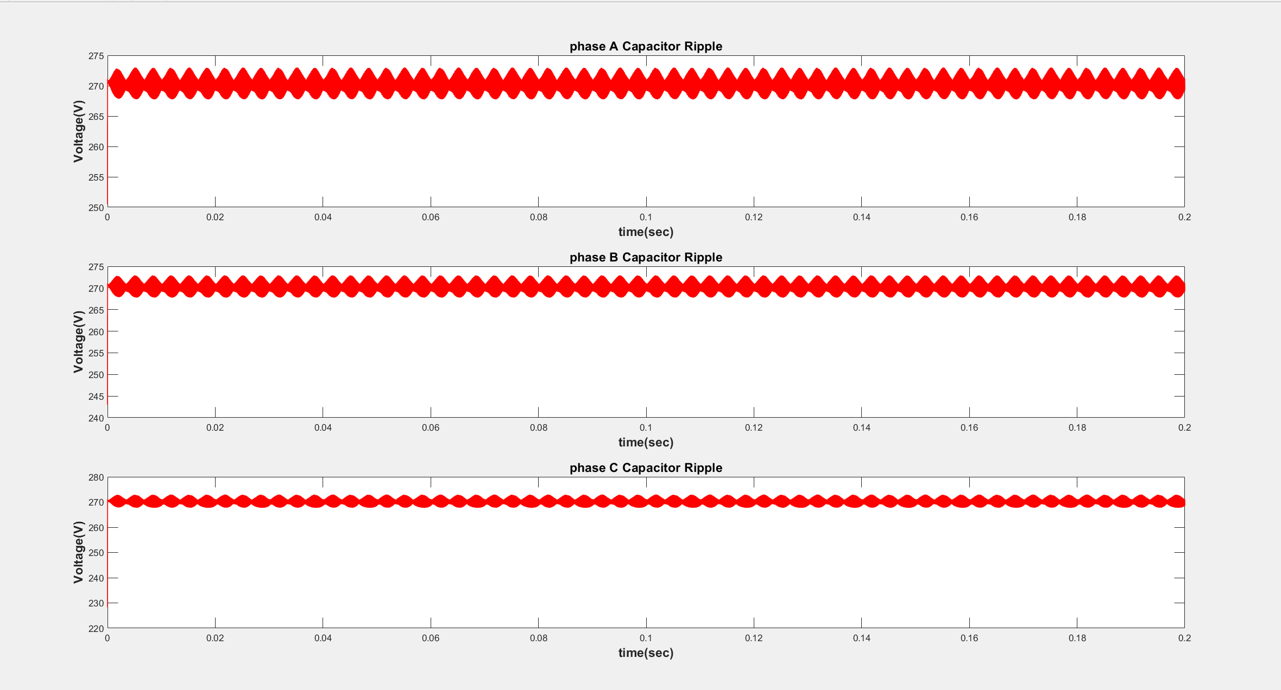

Slide 5
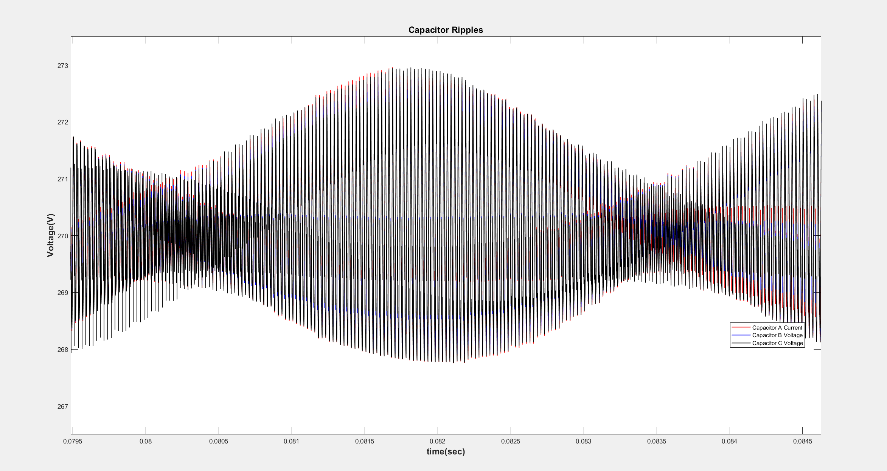
Envelope

Slide 6
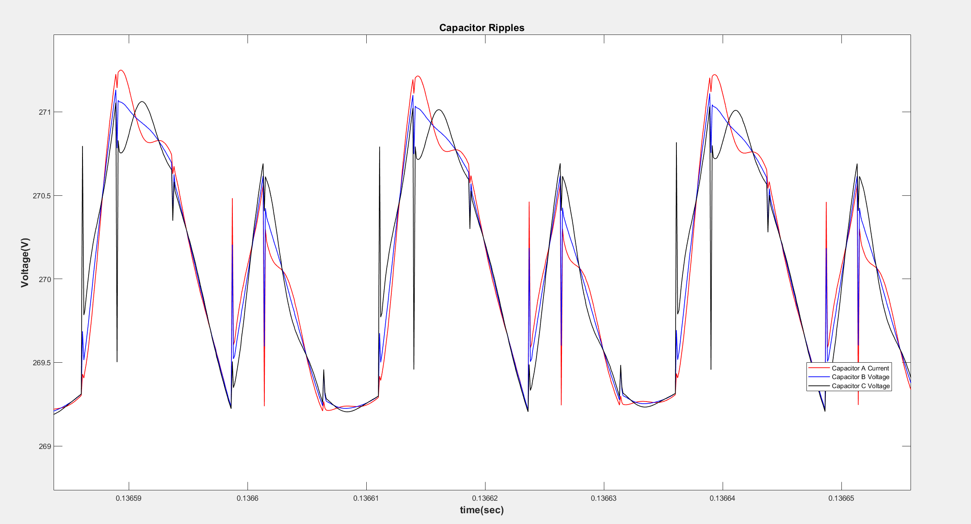

Slide 7
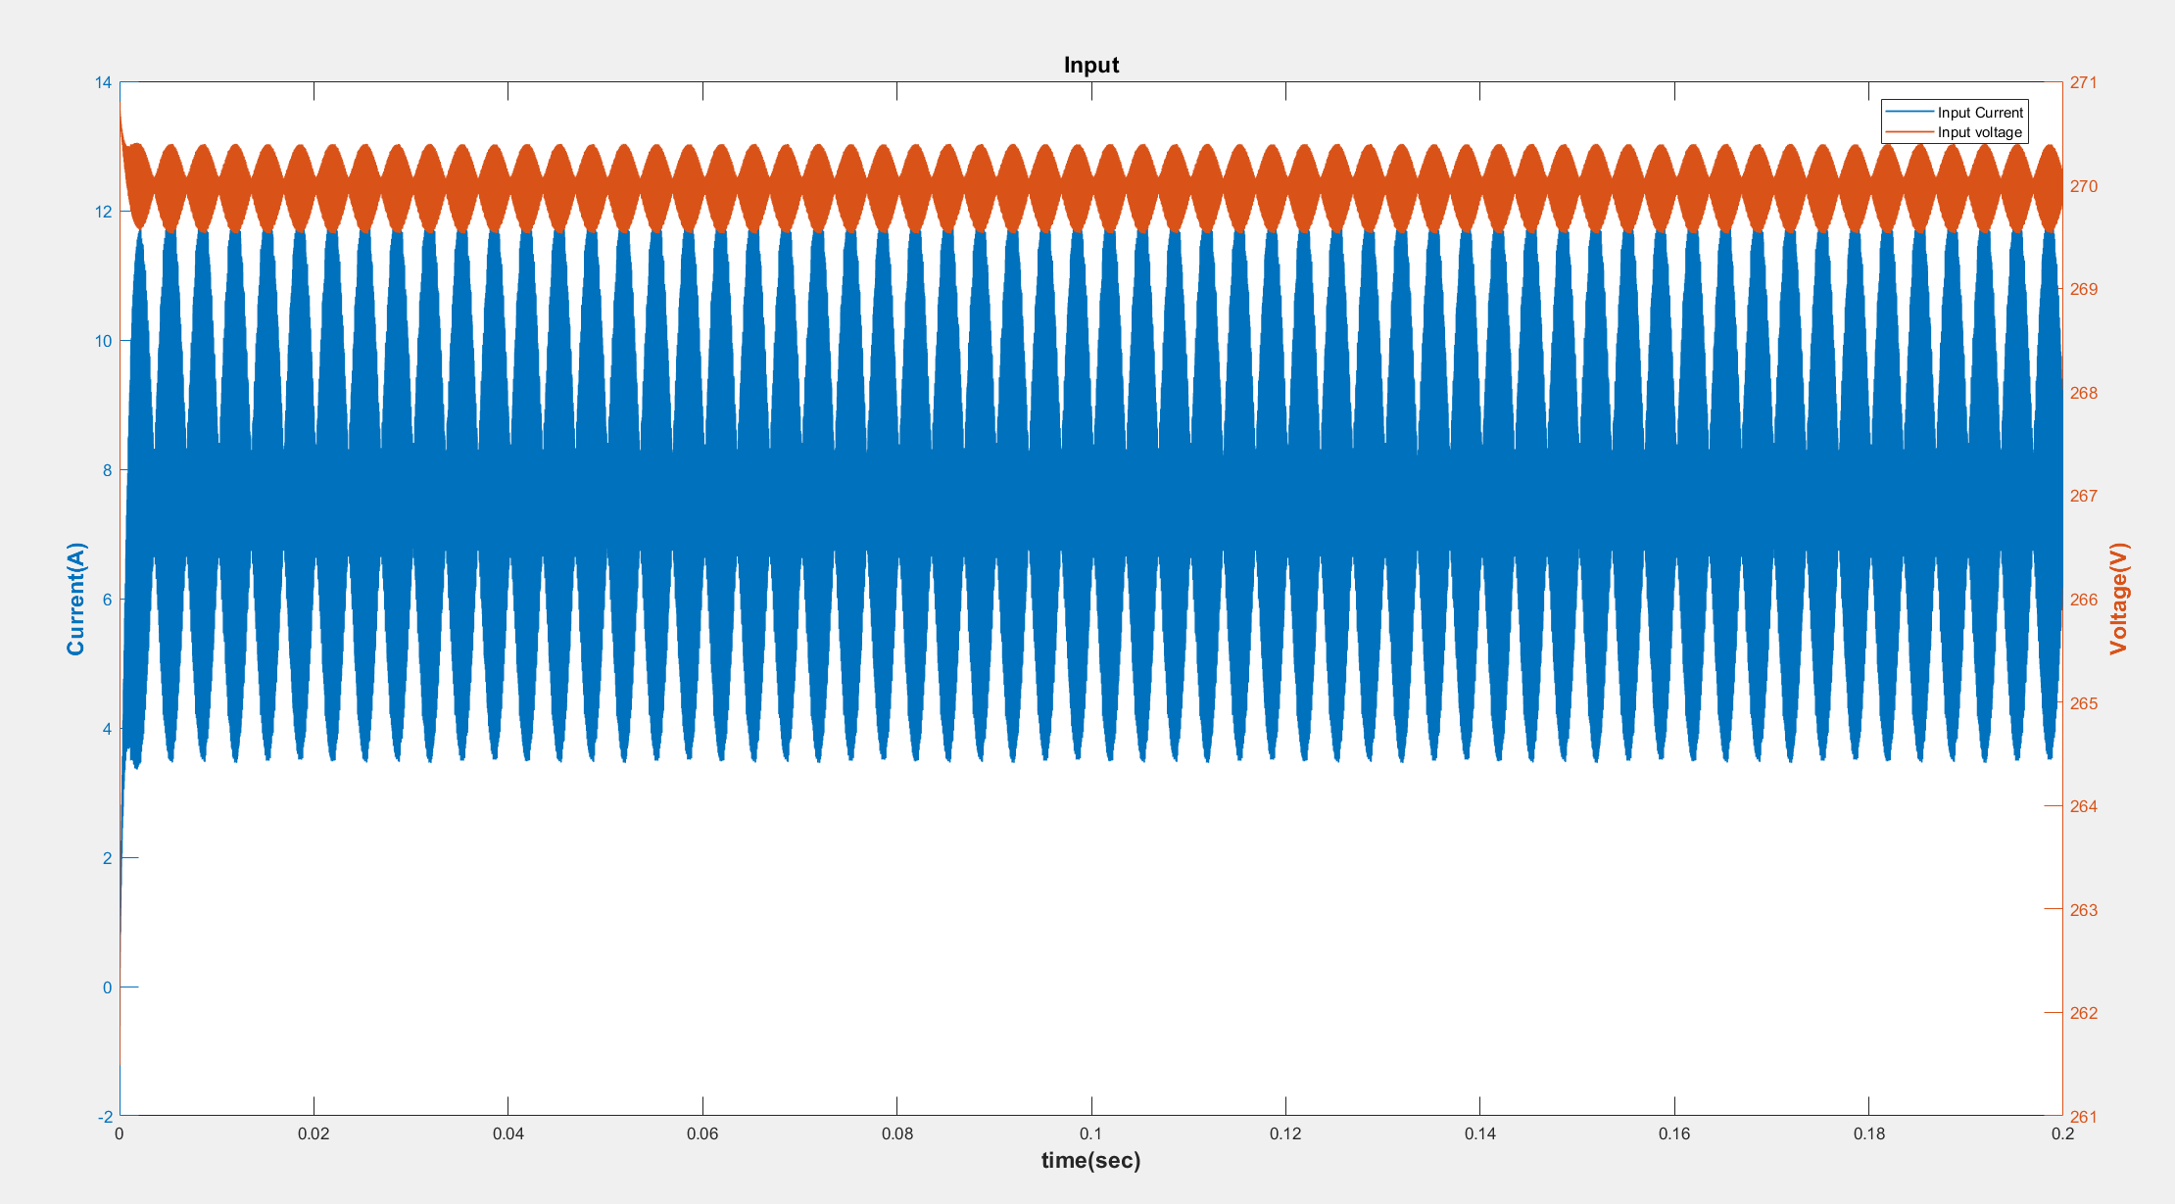
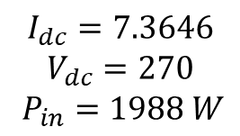
I place inductor as 1 micro Henry since cap B is directly is connected with DC input
$$I_{dc}=7.3646$$
$$V_{dc}=270$$
$P_{in}=1988 W$

Slide 8
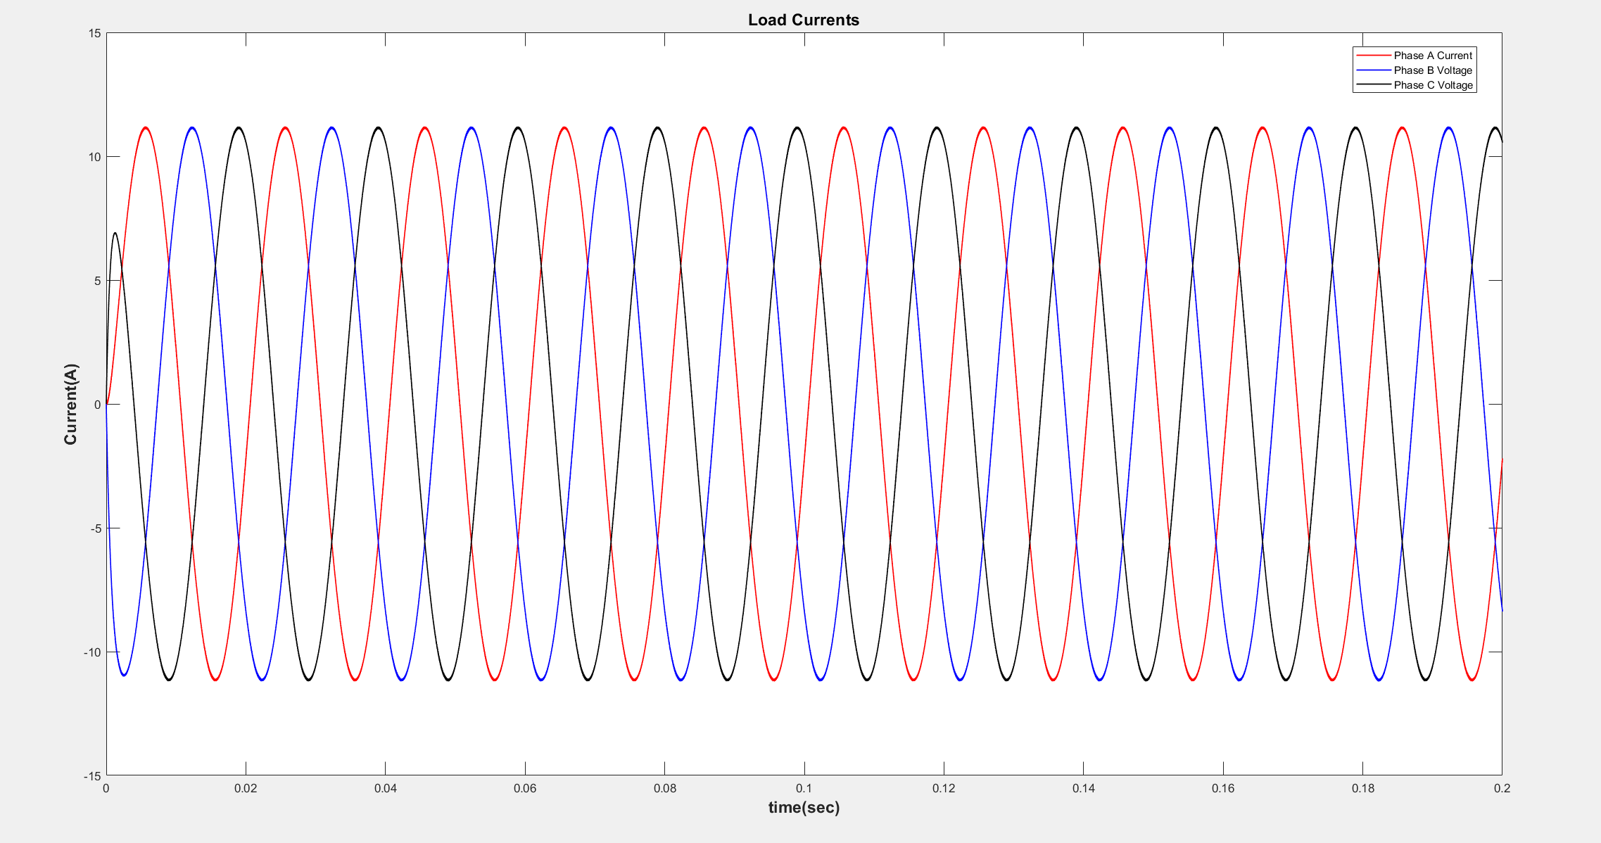

$I_{A}=7.9193$ A rms

Slide 9
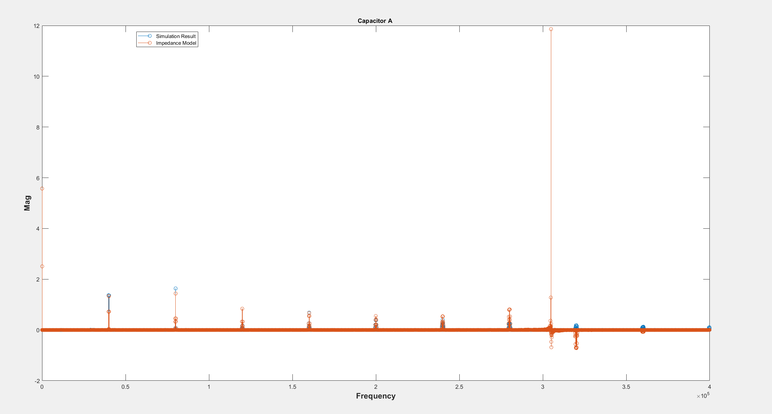

Slide 10
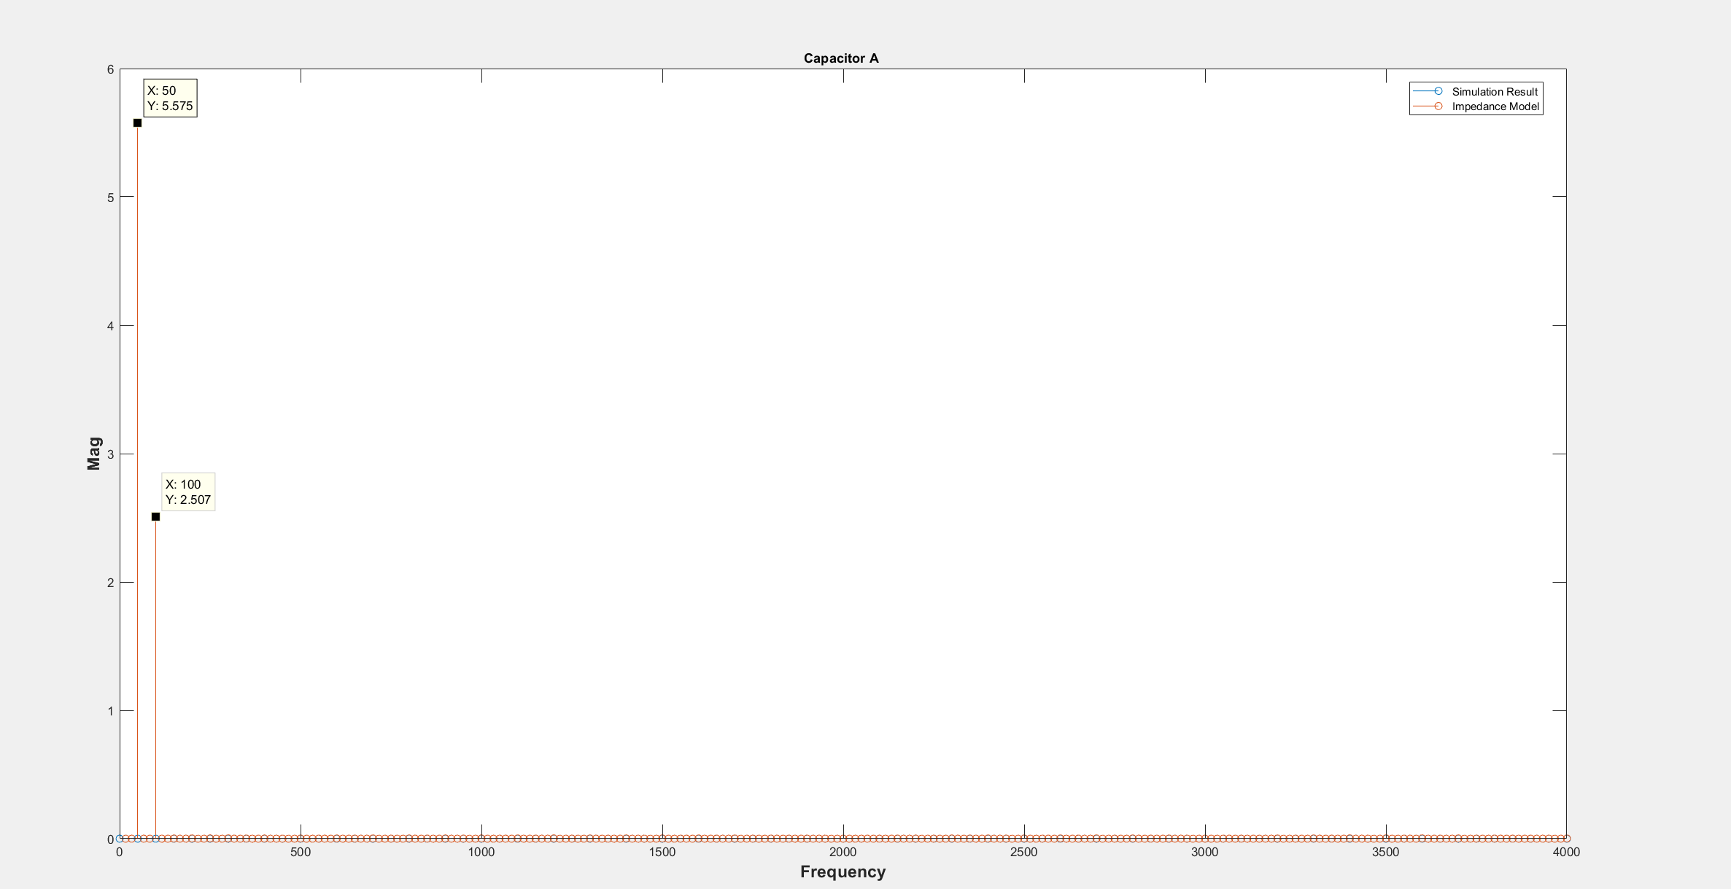

Slide 11
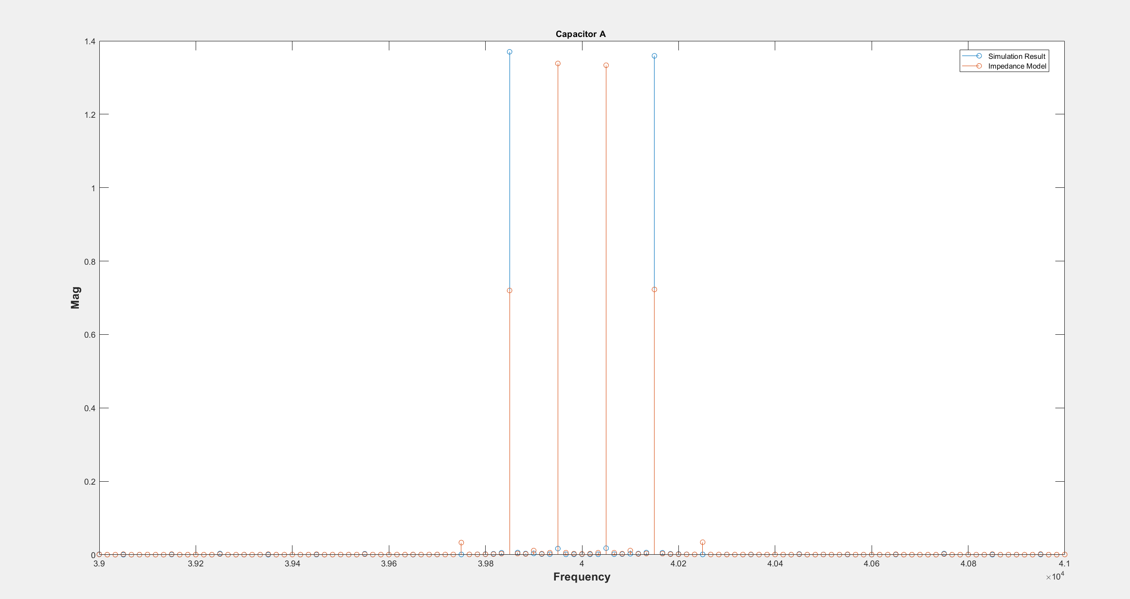

Slide 12
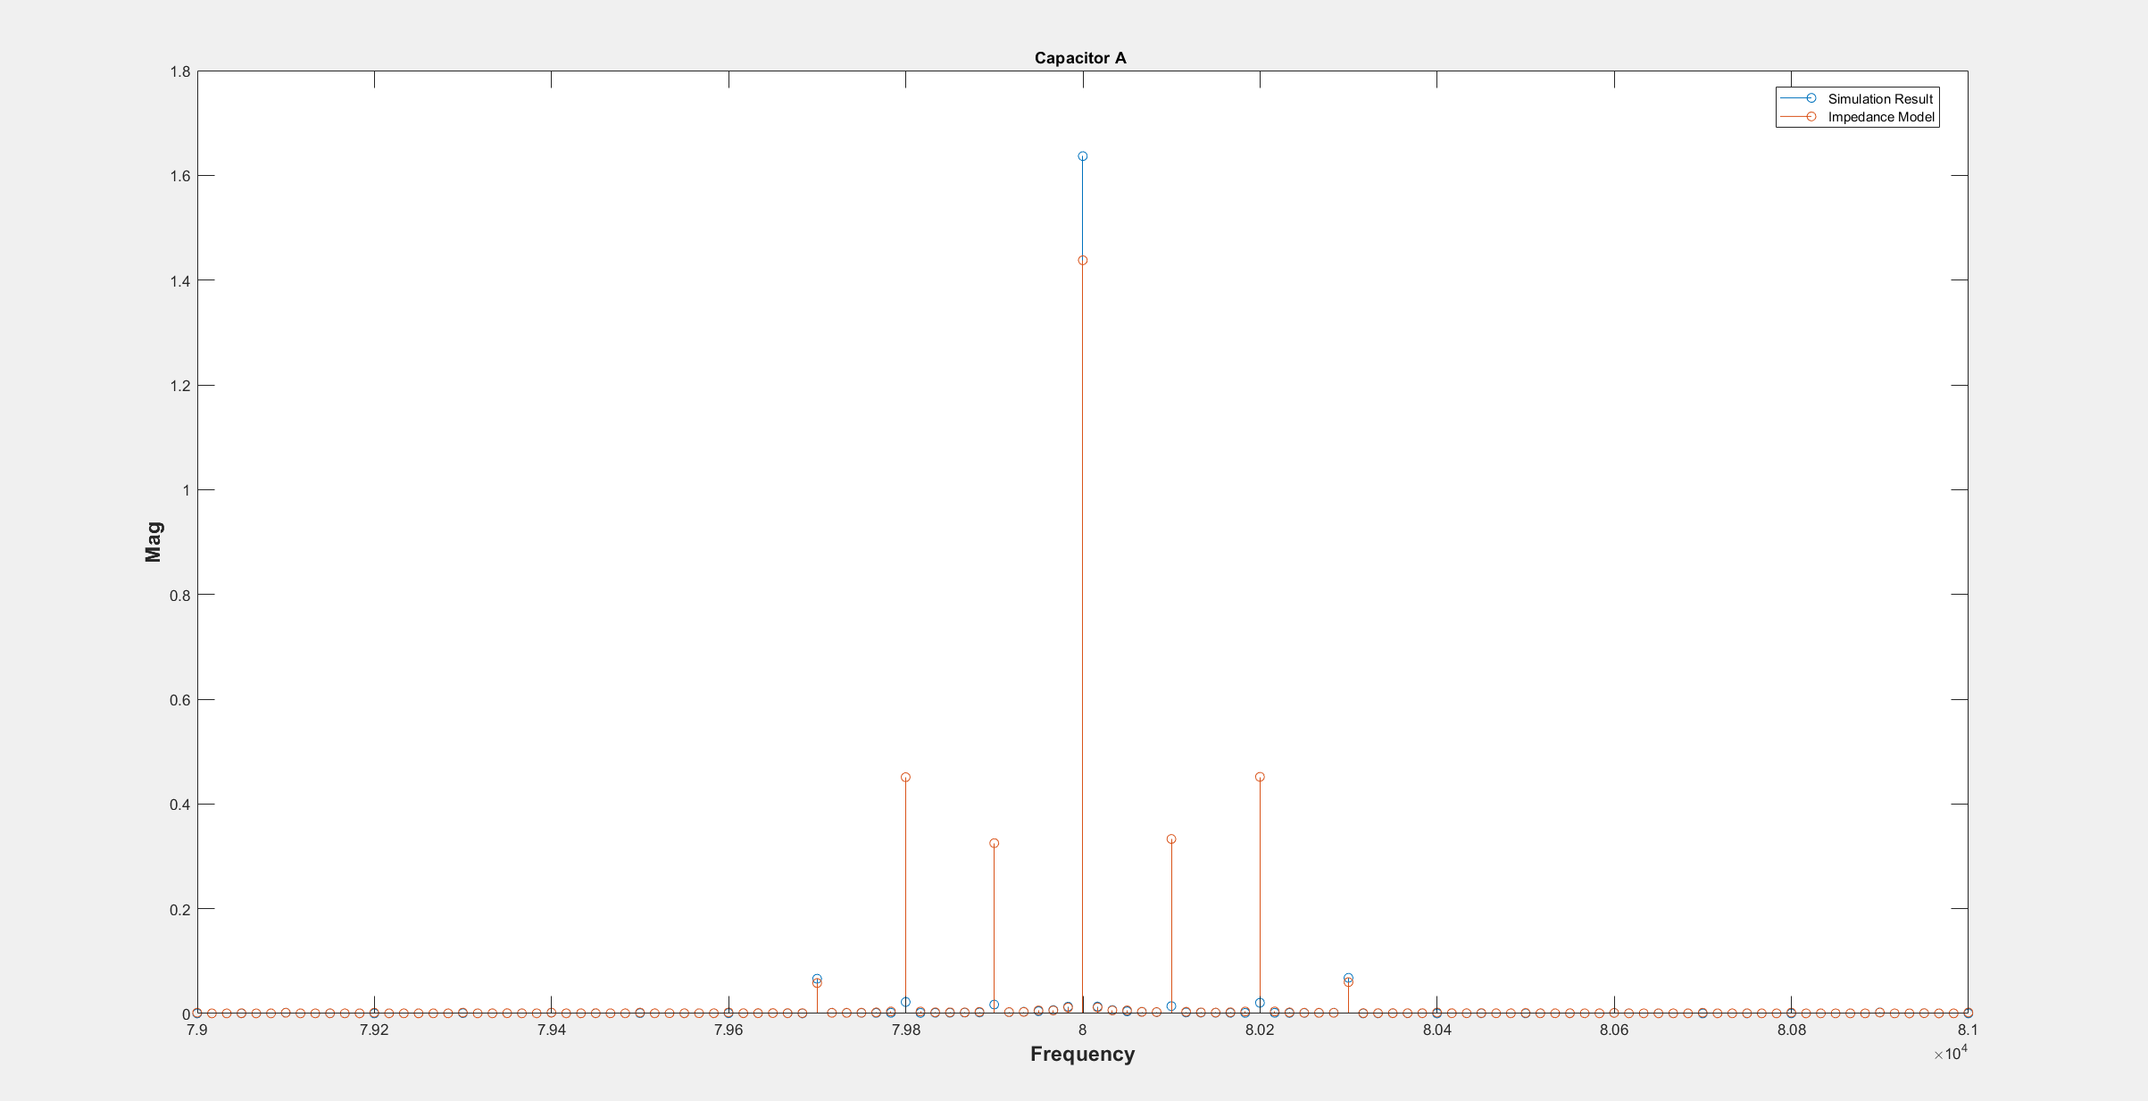

Slide 13
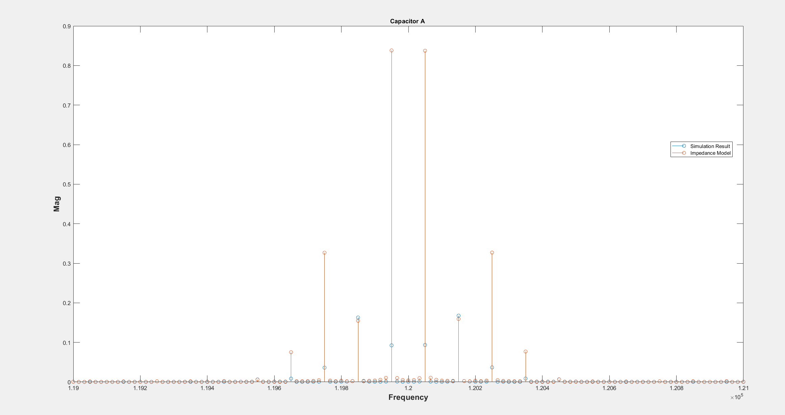

Slide 14
WHY does the impedance model give the false results!!!
We ignored the input
The current distribution is not valid if the input side has a current ripple.
We should integrate the input side to impedance model

