Slide 1
AC to DC Inductive Power Transfer with Power Factor Correction

Slide 2
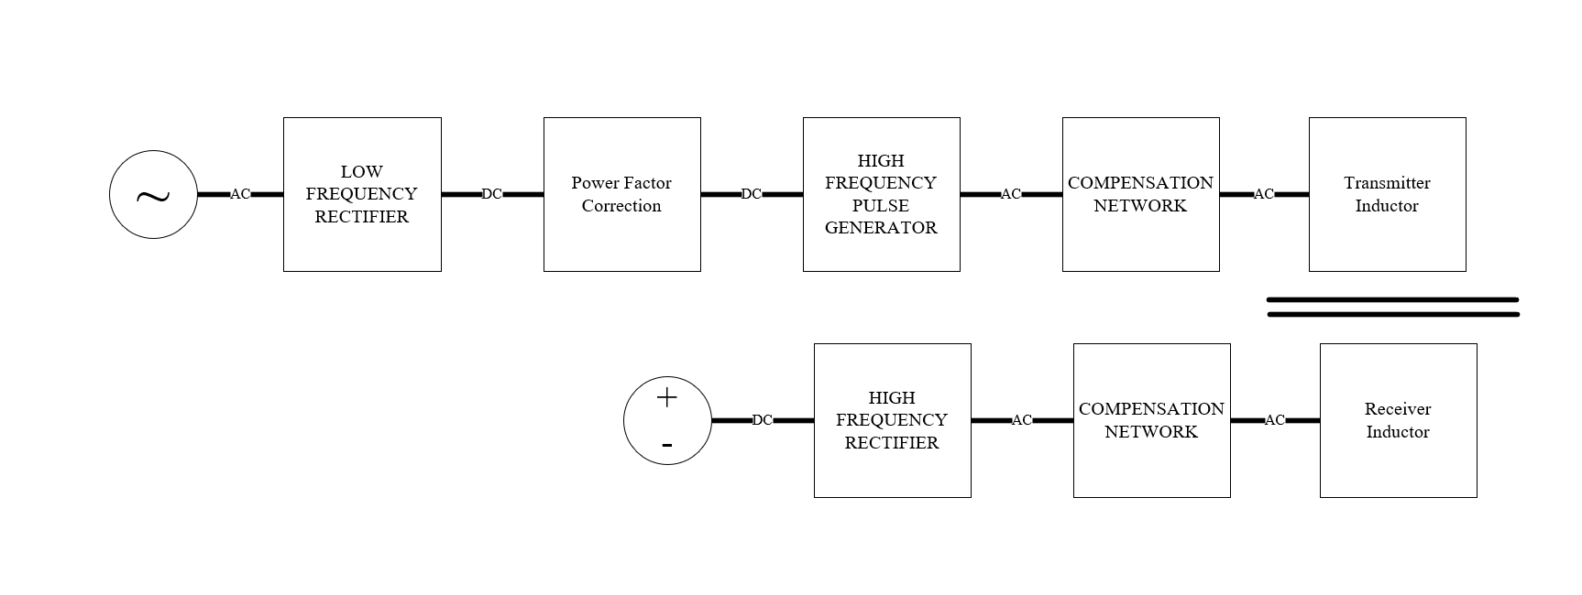
General block diagram of AC-to-Dc conversion.

Slide 3
Aim :
LF-Rectifier, PFC and Pulse Generator can be combined to obtain a design with :
lower cost
lower loss
lower semiconductor devices.
Higher Efficiency

Slide 4
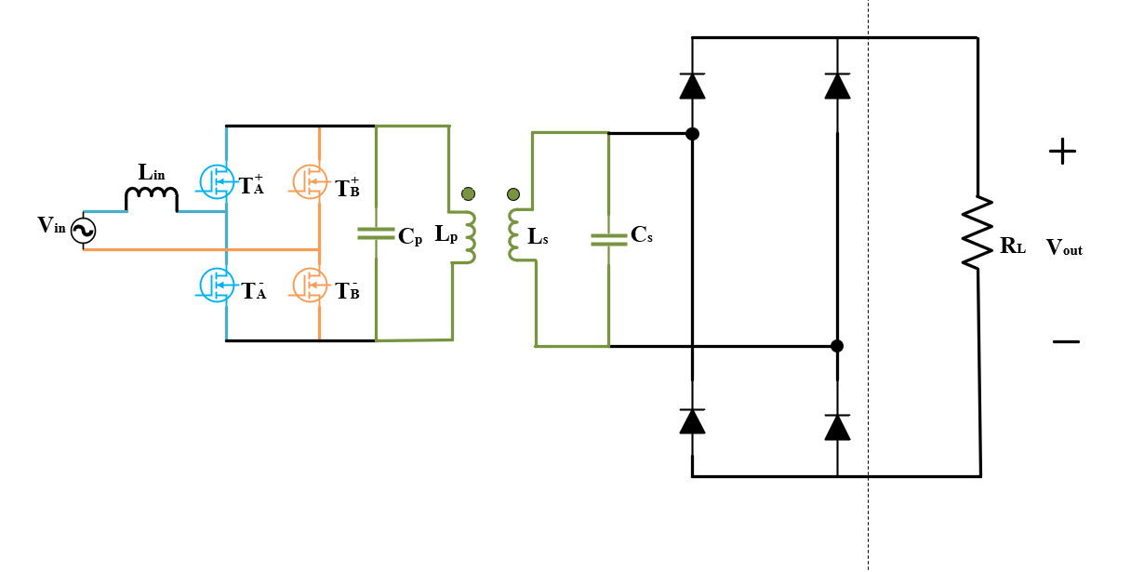
Proposed-Design

Slide 5
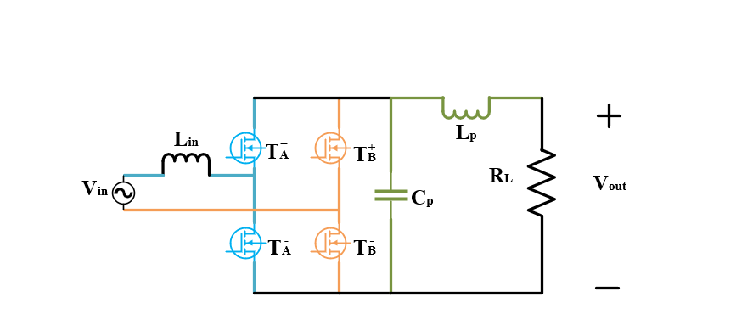
Simplified-Design

Slide 6
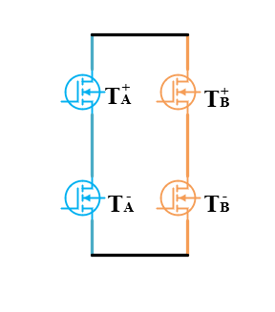
Switching Conditions
High Frequency Switch
Gan or SiC devices
ZVS
Low Frequency Switch
Low conduction resistance
Low cost

Slide 7
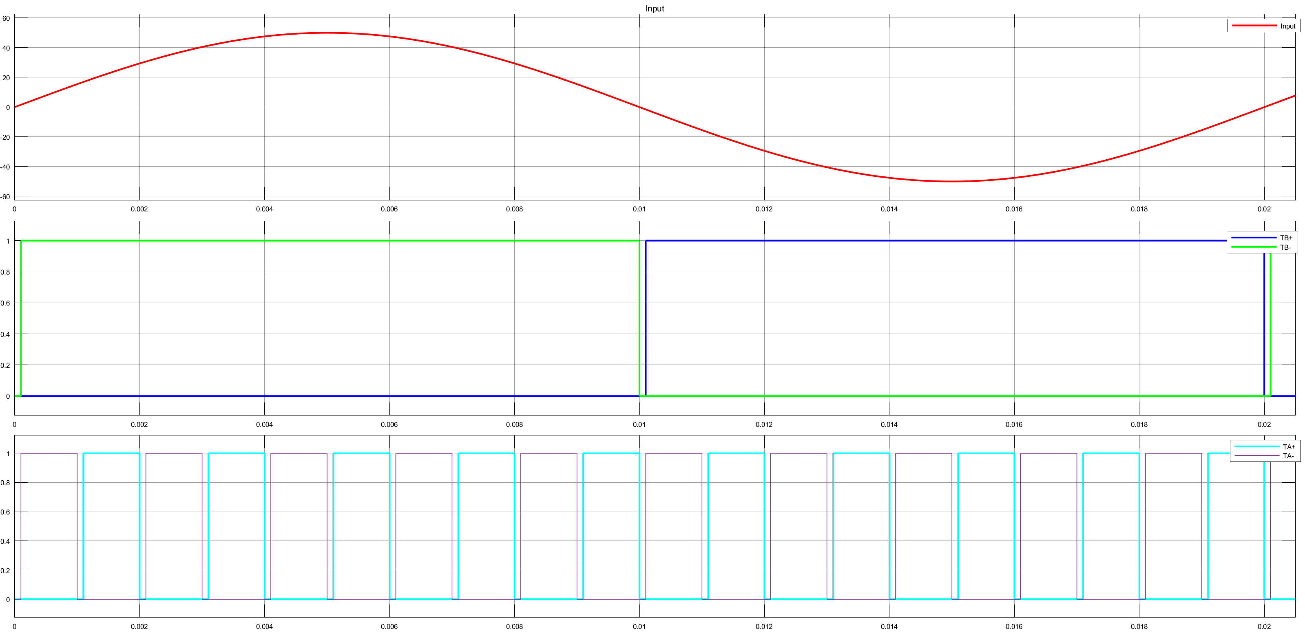

Slide 8
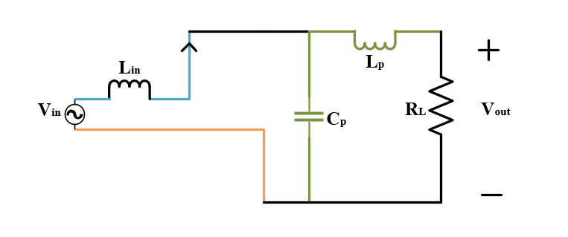
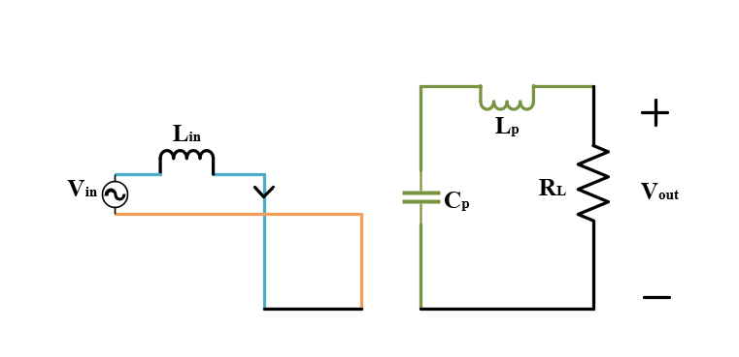


$T_{B}^{−}$ is on and $T_{A}^{+}$ is on
$T_{B}^{−}$ is on and $T_{A}^{−}$ is on

Slide 9
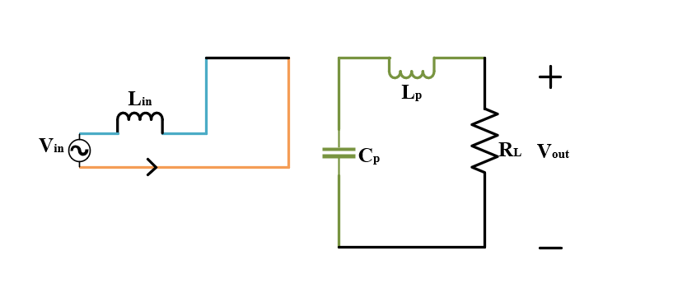
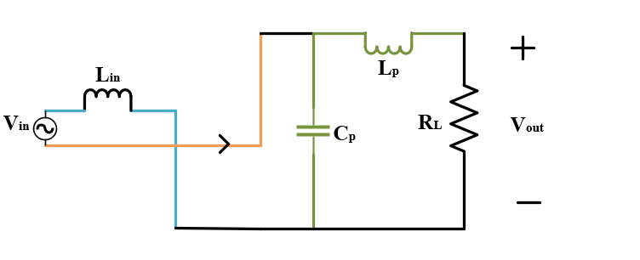


$T_{B}^{+}$ is on and $T_{A}^{+}$ is on
$T_{B}^{+}$ is on and $T_{A}^{−}$ is on

