Slide 1
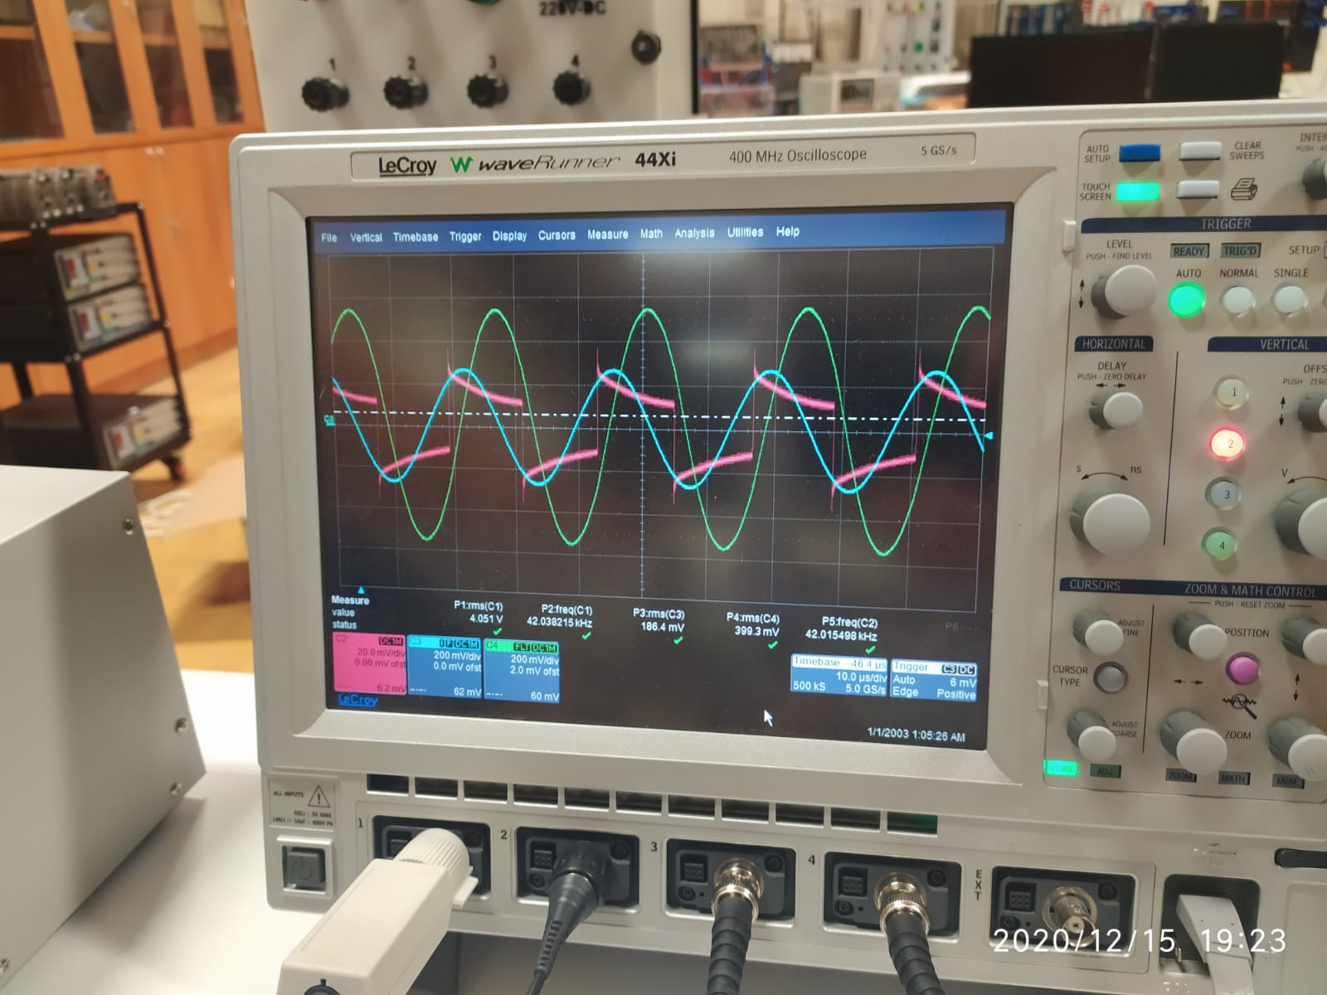
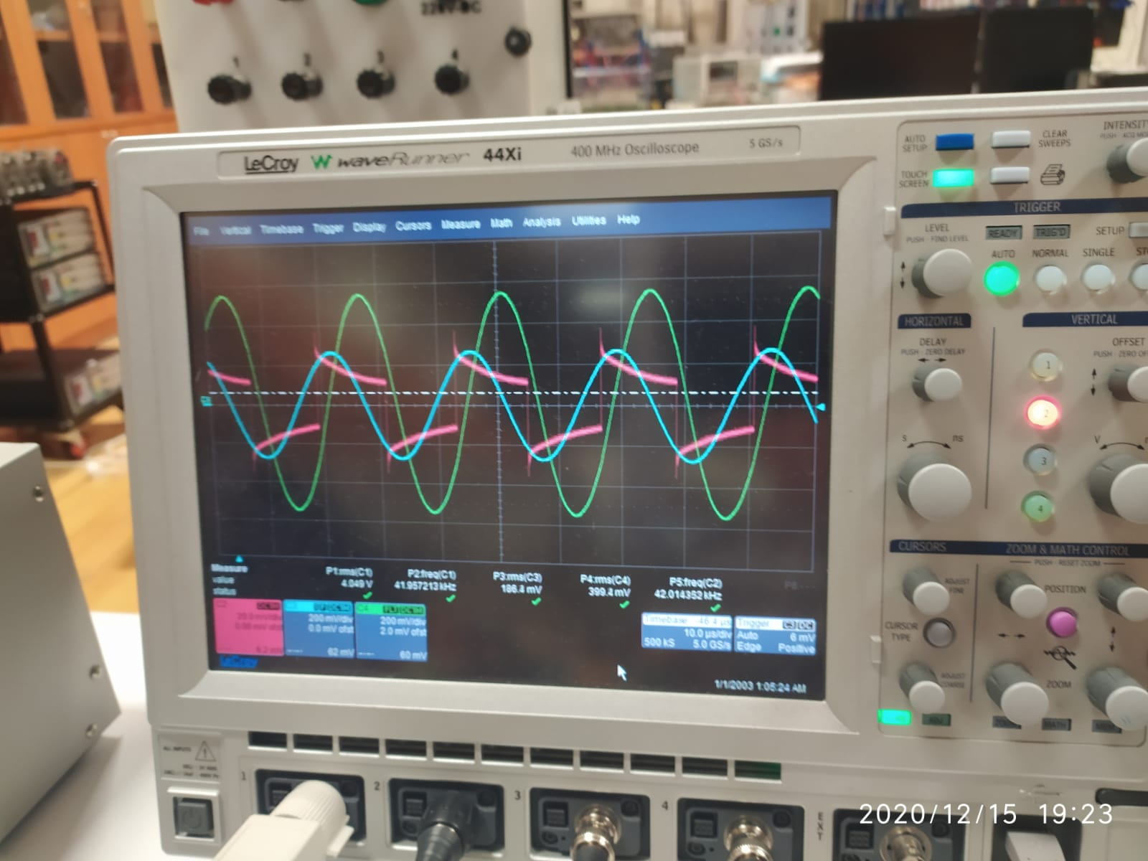

Slide 2
ma=0.95;
ffund=50;
fsw=20e3;
wr=fsw*2*pi;
Tfinal=0.20;
SampleTime=(1/fsw)/100;
Vdc=24;
C_DC=10e-9;
Rload= 1.8586;
LLoad=1e-3;
Lp=120e-6;
Ls=120e-6;
M=24e-6;
RL=12;
Cp=1/(4*wr^2*Lp);
Cs=1/(4*wr^2*Ls);
LSource= 1e-9;
RSource= 1e-9;
LCAHA= 1e-9;
LHACB= 1e-9;
LCBHB= 1e-9;
COUT=100e-6;

Slide 3
DC BUS

Slide 8
MOTOR

Slide 10
WPT

Slide 12
ma=0.8;
ffund=50;
fsw=20e3;
wr=fsw*2*pi;
Tfinal=0.20;
SampleTime=(1/fsw)/100;
Vdc=24;
C_DC=10e-9;
Rload= 1.8586;
LLoad=1e-3;
Lp=120e-6;
Ls=120e-6;
M=24e-6;
RL=12;
Cp=1/(4*wr^2*Lp);
Cs=1/(4*wr^2*Ls);
LSource= 1e-9;
RSource= 1e-9;
LCAHA= 1e-9;
LHACB= 1e-9;
LCBHB= 1e-9;
COUT=100e-6;

Slide 13
DC BUS

Slide 18
MOTOR

Slide 20
WPT

Slide 22
ma=0.5;
ffund=50;
fsw=20e3;
wr=fsw*2*pi;
Tfinal=0.20;
SampleTime=(1/fsw)/100;
Vdc=24;
C_DC=10e-9;
Rload= 1.8586;
LLoad=1e-3;
Lp=120e-6;
Ls=120e-6;
M=24e-6;
RL=12;
Cp=1/(4*wr^2*Lp);
Cs=1/(4*wr^2*Ls);
LSource= 1e-9;
RSource= 1e-9;
LCAHA= 1e-9;
LHACB= 1e-9;
LCBHB= 1e-9;
COUT=100e-6;

Slide 23
DC BUS

Slide 28
MOTOR

Slide 30
WPT

Slide 32
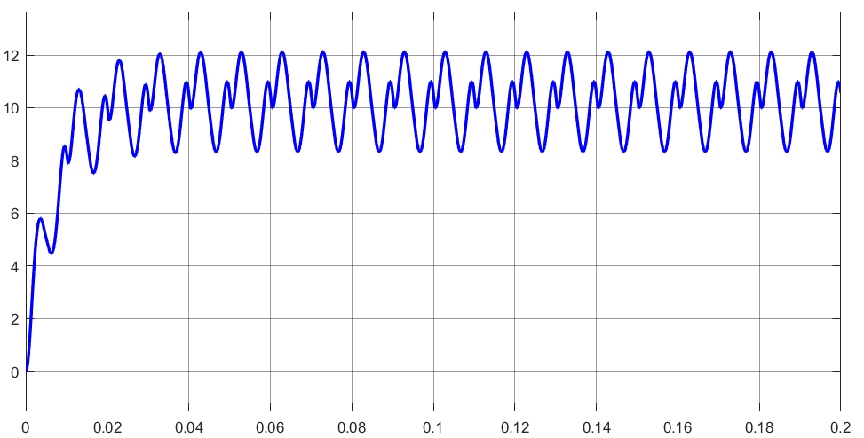
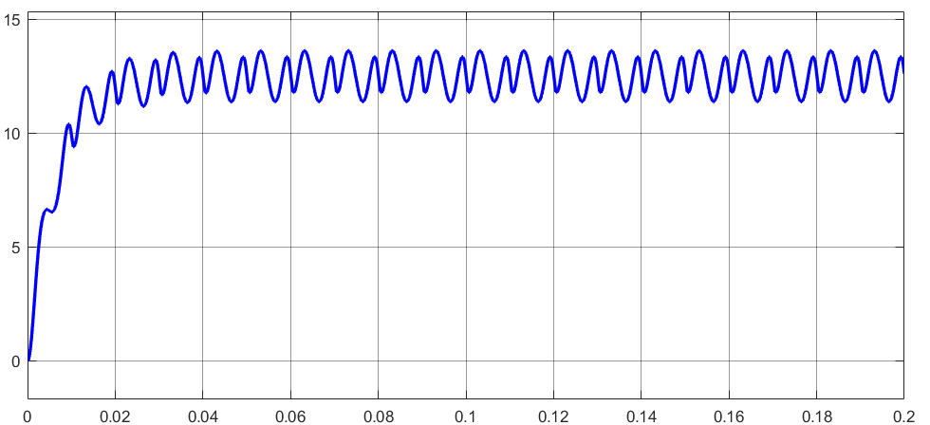
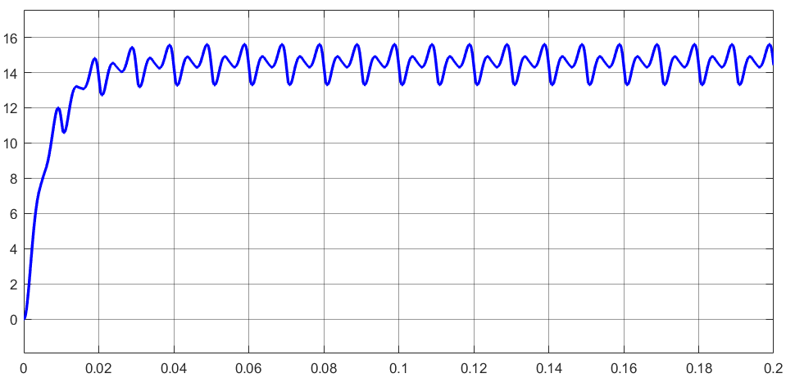
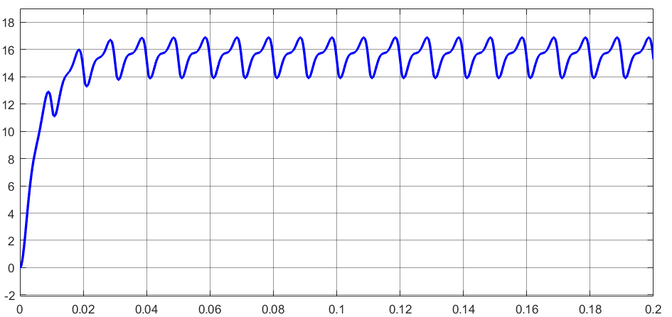
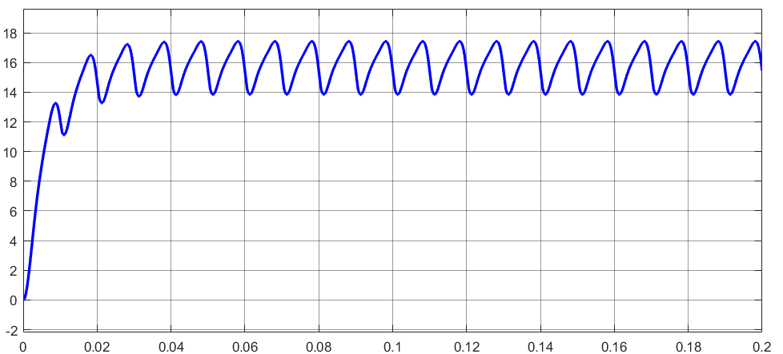
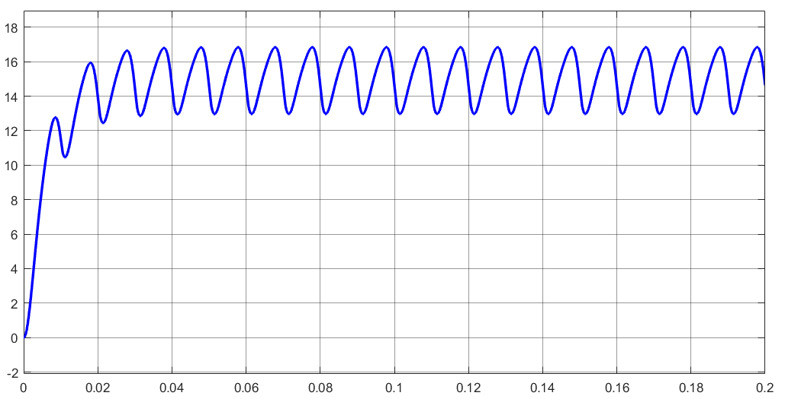
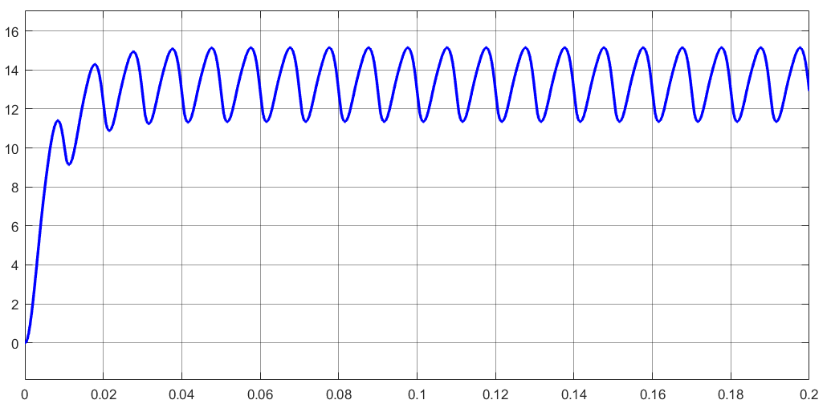
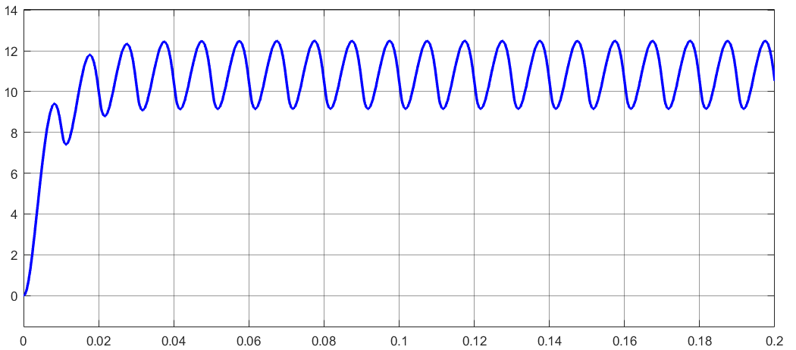
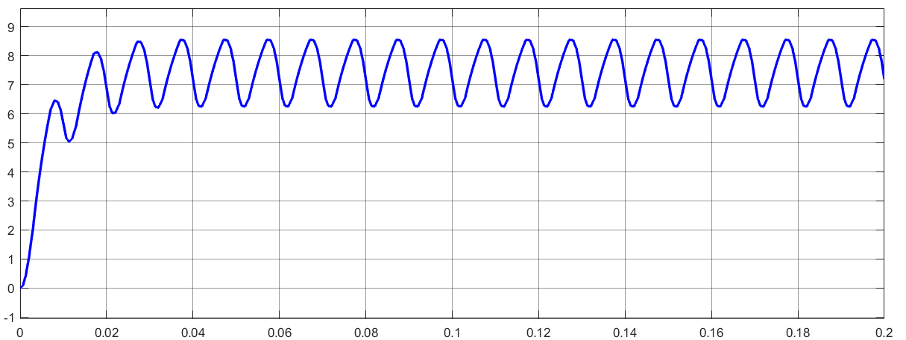
1- 0.9 - 0.8/
0.7- 0.6- 0.5/
0.4-0.3-0.2
OUTPUT

Slide 33
