Slide 1
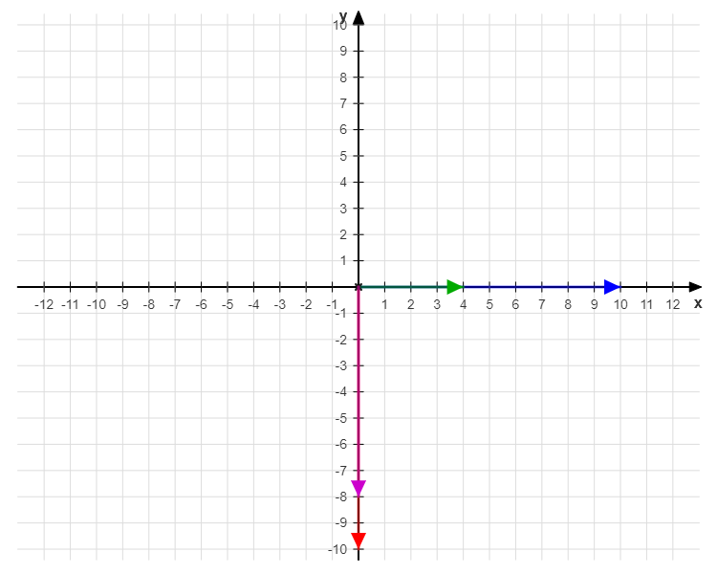





$$I_{p}$$
$$V_{in}$$
$$wM_{ps2 }I_{p}$$
$$V_{out}$$
$$wM_{ps1 }I_{p}$$

Slide 2
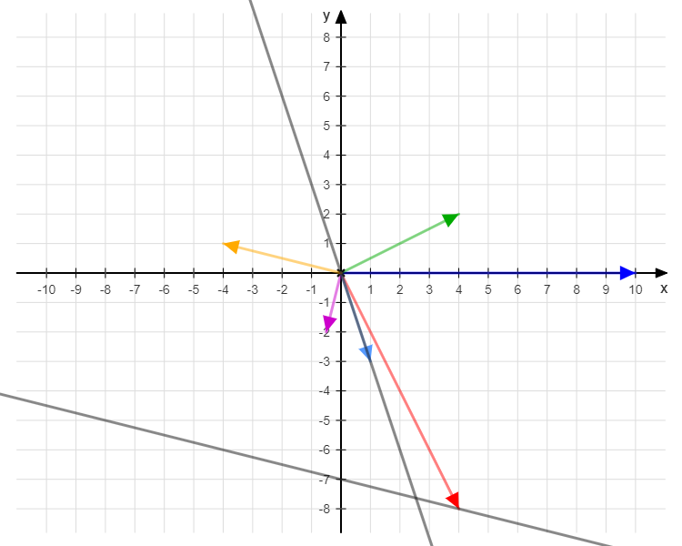








$$I_{p}$$
$$wM_{s }I_{s2}$$
$$V_{in}$$
$$I_{s2}$$
$$I_{s1}$$
$$Θ_{s2}$$
$$wM_{ps1 }I_{p}$$
$$V_{out}$$

Slide 3
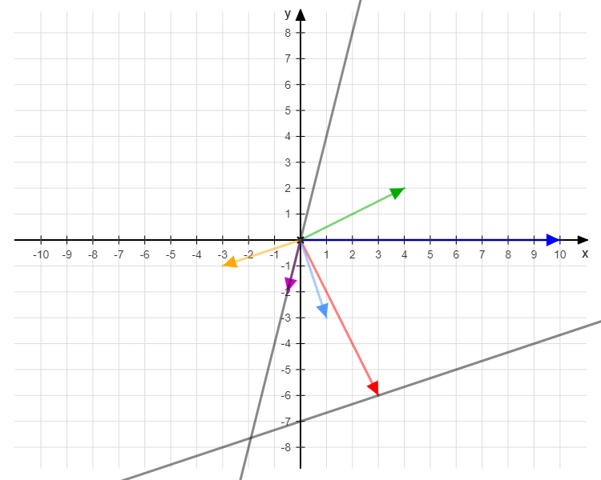








$$I_{p}$$
$$V_{in}$$
$$wM_{s }I_{s1}$$
$$I_{s2}$$
$$I_{s1}$$
$$wM_{ps2 }I_{p}$$
$$V_{out}$$
$$Θ_{s1}$$

Slide 4




$$V_{in}sin⁡(wt)$$
$$I_{p}sin⁡(wt−θ)$$
$$I_{s1}sin⁡(wt−α)$$
$$I_{s2}sin⁡(wt−β)$$
$$V_{in}\sin\left(wt\right)=−(wM_{1}I_{s1}\cos\left(wt−α\right)+wM_{2}I_{s2}cos⁡(wt−β))$$
Primer
$$wM_{1}I_{p}\cos\left(wt−θ\right)+wM_{s}I_{s2}\cos\left(wt−β\right)=V_{out}sin⁡(w_{t}−α)$$
Seconder
$$wM_{2}I_{p}\cos\left(wt−θ\right)+wM_{s}I_{s1}\cos\left(wt−α\right)=V_{out}sin⁡(w_{t}−β)$$

Slide 5
$$V_{in}\sin\left(wt\right)=−wM_{1}I_{s1}\left(\cos\left(α\right)\cos\left(wt\right)+\sin\left(α\right)\sin\left(wt\right)\right)−wM_{2}I_{s2}(\cos\left(β\right)\cos\left(wt\right)+\sin\left(β\right)sin⁡(wt))$$
$$wM_{1}I_{p}(\cos\left(θ\right)\cos\left(wt\right)+\sin\left(θ\right)sin⁡(wt))+wM_{s}I_{s2}(\cos\left(β\right)\cos\left(wt\right)+\sin\left(β\right)sin⁡(wt))=V_{out}(cos\left(α\right)\sin\left(wt\right)−\sin\left(α\right)cos⁡(wt))$$
$$wM_{2}I_{p}(\cos\left(θ\right)\cos\left(wt\right)+\sin\left(θ\right)sin⁡(wt))+wM_{s}I_{s1}(\cos\left(α\right)\cos\left(wt\right)+\sin\left(α\right)sin⁡(wt))=V_{out}(cos\left(β\right)\sin\left(wt\right)−\sin\left(β\right)cos⁡(wt))$$

Slide 6
$$V_{in}\sin\left(wt\right)=−wM_{1}I_{s1}\sin\left(α\right)\sin\left(wt\right)−wM_{2}I_{s2}\sin\left(β\right)sin⁡(wt)$$
Alfa beta
$$0=−wM_{1}I_{s1}\cos\left(α\right)\cos\left(wt\right)−wM_{2}I_{s2}\cos\left(β\right)\cos\left(wt\right)$$
$$wM_{1}I_{p}cos⁡(θ)\cos\left(wt\right)+wM_{s}I_{s2}\cos\left(β\right)\cos\left(wt\right)=−V_{out}\sin\left(α\right)cos⁡(wt)$$
$$wM_{1}I_{p}\sin\left(θ\right)\sin\left(wt\right)+wM_{s}I_{s2}\sin\left(β\right)sin⁡(wt)=V_{out}cos\left(α\right)\sin\left(wt\right)$$
theta ve Ms
$$wM_{2}I_{p}cos⁡(θ)\cos\left(wt\right)+wM_{s}I_{s1}\cos\left(α\right)\cos\left(wt\right)={−V}_{out}\sin\left(β\right)cos⁡(wt)$$
$wM_{2}I_{p}\sin\left(θ\right)\sin\left(wt\right)+wM_{s}I_{s1}\sin\left(α\right)sin⁡(wt)=V_{out}cos\left(β\right)$ $sin⁡(wt)$

Slide 7




$$V_{in}\sin\left(wt\right)=−wM_{1}I_{s1}\sin\left(α\right)\sin\left(wt\right)−wM_{2}I_{s2}\sin\left(β\right)sin⁡(wt)$$
$$0=−wM_{1}I_{s1}\cos\left(α\right)\cos\left(wt\right)−wM_{2}I_{s2}\cos\left(β\right)\cos\left(wt\right)$$
$$K_{1}=wM_{1}I_{s1}$$
$$K_{2}=wM_{2}I_{s2}$$
$K_{1}^{2}+K_{2}^{2}−2K_{1}K_{2}cos\left(180−abs(β)+abs(α)\right)=V_{in}^{2}$
$$cos\left(180−abs(β)+abs(α)\right)=\frac{{V_{in}^{2}−K_{1}^{2}−K}_{2}^{2}}{−2K_{1}K_{2}}$$
$$\left(180−abs(β)+abs(α)\right)=arccos(\frac{{V_{in}^{2}−K_{1}^{2}−K}_{2}^{2}}{−2K_{1}K_{2}})$$

Slide 8
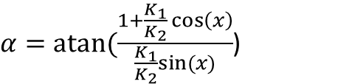

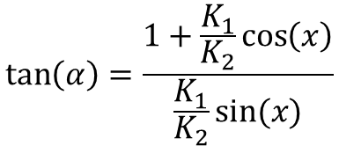

$$\frac{cos\left(α\right)}{\cos\left(β\right)} =−\frac{wM_{1}I_{s1}}{wM_{2}I_{s2}}$$
x1=$\left(180−β+α\right)=arccos(\frac{{V_{in}^{2}−K_{1}^{2}−K}_{2}^{2}}{−2K_{1}K_{2}})$
$x=$180-x1
$$\frac{cos\left(α\right)}{\cos\left(x+a\right)} =−\frac{wM_{1}I_{s1}}{wM_{2}I_{s2}}$$
$$\tan\left(α\right)=\frac{1+\frac{K_{1}}{K_{2}}\cos\left(x\right)}{\frac{K_{1}}{K_{2}}sin⁡(x)}$$
$α=atan⁡(\frac{1+\frac{K_{1}}{K_{2}}\cos\left(x\right)}{\frac{K_{1}}{K_{2}}sin⁡(x)}$)

Slide 9
$$wM_{1}I_{p}cos⁡(θ)\cos\left(wt\right)+wM_{s}I_{s2}\cos\left(β\right)\cos\left(wt\right)=−V_{out}\sin\left(α\right)cos⁡(wt)$$
$$wM_{1}I_{p}\sin\left(θ\right)\sin\left(wt\right)+wM_{s}I_{s2}\sin\left(β\right)sin⁡(wt)=V_{out}cos\left(α\right)\sin\left(wt\right)$$
$$wM_{2}I_{p}cos⁡(θ)\cos\left(wt\right)+wM_{s}I_{s1}\cos\left(α\right)\cos\left(wt\right)={−V}_{out}\sin\left(β\right)cos⁡(wt)$$
$wM_{2}I_{p}\sin\left(θ\right)\sin\left(wt\right)+wM_{s}I_{s1}\sin\left(α\right)sin⁡(wt)=V_{out}cos\left(β\right)$ $sin⁡(wt)$

