Slide 1
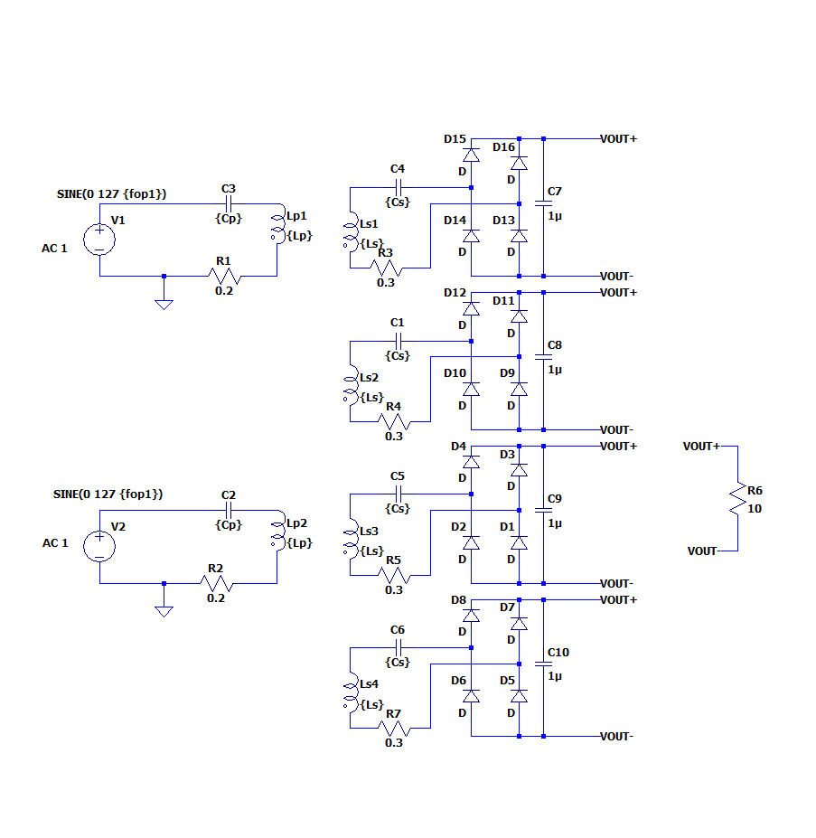
As in the right circuit diagram from LTSpice,
We have 4 secondary modules which are connected a common DC Bus and they are coupled with two primaries.
Each secondary can be coupled with one or two primaries because our system is mechanically rotated.
We will investigate two conditions, named as ‘aligned’ and ‘misaligned’.
Aligned means that each secondary is coupled with only one primary.
Misaligned means that two secondaries are coupled with two primaries and other secondaries are coupled with a primaries.
In misaligned situation, the total coupling factor is smaller than aligned.

Slide 2
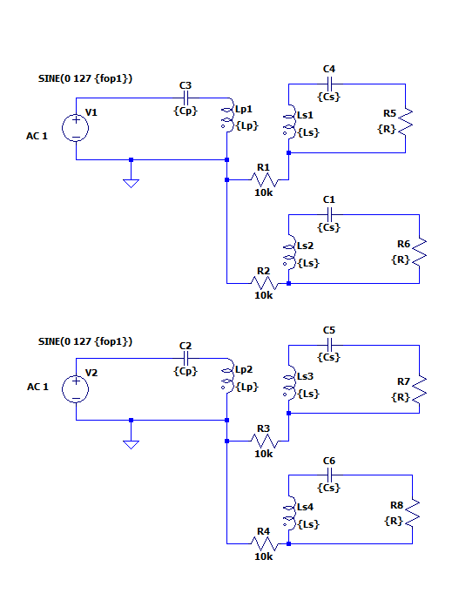
The load from rectifier can be modelled as resistance at AC side. For aligned and perfectly symmetrical system, we observe that each module has equal resistance. We know that resistance voltages are the same due to common bus. Thus, the current is distributed equal for ideal case.

Slide 3
%% FILL INFORMATION BELOW
Vin=90; %V (rms)
Vout=100; %V (rms)
P_o=500; %W
Qs=4; % unitless
f=150e3; %Hz
res_w=2*pi*f; %rad/sec
k=0.23; % chosen coupling factor
%% Calculation
R_L=(10*8/pi^2)*2;
Vout=sqrt(P_o*R_L); %load resistance
% R_L=10.3;
Ls=Qs*R_L/res_w; % secondary coil inductance
Is_rms= Vout/(R_L); %secondary current
Is_rms2= sqrt(P_o/R_L);
Ip_rms= P_o/Vin; % primary current assuming eff=1
M=Is_rms*R_L/(res_w*Ip_rms); %calculated mutual inductance
k_c=(2/Qs)*sqrt(1-1/(Qs*Qs))/sqrt(2); %critical coupling factor
Lp=M^2/(k^2*Ls); %primary inductance
Cp=1/(res_w^2*Lp); %primary compansation
Cs=1/(res_w^2*Ls); %secondary compansation
Lp=10^6*Lp;
Ls=10^6*Ls;
M=10^6*M;
For this aligned and ideal case, we consider only primary to secondary mutual inductances and self inductances.
the analytical model of the design for this case is written in the left ‘matlab code’.
The code gives the capacitance value, self inductances and primary to secondary mutual inductances.

Slide 4
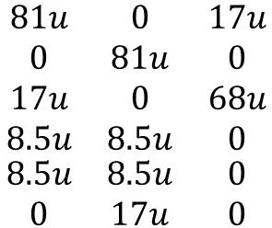
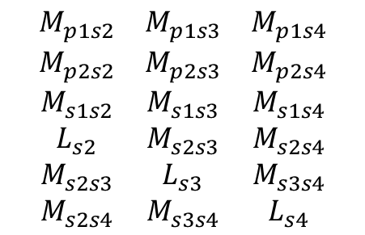
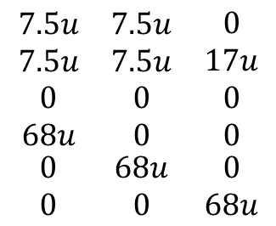
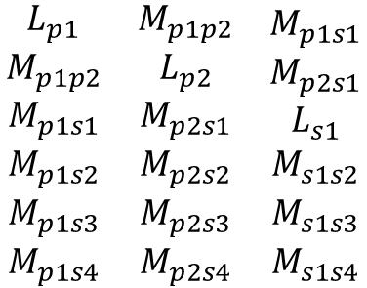
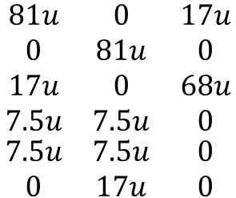
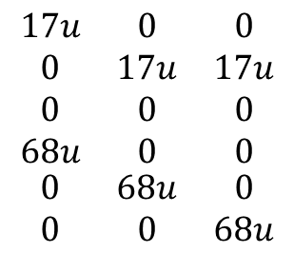
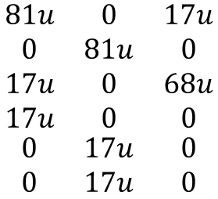
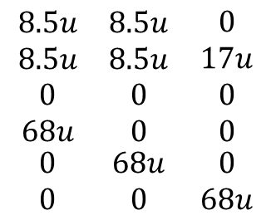
$$\begin{matrix}\begin{aligned}L_{p1} \\ M_{p1p2} \\ M_{p1s1} \\ M_{p1s2}\end{aligned} & \begin{aligned}M_{p1p2} \\ L_{p2} \\ M_{p2s1} \\ M_{p2s2}\end{aligned} & \begin{aligned}M_{p1s1} \\ M_{p2s1} \\ L_{s1} \\ M_{s1s2}\end{aligned} \\ M_{p1s3} & M_{p2s3} & M_{s1s3} \\ M_{p1s4} & M_{p2s4} & M_{s1s4}\end{matrix}$$
$$\begin{matrix}\begin{aligned}M_{p1s2} \\ M_{p2s2} \\ M_{s1s2} \\ L_{s2}\end{aligned} & \begin{aligned}M_{p1s3} \\ M_{p2s3} \\ M_{s1s3} \\ M_{s2s3}\end{aligned} & \begin{aligned}M_{p1s4} \\ M_{p2s4} \\ M_{s1s4} \\ M_{s2s4}\end{aligned} \\ M_{s2s3} & L_{s3} & M_{s3s4} \\ M_{s2s4} & M_{s3s4} & L_{s4}\end{matrix}$$
$$\begin{matrix}\begin{aligned}17u \\ 0 \\ 0 \\ 68u\end{aligned} & \begin{aligned}0 \\ 17u \\ 0 \\ 0\end{aligned} & \begin{aligned}0 \\ 17u \\ 0 \\ 0\end{aligned} \\ 0 & 68u & 0 \\ 0 & 0 & 68u\end{matrix}$$
$$\begin{matrix}\begin{aligned}81u \\ 0 \\ 17u \\ 17u\end{aligned} & \begin{aligned}0 \\ 81u \\ 0 \\ 0\end{aligned} & \begin{aligned}17u \\ 0 \\ 68u \\ 0\end{aligned} \\ 0 & 17u & 0 \\ 0 & 17u & 0\end{matrix}$$
The design algorithm gives only the self inductances and primary to secondary inductances at aligned position. For misaligned inductance matrices can be transformed by using aligned model.
The total mutual inductance (90 percent) is smaller for misaligned modules due to the transition between two primaries. To test the design, we use three inductance matrices. One is for aligned, other two are for misaligned. One of the misaligned is for ideal case (Total mutual is constant). Other one is realistic which gives decrement of the total mutual for misaligned coils.
$$\begin{matrix}\begin{aligned}81u \\ 0 \\ 17u \\ 7.5u\end{aligned} & \begin{aligned}0 \\ 81u \\ 0 \\ 7.5u\end{aligned} & \begin{aligned}17u \\ 0 \\ 68u \\ 0\end{aligned} \\ 7.5u & 7.5u & 0 \\ 0 & 17u & 0\end{matrix}$$
$$\begin{matrix}\begin{aligned}7.5u \\ 7.5u \\ 0 \\ 68u\end{aligned} & \begin{aligned}7.5u \\ 7.5u \\ 0 \\ 0\end{aligned} & \begin{aligned}0 \\ 17u \\ 0 \\ 0\end{aligned} \\ 0 & 68u & 0 \\ 0 & 0 & 68u\end{matrix}$$
$$\begin{matrix}\begin{aligned}81u \\ 0 \\ 17u \\ 8.5u\end{aligned} & \begin{aligned}0 \\ 81u \\ 0 \\ 8.5u\end{aligned} & \begin{aligned}17u \\ 0 \\ 68u \\ 0\end{aligned} \\ 8.5u & 8.5u & 0 \\ 0 & 17u & 0\end{matrix}$$
$$\begin{matrix}\begin{aligned}8.5u \\ 8.5u \\ 0 \\ 68u\end{aligned} & \begin{aligned}8.5u \\ 8.5u \\ 0 \\ 0\end{aligned} & \begin{aligned}0 \\ 17u \\ 0 \\ 0\end{aligned} \\ 0 & 68u & 0 \\ 0 & 0 & 68u\end{matrix}$$

Slide 5
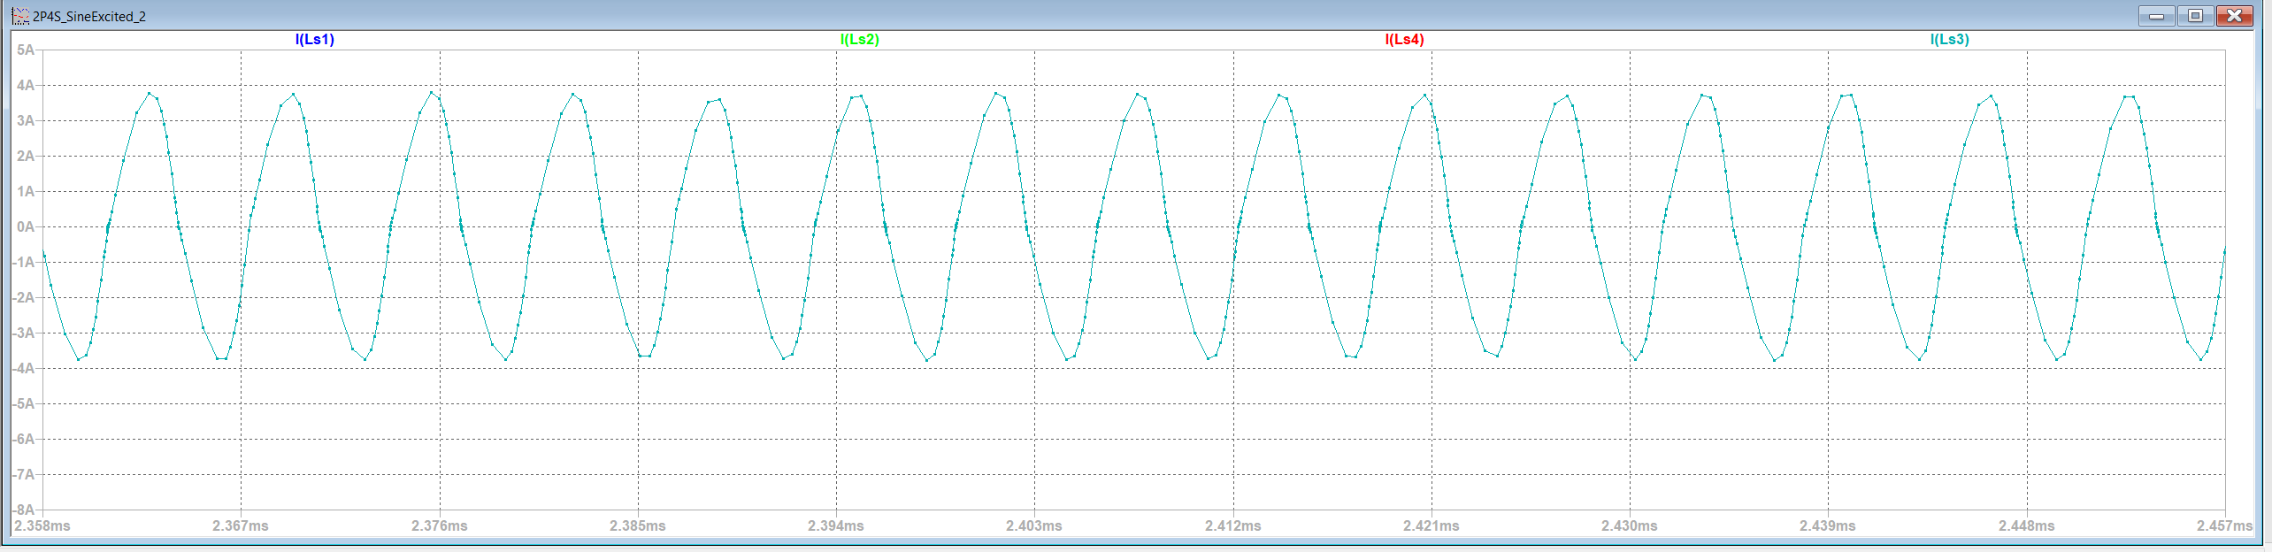
For aligned current distribution
Each module shares the currents as equal.

Slide 6
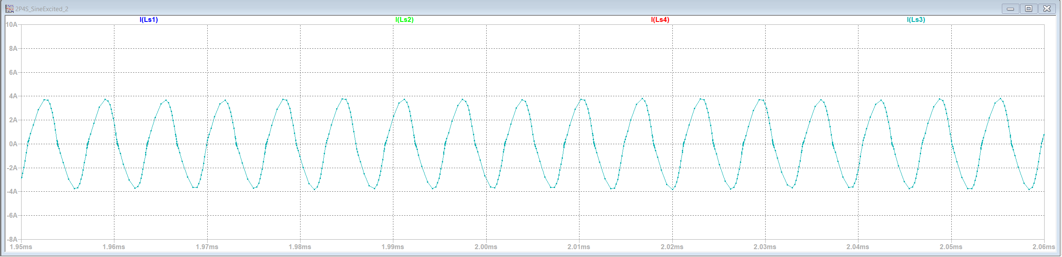
For misaligned current distribution(Ideal)
Each module shares the currents as equal. Also, we observe that nothing is changing. Thus, the ideal misaligned is the same as aligned situation.

Slide 7
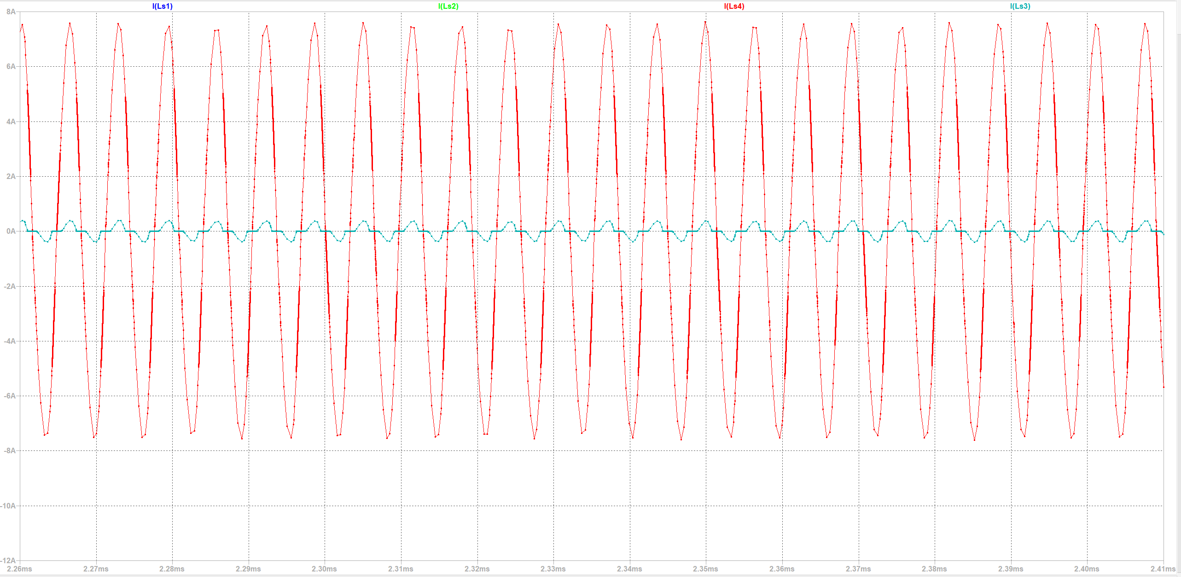
For misaligned current distribution(Realistic)
For this case, we observe that two modules which total mutuals bigger transfer the all power. Thus, the four modules can not be used at this point.

Slide 8
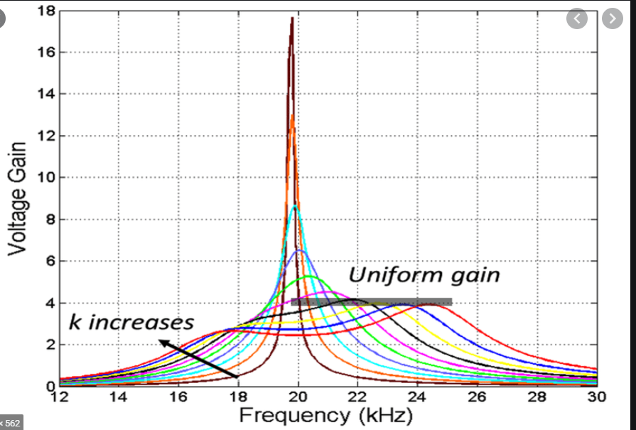
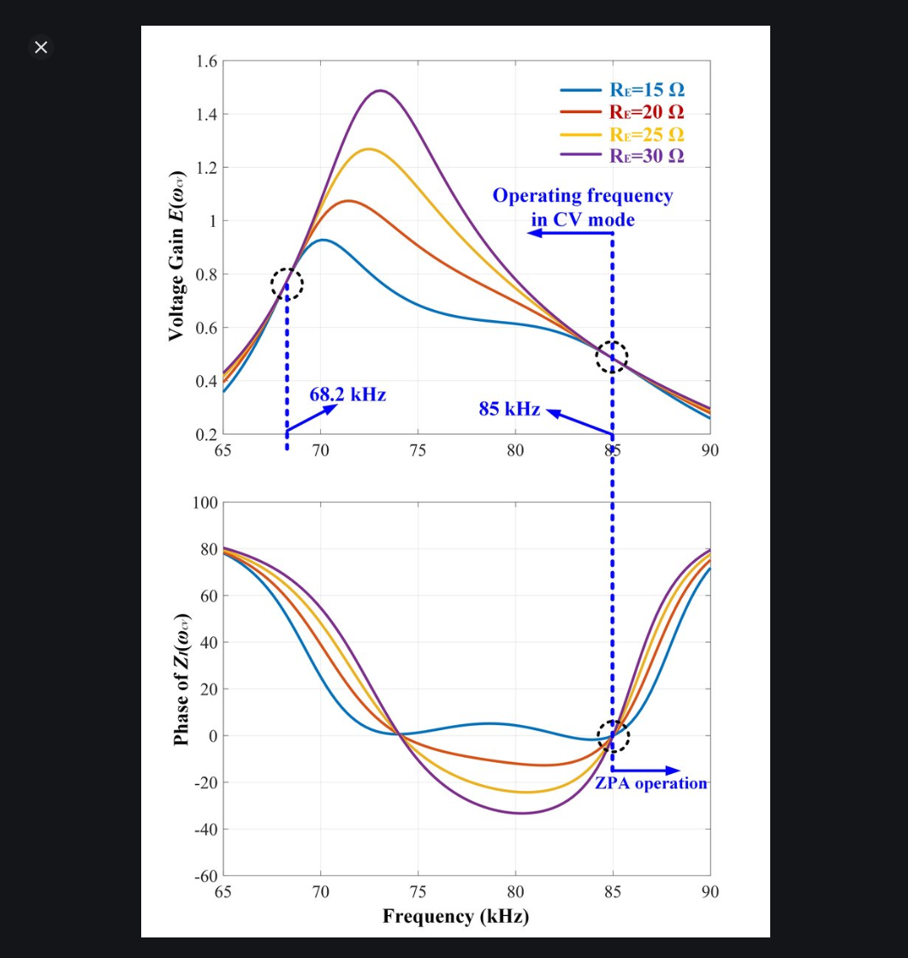
Thus !!!!
In ideal case, the modules sees the equal resistance. With same coupling and resistance means that the same operation. However, the coupling chanes the operation point and also the resistance it sees.

Slide 9
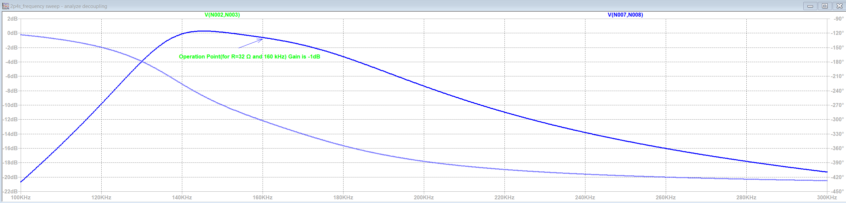
Each module has the same frequency response. (Ideal case)

Slide 10
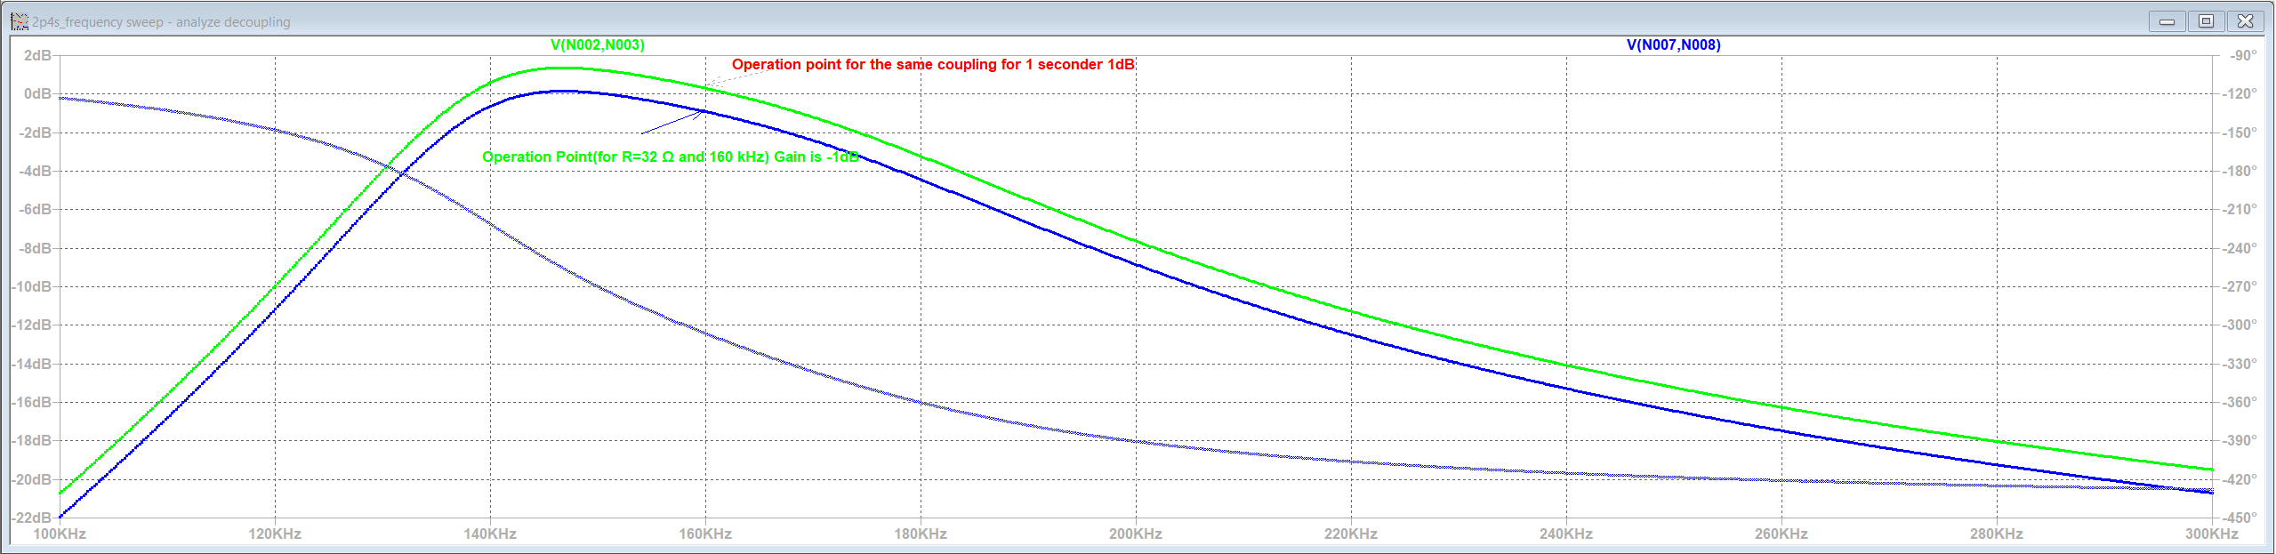
Operation point is changed. The modules which have higher coupling gives more gain if the resistance would be the same.

Slide 11
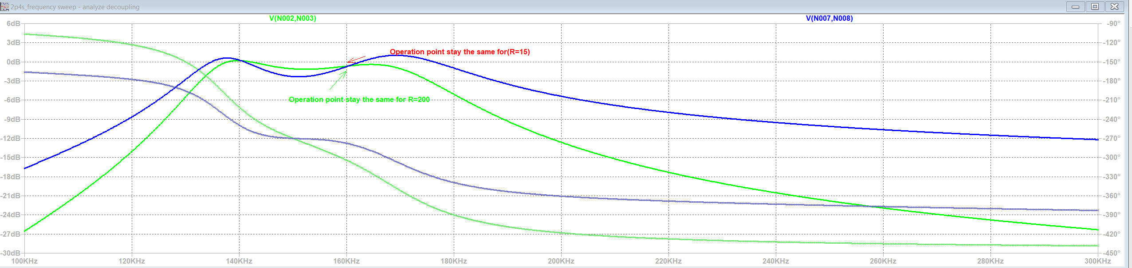
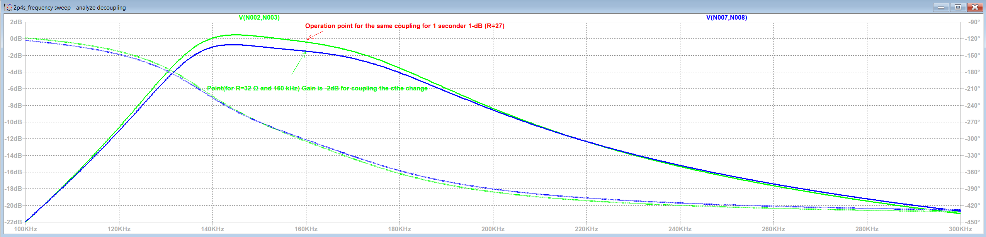
The rectifier effects the resistance change. Thus, the more coupled modules see the lower resistance for the same output voltage. Inversely, the more loosely coupled modules sees the higher resistance. So, the mor coupled modules transfers the most of the output power.

Slide 12
Solution:
We observe that negative coupling between the secondary coils decreases the effect of the rectifier and modules are prone to distribute equal current in theis case.
Negative coupling between secondaries is realistic and it has already exist for our inductor design.
However, How much should the coupling factor be?

Slide 13
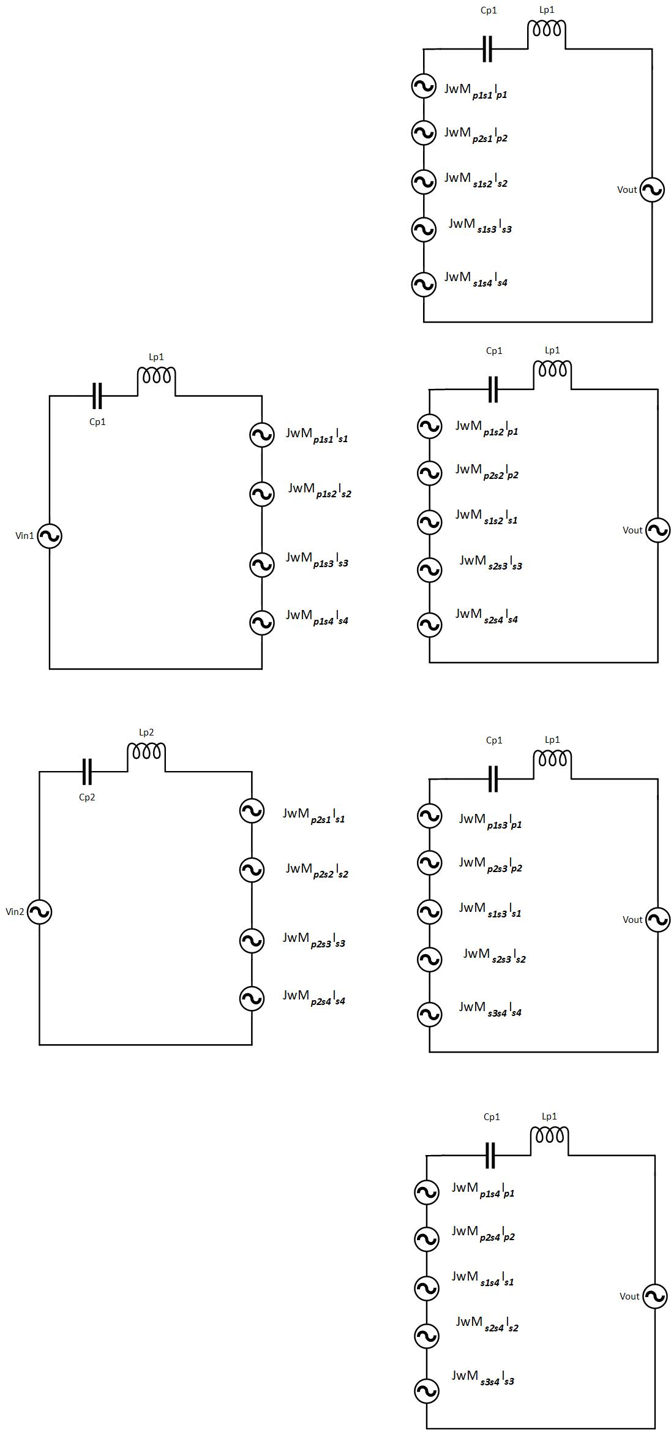
Actually, the mutual inductances can be modelled as voltage sources.
The voltage sources is affected by mutual inductances and currents.
In our model, the voltage sources can be deleted for situation of secondaries.(Aligned or misaligned)
And also, we can invesitage only two secondaries and one primaries thanks to symetry.

Slide 14
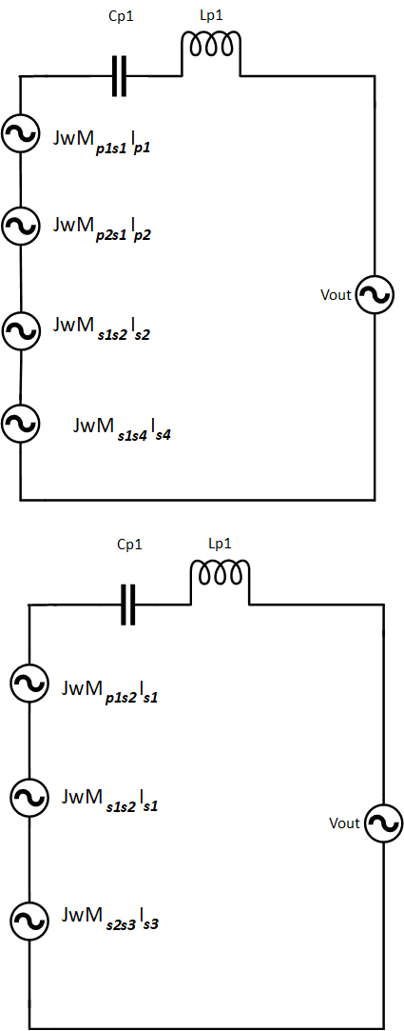
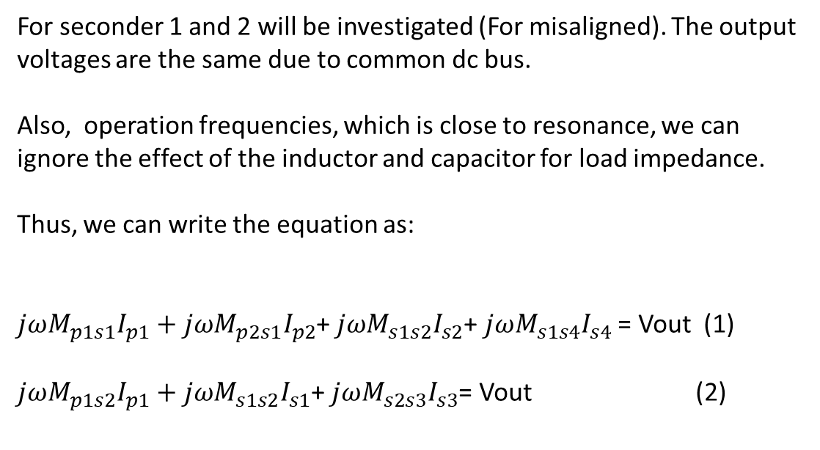
For seconder 1 and 2 will be investigated (For misaligned). The output voltages are the same due to common dc bus.
Also, operation frequencies, which is close to resonance, we can ignore the effect of the inductor and capacitor for load impedance.
Thus, we can write the equation as:
$jωM_{p1s1}I_{p1}+jωM_{p2s1}I_{p2}$+ $jωM_{s1s2}I_{s2}$+ $jωM_{s1s4}I_{s4}$ = Vout (1)
$jωM_{p1s2}I_{p1}+jωM_{s1s2}I_{s1}$+ $jωM_{s2s3}I_{s3}$= Vout (2)

Slide 15
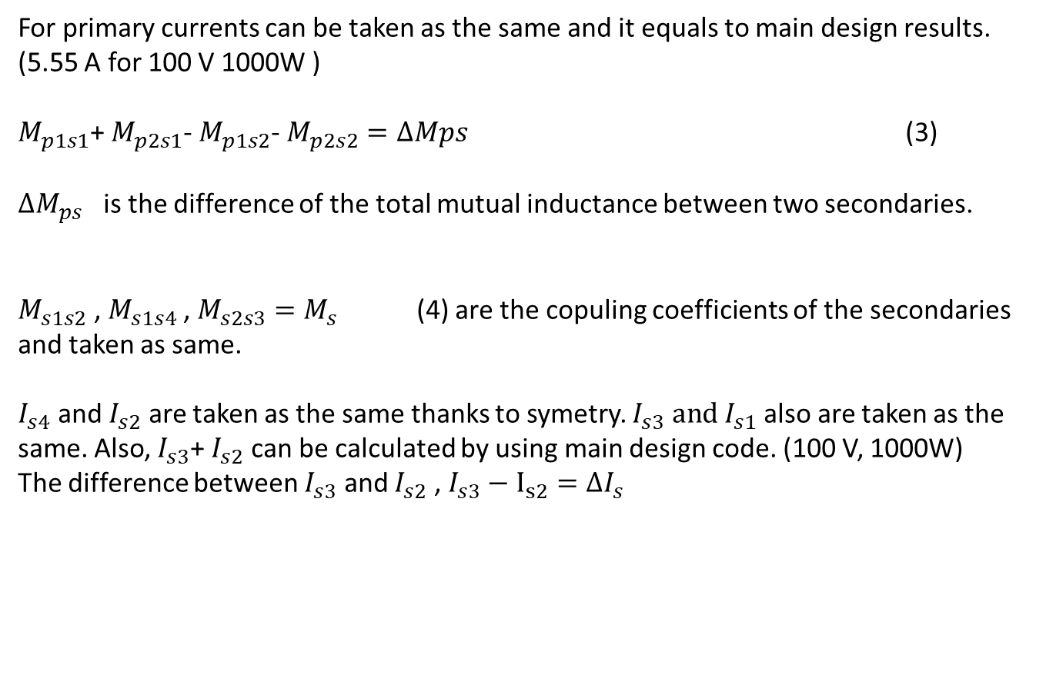
For primary currents can be taken as the same and it equals to main design results. (5.55 A for 100 V 1000W )
$M_{p1s1}$+ $M_{p2s1}$- $M_{p1s2}$- $M_{p2s2}=ΔMps$ (3)
$ΔM_{ps}$ is the difference of the total mutual inductance between two secondaries.
$M_{s1s2}$ , $M_{s1s4}$ , $M_{s2s3}=M_{s}$ (4) are the copuling coefficients of the secondaries and taken as same.
$I_{s4}$ and $I_{s2}$ are taken as the same thanks to symetry. $I_{s3} and I_{s1}$ also are taken as the same. Also, $I_{s3}$+ $I_{s2}$ can be calculated by using main design code. (100 V, 1000W)
The difference between $I_{s3}$ and $I_{s2}$ , $I_{s3}−$ $I_{s2}=ΔI_{s}$

Slide 16
From the equation 1 and 2
$jωM_{p1s1}I_{p1}+jωM_{p2s1}I_{p2}$+ $jωM_{s1s2}I_{s2}$+ $jωM_{s1s4}I_{s4}$ = $jωM_{p1s2}I_{p1}+jωM_{ss3}I_{s1}$+ $jωM_{s2s3}I_{s3}$
We gives the $ΔMps \left(which is taken as 17μ−14.84μ=2.23μ\right),I_{p}$ is taken as 5.55 A. $ΔI_{s}$ is desired 1 $A_{rms } .$
$ΔMps I_{p}=2M_{s}$ ($ΔI_{s}$ )
$$M_{s}=ΔM_{ps} I_{p}/(2ΔI_{s})$$
Thus, we can calculate required coupling between the secondaries.

Slide 17
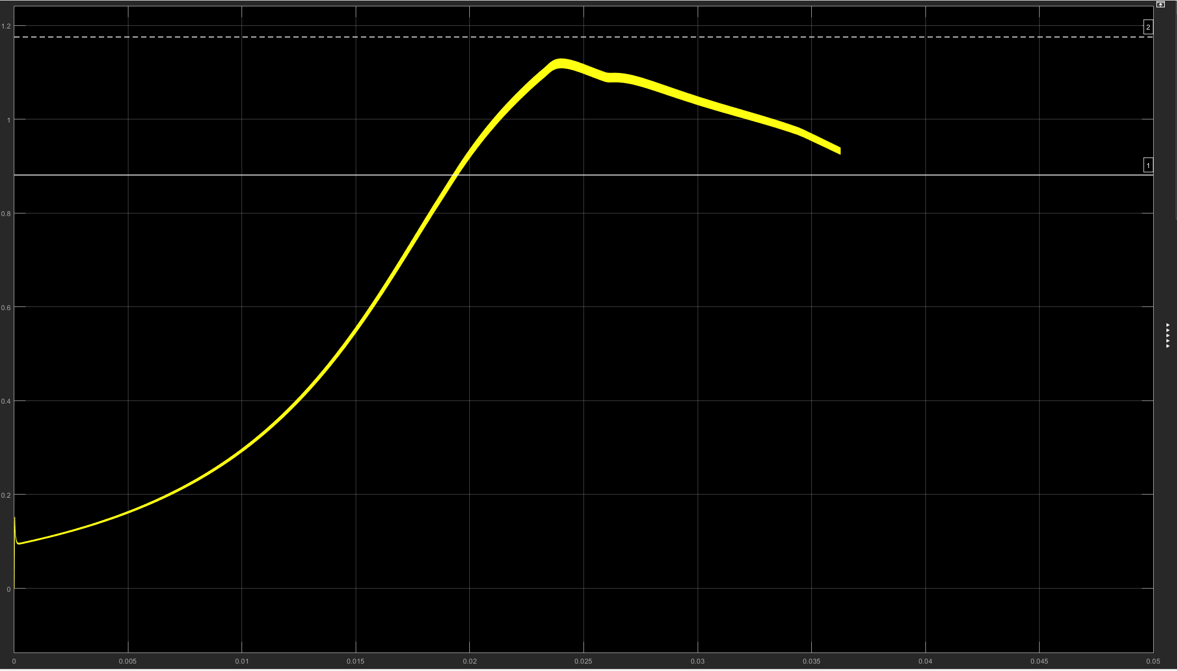
Ks=-0.06 Kp=-0.06

Slide 18
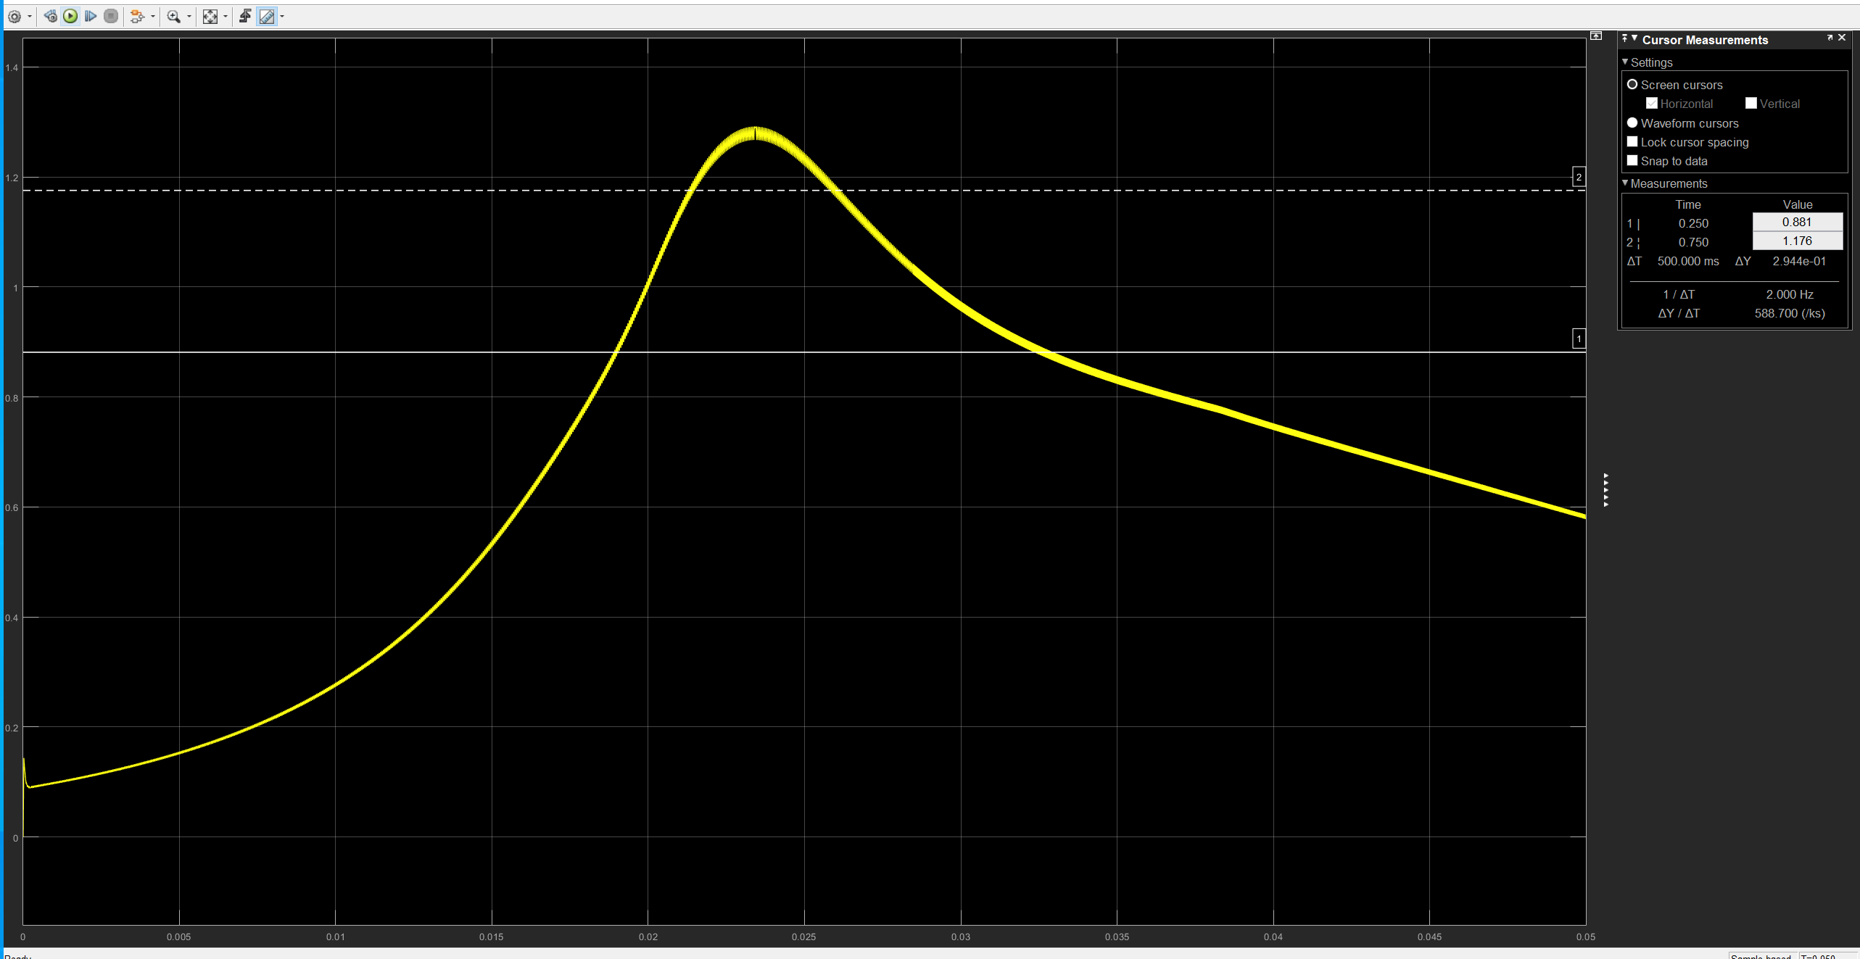
Ks=-0.12 Kp=-0.06

Slide 19
Inductor Design

Slide 20
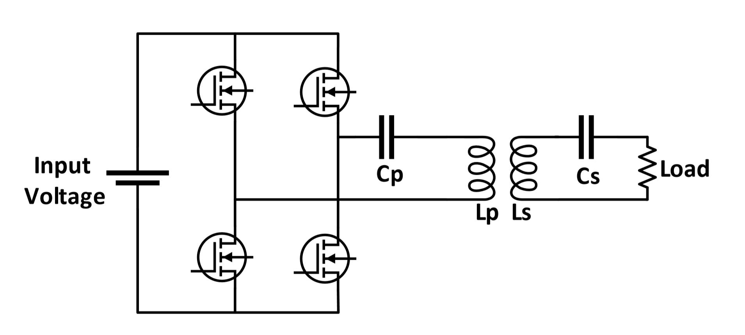
Series-Series Compensated Resonance Converter
Series-Series Compensated System :
Resonance Frequency is independent from load
Resonance Frequency is independent of coupling coefficient
However, no-load condition or very low mutual condition is a issue

Slide 21
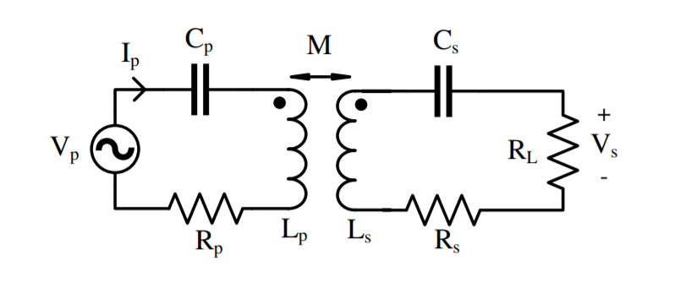
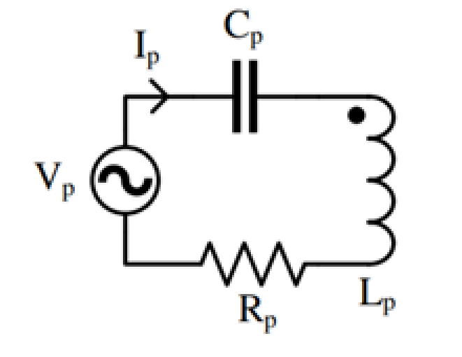
No load Condition
Short-circuited primary.
Actually, primary is not coupled with any load. Thus, the primer current at resonance frequency is restricted with only parasitic resistance and inductor resistance.

Slide 22
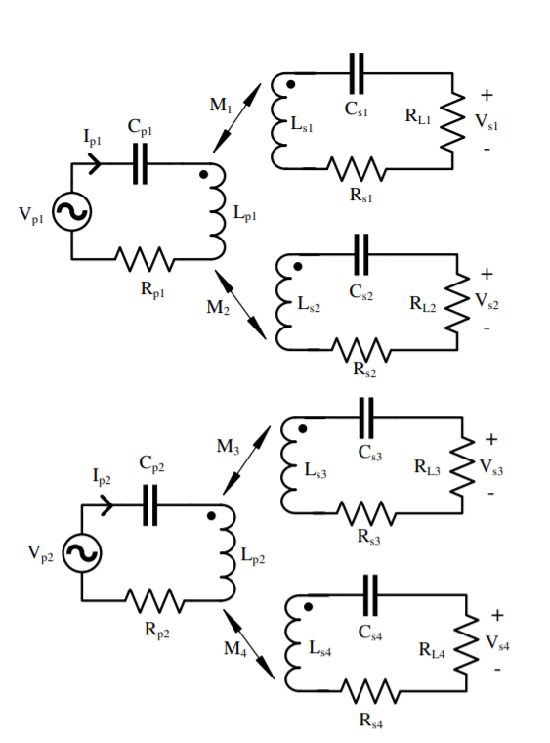
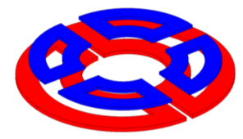
Solution for no-load condition
Modular Design :
2 Primary and 4 Secondary
A primary is coupled with at least two secondary.

Slide 23
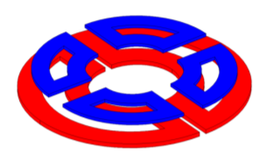
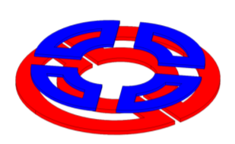
Rotational Misalignment
In our sytem, secondary side windings are rotated.
45°
Fully aligned secondaries with primaries. (0° )
Misaligned secondaries with primaries. (45°)
Thus, rotation does not cause a no-load condition for primary side.

Slide 24
Primary Winding
2 half circle with a hole for motor shaft
Why does not it have a circular shape ? Beacuse is it required to mount motor without any mechanical decomposition

Slide 25
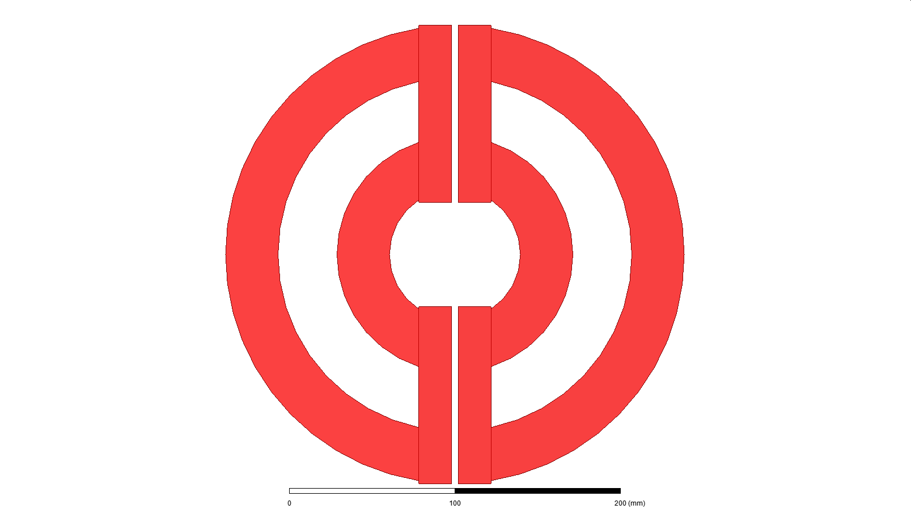
Formerly Proposed Design
Top view
(only windings)
Modular design
Primary windings can be thought as decoupled (0.05 coupling coefficient)
Not giving a constant flux
Flux is destroyed at transition between two primaries
Constant flux regions
Flux distortion region

Slide 26
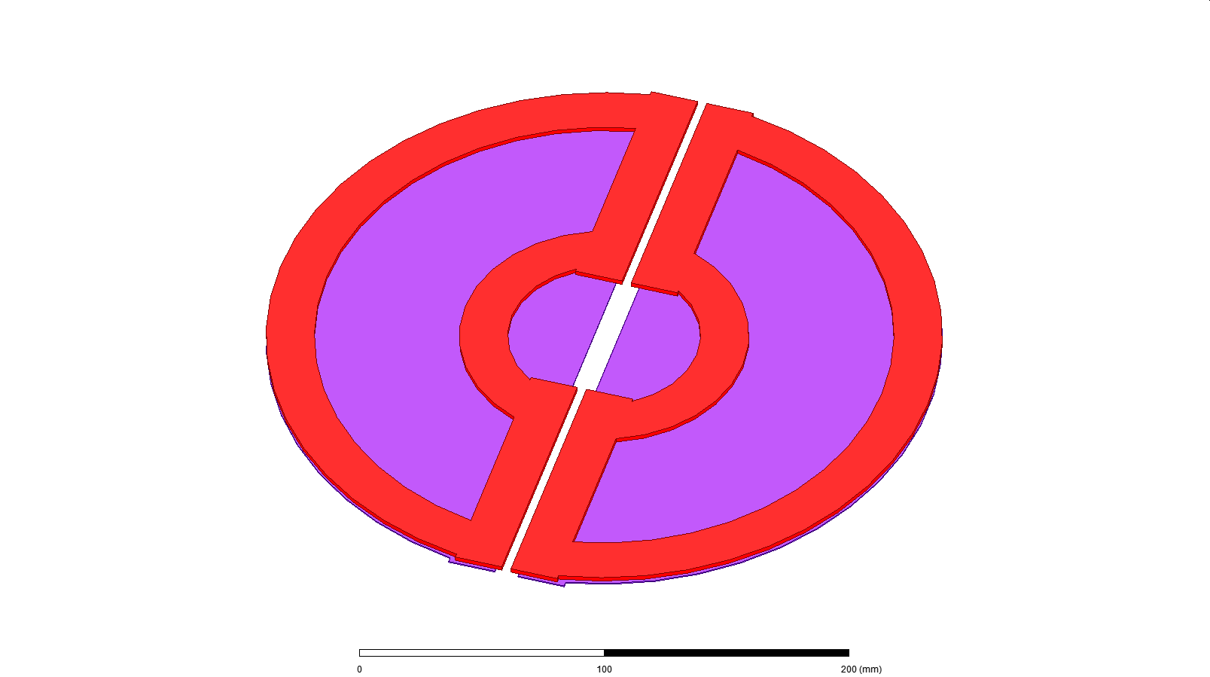
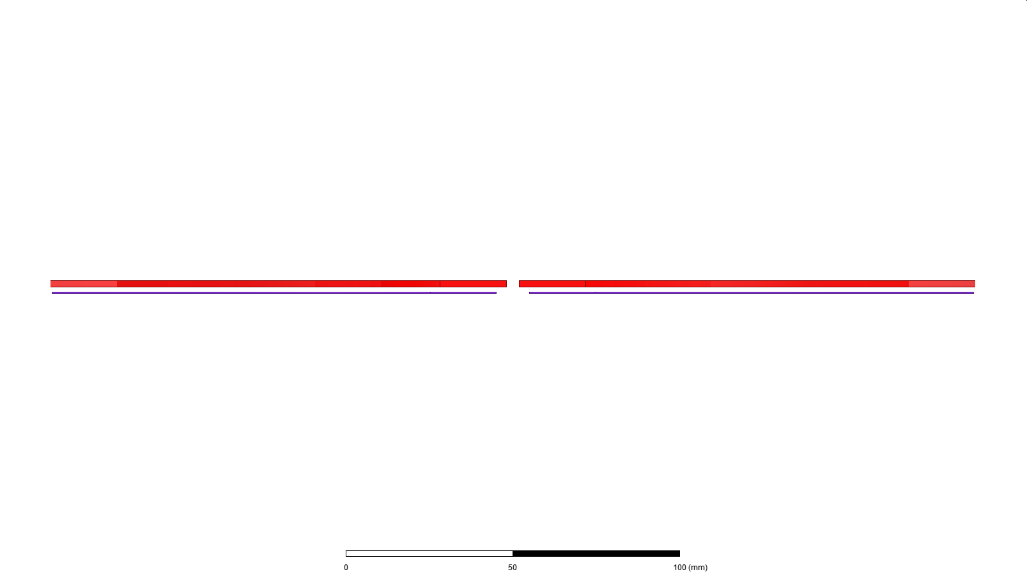
Winding(Red)
Ferrite(Purple)
Sideview

Slide 27
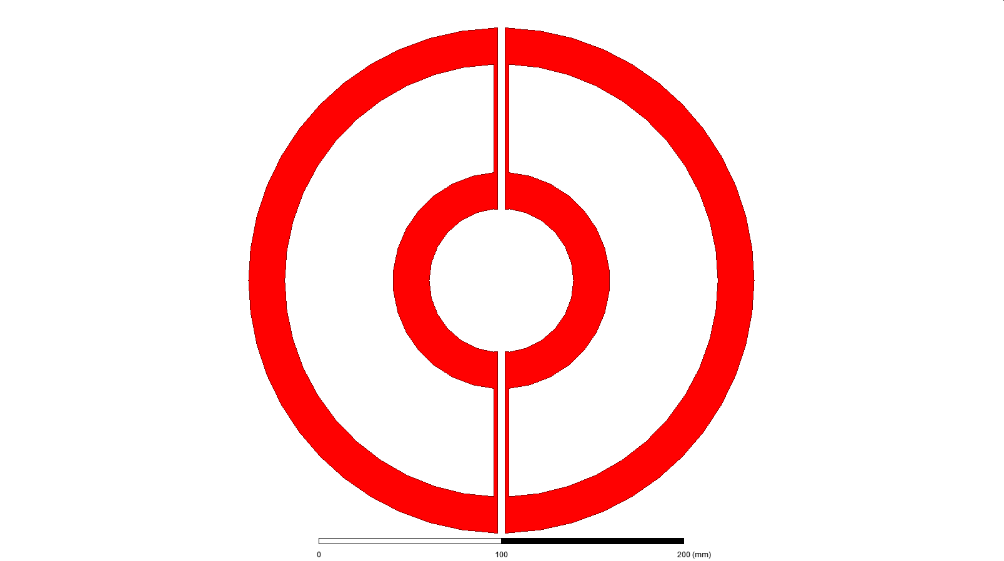
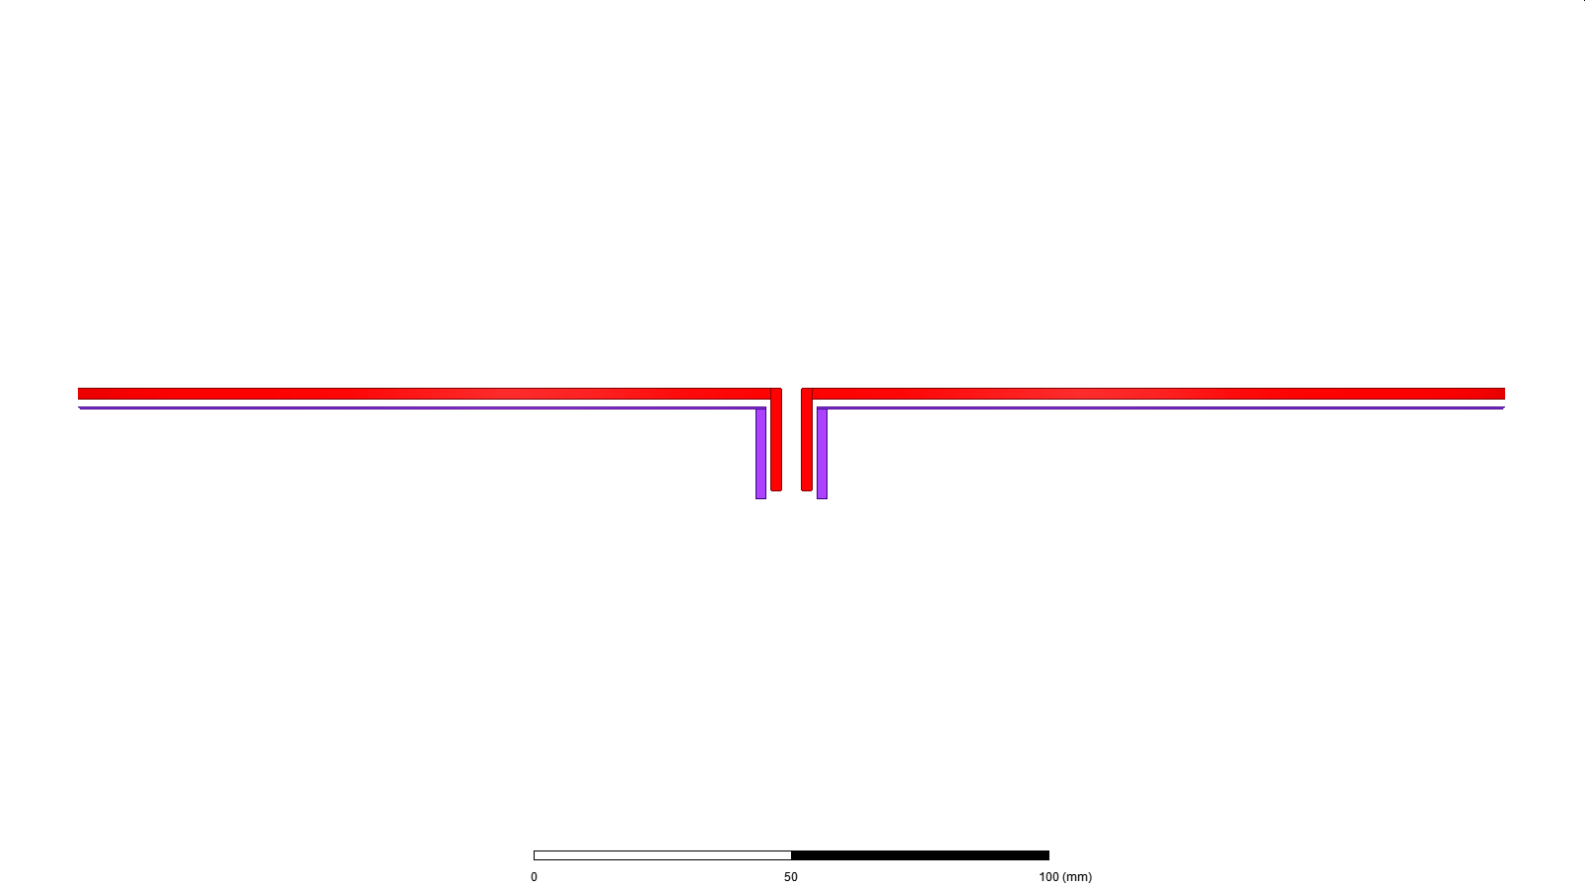
Proposed Design
Problem: Flux distribution is not constant
Solution : Bended endwindings of primary winding

Slide 28
Pros and Cons
Primary to primary flux is bigger than expectation .
Flux change is 10 percent between fully aligned and transition between two primaries.
Primary to primary flux
Change on flux is 10 percent
Primary to primary flux
Constant Flux

Slide 29
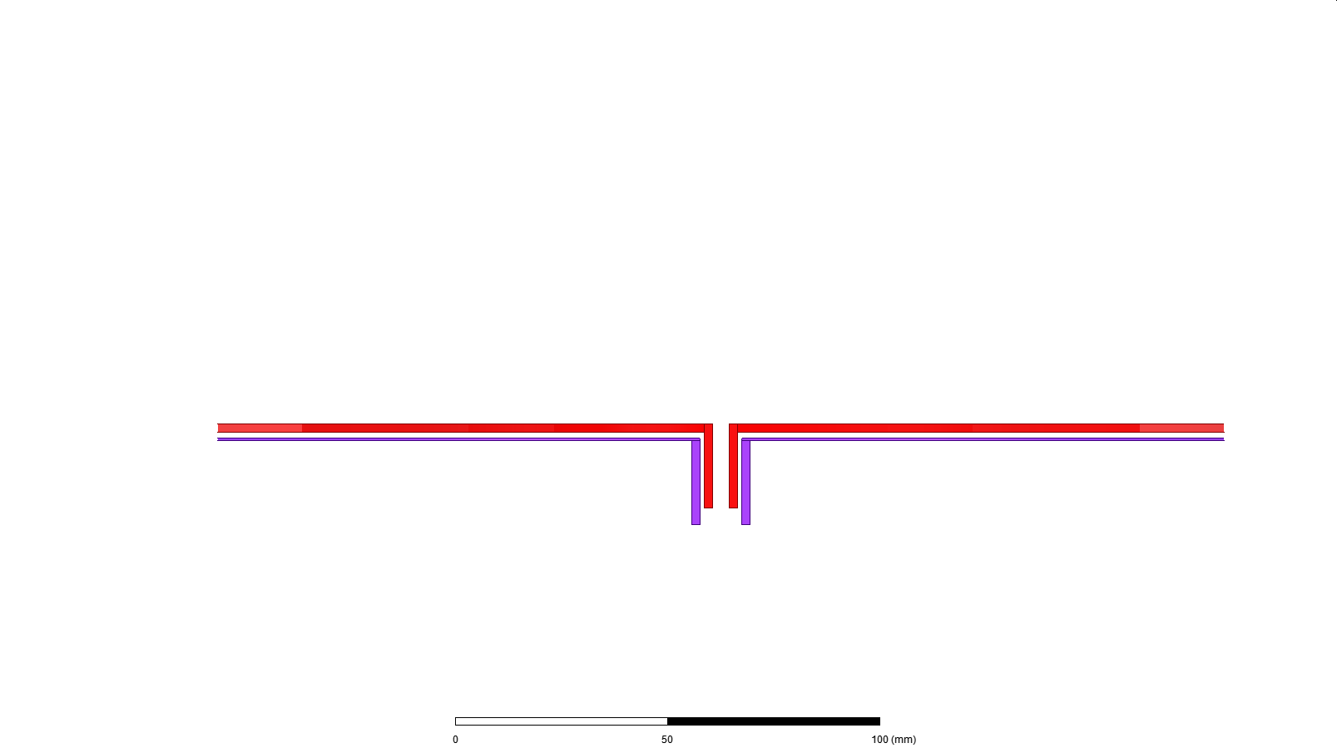

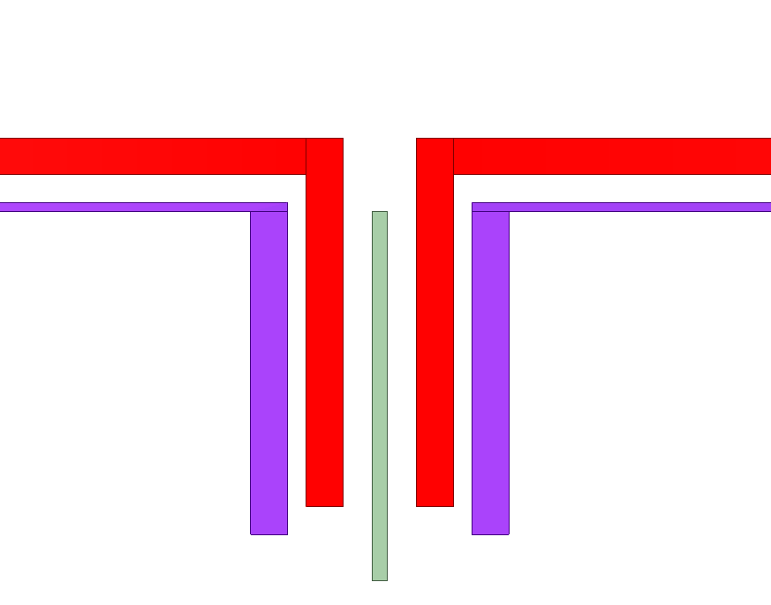
How can we decrease mutual indcutance between two primary windings?
Solution: Middle Ferrite core to decouple two primary windings
Middle core ferrite
(Decoupled
primary windings)

Slide 30
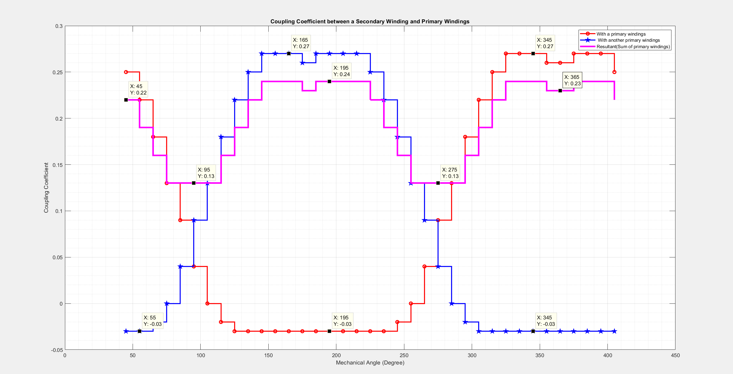
Results for Previous

Slide 31
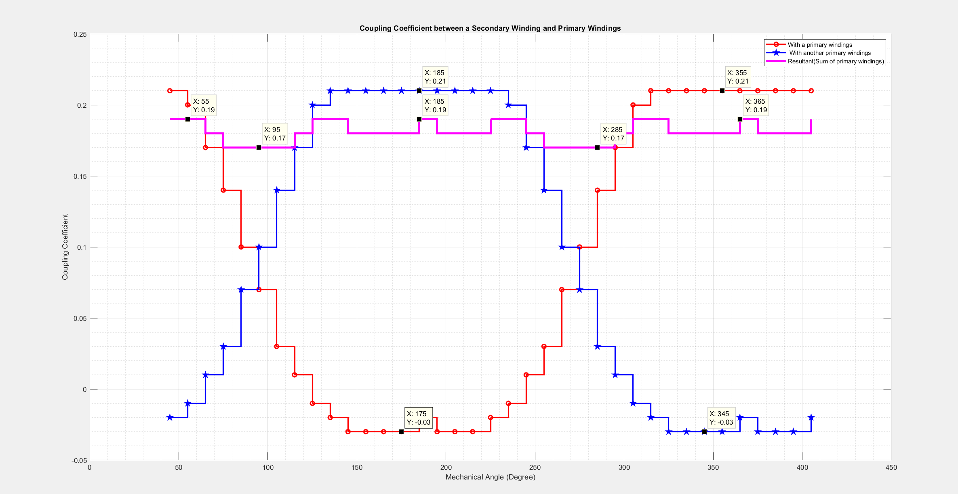
Results for Proposed

Slide 32
Secondary Winding
In our sytem, secondary side windings are rotated.
4 quarter circle is designed for
However,Primary to secondary mutual inductances are not perfectly the same. It causes that all power is transferred by only one secondary.
45°
Fully aligned secondaries with primaries. (0° )
Misaligned secondaries with primaries. (45°)

Slide 33
Problem
For misaligned coils or non-equal couplings at aligned condition, The power is transffered by only one having bigger coupling due to rectifier circuit.

Slide 34
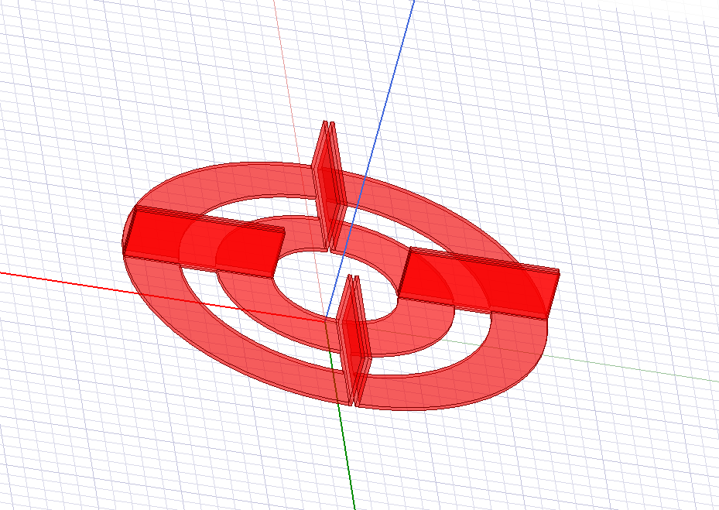
Solution
If there are negative coupling between secondaries, the transferred power is distributed thanks to negative feedback.
Increasing negative mutual between two secondaries occurs for bended secondary windings.

