Slide 1
A Generalized
Multi-receiver with a
Common DC BUS
for 2-element compensation

Slide 2
The multi-receivers can be used for :
Fault-Tolerance
Stress-on semiconductor
Required passive elements(Inductance)
Heat Capacitance and Thermal Management
More than one load

Slide 3
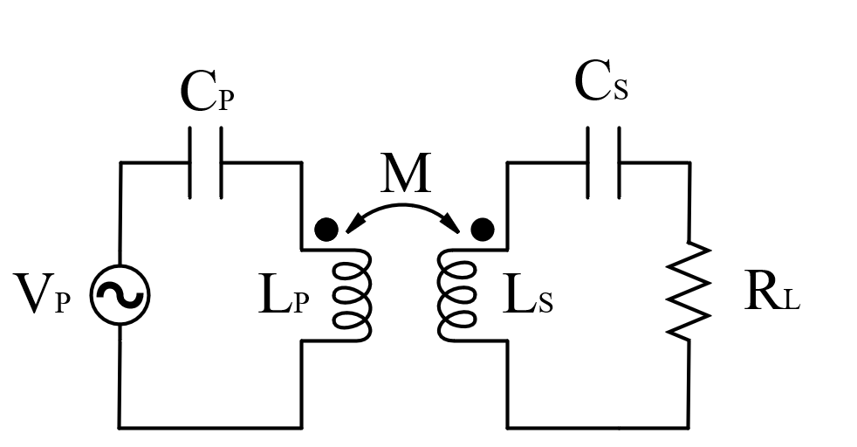
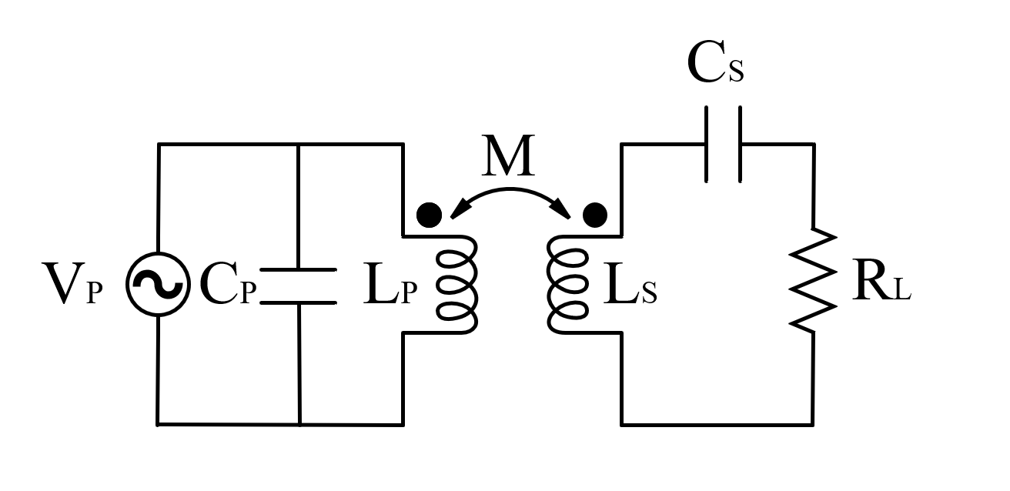
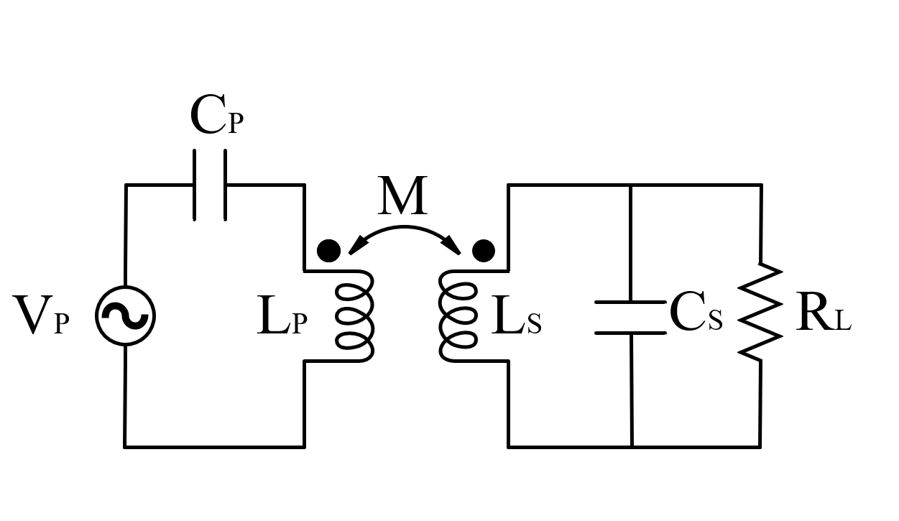
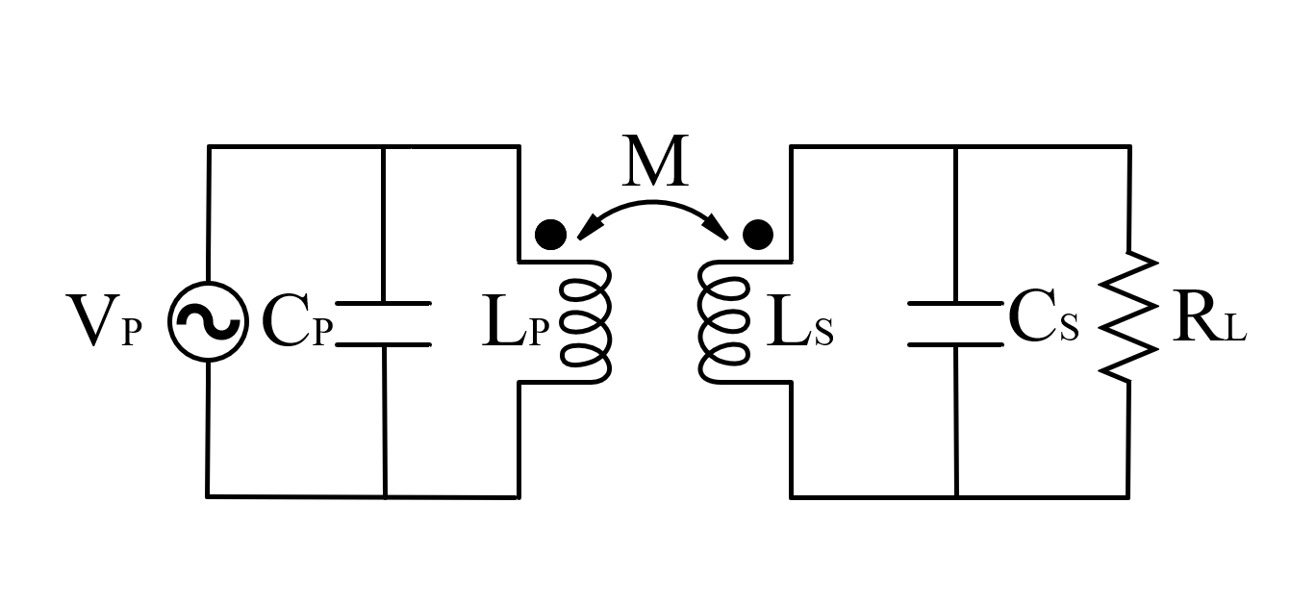
Compensation Methods
Voltage Source Input
Series-Series
Parallel-Series
Series-Parallel
Parallel-Parallel

Slide 4
Compensation Methods
Series-Series
Parallel-Series
Series-Parallel
Parallel-Parallel

Slide 5
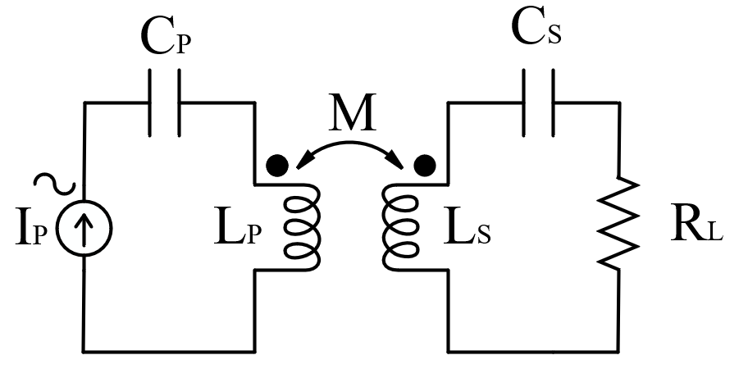
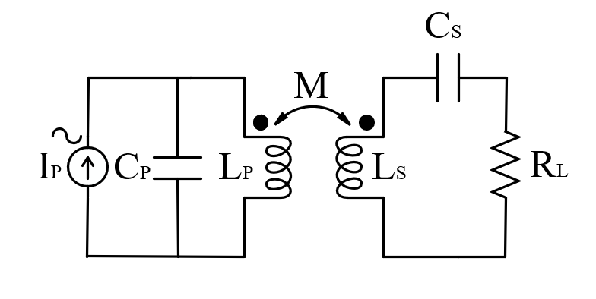
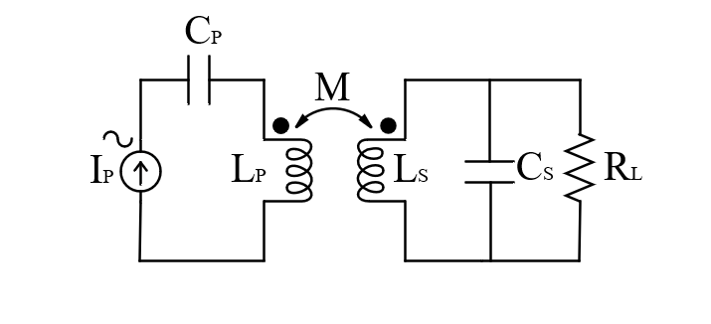
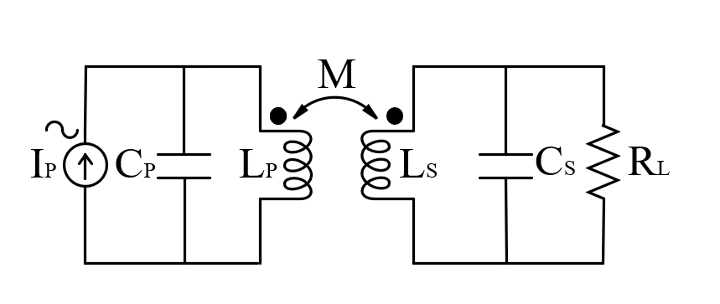
Current Source Input
Series-Series
Parallel-Series
Series-Parallel
Parallel-Parallel

Slide 6
Transmitter Side:
If Pulse Generator is a voltage-source fed, the transmitter side is chosen as Series-Compensation to filter DC-Voltage and the resonant inductor current will be sinusoidal.
If Pulse Generator is a current-source fed, the transmitter side is chosen as Parallel-Compensation to filter DC-Current and the resonant inductor current will be sinusoidal.

Slide 7
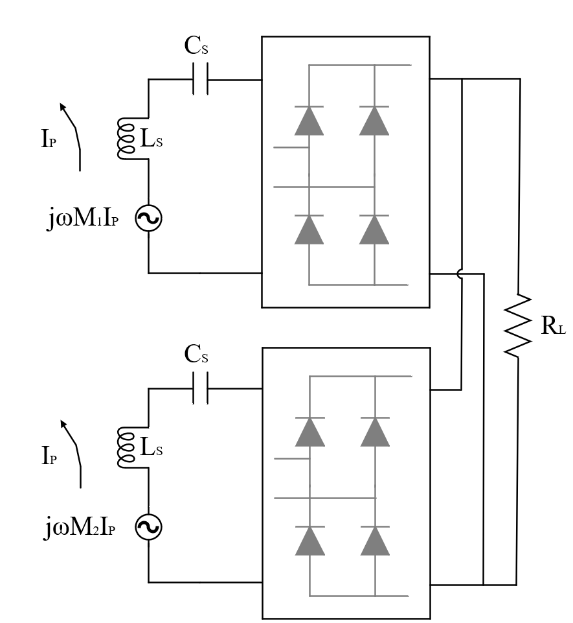
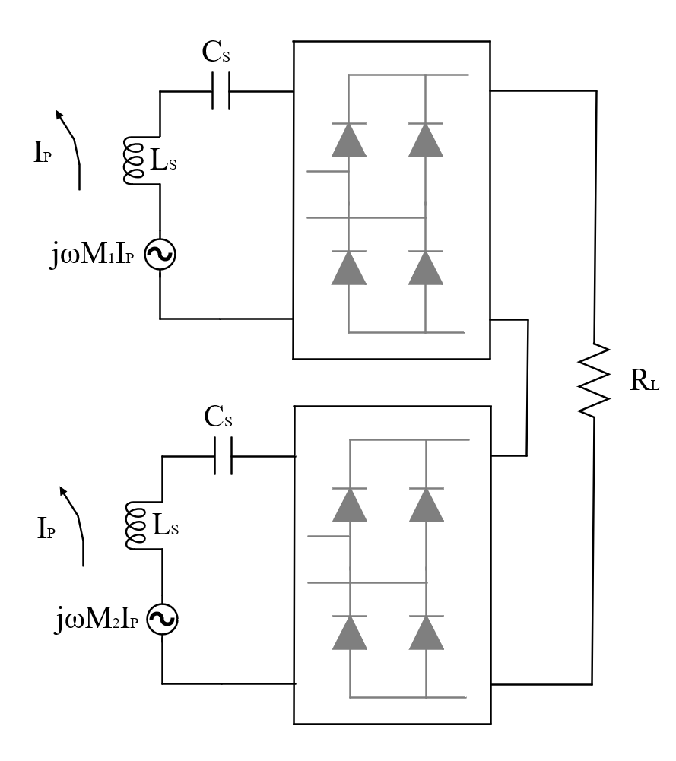
The design variants of Common DC-Bus
Series Compensation

Slide 8
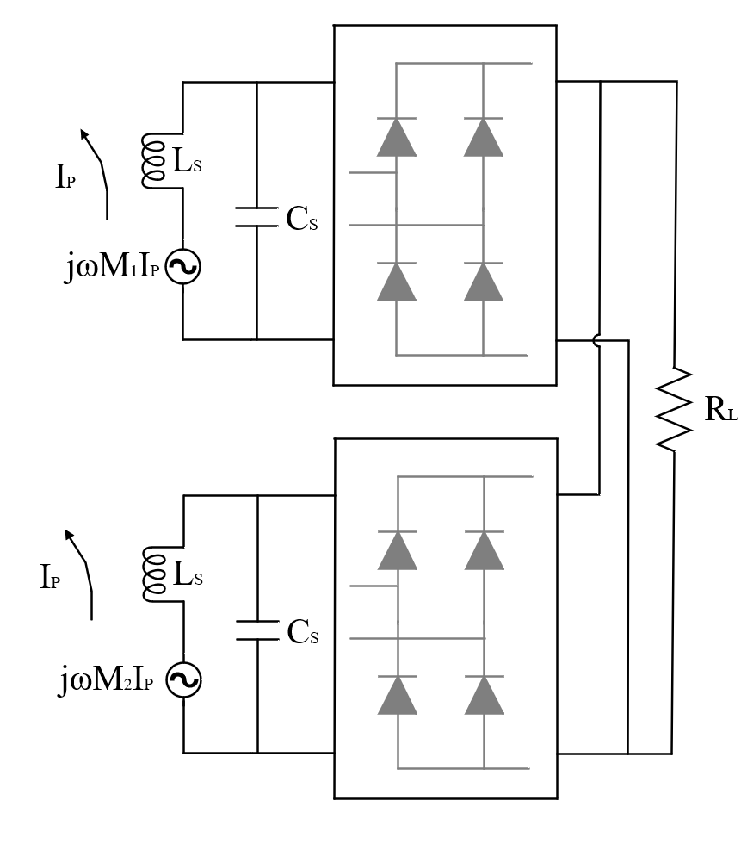
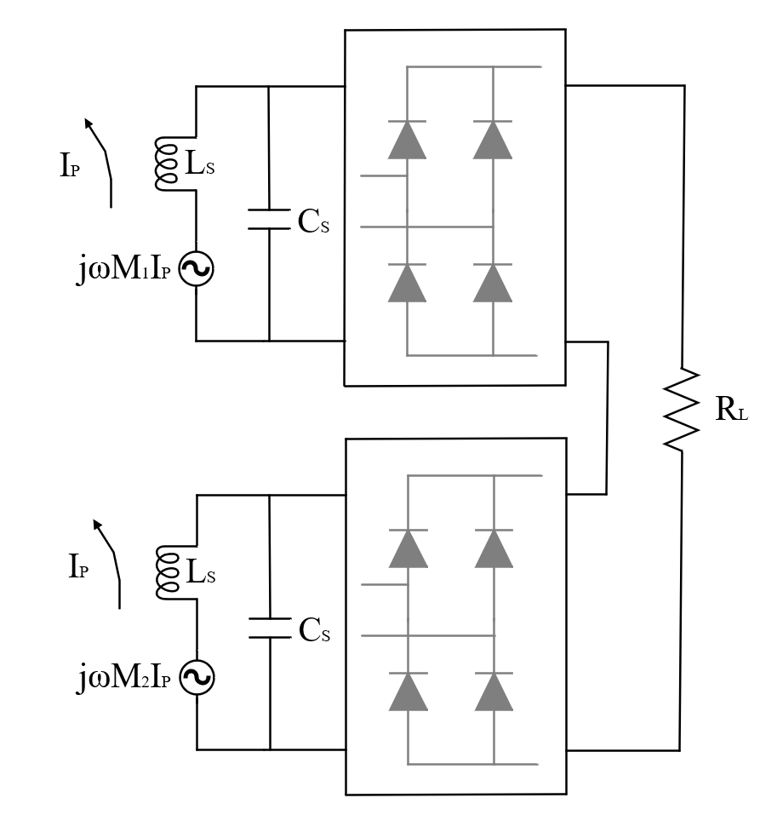
Parallel Compensation

Slide 9
Analytical Modelling
Series Compensation- Series DC BUS
Series Compensation- Parallel DC BUS
Parallel Compensation- Series DC BUS
Parallel Compensation- Parallel DC BUS

Slide 10
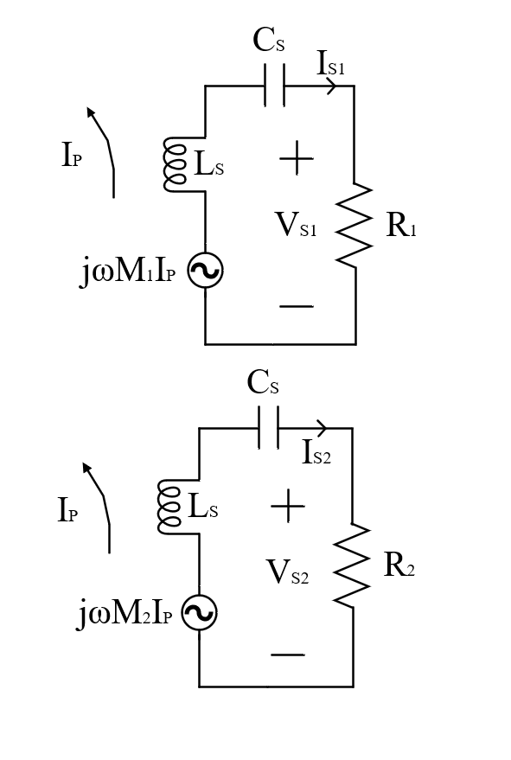


Series Compensation- Series DC BUS
$${|I}_{S1}|={|I}_{S2}| ….(1)$$
$$R_{1}+R_{2}=R_{L} …. (2)$$

Slide 11
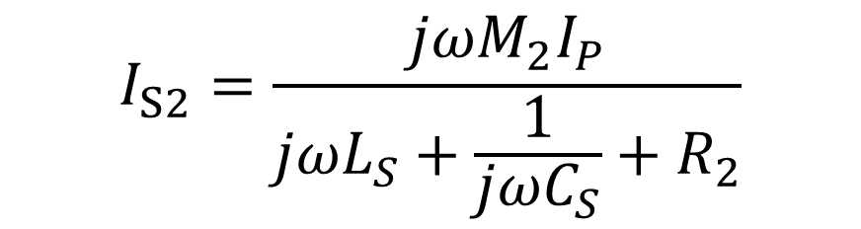
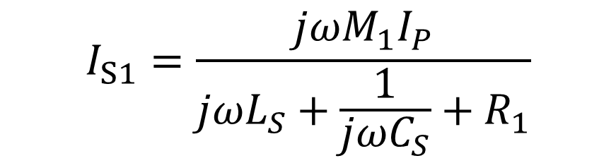
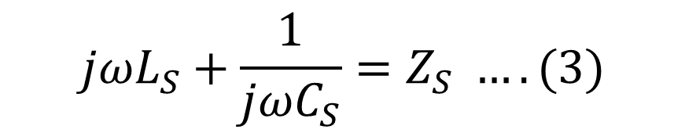
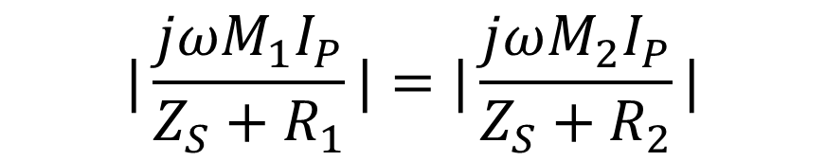
$$I_{S1}=\frac{jωM_{1}I_{P}}{jωL_{S}+\frac{1}{jωC_{S}}+R_{1}}$$
$$I_{S2}=\frac{jωM_{2}I_{P}}{jωL_{S}+\frac{1}{jωC_{S}}+R_{2}}$$
$$jωL_{S}+\frac{1}{jωC_{S}}=Z_{S} ….(3)$$
From (1) and (3)
$$|\frac{jωM_{1}I_{P}}{Z_{S}+R_{1}}|=|\frac{jωM_{2}I_{P}}{Z_{S}+R_{2}}|$$

Slide 12
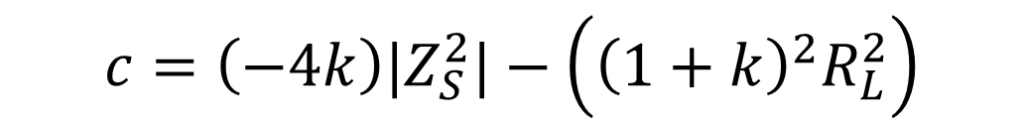
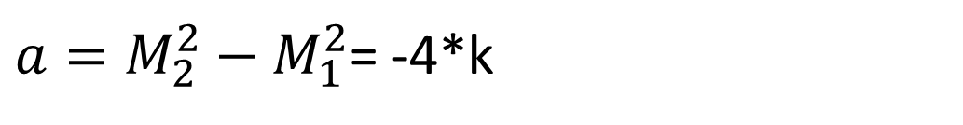
$${(|Z}_{S}^{2}|+R_{1}^{2})M_{2}^{2}={(|Z}_{S}^{2}|+R_{2}^{2})M_{1}^{2}$$
$$\left(M_{1}^{2}−M_{2}^{2}\right){|Z}_{S}^{2}|=M_{2}^{2}R_{1}^{2}−M_{1}^{2}R_{2}^{2}$$
From (2)
$$\left(M_{1}^{2}−M_{2}^{2}\right){|Z}_{S}^{2}|=M_{2}^{2}R_{1}^{2}−M_{1}^{2}{(R}_{1}^{2}+R_{L}^{2}−2R_{1}R_{L})$$
From (1)
$${aR}_{1}^{2}+bR_{1}+c=0$$
$a=M_{2}^{2}−M_{1}^{2}$= -4*k
$$b=2{\left(1+k\right)}^{2}R_{L}$$
$$c=\left(−4k\right){|Z}_{S}^{2}|−\left({\left(1+k\right)}^{2}R_{L}^{2}\right)$$

Slide 13
$$R_{1}= \frac{\text{(}R_{L} + 2R_{L}.k + R_{L}k^{2} −\sqrt{(−(− R_{L}k^{2} + 4Z_{s}k + R_{L})(R_{L}k^{2} + 4Z_{s}k − R_{L}))})}{(4k)}$$
$$R_{2} =R_{L}−R_{1}$$

Slide 15

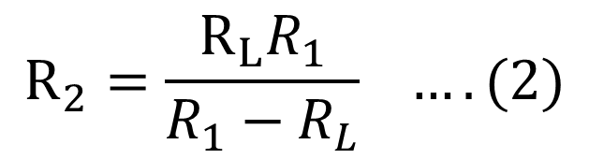

Series Compensation- Parallel DC BUS
$${|V}_{s1}|=|V_{s2}| ….(1)$$
$$R_{1}//R_{2}=R_{L}$$
$$R_{2}=\frac{R_{L}R_{1}}{R_{1}−R_{L}} …. (2)$$

Slide 16
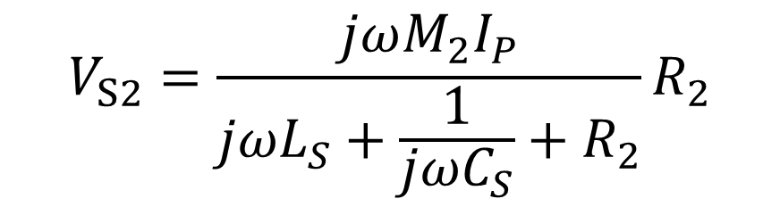
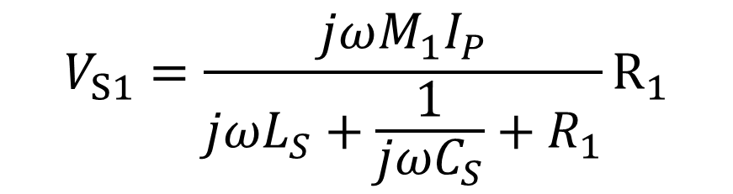
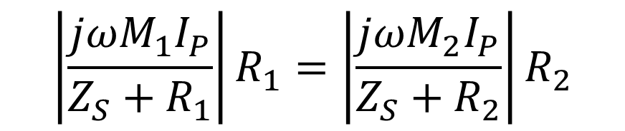
$$V_{S1}=\frac{jωM_{1}I_{P}}{jωL_{S}+\frac{1}{jωC_{S}}+R_{1}}R_{1}$$
$$V_{S2}=\frac{jωM_{2}I_{P}}{jωL_{S}+\frac{1}{jωC_{S}}+R_{2}}R_{2}$$
$$jωL_{S}+\frac{1}{jωC_{S}}=Z_{S} ….(3)$$
From (1) and (3)
$$\left|\frac{jωM_{1}I_{P}}{Z_{S}+R_{1}}\right|R_{1}=\left|\frac{jωM_{2}I_{P}}{Z_{S}+R_{2}}\right|R_{2}$$

Slide 17

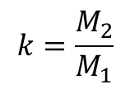
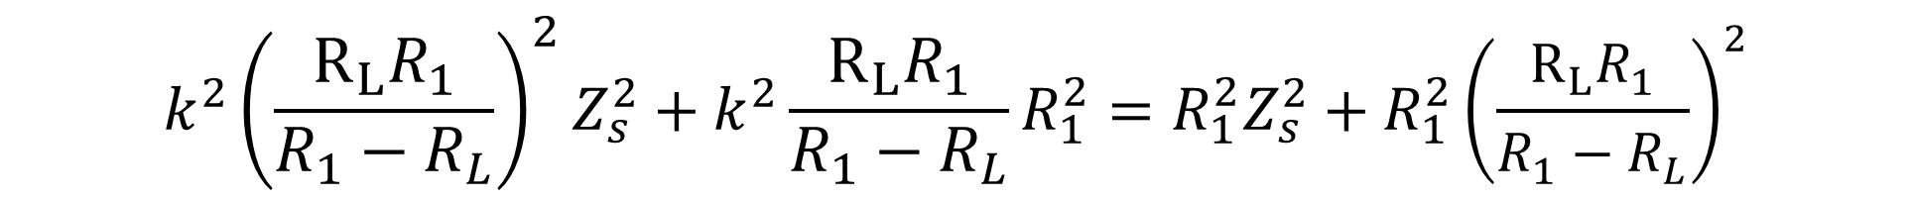
$${(|Z}_{S}^{2}\left|+R_{1}^{2}\right)M_{2}^{2}R_{2}^{2}={(|Z}_{S}^{2}|+R_{2}^{2})M_{1}^{2}R_{1}^{2}$$
$$k=\frac{M_{2}}{M_{1}}$$
$$k^{2}R_{2}^{2}Z_{s}^{2}+k^{2}R_{2}^{2}R_{1}^{2}=R_{1}^{2}Z_{s}^{2}+R_{1}^{2}R_{2}^{2}$$
From (2)
$$k^{2}{\left(\frac{R_{L}R_{1}}{R_{1}−R_{L}}\right)}^{2}Z_{s}^{2}+k^{2}\frac{R_{L}R_{1}}{R_{1}−R_{L}}R_{1}^{2}=R_{1}^{2}Z_{s}^{2}+R_{1}^{2}{\left(\frac{R_{L}R_{1}}{R_{1}−R_{L}}\right)}^{2}$$
$$k^{2}{\left(\frac{R_{L}}{R_{1}−R_{L}}\right)}^{2}Z_{s}^{2}+k^{2}\frac{R_{L}R_{1}}{R_{1}−R_{L}}=Z_{s}^{2}+{\left(\frac{R_{L}R_{1}}{R_{1}−R_{L}}\right)}^{2}$$
$$k^{2}R_{L}^{2}{\left(R_{L}\right)}^{2}Z_{s}^{2}+k^{2}{(R}_{1}−R_{L}){(R}_{L}R_{1})={\left(R_{1}−R_{L}\right)}^{2}Z_{s}^{2}+{\left(R_{L}R_{1}\right)}^{2}$$

Slide 18
$$k^{2}R_{L}^{2}{\left(R_{L}\right)}^{2}Z_{s}^{2}+k^{2}{(R}_{1}−R_{L}){(R}_{L}R_{1})={\left(R_{1}−R_{L}\right)}^{2}Z_{s}^{2}+{\left(R_{L}R_{1}\right)}^{2}$$
$$k^{2}R_{L}^{4}Z_{s}^{2}+k^{2}R_{L}R_{1}^{2}−k^{2}R_{1}R_{L}^{2}={(R}_{1}^{2}+R_{L}^{2}−2R_{L}R_{1} )Z_{s}^{2}+{\left(R_{L}R_{1}\right)}^{2}$$
$$k^{2}R_{L}^{4}Z_{s}^{2}+k^{2}R_{L}R_{1}^{2}−k^{2}R_{1}R_{L}^{2}={(Z_{s}^{2}R}_{1}^{2}+{Z_{s}^{2}R}_{L}^{2}−2R_{L}Z_{s}^{2}R_{1}) +{\left(R_{L}R_{1}\right)}^{2}$$
From (1)
$$a=k^{2}R_{L}^{2}−R_{L}^{2}−Zs^{2}$$
$$b=2R_{L}$$
$$c=\left(k^{2}−1\right){Z_{s}^{2}R}_{L}^{2}$$

Slide 19

$$R_{1}= \frac{R_{L}Zs^{2} +\sqrt{R_{L}Z_{s}\left(\left(− R_{L}k^{2} + Z_{s}k + R_{L}\right)\left(R_{L}k^{2} + Z_{s}k − R_{L}\right)\right)}}{(− R_{L}^{2}k^{2} + R_{L}^{2} + Z_{s}^{2})}$$
$$R_{2} =\frac{R_{L}R_{1}}{R_{1}−R_{L}}$$

Slide 21
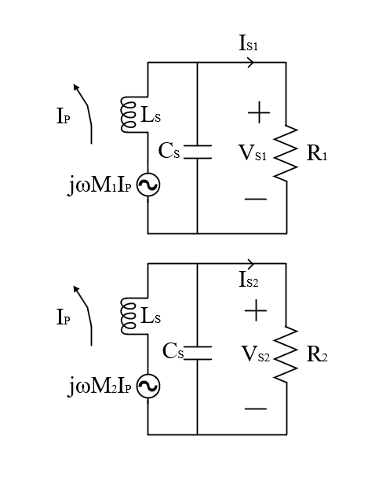
Parallel Compensation- Parallel DC BUS
$${|V}_{s1}|=|V_{s2}| ….(1)$$
$$R_{1}//R_{2}=R_{L}$$
$$R_{2}=\frac{R_{L}R_{1}}{R_{1}−R_{L}} …. (2)$$

Slide 22
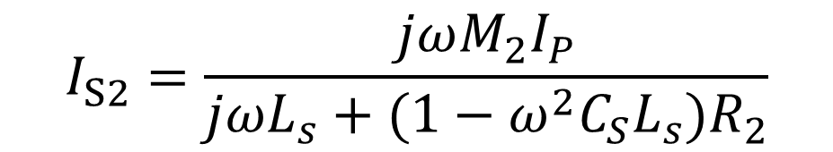
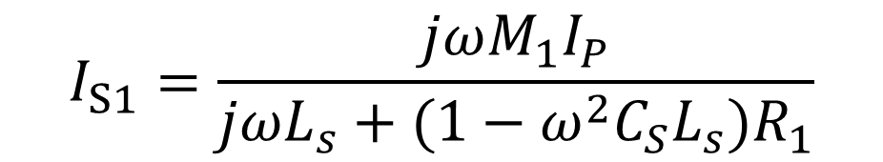
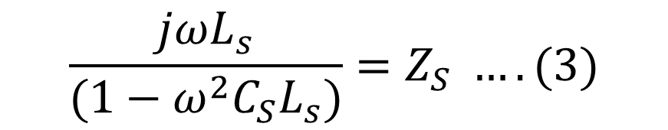

$$I_{S1}=\frac{jωM_{1}I_{P}}{jωL_{s}+(1−ω^{2}C_{S}L_{s})R_{1}}$$
$$I_{S2}=\frac{jωM_{2}I_{P}}{jωL_{s}+(1−ω^{2}C_{S}L_{s})R_{2}}$$
$$\frac{jωL_{s}}{(1−ω^{2}C_{S}L_{s})}=Z_{S} ….(3)$$
From (1) and (3)
$$\left|\frac{jωM_{1}I_{P}}{Z_{S}+R_{1}}\right|=\left|\frac{jωM_{2}I_{P}}{Z_{S}+R_{2}}\right|$$

Slide 23
$${(|Z}_{S}^{2}\left|+R_{1}^{2}\right)M_{2}^{2}R_{2}^{2}={(|Z}_{S}^{2}|+R_{2}^{2})M_{1}^{2}R_{1}^{2}$$
$$k=\frac{M_{2}}{M_{1}}$$
$$k^{2}R_{2}^{2}Z_{s}^{2}+k^{2}R_{2}^{2}R_{1}^{2}=R_{1}^{2}Z_{s}^{2}+R_{1}^{2}R_{2}^{2}$$
From (2)
$$k^{2}{\left(\frac{R_{L}R_{1}}{R_{1}−R_{L}}\right)}^{2}Z_{s}^{2}+k^{2}\frac{R_{L}R_{1}}{R_{1}−R_{L}}R_{1}^{2}=R_{1}^{2}Z_{s}^{2}+R_{1}^{2}{\left(\frac{R_{L}R_{1}}{R_{1}−R_{L}}\right)}^{2}$$
$$k^{2}{\left(\frac{R_{L}}{R_{1}−R_{L}}\right)}^{2}Z_{s}^{2}+k^{2}\frac{R_{L}R_{1}}{R_{1}−R_{L}}=Z_{s}^{2}+{\left(\frac{R_{L}R_{1}}{R_{1}−R_{L}}\right)}^{2}$$
$$k^{2}R_{L}^{2}{\left(R_{L}\right)}^{2}Z_{s}^{2}+k^{2}{(R}_{1}−R_{L}){(R}_{L}R_{1})={\left(R_{1}−R_{L}\right)}^{2}Z_{s}^{2}+{\left(R_{L}R_{1}\right)}^{2}$$

Slide 24
$$k^{2}R_{L}^{2}{\left(R_{L}\right)}^{2}Z_{s}^{2}+k^{2}{(R}_{1}−R_{L}){(R}_{L}R_{1})={\left(R_{1}−R_{L}\right)}^{2}Z_{s}^{2}+{\left(R_{L}R_{1}\right)}^{2}$$
$$k^{2}R_{L}^{4}Z_{s}^{2}+k^{2}R_{L}R_{1}^{2}−k^{2}R_{1}R_{L}^{2}={(R}_{1}^{2}+R_{L}^{2}−2R_{L}R_{1} )Z_{s}^{2}+{\left(R_{L}R_{1}\right)}^{2}$$
$$k^{2}R_{L}^{4}Z_{s}^{2}+k^{2}R_{L}R_{1}^{2}−k^{2}R_{1}R_{L}^{2}={(Z_{s}^{2}R}_{1}^{2}+{Z_{s}^{2}R}_{L}^{2}−2R_{L}Z_{s}^{2}R_{1}) +{\left(R_{L}R_{1}\right)}^{2}$$
From (1)
$$a=k^{2}R_{L}^{2}−R_{L}^{2}−Zs^{2}$$
$$b=2R_{L}$$
$$c=\left(k^{2}−1\right){Z_{s}^{2}R}_{L}^{2}$$

Slide 25
$$R_{1}= \frac{R_{L}Zs^{2} +\sqrt{R_{L}Z_{s}\left(\left(− R_{L}k^{2} + Z_{s}k + R_{L}\right)\left(R_{L}k^{2} + Z_{s}k − R_{L}\right)\right)}}{(− R_{L}^{2}k^{2} + R_{L}^{2} + Z_{s}^{2})}$$
$$R_{2} =\frac{R_{L}R_{1}}{R_{1}−R_{L}}$$

Slide 27
Parallel Compensation- Series DC BUS
$${|I}_{S1}|={|I}_{S2}| ….(1)$$
$$R_{1}+R_{2}=R_{L} …. (2)$$

