Slide 1
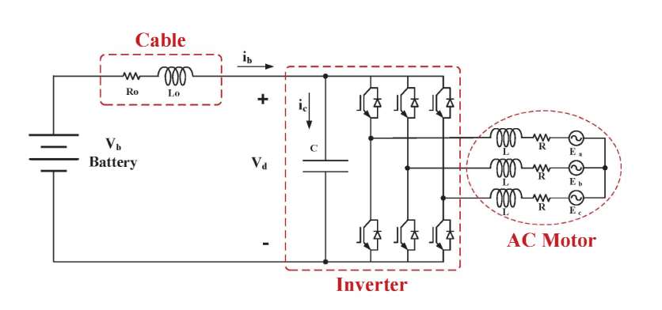
Harmonic Modeling of a Vehicle Traction Circuit Towards the DC Bus
The 2014 International Power Electronics Conference
DC Bus current is modelled by harmonics. The inverter and AC motor can be modelled as harmonic injection. If the cable is long as enough(5-10 m)

Slide 2
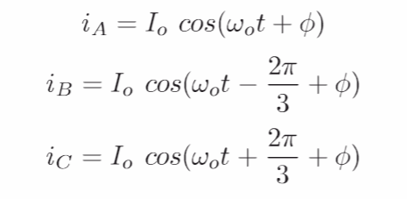
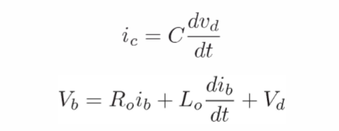

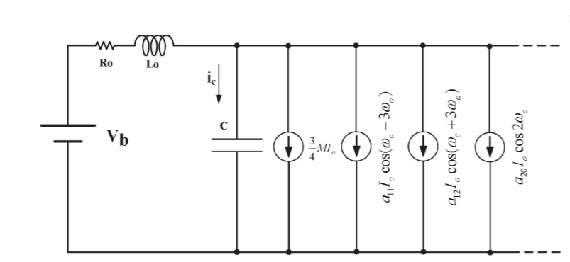
The number of high frequency current sources can be increased if a more accurate model is needed.
Frequency domain analysis.
The inverter currents can be linearized and split into harmonics.
Main harmonics carrier and sidebands, 2nd carrier

Slide 3
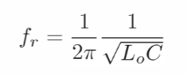
it is not expected to have a perfect match between the simulations and measurement because of lack of accurate models and parameters. However, one can study the nature of different phenomena. For example, it is very easy to see how the cable inductance affects the dc bus voltage ripple.
For an ideal system, the dc bus capacitor absorbs all of the high frequency components (non-dc) of the current, but for a realistic system there are some high frequency terms at input current.
The spectrum of the battery current shows that in addition to the dc component, there is a component around 3.6 kHz due to resonance between the cable and dc bus capacitor and some components around multiple of the carrier frequencies.

Slide 4
A General Analytical Method for Calculating Inverter DC-Link Current Harmonics
IEEE TRANSACTIONS ON INDUSTRY APPLICATIONS, VOL. 45, NO. 5, SEPTEMBER/OCTOBER 20
Recalling that multiplication in the time domain is equivalent to convolution in the frequency domain.
phase-leg-switching function and its load current in the time domain, which defines the switched current flowing through the phase leg, can be evaluated in the frequency do-main by convolving the spectra of these two time-varying functions.
PWM process can be readily determined using double Fourier series analysis
However, the frequency spectrum of the output load current contains both an output fundamental and harmonic ripple components. If the harmonic ripple compo-nents are neglected, the convolution operation is significantly simplified and allows closed-form analytic solutions for the dc-link current to be developed
The overall dc bus current is then the superposition summation of the switched current pulses from each phase leg

Slide 5
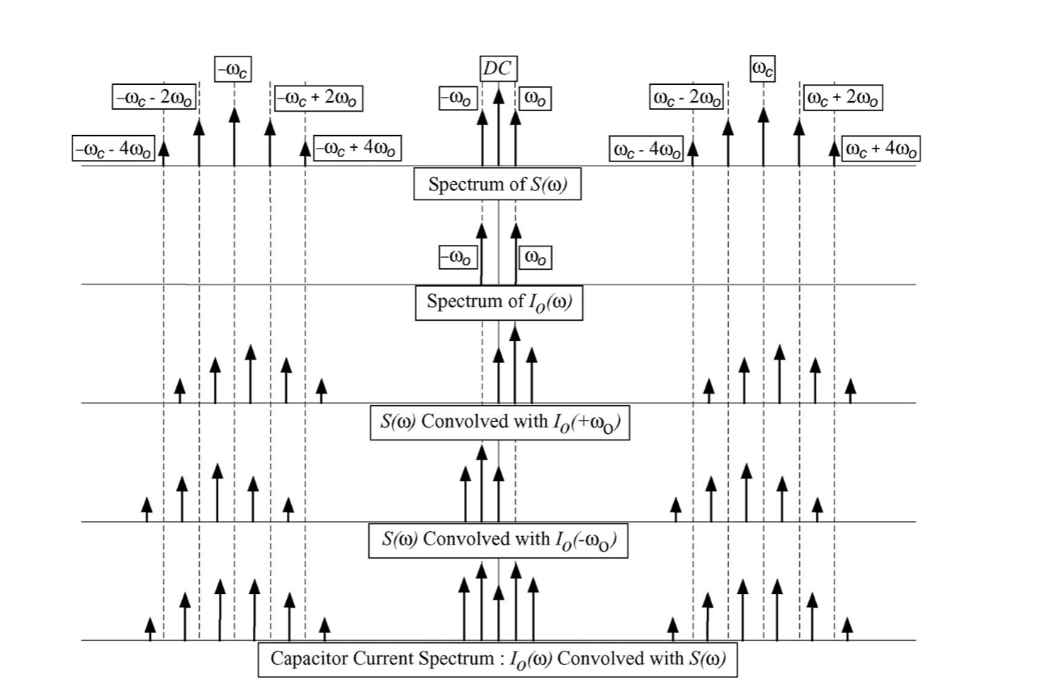
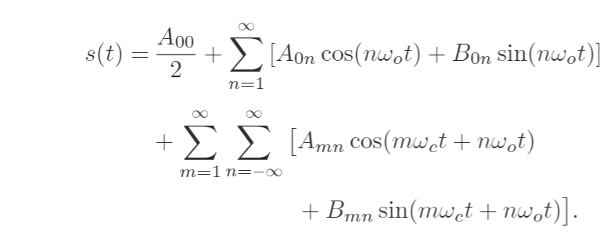
positively and negatively shifted switching-function spectra, while the lower trace shows the superposition of the frequency-shifted spectra
To calculate these harmonic components for any other spe-cific converter topology, all that is required is the double Fourier series representation of the converter’s PWM strategy and a selection from the product terms (1)–(8) as appropriate for the particular converter topology that is to be considered.

Slide 6
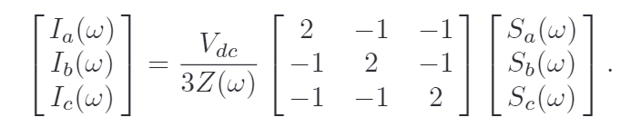
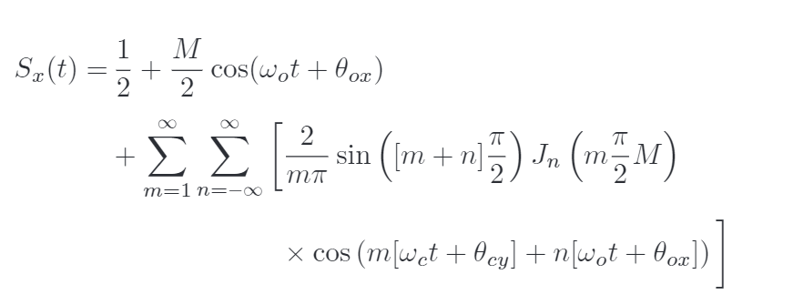


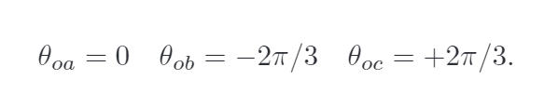
If the output current harmonics are not negligible, the system can not be bringed a closed form.However, it is still computational.

Slide 7
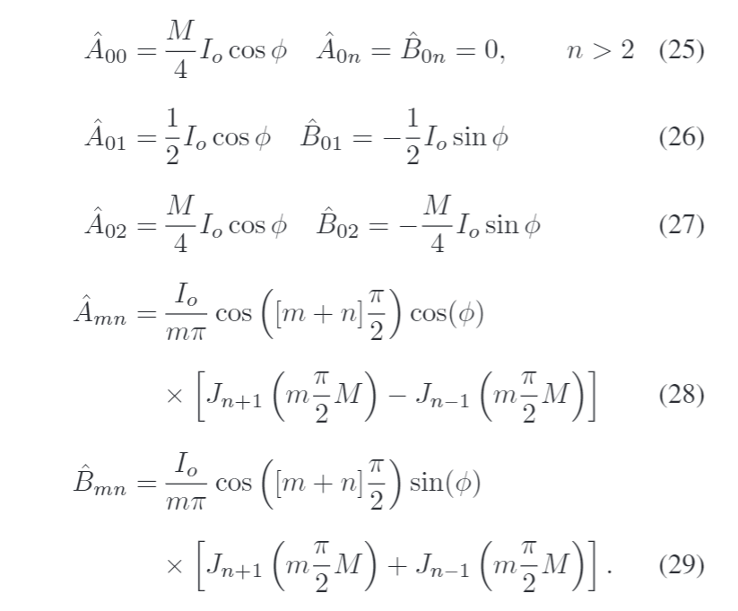
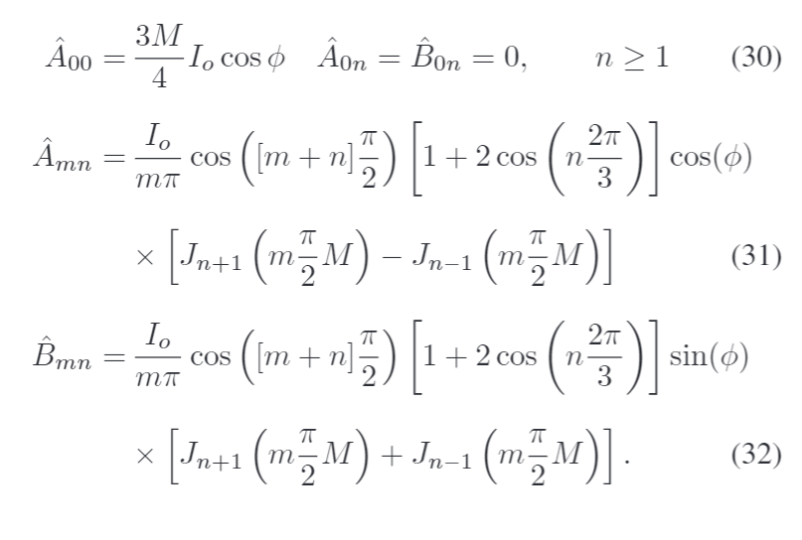

Slide 8

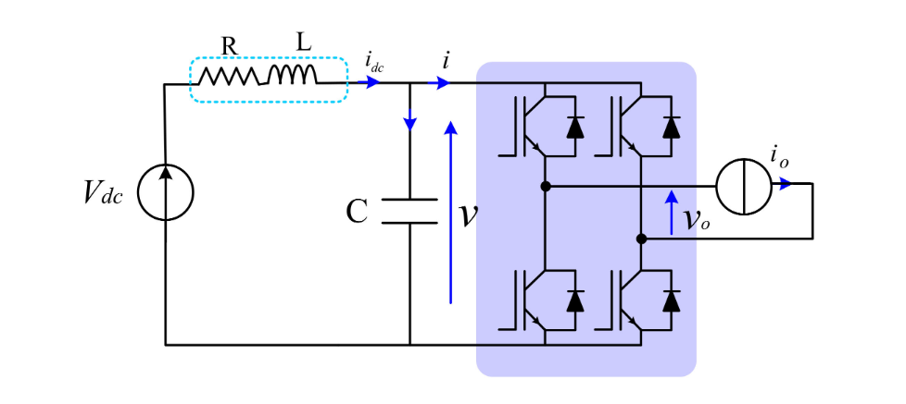
Theoretical and Experimental Investigation of Switching Ripple in the DC-Link Voltage of Single-Phase H-Bridge PWM Inverters
The DC voltage ripple amplitude is theoretically estimated as a function of the output current, both amplitude and phase angle, and the modulation index.
he DC (average) component, the low-frequency component (double-fundamental frequency, 100 Hz), and the high-frequency component (switching, many kHz)

Slide 9

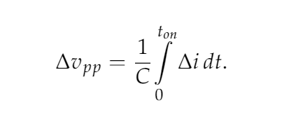
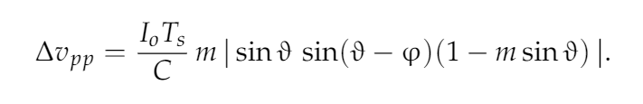
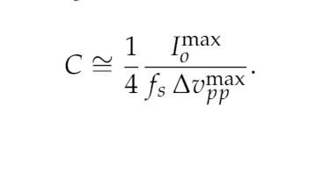

Slide 10
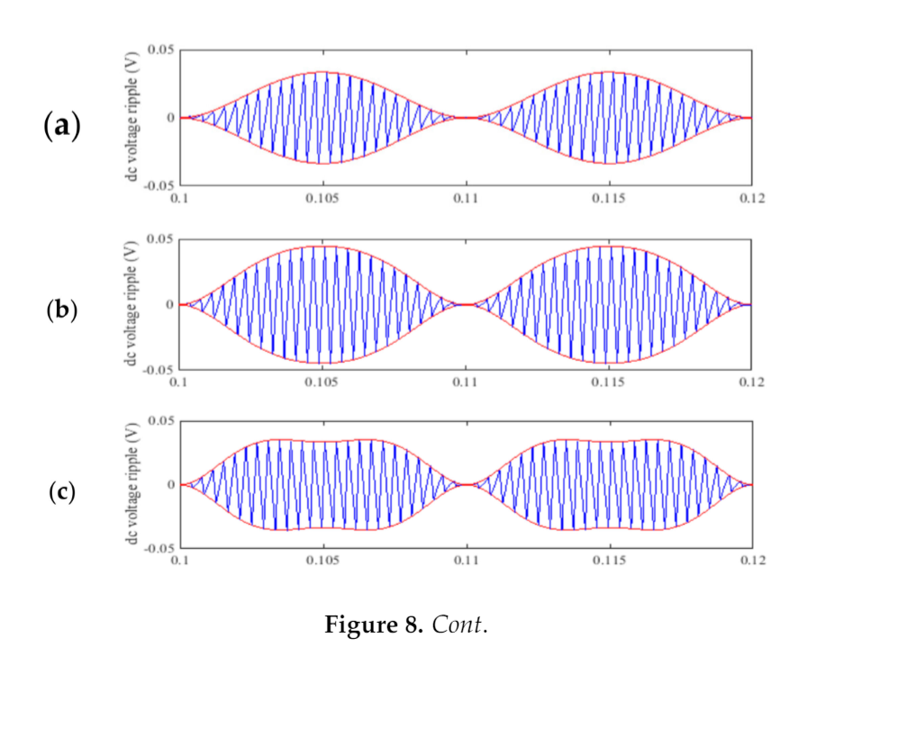
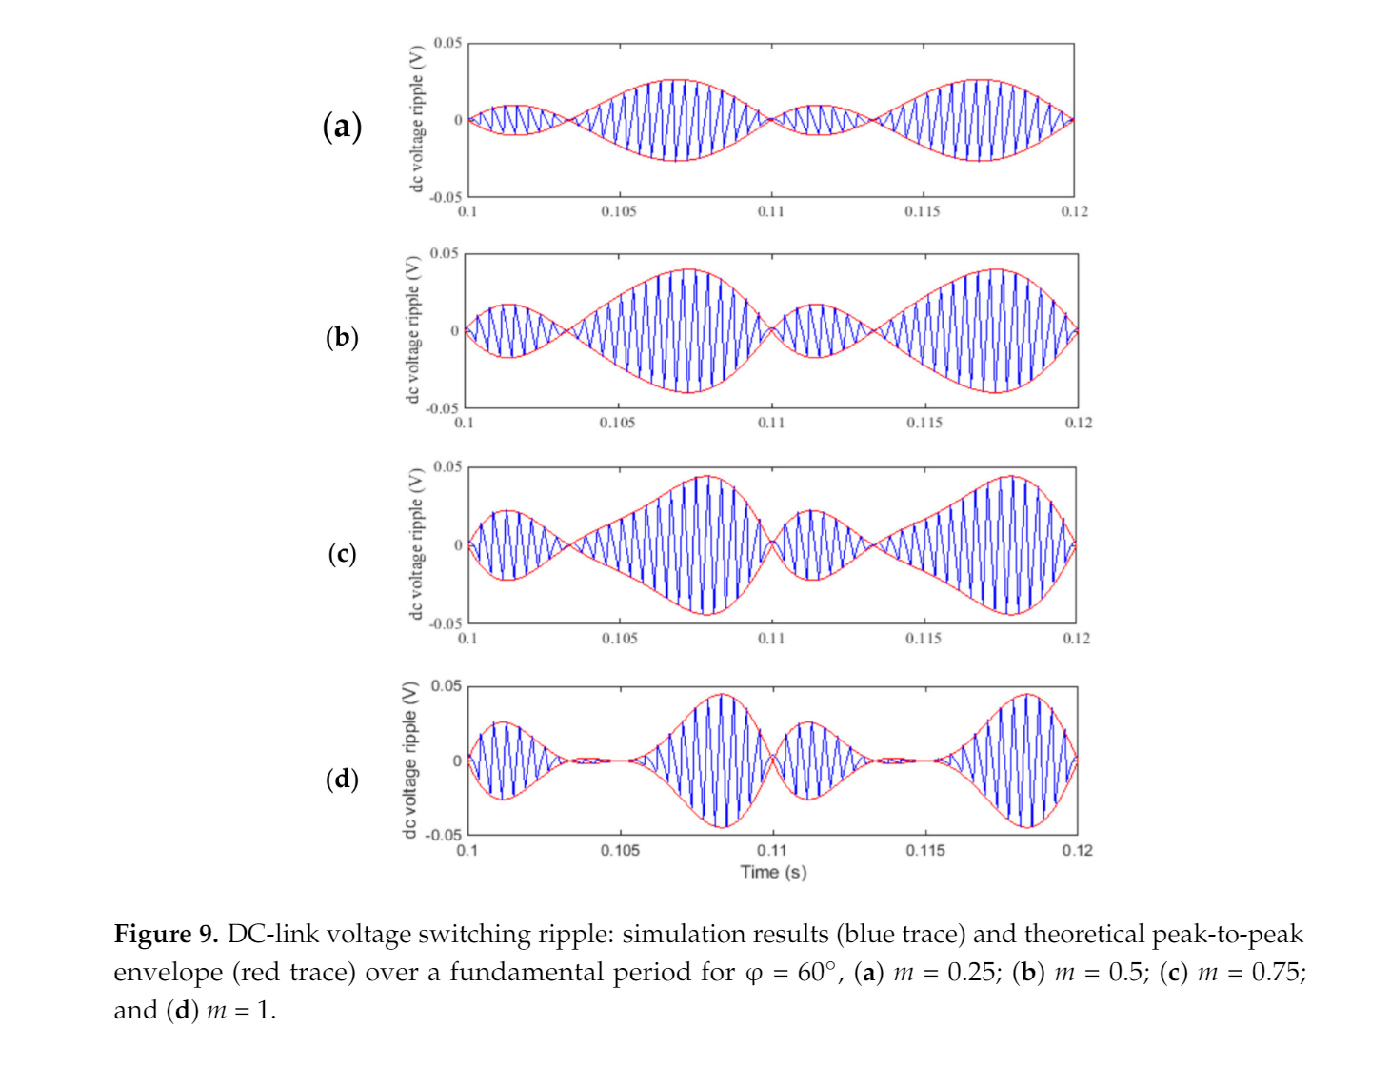

Slide 11
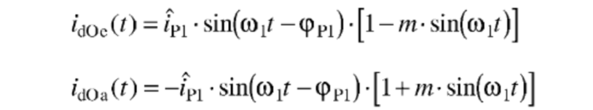
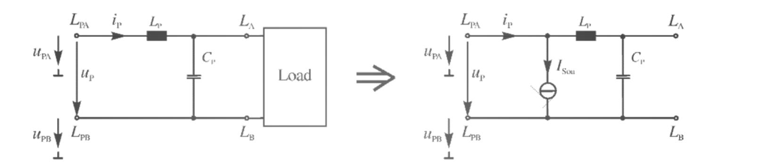
The DC-Link Capacitor Current in Pulsed Single-Phase H-Bridge Inverters (EPE2005)
With sinusoidal output current the positive and negative sidebands are arranged in each case symmetrically to each other.

Slide 12
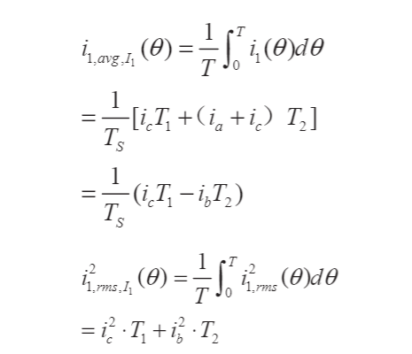
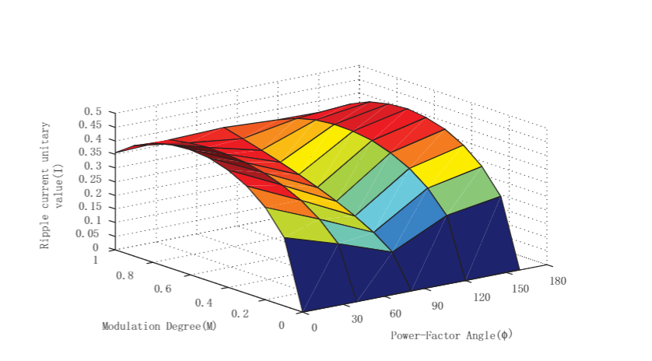
Electrolytic Capacitor Ripple Current Analysis of SPWM NPC Three-Level Inverter
2018 13th IEEE Conference on Industrial Electronics and Applications (ICIEA)

Slide 13

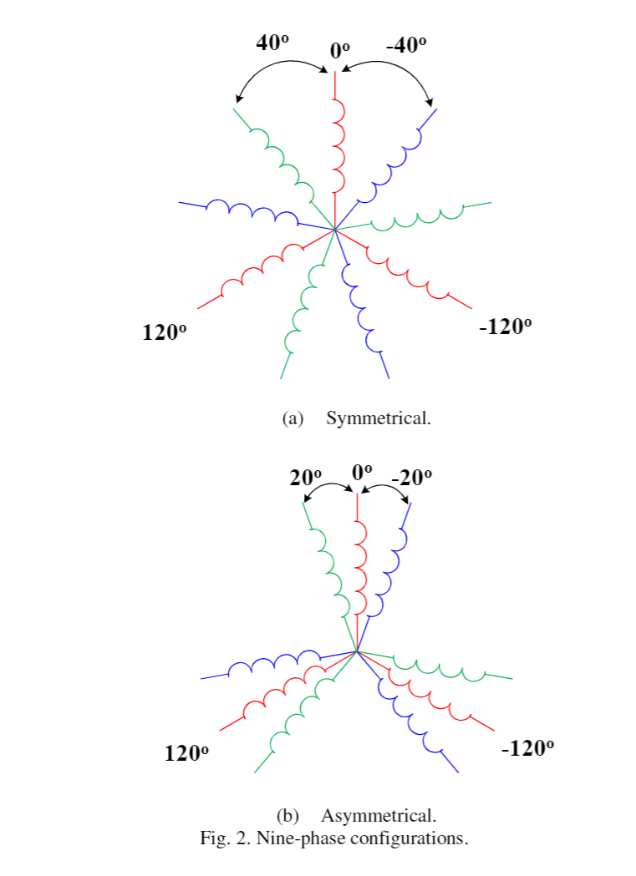
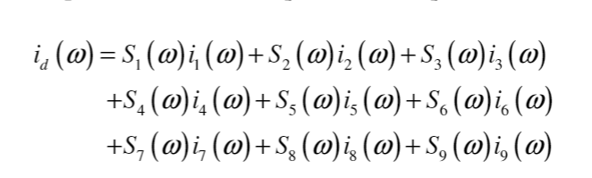
Input Current Ripple Analysis of Nine-Phase PWM Inverters
Among three three-phas e stator windings are displaced by either 20 (asymmetrical) or 40 (symmetrical) electrical degrees.

Slide 14
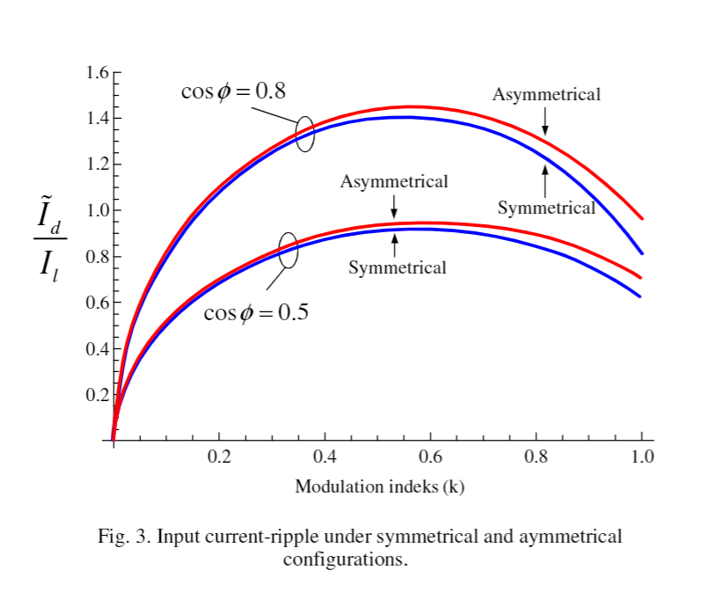
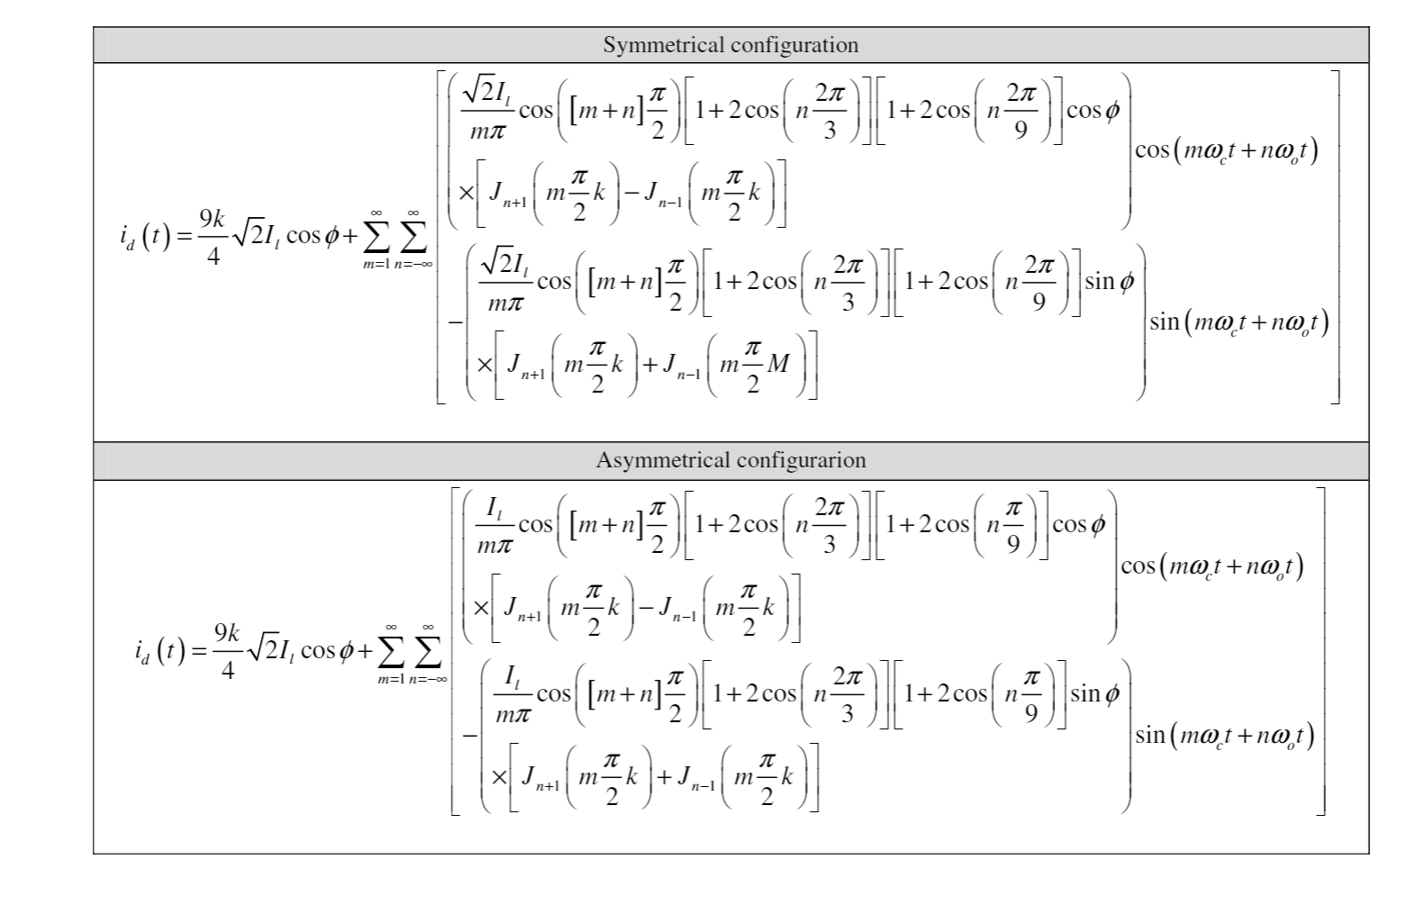
The stat or windings are rewound to be symmetrical and asymmetrical nine -phase stator windings with separate neutral points

Slide 15
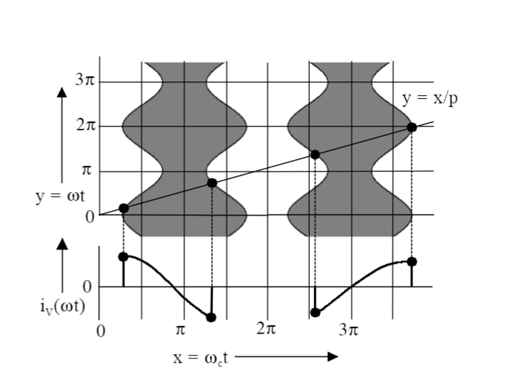
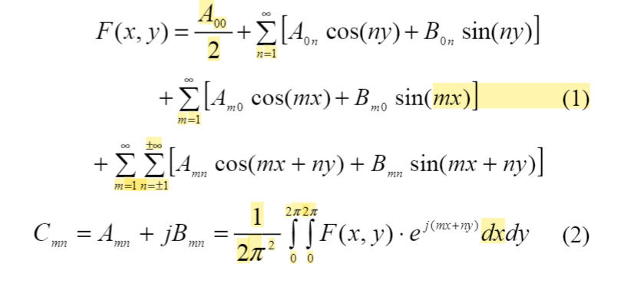
DC Link Harmonics of Three Phase Vo ltage Source Converters Influenced by the Pulse Width Modulation Strategy – an Analysis
The Geometric Wall Model
the Double Fourier Series

Slide 16
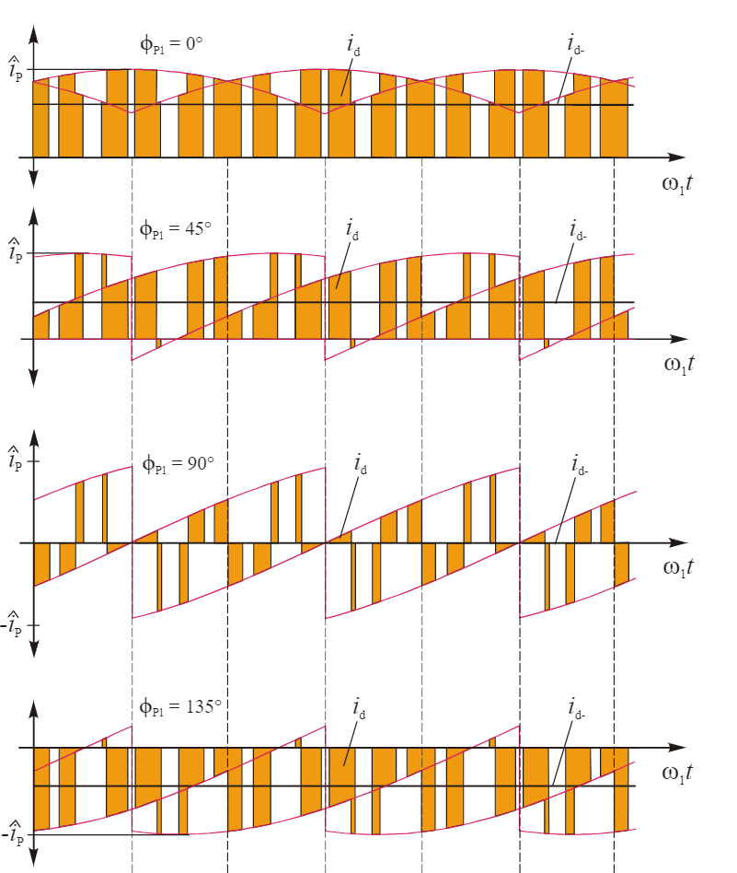
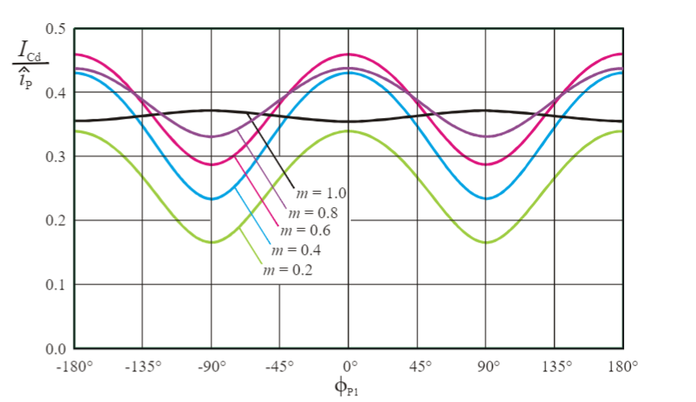
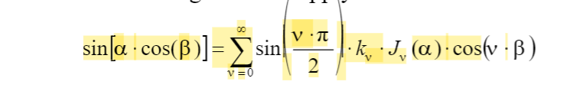
Analytic Calculation of the DC-Link Capacitor Current for Pulsed Three-Phase Inverters
From the drawn envelopes it is clearly recognizable, that the waveforms of the curves after 1/6 of the fundamental period repeat always

Slide 17
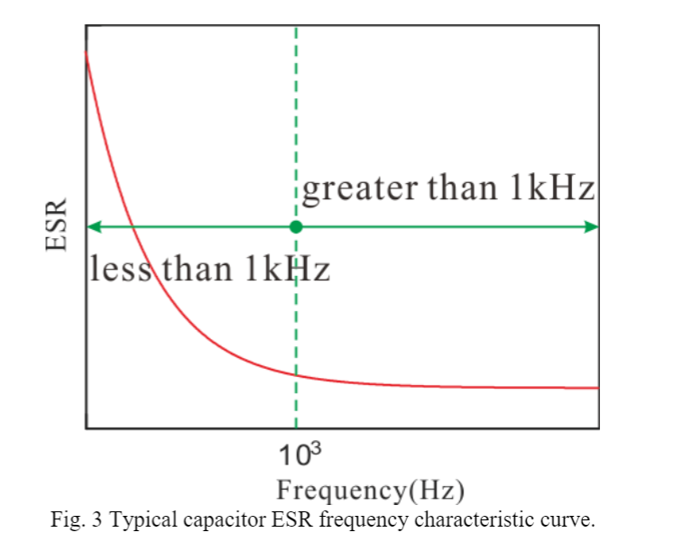
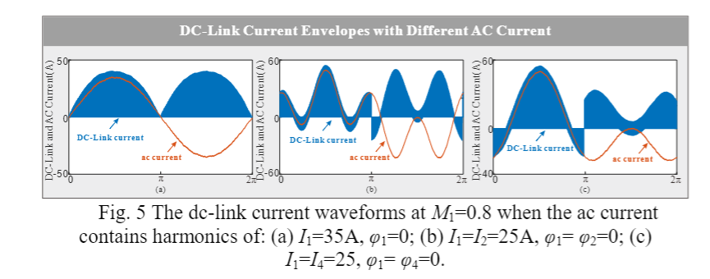
Analysis of the DC-Link Current for the Single Phase H-Bridge Inverter Under Harmonic Output Currents
LOH ➔ Low order harmonics
SHC ➔ Switching Harmonics

Slide 18
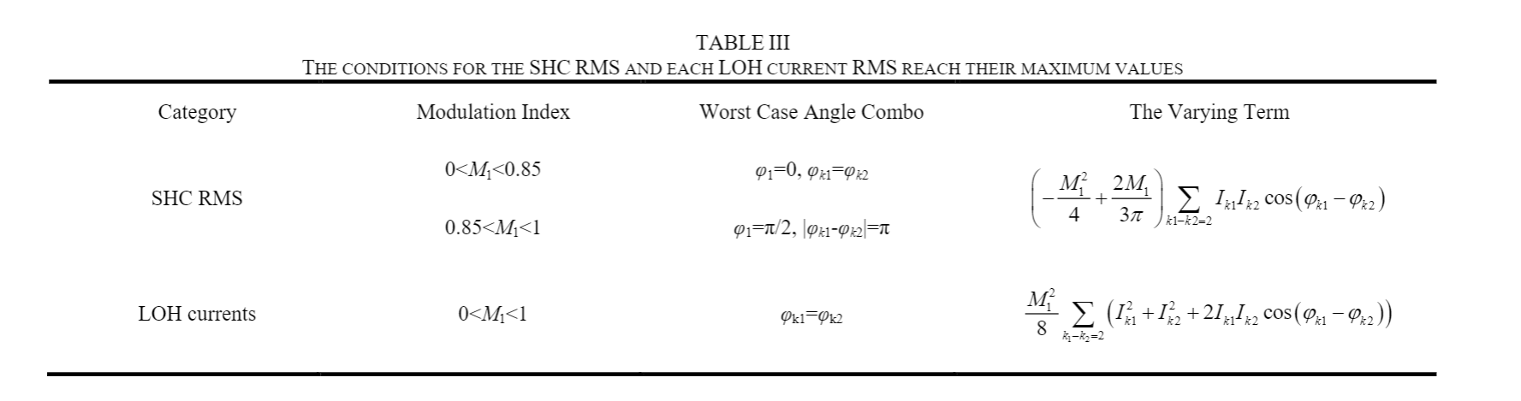

Slide 19
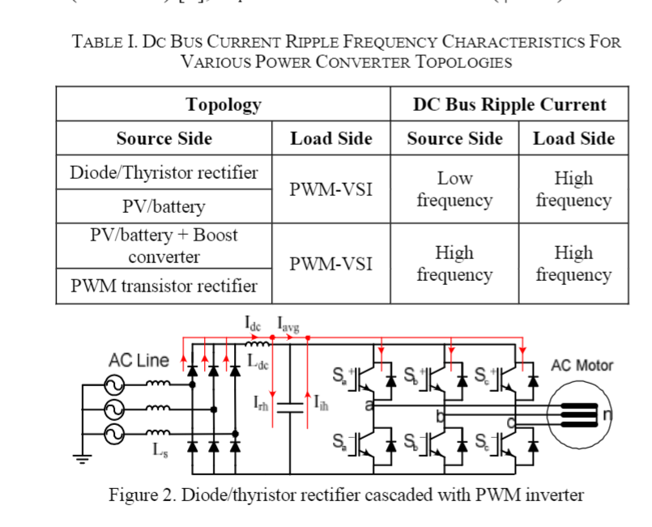
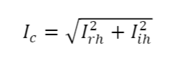
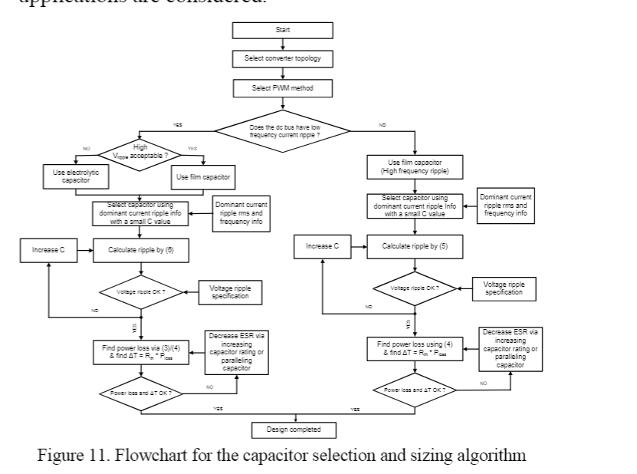
A DC Bus Capacitor Design Method for Various Inverter Applications

Slide 20
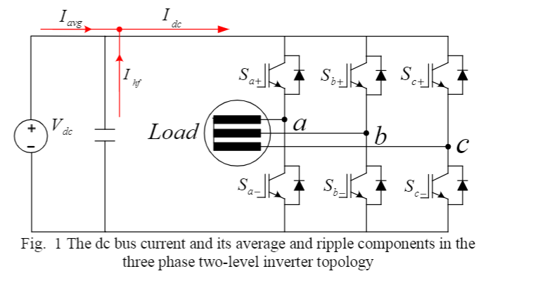
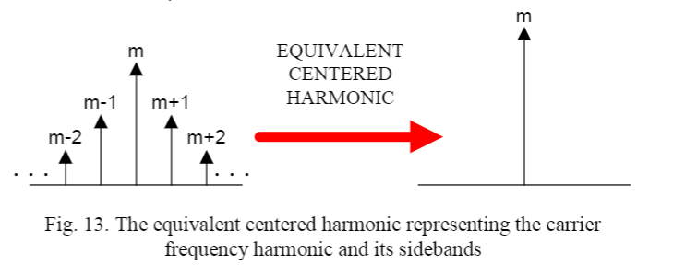
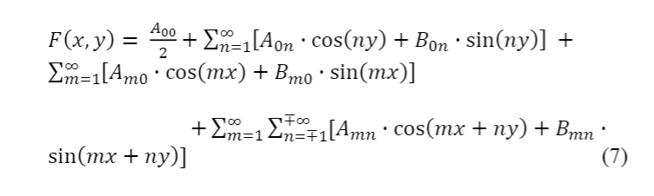
Analysis and Characterization of DC Bus Ripple Current of Two-Level Inverters Using The Equivalent Centered Harmonic Approach

Slide 21
DC BUS Ripple Calculation
RMS
Double Fourier Series
Actually, it is switching function
Considering Output Ripple
It can be bringed closed form
Ignoring Output ripple
Balanced
Unbalanced
Positive Sequence only and superimposed for each phase
Positive and Negative Sequence and superposition
$$V_{dc}+V_{hf}$$
$$V_{dc}+V_{hf}+V_{lf}$$

Slide 22
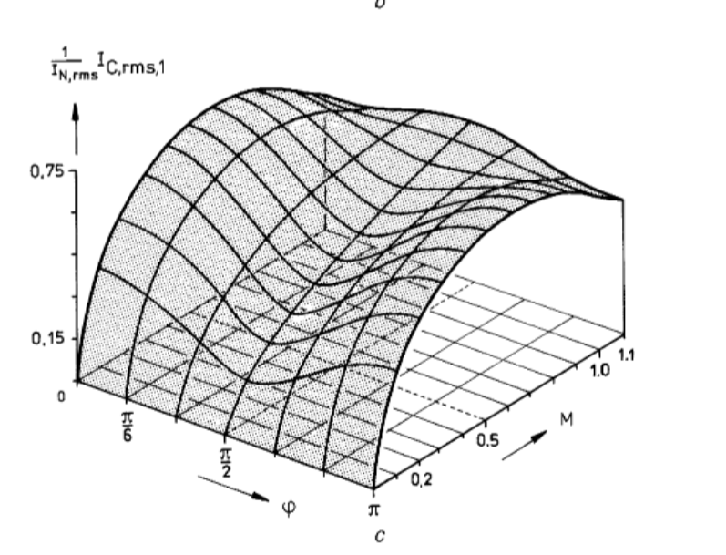
Analytical calculation of the RMS current stress on the DC-link capacitor of voltage-PWM converter systems (Kolar)

