Slide 1
AC-AC Inductive Power Transfer with Power Factor Correction(PFC) or Unity Power Factor(UPF)

Slide 2
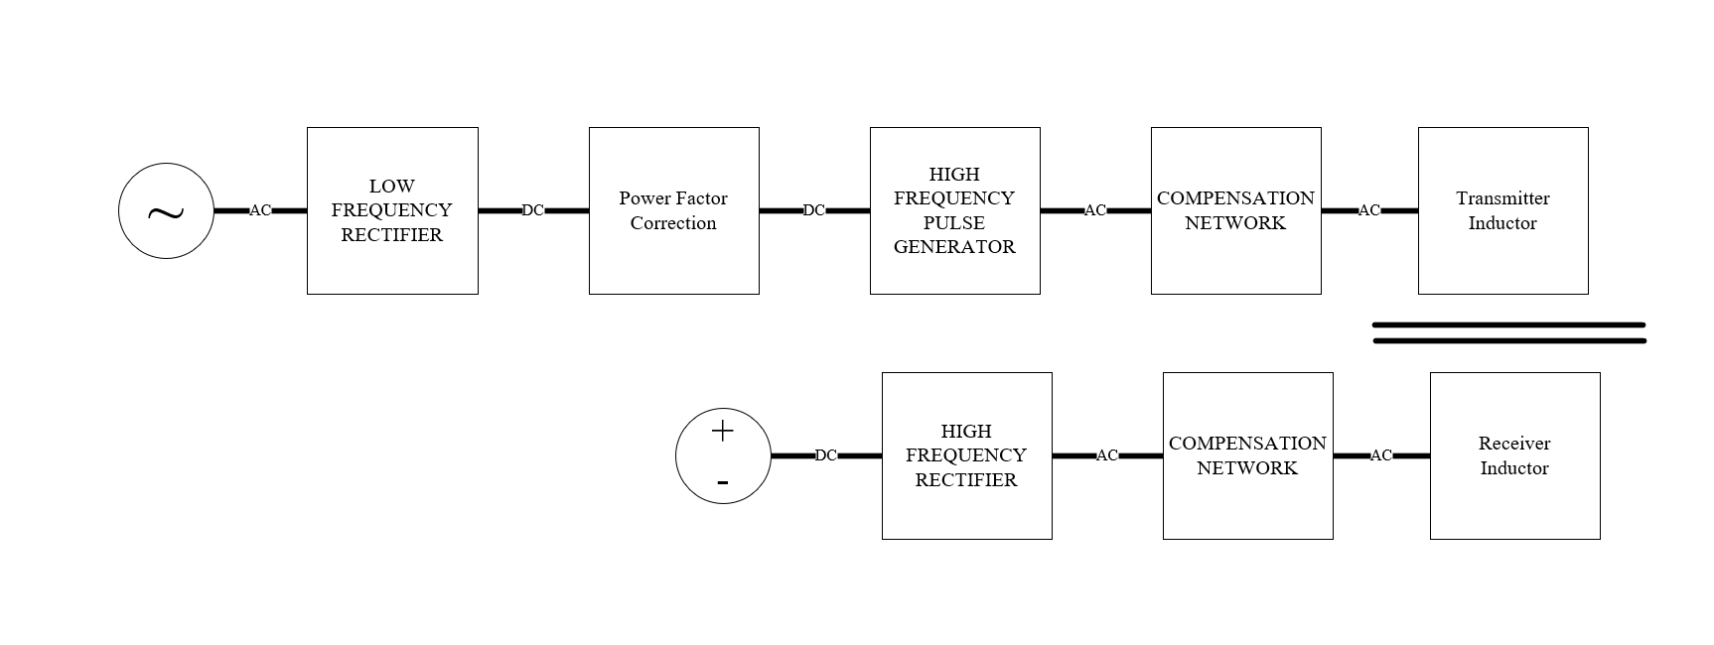
General block diagram of AC-to-DC conversion.

Slide 3
Aim :
LF-Rectifier, PFC or UPF and Pulse Generator can be combined to obtain a design with :
Single stage
A small number of the semiconductor devices. (lower cost)
Higher efficiency (ZCS,ZVS)

Slide 4
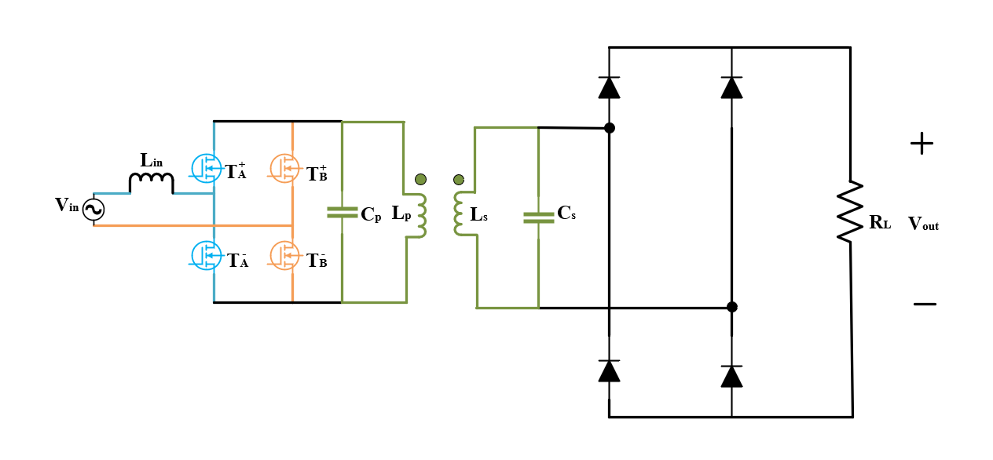
Proposed Design
All semiconductors are ideal and bidirectional voltage blocking for now.

Slide 5
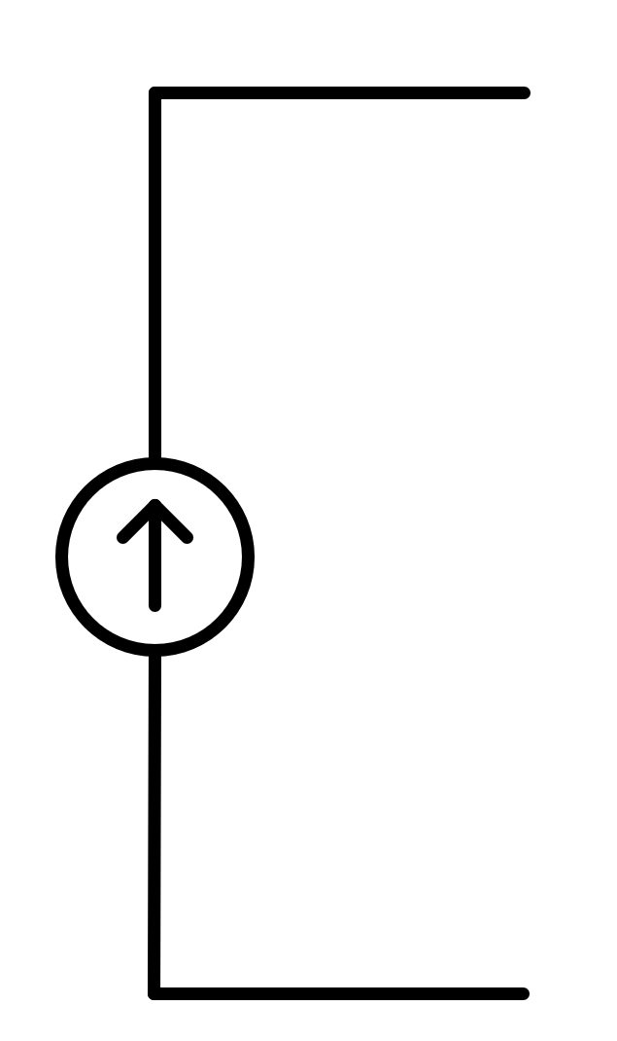
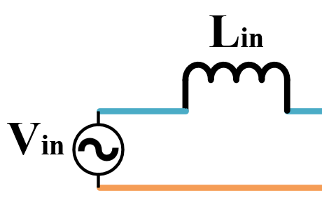
Input Side
For PFC or UPF, input side should behave like a current source
Line inductance or extra inductance is required to behave like a current source
The inductance value depend on desired ripple magnitude,switching frequency and input voltage.
Now, we can think that the input side is ideal current source.

Slide 6
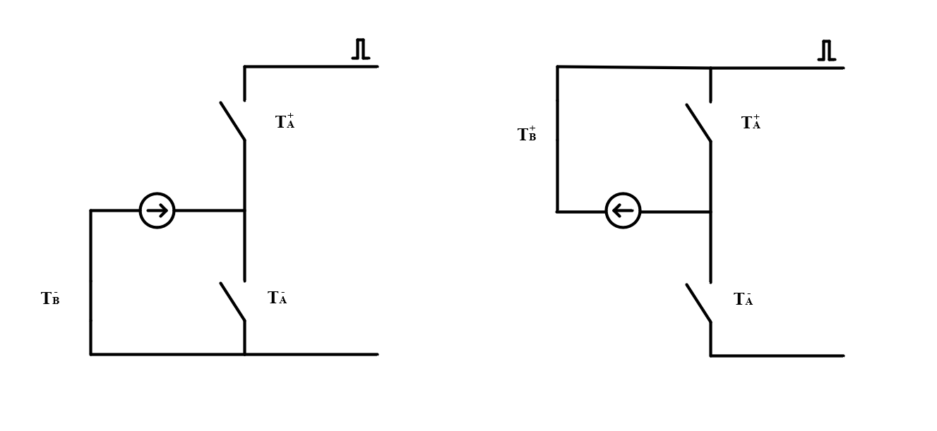
Input Side, Boost type

Slide 7
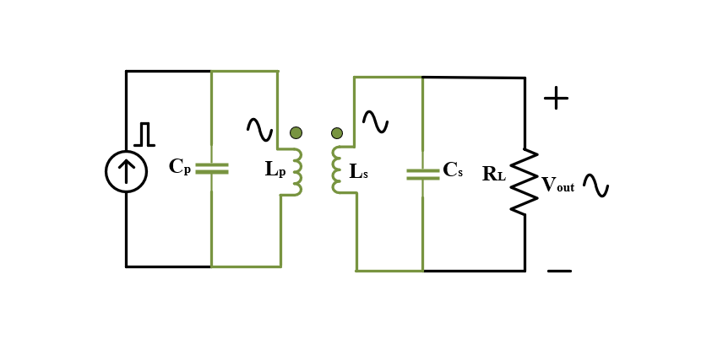
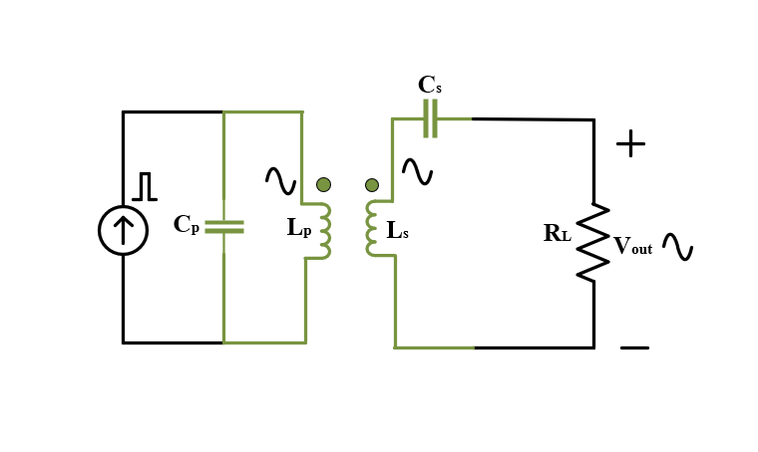
Resonant Circuit
The resonant circuit is fed by current. Then, the transmitter side should be parallel compensated (Or Hybrid compensated) to sinusoidal excitated inductor current.
Receiver side can be series or parallel compensated.
(For modular design, the series compensation for paralled common DC Bus or the parallel compensation for series common DC Bus)

Slide 8
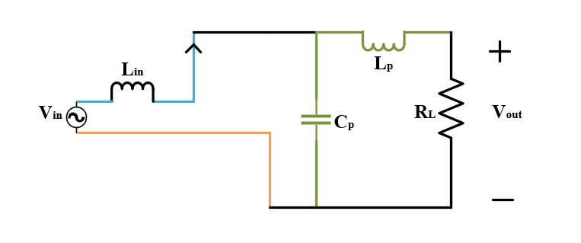
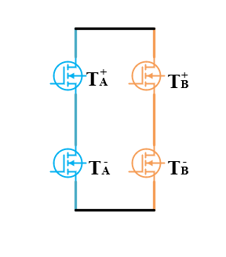
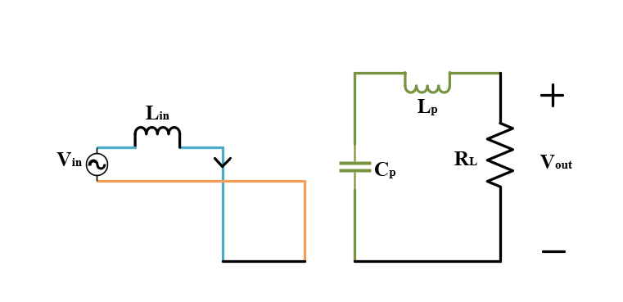


$T_{B}^{−}$ is on and $T_{A}^{+}$ is on
$T_{B}^{−}$ is on and $T_{A}^{−}$ is on

Slide 9
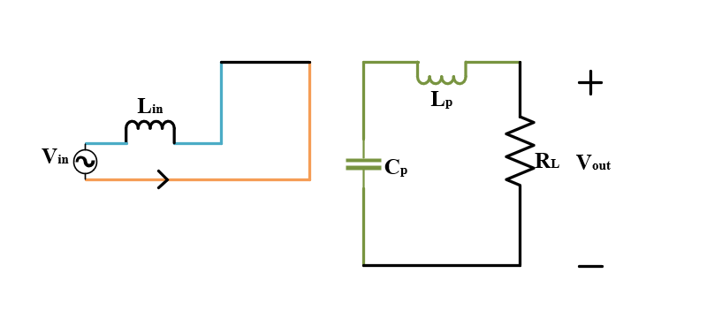
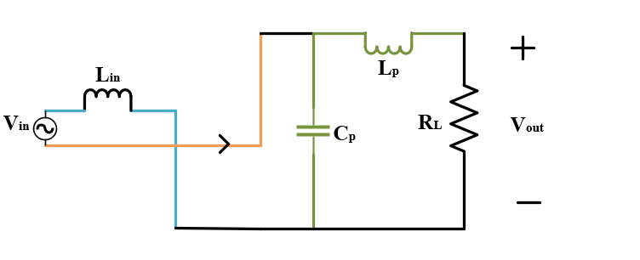


$T_{B}^{+}$ is on and $T_{A}^{+}$ is on
$T_{B}^{+}$ is on and $T_{A}^{−}$ is on

Slide 10
Simulation
DC positive simulation
DC negative simulation
AC simulation
Results are compared
Realization of switches (blocking voltage and current direction)
Voltage ratings
Current ratings

Slide 11
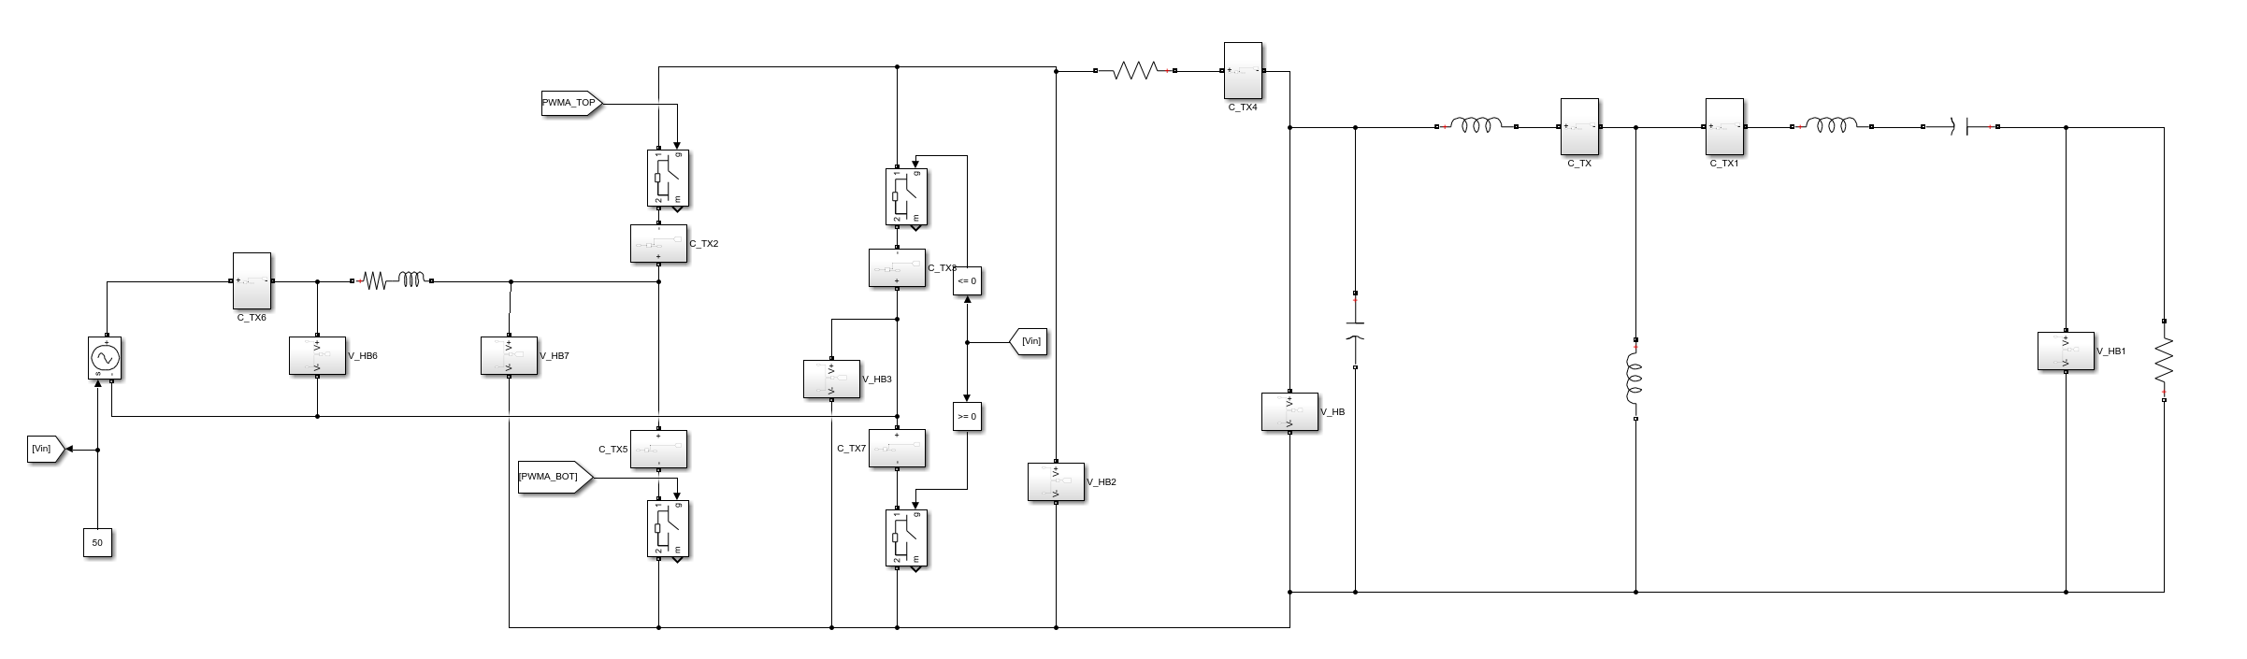
fs=150 kHz
Lp=32 uH
Ls=66 uH
Cs=17 nF
Cp=35.1 nF
RLOAD=16.2 ohm
k=0.2
M=9.2 uH
Lline=1.5 mH

Slide 12
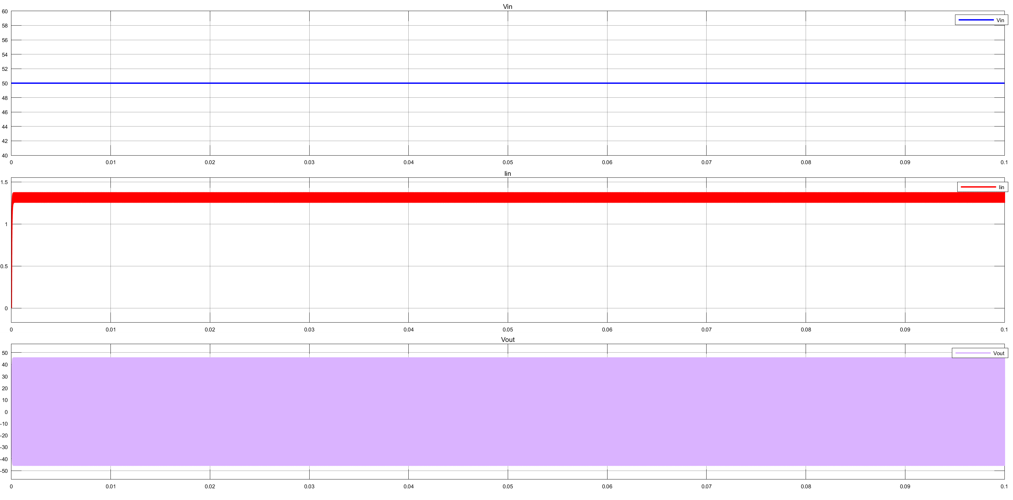
Vin = 50V
Iin = 1.3A
Vout= 32.5V

Slide 13
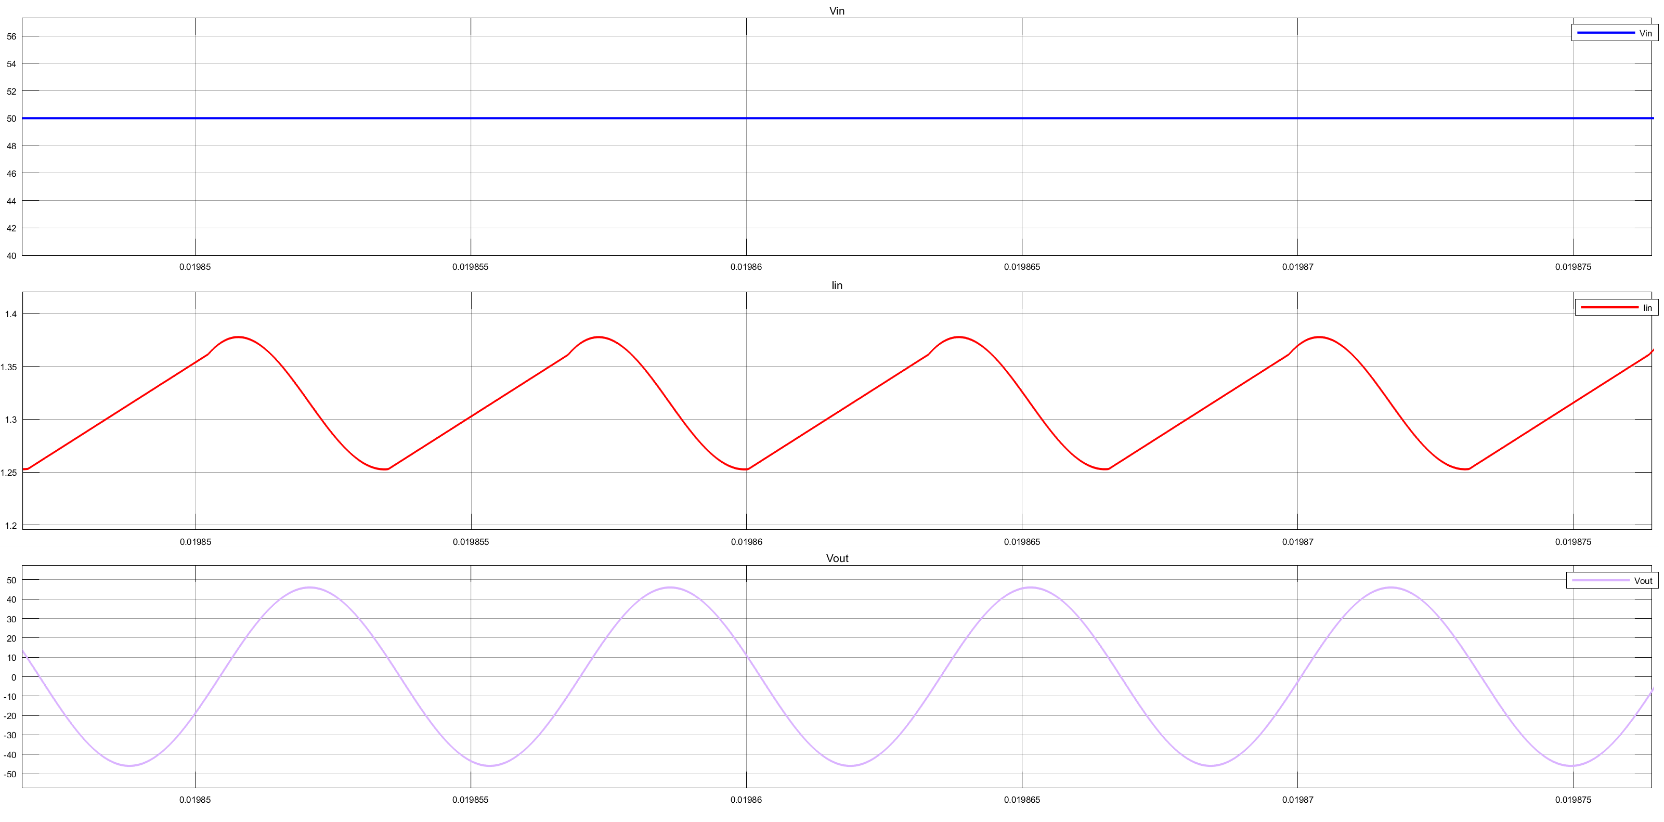

Slide 14
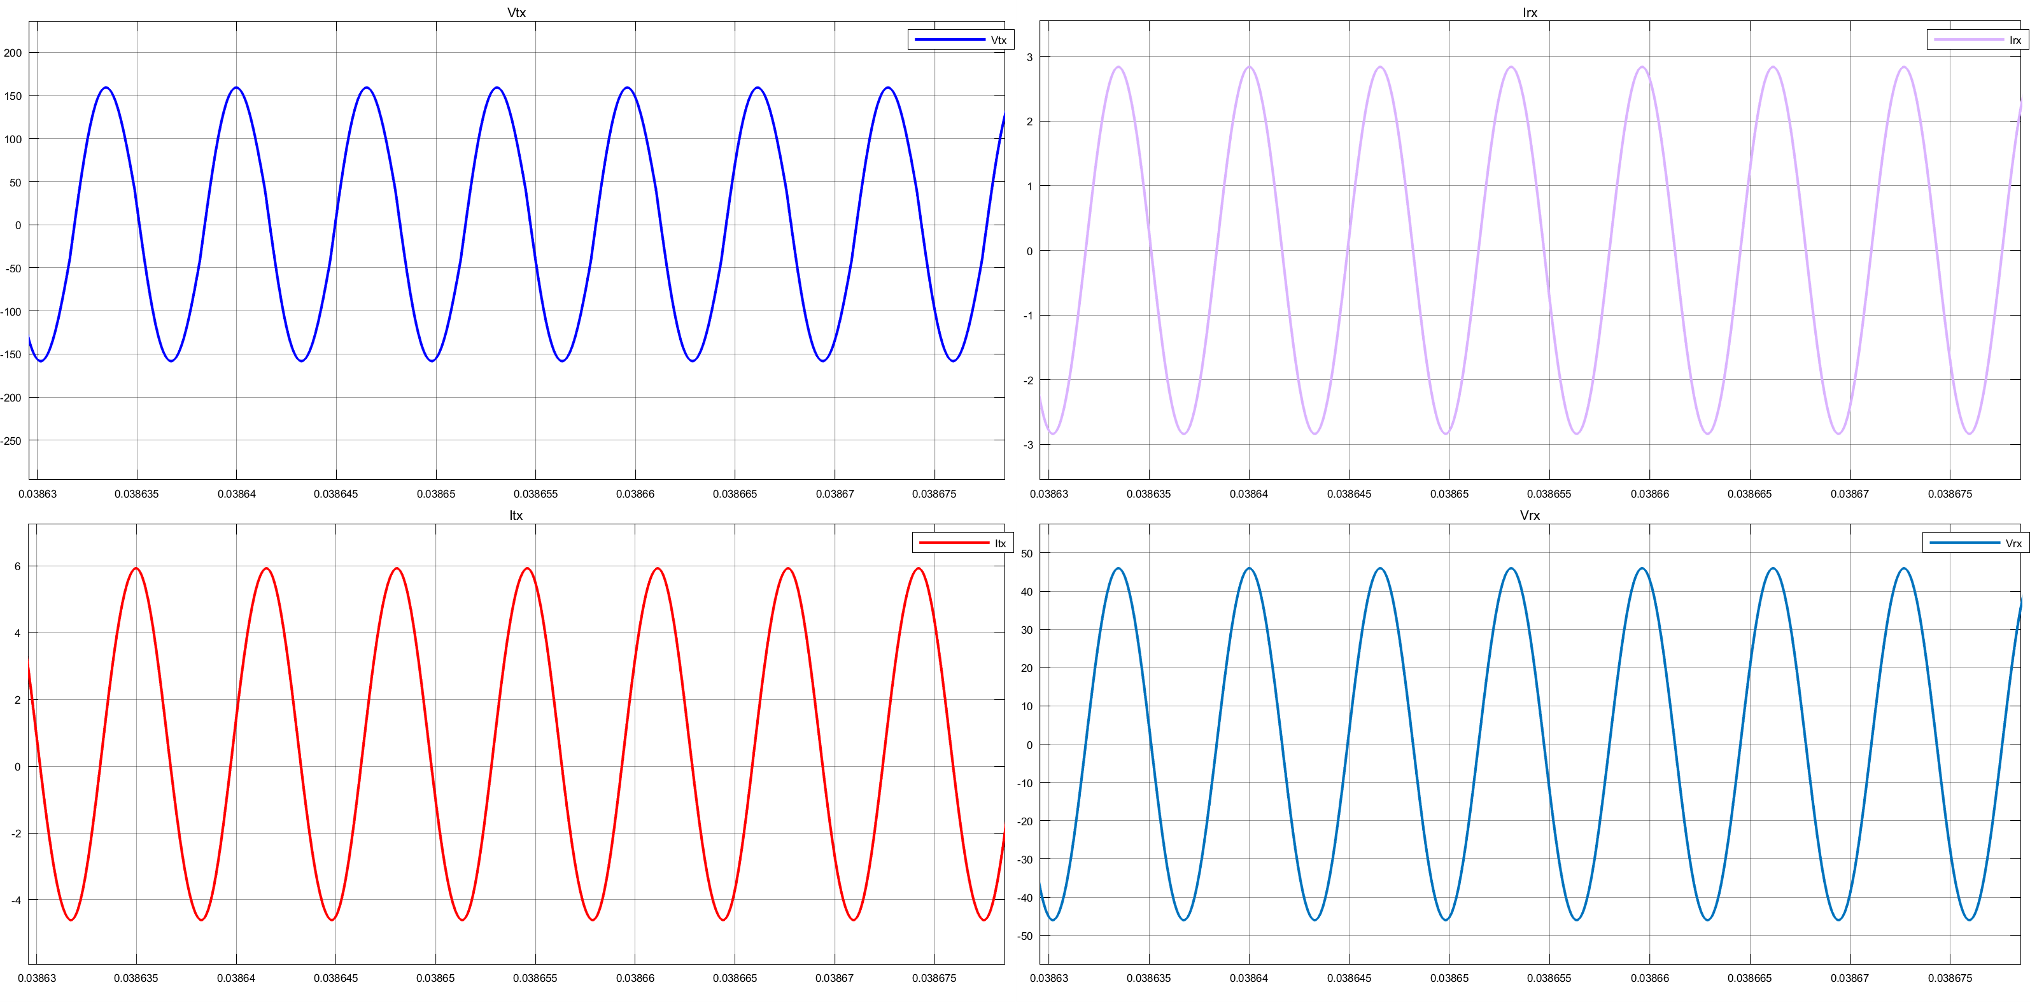

Slide 15
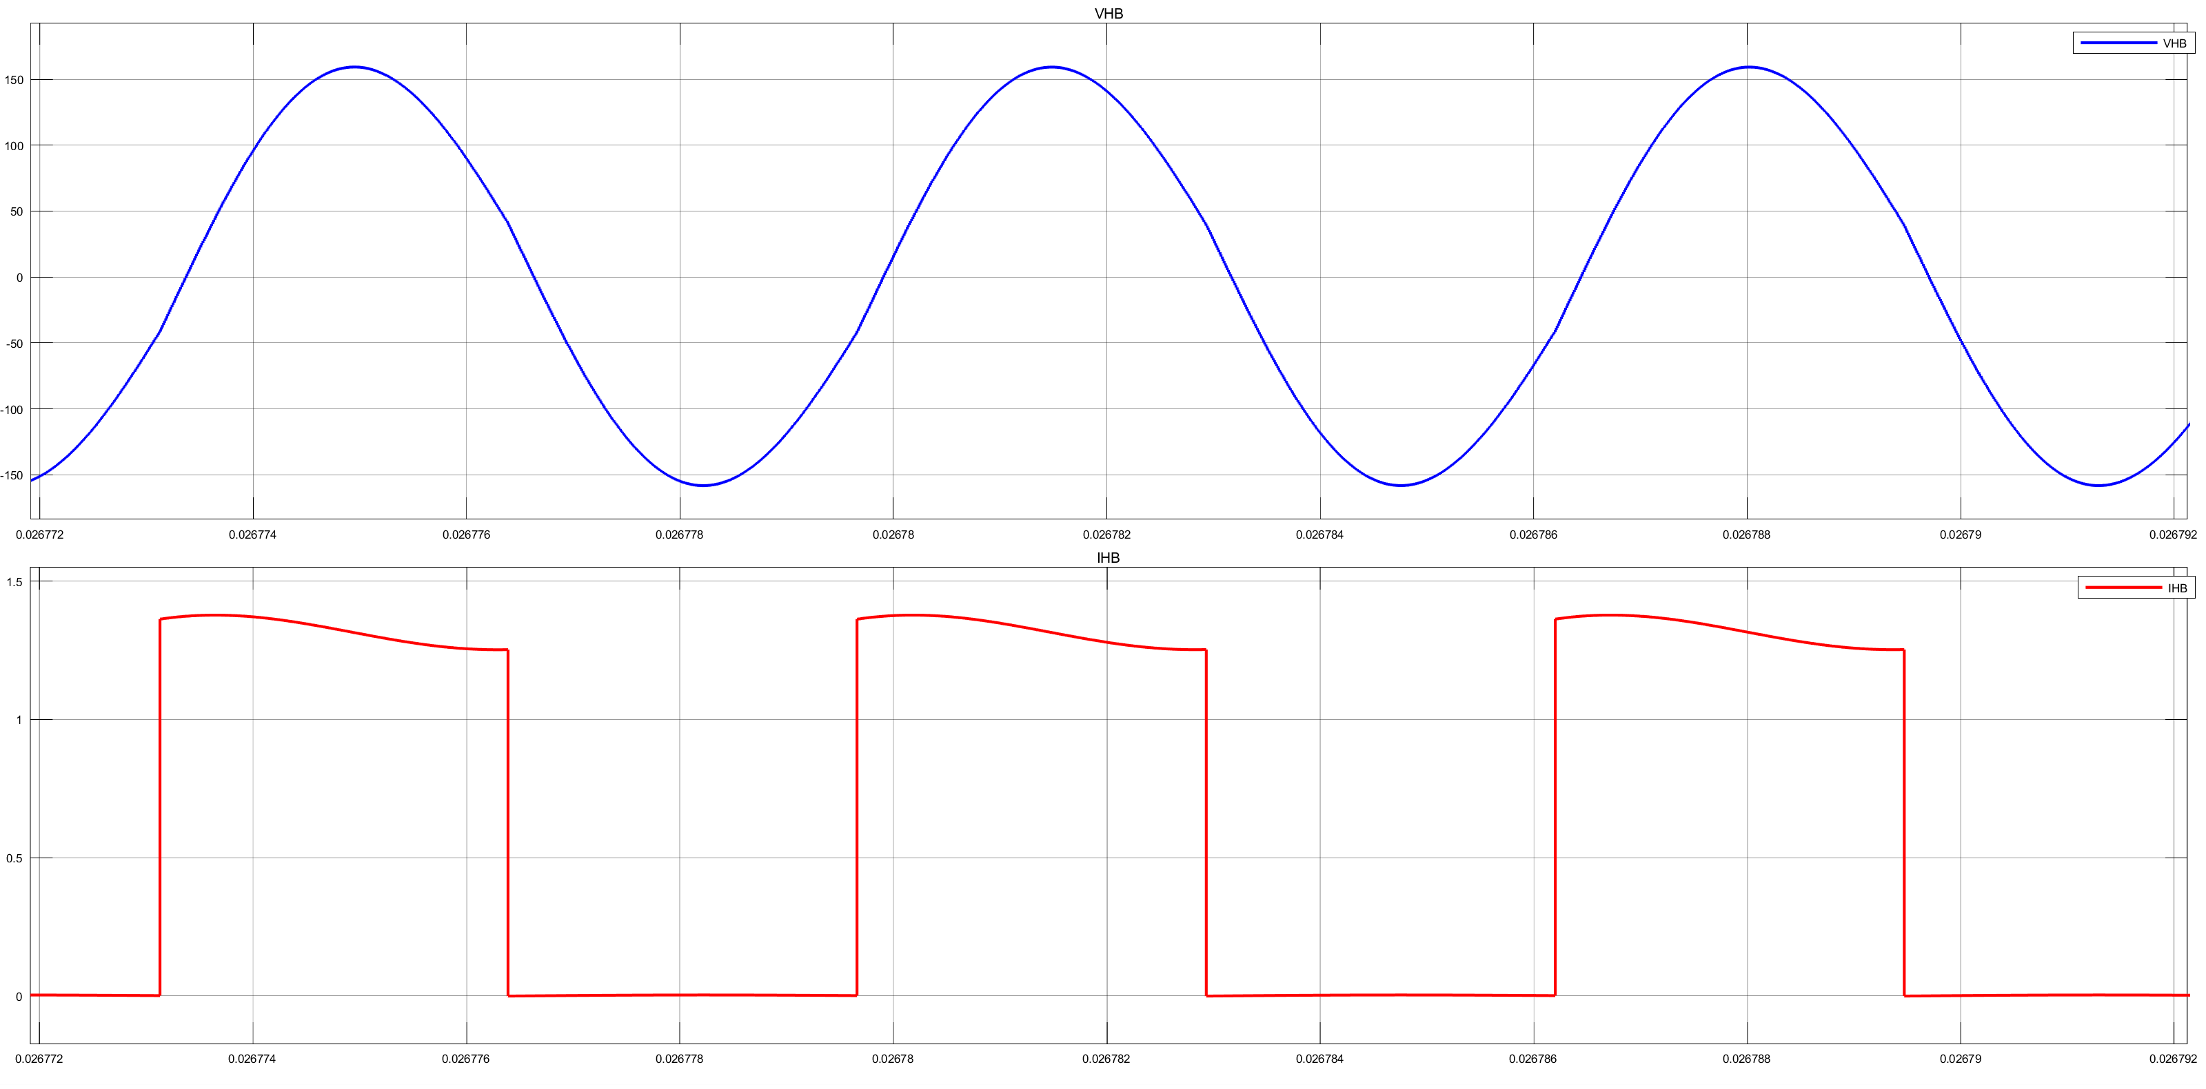

Slide 16
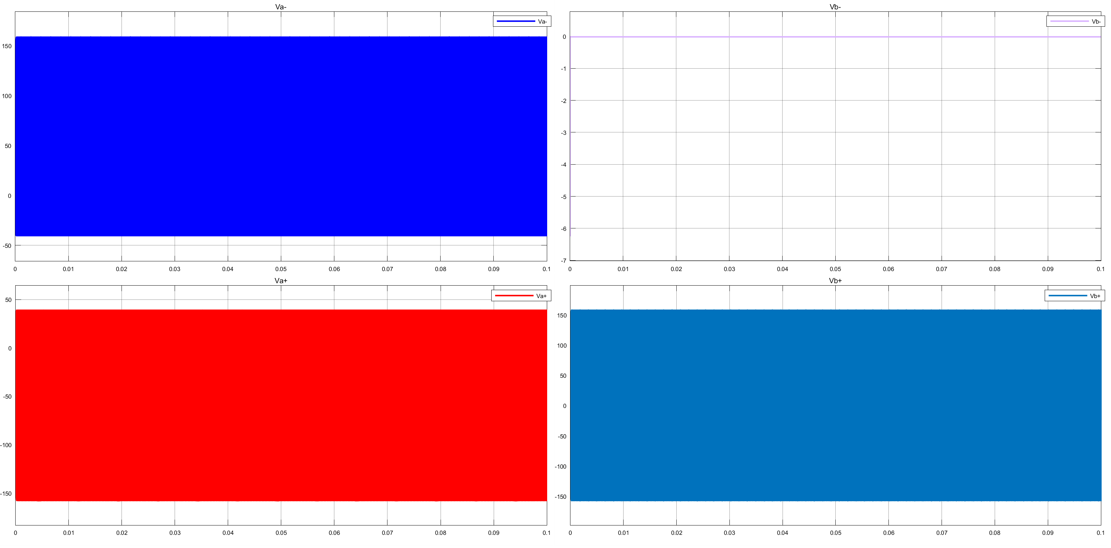

Slide 17
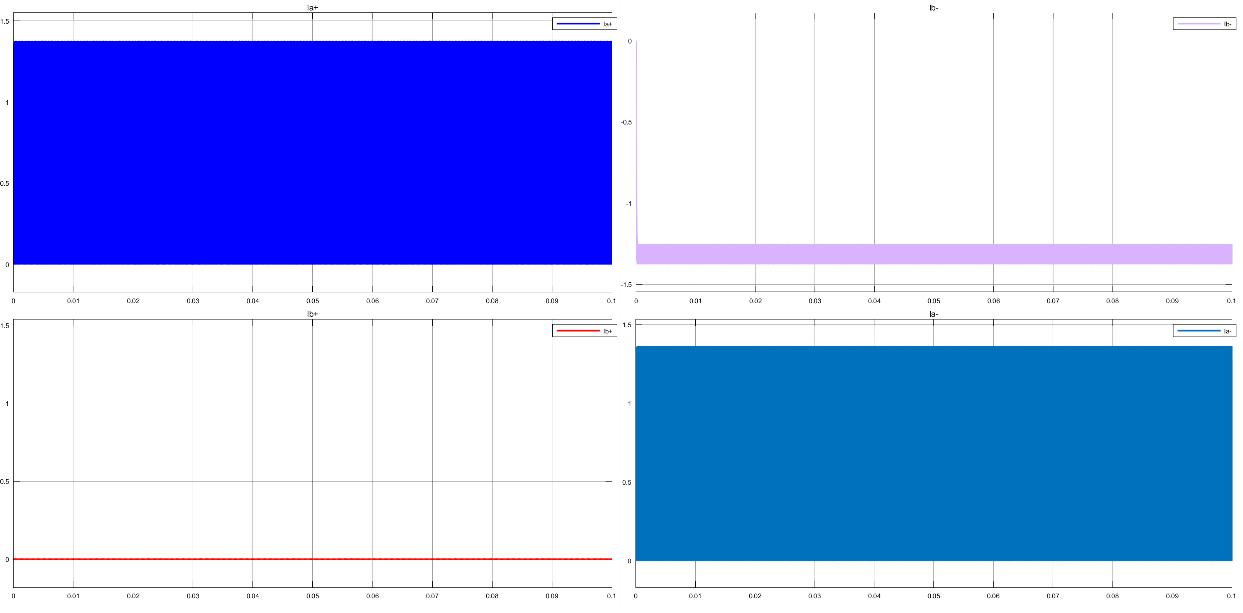

Slide 19
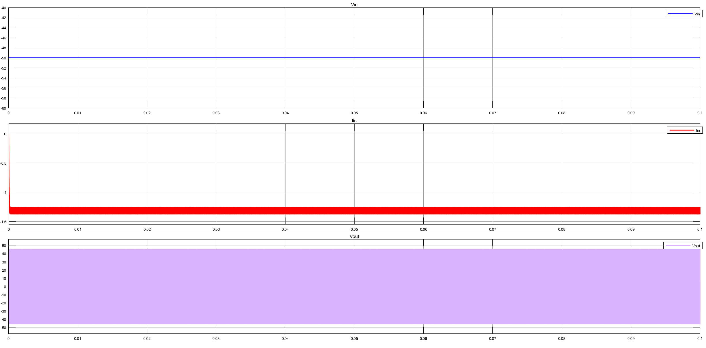

Slide 20
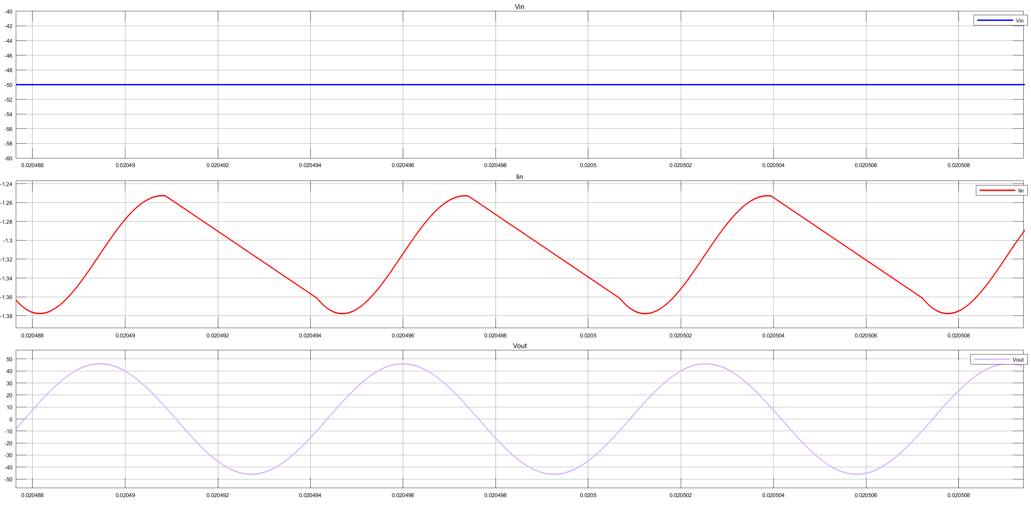

Slide 21
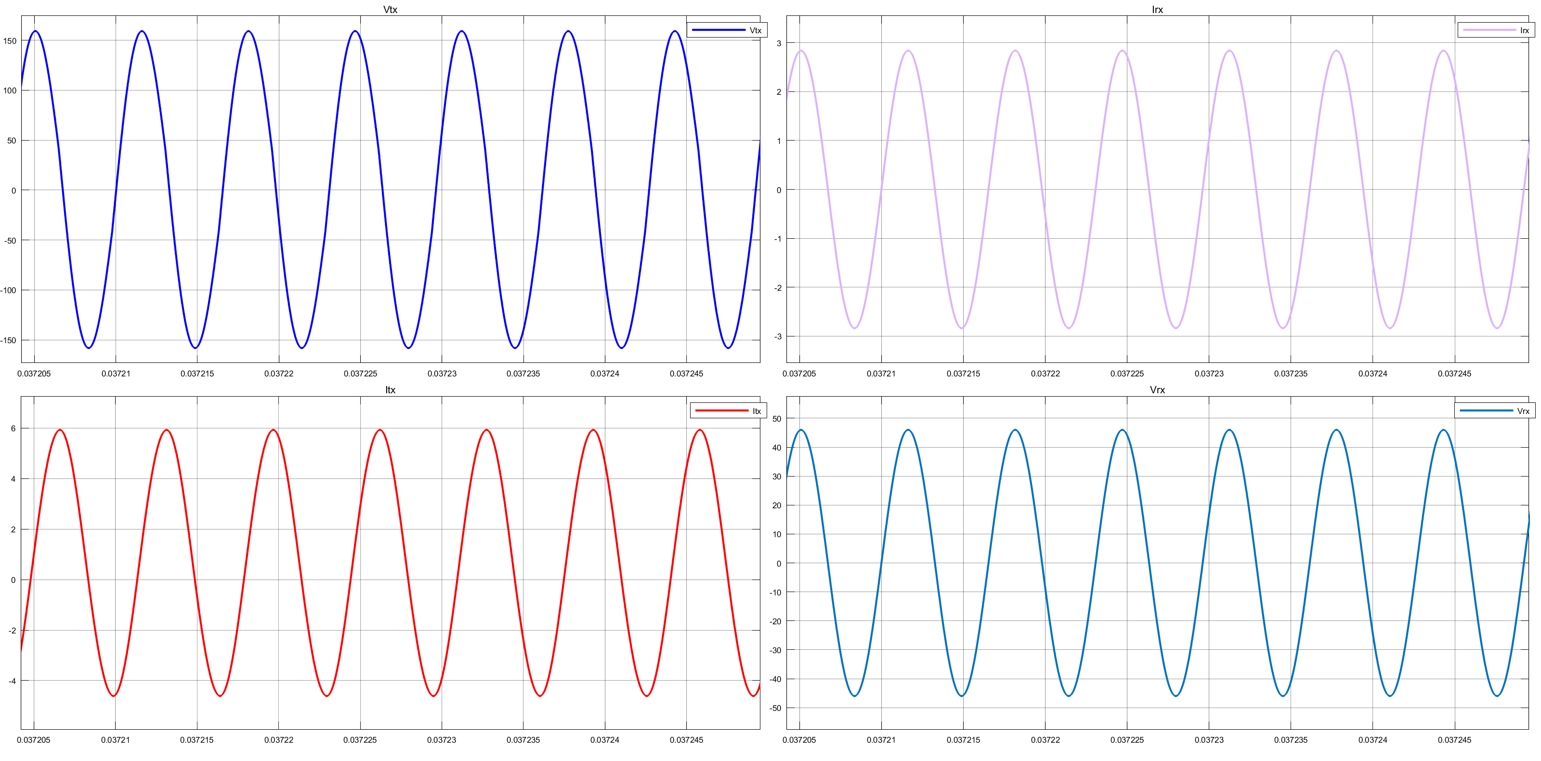

Slide 22
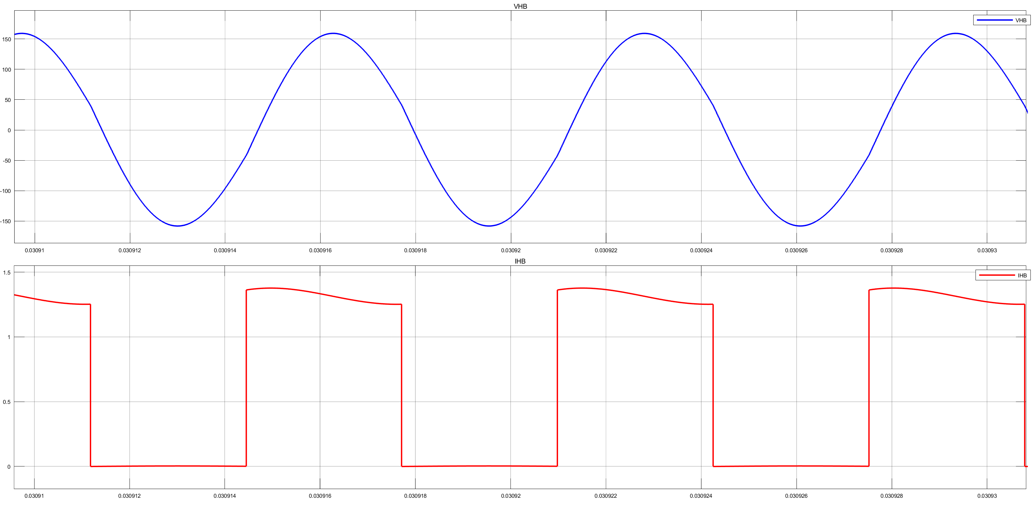

Slide 23
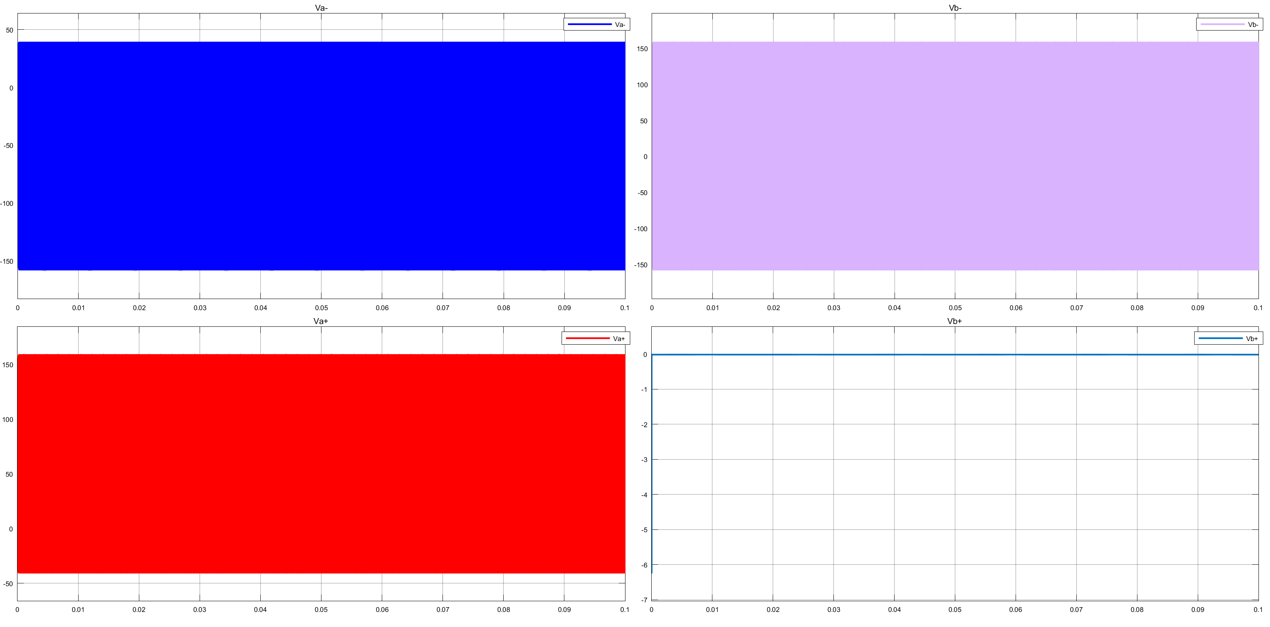

Slide 24
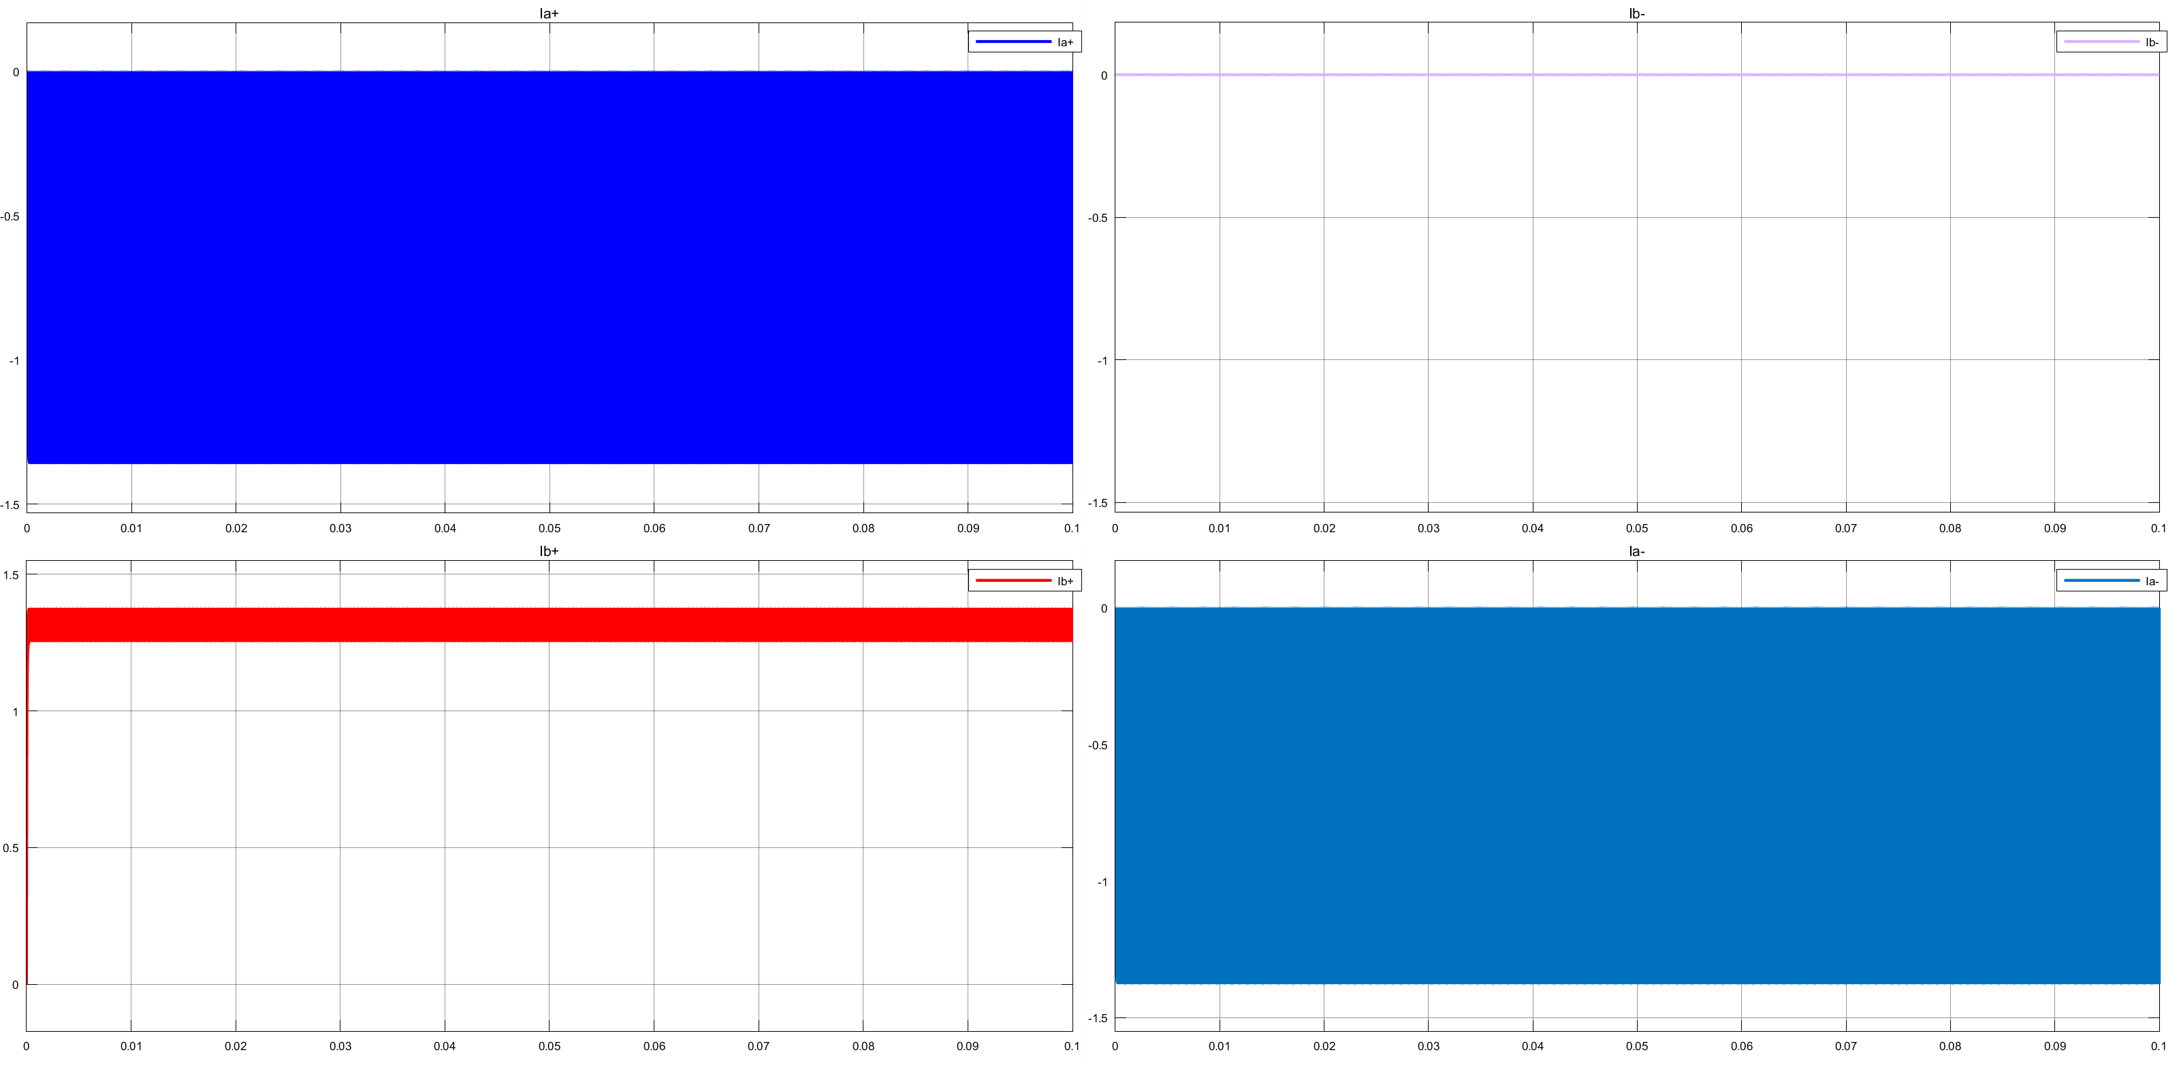

Slide 26
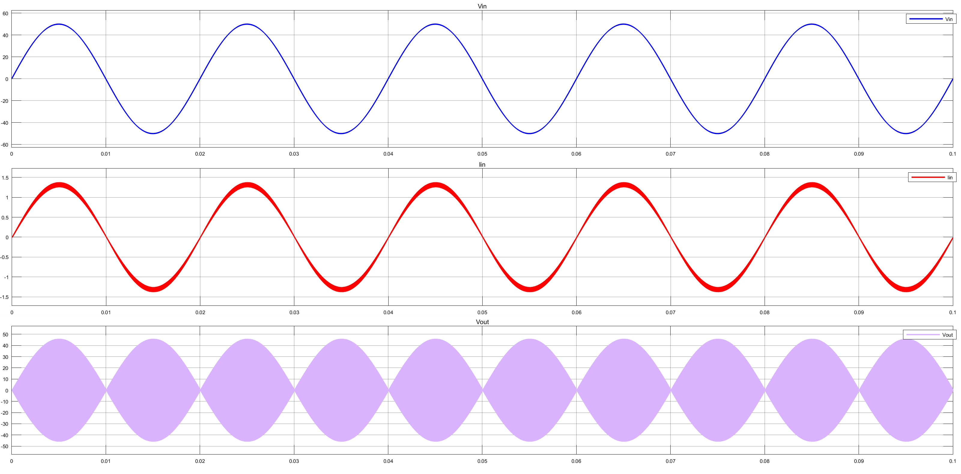

Slide 27
