Slide 1
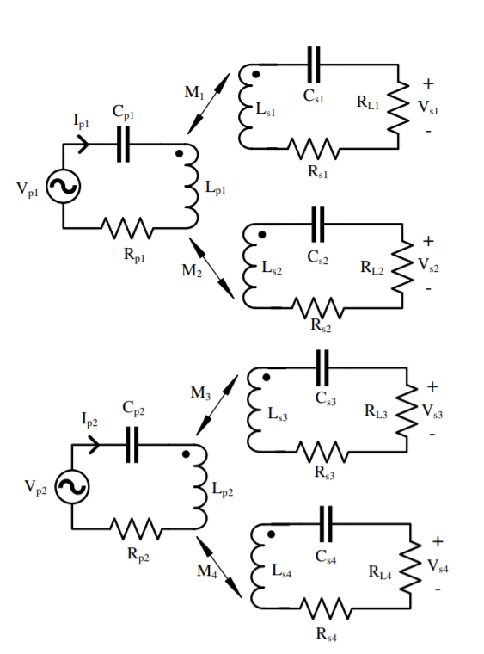
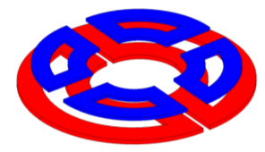
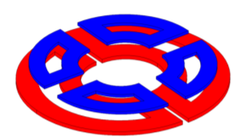
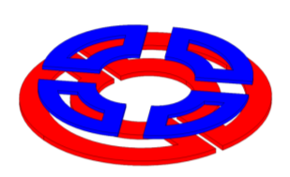
45°
Fully aligned secondaries with primaries. (0° )
Misaligned secondaries with primaries. (45°)

Slide 2
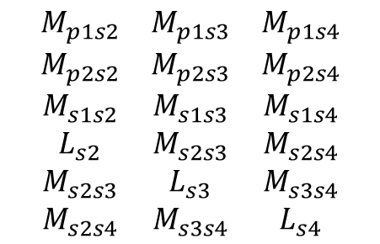
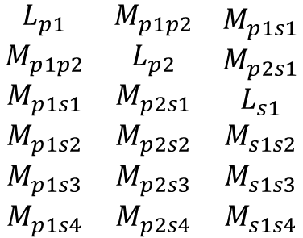
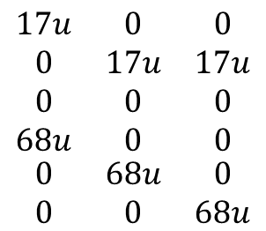
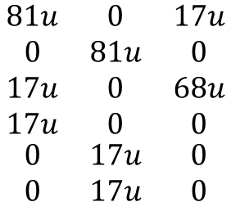
First Design
$$\begin{matrix}\begin{aligned}L_{p1} \\ M_{p1p2} \\ M_{p1s1} \\ M_{p1s2}\end{aligned} & \begin{aligned}M_{p1p2} \\ L_{p2} \\ M_{p2s1} \\ M_{p2s2}\end{aligned} & \begin{aligned}M_{p1s1} \\ M_{p2s1} \\ L_{s1} \\ M_{s1s2}\end{aligned} \\ M_{p1s3} & M_{p2s3} & M_{s1s3} \\ M_{p1s4} & M_{p2s4} & M_{s1s4}\end{matrix}$$
$$\begin{matrix}\begin{aligned}M_{p1s2} \\ M_{p2s2} \\ M_{s1s2} \\ L_{s2}\end{aligned} & \begin{aligned}M_{p1s3} \\ M_{p2s3} \\ M_{s1s3} \\ M_{s2s3}\end{aligned} & \begin{aligned}M_{p1s4} \\ M_{p2s4} \\ M_{s1s4} \\ M_{s2s4}\end{aligned} \\ M_{s2s3} & L_{s3} & M_{s3s4} \\ M_{s2s4} & M_{s3s4} & L_{s4}\end{matrix}$$
Only self inductances and the mutual inductance between Tx’s and Rx’s
No cross-coupling
$$\begin{matrix}\begin{aligned}81u \\ 0 \\ 17u \\ 17u\end{aligned} & \begin{aligned}0 \\ 81u \\ 0 \\ 0\end{aligned} & \begin{aligned}17u \\ 0 \\ 68u \\ 0\end{aligned} \\ 0 & 17u & 0 \\ 0 & 17u & 0\end{matrix}$$
$$\begin{matrix}\begin{aligned}17u \\ 0 \\ 0 \\ 68u\end{aligned} & \begin{aligned}0 \\ 17u \\ 0 \\ 0\end{aligned} & \begin{aligned}0 \\ 17u \\ 0 \\ 0\end{aligned} \\ 0 & 68u & 0 \\ 0 & 0 & 68u\end{matrix}$$

Slide 3
Rotational Misalignment
45°
Fully aligned secondaries with primaries. (0° )
Misaligned secondaries with primaries. (45°)

Slide 4
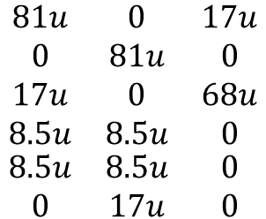
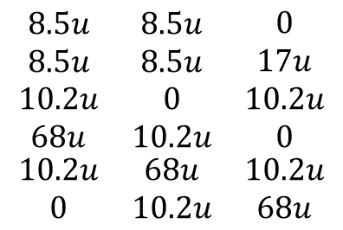
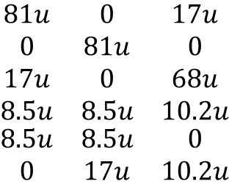
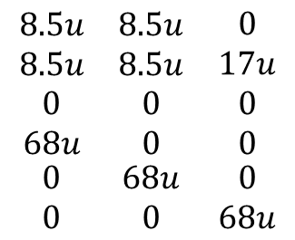
$$\begin{matrix}\begin{aligned}81u \\ 0 \\ 17u \\ 8.5u\end{aligned} & \begin{aligned}0 \\ 81u \\ 0 \\ 8.5u\end{aligned} & \begin{aligned}17u \\ 0 \\ 68u \\ 0\end{aligned} \\ 8.5u & 8.5u & 0 \\ 0 & 17u & 0\end{matrix}$$
$$\begin{matrix}\begin{aligned}8.5u \\ 8.5u \\ 0 \\ 68u\end{aligned} & \begin{aligned}8.5u \\ 8.5u \\ 0 \\ 0\end{aligned} & \begin{aligned}0 \\ 17u \\ 0 \\ 0\end{aligned} \\ 0 & 68u & 0 \\ 0 & 0 & 68u\end{matrix}$$
Load balancing is ensured with cross-coupling
For load balancing
$$\begin{matrix}\begin{aligned}81u \\ 0 \\ 17u \\ 8.5u\end{aligned} & \begin{aligned}0 \\ 81u \\ 0 \\ 8.5u\end{aligned} & \begin{aligned}17u \\ 0 \\ 68u \\ 10.2u\end{aligned} \\ 8.5u & 8.5u & 0 \\ 0 & 17u & 10.2u\end{matrix}$$
$$\begin{matrix}\begin{aligned}8.5u \\ 8.5u \\ 10.2u \\ 68u\end{aligned} & \begin{aligned}8.5u \\ 8.5u \\ 0 \\ 10.2u\end{aligned} & \begin{aligned}0 \\ 17u \\ 10.2u \\ 0\end{aligned} \\ 10.2u & 68u & 10.2u \\ 0 & 10.2u & 68u\end{matrix}$$

Slide 5
Real Values for aligned case
82.47 | -4.235 | 17.065 | 15.265 | 0.465 | 0.815
-4.235 | 83 | 1 | 0.9 | 13.9 | 16.4
17.065 | 1 | 63.7 | -6.65 | -0.65 | -9.55
15.265 | 0.9 | -6.65 | 66.2 | -9.55 | -0.85
0.465 | 13.9 | -0.65 | -9.55 | 64.2 | -5.8
0.815 | 16.4 | -9.55 | -0.85 | -5.8 | 65.9
1 | -0.051187789 | 0.235444516 | 0.206595005 | 0.006390538 | 0.011055208
-0.051187789 | 1 | 0.013752803 | 0.012141559 | 0.190418106 | 0.221749217
0.235444516 | 0.013752803 | 1 | -0.102405418 | -0.010164268 | -0.147397782
0.206595005 | 0.012141559 | -0.102405418 | 1 | -0.146489624 | -0.012869072
0.006390538 | 0.190418106 | -0.010164268 | -0.146489624 | 1 | -0.089169796
0.011055208 | 0.221749217 | -0.147397782 | -0.012869072 | -0.089169796 | 1

Slide 6
Real Values for 45 degree misaligned case
82.3 | -4.3 | 8.275 | 18.55 | 6.025 | -0.15
-4.3 | 82.3 | 7 | 0.15 | 6.475 | 18.35
8.275 | 7 | 63.6 | -6.4 | -0.825 | -9.7
18.55 | 0.15 | -6.4 | 66.2 | -9.825 | -0.85
6.025 | 6.475 | -0.825 | -9.825 | 64.65 | -5.575
-0.15 | 18.35 | -9.7 | -0.85 | -5.575 | 66
1 | -0.052247874 | 0.114377217 | 0.251313027 | 0.082598635 | -0.002035258
-0.052247874 | 1 | 0.096754142 | 0.002032181 | 0.088767827 | 0.24897984
0.114377217 | 0.096754142 | 1 | -0.098633041 | -0.012865928 | -0.149717032
0.251313027 | 0.002032181 | -0.098633041 | 1 | -0.15018249 | -0.012859319
0.082598635 | 0.088767827 | -0.012865928 | -0.15018249 | 1 | -0.085347075
-0.002035258 | 0.24897984 | -0.149717032 | -0.012859319 | -0.085347075 | 1

Slide 7
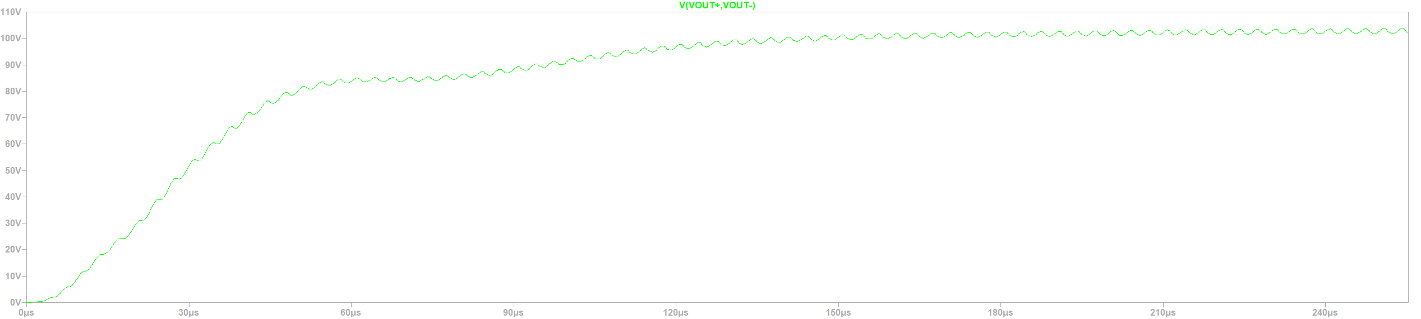
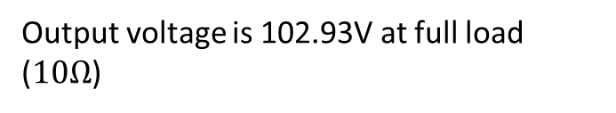
Simulation with real values for aligned case
The capacitor values and resonance freequency (operation) is taken as ideal case.
Output voltage is 102.93V at full load ($10Ω$)

Slide 8
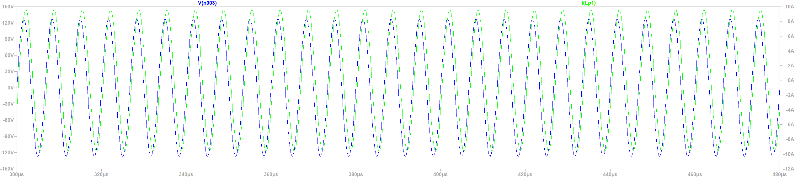
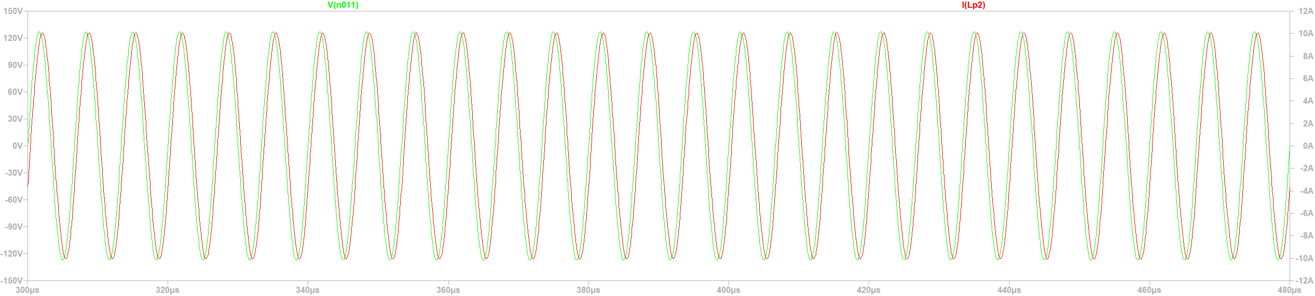


$$I_{p2}=7.07 A(rms)$$
$$I_{p1}=6.713 A(rms)$$
Also, both inductor currents lag the input voltages.

Slide 9
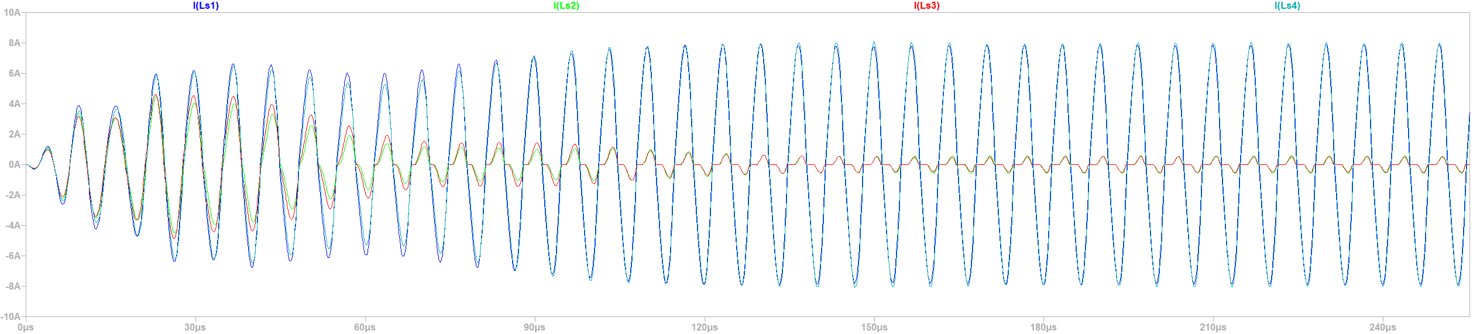




WHY??
First reason is cross-coupling is smaller than expected.
Second reason is sum of cross-coupling problem. We design the 1Tx-2Rx and found the cross-coupling is above 0.30. For 2Tx-4Rx design, a Rx’s are supported by 2 Rx’s and we can decrease the required coupling to 0.15.
However, there is a problem for these method.
If two neighbor Rx’s has smaller coupling than other two. They can not support each other.
In our case, both first and second occur.
$I_{s1}= 384.6mA$(rms )
$I_{s2}=$ 369.21mA (rms)
$I_{s3}=$ 5.4543A (rms)
$I_{s4}=5.5364A$ (rms)

Slide 10
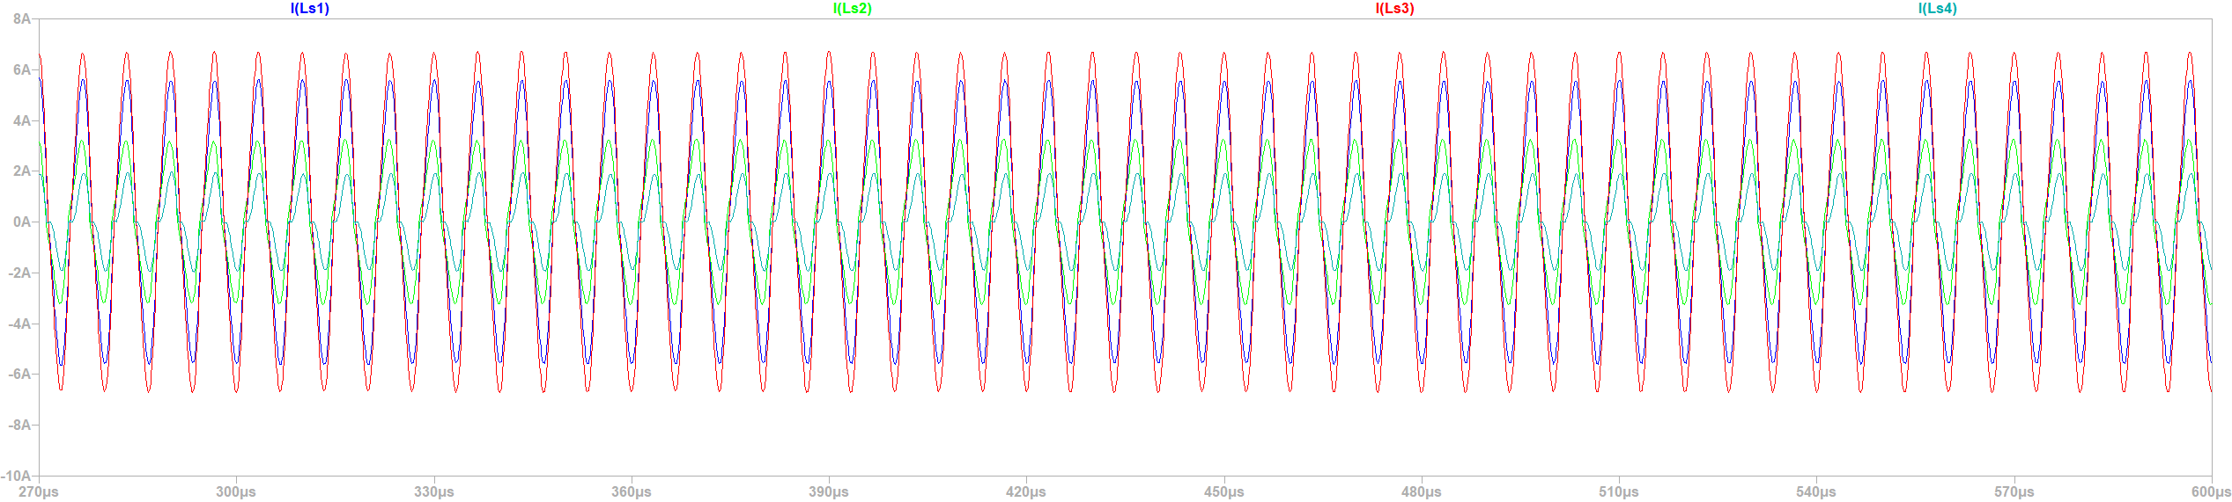




Change only, S4 and S2 couplings
$I_{s1}=3.7849$(rms )
$I_{s2}=$ 2.1648A (rms)
$I_{s3}=$ 4.5967 A (rms)
$I_{s4}=1.1481$(rms)

Slide 11
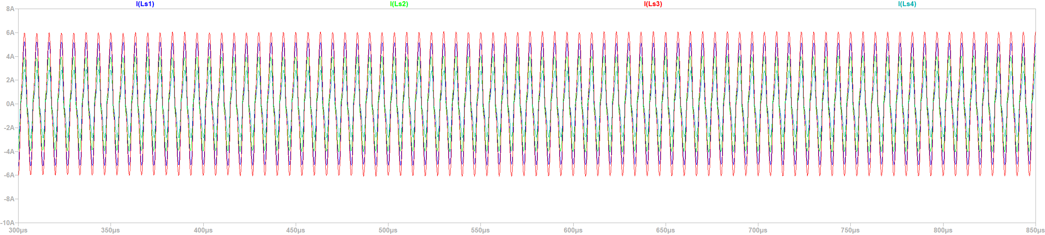




Change the cross-coupling (İncrease the lower cross-coupling to 0.15)
The values can be acceptable considering the coupling ratios as
0.235
0.2060
0.2217
0.1904
$I_{s1}=3.4227A$(rms )
$I_{s2}=$ 2.6806 (rms)
$I_{s3}=$ 4.0976 A (rms)
$I_{s4}=1.77881$(rms)

Slide 12
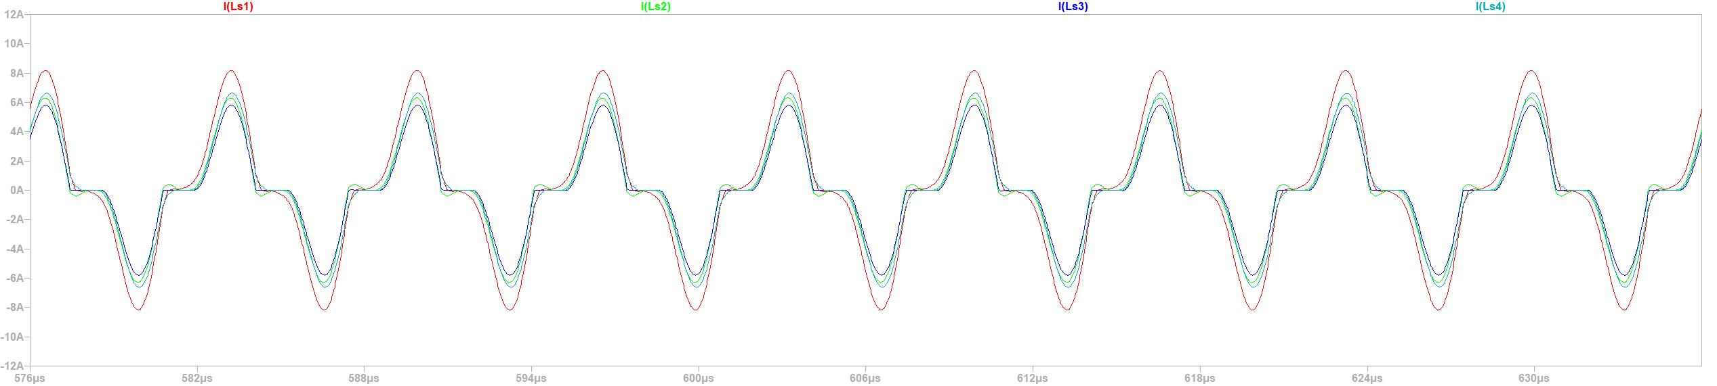
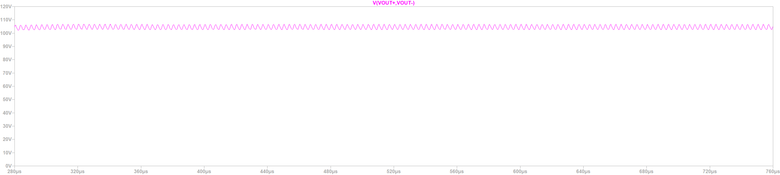





The couplings stay the same and increasing cross-coupling to -0.35
$I_{s1}=4.5426A$(rms )
$I_{s2}=$3.3522 A(rms)
$I_{s3}=$ 3.0514 A (rms)
$I_{s4}=3.578$ A(rms)
$$V_{out}=104.55 V$$

Slide 13
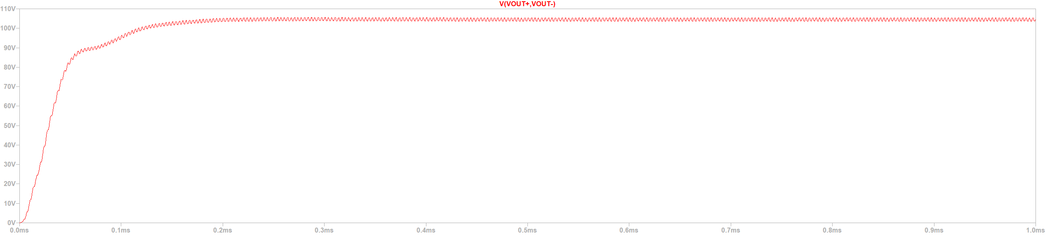

Simulation with real values for 45 degree misaligned case
Output voltage is 104.51V at full load ($10Ω$)

Slide 14
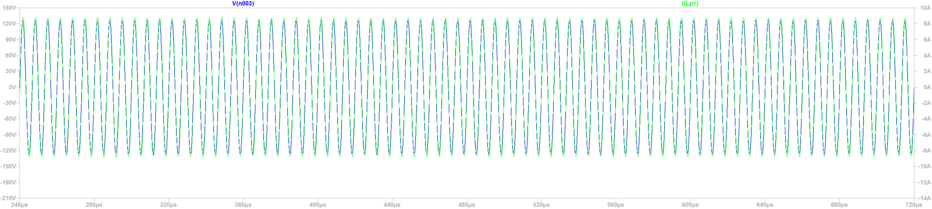
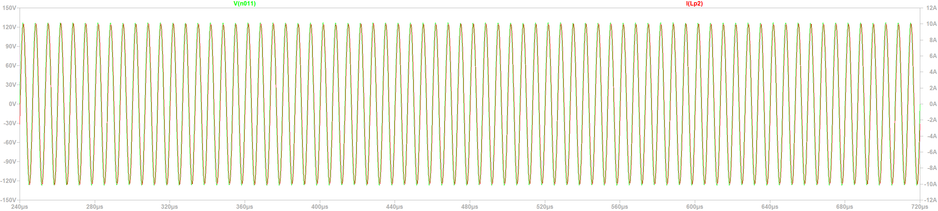


$$I_{p2}=7.0345 A(rms)$$
$$I_{p1}=6.1865 A(rms)$$
Also, both inductor currents lag the input voltages.

Slide 15
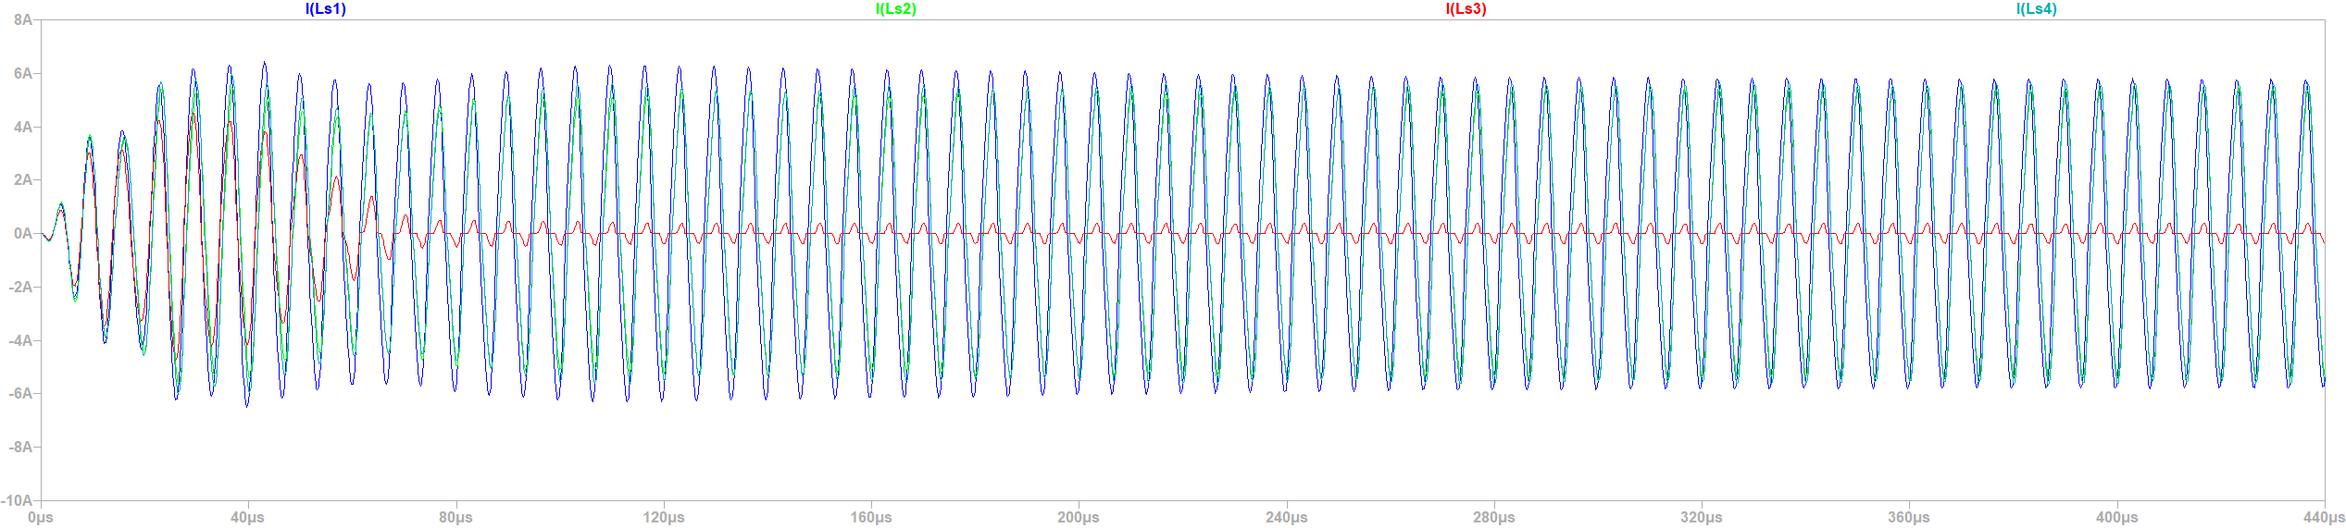




$I_{s1}=4.127$ A(rms )
Third seconder has lower coupling and the coupling is unexpected (very low)
0.114+0.097 =0.21
0.2513 +0.002= 0.2515
0.0826+0.088=0.1706
0.002+0.24 = 0.2402
$I_{s2}=$ 3.5523A (rms)
$I_{s3}= 911.51mA$(rms)
$I_{s4}=3.6977A$ (rms)
Also, secondary 3 has lower cross-coupling

Slide 16
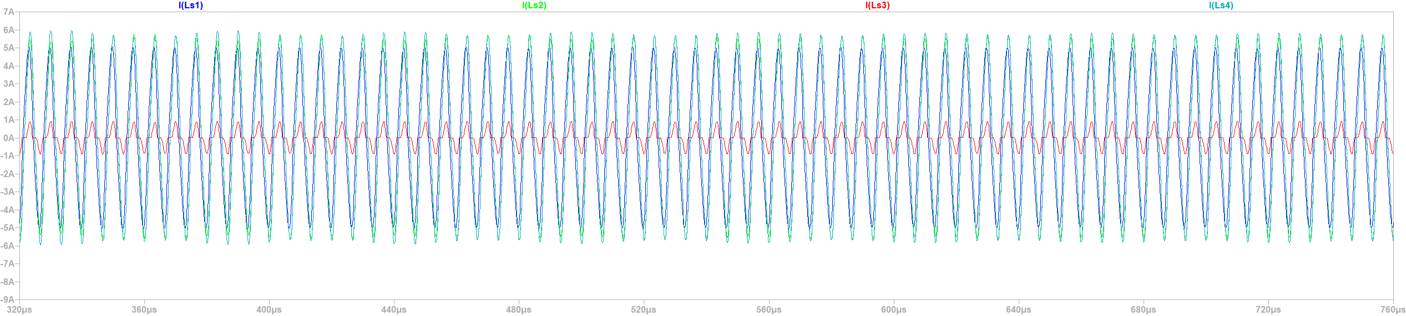
Increasing cross coupling of secondary 3 ( 0.085 ➔ 0.15)
Not working !!

Slide 17
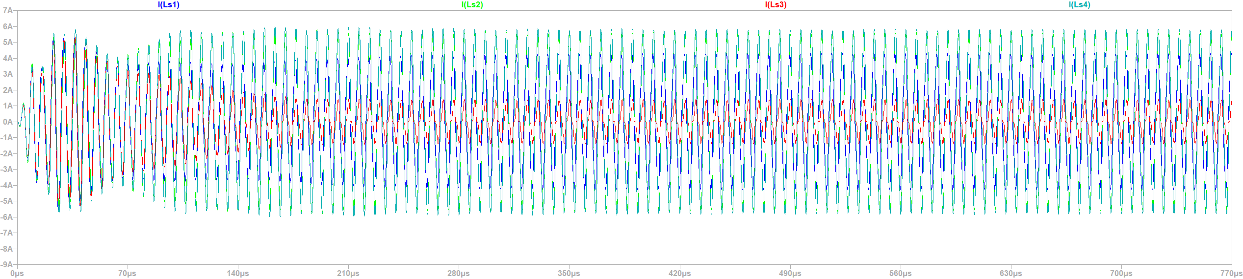




İncreasing the coupling of S3
0.0826+0.088=0.1706
0.10+0.105 = 0.205
$I_{s1}=2.9364A$ (rms )
0.114+0.097 =0.21
0.2513 +0.002= 0.2515
0.10+0.105 = 0.205 0.002+0.24 = 0.2402
$I_{s2}=$ 3.8186A (rms)
$$I_{s3}=798.81mA$$
$$I_{s4}=3.9815A$$

Slide 18
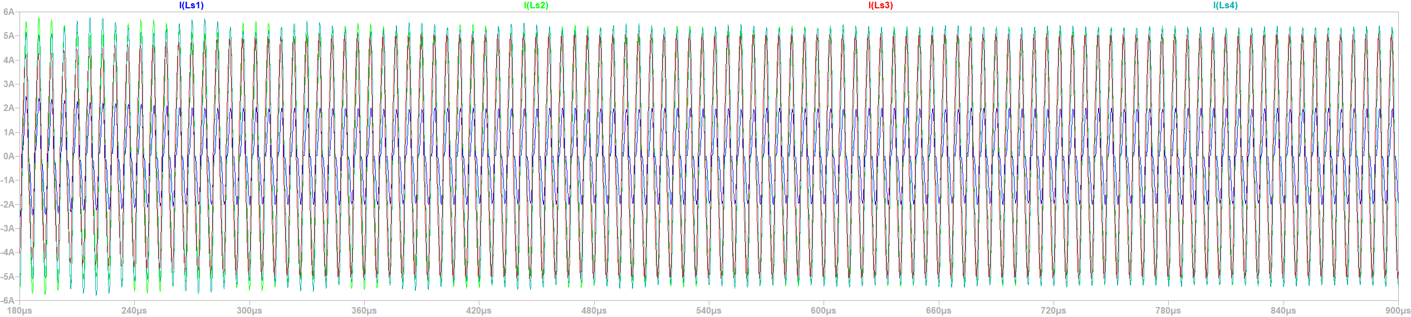
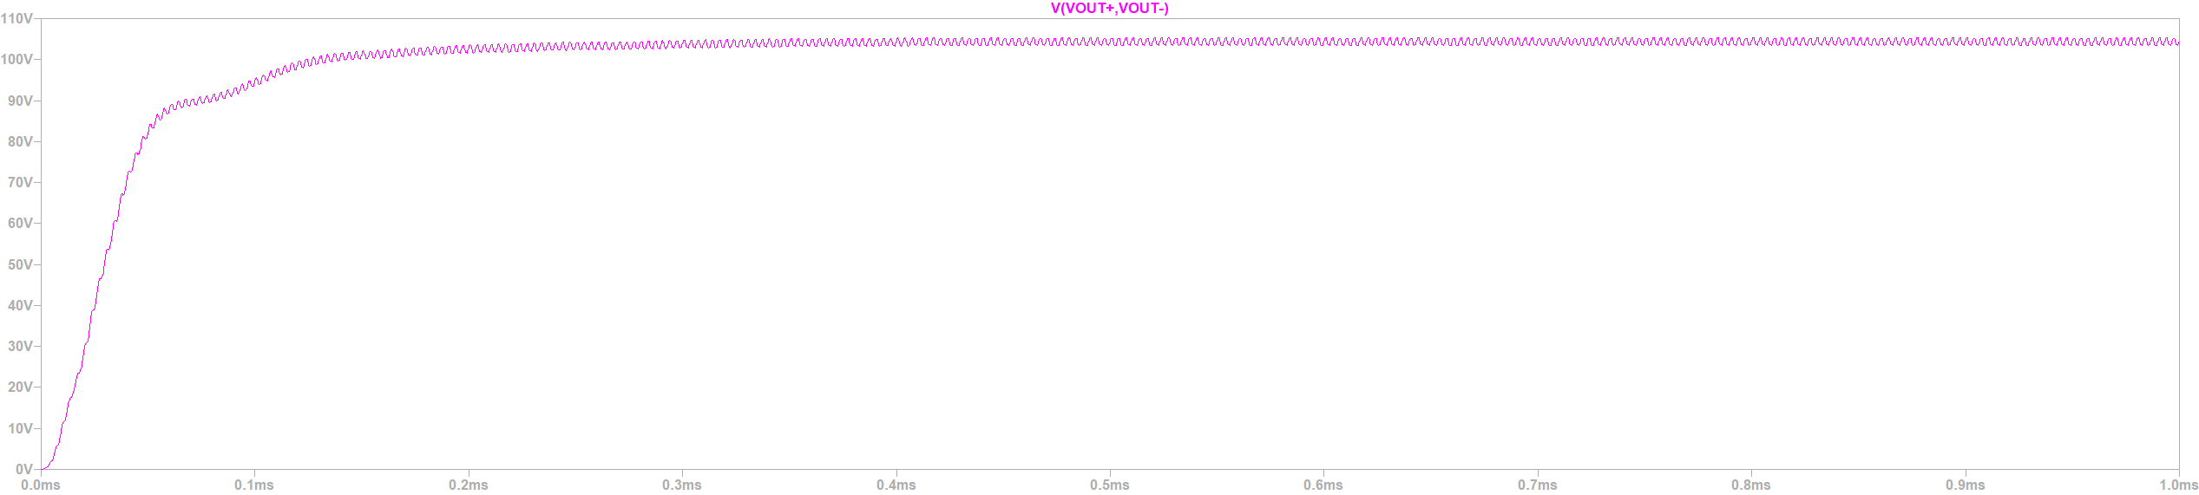





increasing cross-coupling to -0.15
$I_{s1}=1.2102A$(rms )
$I_{s2}=$3.6106A (rms)
$I_{s3}=$ 3.484A (rms)
$I_{s4}=3.6223A$(rms)
$$V_{out}=104.18V$$

Slide 19
Seconder Windings
Main mutual inductance part
Control the required inductance part:
Main Coupling
Cross-coupling
Cross-mutual inductance
Outer Turn
İnner Turn

Slide 20
We can
Wind a outer turn while remove a inner turn (C1)
Wind a inner turn (C2)
Wind a outer turn (C3)
Case | Inner radius(mm) | Outer radius(mm) | # Turn | Inductance ( micro H ) | Cross-coupling1 | Cross-coupling 2 | Coupling
Our design | 35 | 132 | 16 | 68.239 | -10.43 | -10.42 | 17.775
C1 | 32.6 | 134.4 | 16 | 72.348 | -11.214 | -11.258 | 18.617
C2 | 35 | 132 | 17 | 73.959 | -11.935 | -11.779 | 18.203
C3 | 32.6 | 134.4 | 17 | 78.881 | -12.689 | -12.797 | 19.118
 | Inductance ( micro H ) | Cross-coupling1 | Cross-coupling 2 | Coupling
Difference between inner and outer turn | 4.109 | -0.784 | -0.838 | 0.842
extra inner turn | 5.72 | -1.505 | -1.359 | 0.428
extraouter turn | 10.642 | -2.259 | -2.377 | 1.343

