Slide 1
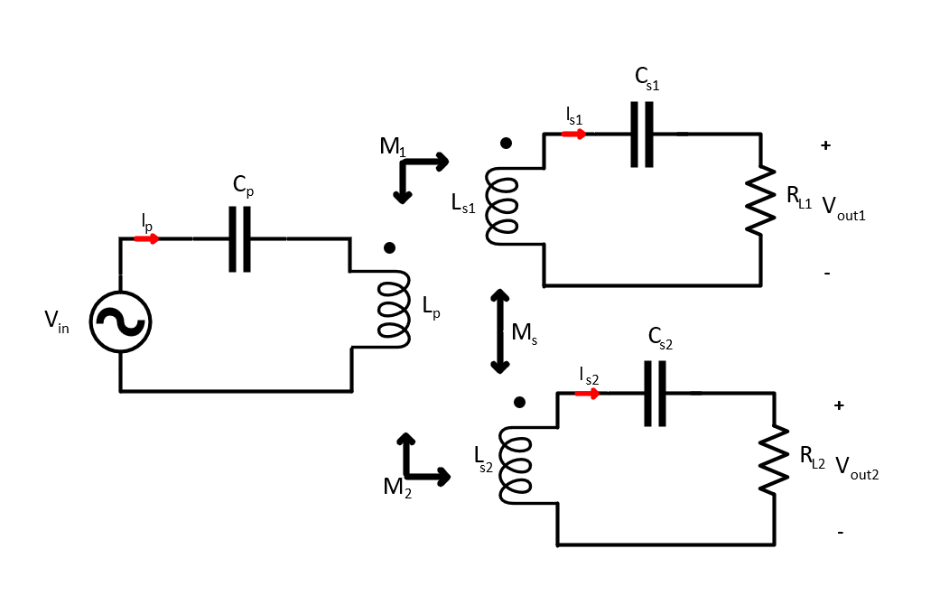
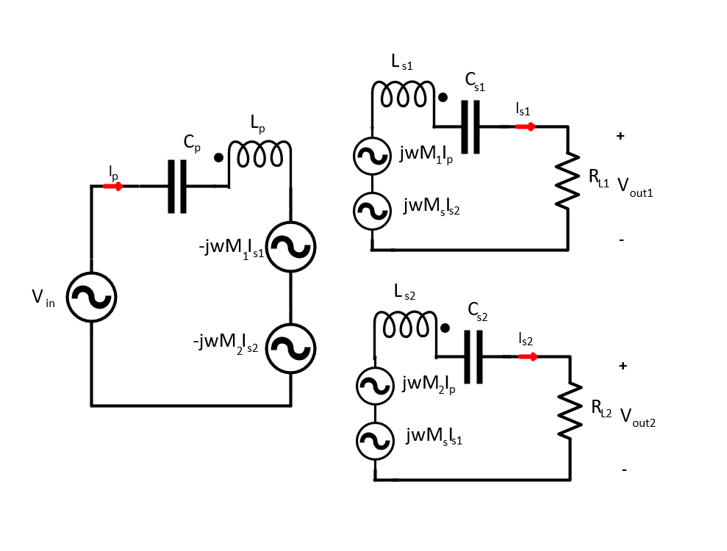
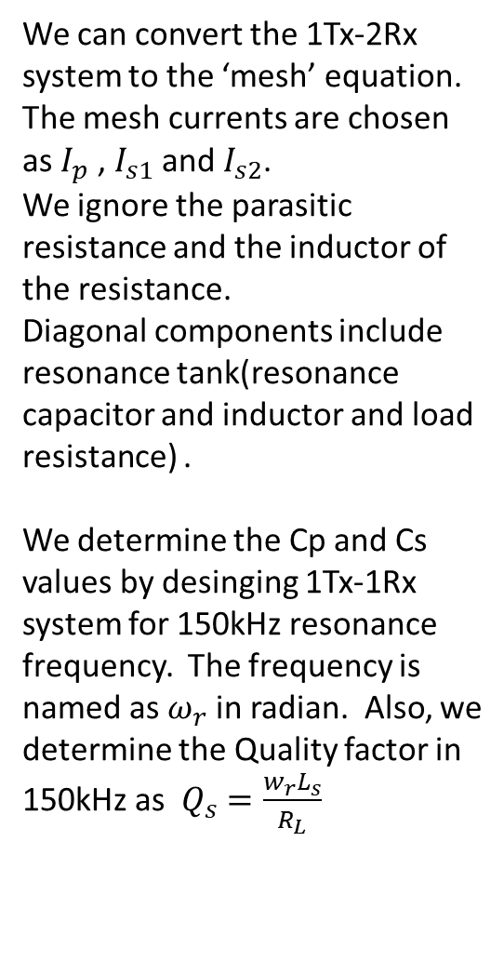
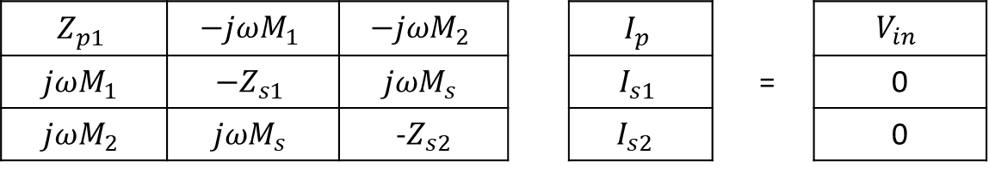
1Tx- 2Rx Design
We can convert the 1Tx-2Rx system to the ‘mesh’ equation.
The mesh currents are chosen as $I_{p}$ , $I_{s1}$ and $I_{s2}$.
We ignore the parasitic resistance and the inductor of the resistance.
Diagonal components include resonance tank(resonance capacitor and inductor and load resistance) .
We determine the Cp and Cs values by desinging 1Tx-1Rx system for 150kHz resonance frequency. The frequency is named as $ω_{r}$ in radian. Also, we determine the Quality factor in 150kHz as $Q_{s}=\frac{w_{r}L_{s}}{R_{L}}$
$$Z_{p1}$$ | $$−jωM_{1}$$ | $$−jωM_{2}$$ |  | $$I_{p}$$ |  | $$V_{in}$$
$$jωM_{1}$$ | $${−Z}_{s1}$$ | $$jωM_{s}$$ |  | $$I_{s1}$$ | = | 0
$$jωM_{2}$$ | $$jωM_{s}$$ | -$Z_{s2}$ |  | $$I_{s2 }$$ |  | 0

Slide 2

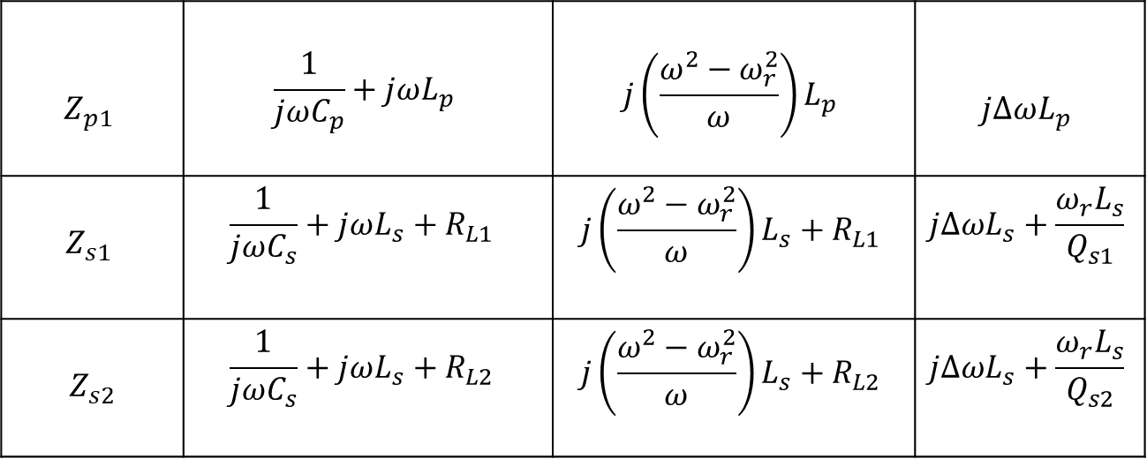
$$Z_{p1}$$ | $$\frac{1}{jωC_{p}}+jωL_{p}$$ | $$j\left(\frac{ω^{2}−ω_{r}^{2}}{ω}\right)L_{p}$$ | $$jΔωL_{p}$$
$$Z_{s1}$$ | $$\frac{1}{jωC_{s}}+jωL_{s}+R_{L1 }$$ | $$j\left(\frac{ω^{2}−ω_{r}^{2}}{ω}\right)L_{s}+R_{L1}$$ | $$jΔωL_{s}+\frac{ω_{r}L_{s}}{Q_{s1}}$$
$$Z_{s2}$$ | $$\frac{1}{jωC_{s}}+jωL_{s}+R_{L2 }$$ | $$j\left(\frac{ω^{2}−ω_{r}^{2}}{ω}\right)L_{s}+R_{L2}$$ | $$jΔωL_{s}+\frac{ω_{r}L_{s}}{Q_{s2}}$$
Primar and secondary self impedances are derived as right.
First of all, we should obtain the current formulation by take a inverse of Impedance matrices and multiplying voltage matrices.
$$I=Z^{−1}V$$

Slide 3
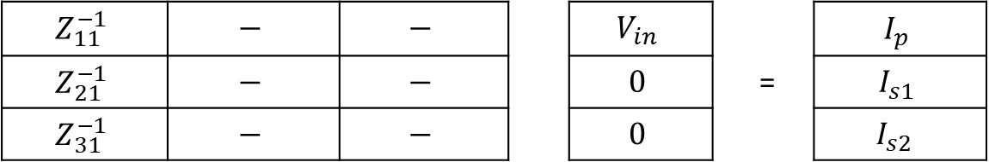
Take a inverse by using adjoint matrices
We know that only first column of the inverse impedance matrices are needed to calculate currents.
$$Z_{11}^{−1}$$ | $$−$$ | $$−$$ |  | $$V_{in}$$ |  | $$I_{p}$$
$$Z_{21}^{−1}$$ | $$−$$ | $$−$$ |  | $$0$$ | = | $$I_{s1}$$
$$Z_{31}^{−1}$$ | $$−$$ | $$−$$ |  | $$0$$ |  | $$I_{s2 }$$
Firstly, we take a determinant of $Z$ matrices and after that we find the sirst column of inverse of Z matrices by using matrix of minors, matrix of cofactorsi matrix of adjoint.

Slide 4

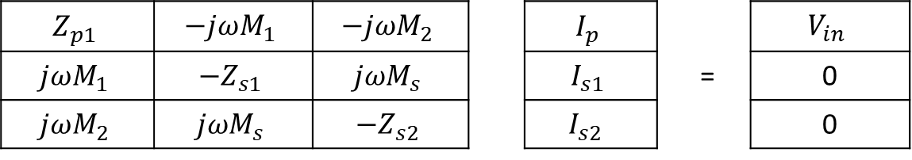
$$Z_{p1}$$ | $$−jωM_{1}$$ | $$−jωM_{2}$$ |  | $$I_{p}$$ |  | $$V_{in}$$
$$jωM_{1}$$ | $${−Z}_{s1}$$ | $$jωM_{s}$$ |  | $$I_{s1}$$ | = | 0
$$jωM_{2}$$ | $$jωM_{s}$$ | $${−Z}_{s2}$$ |  | $$I_{s2 }$$ |  | 0
By using the first raw and 2-by-2 matrices determinants
$\det\left(Z\right)=Z_{p1}$($Z_{s1}Z_{s2}$ - $jωM_{s}jωM_{s}$) -($−jωM_{1}$)($jωM_{1}Z_{s2}$-$jωM_{s}jωM_{2}$) + ($−jωM_{2}$) )($jωM_{1}jωM_{s}$-(${\text{−}Z}_{s1}jωM_{2}$))
$$\det\left(Z\right)=Z_{p1}Z_{s1}Z_{s2}+ω^{2}M_{s}^{2}Z_{p1}+ω^{2}M_{1}^{2}Z_{s2}+ω^{2}M_{2}^{2}Z_{s1}+2jω^{3}M_{1}M_{2}M_{s}$$
We take $M_{1}$ and $M_{2}$ are equal and named as $M$
And also, $Z_{s1}$ and $Z_{s2}$ are equal, named as $Z_{s}$
$$\det\left(Z\right)=Z_{p1}Z_{s}^{2}+ω^{2}M_{s}^{2}Z_{p1}+{2ω}^{2}M^{2}Z_{s}+2jω^{3}M_{1}M_{2}M_{s}$$

Slide 5

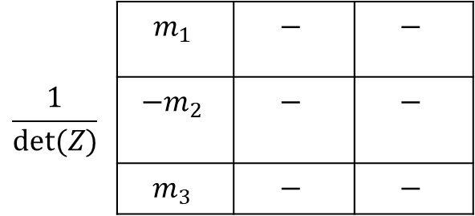
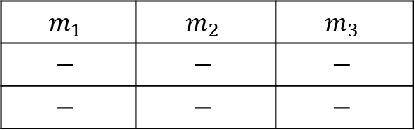

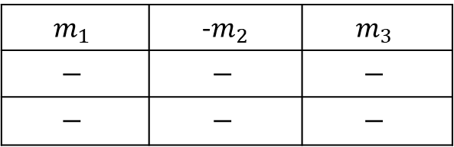

Only we calculate first row of matrix of minors.
$$m_{1}$$ | $$m_{2}$$ | $$m_{3}$$
$$−$$ | $$−$$ | $$−$$
$$−$$ | $$−$$ | $$−$$
$$m_{1}=Z_{s1}Z_{s2}+ω^{2}M_{s}^{2}$$
$$m_{2}=−jωM_{1}Z_{s2}+ω^{2}M_{2}M_{s}$$
$$m_{2}=−ω^{2}M_{1}M_{s}+jωM_{2}Z_{s1}$$
 | $$m_{1}$$ | $$−$$ | $$−$$
$$\frac{1}{det⁡(Z)}$$ | $${−m}_{2}$$ | $$−$$ | $$−$$
 | $$m_{3}$$ | $$−$$ | $$−$$
$$m_{1}$$ | -$m_{2}$ | $$m_{3}$$
$$−$$ | $$−$$ | $$−$$
$$−$$ | $$−$$ | $$−$$
Only we calculate first row of matrix of cofactors
Adjoint divided by determinat gives inverse of the matrices

Slide 6
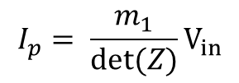
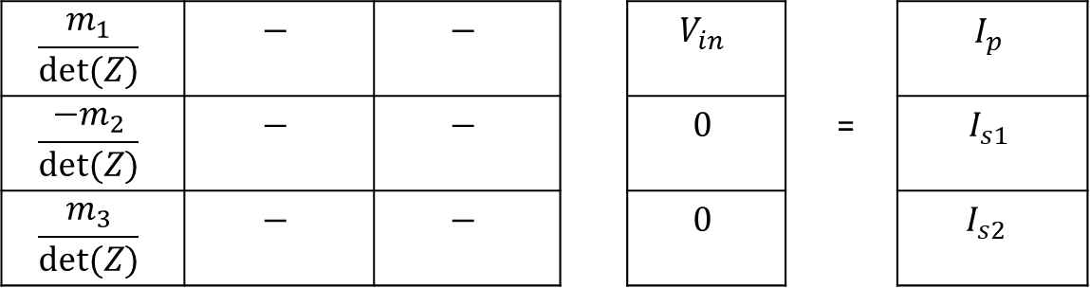

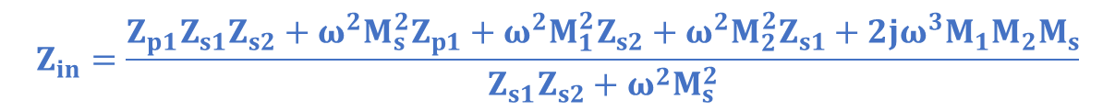
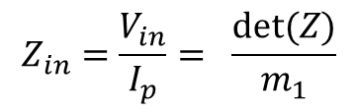
$$\frac{m_{1}}{det⁡(Z)}$$ | $$−$$ | $$−$$ |  | $$V_{in}$$ |  | $$I_{p}$$
$$\frac{{−m}_{2}}{det⁡(Z)}$$ | $$−$$ | $$−$$ |  | $$0$$ | = | $$I_{s1}$$
$$\frac{m_{3}}{det⁡(Z)}$$ | $$−$$ | $$−$$ |  | $$0$$ |  | $$I_{s2 }$$
$$I_{p}= \frac{m_{1}}{det⁡(Z)}V_{in}$$
$$Z_{in}=\frac{V_{in}}{I_{p}}= \frac{det⁡(Z)}{m_{1}}$$
$$Z_{in}=\frac{Z_{p1}Z_{s1}Z_{s2}+ω^{2}M_{s}^{2}Z_{p1}+ω^{2}M_{1}^{2}Z_{s2}+ω^{2}M_{2}^{2}Z_{s1}+2jω^{3}M_{1}M_{2}M_{s}}{Z_{s1}Z_{s2}+ω^{2}M_{s}^{2}}$$
$$∠^{Z_{in}}=0 for which ω values$$

Slide 7
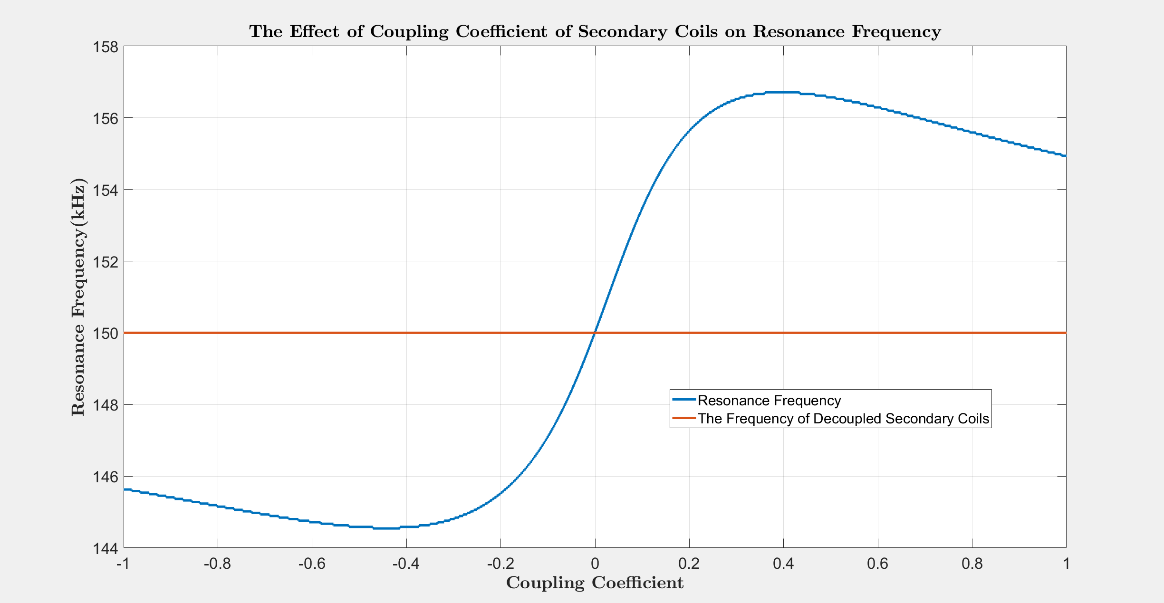

Slide 8
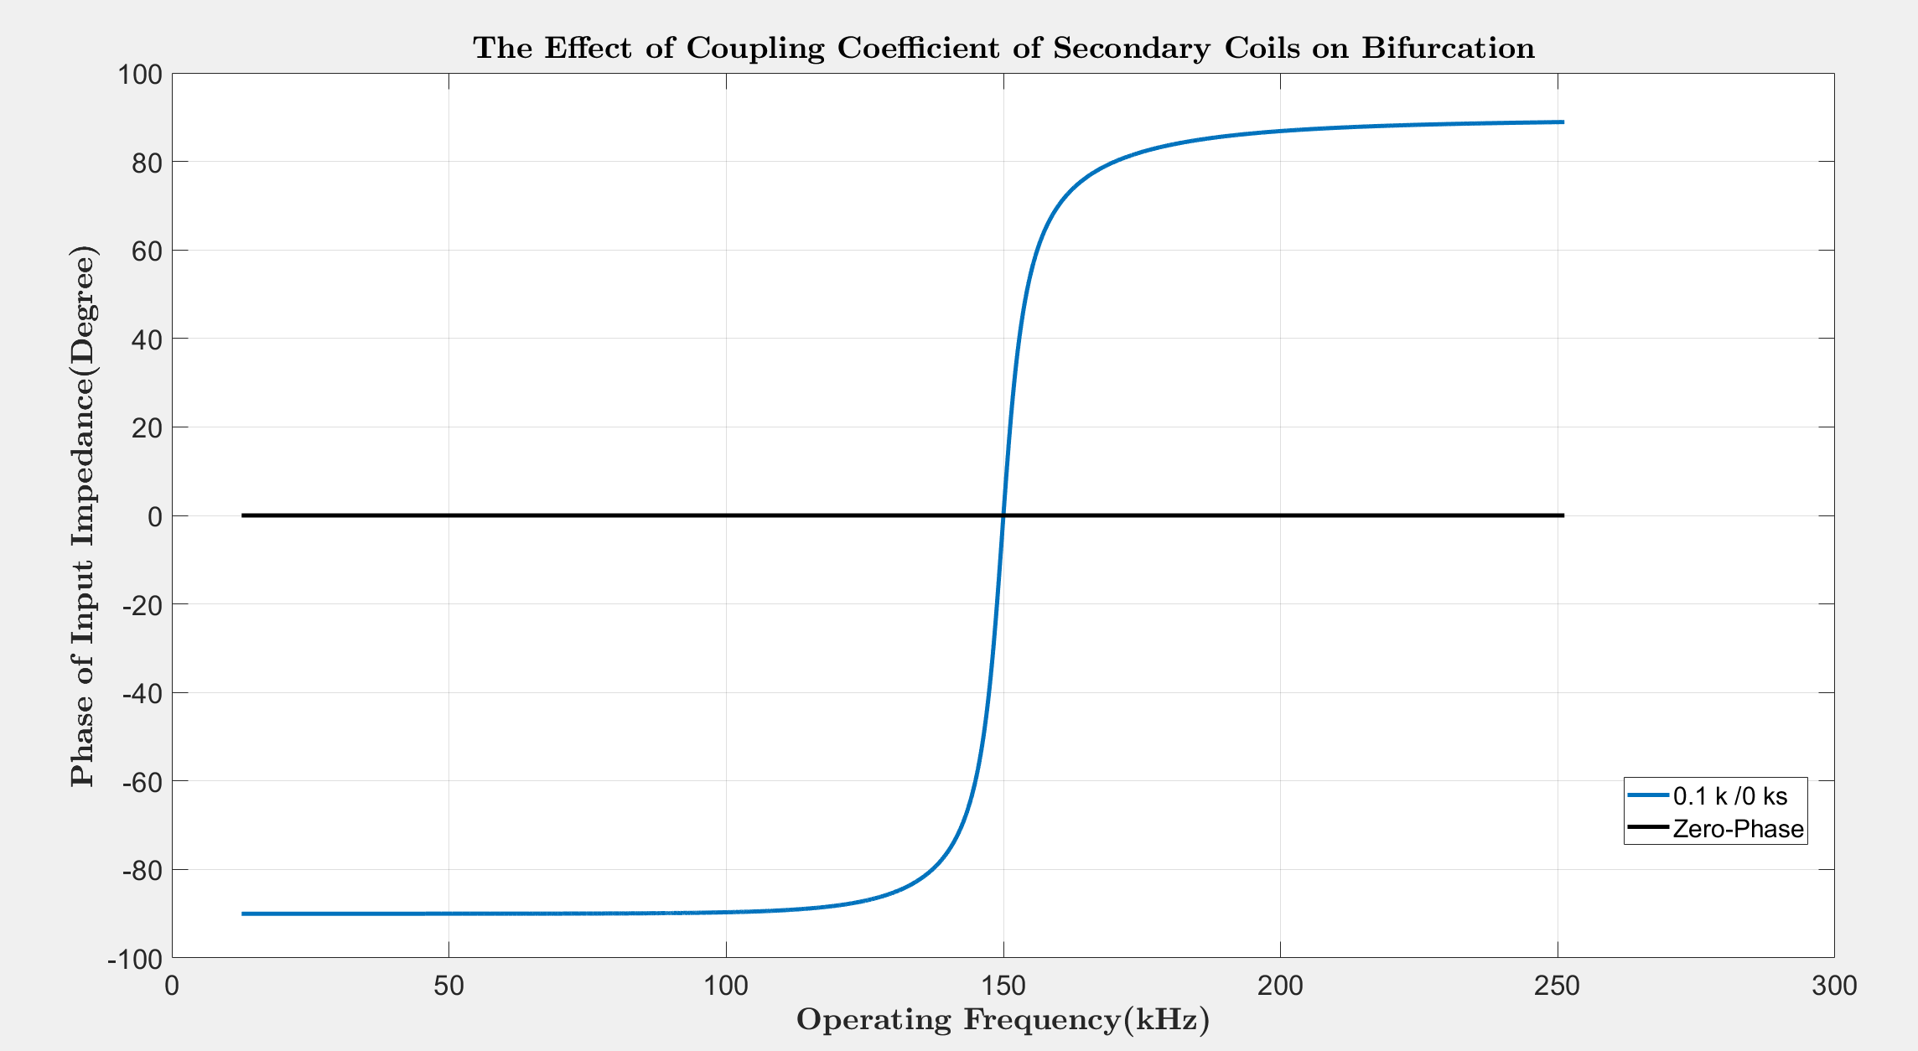
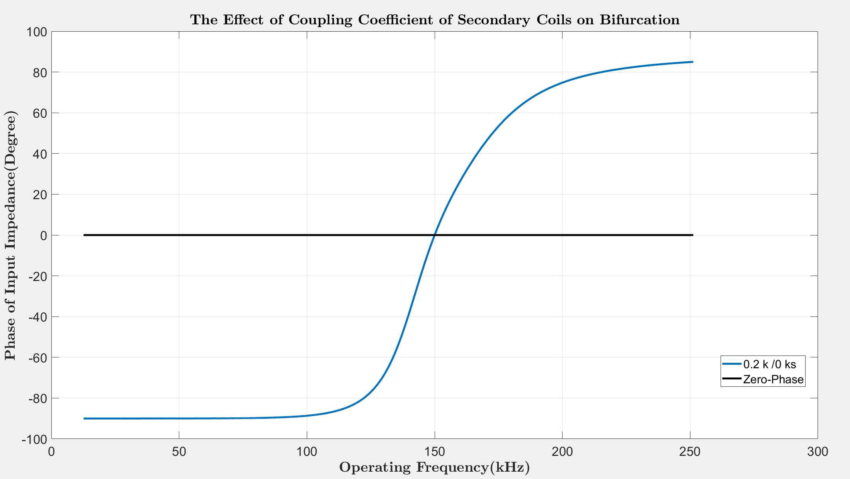
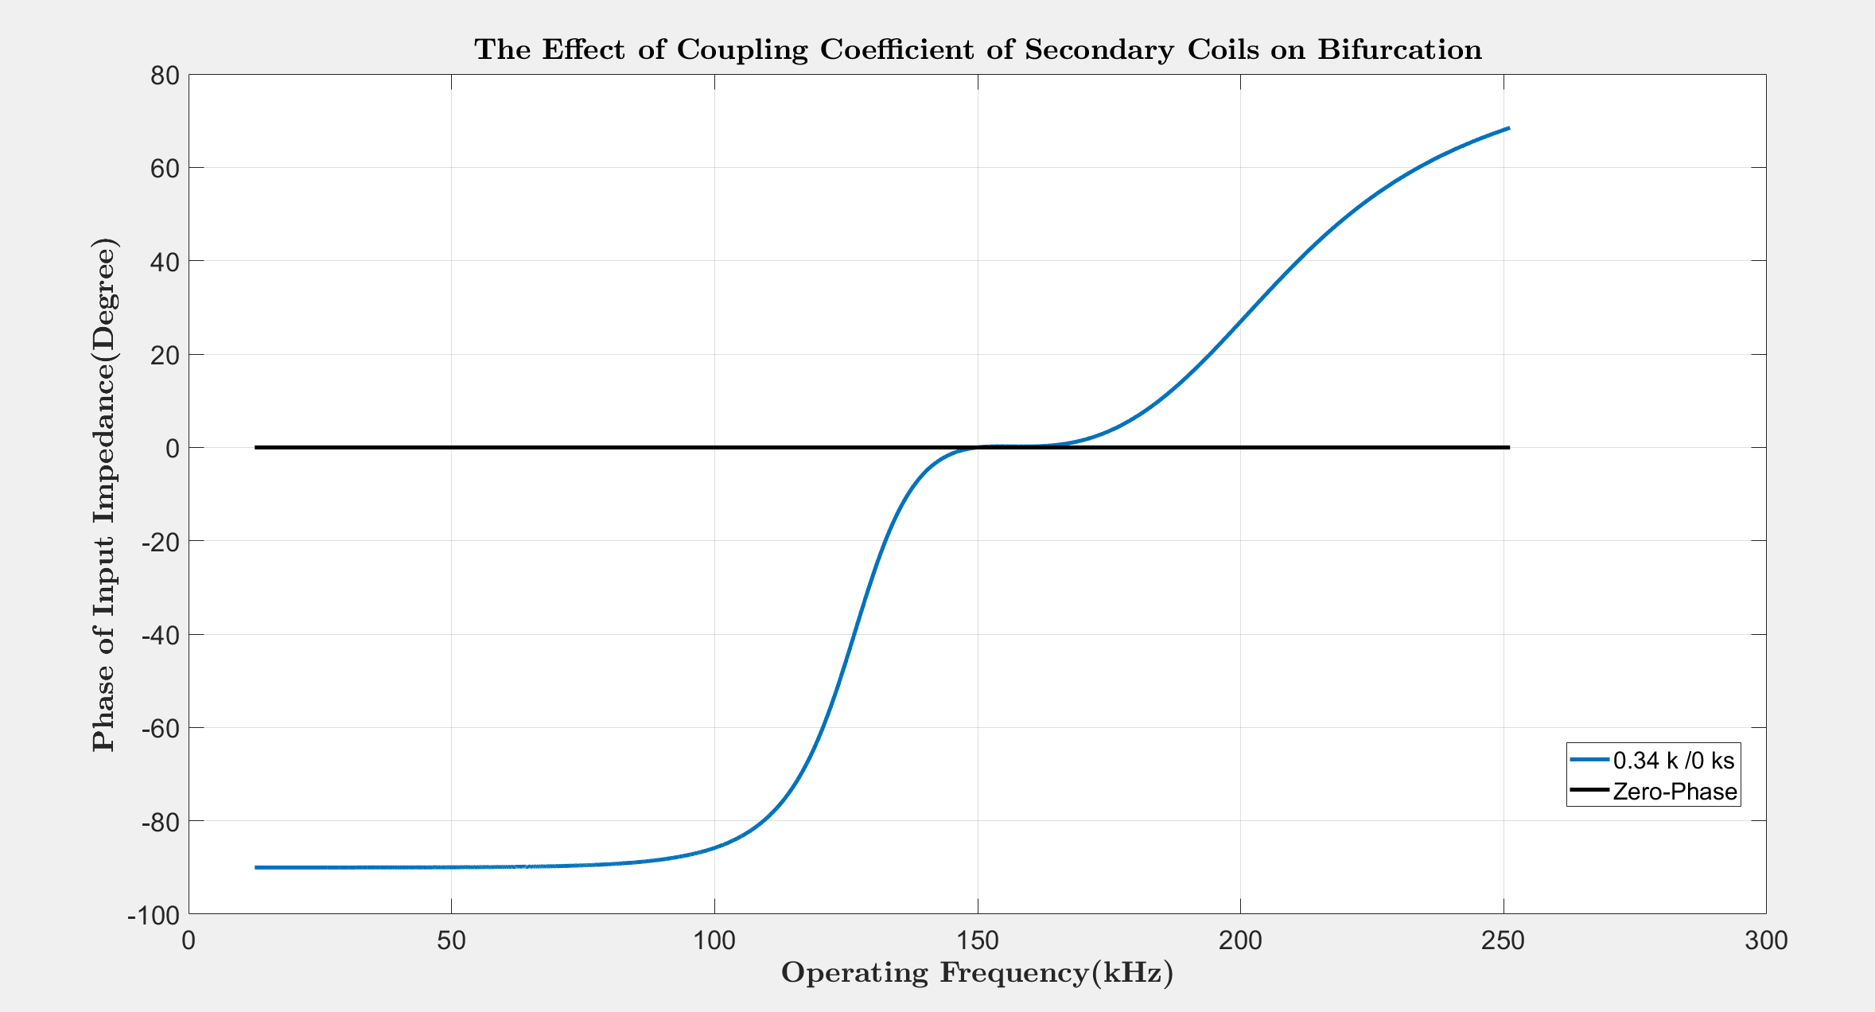
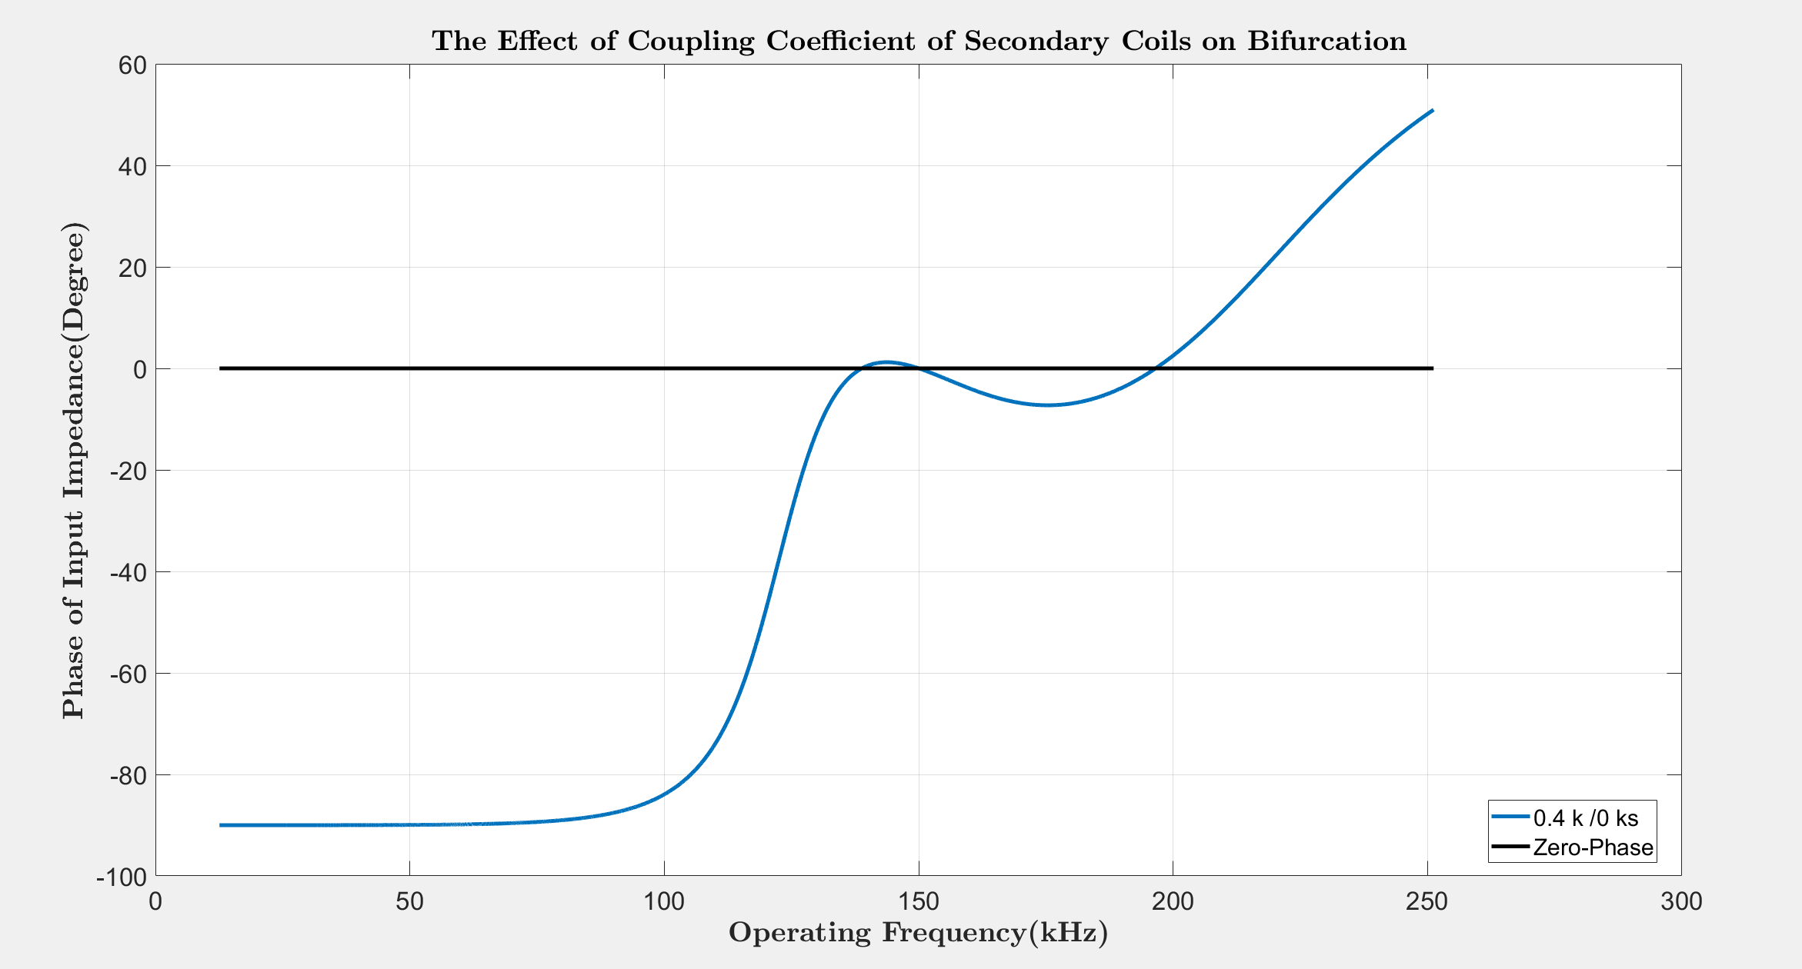

Slide 9
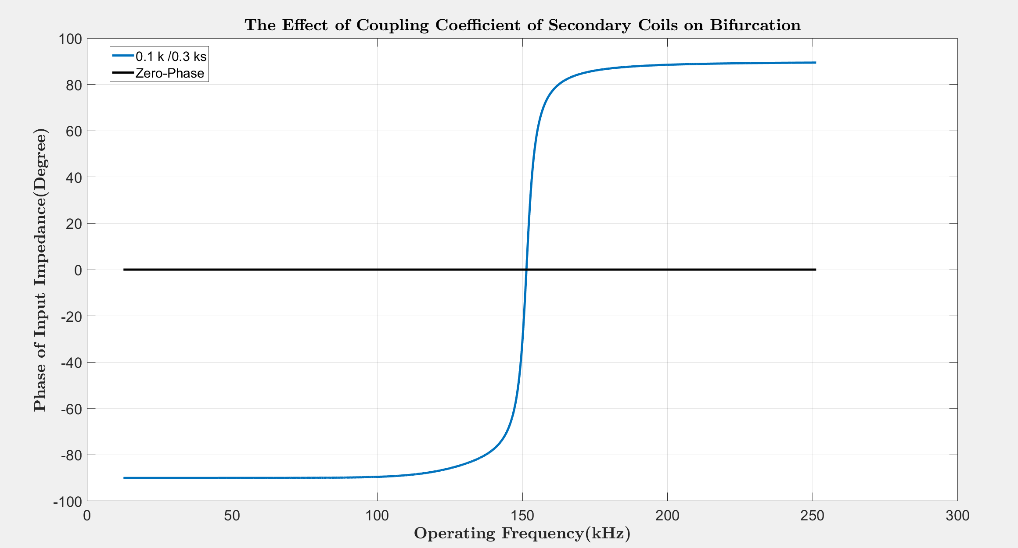
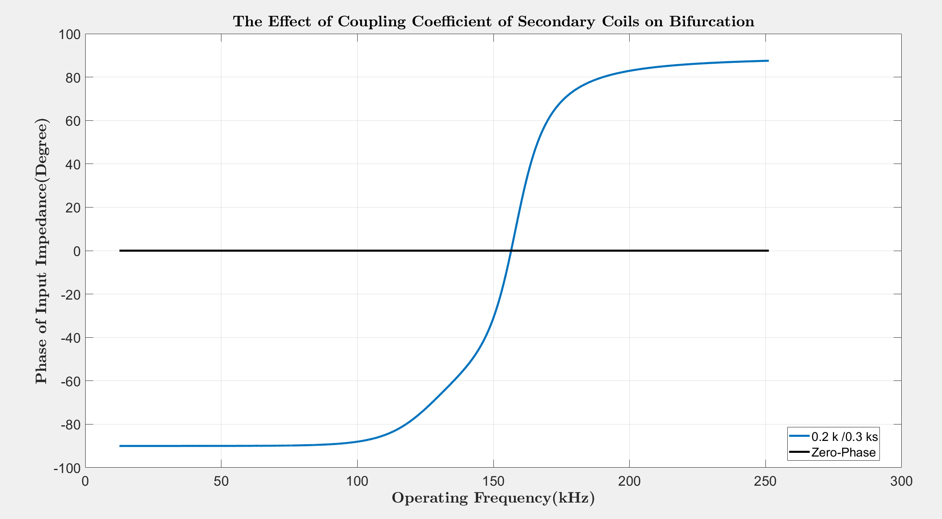
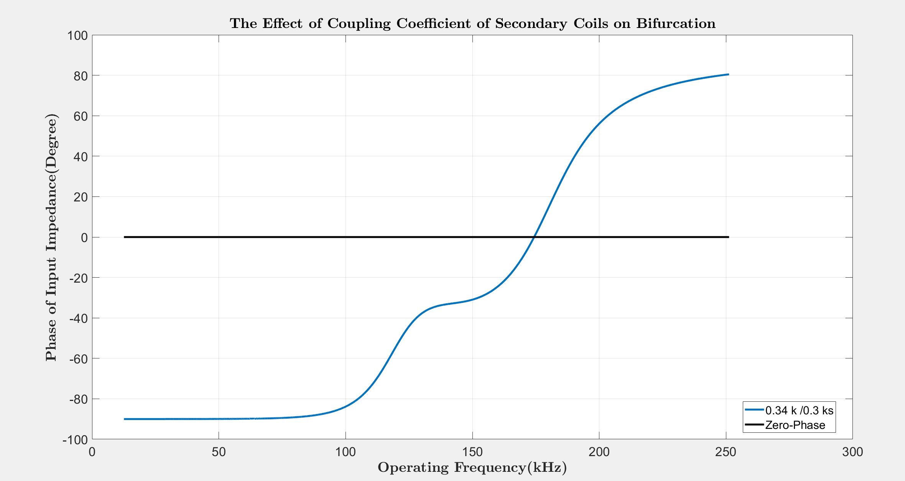
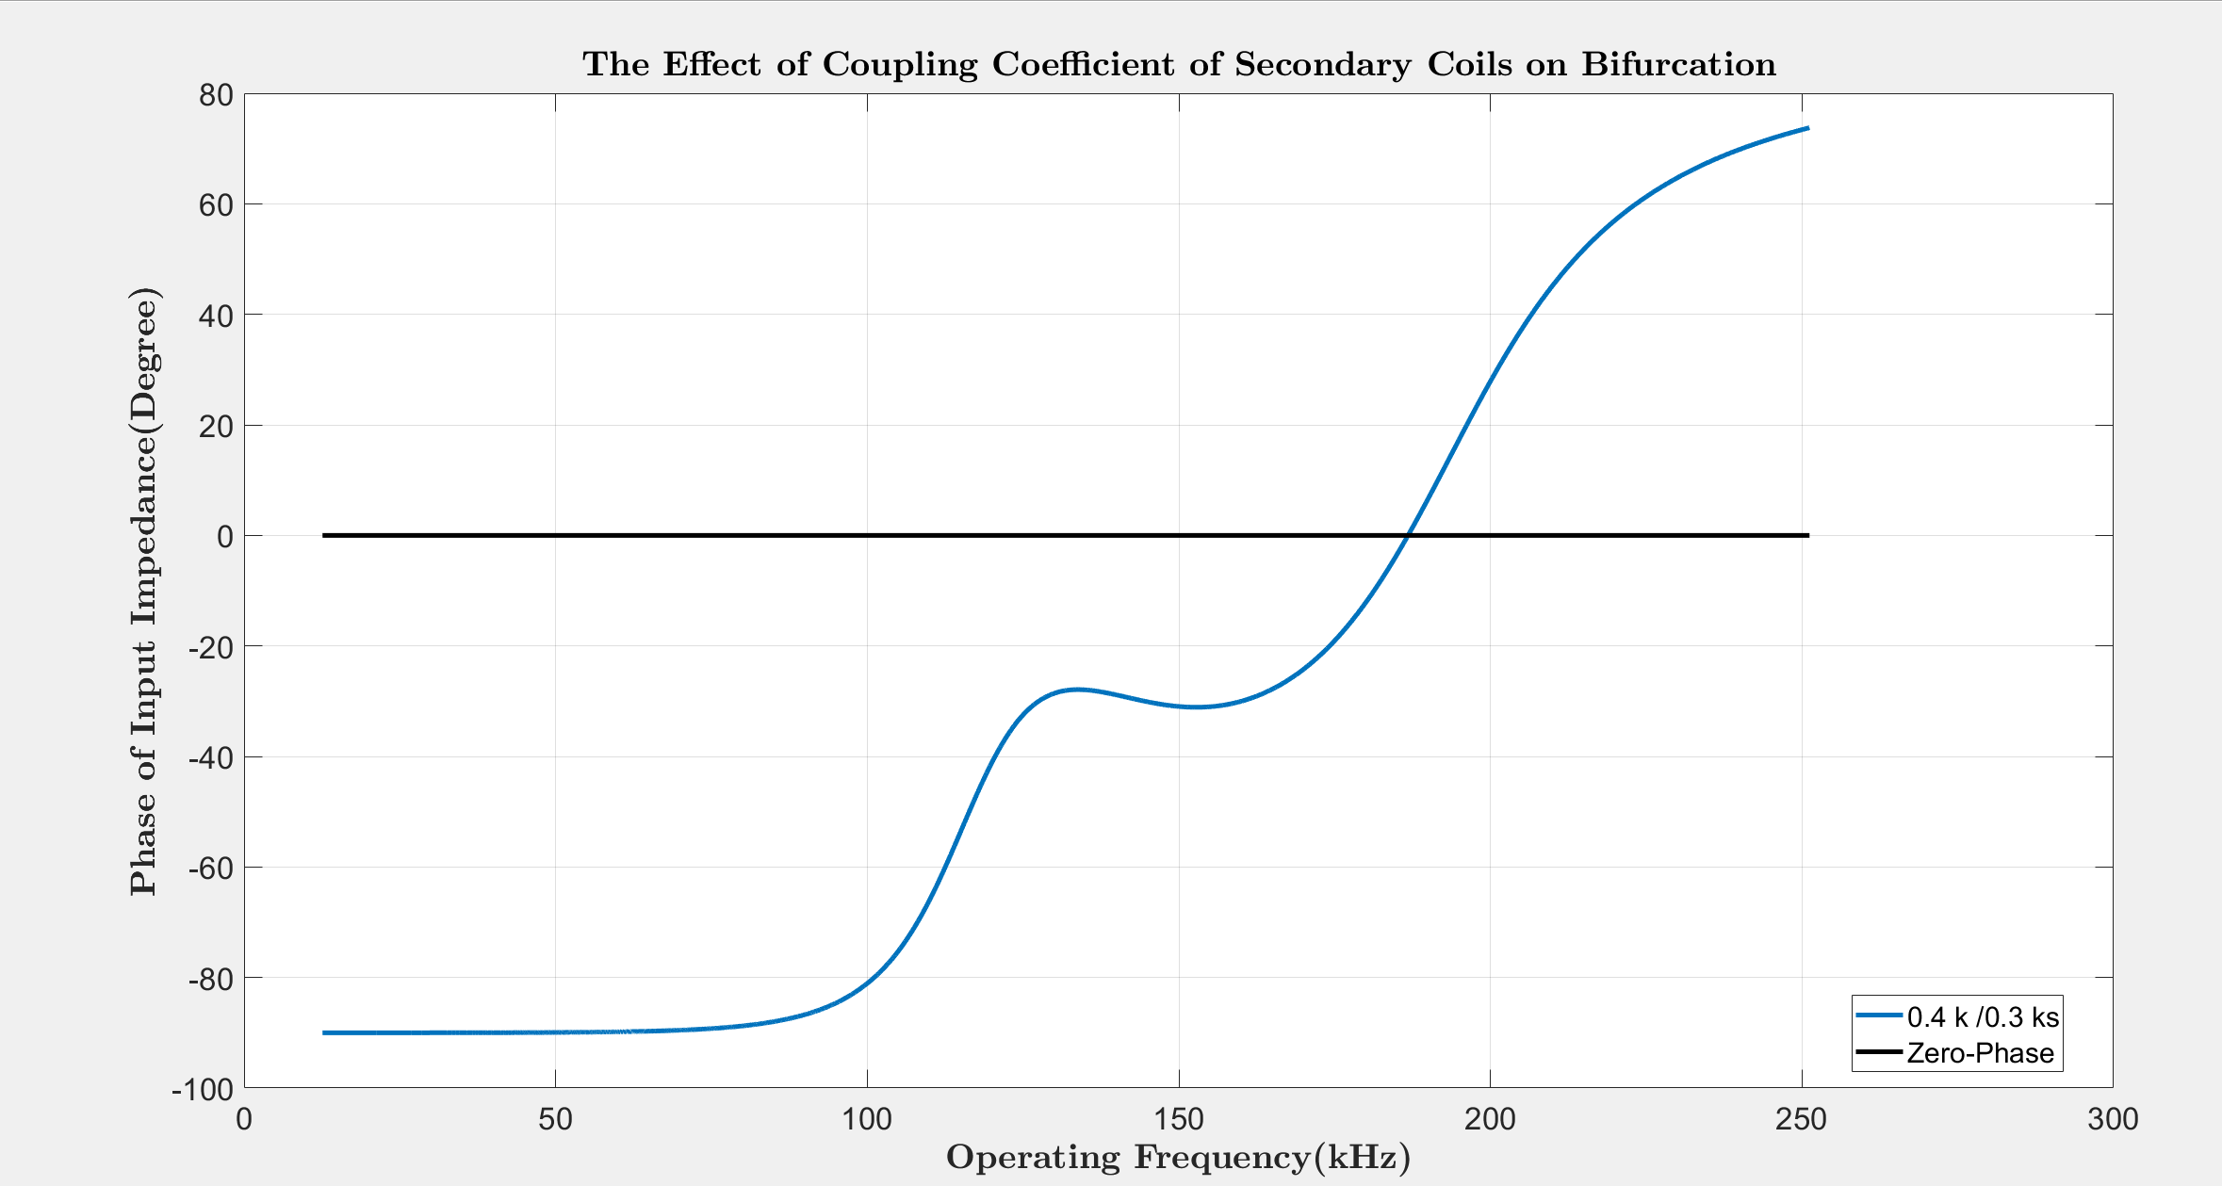

Slide 10
