Slide 1
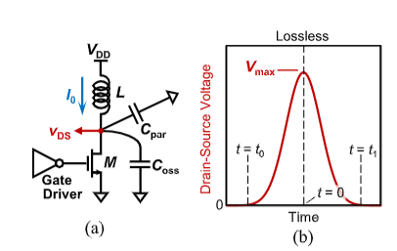
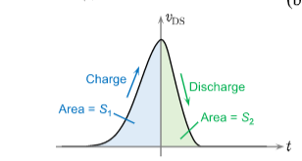

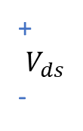
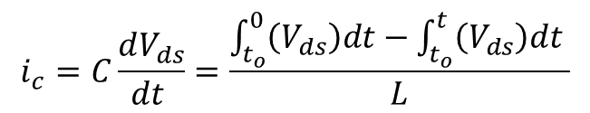

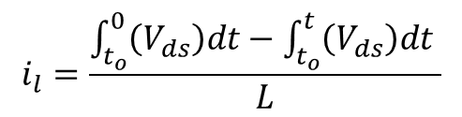
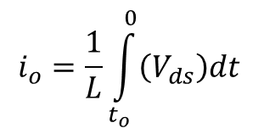

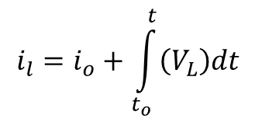
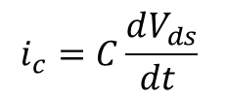
$$i_{l}=i_{o}+\int_{t_{o}}^{t}{\left(V_{L}\right)dt}$$
$$i_{c}=C\frac{dV_{ds}}{dt }$$
$$i_{l}=i_{c} and V_{L}=−V_{ds}$$
$$i_{o}=\frac{1}{L}\int_{t_{o}}^{0}{\left(V_{ds}\right)dt}$$
$$i_{l}=\frac{\int_{t_{o}}^{0}{\left(V_{ds}\right)dt}−\int_{t_{o}}^{t}{\left(V_{ds}\right)dt} }{L}$$
$$i_{c}=C\frac{dV_{ds}}{dt }=\frac{\int_{t_{o}}^{0}{\left(V_{ds}\right)dt}−\int_{t_{o}}^{t}{\left(V_{ds}\right)dt} }{L}$$
$$I_{l}$$
+
$$V_{ds}$$
-

Slide 2
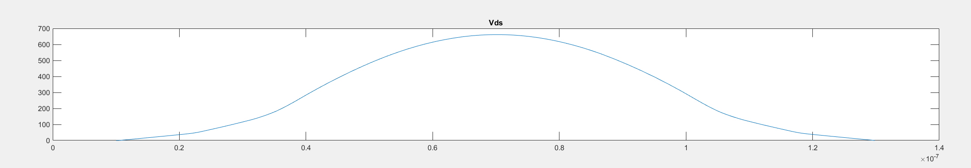
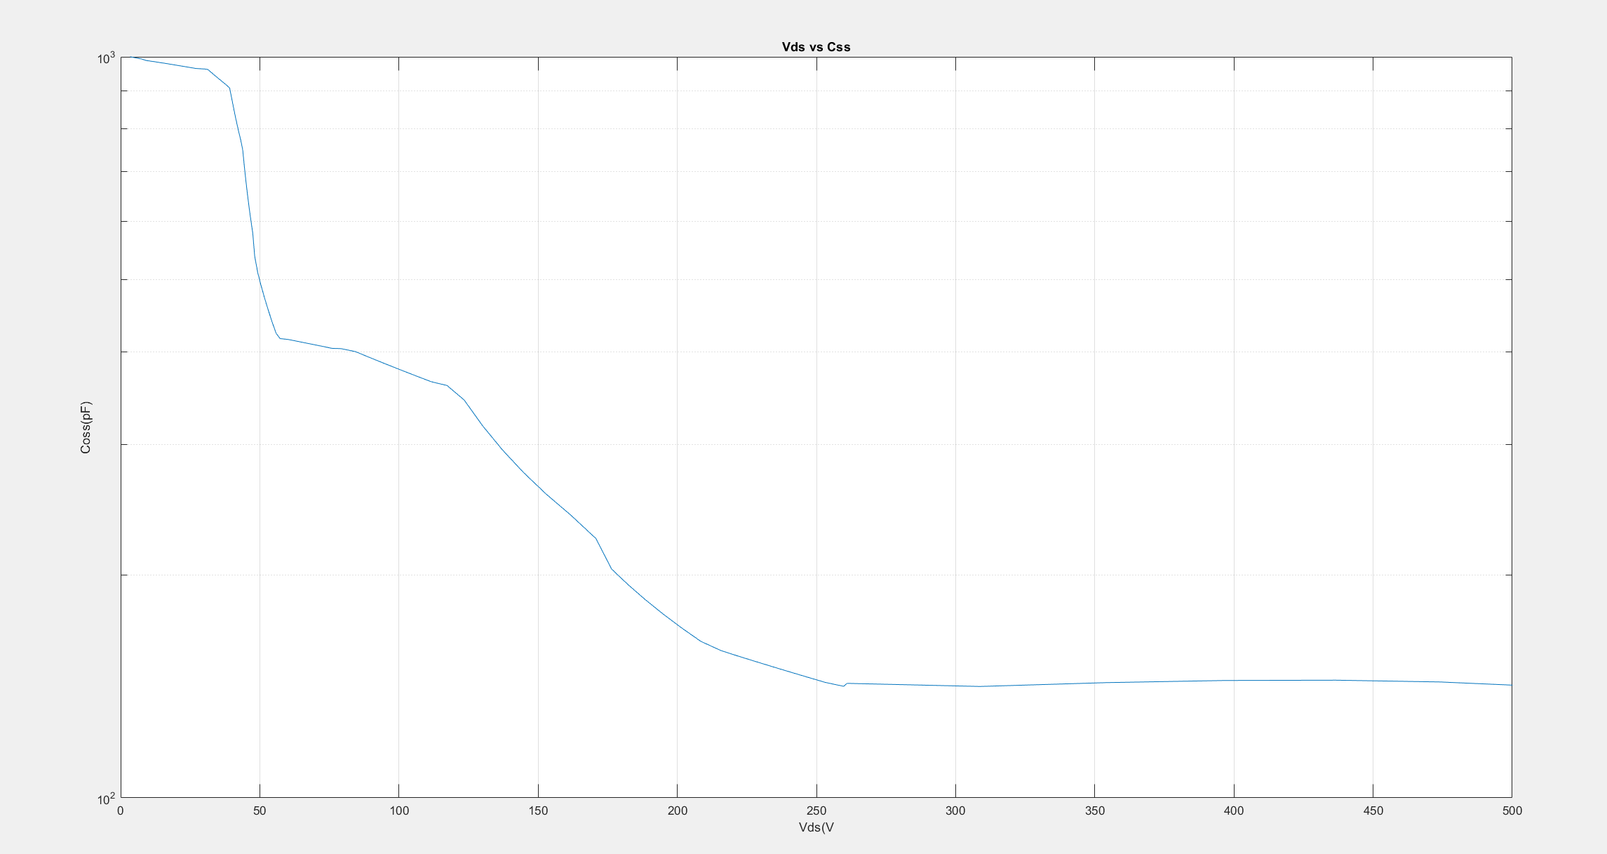

Slide 3
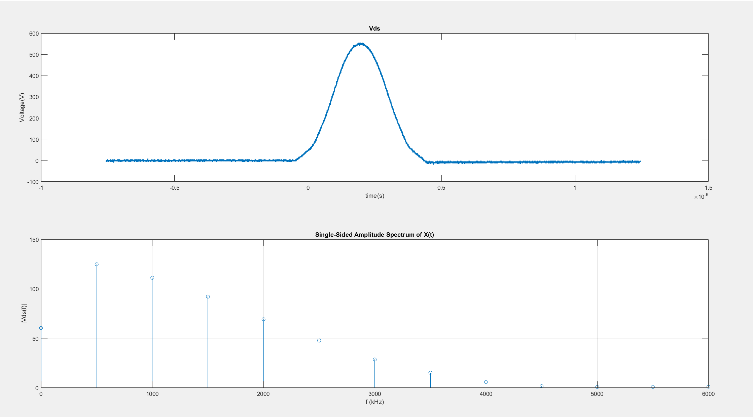
532 mV Vdd- 195us charge

Slide 4
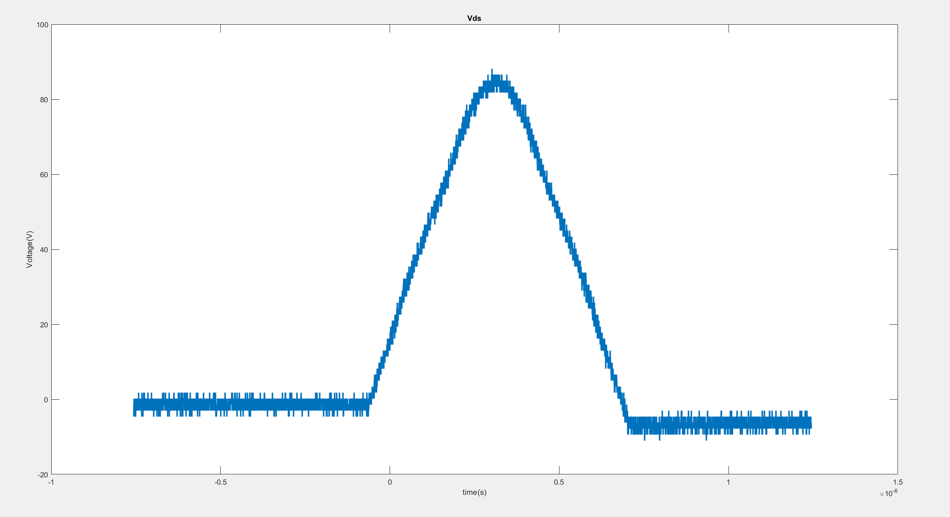
160 mV Vdd- 200us charge

Slide 5
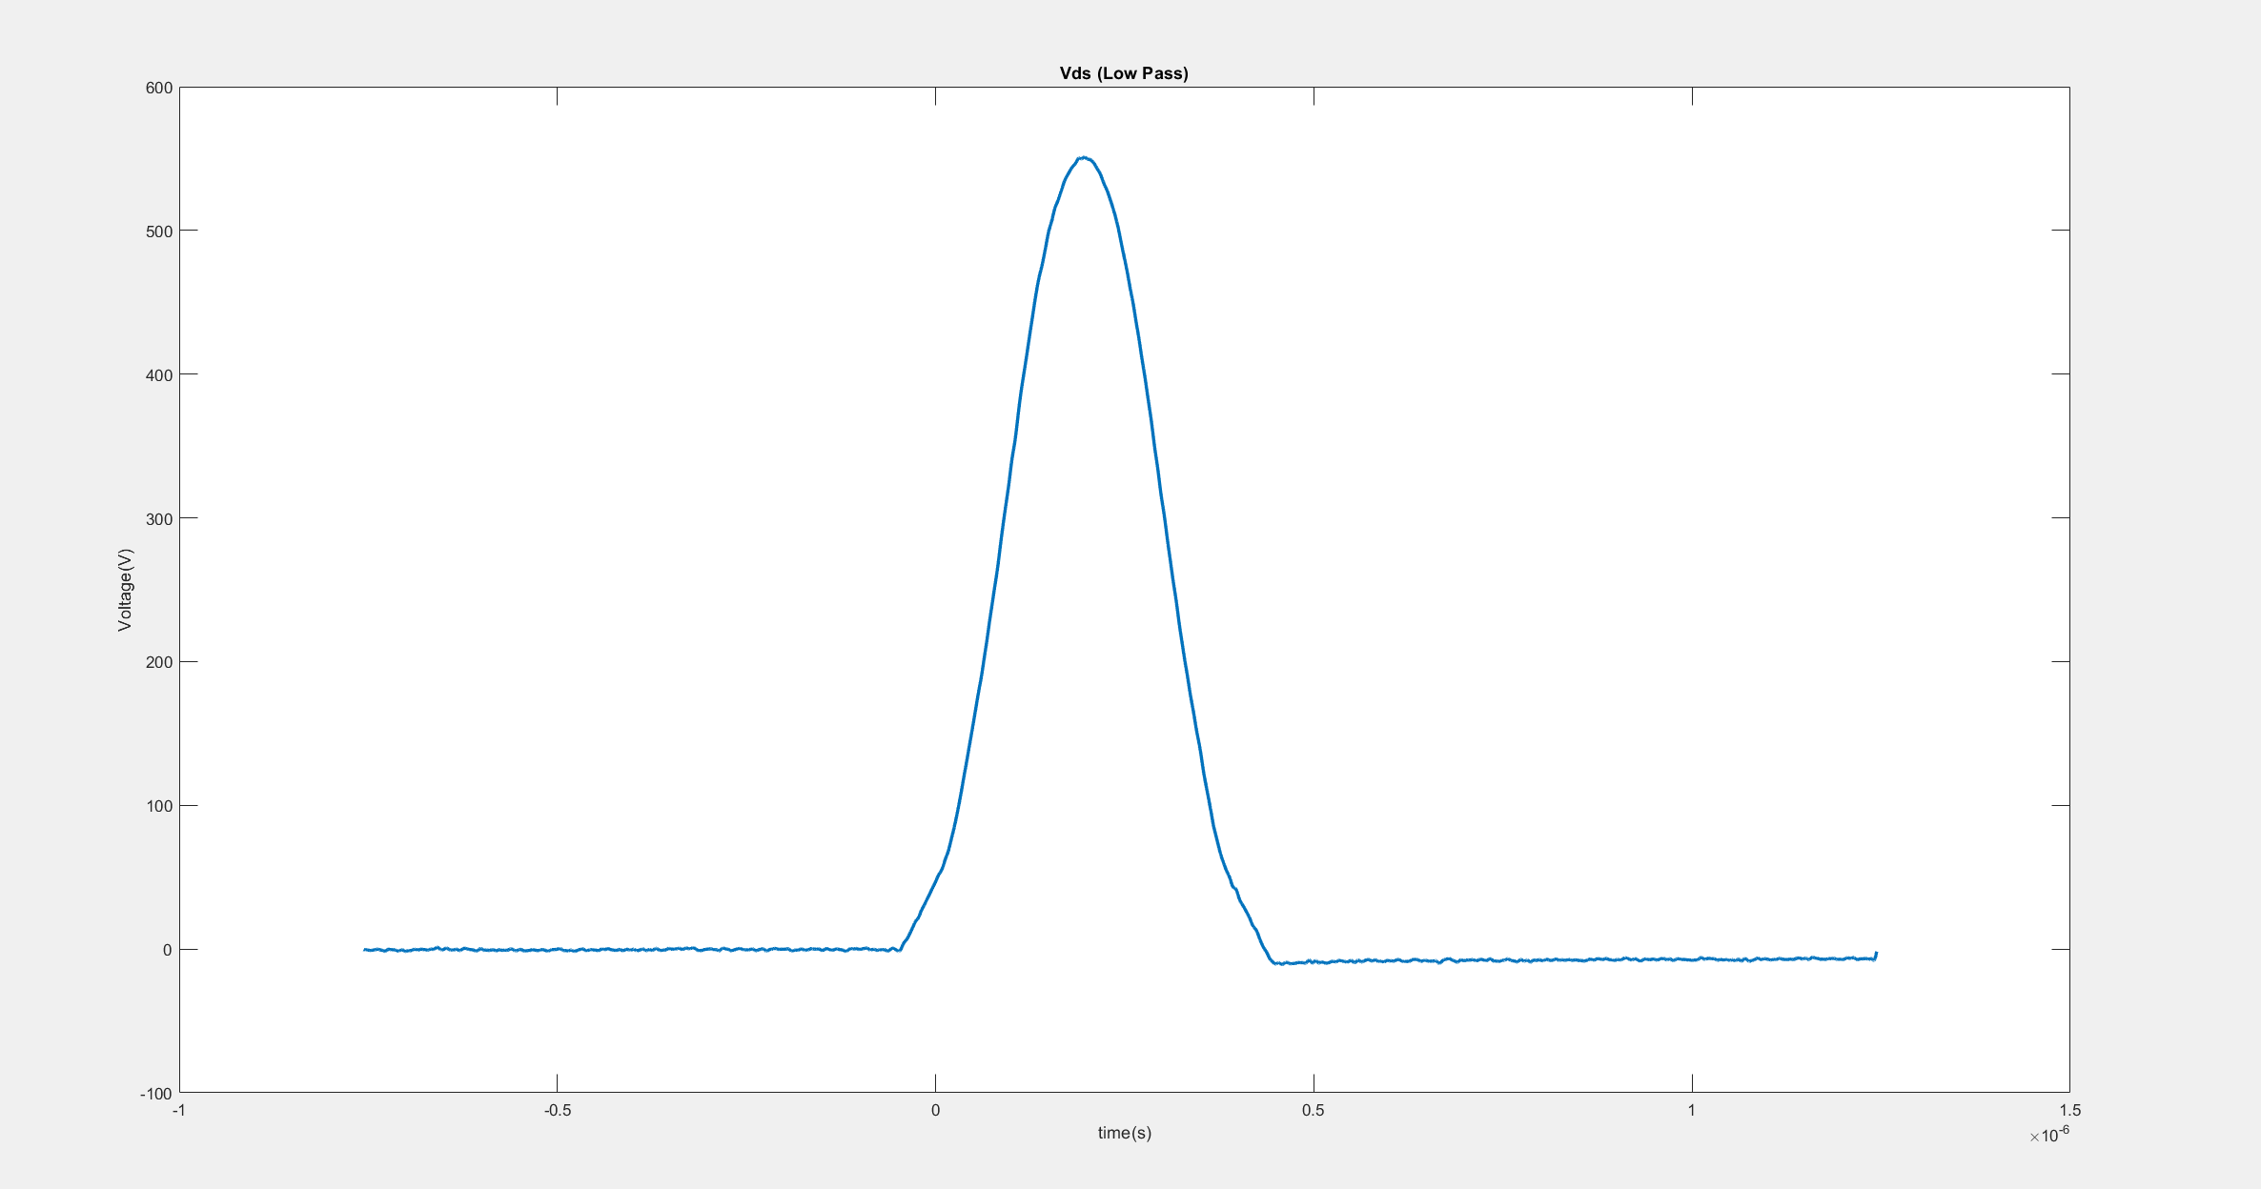

Slide 6
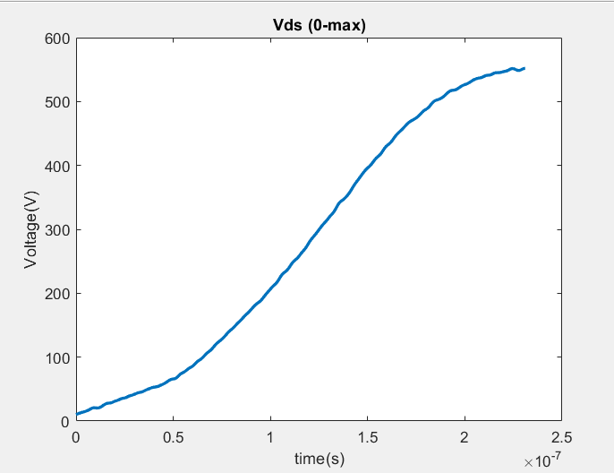

Slide 7
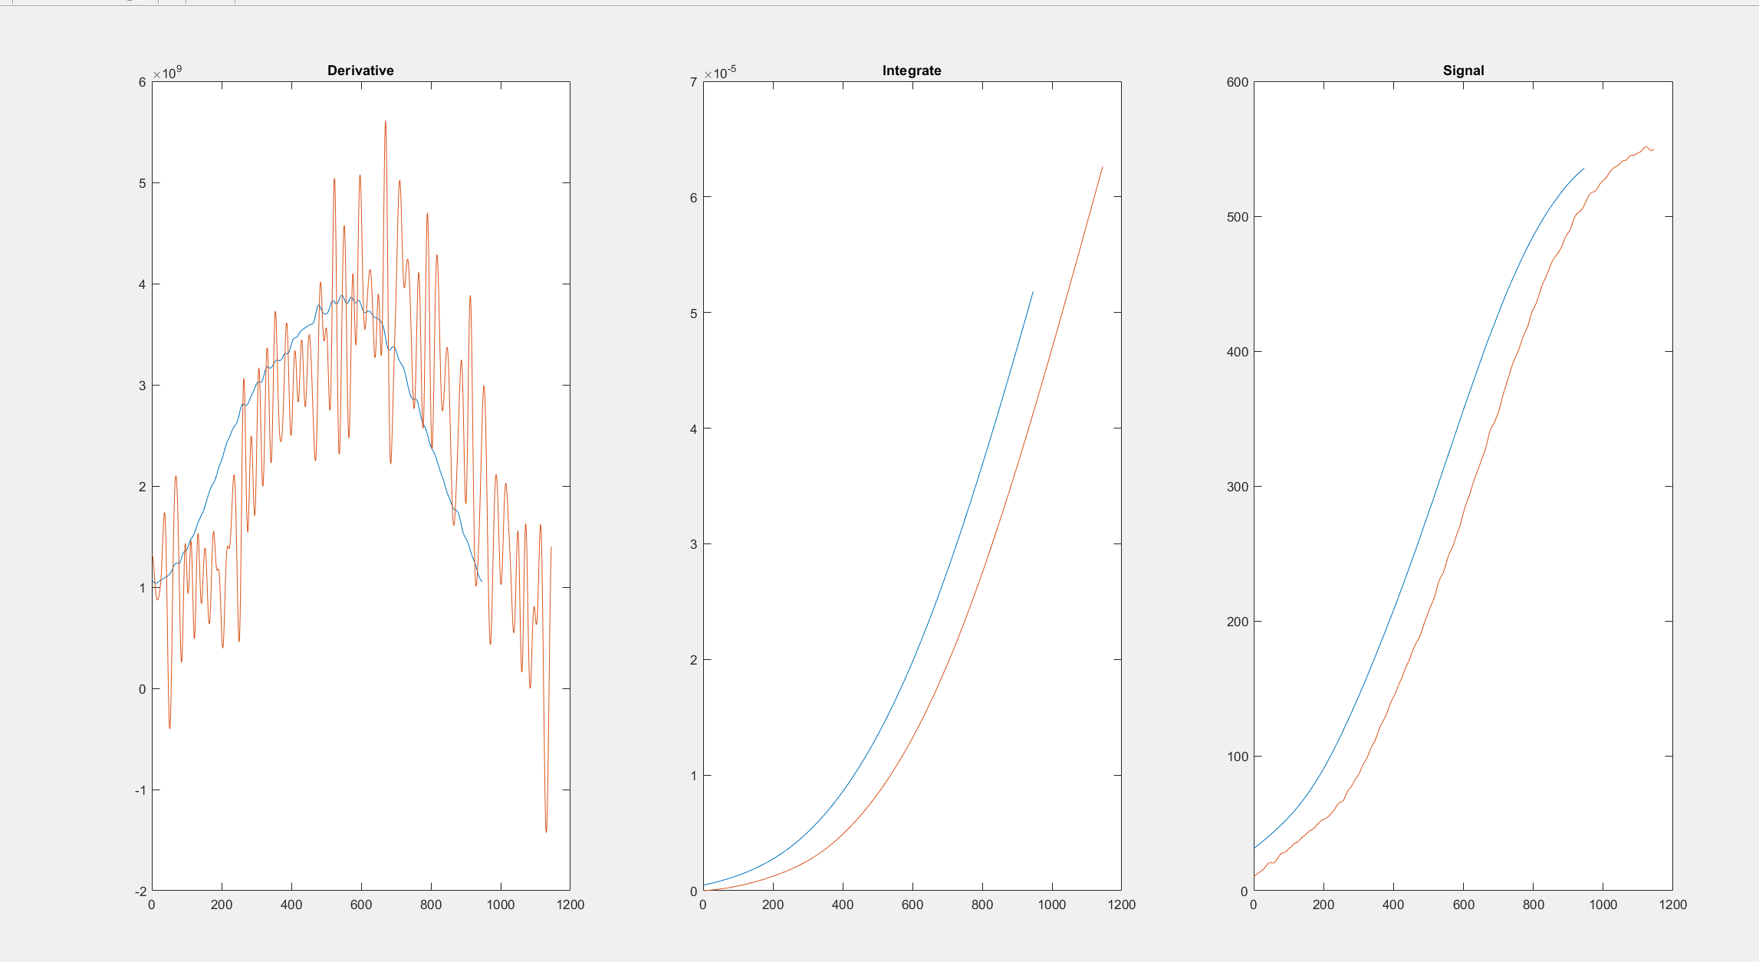

Slide 8
