Slide 1
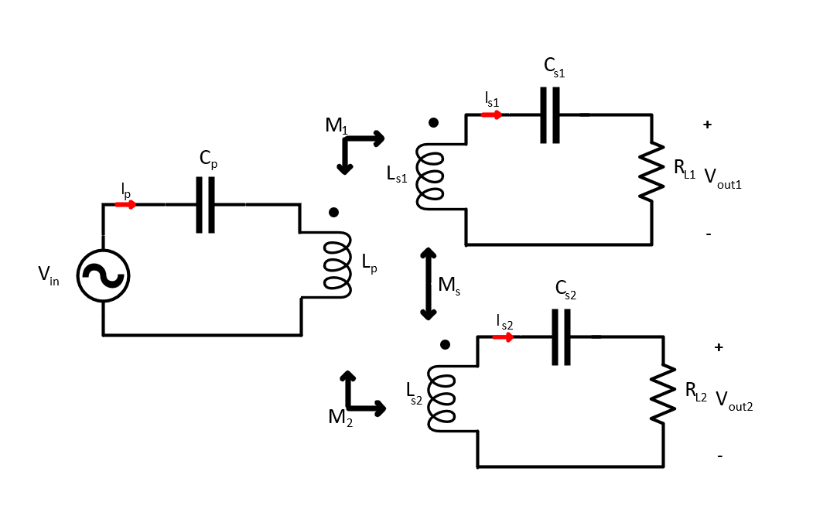
BRIEF EXPLANATION
In this presentation, we try to validate our proposed methods to share current in paralled connected common DC Bus series-series WPT system.
The experiment data will be compared with each others and LTSpice models.

Slide 2
Test-Setup-Measurement
Decoupled Receiver |  |  |  | Cross-coupled receivers
Full-Aligned |  | Misaligned |  | Full-Aligned |  | Misaligned
150kHz Resonant Cap | 135kHz Resonant Cap | 150kHz Resonant Cap | 135kHz Resonant Cap | 150kHz Resonant Cap | 135kHz Resonant Cap | 150kHz Resonant Cap | 135kHz Resonant Cap
Tx Current | Tx Current | Tx Current | Tx Current | Tx Current | Tx Current | Tx Current | Tx Current
Rx-1 Current | Rx-1 Current | Rx-1 Current | Rx-1 Current | Rx-1 Current | Rx-1 Current | Rx-1 Current | Rx-1 Current
Rx-2 Current | Rx-2 Current | Rx-2 Current | Rx-2 Current | Rx-2 Current | Rx-2 Current | Rx-2 Current | Rx-2 Current
Tx Voltage (Square) | Tx Voltage (Square) | Tx Voltage (Square) | Tx Voltage (Square) | Tx Voltage (Square) | Tx Voltage (Square) | Tx Voltage (Square) | Tx Voltage (Square)

Slide 3
First mission : We investigate the secondary coupling effect by using the test data which are decoupled 150Khz resonant capacitor and cross-coupled 150kHz resonant capacitor for both aligned and misaligned conditions. (Column 1-5 and column 3-7)
Second mission: We investigate the effect of resonance frequency of receeiver side by using test data which are decoupled 150kHz and 135kHz resonant capacitor for both aligned and misaligned condition.
Column 1-2 and column 3-4)
For first and second missions, we took the inductance matrice data and output resistance and voltage. We will establish Spice model and it will be compared with our experiment results.
The inductance matrices for Full-Aligned and Misaligned conditions for both decoupled and coupled conditions are given.

Slide 4
Full-Aligned Coupled

Slide 5
Miss-Aligned Coupled

Slide 6
Full-Aligned Decoupled

Slide 7
Miss-Aligned Decoupled

Slide 8
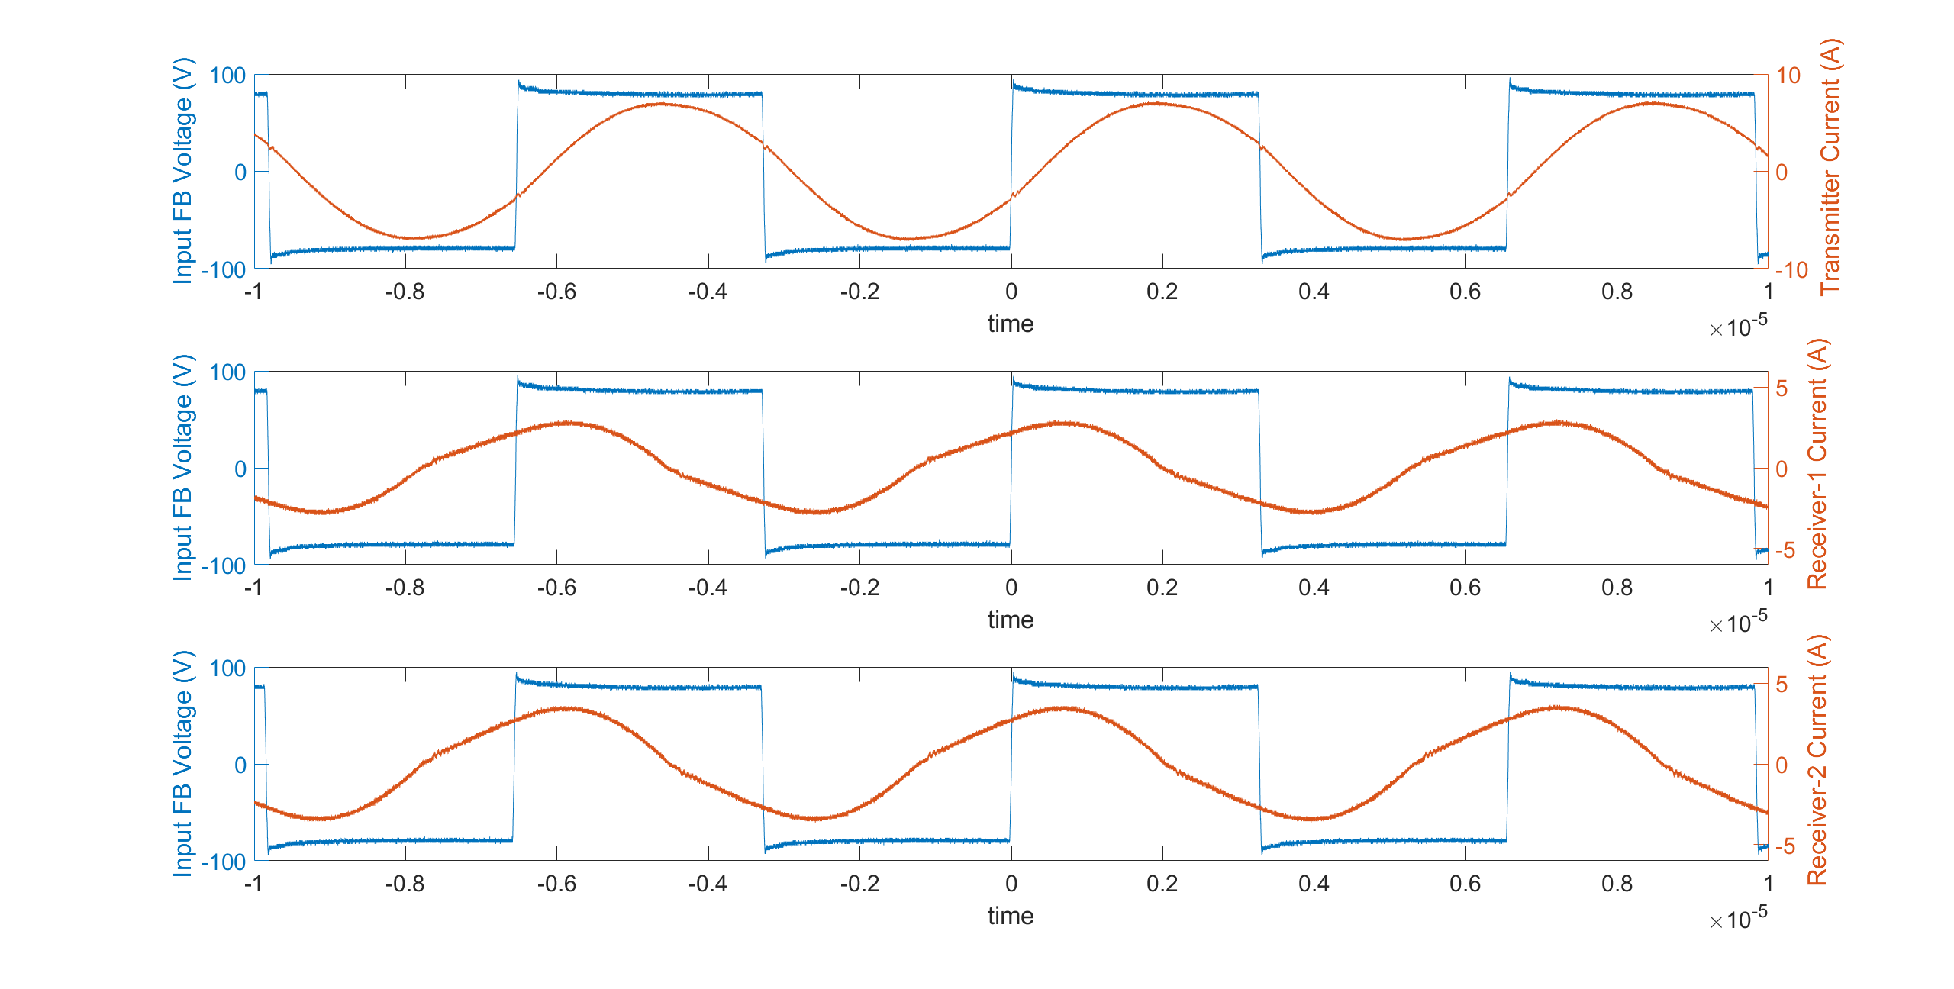
FA-Decoupled-150kHz (1)
Frequency | Ip (peak) | Is1(peak) | Is2(peak) | Ip (angle) | Is1(angle) | Is2(angle)
152kHz | 7.17A | 2.93A | 3.57A | 19.93 | 67.5 | 65.2

Slide 9
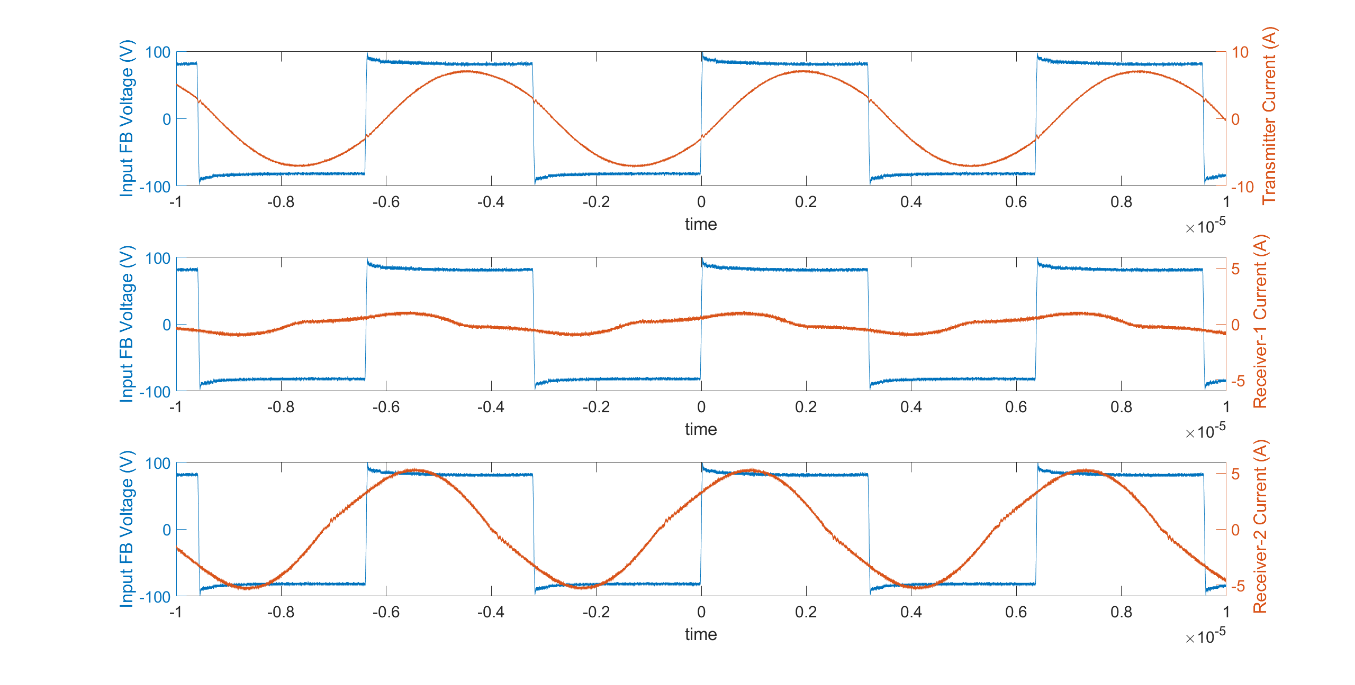
MA-Decoupled-150kHz (3)
Frequency | Ip (peak) | Is1(peak) | Is2(peak) | Ip (angle) | Is1(angle) | Is2(angle)
156.8kHz | 7.25A | 1.17A | 5.09A | 22.8711 | 74.8448 | 44.1957

Slide 10
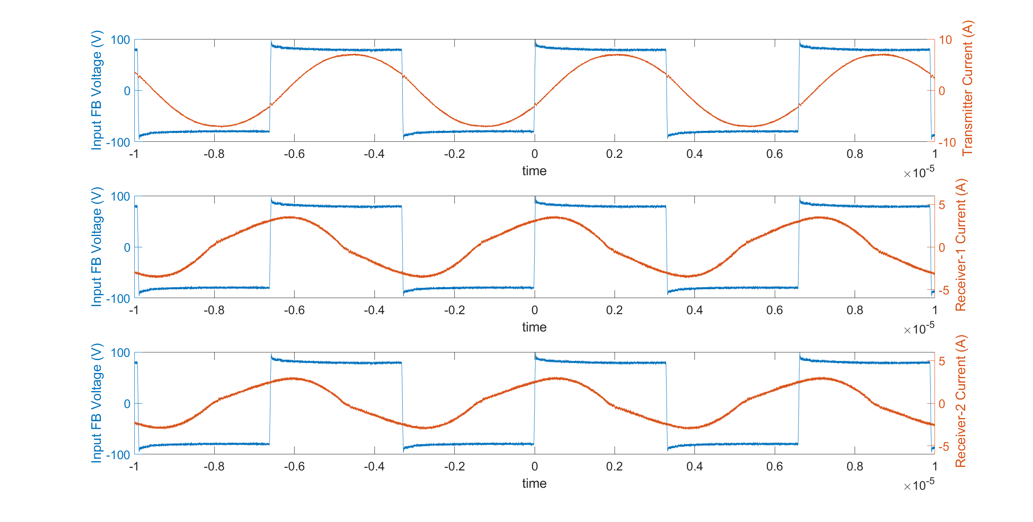
FA-Coupled-150kHz (5)
Frequency | Ip (peak) | Is1(peak) | Is2(peak) | Ip (angle) | Is1(angle) | Is2(angle)
151.6kHz | 7.17A | 3.65A | 3.09A | 22.524 | 76.68 | 74.1722

Slide 11
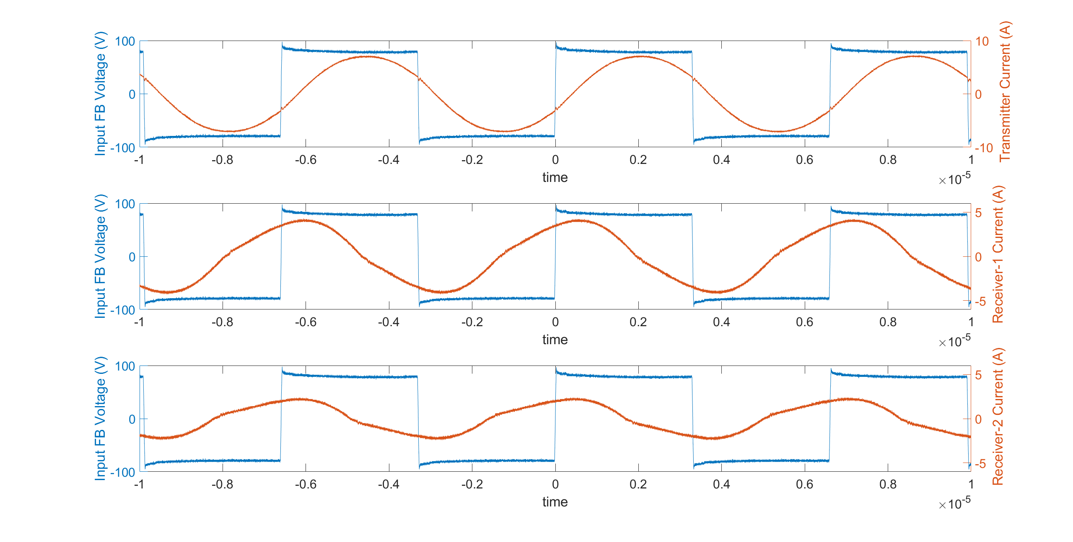
MA-Coupled-150kHz (7)
Frequency | Ip (peak) | Is1(peak) | Is2(peak) | Ip (angle) | Is1(angle) | Is2(angle)
151.3kHz | 7.17A | 4.21A | 2.37A | 22.31 | 72.18 | 82.7542

Slide 13
FA-Decoupled-150kHz (1)
Frequency | Ip (peak) | Is1(peak) | Is2(peak) | Ip (angle) | Is1(angle) | Is2(angle)
152kHz | 7.17A | 2.93A | 3.57A | 19.93 | 67.5 | 65.2

Slide 14
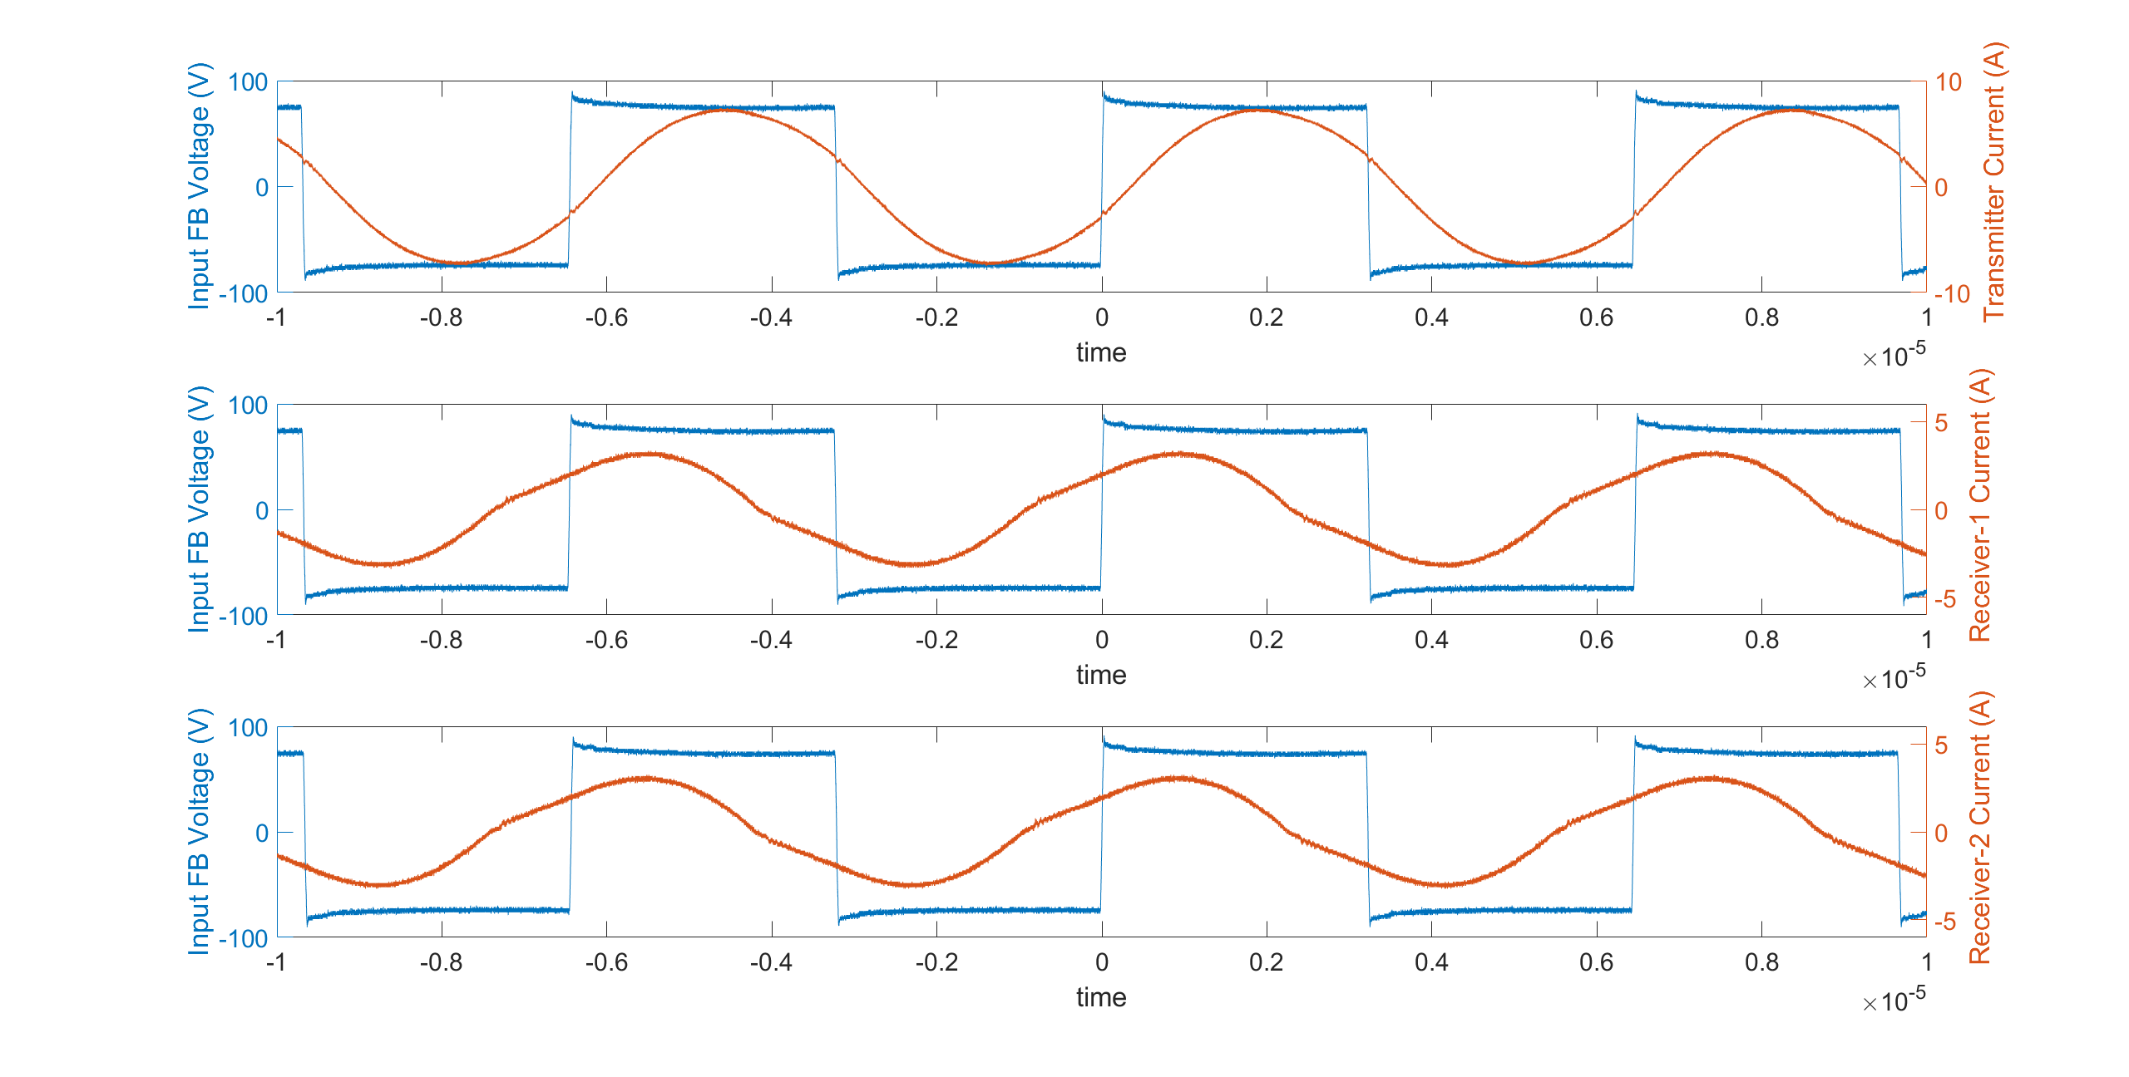
FA-Decoupled-135kHz (2)
Frequency | Ip (peak) | Is1(peak) | Is2(peak) | Ip (angle) | Is1(angle) | Is2(angle)
154.75kHz | 7.41A | 3.33A | 3.17A | 20.310 | 46.752 | 51.4652

Slide 15
MA-Decoupled-150kHz (3)
Frequency | Ip (peak) | Is1(peak) | Is2(peak) | Ip (angle) | Is1(angle) | Is2(angle)
156.8kHz | 7.25A | 1.17A | 5.09A | 22.8711 | 74.8448 | 44.1957

Slide 16
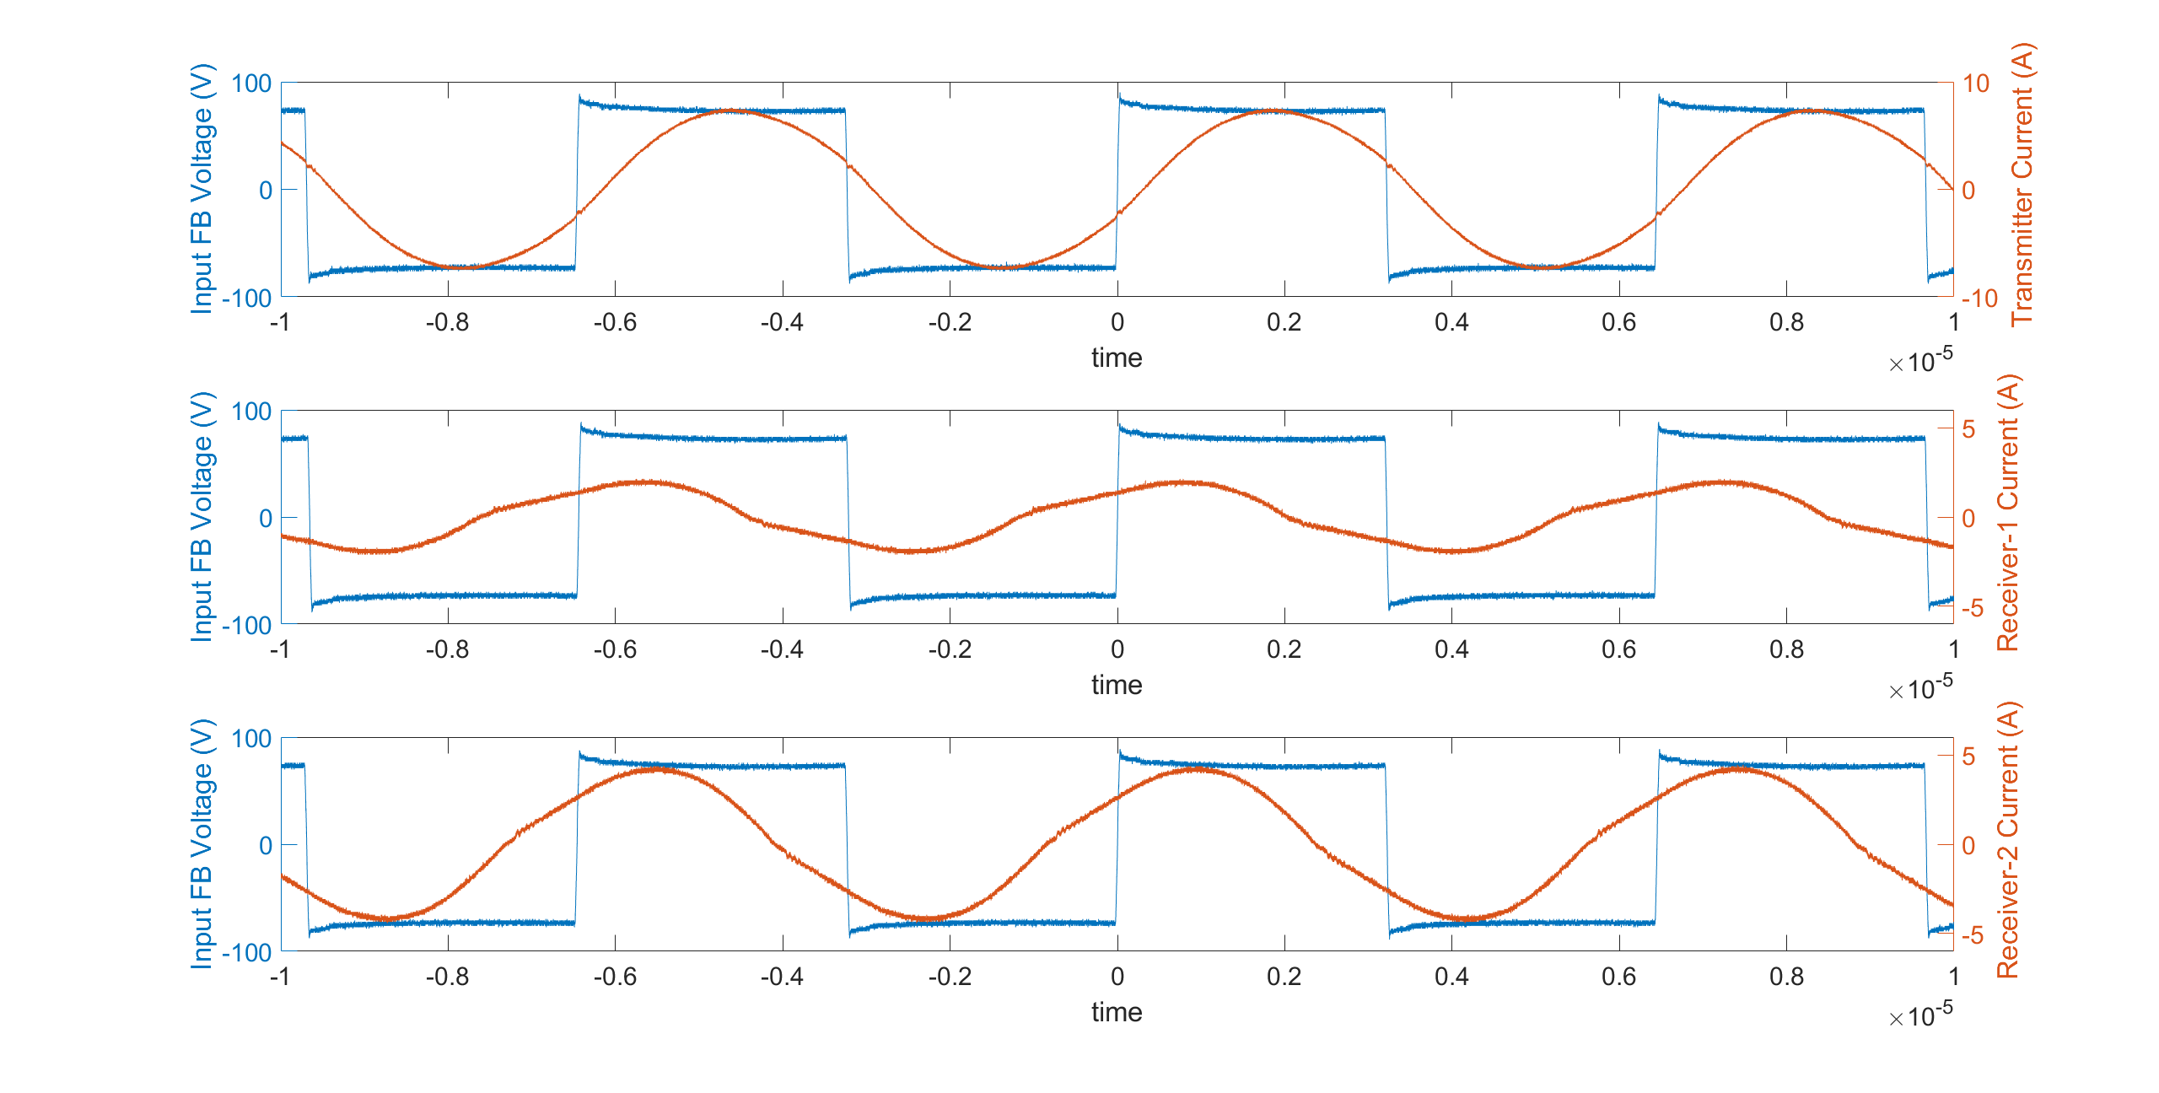
MA-Decoupled-135kHz (4)
Frequency | Ip (peak) | Is1(peak) | Is2(peak) | Ip (angle) | Is1(angle) | Is2(angle)
155.3kHz | 7.49A | 2.13A | 4.29A | 18.34 | 65.75 | 47.75

Slide 17
SPICE MODELS

Slide 18
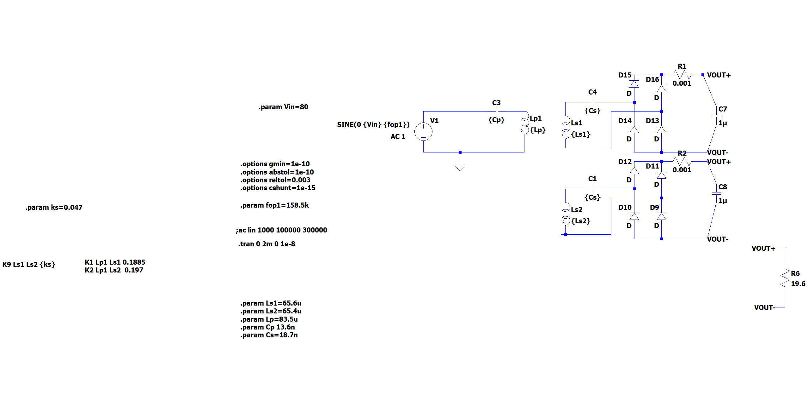
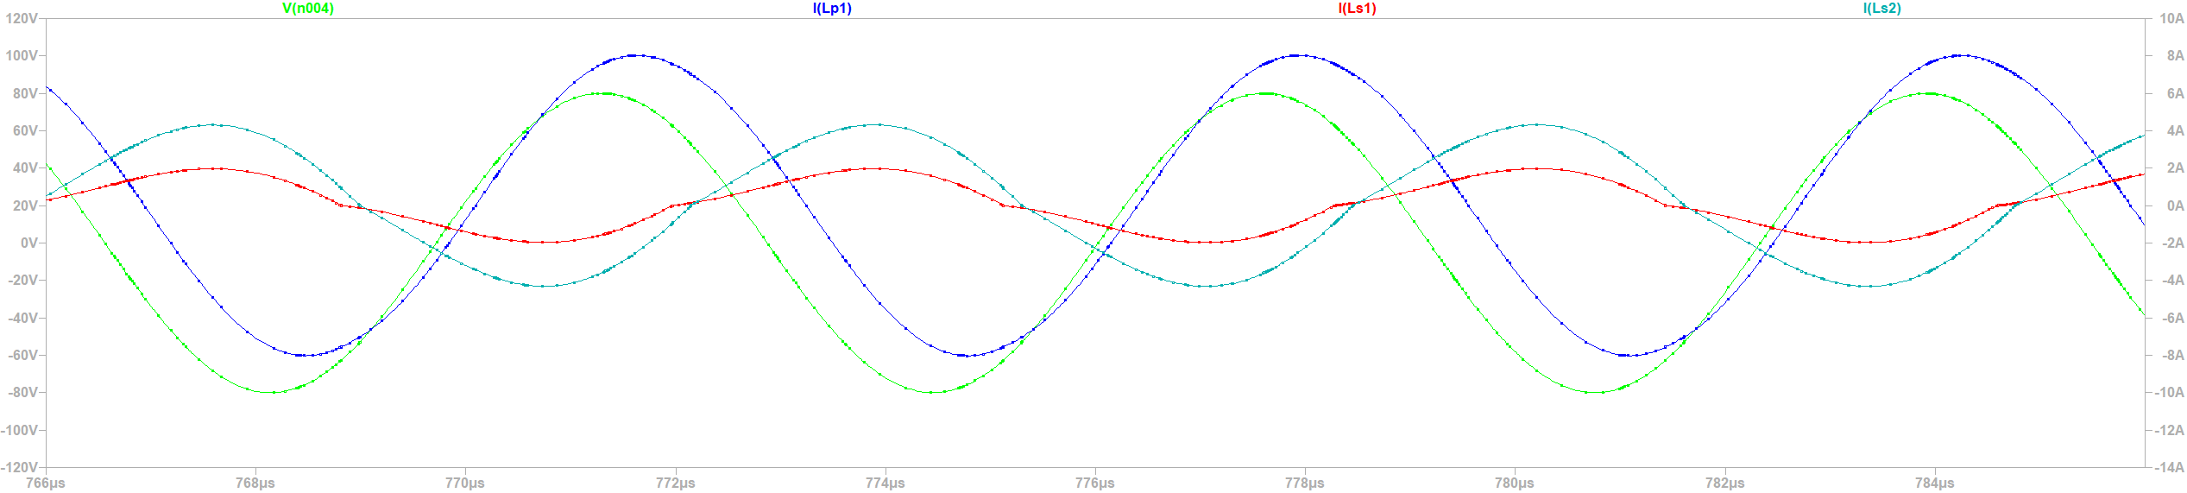
Case-1
Frequency | Ip (peak) | Is1(peak) | Is2(peak) | Ip (angle) | Is1(angle) | Is2(angle)
152kHz | 7.17A | 2.93A | 3.57A | 19.93 | 67.5 | 65.2
Frequency | Ip (peak) | Is1(peak) | Is2(peak) | Ip (angle) | Vout
158.5kHz | 7.98A | 1.88A | 4.273A | 20.90 | 75.76

Slide 19
Case-5
Frequency | Ip (peak) | Is1(peak) | Is2(peak) | Ip (angle) | Is1(angle) | Is2(angle)
154.75kHz | 7.41A | 3.33A | 3.17A | 20.310 | 46.752 | 51.4652
Frequency | Ip (peak) | Is1(peak) | Is2(peak) | Ip (angle) | Vout
158.5kHz | 7.98A | 1.88A | 4.273A | 20.90 | 75.76

Slide 20
Case-3

Slide 21
Case-7

Slide 22
Case-2

Slide 23
Case-4

