Slide 1
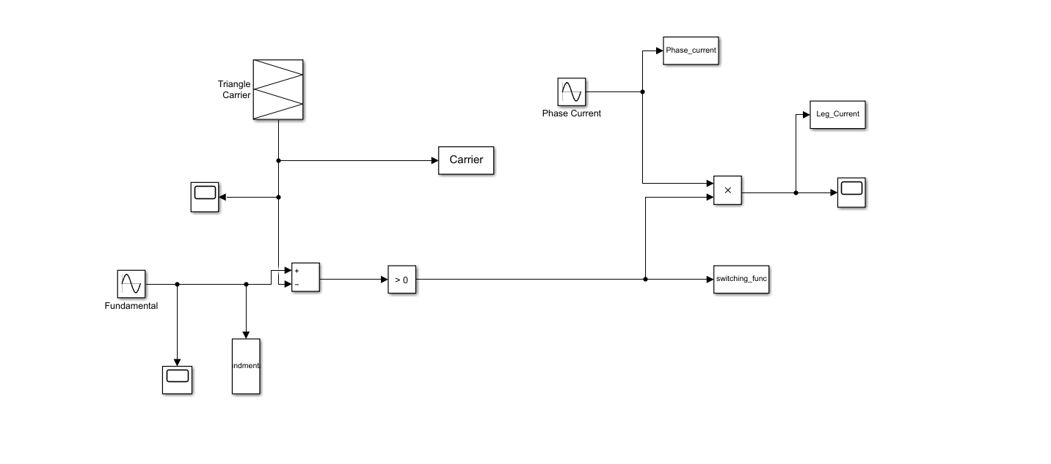
SIMULATION SETUP
Simulink model is created with triangular carrier based sinusoidal PWM.

Slide 2
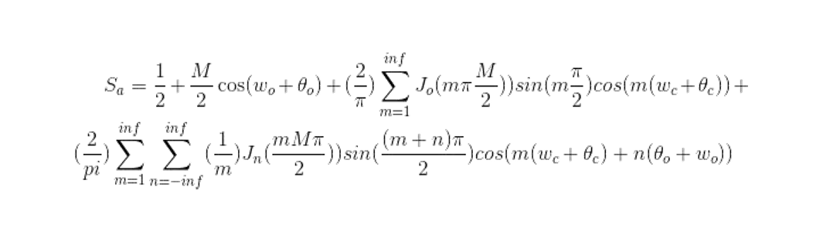
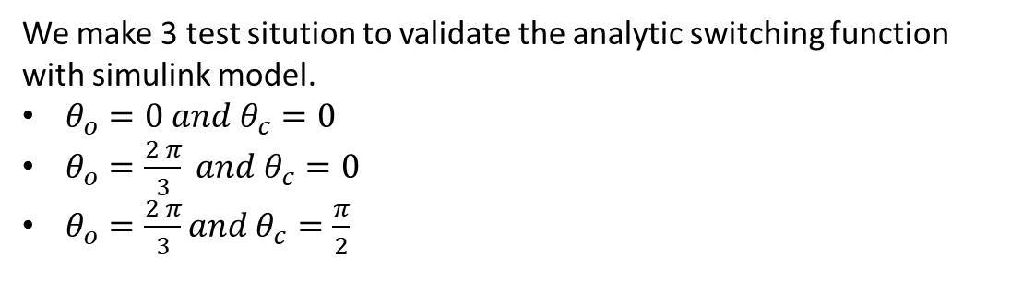
Switching Function
k=M % modulation index
f_o % output frequcency(fundamental)
f_c % carrier frequency (switching)
The_o % output phase
The_c % carrier phase
m_max % maximum harmonics of carrier
n_max % The number of sidebands
We make 3 test sitution to validate the analytic switching function with simulink model.
$θ_{o}=0 and θ_{c}=0$
$θ_{o}=\frac{2 π}{3} and θ_{c}=0$
$θ_{o}=\frac{2 π}{3}and θ_{c}=\frac{π}{2}$
Attention:
Carrier and fundamental phase at different at matlab code because all of the simulations have become messy.

Slide 3
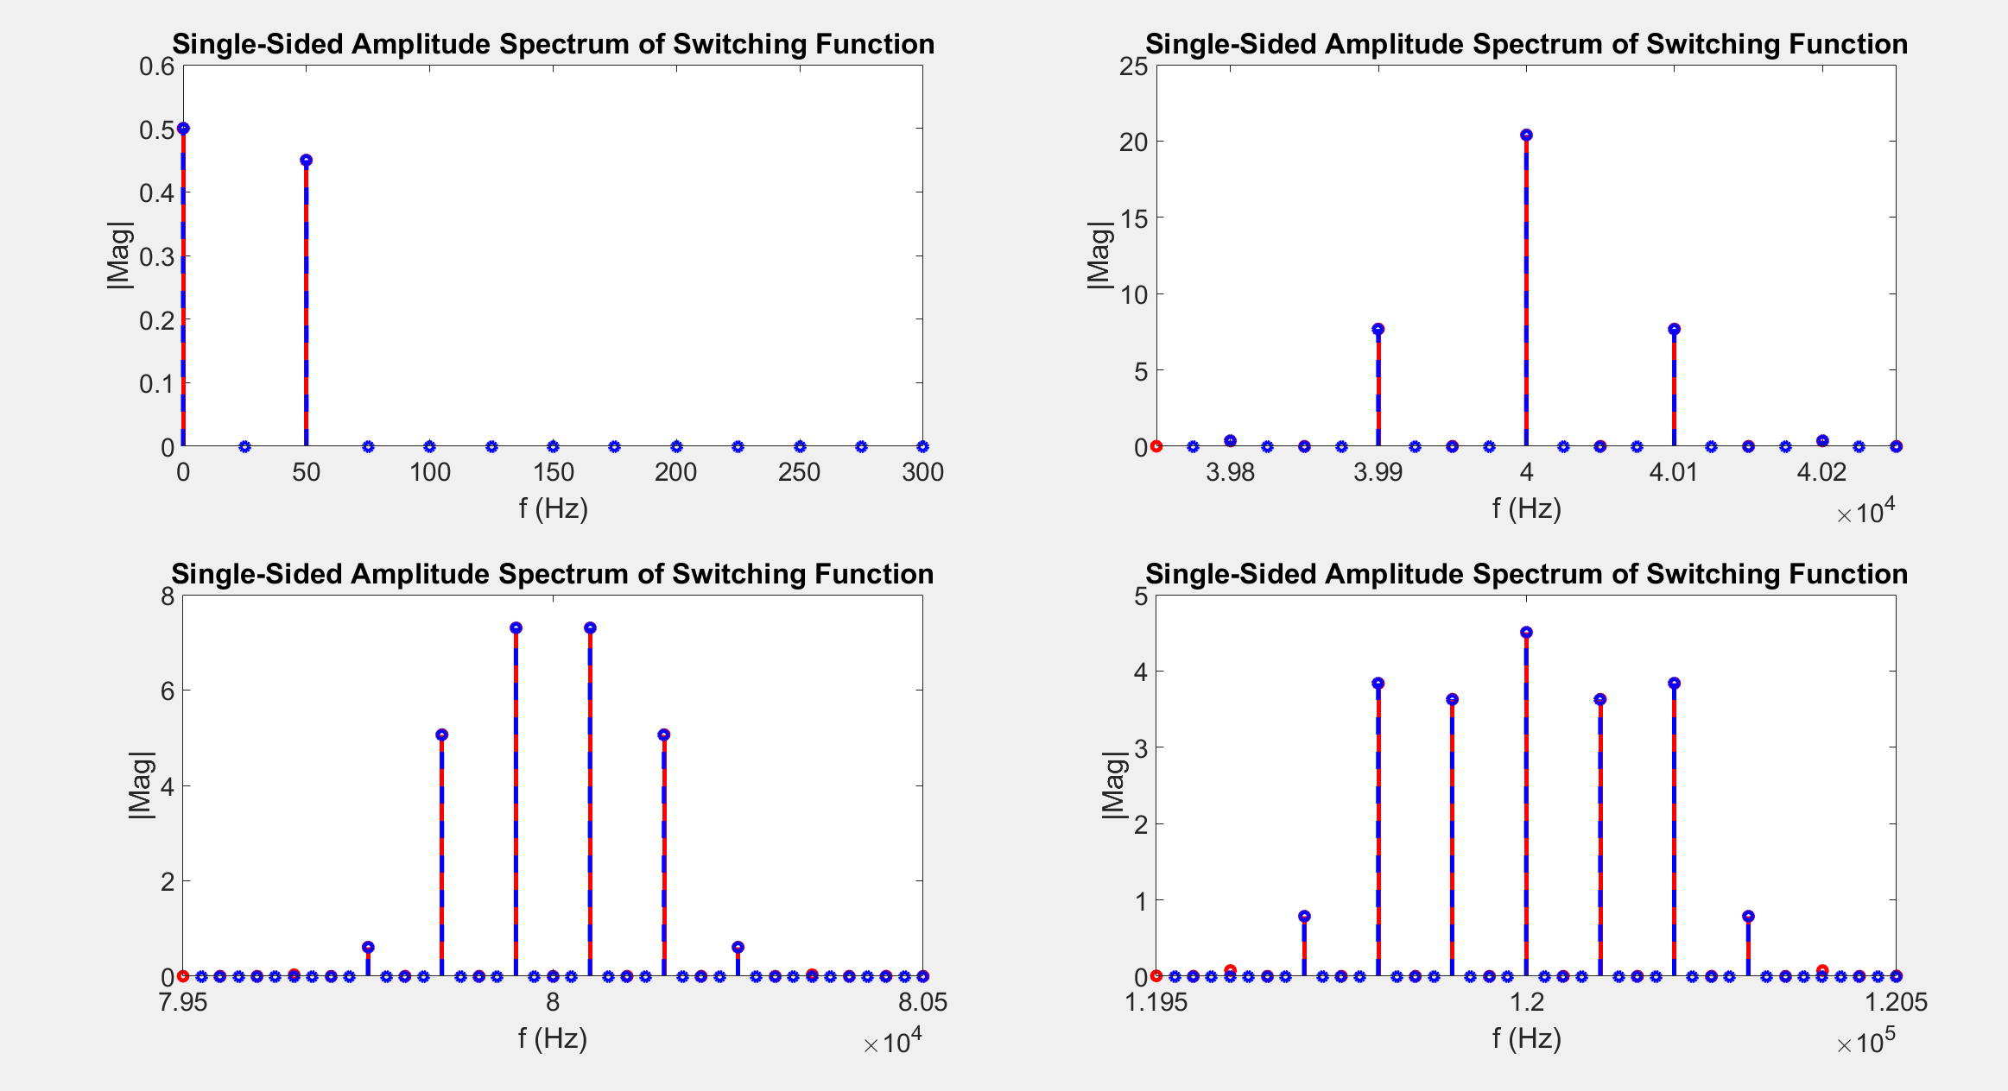
$$θ_{o}=0 and θ_{c}=0$$

Slide 4
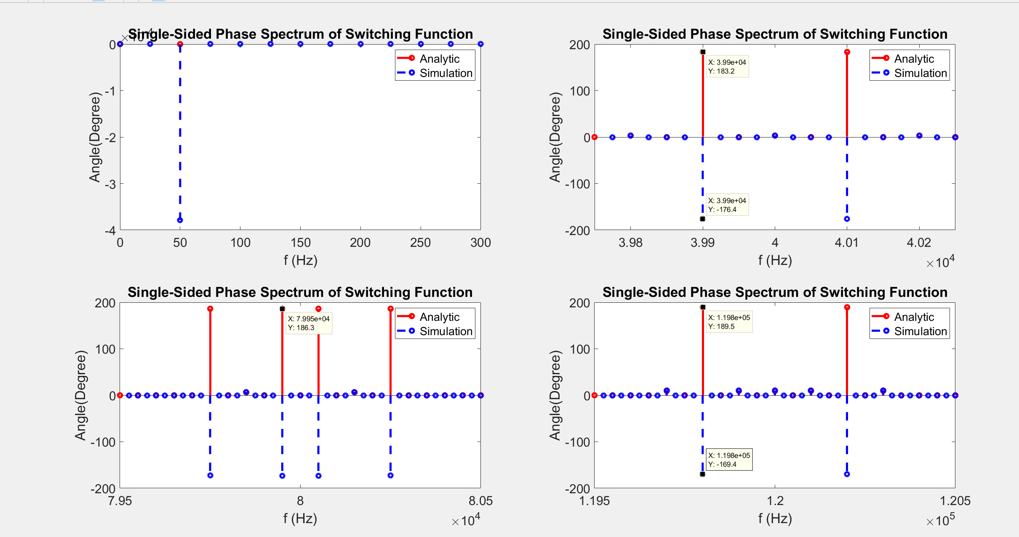

Slide 5
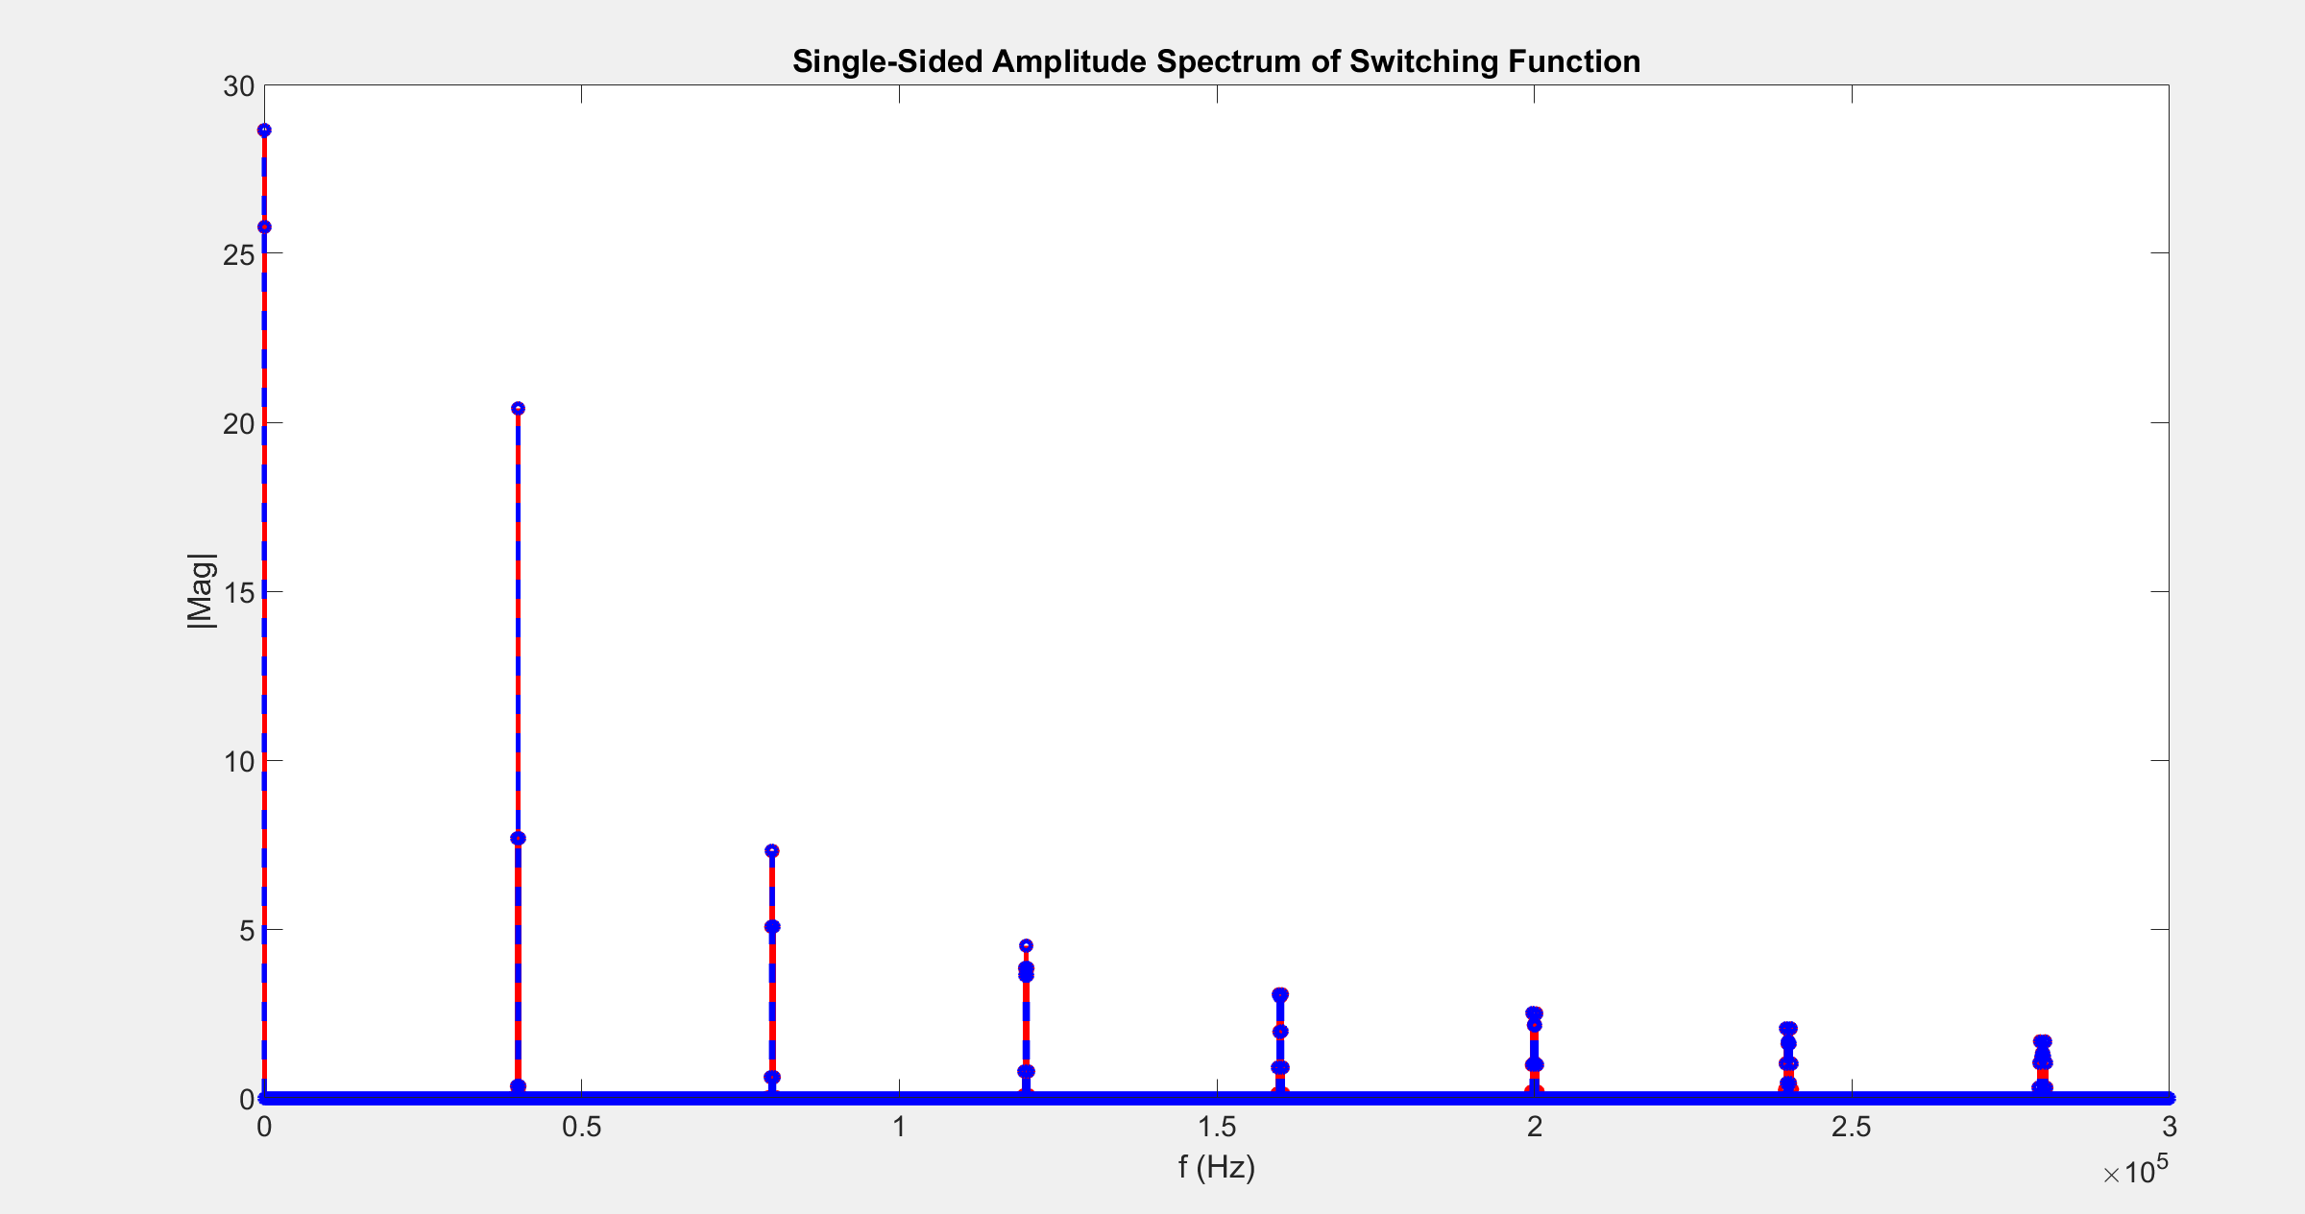

Slide 6
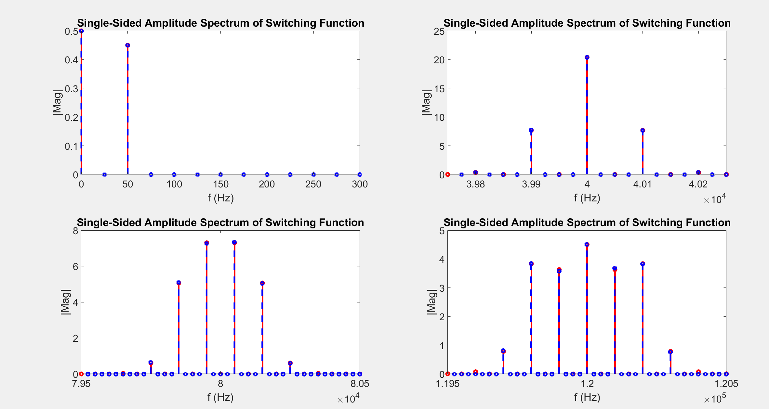

$$θ_{o}=\frac{2π}{3} and θ_{c}=0$$

Slide 7
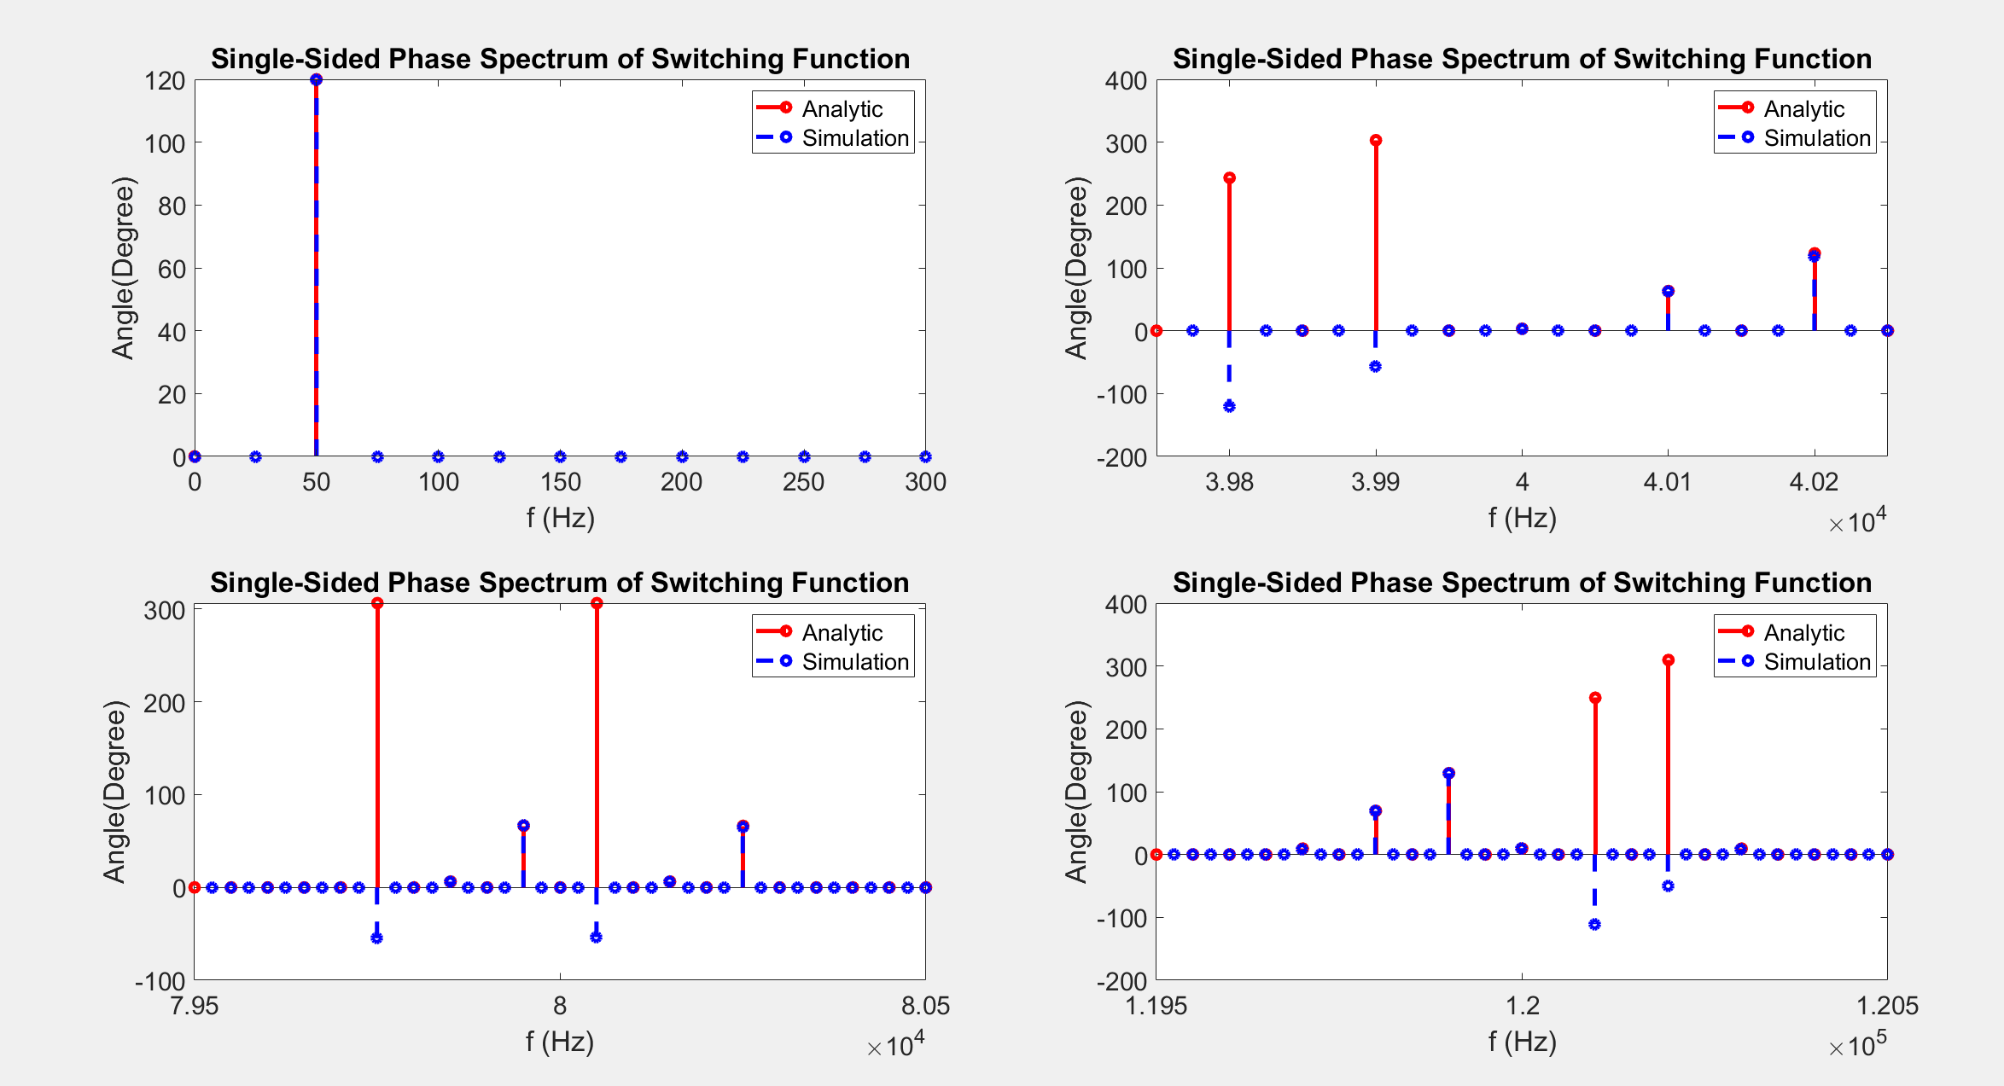

Slide 8
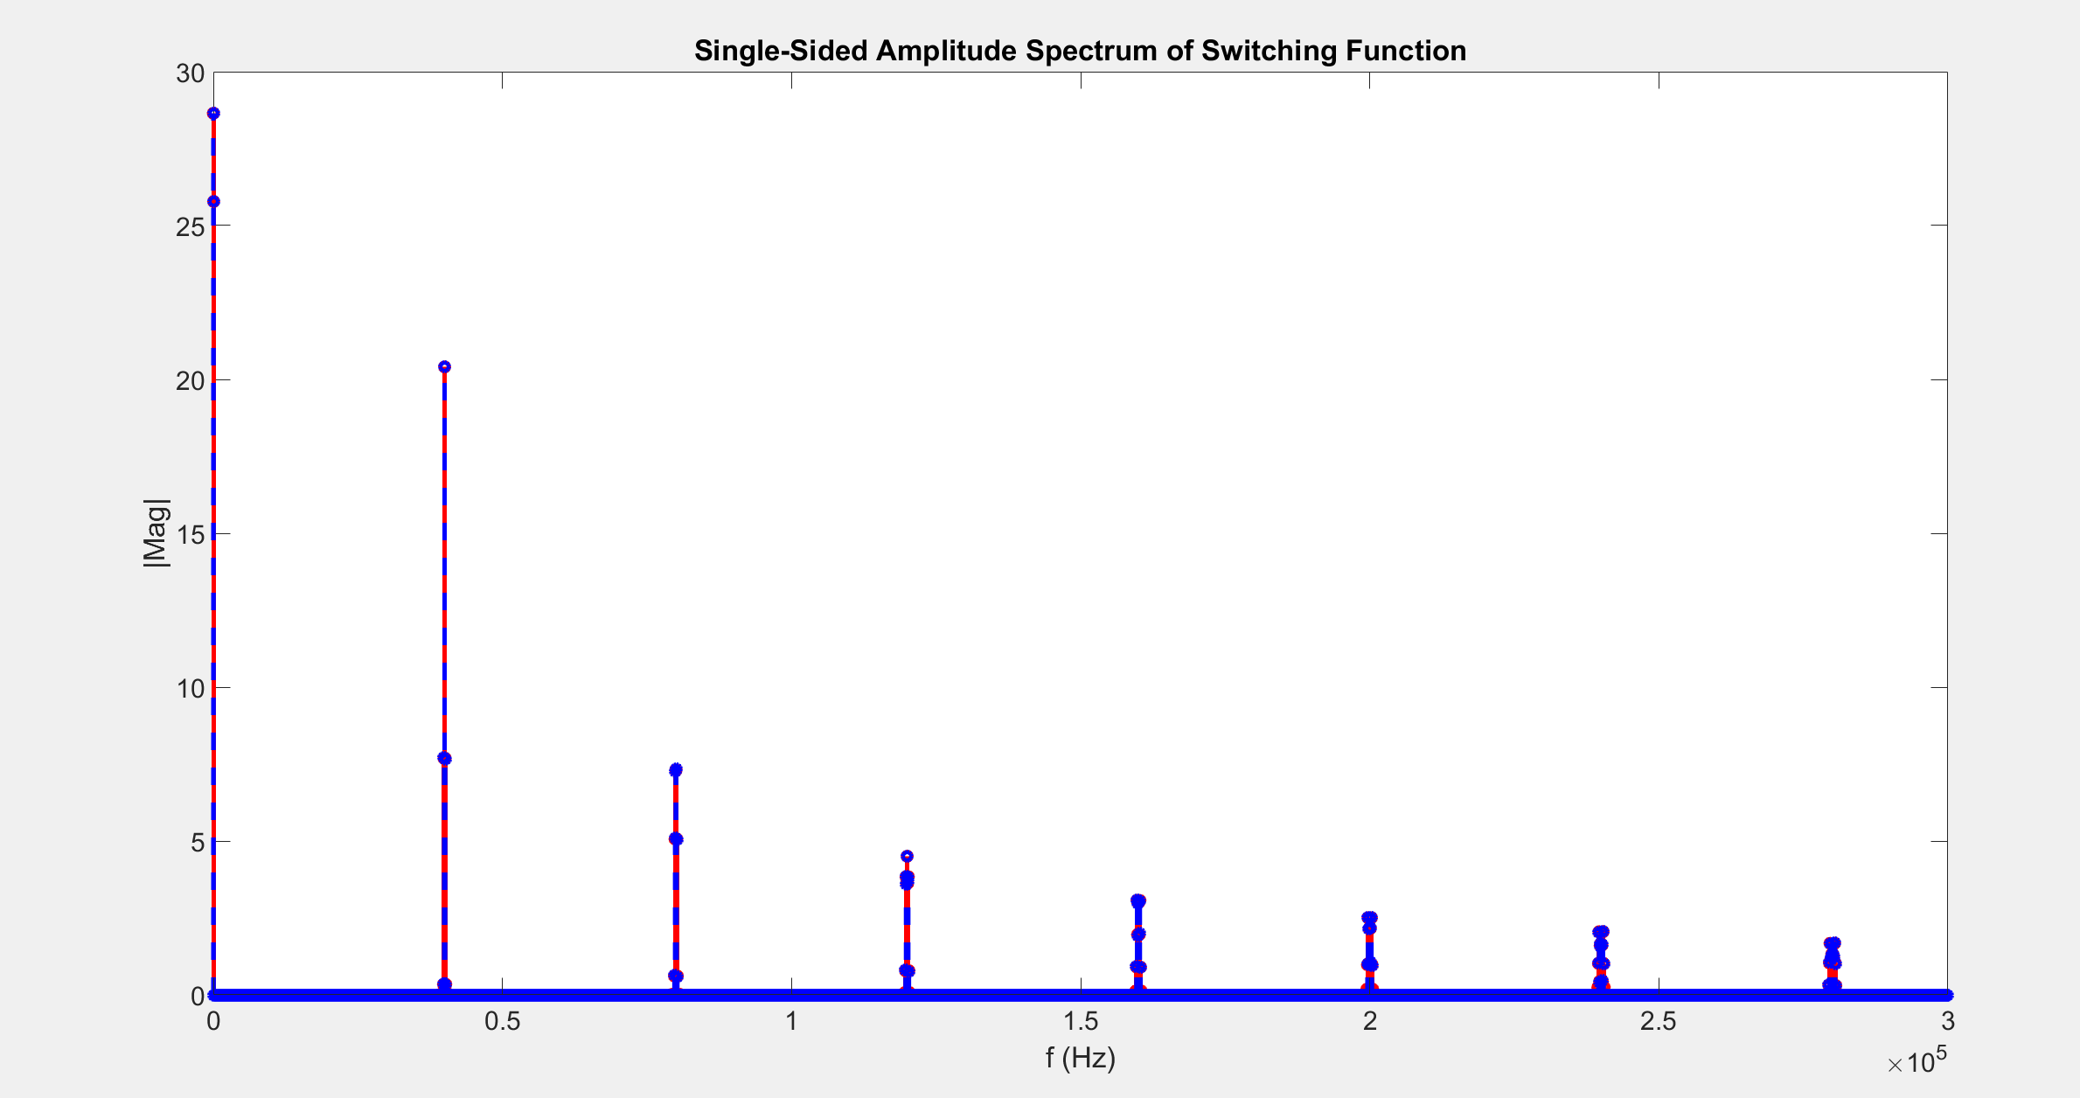

Slide 9
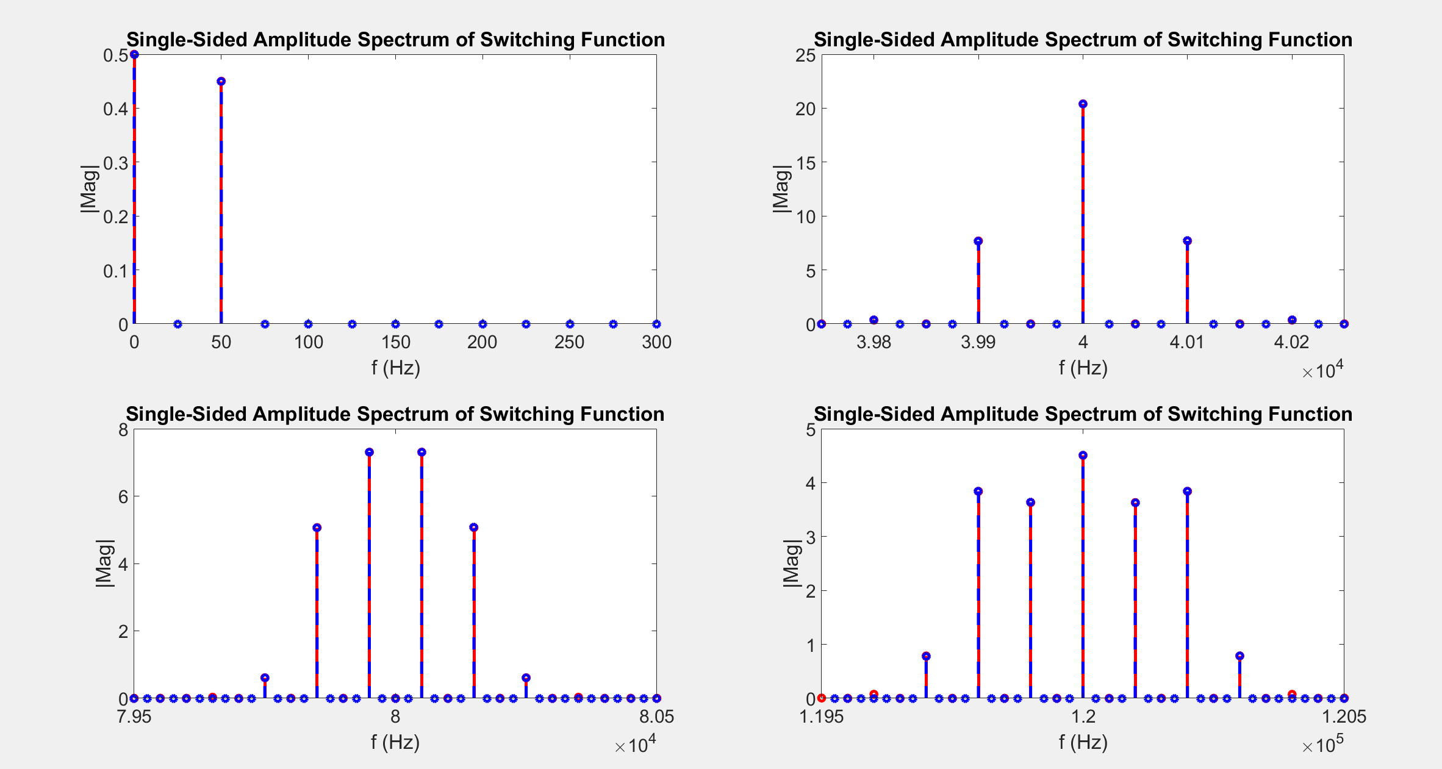
$$θ_{o}=\frac{2π}{3} andθ_{c}=\frac{π}{2}$$

Slide 10
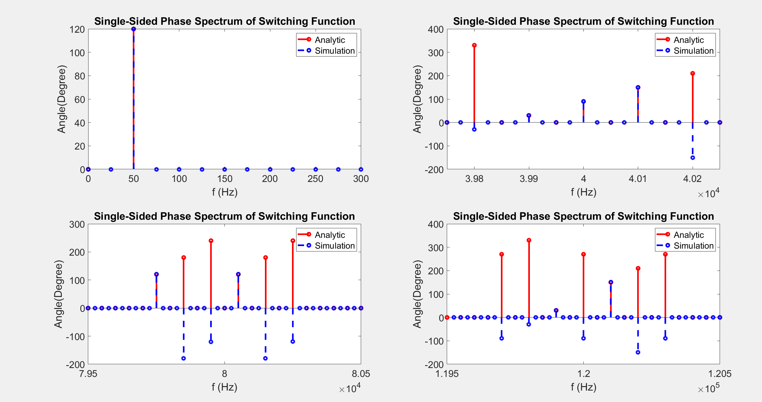

Slide 11
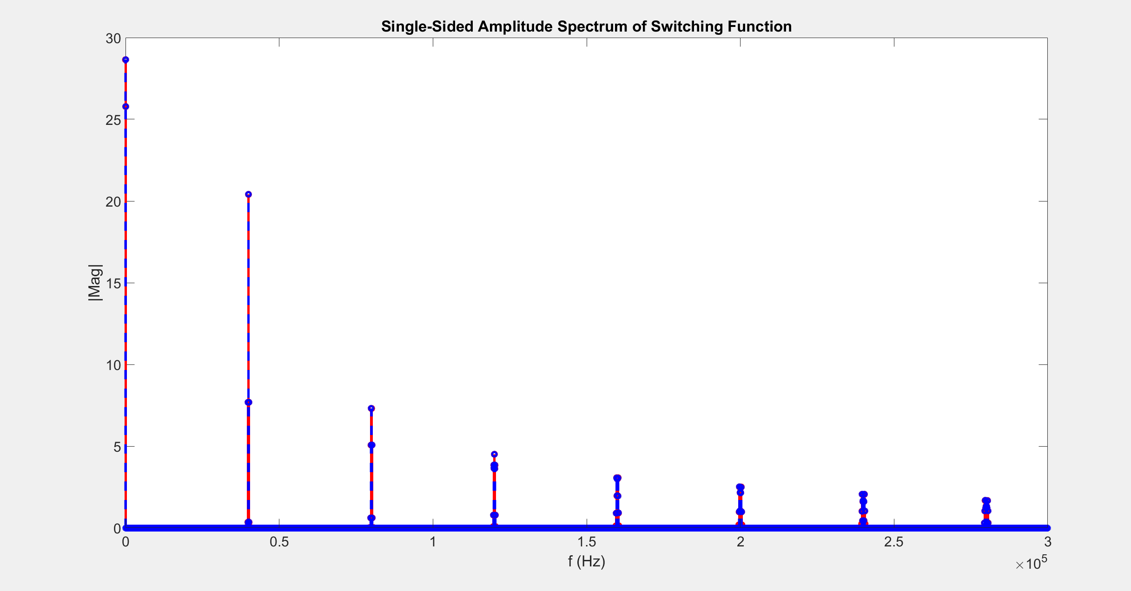

Slide 12
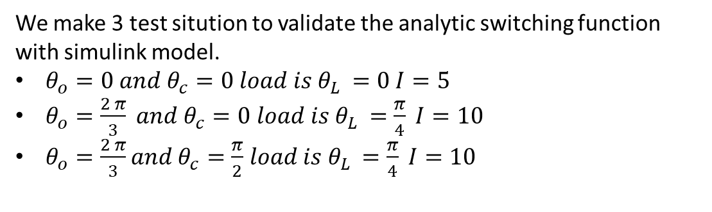
LEG CURRENT
We make 3 test sitution to validate the analytic switching function with simulink model.
$θ_{o}=0 and θ_{c}=0 load is θ_{L }=0 I=5$
$θ_{o}=\frac{2 π}{3} and θ_{c}=0$ $load is θ_{L }=\frac{π}{4} I=10$
$θ_{o}=\frac{2 π}{3}and θ_{c}=\frac{π}{2}$ $load is θ_{L }=\frac{π}{4} I=10$

Slide 13
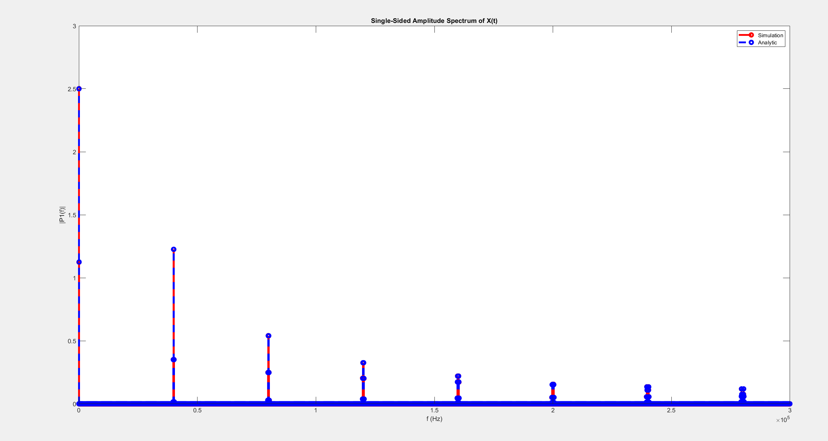

$θ_{o}=0 and θ_{c}=0 load is θ_{L }=0 I=5$

Slide 14
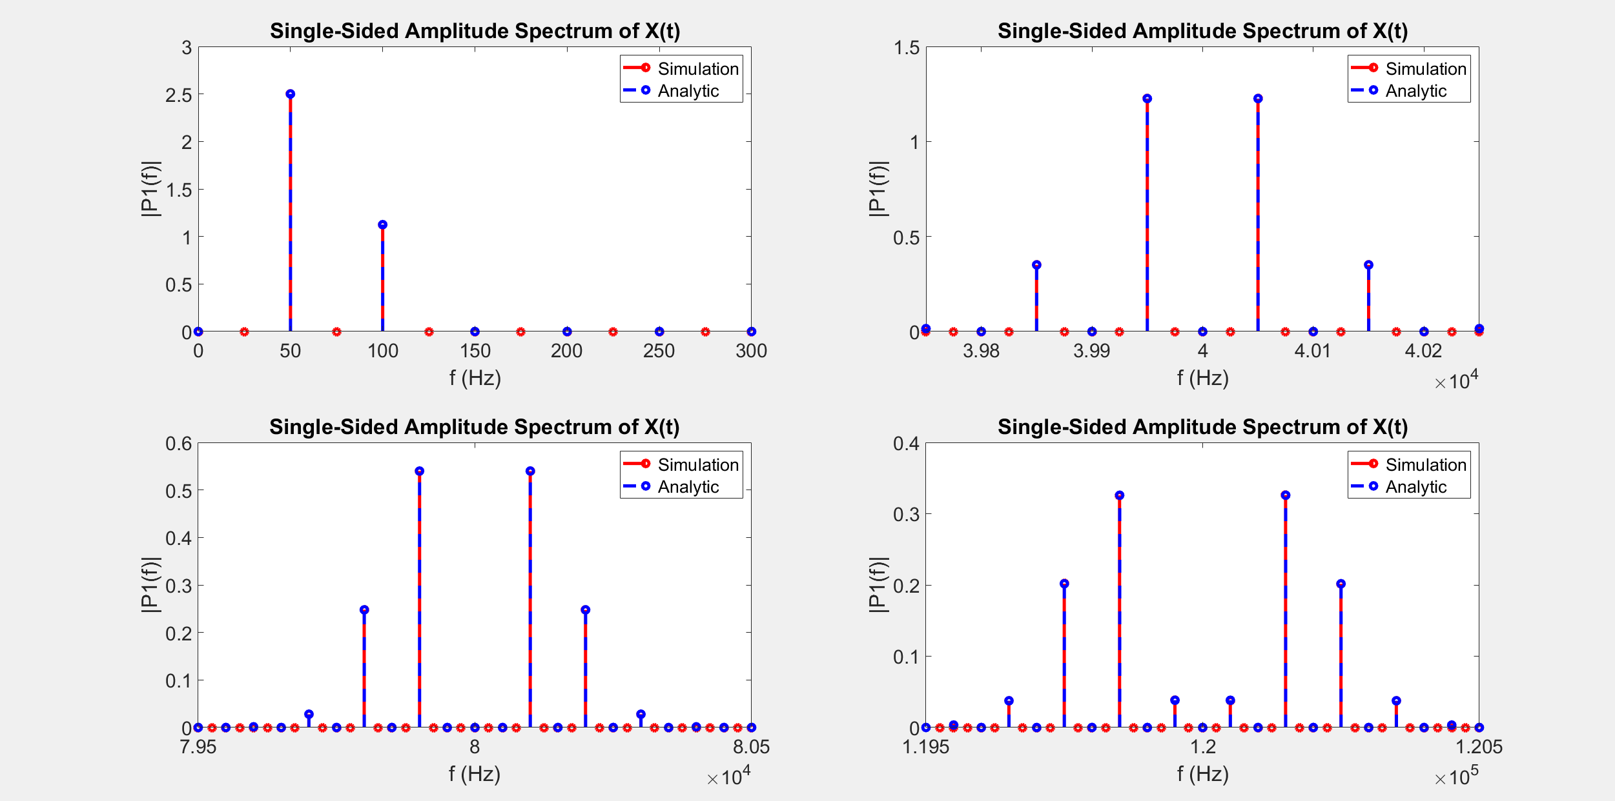

Slide 15
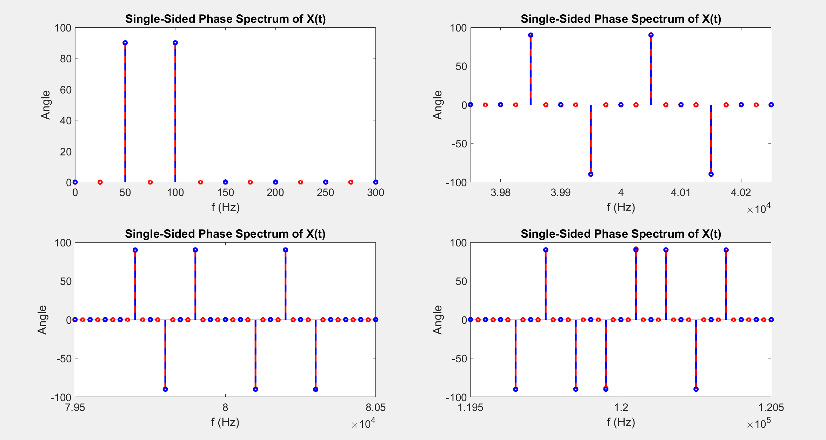

Slide 16
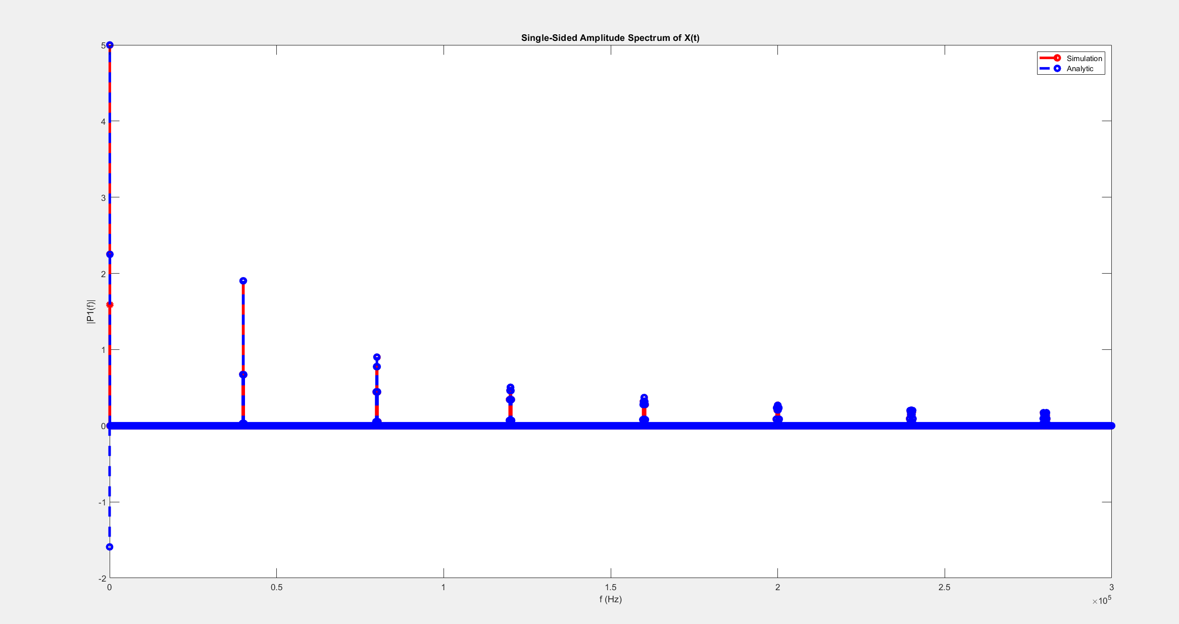

$θ_{o}=\frac{2 π}{3} and θ_{c}=0$ $load is θ_{L }=\frac{π}{4} I=10$

Slide 17
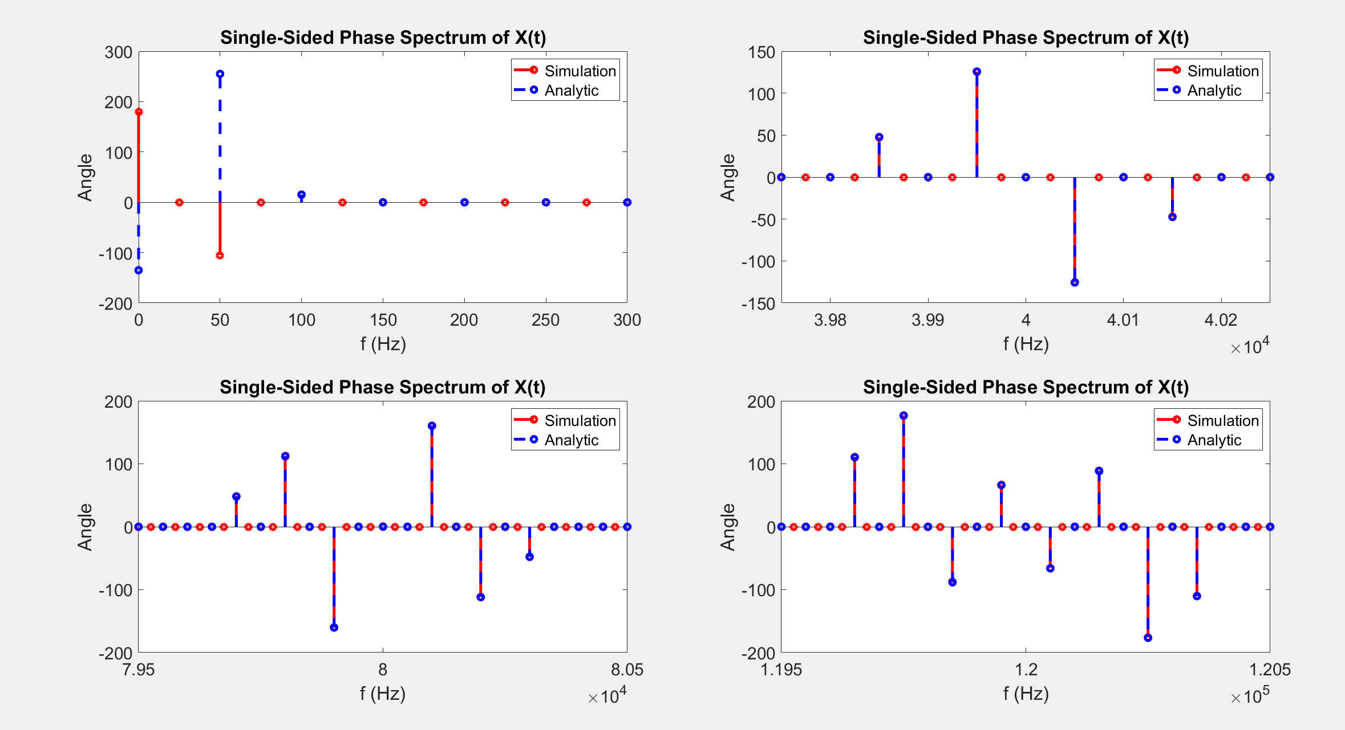

Slide 18
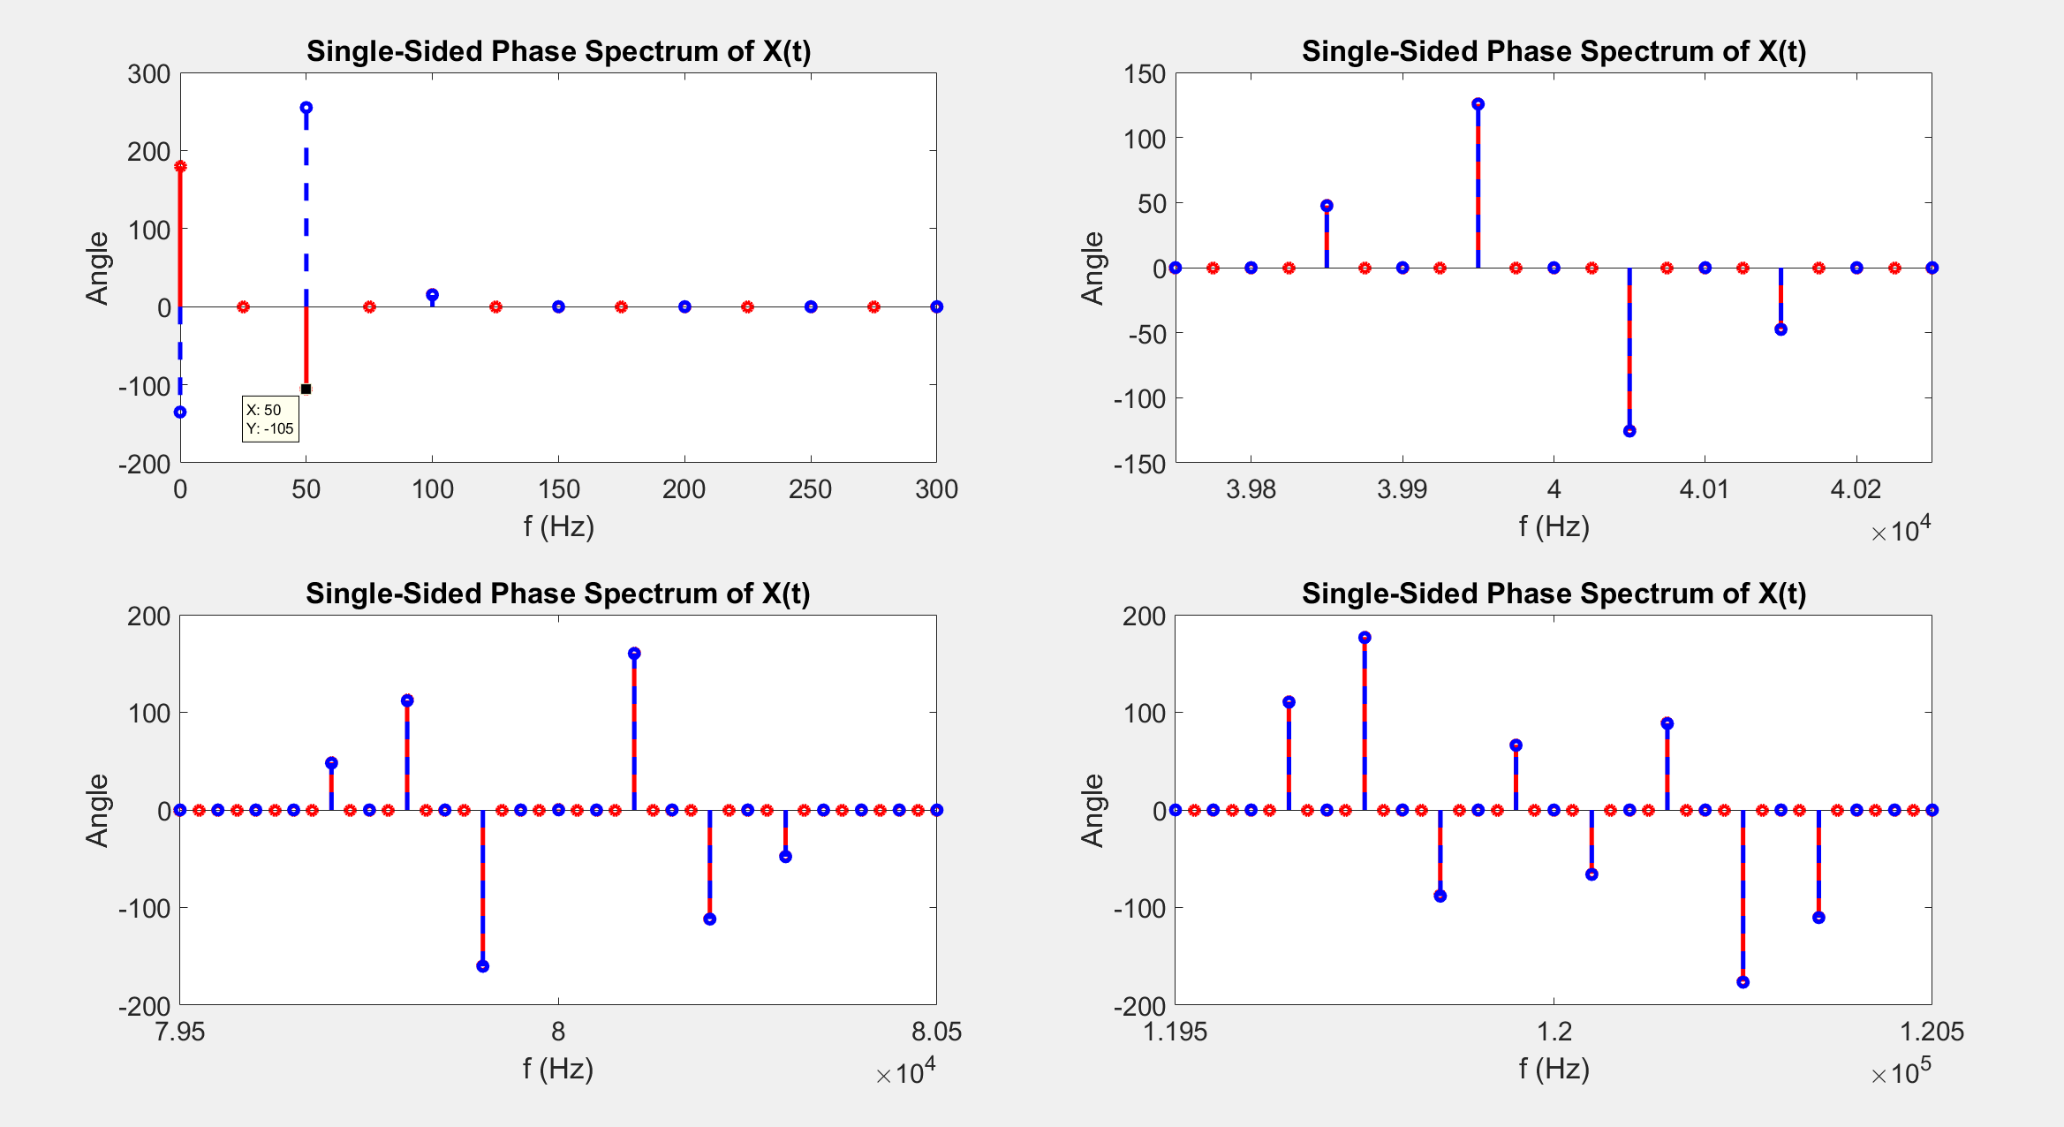

Slide 19
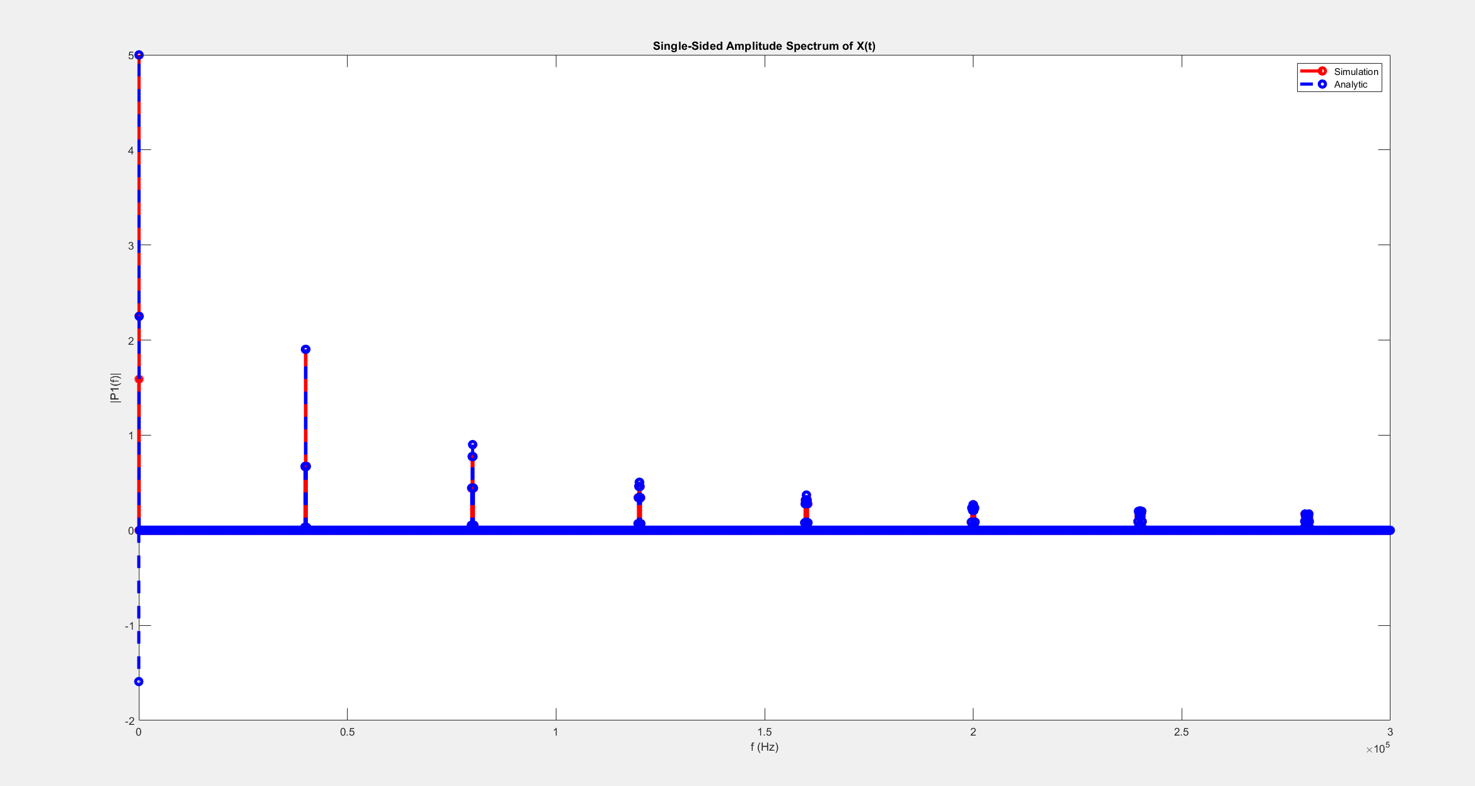

$θ_{o}=\frac{2 π}{3}and θ_{c}=\frac{π}{2}$ $load is θ_{L }=\frac{π}{4} I=10$

Slide 20
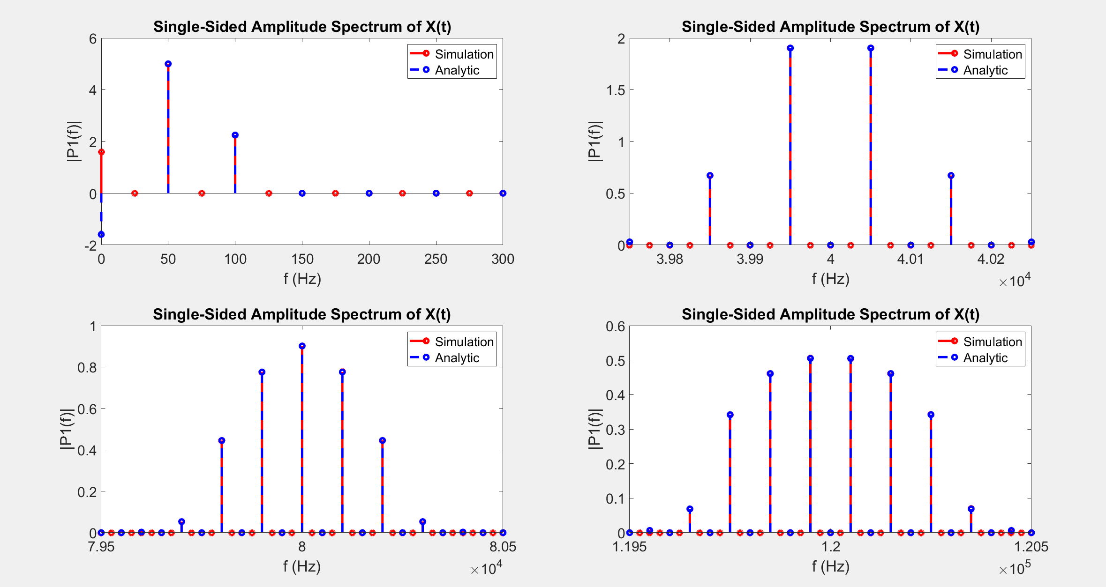

Slide 21
