Slide 1
Primary Winding
2 half circle with a hole for motor shaft
Why is it a circular ? beacuse is it required to mount motor without any mechanical decomposition

Slide 2
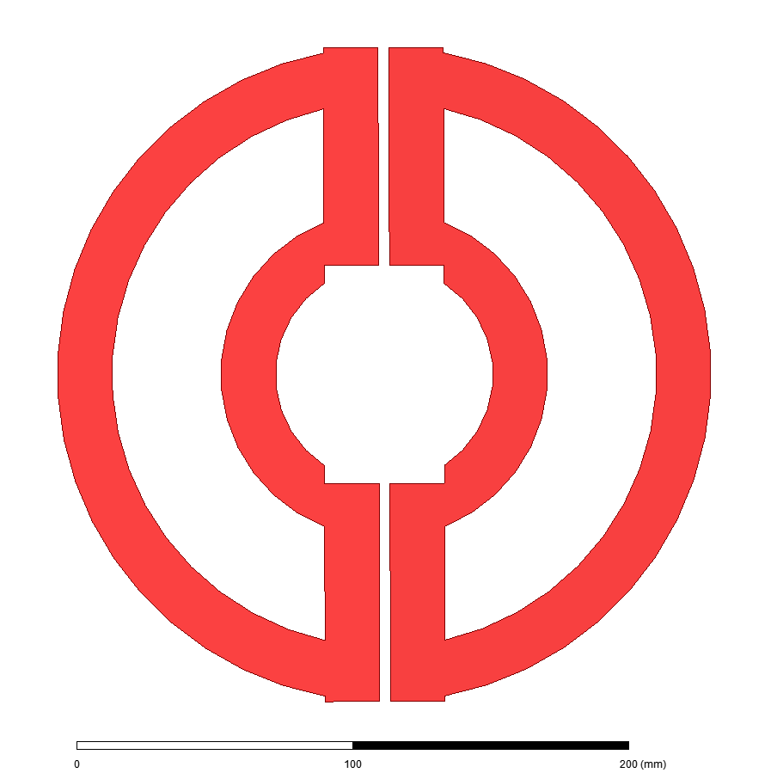
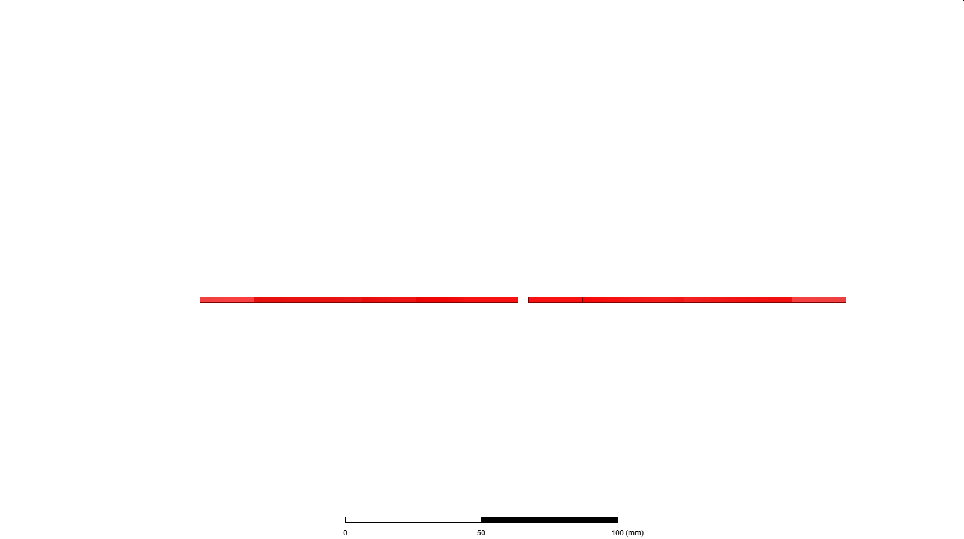
Formerly Proposed Design
Modular design
2 winding can be thought as decoupled (0.05 coupling coefficient)
Not giving a constant flux
Flux is destroyed at passage between two primaries

Slide 3
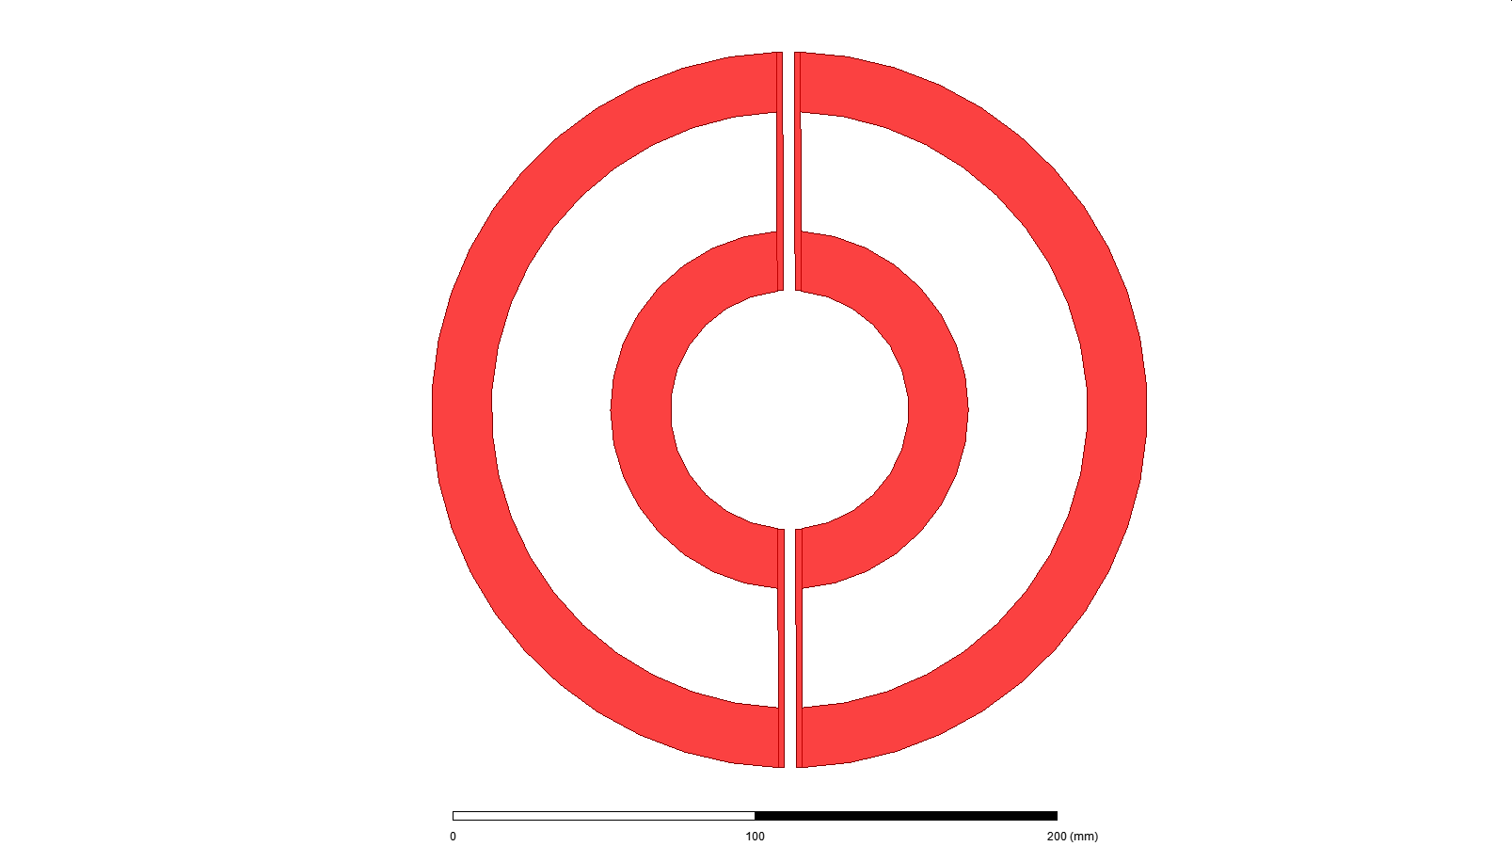
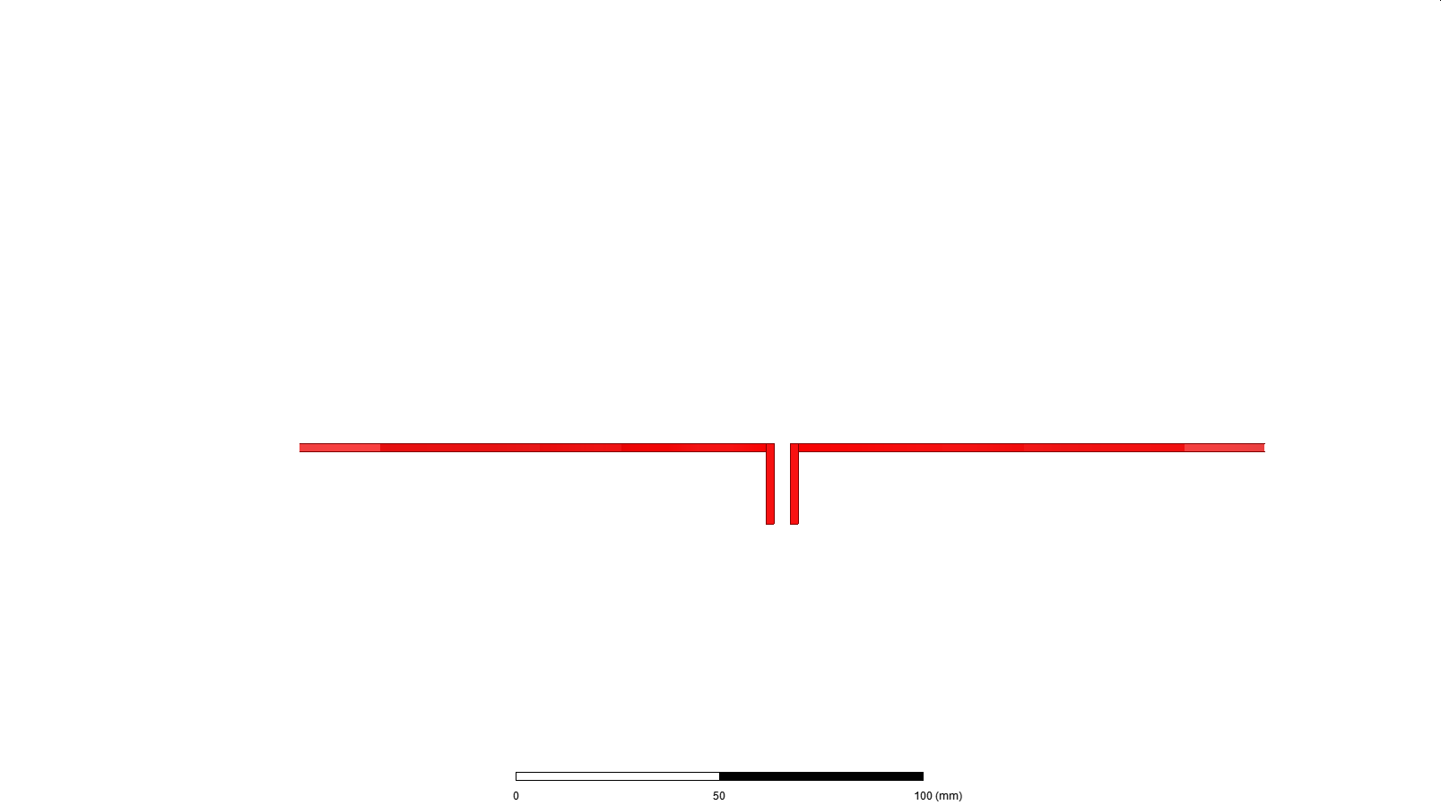
Proposed Design
Problem: Flux distribution is not constant
Solution : Bended endwindings of primaries

Slide 4
Pros and Cons
Flux change is 10 percent between fully aligned and transition between two primaries.
Leakage flux (primary to primary ) is bigger than expectation .

Slide 5
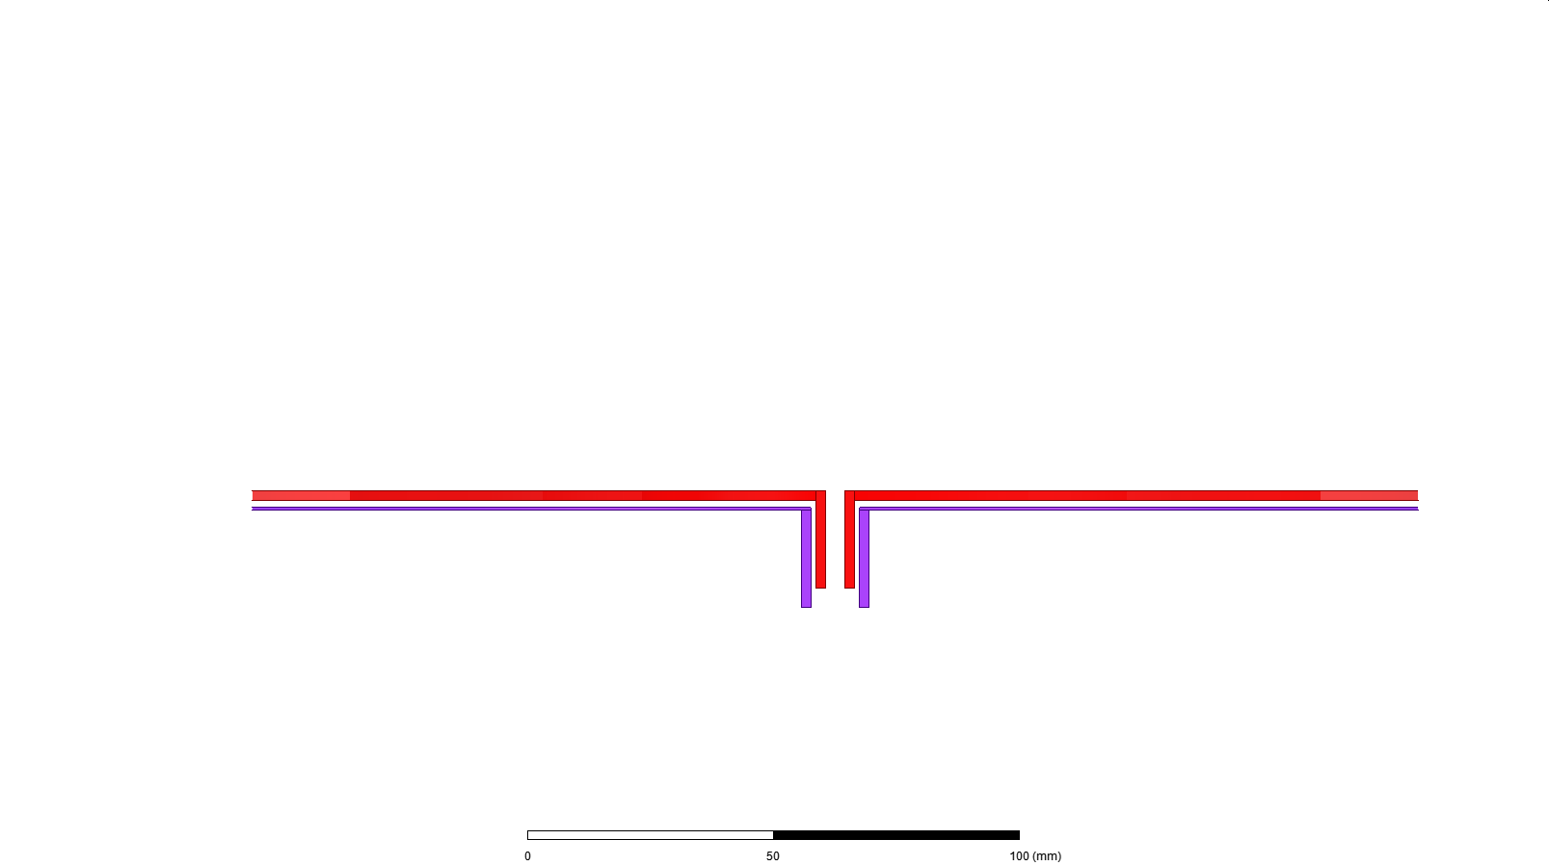

How can we decrease mutual indcutance between two primeries?
Solution: Middle Ferrite core to decouple two primaries

Slide 6
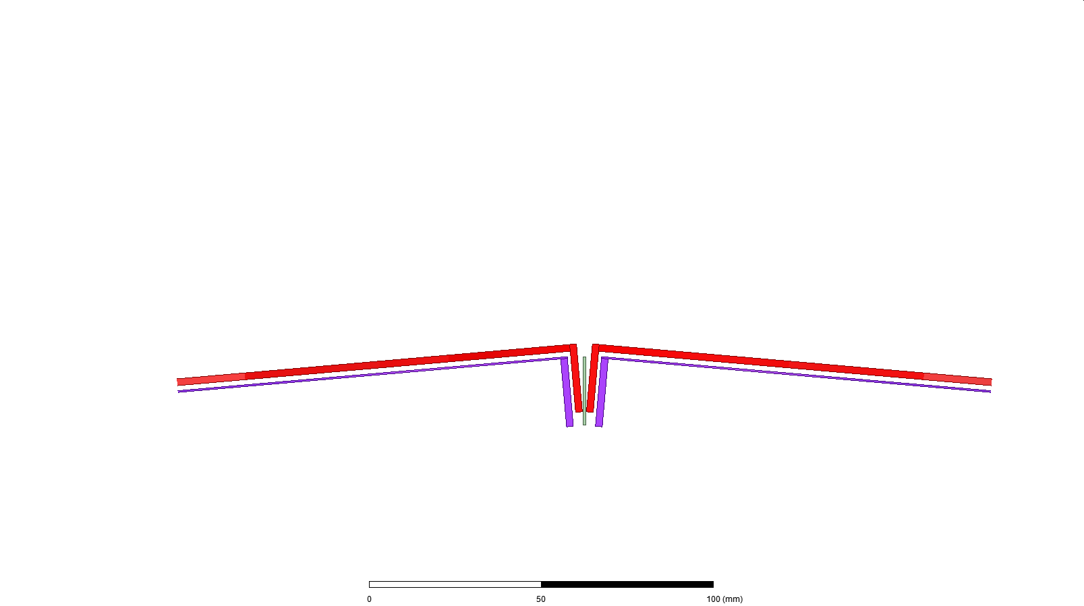
New Problems: Linked Flux distribution is disturbed. The change becomes 20 percent.
Solution: Changing Air gap.
Airgap is adjusted to make linked flux distribution constant. Thus, bended with a determined slope.

Slide 7
