Slide 1
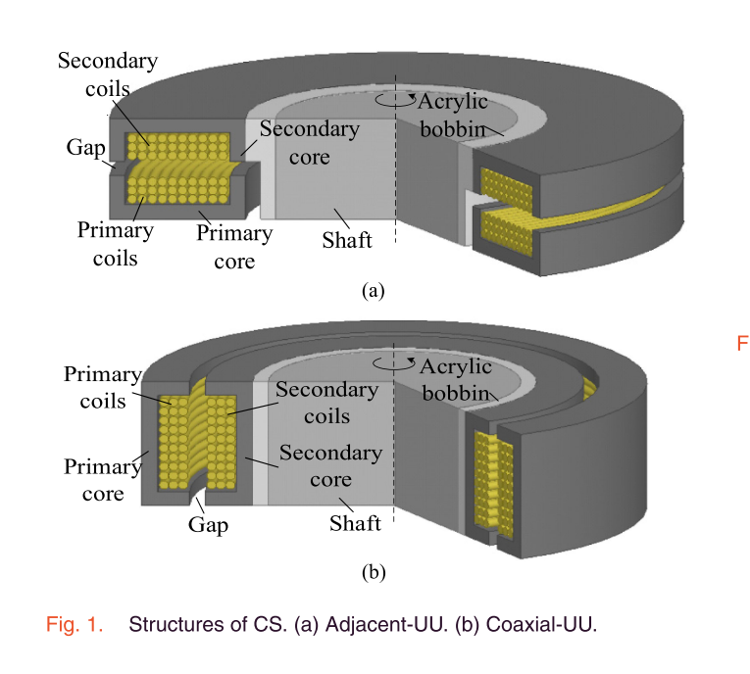

Slide 2
shaft_radius
Ferrite_width
s2f
Ferrite_length
shaft_height
x

