Slide 1
High Frequency Response at switching times
It actullay shows how to share current drawings of phases at switching time from capacitors A, B,C
We observe that capacitors are perfectly shorted and share the currents equal for lower frequecny than 100 kHz
Also, capacitor currrents have some local maxima and minima, it can be observed because of impedance shown by each capacitance
There are 9 situation for each capacitors for each phases .

Slide 2
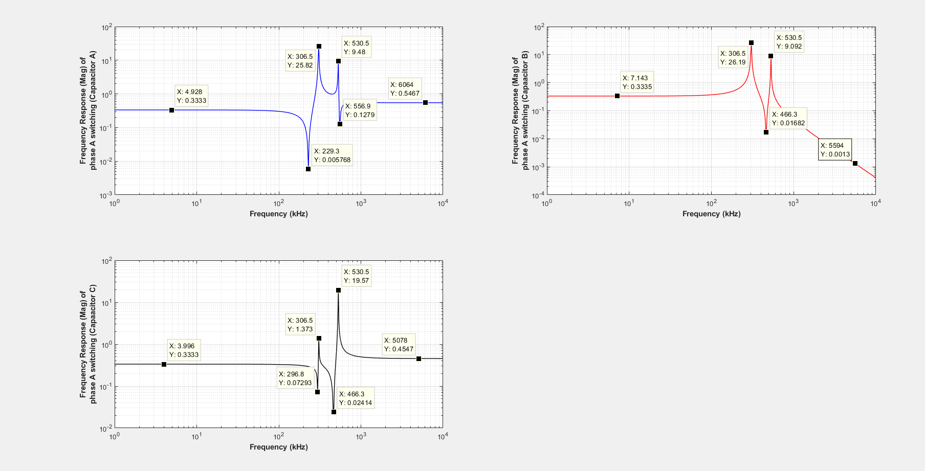

Slide 3
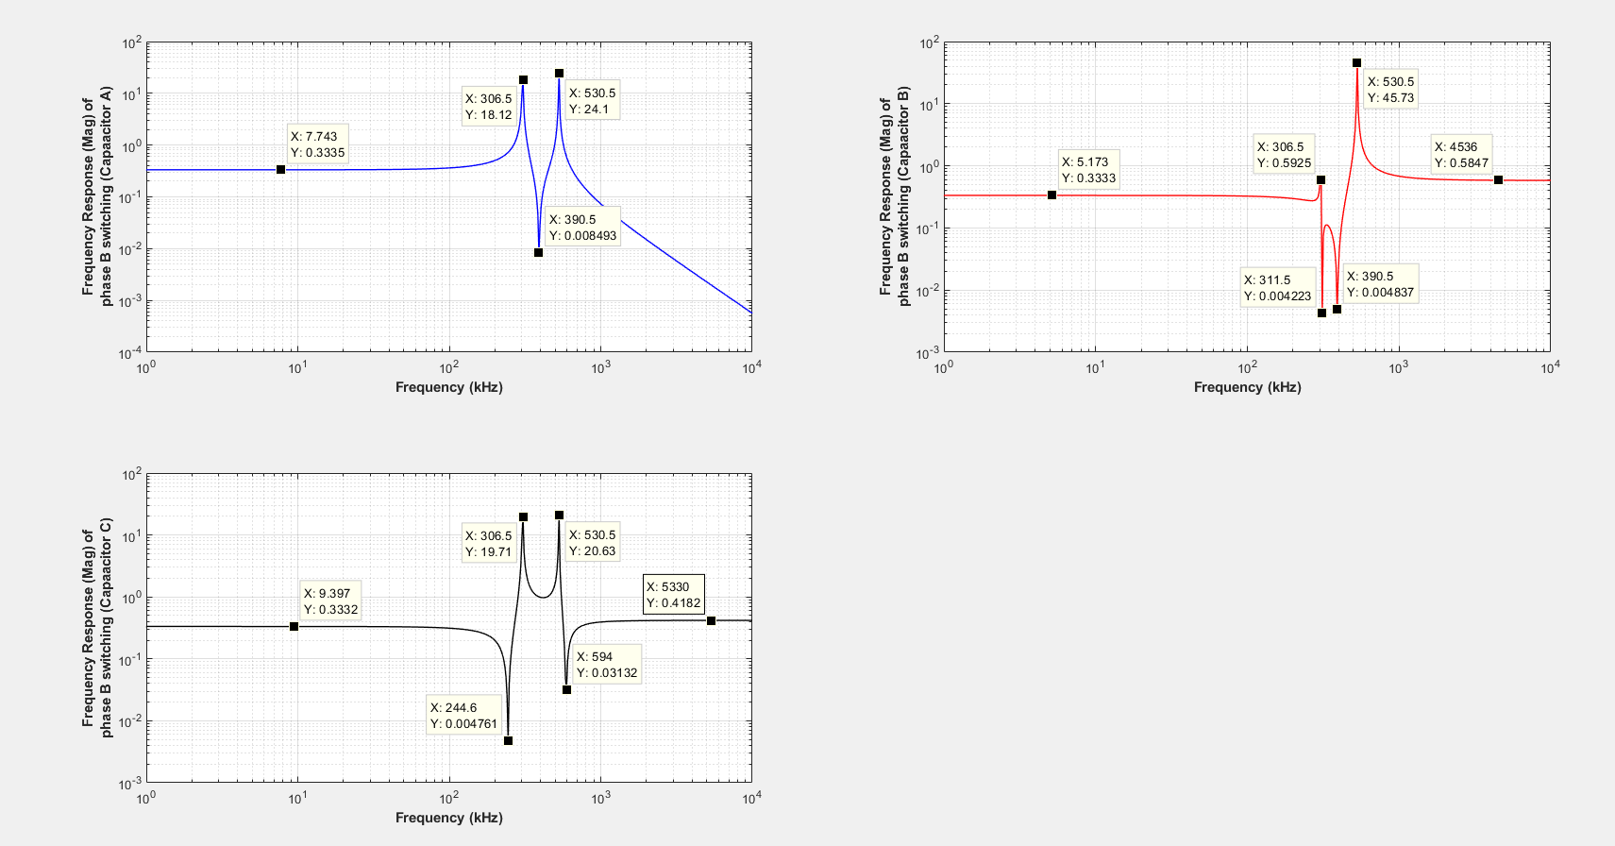

Slide 4
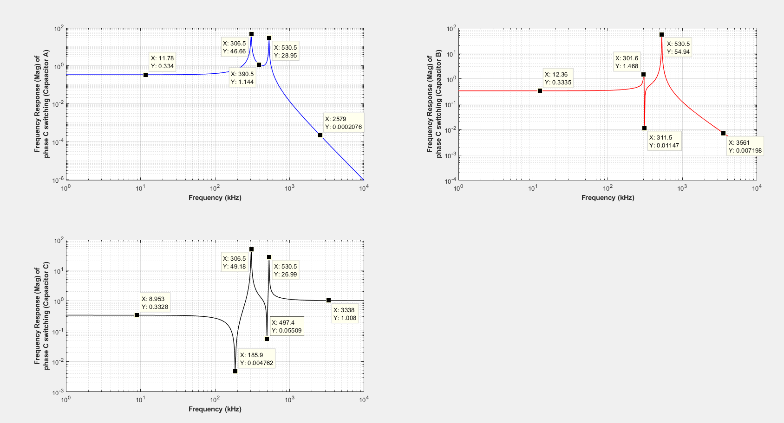

Slide 5
State space model is updated and the model merged by rectifier circuit.
We can think that rectifier model is split in two part. One of them is 3 phase(six pulse ) supply voltages and it supply current for inverter and capacitors of rectifier.
If rectifier capacitors exceed the voltage of six pulse, six pulses behaves like open circuit and the current of inverter is supplied by rectifier capacitor untill the rectifier capacitor voltages become lower than rectifier voltages.

Slide 6
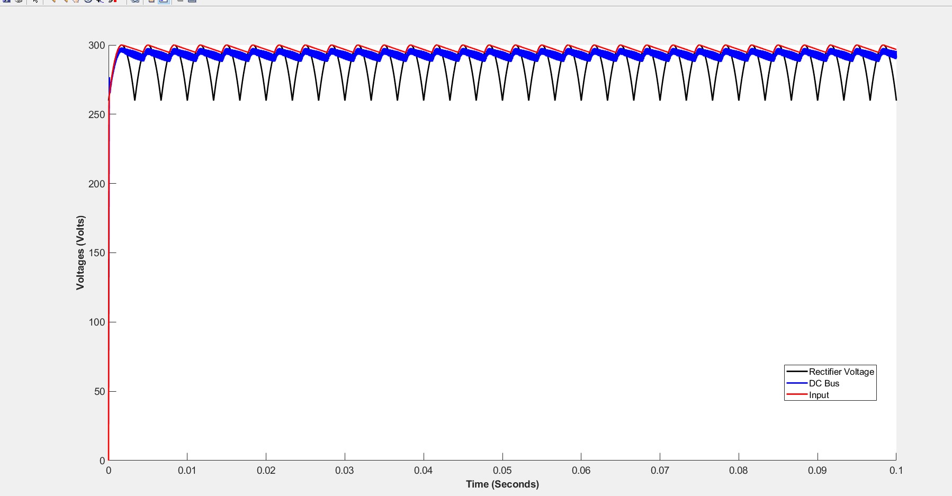
R_rec= 1e-2 (It determines the time constant of capacitor charging)
ma=0.5 (it determines the current supplied by capacitor at discharging mode)
delta=pi/2 (phase of reference voltages )
Cdrec= 1.1 mF (realistic value)

Slide 7
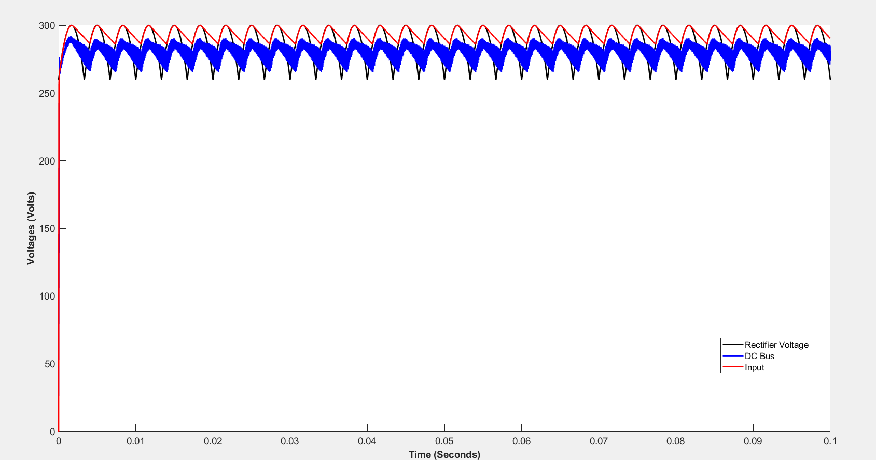
R_rec= 1e-2 (It determines the time constant of capacitor charging)
ma=0.9 (it determines the current supplied by capacitor at discharging mode)
delta=pi/2 (phase of reference voltages )
Cdrec= 1.1 mF (realistic value)

Slide 8
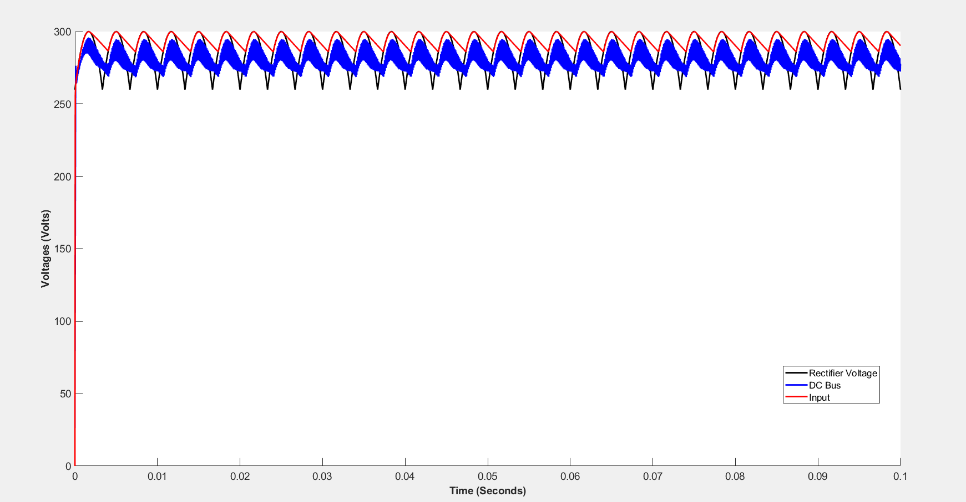
R_rec= 1e-2 (It determines the time constant of capacitor charging)
ma=0.9 (it determines the current supplied by capacitor at discharging mode)
delta=0(phase of reference voltages )
Cdrec= 1.1 mF (realistic value)

Slide 9
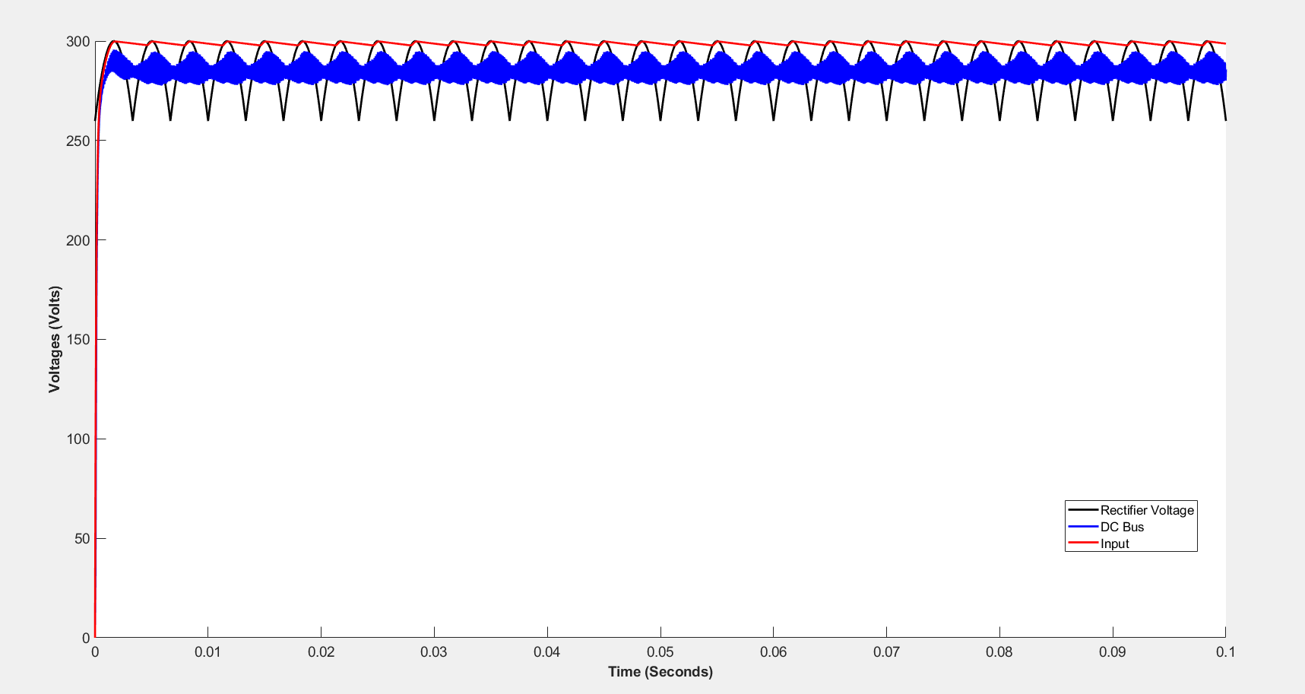
R_rec= 1e-2 (It determines the time constant of capacitor charging)
ma=0.9 (it determines the current supplied by capacitor at discharging mode)
delta=0(phase of reference voltages )
Cdrec= 10 mF (unrealistic value)

Slide 10
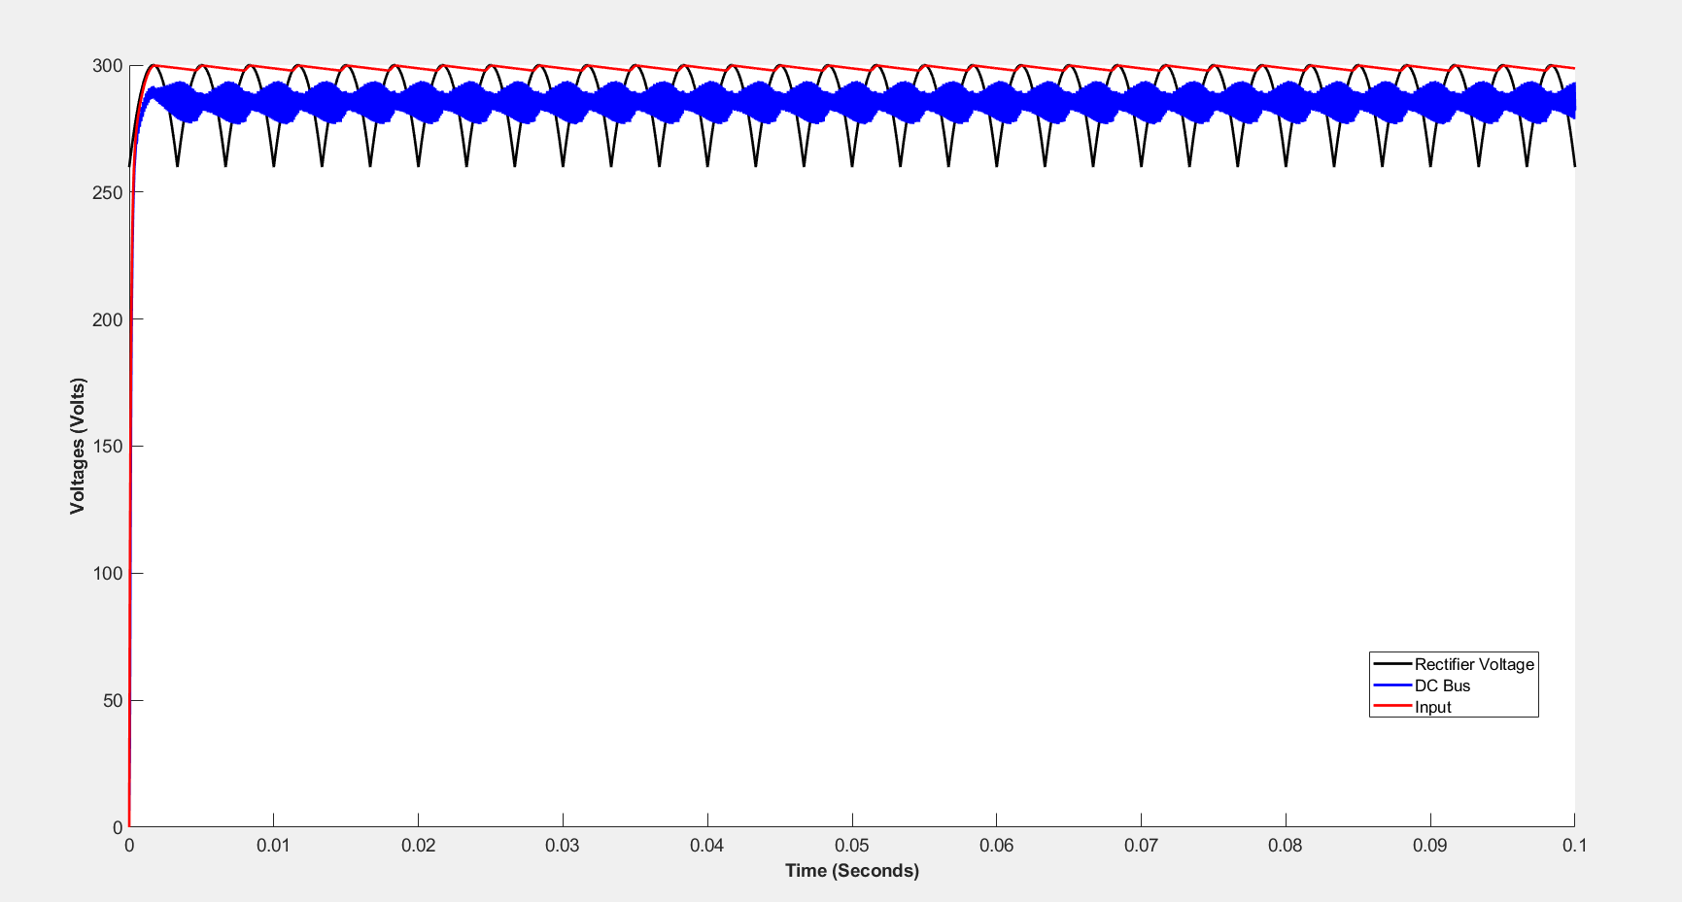
R_rec= 1e-2 (It determines the time constant of capacitor charging)
ma=0.9 (it determines the current supplied by capacitor at discharging mode)
delta=pi/2(phase of reference voltages )
Cdrec= 10 mF (unrealistic value)

Slide 11
Actually, the dc bus has third harmonic injected by 3 phase (non linear, we do not know other other injection).
It is actually low frequency part and we can observe this at fft analysis and eyes.
Also, dc bus has a envelope(six step) . Envelope is not low frequenct part, it is actually modulation of high frequency and low frequecny part. We can observe because of side band.
Reference voltages phases changes the envelope phase.
Vdcbus= Vdc +
V_3rd*sin(2*pi*300*t+ Phi1)+
V_envelope* sin(2*pi*fs*t+Phi20)*sin(2*pi*150*t+Phi3+Delta)
I think that those low frequency part and sideband do not change the interleaving ???

