Slide 1


Middle East Technical University
Department of Electrical and Electronics Engineering
Development of an Integrated Modular Motor Drive (IMMD) System
Mesut Uğur
31.05.2017

Slide 2

Research Group
Research Fields
Renewable Energy
Power Quality
Smart Grids
Power Electronics
Electrical Machines
Events
Weekly seminars
Journal Club
Research League
Multi-disciplinary project
Undergraduate students
http://power.eee.metu.edu.tr

Slide 3
Outline
What is IMMD?
Why IMMD?
Challenges
DC Link Capacitor Optimization
IMMD Design
Future Work

Slide 4
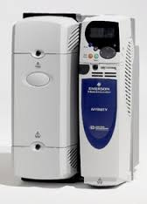
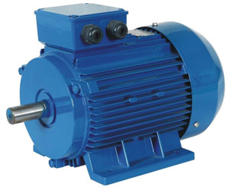
Conventional Motor Drives
Drives are placed in a separate cabinet
Increased volume, weight and cost
Connection with long cables
Long cable effect, EMI problems

Slide 5
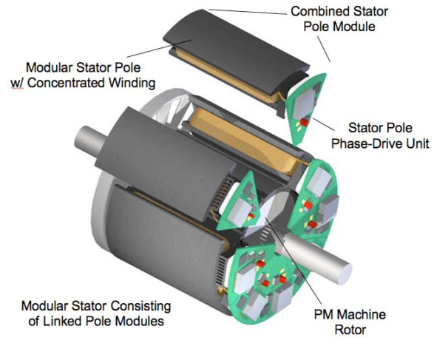
Integrated Modular Motor Drives (IMMDs)
The motor drive is integrated to the motor back-end
Both the motor and the drive are modularized

Slide 6
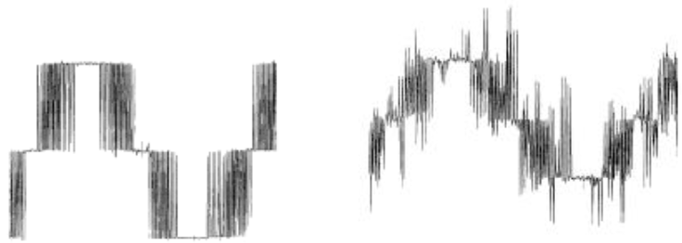
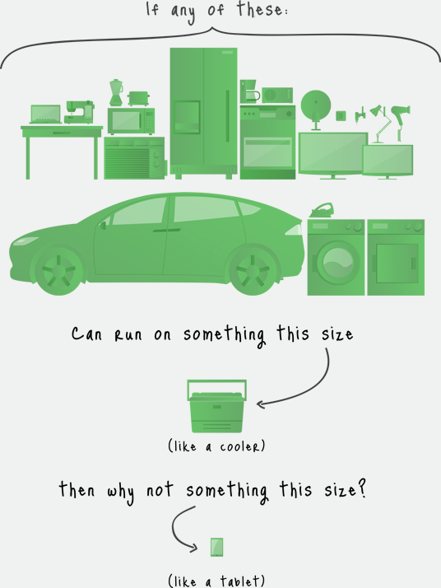
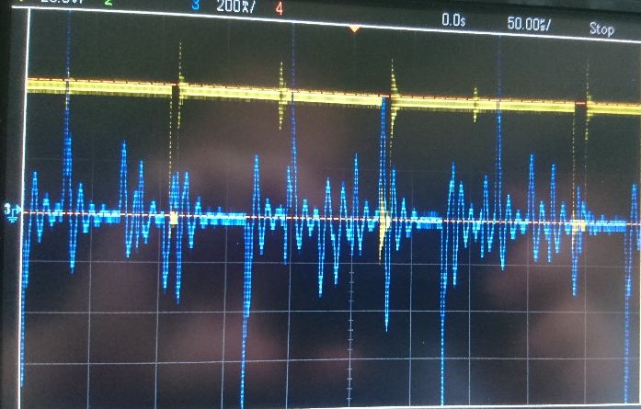
Motivation - Integration
Power density
Voltage overshoots
Motor lifetime

Slide 7
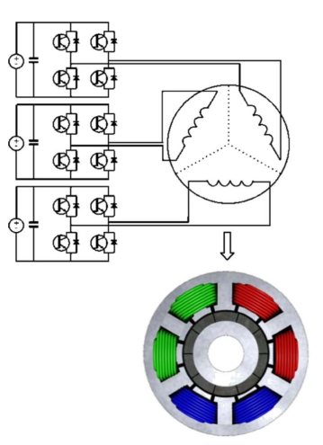
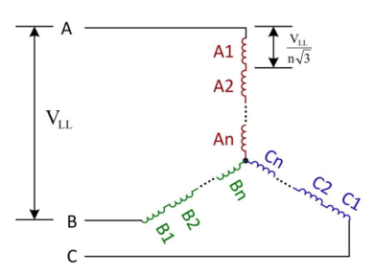
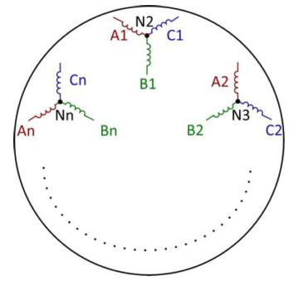
Motivation - Modularization
Increased fault tolerance
Distributed heat dissipation
Reduced voltage stress

Slide 8
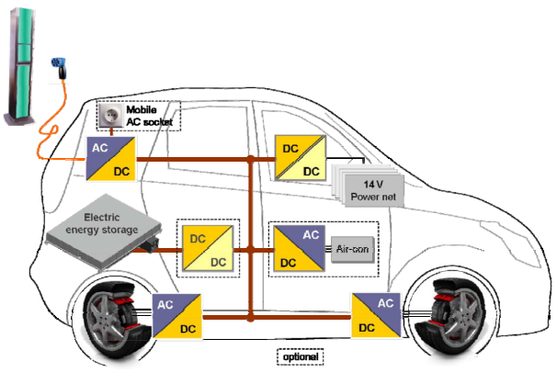
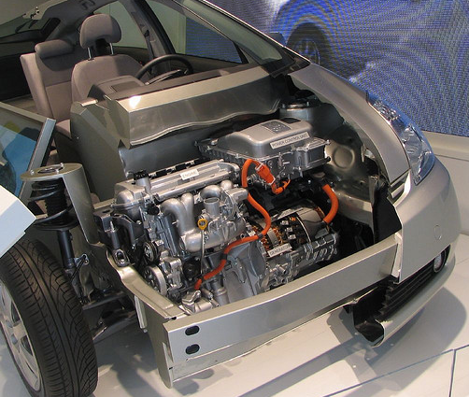
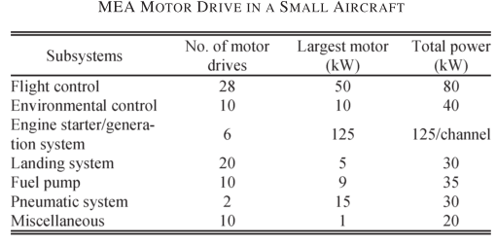
Critical Applications
Electric traction: EVs, HEVs, Trains
Aerospace: Aircrafts, Space crafts

Slide 9
Challenges
Fitting into a small volume requires size reduction and optimum placement of components.
Passive component size reduction
Heat sink size reduction
Cooling of both units should be achieved simultaneously.
Achieve superior drive efficiency
Heat distribution

Slide 10
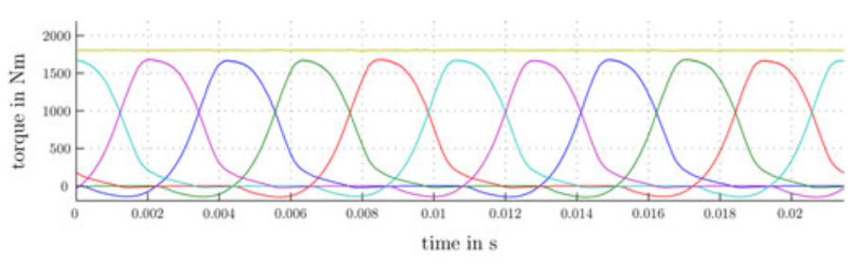
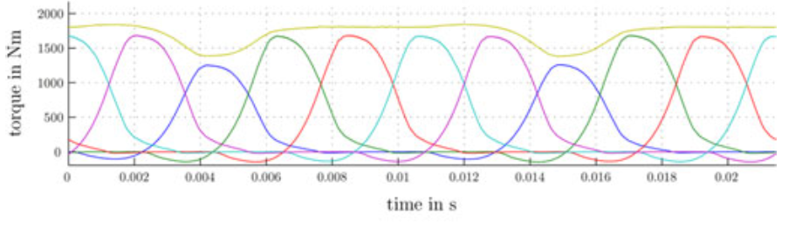
Challenges
Power and control electronics components are subjected to high temperature and vibration.
In case one module is in fault, torque balance should be ensured.

Slide 11
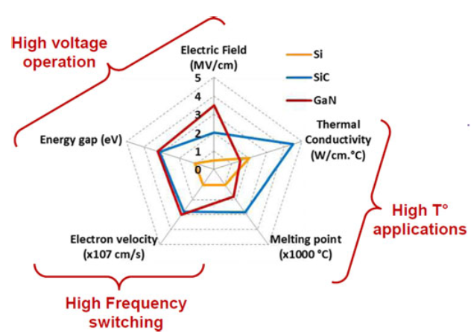
Gallium Nitride (GaN) Power Semiconductors
Wide band-gap (WBG) power semiconductor devices
Low semiconductor loss: heat sink size is reduced
High operation frequency: passive component size is reduced
High speed device
Low R_{ds_on}
Low E_{on} & E_{off}
High junction temperature
Low C_{in} and C_{out}

Slide 12
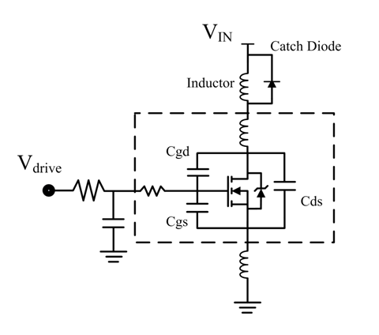
Gallium Nitride (GaN) Power Semiconductors
Parasitic components become significant
Careful layout design is required
Commercial availability
Low ratings
Reliability

Slide 13
DC Link Capacitor Optimization
DC link capacitors constitute
20% of cost and weight
30% of volume
Critical parameters
DC Link capacitor types
Capacitance per volume
RMS current per volume
Cost
ESL & ESR
Reliability & lifetime
Mechanical durability
Aluminum electrolytic
Metal Film
Multilayer ceramic (MLCC)

Slide 14
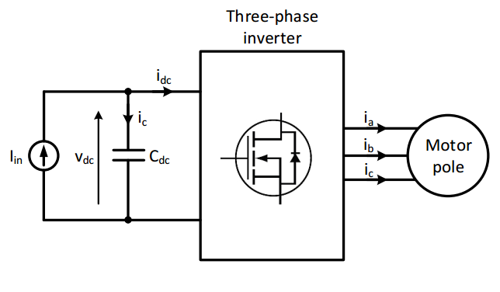
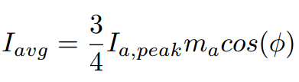

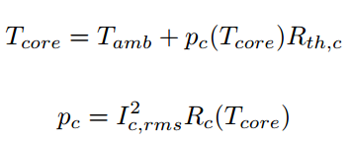
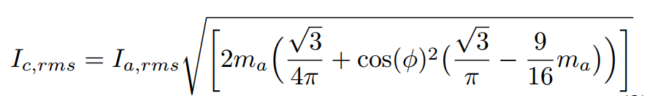
DC Link Capacitor Optimization
DC Link average current
DC Link ripple voltage
Capacitor heating
DC Link RMS current

Slide 15
DC Link Capacitor Optimization
Analytical model
RMS current
Capacitance (ripple voltage)
Heating
Interleaving

Slide 16
DC Link Capacitor Optimization
Selection aspects
Selection algorithm
Results

Slide 17
DC Link Capacitor Optimization
Results

Slide 18
IMMD Design
Four three-phase inverter modules (two-series and two-parallel)
Power stage with cascode GaN FETs
Permanent Magnet Brushless DC (PM-BLDC) motor
Fractional Slot Concentrated Winding (FSCW) stator
Specifications
Four three-phase modules
6 kW total output power
24 slot double layer stator
20 pole PM rotor
600V – 20A GaN FETs
Four 20μF, 450V capacitors

Slide 19
IMMD Design
Buraya bir çizim koyalım
Devre ve motor

Slide 20
IMMD Design
Loss Characterization

Slide 21
Future Work
Near future
An IMMD laboratory prototype is being developed with the given specifications. The aimed performance is:
Drive efficiency: 98.5%
Drive power density: 15 W/cm³
Increased fault tolerance
Motor housing for cooling (no heatsink)
Ultimately
An IMMD laboratory prototype is being developed with the given specifications. The aimed performance is:
Drive efficiency: 98.5%
Drive power density: 15 W/cm³
Increased fault tolerance
Motor housing for cooling (no heatsink)

Slide 22
References
G. Lo Calzo et al., “Integrated motor drives: state of the art and future trends,” IET Electr. Power Appl., vol. 10, no. 8, pp. 757–771, Sep. 2016.
J. Wang, Y. Li, and Y. Han, “Integrated Modular Motor Drive Design With GaN Power FETs,” IEEE Trans. Ind. Appl., vol. 51, no. c, pp. 3198–3207, 2015.
J. J. Wolmarans, M. B. Gerber, H. Polinder, S. W. H. De Haan, J. A. Ferreira, and D. Clarenbach, “A 50kW integrated fault tolerant permanent magnet machine and motor drive,” PESC Rec. - IEEE Annu. Power Electron. Spec. Conf., pp. 345–351, 2008.

Slide 23

Thank you !

